Slide 1
Word Type effects on Grand Mean ERPs of all active channels within specified area for all patients

Slide 2
Divided by Superior and inferioR to Sylvian Fissure

Slide 3

Superior and Inferior SF Mean ERP
Inf SF
Sup SF
Perception
Beep
Word Groups Legend
Sef= short easy frequent
Sel= short easy Lhi=long hard infrequent
Lef= long easy frequent
Lel=long easy Lhi=long hard infrequent
Lhf= long hard frequent
Lhi=long hard infrequent
Production

Slide 4
Superior and Inferior Sylvian Fissure (Peak Amplitude Zscore)
Inferior SF
Superior SF
Word Groups Legend
Sef= short easy frequent
Sel= short easy Lhi=long hard infrequent
Lef= long easy frequent
Lel=long easy Lhi=long hard infrequent
Lhf= long hard frequent
Lhi=long hard infrequent
Red=During Perception
Blue= During Production
Below SF (temporal lobe) maximum amplitude increase with word length and difficulty during perception

Slide 5
Above and Below SF (peakTime)
Inferior SF
Superior SF
Peak time increase with word length and difficulty during production for sensorimotor regions

Slide 6
Divided by Quadrant (ant/Post central sulcus, Sup/Inf Sylvian Fissure)
Central Sulcus
Anterior CS Superior SF | Posterior CS Superior SF
Anterior CS Inferior SF | Posterior CS Inferior SF
Sylvian
Fissure

Slide 7
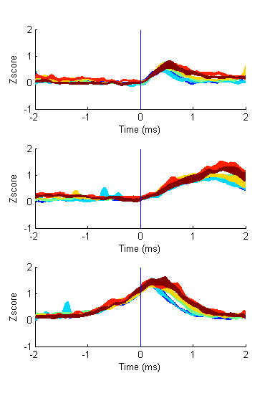
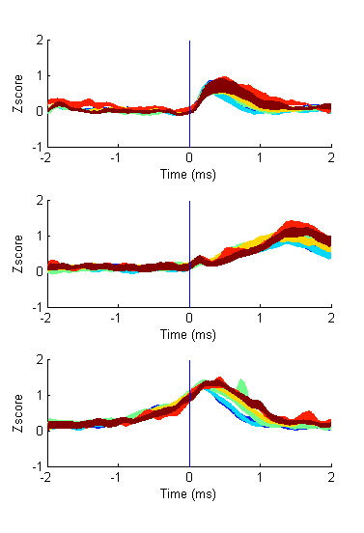
Superior Sylvian Fissure Mean ERP
Sup SF, Ant CS
Sup SF, Post CS
Perception
Beep
Production

Slide 8
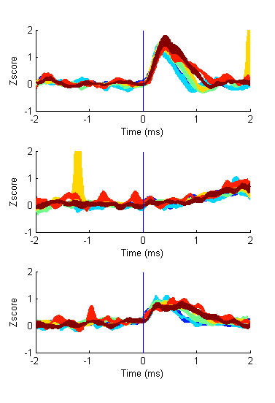
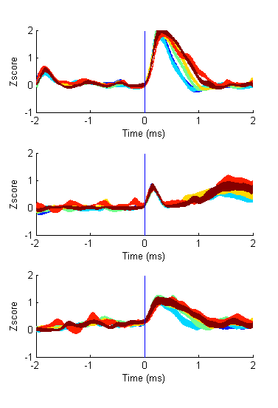
Inferior Sylvian Fissure Mean ERP
Inf SF, Ant CS
Inf SF, Post CS
Perception
Beep
Production

Slide 9
Quadrant (peaktime)
Posterior CS
Superior SF
Anterior CS
Superior SF
Red=During Perception
Blue= During Production
Anterior CS
Inferior SF
Posterior CS
Inferior SF
Peak time increase with word length and difficulty during production for mostly parietal regions

Slide 10
Quadrant max zscore
Posterior CS
Superior SF
Anterior CS
Superior SF
Anterior CS
Inferior SF
Posterior CS
Inferior SF
Peak Zscore increase with word length and difficulty during perception for mostly posterior temporal lobe. Minor increase during perception in motor regions

Slide 11
Quadrant Mean zscore
Posterior CS
Superior SF
Anterior CS
Superior SF
Anterior CS
Inferior SF
Posterior CS
Inferior SF
Mean zscore increase for all. Not very surprising because longer words tend to have longer activations

