Slide 1
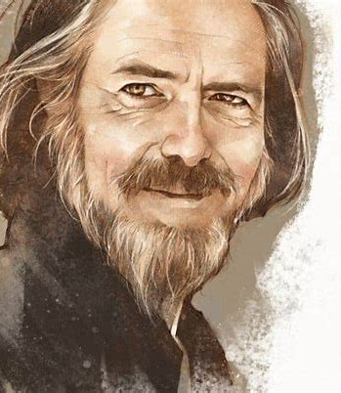
Alan Watts
English philosopher 1915-1973

Slide 2
Biography
Born in England, he moved to the United States in his twenties, where he studied theology and became an Episcopal priest. However, he later left the church to explore a more personal and philosophical path. He spent much of his life lecturing, writing, and recording talks that challenged Western ideas about control, success, and the self.
Rather than giving strict answers, Watts invited people to question their assumptions, embrace uncertainty, and understand life as something to be experienced, not conquered. His most famous works include The Way of Zen, The Wisdom of Insecurity, and The Book: On the Taboo Against Knowing Who You Are.

Slide 3
Question
“What if the more you try to force progress, the more you actually hinder it?”

Slide 4
“Happiness”
You feel like crap because you failed your French test. To cope and release dopamine, you scroll through Instagram and feel even worse because everyone else seems to be having such a great time. Your friend goes on a cruise. And here you are, scrolling reels mindlessly while thinking why your life sucks and how it’s unfair your friend got a higher score than you and everyone else is happy.

Slide 5
The Backwards Law
Alan Watts’ Backwards Law states that the more we pursue something directly, the less likely we are to find it. Happiness, peace, and success come not from chasing them but from letting go of the obsession with them. The more you want to be rich, the more poor and unworthy you feel. The more desperately you want to be liked, the more times you think you’ve embarrassed yourself and others think you’re an idiot.

Slide 6
Examples
You work tirelessly on a project, but exhaustion and stress lead to decreased productivity. When you take a break, you find that you’re able to explore new ideas and solutions effortlessly. The person that cares the least about a test tends to score better because they are not obsessed with getting a full score and absorbs information with an open mindset.

Slide 7
The Real Way to Success
The law works in reverse. If pursuing the positive is a negative, pursuing a negative is a positive.
Everything worthwhile in life is won by surmounting the associated negative experience. Any attempt to escape pain will backfire. The avoidance of suffering is a form of suffering. The avoidance of struggle is a struggle. The denial of failure is a failure.

Slide 8
Watt’s Take On Admittance
Watts often said that trying to maintain a perfect image or constantly prove your worth is a kind of self-deception. The more you try to hide your shortcomings, the more you suffer. By admitting your flaws, you free yourself from that false identity. “Man suffers only because he takes seriously what the gods made for fun.” – Alan Watts

Slide 9
Final Thought
True growth comes when we stop forcing it. Letting go of the need for constant achievement, embracing failure, and accepting pain as part of life leads to greater peace, happiness, and success.

Slide 10
Extra Quotes
“The more you try to control something, the more it controls you. Free yourself and let things take their own natural course.”
“When you try to stay on the surface of the water, you sink; but when you try to sink, you float.”
“The meaning of life is just to be alive. It is so plain and so obvious and so simple. And yet, everybody rushes around in a great panic as if it were necessary to achieve something beyond themselves.”

Slide 11
Thank you

