Slide 1
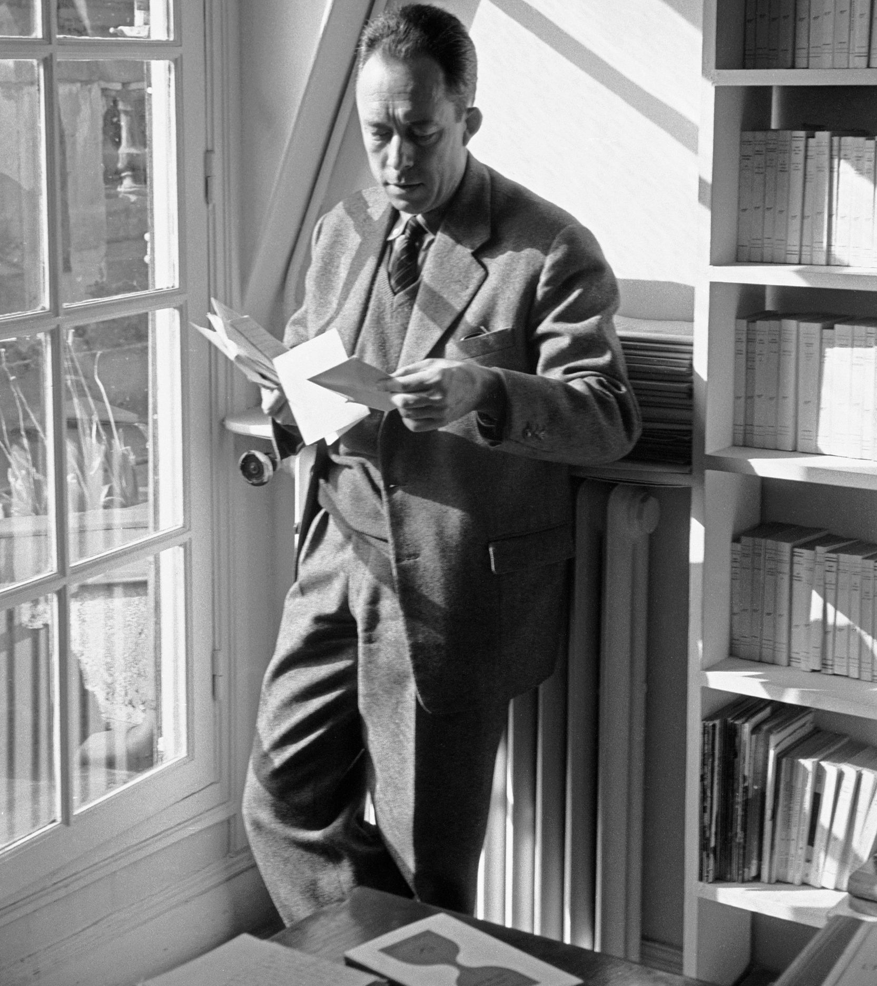
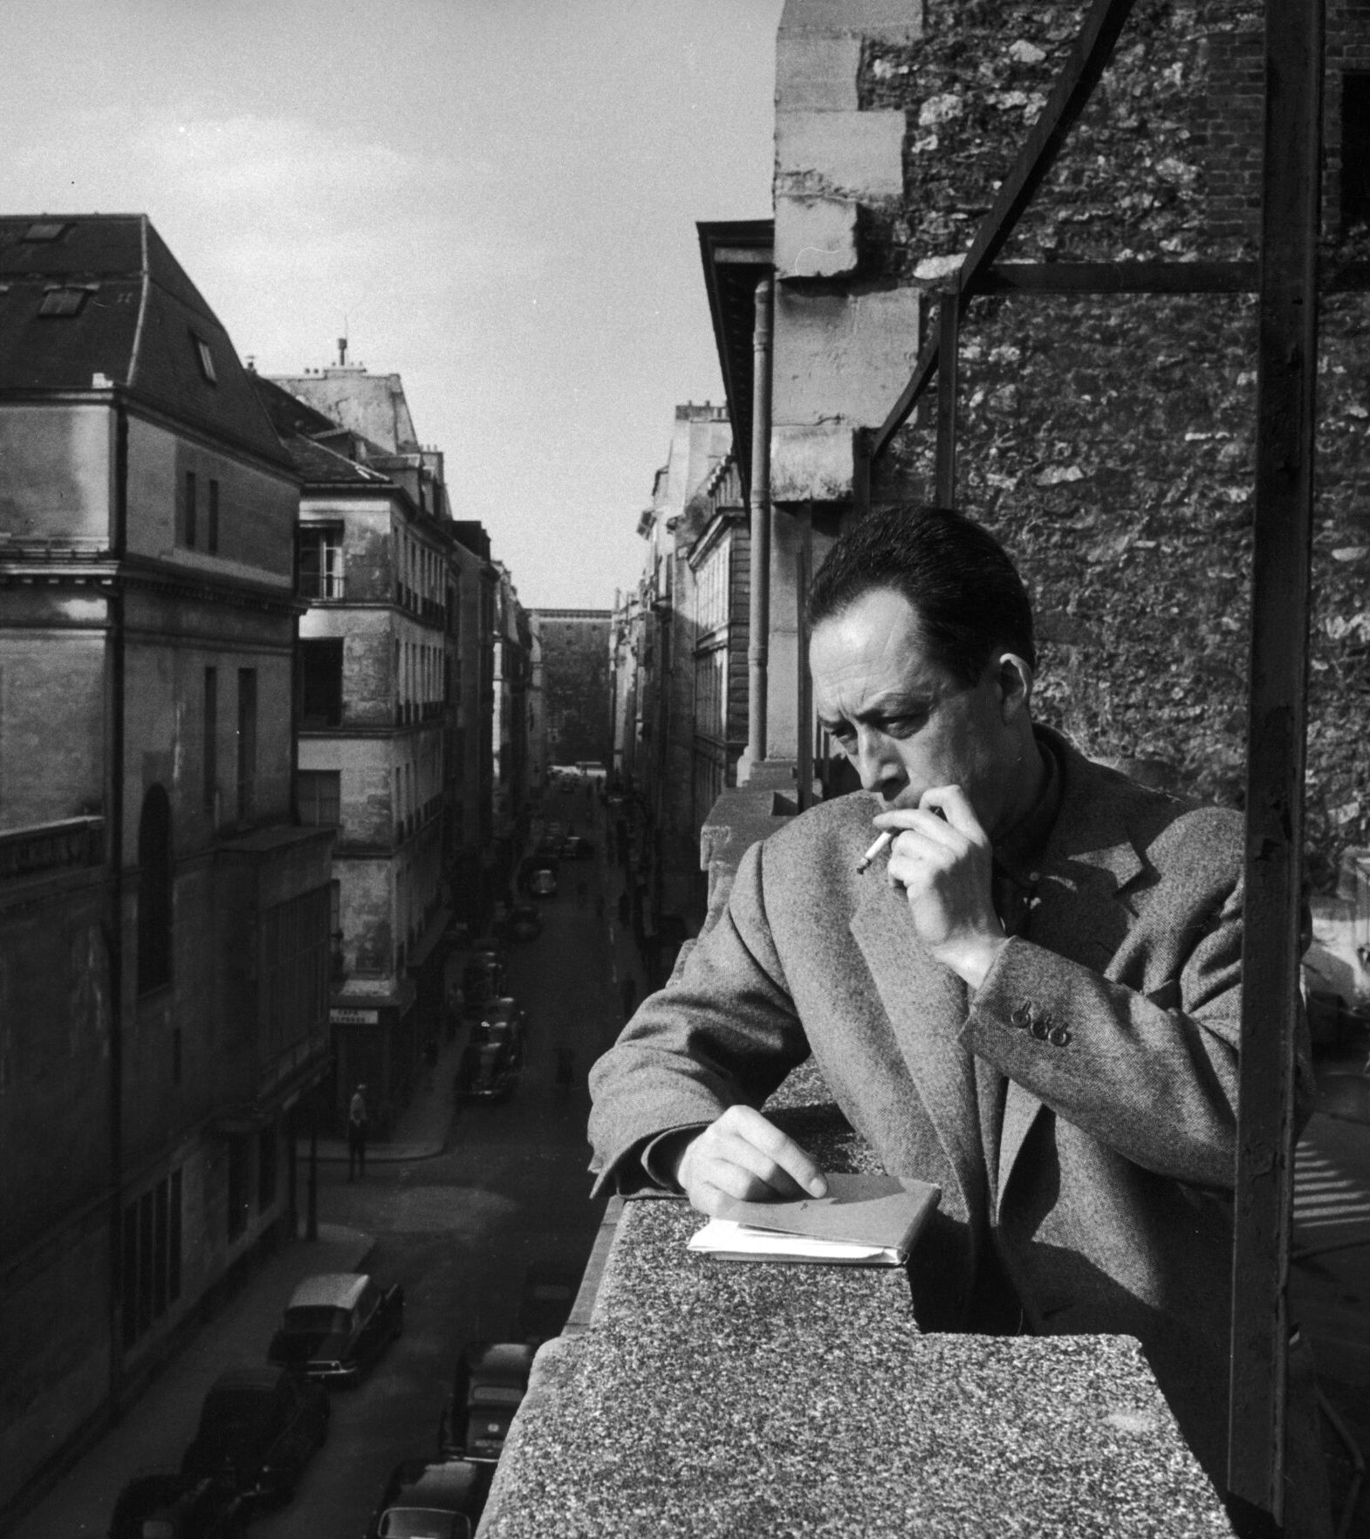
Introduction to Albert Camus (1913-1960)
Notes:
Born time effect

Slide 2
Biographie
Influenced by his teacher and mentor Jean Grenier, who shaped his philosophical ideas.
Born in Algiers, Algeria, which is where the novel is set.
Father died in World War I, and mother was partially deaf and blind.

Slide 3
-Albert Camus, 1942
“Rising, streetcar, four hours in the office or the factory, meal, streetcar, four hours of work, meal, sleep, and Monday Tuesday Wednesday Thursday Friday and Saturday according to the same rhythm”
“But one day the “why” arises and everything begins in that weariness tinged with amazement.”

Slide 4
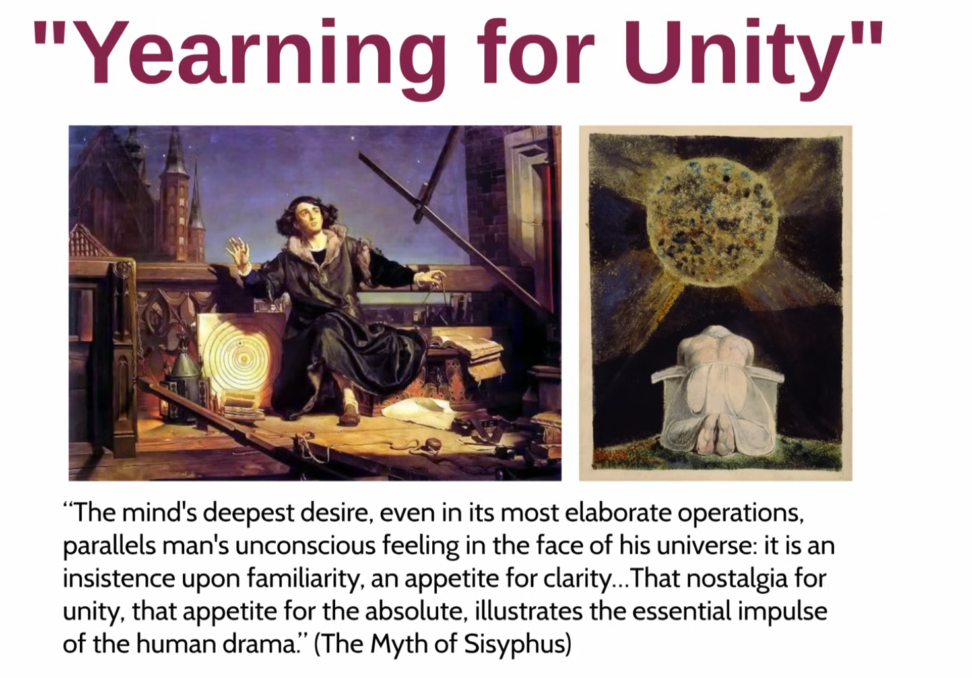

Slide 5
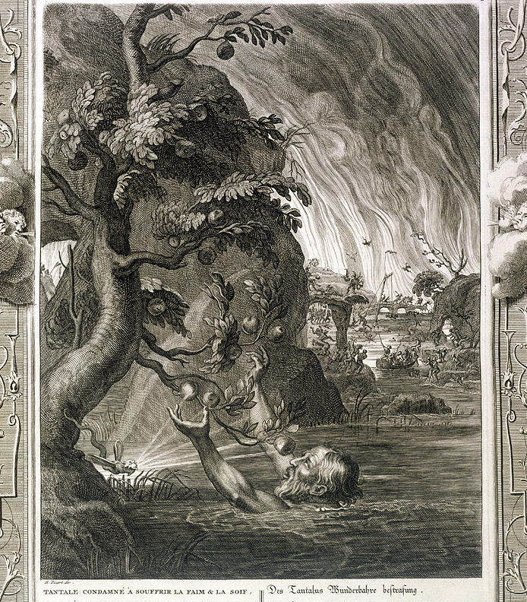
Tantalus Torment, 1731

Slide 6
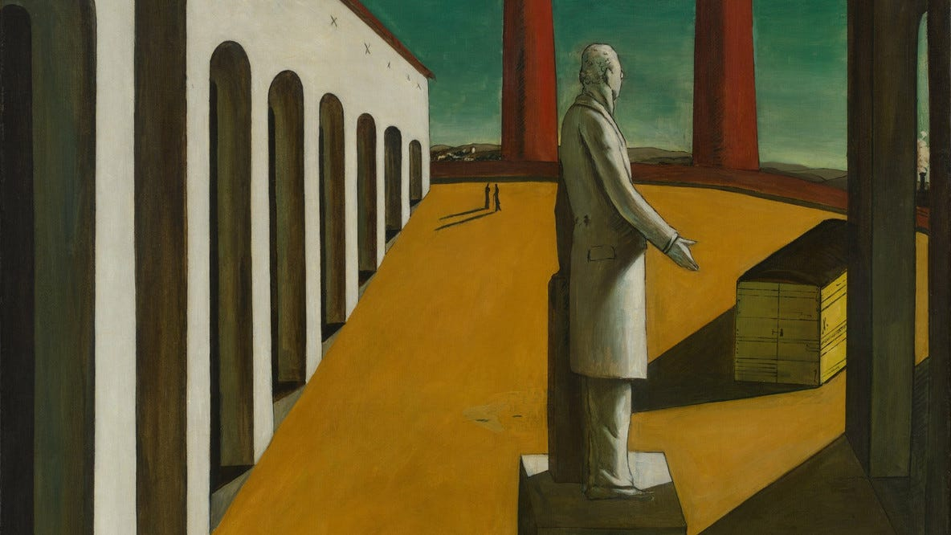
The Absurd
“Man stands face to face with the irrational. He feels within him his longing for happiness and for reason. The absurd is born of this confrontation between the human need and the unreasonable silence of the world.” ― Albert Camus, The Myth of Sisyphus and Other Essays

Slide 7
Absurdism
Life has no inherent meaning, but humans seek it.
The Absurd: tension between desire for meaning & universe’s indifference.
Response: Accept it, revolt, and create your own meaning.

Slide 8
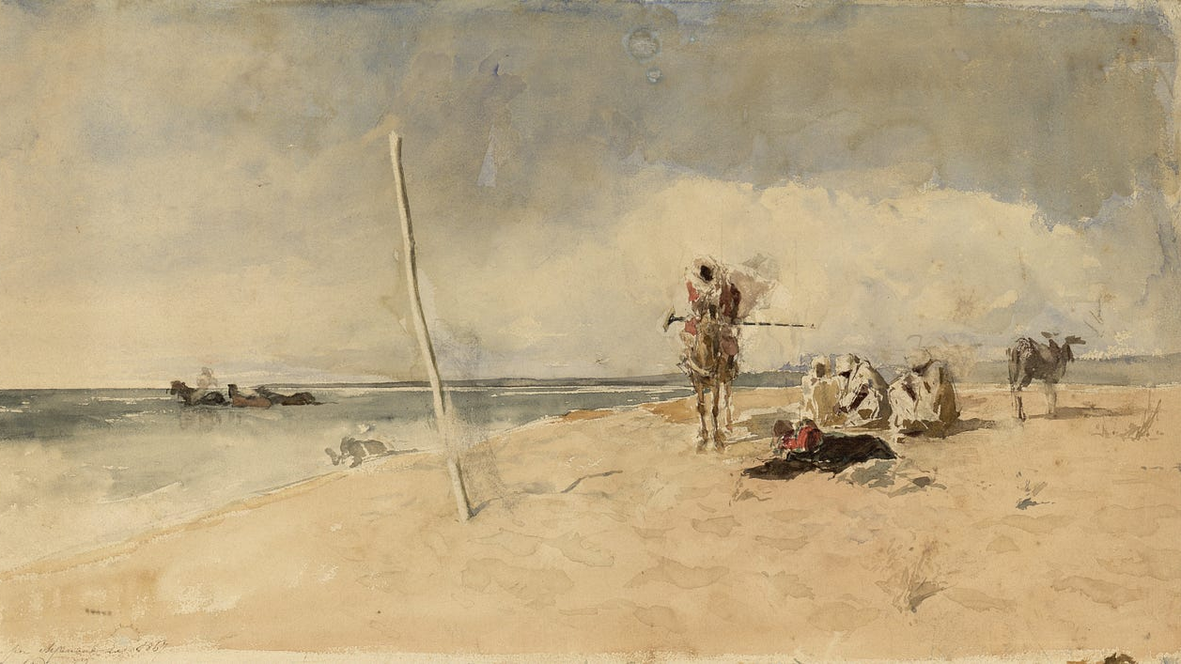
L'Étranger, The Stranger, The Outsider
1937 & May 1941
The Indifference of The World, Harry Readhead

Slide 9
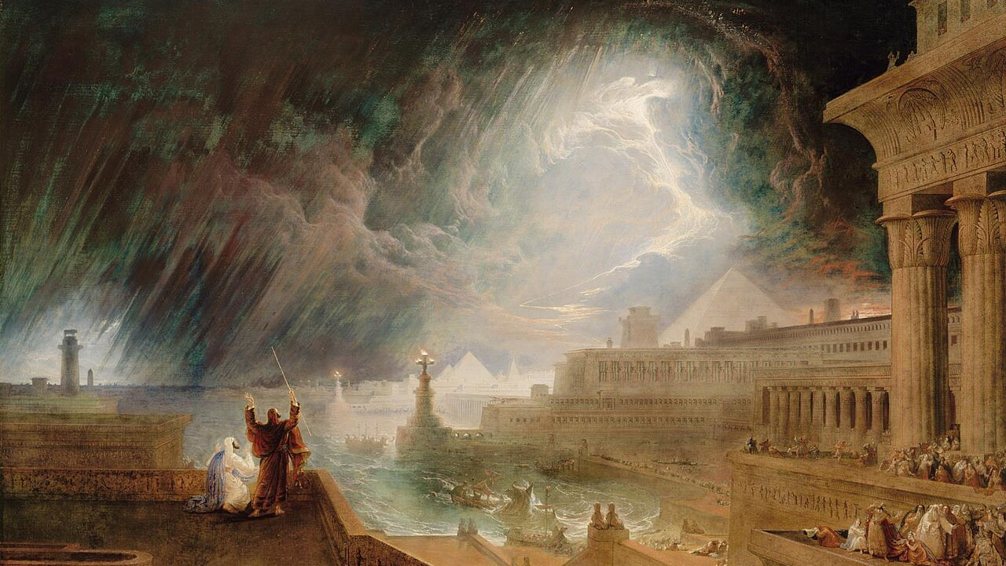
The Plague, La Peste
Written in 1947

Slide 10
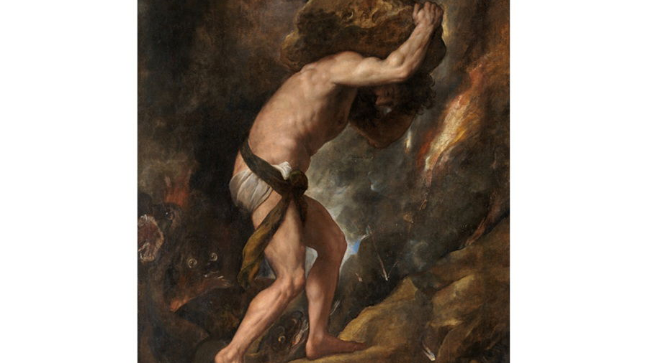
The Myth of Sisyphus, Le Mythe de Sisphe
Written in 1942

Slide 11
Suicides
Physical suicide is ending life to escape suffering or meaninglessness, which Camus rejects.
Philosophical suicide is turning to religion or absolute beliefs to escape the absurd, which Camus also rejects.

Slide 12
The Hero
Lives fully aware of life’s absurdity and accepts it without escape.
Embraces life’s struggles and finds personal meaning in action.
Examples include Sisyphus in The Myth of Sisyphus and Meursault in The Stranger.

Slide 13
Absurdism vs Nihilism
Absurdism: Life has no ultimate meaning, but we should still live and create value.
Nihilism: Life has no meaning or value, so nothing truly matters.
Nihilism is a precursor

Slide 14
Religion
Camus believed religion refuses to confront the absurd
Camus calls this “philosophical suicide”
Abandonment of suffering as God’s plan
Advocates for the rejection of transcendence.

Slide 15

"The only way to deal with an unfree world is to become so absolutely free that your very existence is an act of rebellion."(Camus, The Rebel)

