Slide 1
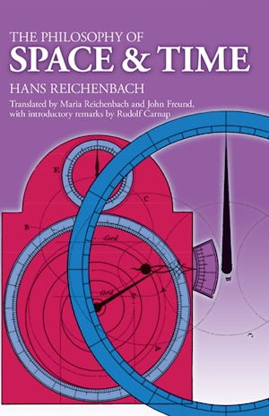
Metaphysics II “Of Space and Time”
12/19/24

Slide 2
Re-cap on Metaphysics
A philosophy that investigates the nature of reality, including concepts like existence, objects, and their properties. "Metaphysics is a dark ocean without shores or a lighthouse, strewn with many a philosophic wreck."
- Immanuel Kant

Slide 3
Linear Time
Progresses from past to present to future, like a straight line (This is how most humans look at time)

Slide 4
Cyclical Time
Time is viewed as repeating in cycles. Events don’t just move forward, they return in patterns or loops.

Slide 5
Space
-Absolute Space: -Space exists independently, like an empty container -Relational Space: -Space exists only in relation to objects and their interactions. -In other words: Space only exists because other things relate to it.

Slide 6
Debate on Linear Time
Is time a real, independent entity (as in linear time), or is it just a human construct based on our experiences?

Slide 7
Absolute vs Relational
Does space exist without objects(absolute space), or is it just defined by the things in it? (relational space)

Slide 8
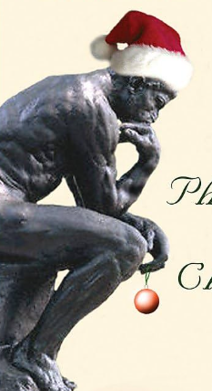
Effects of Holidays on Collective Consciousness
Does excessive rest reduce society's efficiency, or does it foster greater peace and contentment among the public?

