Slide 1
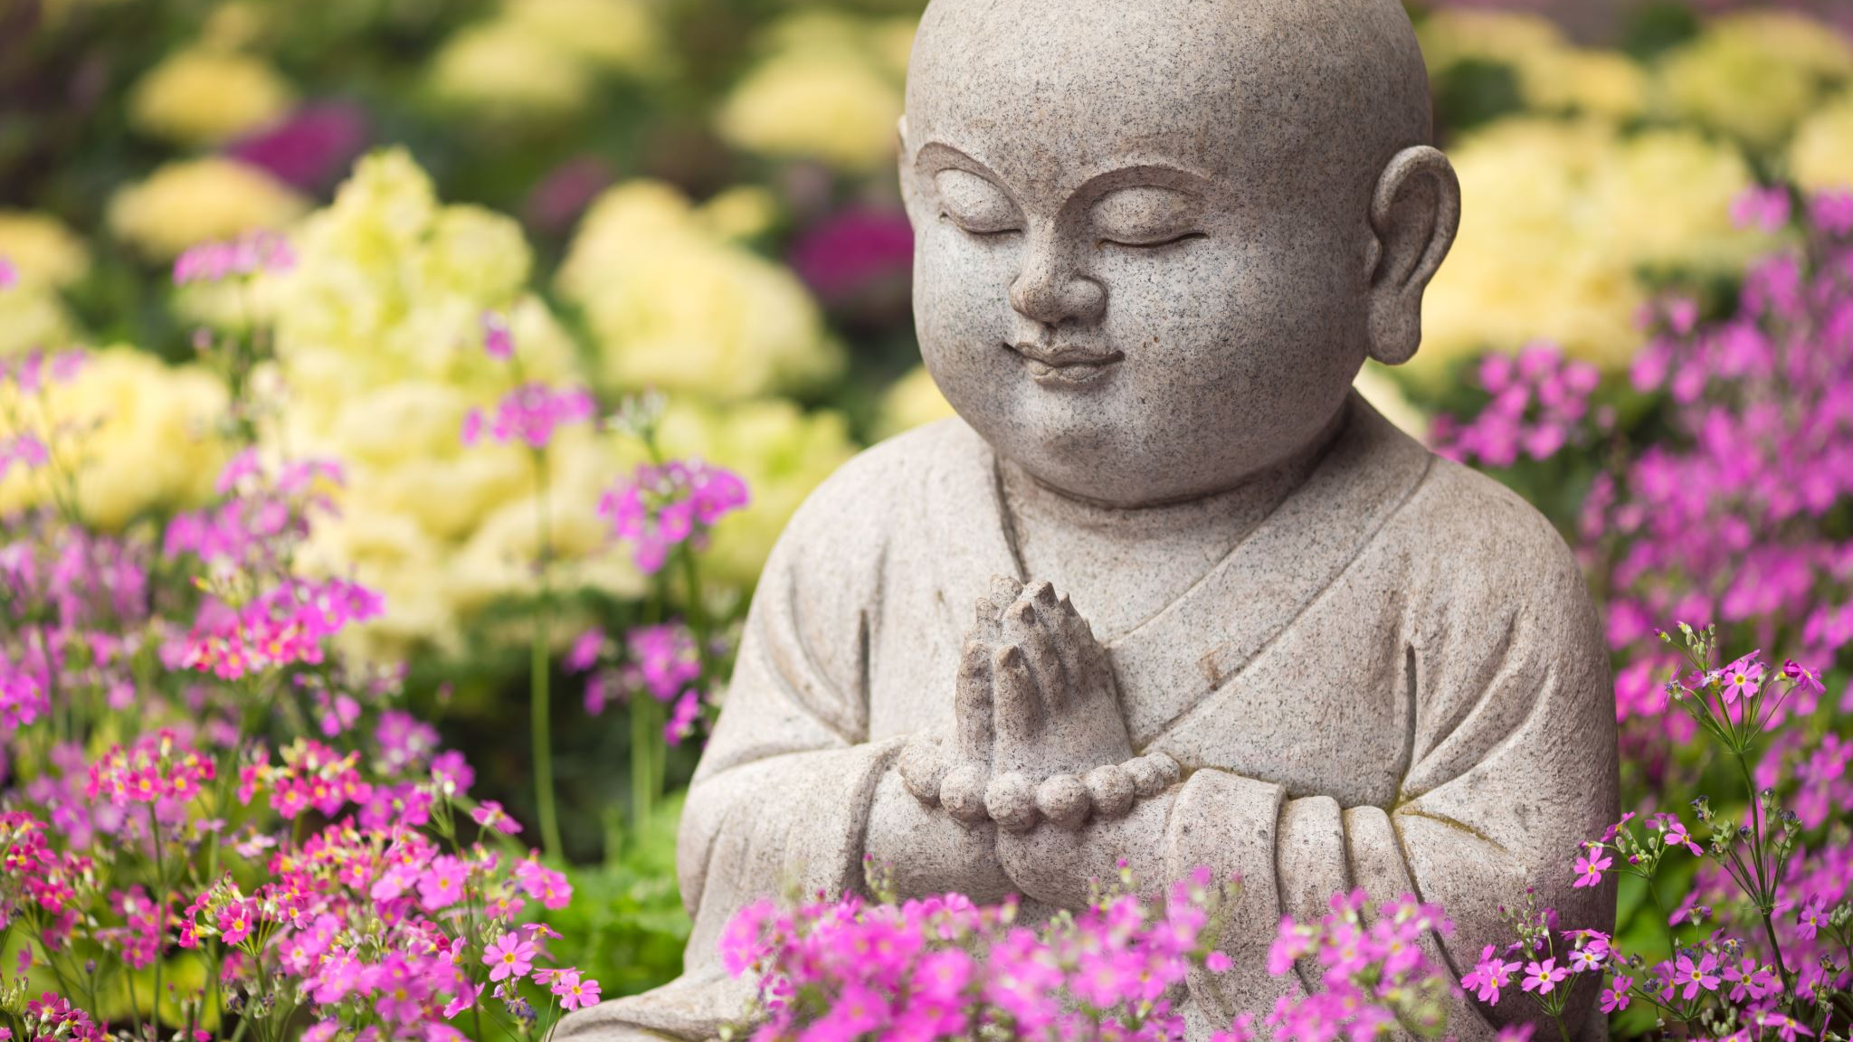
Confucius (孔夫子)
Chinese Philosopher

Slide 2
Who was Confucius?
Born 551 BCE in China
Philosopher, Teacher, Political Thinker
Founder of Confucianism

Slide 3
Confucian Ideals
Ren (仁): Benevolence and humanity.
Li (禮): Rituals, propriety, and social harmony.
Xiao (孝): Filial piety and respect for parents/elders.
Yi (義): Righteousness and moral integrity.

Slide 4
Ren (仁): Benevolence and humanity
If you were treated unfairly, would you confront the opposing party with benevolence and humanity?
Confucius would stress that you must treat others with kindness, hence “Do not impose on others what you yourself do not desire.”

Slide 5
Li (禮): Rituals, propriety, and social harmony.
Have rituals and societal practices lost their meaning?
Confucius: Rituals have not, they are essential to create order and social harmony.

Slide 6
Xiao (孝): Filial piety and respect for parents/elders.
Do you wish to respect your parents and elders?
Confucius: Filial piety is the cornerstone of moral development.
“If one cannot honor those closest to them, how can they be trusted to uphold responsibilities to others?"

Slide 7
Yi (義): Righteousness and moral integrity.
Does it make sense to sacrifice personal possessions for the sake of moral righteousness, or the other way around?
Confucius: “The noble person acts not for personal gain but for what is just. Even when difficult, one must stand firm in their principles to uphold justice.”

Slide 8
Thank You

