Slide 1
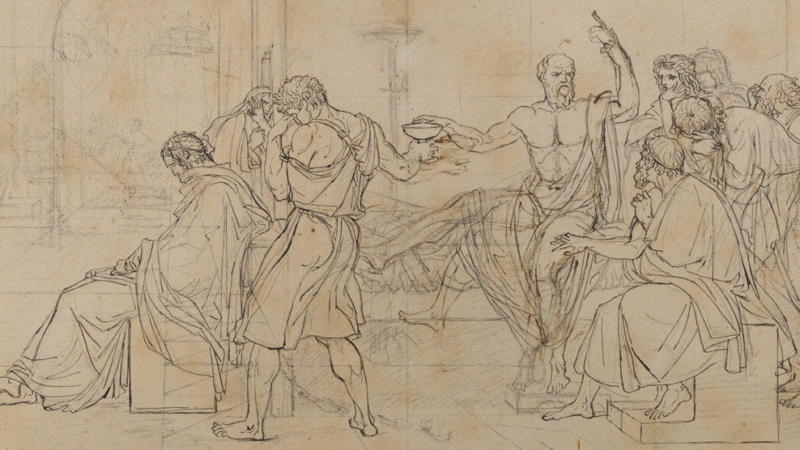
Philosophy Club 10/17/24

Slide 2
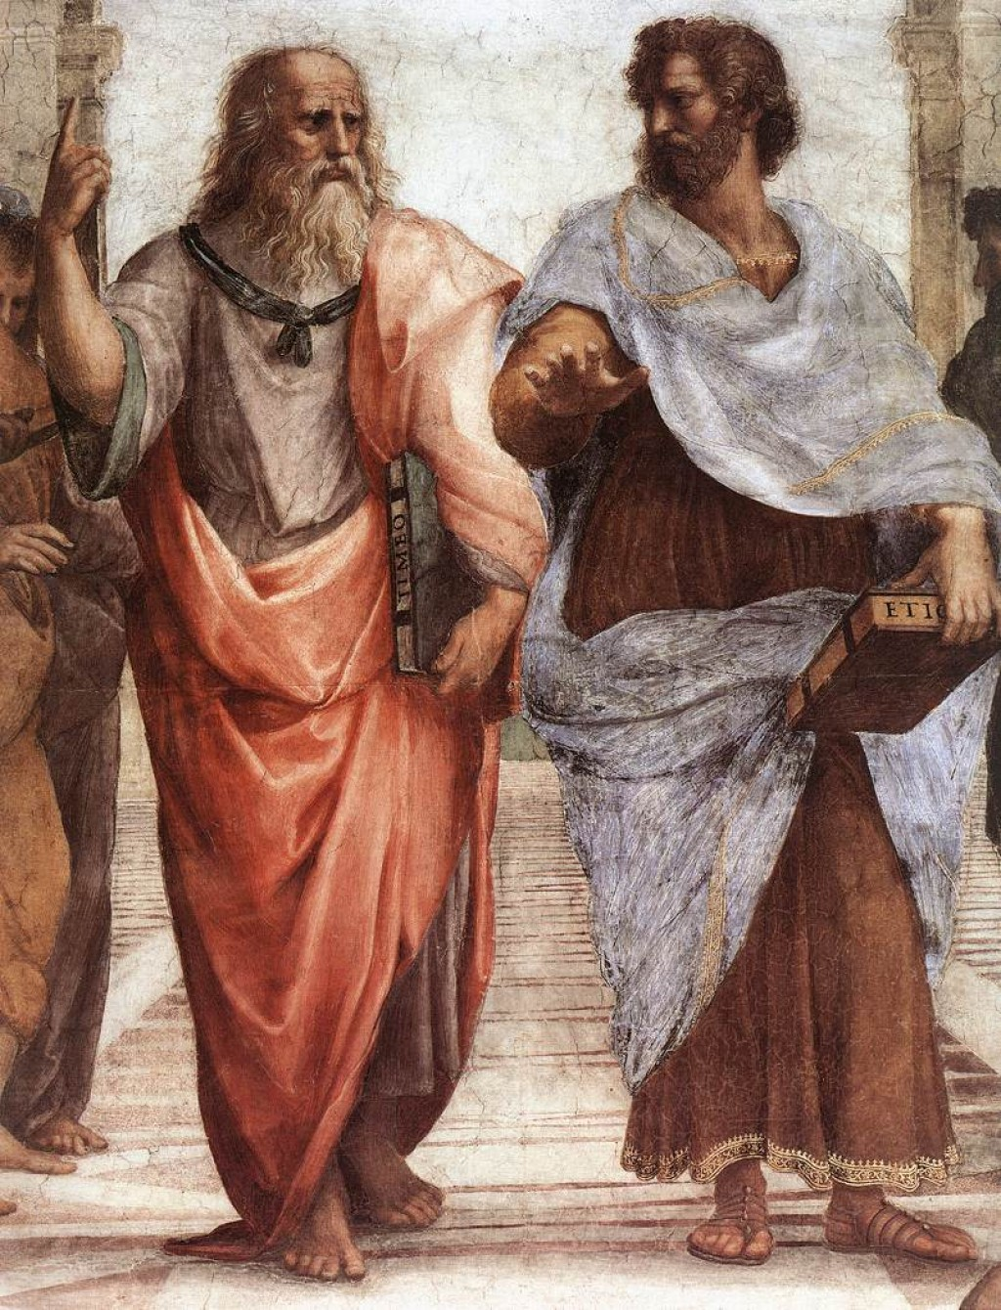

Introduction to Metaphysics (The first Philosophy/theology)
"Metaphysics is a dark ocean without shores or a lighthouse, strewn with many a philosophic wreck."
Plato & Aristotle

Slide 3
Etymology
Metá+phusiká (What comes after the physics).

Slide 4
Theory of the Mind
Most famous branch of Metaphysics

Slide 5
Discussion #1 Mind-body Problem
Is the mind and body a single being or separate?

Slide 6
Scary thought (Ockham’s (Occam’s) Razor)
The simplest definition for consciousness is a single mind that is hallucinating everything around it, and you have the only conscious mind about the universe.

Slide 7
 | Mind exists and can control the individual | Mind does not exist and therefore cannot control the individual
Body (including the physical brain) can control the individual | Interactionism (Both body and mind can control what a person does) | Physicalism (Mind is nothing but chemicals and reactions)
Body (including the physical brain) cannot control the human | Solipsism, where only the mind exists and everything else is a hallucination. | Well, that’s not true because we obviously are able to process information, either with both our mind and body or with body only. eal term)

Slide 8

Cogito, ergo sum (I think therefore I am)
In René Descartes' Meditations on First Philosophy, he addresses radical skepticism and concludes that the only mind one can be certain exists is one's own.

Slide 9
Discussion #2
Is Solipsism a valid philosophical position, and what are the implications of accepting or rejecting it?
Solipsism: The view or theory that the self is all that can be known to exist, and that everything else are figments of your mind (Previous slide)

