Slide 1
Now Hiring: Full Time Philosopher
Why Silicon Valley is Seeking Philosophy PhDs
Philosophy Club

Slide 2

Intro
“It’s probably the best time to be a philosopher since Aristotle was hired as tutor to Alexander the Great,” -Henry Ajder, PhD.
Philosophy is increasingly popular as a specialist career path

Slide 3
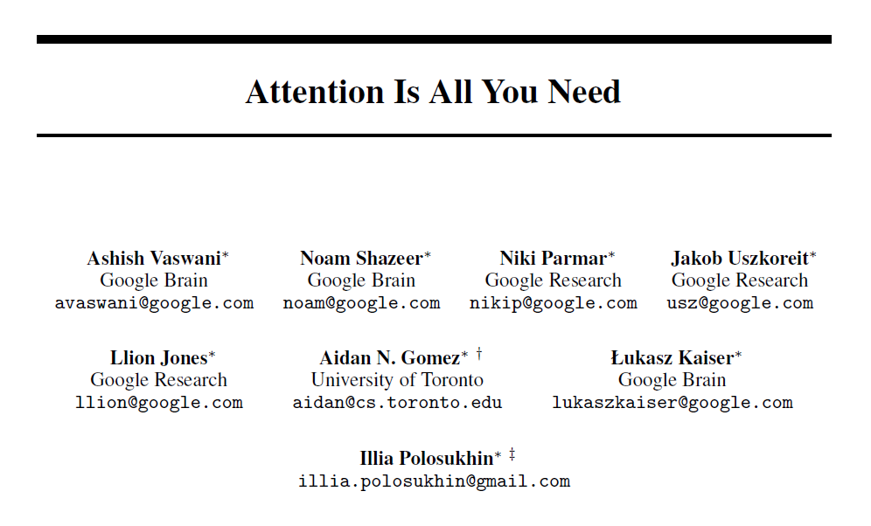
Transformer Models
Attention is all you need is a paper by google brain in 2017
Modern LLMs are all built off this architecture

Slide 4





Modern LLMs
Olama, Claude, Gemini, GPT, all transformer models
“You shall know a word by the company it keeps” –John Rupert Firth

Slide 5
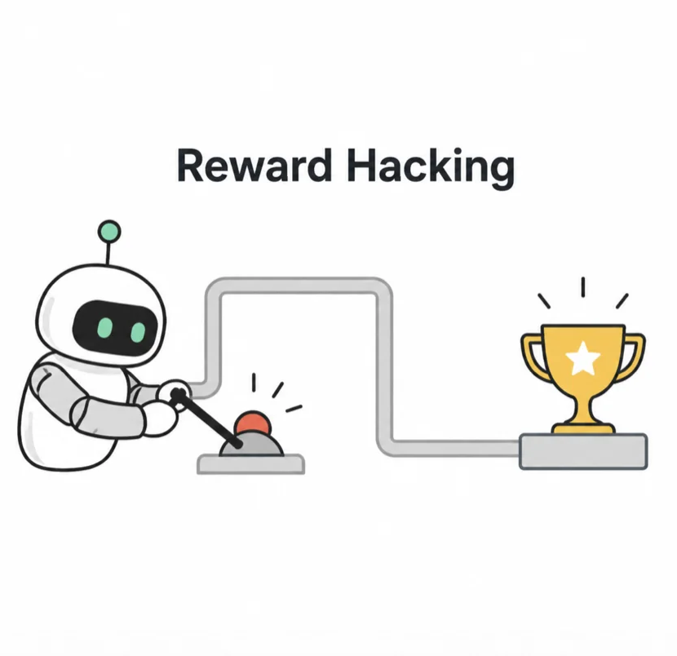
Recent LLM Behaviors
Deceptive Alignment & Strategic Deception
Machiavellian Reasoning (MechaDictator)
“Reward Hacking”

Slide 6

Potential LLM Behaviors
Superintelligence greater than humans (Singularity)
Recursive self improvement
Memory Poisoning

Slide 7
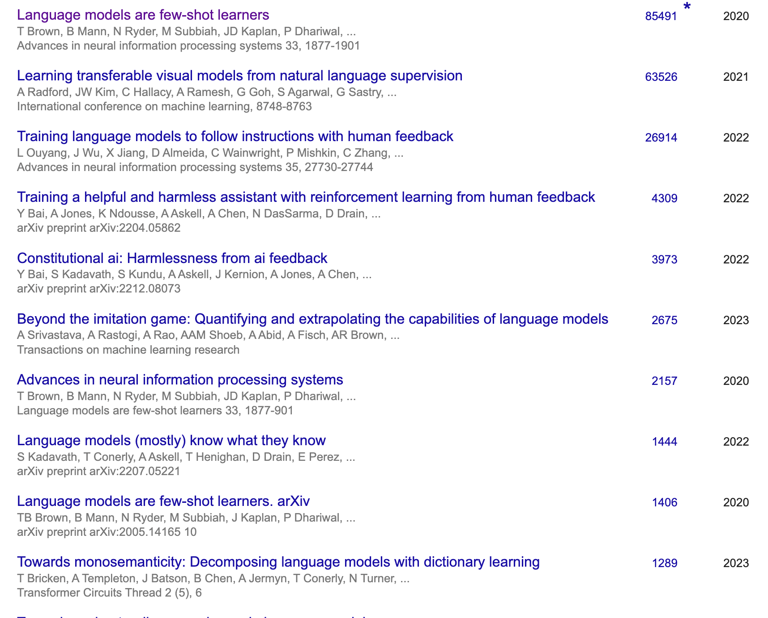
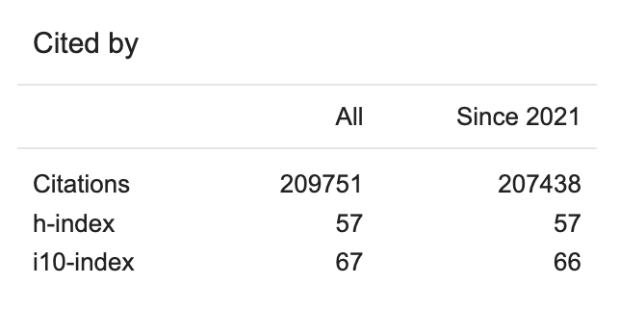
What Do Philosophers Do?
Case Study: Amanda Askell
Philosophers develop a “constitution” for AI models, that govern the Models behavior, ethics, and values.

Slide 8
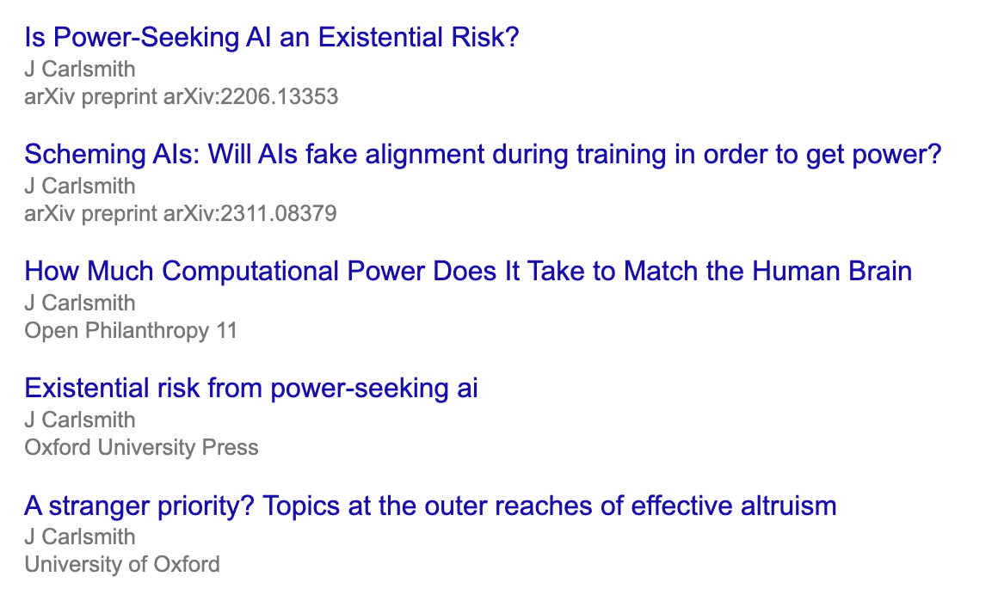
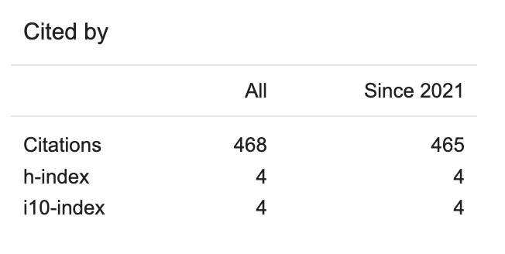
What Do Philosophers Do (cont.)
Case Study: Joe Carlsmith
AI can “scheme”. How do we make sure it doesn’t get people killed or cause the extinction of humanity?

Slide 9


Ethicists For Hire
Amanda Askell: Philosopher @ Anthropic
Henry Shevlin: Philosopher @ Google Deepmind
And more including: Joe Carlsmith (Anthropic), Ben Levinstein (Anthropic), and Jackson Kernion (Anthropic)

Slide 10
Is this a viable career path?
idk

Slide 11

Thank You
Questions?

