Slide 1
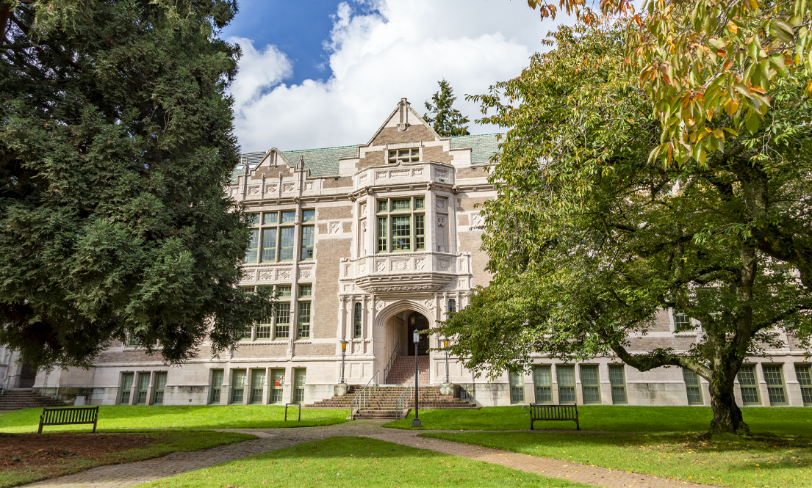
Erika Bigelow Interview
Philosophy Club

Slide 2
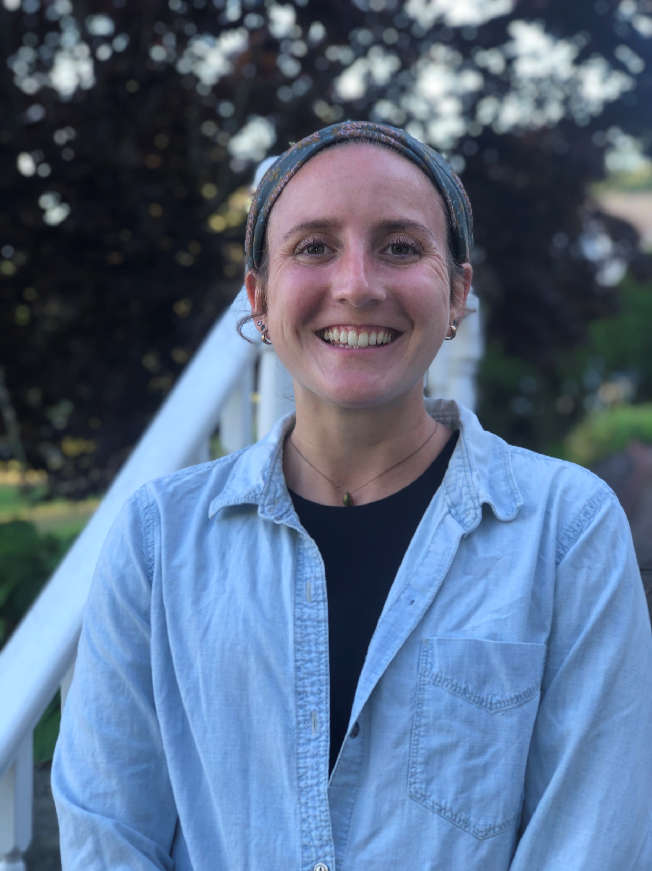
Introduction
Erica Bigelow is a philosopher and educator at the University of Washington whose research focuses on disability, feminist philosophy, the emotions, and the ethics of emerging technologies, particularly artificial intelligence. Alongside her research, she is an award-winning teacher dedicated to making philosophy accessible to students of all ages, from K–12 classrooms to the university level, encouraging thoughtful discussion and critical thinking.

Slide 3
Question #1
What made you get into philosophy?

Slide 4
Question #2
What branch are you interested in?

Slide 5
Question #3
Would you like to talk about your most recent work?

Slide 6
Question #4
What do you plan on doing after getting your PhD?

Slide 7
Question #5
How should we approach philosophy? How do we learn philosophy and how should we think about it?

