Slide 1

Are we alone in the universe?

Slide 2
Fermi Paradox
The Fermi paradox is the discrepancy between the lack of conclusive evidence of advanced extraterrestrial life and the apparently high likelihood of its existence.
There is a extremely high likelihood of its existence, but why haven’t we found any yet?

Slide 3
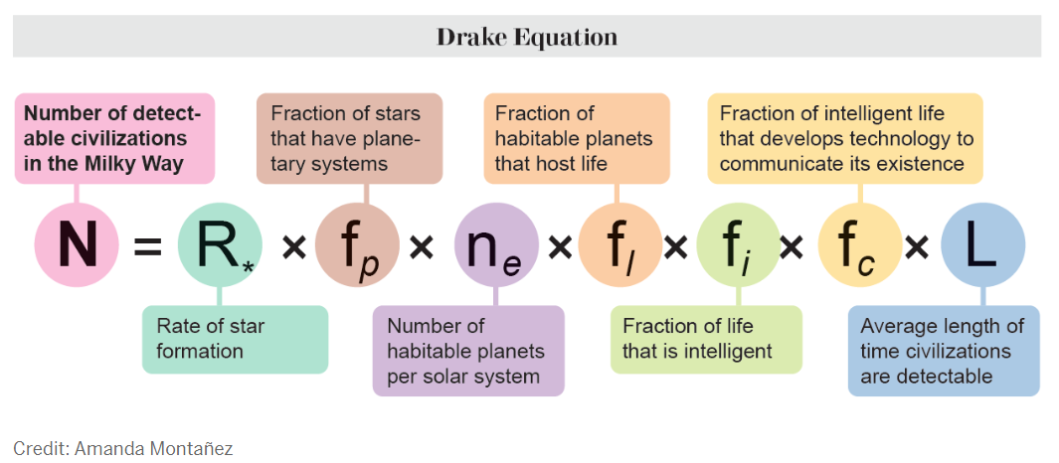
The Fermi Paradox
The Drake Equation estimates the number of active, communicative extraterrestrial civilizations in our galaxy. It multiplies several probabilities related to star formation, planet formation, the development of life, and technological advancement to gauge how many civilizations might be out there.
Notes:
Whoever goes “haha drake” during this part of the presentation deserves to get kicked from the club

Slide 4

About the Fermi Paradox
Origin: Named after physicist Enrico Fermi who famously asked, “Where is everybody?”
Key Points:
Vastness of the universe.
High number of potentially habitable planets.
Silence from the cosmos.

Slide 5
Possible Solutions
Great Filter: Some step in the evolution of life is extremely hard to get past.
Rare Earth Hypothesis: Complex life is incredibly rare.
Galactic Zoo Hypothesis: Advanced civilizations are deliberately avoiding us.
Technological Limitations: We may not have the means to detect other civilizations yet.

Slide 6
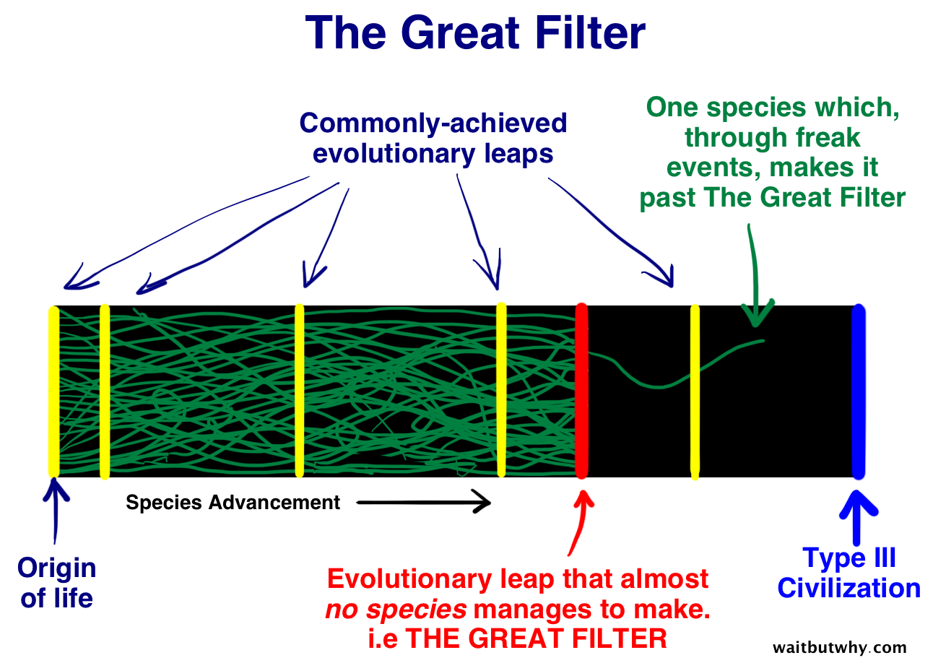
The Great Filter

