Slide 1

The Supply Chain Resilience Initiative
Group 5: Aren Mizuno, Daniel Babnigg, Emily Xue, Hoon Yum
March 9, 2026
Machine Learning I
Notes:
Emily

Slide 2


01
Executive Summary
Problem Definition
Model Selection
Financial Impact
Recommendations
LogistiCorp lacks a forward-looking, proactive risk management system to predict shipment disruption probability and delay severity before dispatch.
We built a linear regression model that explains 45% of delivery time deviation using pre-departure signals, which enables preemptive action for the highest-risk shipments.
Deploying our model enables proactive risk management that could create $11.7M in net savings per year, assuming a 50% intervention success rate.
Our recommendations include reassigning to alternative routes or higher-scoring drivers, as well as pre-staging and confirming assignments for crew and equipment before dispatch.
Notes:
15% rise in late-delivery penalties stems from reactive scheduling; built a pre-departure prediction model that explains 45% of delivery time deviation using only information before truck leaves, top drivers are route risk level, traffic congestion, weather severity. Deploying this model enables proactive re-routing/ rescheduling of the highest-risk shipments.
Emily

Slide 3

Problem Definition
02
LogistiCorp lacks a forward-looking, proactive risk management system to identify high-value, high-risk shipments before dispatch.
This results in avoidable financial penalties and contract renewal risk among its clients due to erosion of trust.
If identifiable, pre-departure risk signals can be captured to predict disruption probability and delay severity before dispatch, LogistiCorp can assign a shipment-level risk score to enable preemptive action and proactively manage risk.
Notes:
High-value shipments (?), penalty-driven contracts, trust erosion.
Emily

Slide 4
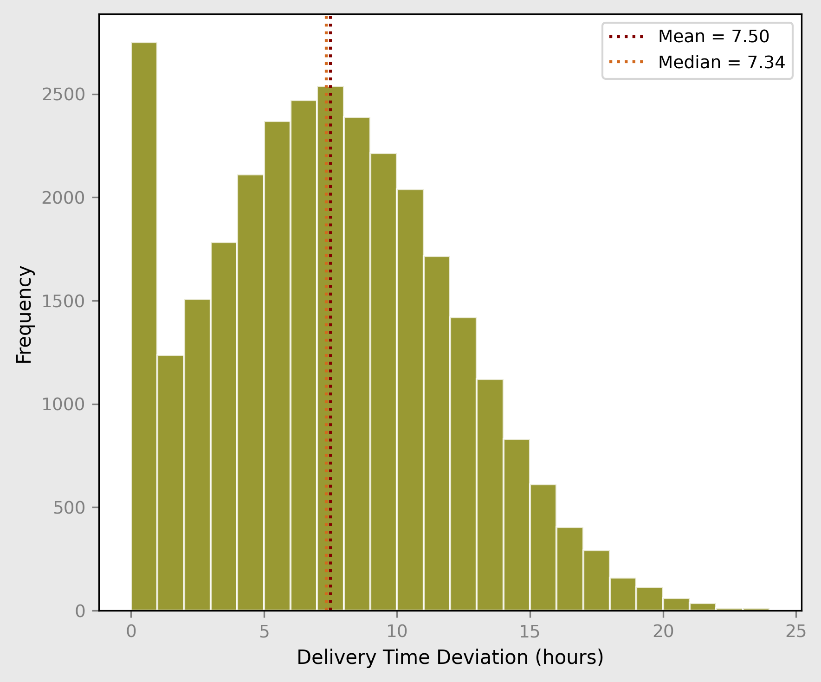
03
Exploratory Analysis
Dataset: 20 columns of shipment-level data ~32k shipments over 3.7 years (GPS, operations, weather, supplier scores, delivery outcomes)
Target: delivery_time_deviation (hours)
predicting deviation enables proactive intervention before departure to avoid late-delivery penalties
Data quality: ~2% missing; rows dropped no severe outliers; invalid inputs removed weak linear correlations with target no severe multicollinearity
Temporal: Uniform daily volume, no trend/seasonality
Notes:
32k shipment records, 20+ columns spanning GPS, weather, supplier scores, driver metrics. Individual shipment records. Careful leakage prevention, excluding all in-transit and post-shipment variables. usin g target delivery_time_deviation, right skewed with mean fo ~7.5 hours and op to 2 days. Only a few features show heavy correlation with target, so signals inherently unpredictable of in-transit events. Low missingness, dropped. No temporal trend, random train/test split justified. 13 features selected, business justification. 2 engineered features, day of week and driver risk score (explain). 20 columns after encoding.
Daniel

Slide 5
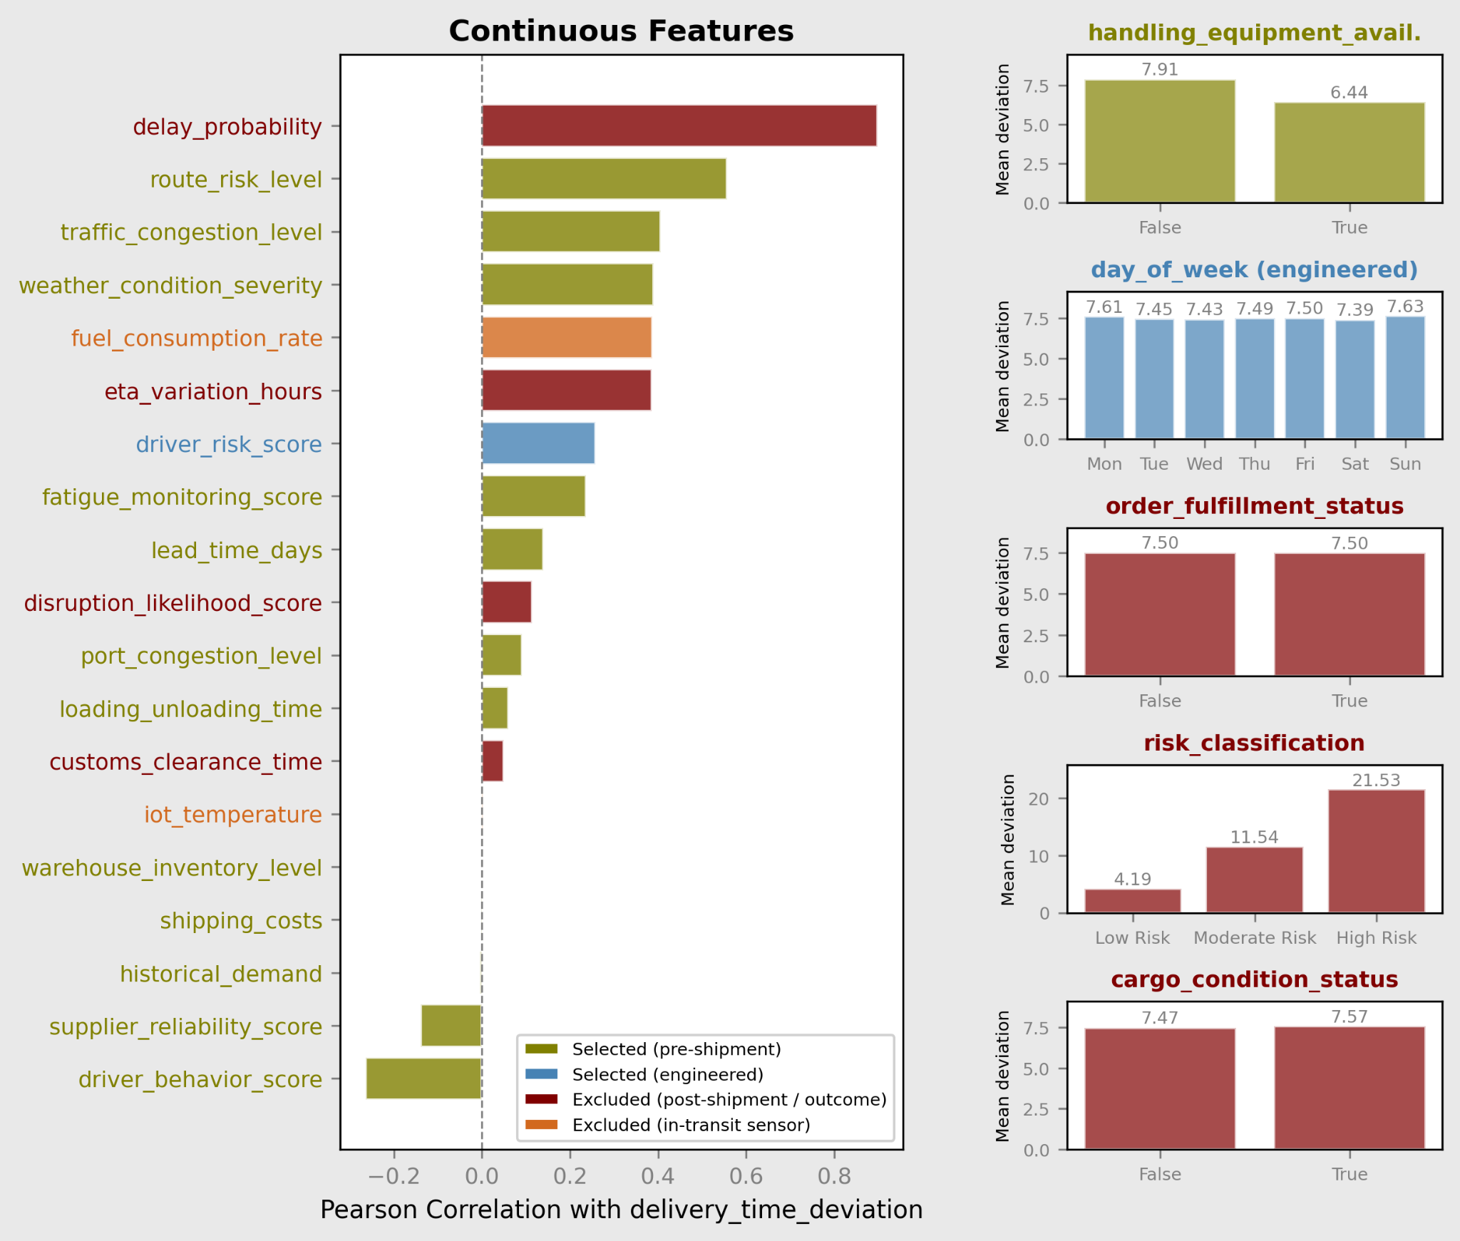
04
Data Preprocessing
Feature selection: retained 13 pre-shipment features excluded post-shipment outcomes (leakage) excluded in-transit sensors, and metadata
Feature engineering: day_of_week (from timestamp) driver_risk_score (interaction: poor behavior × high fatigue)
Encoding: one-hot encoded day_of_week (drop-first, fit on train only)
Train/test split: 80/20 random split; target distribution verified across sets
Scaling: StandardScaler inside Pipeline for linear models unscaled for tree-based models
Notes:
32k shipment records, 20+ columns spanning GPS, weather, supplier scores, driver metrics. Individual shipment records. Careful leakage prevention, excluding all in-transit and post-shipment variables. usin g target delivery_time_deviation, right skewed with mean fo ~7.5 hours and op to 2 days. Only a few features show heavy correlation with target, so signals inherently unpredictable of in-transit events. Low missingness, dropped. No temporal trend, random train/test split justified. 13 features selected, business justification. 2 engineered features, day of week and driver risk score (explain). 20 columns after encoding.
Daniel

Slide 6
05
Model Selection & Performance
Family | Model | Best CV Score | Test RMSE | Test MAE | Test R²
Linear | Linear Regression | -3.4104 | 3.3696 | 2.7073 | 0.4493
Linear | Ridge | -3.4104 | 3.3696 | 2.7073 | 0.4493
Linear | ElasticNet | -3.4103 | 3.3701 | 2.7085 | 0.4491
Linear | Lasso | -3.4102 | 3.3702 | 2.7085 | 0.4491
Tree | Gradient Boosting | -3.4227 | 3.3758 | 2.7203 | 0.4473
Tree | XGBoost | -3.4264 | 3.3760 | 2.7185 | 0.4472
Linear | PolyRidge (deg2) | -5.6823 | 3.3766 | 2.7191 | 0.4470
Tree | Random Forest | -3.4467 | 3.3972 | 2.7396 | 0.4403
Kernel | SVR (RBF) | -3.4489 | 3.4006 | 2.7248 | 0.4391
Predicting delivery_time_deviation, continuous hours a shipment deviates from its scheduled delivery time
Supervised learning
Tested linear, tree, and kernel models on 5-fold CV using gridsearch
RMSE as primary metric
Same unit interpretability
Penalizes large errors
Very similar test metrics
Linear Regression was selected
Best RMSE, MAE, R²
Interpretable
Notes:
Lots of models covered linear (LR, ridge, lasso, elastic net), tree (RF, GBR, XGBoost), kernel (SVR-RBF), polynomial (polyridge deg-2). 5-fold CV with gridsearch CV, primary metric RMSE used. Models converged to around 0.45. Best model maybe is ridge? Simplest model that has good performance. RMSE penalizes large deviations more heavily -> aligned with logisticorp’s penalty structure, bigger deplays = more fines. We did not use classification because we need to think about magnitude of interventions.
Aren

Slide 7
The "Data Why": Key Features Driving the Model
06
Variable | LR Coefficient
traffic_congestion_level | 1.3718
driver_behavior_score | -1.1763
weather_condition_severity | 1.1430
route_risk_level | 0.7780
handling_equipment_availability | -0.6470
port_congestion_level | 0.4454
supplier_reliability_score | -0.3431
lead_time_days | 0.3354
loading_unloading_time | 0.2781
There is a large drop in coefficient magnitude from 0.2781 to 0.0538, so we will focus on the top 9 variables above this cutoff to understand key drivers
A 1 standard deviation increase in the variable increases delivery time by coefficient hours, holding everything else constant
The largest coefficients in the model are traffic congestion (1.37), driver behavior (−1.18), weather severity (1.14), and route risk (0.78) which all relate to the driving environment
Notes:
Aren

Slide 8
07
Financial Impact
Annual Penalty Exposure
$97.1M
8,094 late ships/yr × OTIF 80%
= 6,475 at-risk × $15K
Sweet Spot (Intervention Target)
2,750/yr
deviation 0.5h - 6.0h 31.5% of shipments
Base Case Net Savings
$13.9M/yr
Gross $16.5M - costs $2.6M (OTIF 80% · success 50%)
Sensitivity Analysis - varying Intervention Success Rate (LogistiCorp’s operational effort)
Intervention Success Rate | Ships Saved /yr | Gross Savings | Total Cost | NET Savings | Note
20% | 440 | $6.6M | $2.6M | $4.0M | Minimal effort
50% ◀ Base | 1,100 | $16.5M | $2.6M | $13.9M | Assumed baseline
100% | 2,200 | $33.0M | $2.6M | $30.4M | Theoretical ceiling
Assumptions: cargo $500K/truck · penalty 3% ($15K) · OTIF contract 80% (electronics 3PL norm) · dock threshold 0.5h · max intervention 5.5h (correlation-based, not causal) · consulting $400K/yr · intervention $1K/ship attempt
Annual Cost Assumptions (deducted from gross savings)
Cost Item | Assumption | Annual Amount | Basis
Consulting & model operations | Fixed Annual | $400,000 | System maintenance, monitoring, analyst support
Per-shipment intervention cost | $1,000 / attempt | $2,200,000 | Extra loading/handling on 2,200 at-risk ships
Total annual cost |  | $2,600,000 | Applied regardless of intervention success rate
Notes:
Hoon

Slide 9

08
Operational Recommendations
Where do 8,736 annual shipments land? → Only the Sweet Spot is both saveable and worth intervening.
On-Time 7.3%·642/yr | SWEET SPOT 31.5%·2,750/yr | Moderate Delay 32.0%·2,791/yr | Heavy / Extreme Delay 29.2%·2,553/yr
0.5h
6.0h
10h
predicted deviation →
Sweet Spot: predicted deviation 0.5h < d ≤ 6.0h → close enough for intervention to work : max 5.5h keeps below 0.5h threshold (dock grace period)
Pre-Departure Action Protocol for Sweet Spot Shipments (executed at dispatch flag, before truck departs)
Feature (Model Signal) | Coefficient | Max Reduction (1 IQR shift) | Dispatcher Action on Flagged Shipment | Owner
driver_behavior_score | −1.18 | −2.35h | Swap to higher-scoring driver if available at depot | Dispatcher
handling_equipment_availability | −0.65 | −1.45h | Confirm forklift/dock door assignment before departure window | Yard Ops
route_risk_level (highest impact) | +0.78 | −1.15h | Reassign to alternative corridor with lower congestion/risk score | Dispatcher
loading_unloading_time | +0.28 | −0.53h | Pre-stage crew and equipment 30 min before scheduled loading | Yard Ops
Combined ceiling (all 4 applied) |  | −5.48h | Brings predicted delay from 6.0h → ≤ 0.5h (within dock threshold) → OTIF penalty avoided
Coefficients are correlational, not causal — actual savings require A/B pilot validation. All signals are pre-departure (no in-transit data required). R² = 0.45 · RMSE = 3.37h
Why the Sweet Spot only?
On-Time (≤ 0.5h) · 642/yr | Already within dock threshold. No penalty risk. No intervention needed.
Moderate / Heavy(>6.0h) · 5,344/yr | Predicted delay exceeds max intervention capacity(5.5h) / Even perfect execution cannot bring below threshold. Do no waste resources - escalate or renegotiate appointment
Notes:
Hoon

Slide 10

Thank you!
Any questions?
Notes:
hoon

Slide 11
Appendix A Penalty Rate Structure & Calculation Basis
1. Penalty Rate Structure (Industry Standard)
Penalty Type | Structure | Typical Range | LogistiCorp Scenario
% of Invoice (On-Time In-Full) | Applied to total Purchase Order value at time of Service Level Agreement breach | 1–5% (Walmart: 3%) | $500K × 3% = $15,000/incident
Per-Day Rolling | 1–2%/day, compounding; capped ~10% of shipment value | 1–2%/day | N/A (OTIF % structure assumed)
Flat-Rate Admin Fee | Dock no-show, missed ASN, scheduling failure | $50–$5,000/instance | Not modeled (minor vs. $15K)
2. Late Truck Fate (Industry consensus)
Scenario | Freq. | What Happens | Penalty?
Work-In (wait for open dock) | 75–85% | Driver waits 4–12h unpaid; detention fee uncollectable (SLA breach); ATRI avg $99.54/hr operating cost | Yes — at missed appt. time
Gate Rejection (reschedule) | 15–25% | Next available slot (may be Monday if Friday) | Yes + re-delivery cost
3. Calculation Assumptions
Assumption | Value | Source / Status
Cargo value / truck | $500,000 | Cargo insurance threshold; high-value electronics
Penalty rate | 3% → $15K | Walmart OTIF standard; industry benchmark
Dock grace period | 0.5h | Industry benchmark
Max intervention effect | 5.5h | Correlation-based IQR upper bound; NOT causal
OTIF customer rate | 80% | Electronics 3PL norm (Walmart/Target/Best Buy)
Intervention success | 50% (base) | To be validated via 3-month pilot A/B test
Consulting & model ops | $400K/yr | Fixed annual; system maintenance + analyst support
Intervention cost | $1,000/ship | Extra loading/handling per flagged shipment (2,200 attempts/yr)
ATRI 2024 Detention Report · Walmart OTIF Program
‹#›

Slide 12
Appendix B Financial Impact Calculation Walk-Through (Base Case)
Step | Item | Calculation | Result
1 | Annual shipment volume | 32,060 records ÷ 3.67 years | 8,736 /yr
2 | Max intervention (4 features × −1 IQR) | driver −2.35h + equipment −1.45h + route_risk −1.15h + loading −0.53h | 5.5h
3 | Sweet spot window | dock threshold 0.5h → upper bound 0.5h + 5.5h | 0.5h – 6.0h
4 | Sweet spot shipments / yr | 10,091 records in window ÷ 3.67yr | 2,750 /yr
5 | Penalty-at-risk (OTIF cascade) | 2,750 × OTIF customer rate 80% | 2,200 /yr
6 | Ships saved (base case) | 2,200 × intervention success rate 50% | 1,100 /yr
7 | Gross savings | 1,100 ships × $15,000 penalty avoided | $16,500,000
8a | Less: Consulting & model ops | Fixed annual cost | −$400,000
8b | Less: Intervention cost | 2,200 attempts × $1,000/ship | −$2,200,000
 | NET ANNUAL SAVINGS (Base Case) | $16,500,000 − $400,000 − $2,200,000 | $13.9M /yr
Critical Caveats
① Max intervention 5.5h is correlation-based (IQR × coefficient), NOT causal — actual Δh requires A/B pilot.
② OTIF 80% is industry-norm estimate — LogistiCorp to confirm customer contract mix.
③ Intervention success 50% is unvalidated — the single most critical input to measure in a 3-month pilot.
‹#›

Slide 13
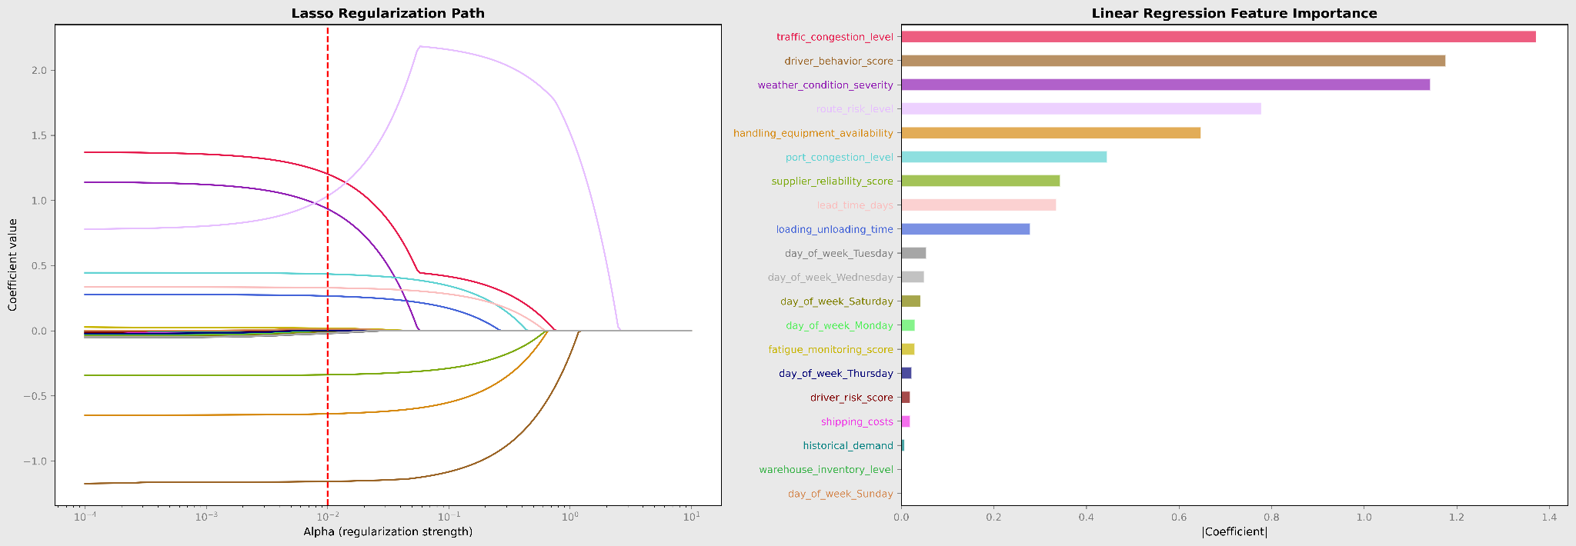
Appendix C Feature Importance
Lasso Regularization Path: As regularization increases, weak features shrink to zero first. route_risk_level, driver_behavior_score, and traffic_congestion_level persist longest - these carry the strongest signal. The red dashed line marks the CV-selected alpha.
Linear Regression Coefficients: Absolute coefficient magnitude confirms the same top features. Day-of-week dummies contribute minimally, consistent with the flat temporal pattern observed in EDA. The two methods agree: a small subset of operational and driver-related features drives most of the prediction.
‹#›

