Slide 1

Beating the 1X2
Can machine learning beat football’s closing market?
ADSP 32021: MLOps Final Project · Professor Abado · Summer 2026
Aren Mizuno · Nick Dhaliwal · Arthur Acker · Nick Mikhail
github.com/arenmizuno/beating-1X2
THE UNIVERSITY OF
CHICAGO
Notes:
[Sources]
- Project repository: https://github.com/arenmizuno/beating-1X2
- UChicago branding inherited from the user-provided source deck.

Slide 2




Meet the Team
Aren Mizuno
Arthur Acker
Nick Mikhail
Nick Dhaliwal
UChicago ‘25 Data Science and Business Economics
Serving, Deployment, Dashboard, MLOps Infra Glue
McGill ‘25 Statistics and Computer Science
Machine Learning Modeling, Evaluation
Pomona College ‘25 Mathematics
Drift Simulation, Anomaly Verification
UC Berkeley ‘24 Economics and Legal Studies
Ingestion, EDA, Harmonization, Feature Engineering
THE UNIVERSITY OF
CHICAGO
2
Notes:
[Sources]
- Team portraits and biographies inherited from the user-provided source deck.

Slide 3
Problem Statement
Research question
Can pre-kickoff signals beat the closing line, or improve it when the market is included as an input?
The task
Classification of Home / Draw / Away using only information available before kickoff
The value bet
Flag a wager where model probability exceeds the market-implied probability by more than a threshold
What “beating the market” means
A lower probabilistic log loss than the vig-free closing line: not just better accuracy
Why it is hard
The closing line aggregates the sharpest money, so beating it is the standard test of market efficiency
THE UNIVERSITY OF
CHICAGO
3
Notes:
[Sources]
- Project README.md, sections Problem framing and evaluation tracks.

Slide 4
Data & EDA
14,285
matches ingested, 2018-19 to 2025-26
99.99%
cross-source join rate (14,284 / 14,285)
13,786
matches usable once rolling metrics are calculated
Three sources, one row per match
EDA highlight
Home advantage is persistent: the home-win rate holds at 44-45% in every season except 2020-21, when it fell to 39.8% with empty stadiums
That dip is not noise. It returns on the monitoring slide as target drift at p < 0.0001, measured against a pre-COVID reference window.
football-data.co.uk: closing odds and results
Understat: shot-level expected goals
ClubElo: team strength ratings
Top-5 European leagues: EPL, La Liga, Bundesliga, Serie A, Ligue 1
Class balance
Home win 44%
Draw 26%
Away win 30%
THE UNIVERSITY OF
CHICAGO
4
Notes:
[Sources]
- football-data.co.uk: https://www.football-data.co.uk/
- Understat: https://understat.com/
- ClubElo: http://clubelo.com/
- Project reports/summary.md.

Slide 5
Evaluation Metric & Two Baselines
Primary metric
Vig-free closing market line
Shin devig: the true odds of a bookmaker
0.9693
Multiclass log loss: a proper scoring rule that punishes overconfident probabilities
The right lens for betting, where a calibrated probability matters more than raw accuracy
Accuracy alone is useless here: a 44% home-win prior gets you most of the way with no skill
Dixon-Coles Poisson goals model
The reasonable-model control. Price-blind, and deliberately kept out of the feature set so it stays an independent comparison
0.9928
Split discipline Five walk-forward evaluation folds; champion selection uses the four folds shared by every candidate. The 2025-26 holdout stays sealed until deployed validation.
THE UNIVERSITY OF
CHICAGO
5
Notes:
[Sources]
- Project reports/summary.md and reports/model_vs_market.csv.
- Project src/splits.py and reports/champion.json for fold protocol.

Slide 6
System Architecture
Training
Ingest
3 sources
→
Harmonize
Hungarian matching
→
Devig
Shin, vig-free
→
Features
leakage-guarded
→
Walk-forward
5 eval folds
→
Compare
18 configs · 4 folds
→
MLflow
champion alias
Serving
Docker + FastAPI
one compose command
→
Resolve alias
models:/beating-1x2@champion
→
Predictions
+ value flags
→
Monitoring
HTTP holdout + alerts
Two orchestrators, two jobs
DVC
Reproducible build DAG
Prefect
Scheduler and runtime: concurrent ingestion, retries, observability
THE UNIVERSITY OF
CHICAGO
6
Notes:
[Sources]
- Project dvc.yaml, flows.py, src/api.py, src/train.py, and README.md.

Slide 7
Ingestion & Feature Engineering
1
Ingestion
Three third-party sources pulled concurrently with retries under Prefect, cached and throttled to be polite towards servers providing data
Leakage discipline
shift-then-roll
Every rolling window is shifted by one match, so a fixture never sees itself. Only prior matches feed a prediction, and the walk-forward splits enforce it
Mutation-tested guard
CI flips shift(1) to shift(0) and fails the build if the leakage tests stay green
One feature code path
Training and serving run the same code, so there is no train/serve skew to reconcile
2
Harmonization
Every club is spelled three ways so team-name matching is solved as a global assignment with the Hungarian algorithm, giving a 99.99% join
3
Market devig
The Shin method strips the bookmaker margin, leaving vig-free market probabilities
86 features, two generations
Base: rolling form over 5 and 10 matches, Elo ratings, rest days, Dixon-Coles attack and defense strengths
Engineered: strength of schedule, Elo over-performance, home and away split form, EWMA-weighted form, fixture congestion, season points per game, promoted-team flag
4
Honest result: the engineered features left the gap to the market unchanged
THE UNIVERSITY OF
CHICAGO
7
Notes:
[Sources]
- Project src/features.py, src/harmonize.py, src/market.py, and tests/test_features.py.

Slide 8
Models & Modeling Approach
market_blind
Features only, no odds. Can we predict outcomes from the game itself?
market_aware
The closing line added as a feature. Given the market’s own number, can we improve on it?
Six model families
Logistic regression
Linear and interpretable
LightGBM
Gradient-boosted trees
XGBoost
Gradient-boosted trees
CatBoost
Gradient-boosted trees
MLP
Neural net (multilayer perceptron)
Stacking
Logistic meta-learner over the calibrated boosters
Each booster also runs a hyperparameter-tuned variant, giving 9 configurations per track and 18 runs in total.
Every model is probability-calibrated: betting needs trustworthy probabilities, not just correct rankings
THE UNIVERSITY OF
CHICAGO
8
Notes:
Arthur

Slide 9
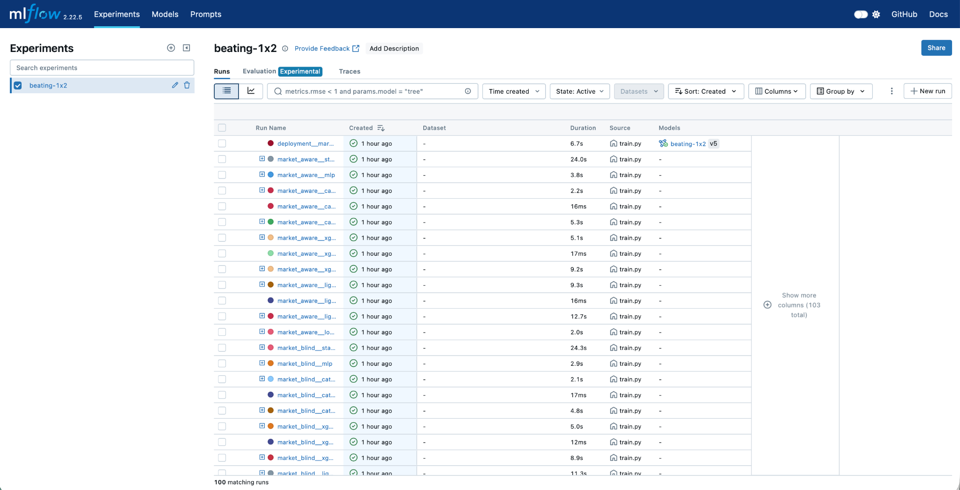
Experiment Tracking & Model Selection
MLflow tracks every run’s params, metrics and artifacts. The registry holds beating-1x2 with a @champion alias and tags
18 candidate configurations across 2 tracks, compared on walk-forward log loss
Champion: market_aware / catboost_tuned, 86 features, MLflow @champion alias, SemVer 1.0.1
Selected at 0.9749 on four common folds
Calibration: sigmoid won all 10 comparisons; isotonic emitted exact zeros (infinite log loss)
THE UNIVERSITY OF
CHICAGO
9
Notes:
Arthur

Slide 10
Model Results
Four common walk-forward folds, market_aware track. Bar length = gap above the market line (lower is better).
This equal-fold view is the protocol used to select the champion.
The market leads every aggregate view
Every full fold, every league aggregate, both tracks. The smallest gap is the champion’s +0.0074.
catboost_tuned (champion)
0.9749 +0.0074
xgboost_tuned
0.9751 +0.0076
stacking
0.9779 +0.0104
catboost
0.9784 +0.0110
market_aware narrows, but cannot close, the gap
Adding the closing line improves ML sharply, yet the best model still trails it
logistic
0.9850 +0.0175
xgboost
0.9878 +0.0203
lightgbm_tuned
0.9896 +0.0221
Dixon-Coles baseline
0.9908 +0.0234
Seven beat Dixon-Coles
Seven of nine configurations land between the market and the price-blind Poisson baseline; only two score worse.
mlp (neural net)
0.9949 +0.0274
lightgbm
0.9990 +0.0316
Market (vig-free close) = 0.9675
THE UNIVERSITY OF
CHICAGO
10
Notes:
Arthur

Slide 11
Value-Bet Backtest
-1.6%
With this few bets at mean odds near 6, the ROI number carries a huge error bar
No configuration is profitable: Across the 0.02-0.20 threshold sweep, not one produces an ROI whose 95% CI excludes zero
Only 23-46% of selections beat the close
flat ROI: champion, walk-forward
95% bootstrap CI [-10.0%, +7.8%]
2,429
bets placed
The trap we avoided
Best point estimate across every model and threshold: +0.03% ROI, from the champion on a relative-edge rule, worth +0.4 units on 1,319 bets. Its CI is [-14.9%, +15.5%]. That is pure noise, and reporting it as a win would be noise-mining.
31.2%
strike rate
-3.4%
mean CLV
THE UNIVERSITY OF
CHICAGO
11
Notes:
Nick D
[Sources]
- Project reports/value_backtest.csv and reports/value_backtest.md.

Slide 12
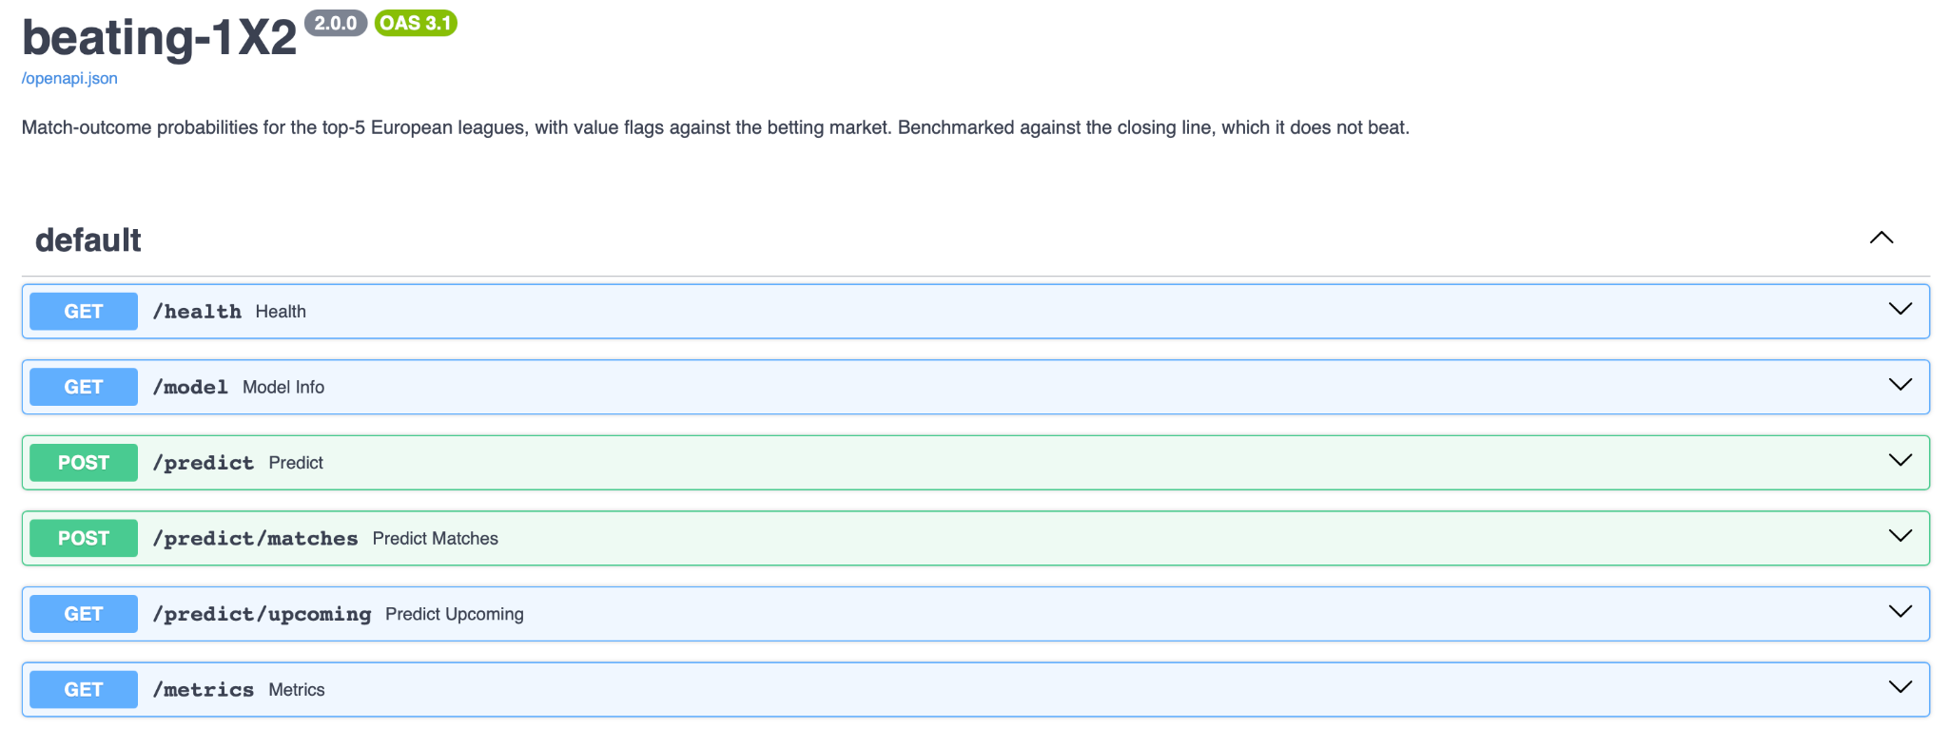
Deployment and Serving: Containerized API
docker compose up --build starts three services: the API on :8000/docs, the monitoring dashboard on :8501, and the MLflow UI on :5001
The model is swappable by alias. Replacing it is a re-registration plus a restart, with zero changes to serving code
GET /health reports the loaded model version, its SemVer and the @champion alias
Live prices are not closing prices
Upcoming fixtures are scored against current, softer odds, so live value flags fire more readily than the backtest does
THE UNIVERSITY OF
CHICAGO
12
Notes:
Nick D.
[Sources]
- Project src/api.py and src/predict.py; screenshot captured from http://127.0.0.1:8000/docs.

Slide 13
Production Monitoring
Stack: custom KS and PSI statistics (version-proof) plus Evidently HTML reports for each season from 2020 to 2025
Reference window is 2018-19 and 2019-20 only. A baseline has to predate the shift you want to detect
Thresholds: KS alpha = 0.01, PSI = 0.20, across 54 monitored features
Recent seasons flag 2 to 6 of the 54 features, consistent with roster and schedule churn. Calibration decay is tracked as gap-to-market, so a hard season for everyone does not false-alarm as model decay
Real detected drift: the 2020-21 COVID season
p < 0.0001
target drift against the pre-COVID reference
39.8%
home-win rate, down from 44 to 45% either side
+0.095
worst calibration gap vs market (market_blind / logistic, 2020)
THE UNIVERSITY OF
CHICAGO
13
Notes:
Nick D
[Sources]
- Project reports/drift/drift_metrics.json and reports/drift/calibration_decay.csv.

Slide 14
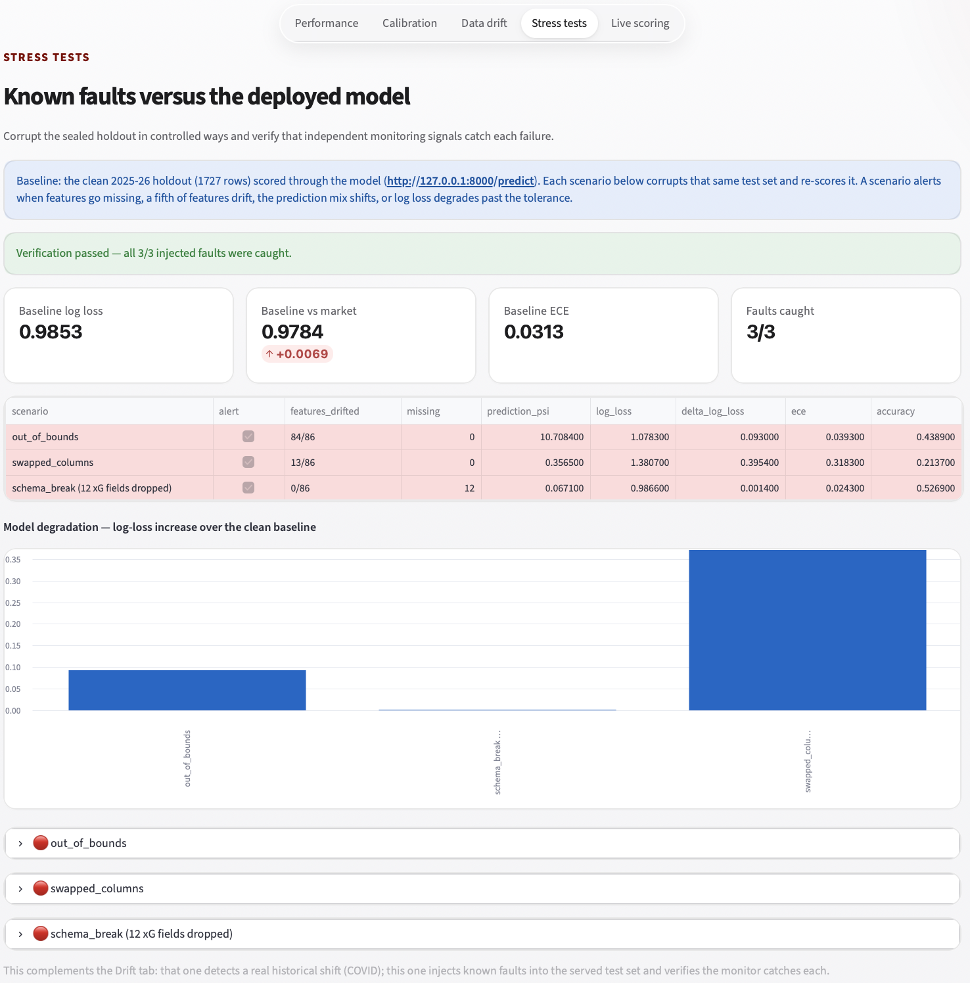
Drift Simulation & Anomaly Verification
Baseline first: clean 2025-26 holdout, 1,727 rows, log loss 0.9853 vs market 0.9784, scored through HTTP /predict. Faults run only after the baseline passes
Injected fault | Corruption | What caught it
out_of_bounds | Every feature pushed 5 to 15x past its range | 84/86 features drift; prediction PSI 10.71
swapped_columns | Home and away swapped, market price flipped | Log loss +0.395; prediction PSI 0.36
schema_break | The xG feature family dropped | 12 missing features; log loss +0.001
One detector is never enough
Input drift catches extreme values; prediction and performance checks expose the column swap; schema validation catches missing xG. The batch validation suite combines every signal before declaring a pass.
THE UNIVERSITY OF
CHICAGO
14
Notes:
[Sources]
- Project reports/drift/stress_test.json and reports/drift/stress_test.html; all scenarios scored through HTTP /predict.

Slide 15
Conclusions
The negative result is the deliverable
No model beats the market in any aggregate fold, league or track comparison: six families across nine configurations, three tuned
On four common folds, tuned CatBoost scores 0.9749 and Dixon-Coles 0.9908; both trail the market at 0.9675
On the deployed 2025-26 holdout, CatBoost scores 0.9853 vs market 0.9784 — a stable +0.0069 gap
No value threshold yields a profit whose CI excludes zero, and CLV is negative throughout
Interpretation: public pre-kickoff data improves a price-blind baseline but adds no reliable edge beyond the closing market
What we delivered: a reproducible, leakage-proof, versioned, deployed and monitored pipeline that establishes a negative result credibly
Why the engineering matters more than the answer
A pipeline that let us fool ourselves into a fake edge would be worse than useless. The value here is that we can trust the “no”: walk-forward splits, an HTTP-scored sealed holdout, a market baseline as leakage tripwire, and bootstrap CIs on every economic claim
THE UNIVERSITY OF
CHICAGO
15
Notes:
[Sources]
- Project reports/champion.json, reports/summary.md, reports/value_backtest.csv, and reports/drift/stress_test.json.

Slide 16
Limitations & Future Work
Limitations
Future work
Longshot bias: at a 0.05 absolute edge the rule flags 74-89% of fixtures at mean odds above 4.7
2020-21 is a genuine distribution shift – no honest tuning fixes it
CLV caveat: value is flagged against closing-derived probability, so this is not a clean bet-at-open simulation
Understat is scraped, with no documented API
Cut from scope: historical injury data (no free feed) and prediction markets as a historical training source
Hosted deployment with a scheduled Prefect server
Train on more data
Historical injury data
Prediction-market prices as a model input (Kalshi, Polymarket)
Automated release promotion and SemVer bumps from CI
THE UNIVERSITY OF
CHICAGO
16
Notes:
[Sources]
- Project README.md, params.yaml, and reports/drift/drift_metrics.json.

Slide 17
Questions?
github.com/arenmizuno/beating-1X2
THE UNIVERSITY OF
CHICAGO
17
Notes:
[Sources]
- Project repository: https://github.com/arenmizuno/beating-1X2
- Verified locally: 98 tests passed; dvc status reported all stages up to date.

