Slide 1

Beating the 1X2
Can machine learning beat football’s closing market?
ADSP 32021: MLOps Final Project · Professor Abado · Summer 2026
Aren Mizuno · Nick Dhaliwal · Arthur Acker · Nick Mikhail
github.com/arenmizuno/beating-1X2
THE UNIVERSITY OF
CHICAGO
Notes:
[Sources]
- Project repository: https://github.com/arenmizuno/beating-1X2
- UChicago branding inherited from the user-provided source deck.

Slide 2




Meet the Team
Aren Mizuno
Arthur Acker
Nick Mikhail
Nick Dhaliwal
MS Applied Data Science, UChicago
BA Data Science & Business Economics, UChicago
Data Science Intern, Actelligent
Data Science Intern, Morningstar
MS Applied Data Science, UChicago
BS Data Science, UChicago
Data Science Project Manager, CharacTour
Data Science Team Member, Internet Equity Initiative
MS Applied Data Science, UChicago
BA Psychology & Minor in Data Science, UChicago
Research Assistant, Social-Human AI Interactions and Impressions Lab
Research Assistant, UChicago Light Lab
MS Applied Data Science, UChicago
BA Economics; Legal Studies, UC Berkeley
Asset Pricing Research, Economics Department, UC Berkeley
Business and Operations Analyst, Grocery Chain
THE UNIVERSITY OF
CHICAGO
2
Notes:
[Sources]
- Team portraits and biographies inherited from the user-provided source deck.

Slide 3
Problem Statement
Research question
Can public pre-kickoff signals beat the closing line—or improve it when the market is included as an input?
The task
Two-track classification of Home / Draw / Away using only information available before kickoff.
The value bet
Flag a wager where model probability exceeds the market-implied probability by more than a threshold.
What “beating the market” means
A lower probabilistic log loss than the vig-free closing line: a genuine informational edge, not just better accuracy.
Why it is hard
The closing line aggregates the sharpest money, so beating it is the standard test of market efficiency.
THE UNIVERSITY OF
CHICAGO
3
Notes:
[Sources]
- Project README.md, sections Problem framing and evaluation tracks.

Slide 4
Data & EDA
14,285
matches ingested, 2018-19 to 2025-26
13,786
usable once both sides need prior history
99.99%
cross-source join rate (14,284 / 14,285)
Three sources, one row per match
EDA highlight
Home advantage is persistent: the home-win rate holds at 44 to 45% in every season except 2020-21, when it fell to 39.8% with empty stadiums.
That dip is not noise. It returns on the monitoring slide as target drift at p < 0.0001, measured against a pre-COVID reference window.
football-data.co.uk: closing odds and results
Understat: shot-level expected goals
ClubElo: team strength ratings
Top-5 European leagues: EPL, La Liga, Bundesliga, Serie A, Ligue 1
Class balance
Home win 44%
Draw 26%
Away win 30%
THE UNIVERSITY OF
CHICAGO
4
Notes:
[Sources]
- football-data.co.uk: https://www.football-data.co.uk/
- Understat: https://understat.com/
- ClubElo: http://clubelo.com/
- Project reports/summary.md.

Slide 5
Evaluation Metric & Two Baselines
Primary metric
Vig-free closing market line
Shin devig. The bar to clear: the sharpest public probability there is. Doubles as a leakage tripwire, since a sharp line lands near 0.95 to 1.02.
Multiclass log loss: a proper scoring rule that punishes overconfident probabilities
The right lens for betting, where a calibrated probability matters more than raw accuracy
Secondary: Brier score, ECE for calibration, accuracy
Accuracy alone is useless here: a 44% home-win prior gets you most of the way with no skill
0.9691
Dixon-Coles Poisson goals model
The reasonable-model control. Price-blind, and deliberately kept out of the feature set so it stays an independent yardstick.
0.9926
Split discipline Five walk-forward evaluation folds; champion selection uses the four folds shared by every candidate. The 2025-26 holdout stays sealed until deployed validation.
THE UNIVERSITY OF
CHICAGO
5
Notes:
[Sources]
- Project reports/summary.md and reports/model_vs_market.csv.
- Project src/splits.py and reports/champion.json for fold protocol.

Slide 6
System Architecture
Training
Ingest
3 sources
→
Harmonize
Hungarian matching
→
Devig
Shin, vig-free
→
Features
leakage-guarded
→
Walk-forward
5 eval folds
→
Compare
18 configs · 4 folds
→
MLflow
champion · SemVer 1.0.0
Serving
Docker + FastAPI
one compose command
→
Resolve alias
models:/beating-1x2@champion
→
Predictions
+ value flags
→
Monitoring
HTTP holdout + alerts
Two orchestrators, two jobs
DVC
Reproducible build DAG. dvc repro rebuilds only what changed.
Prefect
Scheduler and runtime: concurrent ingestion, retries, observability.
Later slides zoom into each subsystem: data and features, models, selection, results, deployment, monitoring.
THE UNIVERSITY OF
CHICAGO
6
Notes:
[Sources]
- Project dvc.yaml, flows.py, src/api.py, src/train.py, and README.md.

Slide 7
Ingestion & Feature Engineering
1
Ingestion
Three third-party sources pulled concurrently with retries under Prefect, cached and throttled to stay polite.
Leakage discipline
shift-then-roll
Every rolling window is shifted by one match, so a fixture never sees itself. Only prior matches feed a prediction, and the walk-forward splits enforce it.
Mutation-tested guard
CI flips shift(1) to shift(0) and fails the build if the leakage tests stay green. A guard that never fails on a broken build is no guard at all.
One feature code path
Training and serving run the same code, so there is no train/serve skew to reconcile.
2
Harmonization
Every club is spelled three ways. Team-name matching is solved as a global assignment with the Hungarian algorithm, giving a 99.99% join.
3
Market devig
The Shin method strips the bookmaker margin, leaving vig-free market probabilities.
86 features, two generations
Base: rolling form over 5 and 10 matches, Elo ratings, rest days, Dixon-Coles attack and defense strengths.
Engineered: strength of schedule, Elo over-performance, home and away split form, EWMA-weighted form, fixture congestion, season points per game, promoted-team flag
4
Honest result: the engineered features left the gap to the market unchanged. The closing line already prices team strength, form and schedule. Kept as evidence, not spin.
THE UNIVERSITY OF
CHICAGO
7
Notes:
[Sources]
- Project src/features.py, src/harmonize.py, src/market.py, and tests/test_features.py.

Slide 8
Models & Modeling Approach
market_blind
Features only, no odds. Can we predict outcomes from the game itself?
market_aware
The closing line added as a feature. Given the market’s own number, can we improve on it?
Six model families
Logistic regression
Linear and interpretable
LightGBM
Gradient-boosted trees
XGBoost
Gradient-boosted trees
CatBoost
Gradient-boosted trees
MLP
Neural net (multilayer perceptron)
Stacking
Logistic meta-learner over the calibrated boosters
Each booster also runs a hyperparameter-tuned variant, giving 9 configurations per track and 18 runs in total.
Every model is probability-calibrated: betting needs trustworthy probabilities, not just correct rankings.
THE UNIVERSITY OF
CHICAGO
8
Notes:
[Sources]
- Project params.yaml and src/train.py.

Slide 9
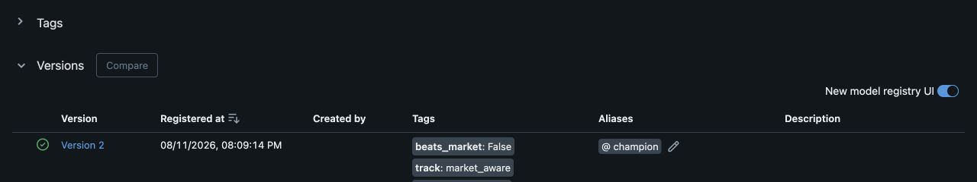
Experiment Tracking & Model Selection
MLflow tracks every run’s params, metrics and artifacts. The registry holds beating-1x2 with a @champion alias and tags.
18 candidate configurations across 2 tracks, compared on walk-forward log loss.
Champion: market_aware / catboost_tuned, 86 features, MLflow v2 / SemVer 1.0.0
Selected at 0.9749 on four common folds; five evaluation folds remain reported. The holdout never selects a model
Six searches × 25 = 150 trials; the holdout scores none.
Calibration: sigmoid, not isotonic
Platt scaling won on all 10 fold and model combinations. Isotonic emitted exact zeros, which log loss treats as an infinite penalty.
THE UNIVERSITY OF
CHICAGO
9
Notes:
[Sources]
- Project reports/champion.json and local MLflow registry at http://127.0.0.1:5000/#/models/beating-1x2.

Slide 10
Model Results
Four common walk-forward folds, market_aware track. Bar length = gap above the market line (lower is better).
This equal-fold view is the protocol used to select the champion.
The market leads every aggregate view
Every full fold, every league aggregate, both tracks. The smallest gap is the champion’s +0.0074.
catboost_tuned (champion)
0.9749 +0.0074
xgboost_tuned
0.9751 +0.0076
stacking
0.9779 +0.0104
catboost
0.9784 +0.0110
market_aware narrows—but cannot close—the gap
Adding the closing line improves ML sharply, yet the best model still trails it. Public features add no reliable incremental edge.
logistic
0.9850 +0.0175
xgboost
0.9878 +0.0203
lightgbm_tuned
0.9896 +0.0221
Dixon-Coles baseline
0.9908 +0.0234
Seven beat Dixon-Coles
Seven of nine configurations land between the market and the price-blind Poisson baseline; only two score worse.
mlp (neural net)
0.9949 +0.0274
lightgbm
0.9990 +0.0316
Market (vig-free close) = 0.9675
THE UNIVERSITY OF
CHICAGO
10
Notes:
[Sources]
- Project reports/champion.json and reports/model_vs_market.csv; values normalized to wf_2021 through wf_2024.

Slide 11
Value-Bet Backtest
-1.6%
ROI is reported with 95% bootstrap CIs. Bets at mean odds near 6.0 are enormously noisy, so a point estimate on its own means nothing.
No configuration is profitable. Across the 0.02 to 0.20 threshold sweep, not one produces an ROI whose 95% CI excludes zero.
Closing-line value is negative in every walk-forward configuration: only 23 to 46% of selections beat the close.
flat ROI: champion, walk-forward, absolute edge
95% bootstrap CI [-10.0%, +7.8%]
2,429
bets placed
The trap we avoided
Best point estimate across every model and threshold: +0.03% ROI, from the champion on a relative-edge rule, worth +0.4 units on 1,319 bets. Its CI is [-14.9%, +15.5%]. That is pure noise, and reporting it as a win would be noise-mining.
31.2%
strike rate
-3.4%
mean CLV
THE UNIVERSITY OF
CHICAGO
11
Notes:
[Sources]
- Project reports/value_backtest.csv and reports/value_backtest.md.

Slide 12
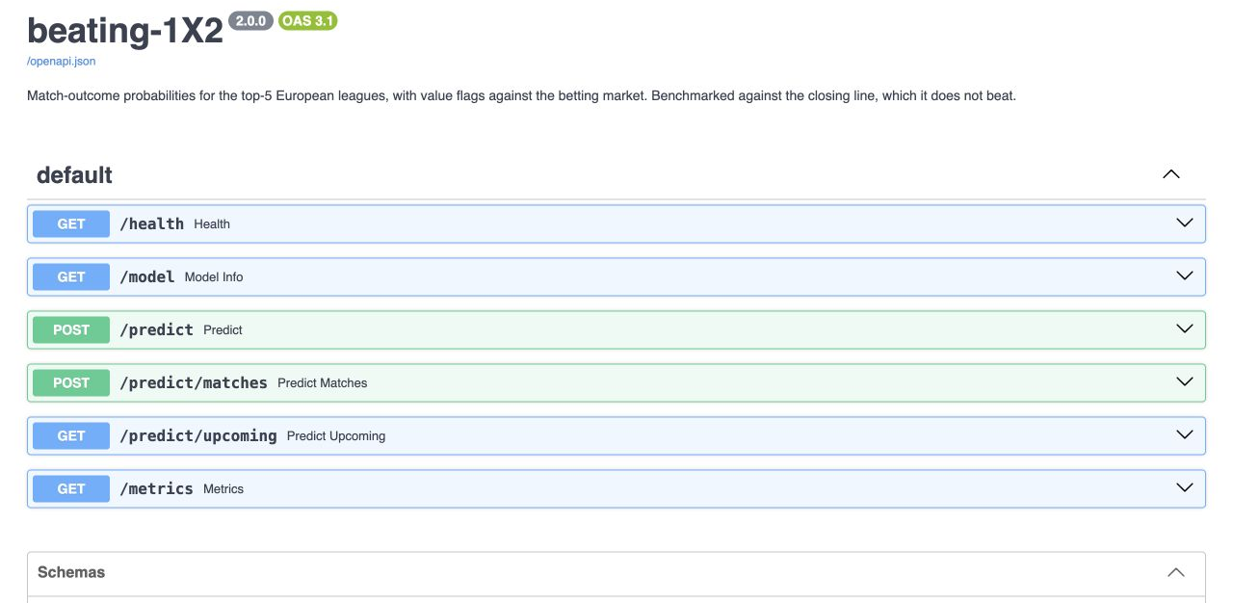
Deployment: Containerized API
docker compose up --build brings up the API on :8000/docs and the dashboard on :8501.
The model is swappable by alias. Replacing it is a re-registration plus a restart, with zero changes to serving code.
GET /health exposes MLflow v2, SemVer 1.0.0 and the @champion alias.
Live prices are not closing prices
Upcoming fixtures are scored against current, softer odds, so live value flags fire more readily than the backtest does. Every response states this explicitly.
THE UNIVERSITY OF
CHICAGO
12
Notes:
[Sources]
- Project src/api.py and src/predict.py; screenshot captured from http://127.0.0.1:8000/docs.

Slide 13
Production Monitoring
Stack: custom KS and PSI statistics (version-proof) plus Evidently HTML reports for each season from 2020 to 2025.
Reference window is 2018-19 and 2019-20 only. A baseline has to predate the shift you want to detect.
Thresholds: KS alpha = 0.01, PSI = 0.20, across 54 monitored features.
Recent seasons flag 2 to 6 of the 54 features, consistent with roster and schedule churn. Calibration decay is tracked as gap-to-market, so a hard season for everyone does not false-alarm as model decay.
Real detected drift: the 2020-21 COVID season
p < 0.0001
target drift against the pre-COVID reference
39.8%
home-win rate, down from 44 to 45% either side
+0.095
worst calibration gap vs market (market_blind / logistic, 2020)
Also the worst-scoring fold for every configuration: empty stadiums removed home advantage.
THE UNIVERSITY OF
CHICAGO
13
Notes:
[Sources]
- Project reports/drift/drift_metrics.json and reports/drift/calibration_decay.csv.

Slide 14
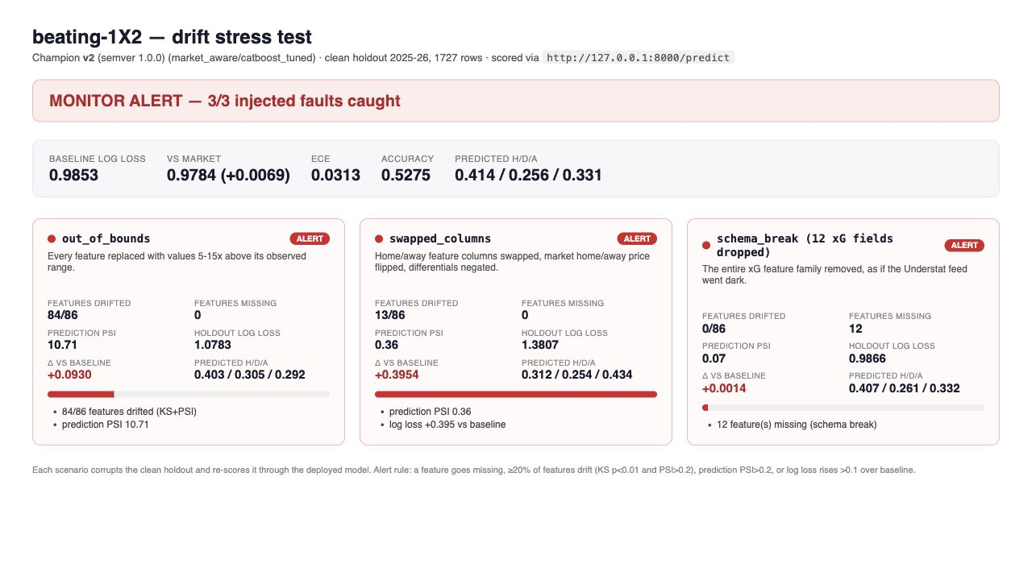
Drift Simulation & Anomaly Verification
Baseline first: clean 2025-26 holdout, 1,727 rows, log loss 0.9853 vs market 0.9784, scored through HTTP /predict. Faults run only after the baseline passes.
Injected fault | Corruption | What caught it
out_of_bounds | Every feature pushed 5 to 15x past its range | 84/86 features drift; prediction PSI 10.71
swapped_columns | Home and away swapped, market price flipped | Log loss +0.395; prediction PSI 0.36
schema_break | The xG feature family dropped | 12 missing features; log loss +0.001
Same view in the dashboard’s Stress test tab.
One detector is never enough
Input drift catches extreme values; prediction and performance checks expose the column swap; schema validation catches missing xG. The batch validation suite combines every signal before declaring a pass.
THE UNIVERSITY OF
CHICAGO
14
Notes:
[Sources]
- Project reports/drift/stress_test.json and reports/drift/stress_test.html; all scenarios scored through HTTP /predict.

Slide 15
Conclusions
The negative result is the deliverable, and it is well evidenced
No model beats the market in any aggregate fold, league or track comparison: six families across nine configurations, three tuned.
On four common folds, tuned CatBoost scores 0.9749 and Dixon-Coles 0.9908; both trail the market at 0.9675.
On the deployed 2025-26 holdout, CatBoost scores 0.9853 vs market 0.9784—a stable +0.0069 gap.
No value threshold yields a profit whose CI excludes zero, and CLV is negative throughout.
Interpretation: public pre-kickoff data improves a price-blind baseline but adds no reliable edge beyond the closing market.
What we delivered: a reproducible, leakage-proof, versioned, deployed and monitored pipeline that establishes a negative result credibly.
Why the engineering matters more than the answer
A pipeline that let us fool ourselves into a fake edge would be worse than useless. The value here is that we can trust the “no”: walk-forward splits, an HTTP-scored sealed holdout, a market baseline as leakage tripwire, and bootstrap CIs on every economic claim.
THE UNIVERSITY OF
CHICAGO
15
Notes:
[Sources]
- Project reports/champion.json, reports/summary.md, reports/value_backtest.csv, and reports/drift/stress_test.json.

Slide 16
Limitations & Future Work
Limitations
Future work
Longshot bias: at a 0.05 absolute edge the rule flags 74 to 89% of fixtures at mean odds above 4.7. A relative-edge filter makes it worse, not better.
2020-21 is a genuine distribution shift. No honest tuning fixes it.
CLV caveat: value is flagged against closing-derived probability, so this is not a clean bet-at-open simulation.
Understat is scraped, with no documented API. Its schema already changed once mid-project.
Cut from scope: historical injury data (no free feed) and prediction markets as a historical training source.
Hosted deployment with a scheduled Prefect server. Local is a deliberate choice for this project, not a limit.
Live prediction-market prices from Kalshi or Polymarket as an inference-time input.
Automated release promotion and SemVer bumps from CI; version 1.0.0 is currently assigned manually.
Risks we called before building
Longshot bias, the 2020-21 distribution shift, and scraped-source fragility were all flagged in the proposal. All three resolved as predicted, which is the point of writing them down first.
THE UNIVERSITY OF
CHICAGO
16
Notes:
[Sources]
- Project README.md, params.yaml, and reports/drift/drift_metrics.json.

Slide 17
Questions?
github.com/arenmizuno/beating-1X2
Reproduce locally
pip install -r requirements.txt, dvc repro, docker compose up. Audited search artifacts are reused; full 150-trial retuning is opt-in.
98 hermetic tests
No network access required.
CI mutation-tests the leakage guard
It flips shift(1) to shift(0) and fails the build if the tests stay green.
THE UNIVERSITY OF
CHICAGO
17
Notes:
[Sources]
- Project repository: https://github.com/arenmizuno/beating-1X2
- Verified locally: 98 tests passed; dvc status reported all stages up to date.

