Slide 1
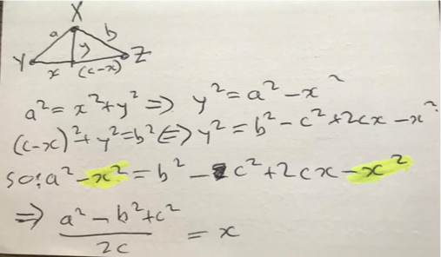
Function main(points):
MIN= sqrt(length(points)) // global
x = any point
Y = furthestFrom(x) // global
Z = furthestFrom(Y) // global
C = distance(Y, Z). // global
for p in points: p.x, p.y = xy(p)
return tree(points)
Function tree(points):
if length(points) >= MIN:
i = node(points). // creates kids
i.e = tree(i.e.points) // may reset kid to nil
i.w = tree(i.w.points)
i.s = tree(i.s.points)
i.n = tree(i.n.points)
return i
function node(points)
out = {e={}, s={}, w={}, n={},
my= median([p.y for p in points]),
mx= median([p.x for p in points])}
for p in points:
compass(p,out).add(p)
for where in {out.e, out.s, out.w, out.n}
replace where’s contents with jiggle(some( points ))
return out
Function trim(x)
return min(1,max(0,x))
Function xy(p)
if not p.x:
a = distance(p, Y)
b = distance(p, Z)
p.x = (a²+c²-b²) / 2C
p.y = sqrt(trim( p.x² – a ²))
return p.x,p.y
Function compass(p,node):
p.x, p.y = xy(p)
up = p.y > node.my
right = p.x > node.mx if up then
return node.n if right else node.w
else
return node.e if right else node.s
Function similar(p, node)
kid = compass(p,node)
return similar(p, kid) if kid else node.points
W
N
S
E

