Slide 1
Investigating Current Velocity Structure
Alice Ren
December 13, 2017
Sarah Gille
Data Analysis 1
Coherence and spatial characteristics of the geostrophic velocity structure in the California Current from glider data

Slide 2
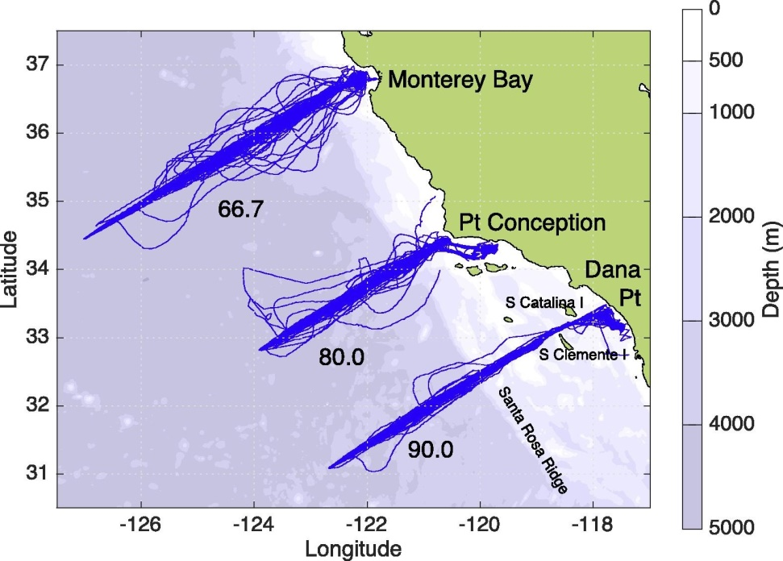
California Current
Geostrophic Velocities
https://spraydata.ucsd.edu/climCUGN/

Slide 3
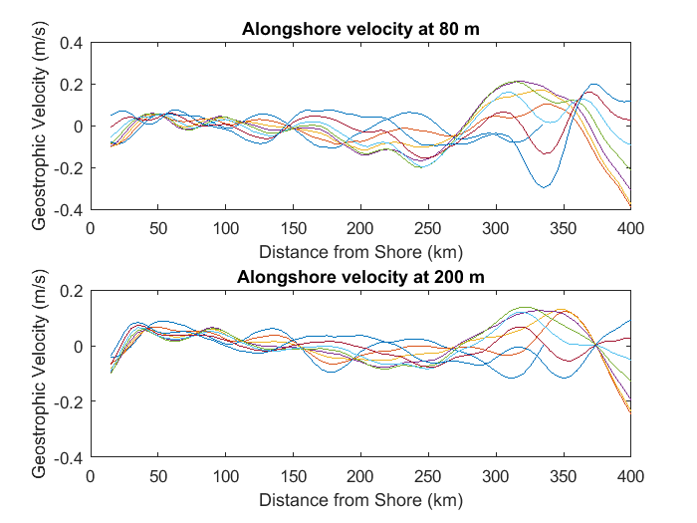
Look at Patterns in Space

Slide 4
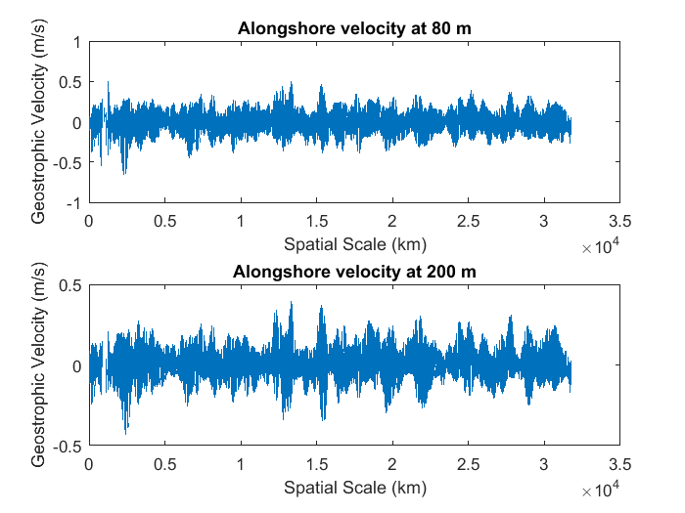

Slide 5
Predictions
Some peaks in wavenumber spectra
Coherence at low wavenumbers only
[Difference between large scale currents and mesoscale to submesoscale phenomena]

Slide 6
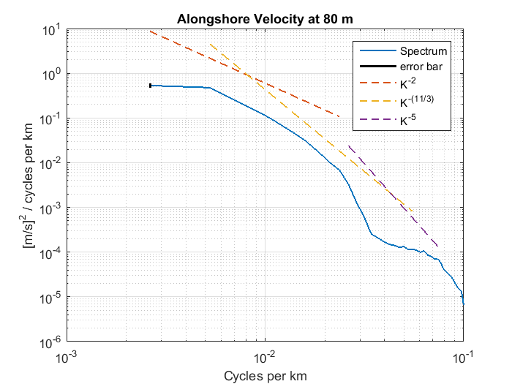
Spectral Energy and Slope

Slide 7
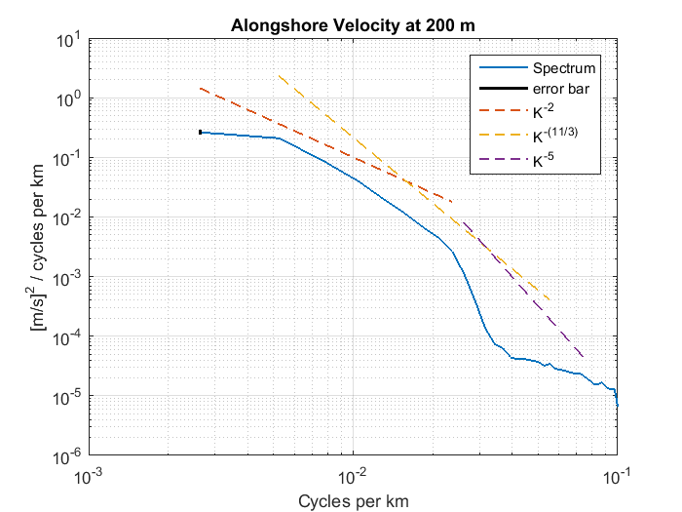
Spectral Energy and Slope

Slide 8
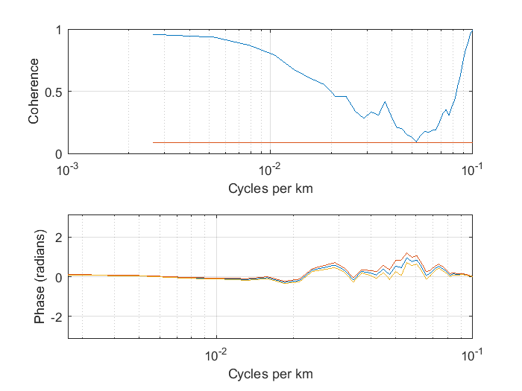
Coherence

Slide 9
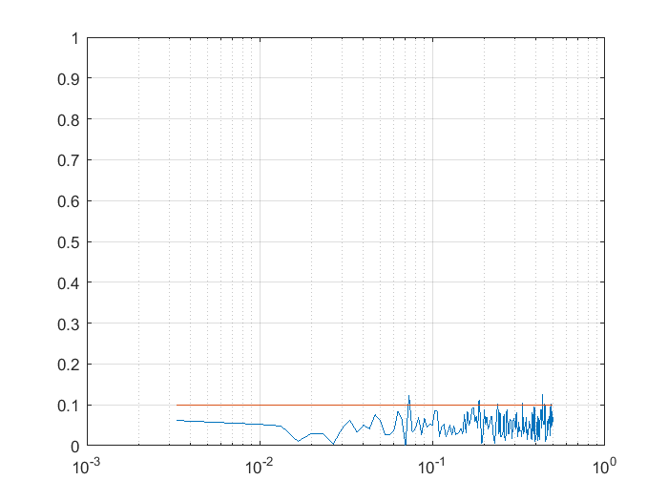
Of Note: Low Threshold
300 segments of 1000 points of random noise

Slide 10
Conclusions
Spectra are red, match theoretical slopes
Geostrophic velocity coherent across all wavenumbers with phase zero
Method of calculation of geostrophic velocity from glider data might be important

