Slide 2
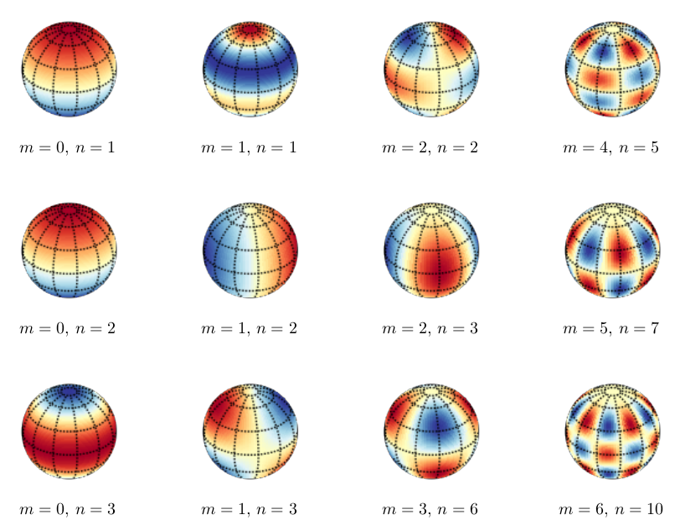
Grace monthly solutions are given as coefficients of a set of spherical harmonics
Examples of how spherical harmonics could capture variations on a sphere or geoid

Slide 3
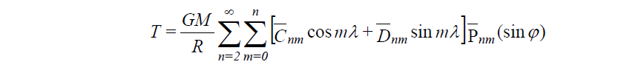
Need to translate changes from spherical harmonics to glacier/ice sheet changes
Given T, the difference between the actual gravity field and the normal gravity potential
Translate to domain using an averaging function; takes into account ice loss not uniform but faster at Greenland’s edges
Remove/correct for many other factors
Either by removing from a field estimated by an outside model (ocean mass changes, atmosphere mass changes, ex: tides)
Quantifying the potential error introduced

Slide 4
Sources of Mass Variability in Velicogna and Wahr 2006 (to exclude from the ice sheet mass variability)
Leakage – due to filtering and the averaging function, a catch-all type term (error term)
Continental water storage outside Greenland
Water in the ocean
Atmospheric mass changes (negligible)
PGR, post-glacial rebound – according to calculations the crust is depressing, adding to the calculated ice loss

Slide 5
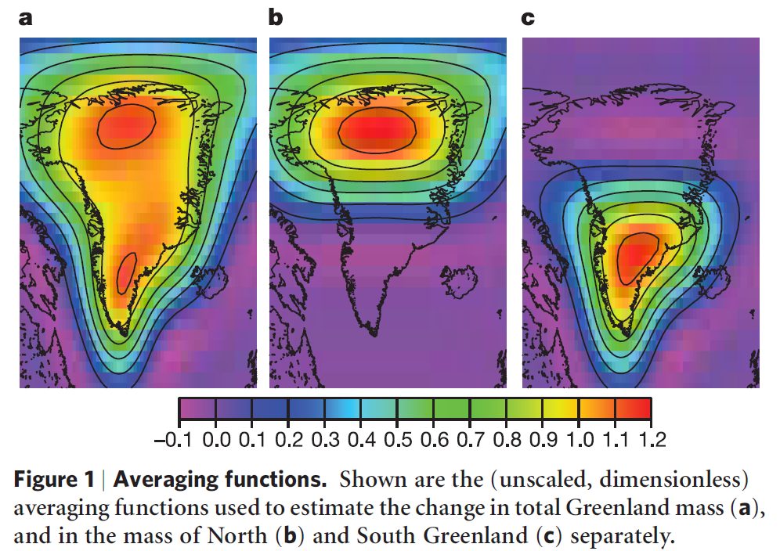
Velicogna and Wahr, 2006, Acceleration of Greenland Ice Mass Loss in Spring 2004

Slide 6
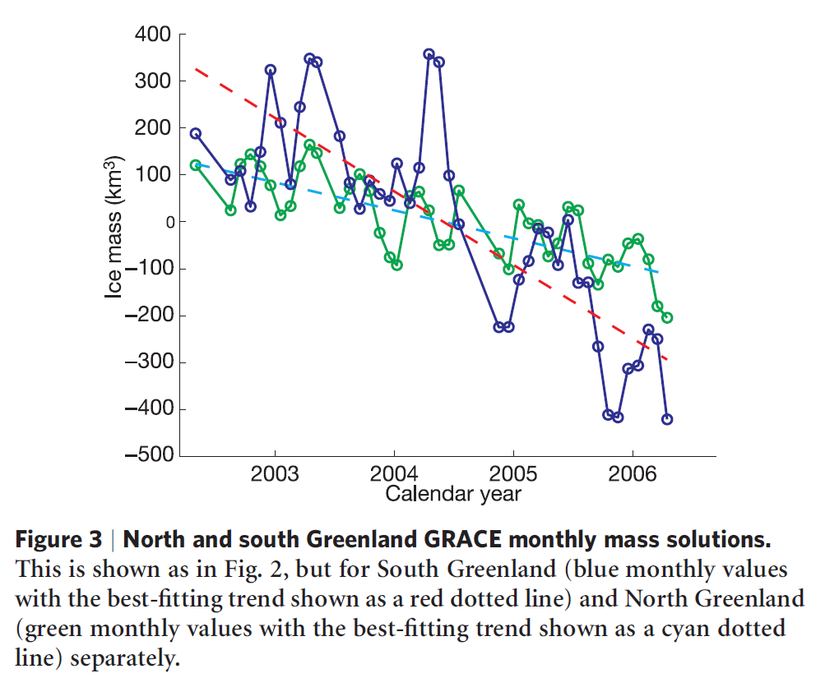
Velicogna and Wahr, 2006
Total Loss: 248 +/- 36 km^3/year
0.5 +/- 0.1 mm/year global SLR
South Greenland:
161 +/- 24 km^3/year
North Greenland:
83 +/- 18 km^3/year
Timing of GRACE acceleration is consistent with the 2004 acceleration of the Kangerdlugssuaq and Helheim glaciers in SE Greenland detected via satellite radar observations

