Slide 1

SPE-221722-MS
Geothermal Energy Assessment in Africa
A Pathway to Renewable Energy
P. Akagbosu , A. Ofi , D. Odofin, Baker Hughes
J. J. Areola Federal University of Technology Akure, Nigeria

Slide 2
Introduction
Geothermal is a renewable energy system that offers promising solutions for sustainable energy production by utilization the earth internal heat generated by decay of radioactive isotopes in the planet’s core and transferred to the surface by conduction & convection
Geothermal energy stands as a promising renewable resource with vast untapped potential in Africa

Slide 3
Introduction Cont’d
The examination of global geothermal hotspots, considering thermal attributes alongside porosity and permeability characteristics, contributes to understanding the efficiency and feasibility of geothermal reservoirs for future sustainable energy initiatives
Typical temperature gradient ranges from 30⁰C - 150⁰C per kilometer

Slide 4
Types of Geothermal Energy production
Depends on heat extraction depth
Very low temperature geothermal energy (100ft-2000ft) requires heat pump for direct heat supply for swimming pools & greenhouses
Low-temperature geothermal energy (2000ft-8000ft ), temperature is relatively high (30°C to 90°C) and can be used within a heating network
High-temperature geothermal energy (> 8000ft) the water’s temperature can exceed 100°C, meaning that the water can be injected into a heating network and even used to produce electricity

Slide 5
Advantages & Challenges
Utilization of geothermal power instead of fossil fuels can reduce emissions of CO2 and and contributing to energy security.
geothermal fluids or steam contain substantial amounts of hydrogen sulphide (H2S) and other non-condensable gases (NCGs), such as CO2
Geothermal resources are often found in remote locations, requiring the construction of transmission connections and other infrastructure to make the sites accessible.

Slide 6
Geological Factors Affecting Geothermal Energy
Rock Types
Geothermal Gradient
The composition and structure of rocks, such as porosity, permeability, and fracture networks, can greatly impact the geothermal reservoir's ability to store and transmit fluids.
The natural increase in temperature with depth is a key factor in determining the viability and potential of a geothermal resource.

Slide 7
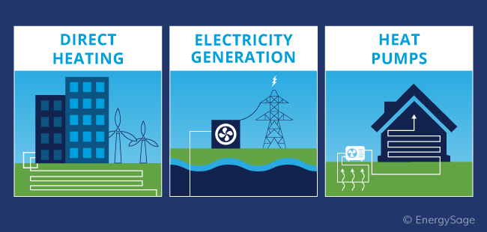
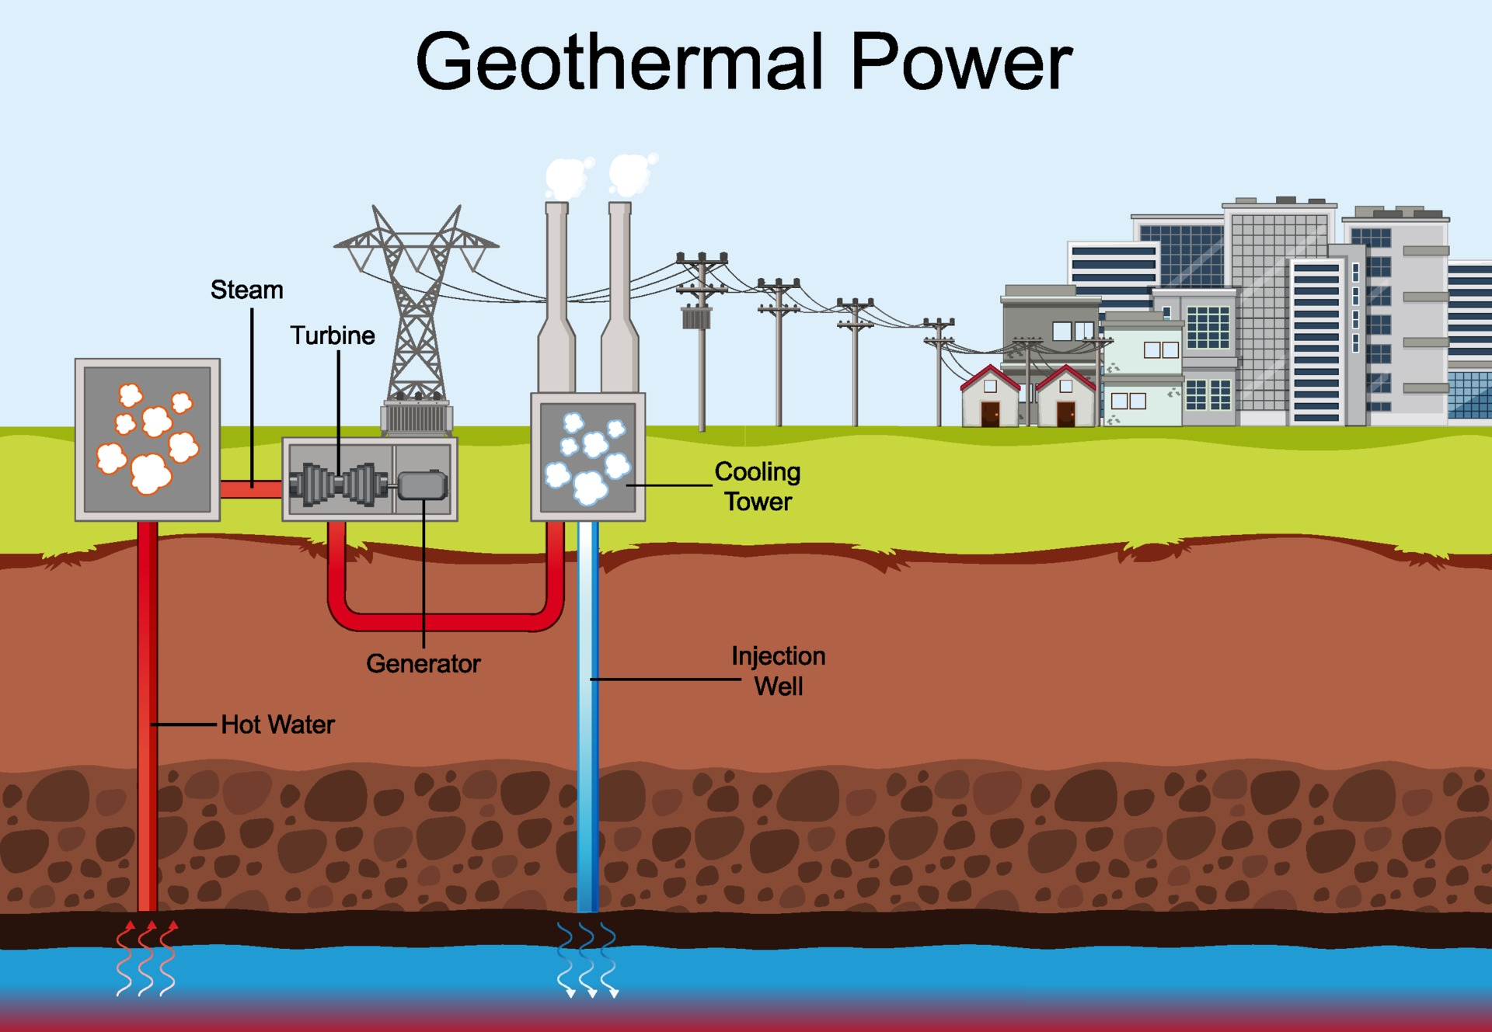
Geothermal Energy Source, Generation and Uses (source: EnergySage)

Slide 8
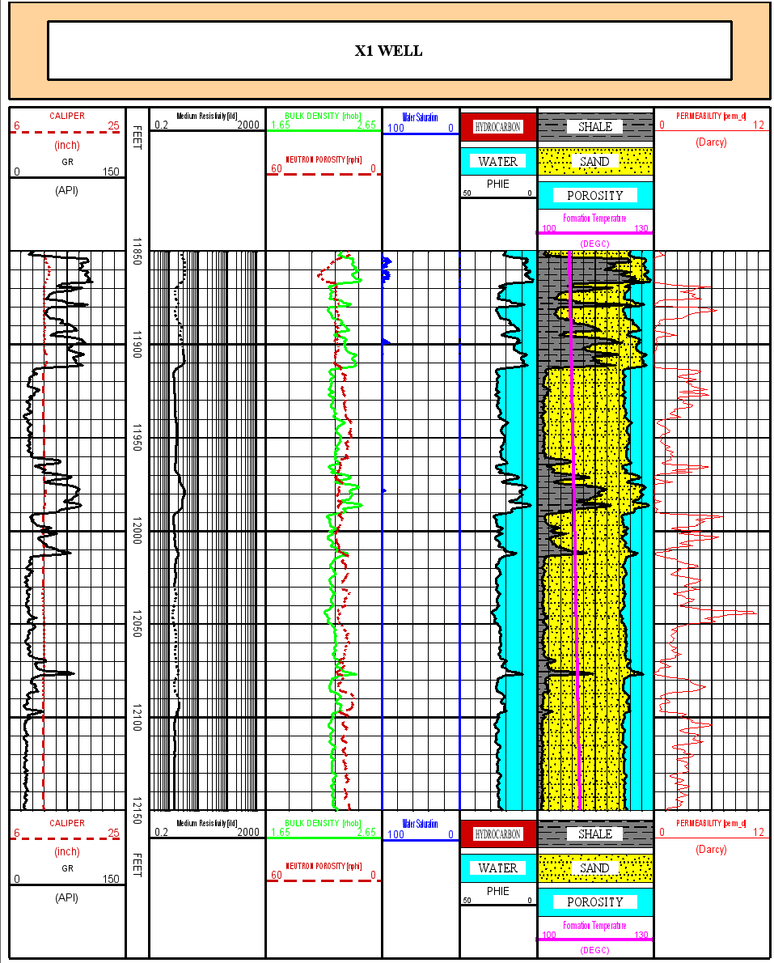
Case study 1
-Sand & Shale lithology sequence
-Geothermal fluid water
-Temperature 110⁰C
-Average porosity 28%
-Average Permeability 3.9D

Slide 9
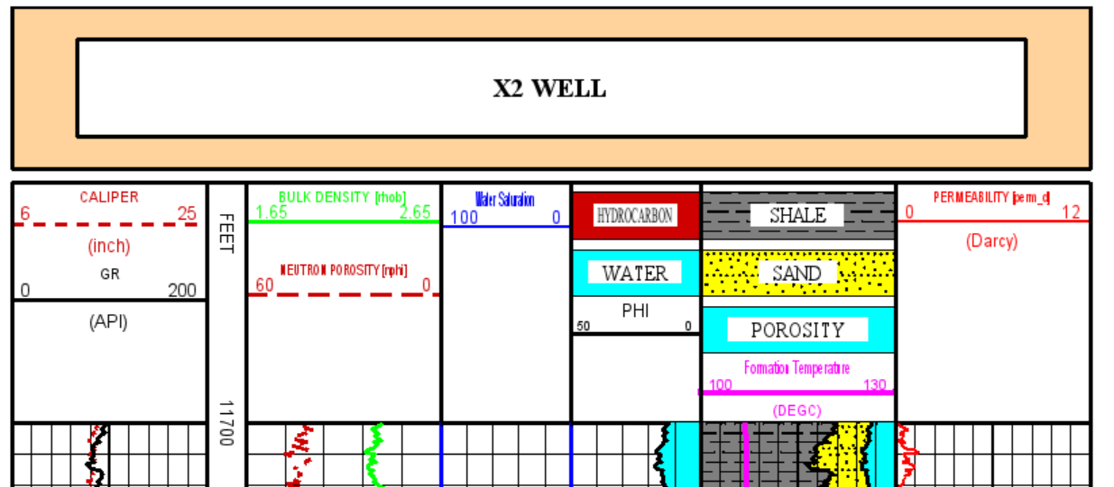
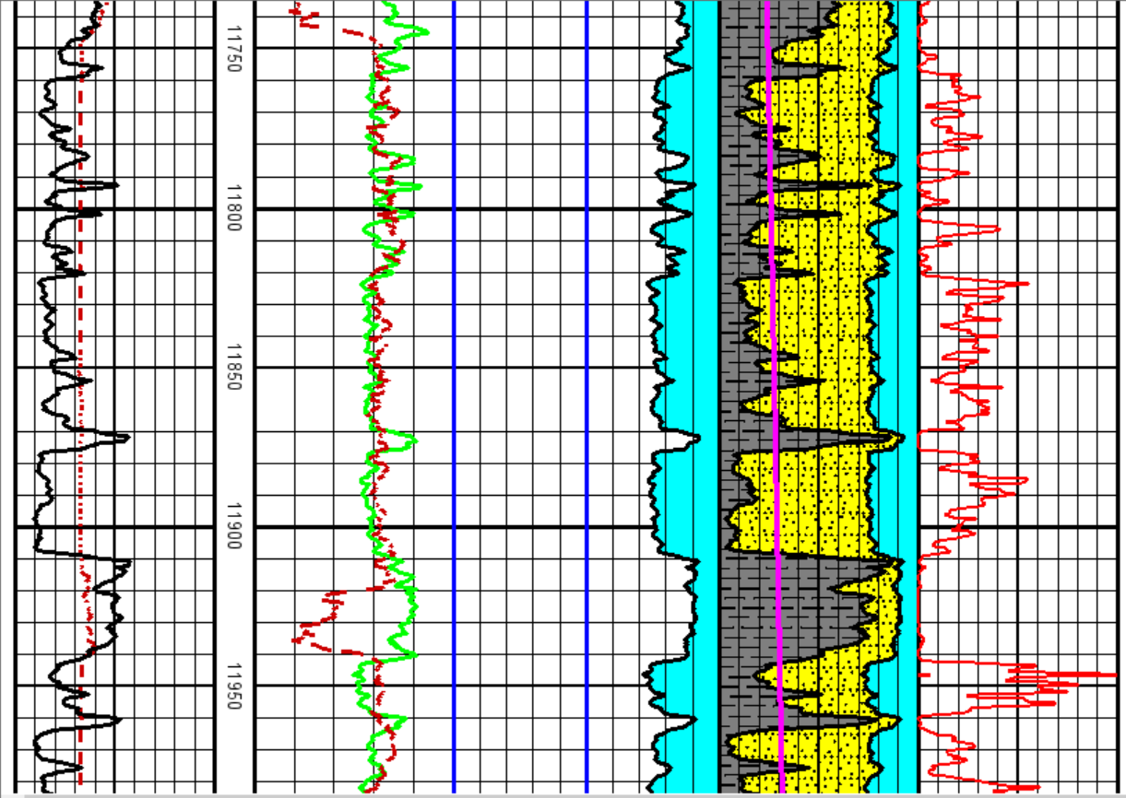
Case study 2
-Sand & Shale lithology sequence
-Geothermal fluid water
-Temperature 108⁰C
-Average porosity 21%
-Average Permeability 3.3 D

Slide 10
Conclusions & recommendation
The fluid required for geothermal energy production is Subsurface aquifer
Rock and fluid properties critical for geothermal energy production are permeability, porosity, providing a comprehensive framework for geothermal reservoir characterization.
Integrating various data sources, including geological, Petrophysical, geophysical (seismic surface maps) & Geomechanics study to gain a comprehensive understanding of subsurface dynamics for sustainable geothermal energy production

Slide 11
Acknowledgments
The authors thank Baker Hughes for permission to publish this paper
Thank You / Questions

Slide 12


Pius Akagbosu Imorgiemeh
Completion, Intervention & Measurement Advisor
GaffneyCline energy advisory
Baker Hughes
Pius is Completion , Intervention & measurements (CIM) advisor in Baker Hughes with about 15 years’ experience in the industry. Expertise in Pulsed Neutron logs analysis (PNC, Carbon oxygen & Sigma), Cement bond logs, Production logs analysis, Open hole saturation analysis, Wireline and MWD data Processing, renewable energy & technical sales. I earned BSc. in Physics & MSc. in Exploration Geophysics in Delta State University & University of Benin respectively.

