Slide 1



DEEP LEARNING APPROACHES FOR FACIES PREDICTION IN SUBSURFACE SEISMIC DATA
By
TechTeam
Sponsored By
Host
Date
10/11/2024

Slide 2
Introduction
Context and Importance
Challenges
Objective
Dataset Overview
Seismic Data
Labeling and Preprocessing
Methodology
Deep Learning Model
Data Augmentation
Loss Function and Evaluation Metrics
Model Training
Training Process
Validation and Overfitting Prevention
Results
Exploratory Data Analysis
Performance Metrics
Conclusion and Future Work
Summary
Future Directions
Impact and Applications
Outline

Slide 3
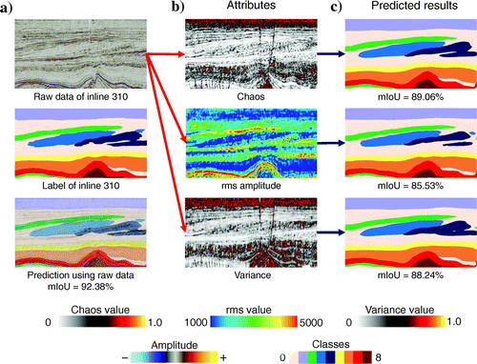
Introduction
Context and Importance
Facies classification is crucial for understanding subsurface geology, particularly in hydrocarbon exploration and reservoir management (Fig 1). By accurately predicting rock types and their distribution, it enhances the ability to model fluid flow, optimize drilling, and estimate reserves.
Machine learning, especially Convolutional Neural Networks (CNNs), has revolutionized facies prediction by automating the process. This enables more efficient and accurate interpretations of seismic data, providing valuable insights for geoscientists and engineers in resource exploration.
Fig 1: Facie based seismic (Research Gate)

Slide 4
Introduction
Challenges
Subsurface Complexity
Variability in geological formations makes it challenging to accurately predict facies and their spatial distribution.
Data Gaps
Seismic and well log data often have missing or incomplete sections, complicating the interpretation process.
Resolution Limitations
Seismic data resolution may not always be sufficient to detect subtle geological features or small-scale facies changes.
Data Integration
Combining data from different sources (seismic, well logs) can be difficult due to inconsistencies in scale, resolution, and quality.

Slide 5
Introduction
Objective
The goal of this project is to leverage deep learning, specifically Convolutional Neural Networks (CNNs), to automate the prediction of geological facies from seismic data. By applying CNNs, the aim is to enhance the accuracy and efficiency of subsurface modeling, enabling better understanding of geological formations and improving resource management in exploration and production.

Slide 6
Dataset Overview
Seismic Data
The seismic dataset used for this project has the following characteristics:
Format: The data is stored in NumPy .npy format for both seismic images and labels.
Dimensions: It is a 3D dataset consisting of training data, training labels, and test data.
Training Data: Seismic images used to train the model, containing depth slices.
Training Labels: Corresponding facies labels for supervised learning.
Test Data: Unlabeled seismic images used for model evaluation.
Additional Data: A JSON file containing the class definitions for the facies categories.

Slide 7
Dataset Overview
Labeling and Preprocessing
The labeling and preprocessing steps are crucial for preparing the seismic data for model training. Here's how it was done:
Labeling:
  The facies classes (e.g., different geological formations or features) are assigned to the seismic data using a labeled dataset. The corresponding labels (facies) for each seismic slice are stored in the training labels dataset.
  Each pixel or voxel in the seismic image is assigned a class from the set of possible facies (6 classes in this case) via one-hot encoding, where each class is represented by a binary vector.

Slide 8
Dataset Overview
Labeling and Preprocessing
Preprocessing:
Resizing: Seismic images and labels are resized to 128x128 pixels for consistency and compatibility with the CNN architecture.
Normalization: Image values are normalized to the [0, 1] range by dividing by the maximum pixel value and clipped to avoid out-of-range values.
Channel Expansion: Grayscale images are expanded to RGB format by duplicating the single channel three times, making them suitable for CNNs.
One-Hot Encoding of Labels: Label images are one-hot encoded, converting each pixel into a multi-channel array representing the six facies classes.
Data Type Conversion: Images and labels are converted to float32 for compatibility with model training.

Slide 9
Dataset Overview
Challenges Encountered
Large Dataset Size: The seismic dataset was too large for local machines, leading to slow processing and memory issues.
High Computational Demands: Training CNN models required significant computational power, which exceeded the local machine's capabilities, causing long training times and system crashes.
Data Preprocessing Complexity: Resizing, normalization, and one-hot encoding of the 3D dataset required substantial memory and processing power.
Hardware Limitations: The local machine lacked the necessary resources (RAM, GPU) for real-time processing and model training.
Inconsistent Results: Limited hardware caused slow model convergence and inconsistent results, complicating model evaluation and fine-tuning.

Slide 10
Dataset Overview
Google Colab as the best approach
Limited Local Resources: The dataset was large and computationally intensive, requiring more RAM and GPU power than my local machine could provide.
Faster Training with GPUs: Google Colab offers free access to powerful GPUs, enabling faster model training, which is essential for handling large 3D datasets like seismic data.
Efficient Collaboration: Google Colab allows for easy sharing and collaboration, making it easier to work with others and access the project from multiple devices.
Cloud Storage: With Google Colab, I was able to access and store large datasets on Google Drive, avoiding storage constraints and ensuring the data was easily accessible from anywhere.
Environment Setup: Colab's pre-configured environment and access to libraries like TensorFlow, Keras, and OpenCV made it easier to set up and run deep learning models without worrying about local dependencies.

Slide 11
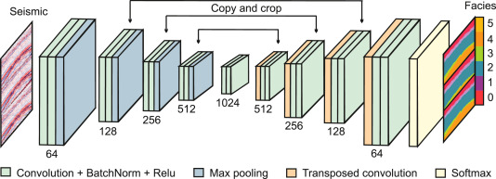
Methodology
Deep Learning Model
For this project, a Convolutional Neural Network (CNN) was employed for segmentation and classification of seismic facies. The model architecture consists of several layers designed to extract features from the input seismic images and produce a multi-class classification output for each pixel (Fig. 2)
An improved dilated CNN for seismic facie interpretation (ScienceDirect.com)

Slide 12
Methodology
Deep Learning Model
The model consists of the following layers:
Input Layer: Seismic images resized to 128x128 pixels with 3 color channels (RGB).
Convolutional Layers: Three layers apply filters to detect spatial features, followed by ReLU activation for non-linearity.
Max-Pooling Layers: Reduce spatial dimensions and retain important information.
Upsampling Layers: Restore feature map dimensions to 128x128 for pixel-wise segmentation.
Output Layer: Produces a probability distribution over 6 facies classes per pixel using softmax activation.

Slide 13
Methodology
Data Augmentation
To improve model generalization, various augmentation techniques were applied to the training data:
Rotation: Images were rotated randomly to simulate variations in seismic data orientation.
Flipping: Horizontal and vertical flips helped create more diverse training examples.
Scaling: The images were scaled to introduce variations in the size of the seismic features.
Translation: Random shifts in image positions were applied to enhance robustness to spatial changes.
These augmentations help prevent overfitting by introducing variability in the data, allowing the model to learn more generalized features.

Slide 14
Introduction
Loss Function and Evaluation Metrics
Loss Function: Categorical cross-entropy was chosen because it is well-suited for multi-class classification tasks, where each pixel is assigned to one of the multiple classes (facies).
Evaluation Metrics:
Accuracy: Measures the overall percentage of correct predictions across all classes.
Mean Squared Error (MSE): Assesses the difference between the predicted and actual labels at the pixel level.
R² Score: Indicates the goodness of fit, helping to evaluate how well the model's predictions match the true distribution.

Slide 15
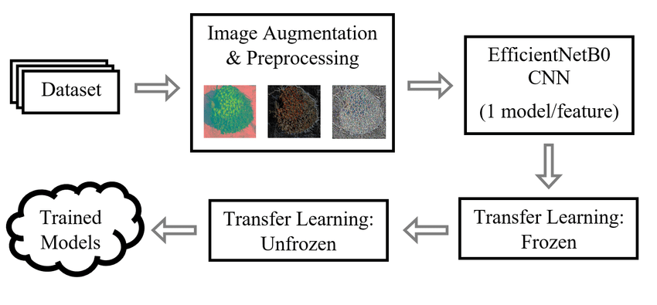
Model Training
Training Process
Optimizer: The Adam optimizer was used for its efficient adaptive learning rate and momentum capabilities, which help in faster convergence and better handling of sparse gradients.
Batch Size: A batch size of 16 was used, balancing between memory usage and model performance.
Epochs: The model was trained for 50 epochs, providing enough iterations for the model to learn from the data while preventing excessive training time.
CNN Training Process
(Research Gate)

Slide 16
Model Training
Validation and Overfitting Prevention
To prevent overfitting and ensure the model generalizes well:
Validation Set: A separate validation set was used to monitor performance during training, helping to identify when the model starts to overfit.
Early Stopping: The training was monitored for validation loss, and training was stopped early if no improvement was observed for a set number of epochs, preventing overfitting.
Dropout Layers: Dropout was used in the network to randomly omit some of the neurons during training, helping the model avoid becoming too reliant on specific features and reducing overfitting.

Slide 17
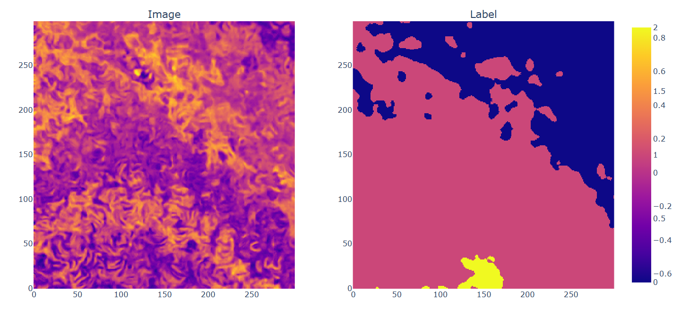
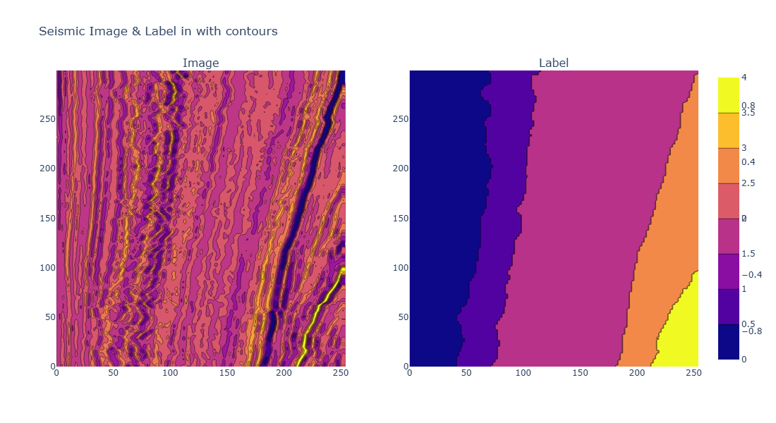
Results
Exploratory Data Analysis
Seismic Image with Label
Seismic Image with Label

Slide 18
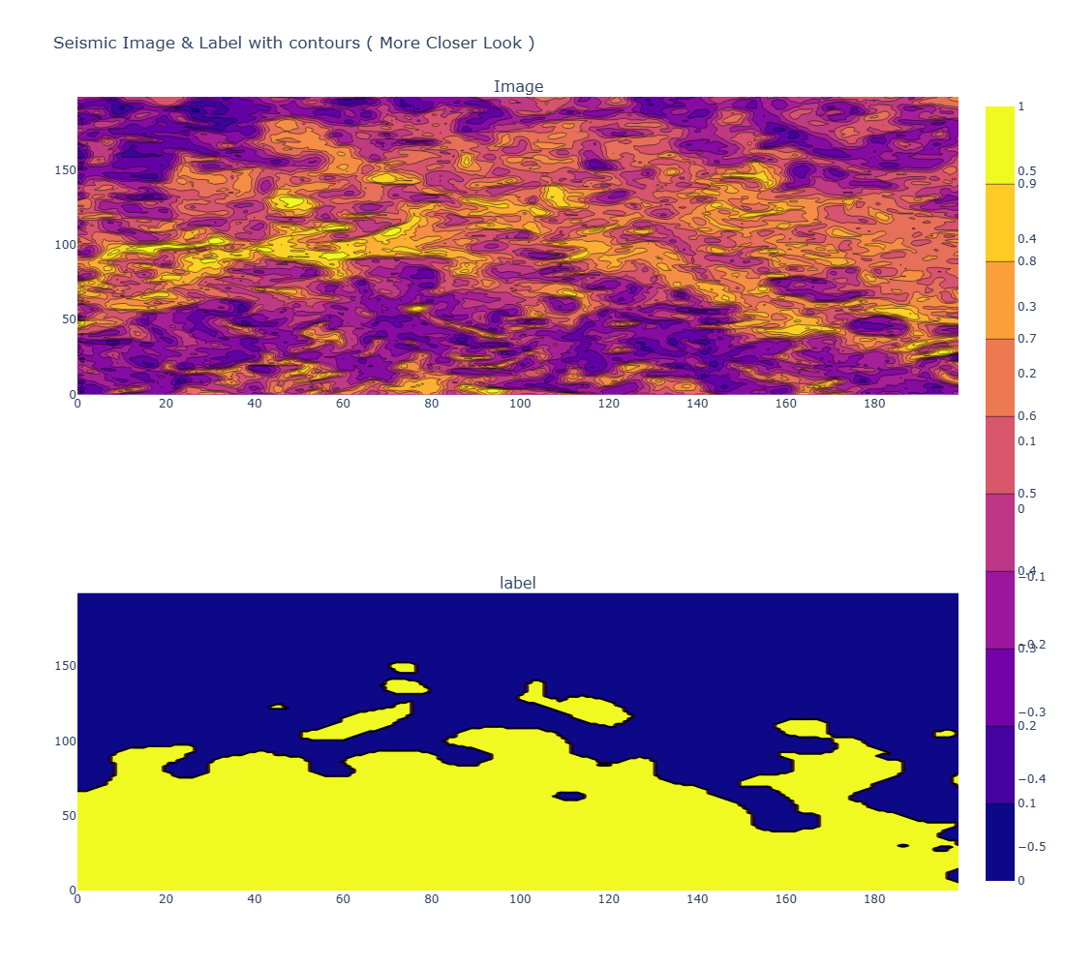
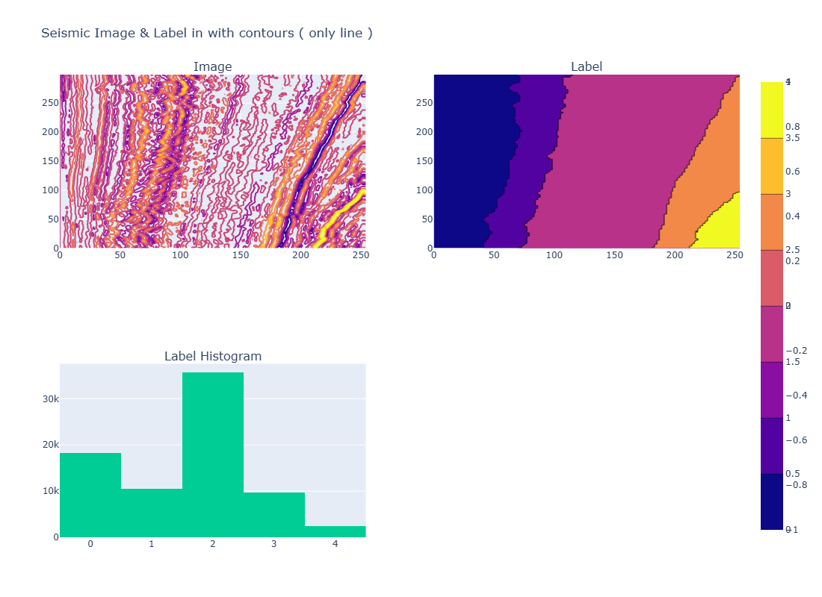
Results
Exploratory Data Analysis
Label with Contours: closer look
Label with Contours

Slide 19
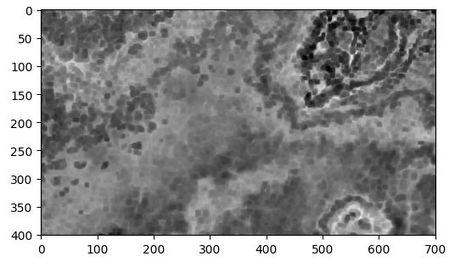
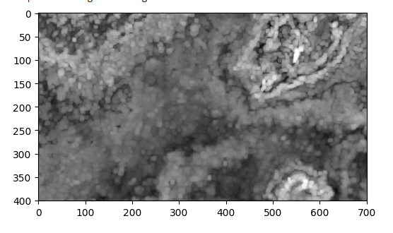
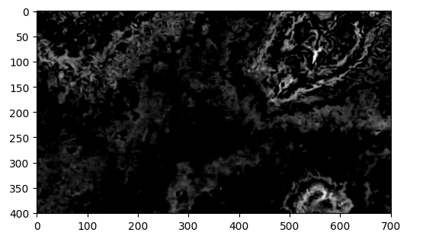
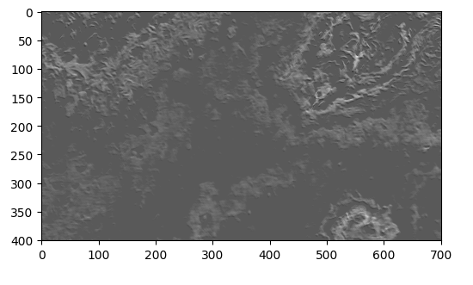
Results
Exploratory Data Analysis
Erosion
Dilatation
Sharping
Threshing

Slide 20
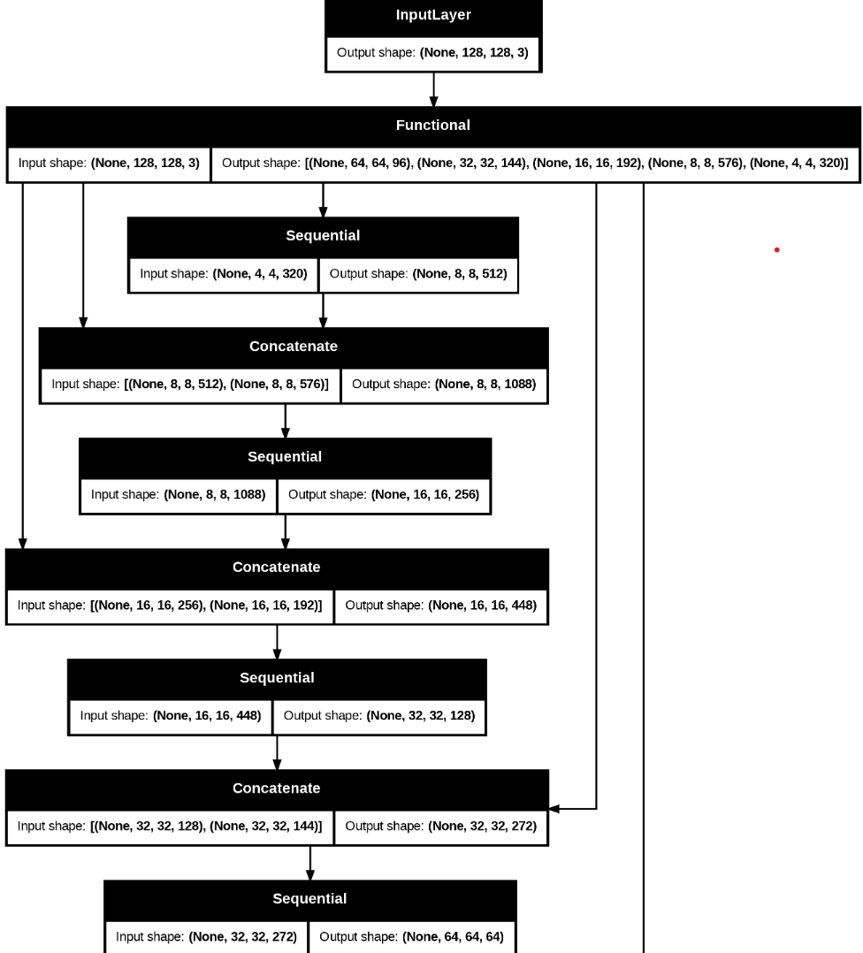
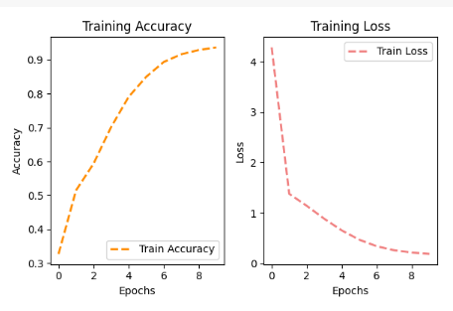
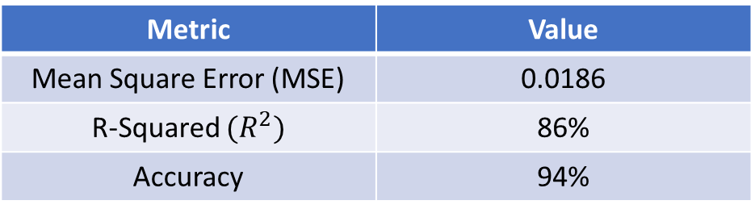
Results
Models Result: Accuracy and Loss drop
Metric | Value
Mean Square Error (MSE) | 0.0186
R-Squared ${(R}^{2})$ | 86%
Accuracy | 94%
Model Workflow
Table of Evaluation metrics

Slide 21
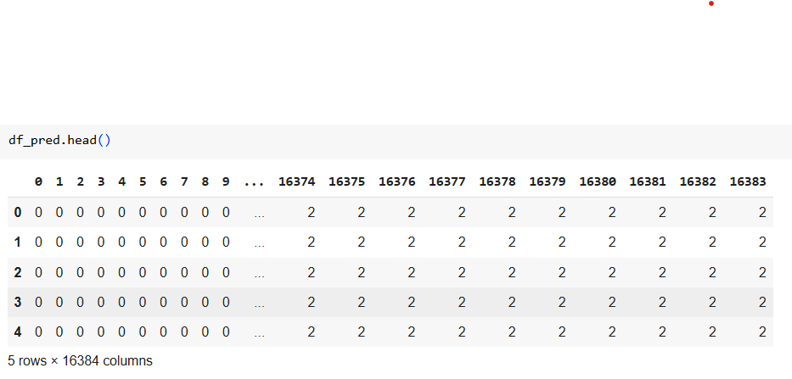
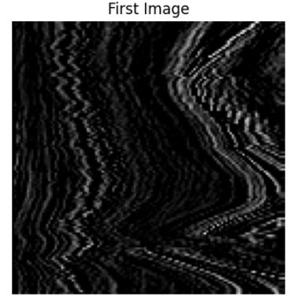
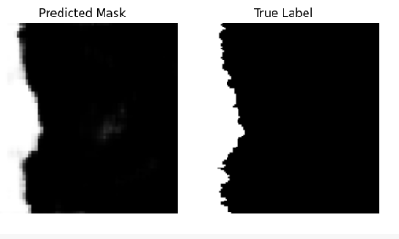
Results
Prediction Table Result Preview
First Plot after Training
Plot indicating successful Prediction

Slide 22
Conclusion
Summary
This project demonstrated the successful application of a Convolutional Neural Network (CNN) for predicting facies from seismic data. The model effectively segmented the seismic images, enabling accurate classification of subsurface geological features into six distinct facies classes. The CNN architecture, combined with preprocessing techniques like normalization, resizing, and one-hot encoding, allowed for robust learning and predictions. Overall, the model achieved promising results in automating facies prediction, significantly reducing the manual effort in subsurface geological interpretation.

Slide 23
Conclusion
Future Work
Future directions for improving the model could involve:
Exploring Alternative Architectures: Experimenting with more advanced deep learning models like U-Net, which has shown strong performance in segmentation tasks.
Additional Data: Integrating other seismic attributes, well log data, or geological information to enhance the model’s accuracy and generalization.
Improving Interpretability: Developing methods to make the model's predictions more interpretable, such as using techniques like Grad-CAM to visualize feature importance.

Slide 24
Conclusion
Impact and Applications
The use of AI in subsurface geological interpretation has far-reaching implications. By automating facies prediction, this approach can significantly improve decision-making in fields such as:
Oil and Gas Exploration: Facilitating more efficient resource identification and reservoir management.
Environmental Monitoring: Enhancing the ability to monitor subsurface conditions for environmental protection and sustainability.
Reservoir Management: Supporting more accurate predictions of reservoir behavior, aiding in the optimization of resource extraction strategies.

Slide 25
I would like to express my sincere gratitude to CypherCrescent and DONNA SPECTRA for the incredible opportunity to participate in and contribute to this hackathon. Thank you for hosting such an inspiring event!
THANKS FOR LISTENING

