Slide 1

NVDP Murthy
Assist Prof
ECE Dept
MPMC – MICROPROCESSORS AND MICROCONTROLLERS

Slide 2
PIO 8255:
• The parallel input-output port chip 8255 is also called as programmable peripheral input-output port The Intel’s 8255
is designed for use with Intel’s 8- bit, 16-bit and higher
capability microprocessors. It has 24 input/output lines
which may be individually programmed in two groups of twelve lines each, or three groups of eight lines.
• The two groups of I/O pins are named as Group A and Group B. Each of these two groups contains a subgroup of
eight I/O lines called as 8-bit port and another subgroup of four lines or a 4-bit port Thus Group A contains an 8-bit port A along with a 4-bit port C upper
.
.

Slide 3
• The port A lines are identified by symbols PA0-PA7 while the port C lines are identified as PC4-PC7. Similarly, Group B contains an 8-bit port B, containing lines PB0-PB7 and
a 4-bit port C with lower bits PC0- PC3. The port C upper and
port C lower can be used in combination as an 8-bit port C.
• Both the port C are assigned the same address. Thus one may have either three 8- bit I/O ports or two 8-bit and two
4-bit ports from 8255. All of these ports can function
independently either as input or as output ports. This can
be achieved by programming the bits of an internal register
of 8255 called as control word register ( CWR ).
• The internal block diagram and the pin configuration of 8255 are shown in fig.

Slide 4
• The 8-bit data bus buffer is controlled by the read/write control logic. The read/write control logic manages all of the
internal and external transfers of bothdata and control words.
• RD , WR , A1, A0 and RESET are the inputs provided by the microprocessor to the READ/ WRITE control logic of 8255.
The 8-bit, 3-state bidirectional buffer is used to interface the 8255 internal data bus with the external system data bus.
• This buffer receives or transmits data upon the execution of input or output instructions by the microprocessor.
The control words or status information is also transferred
through the buffer.

Slide 5
The signal description of 8255 as follows :
PA7-PA0: These are eight port A lines that acts as either latched output or buffered input lines depending upon
the control word loaded into the control word
PC7-PC4 : Upper nibble of port C lines. They may act as either output latches or input buffers lines. This port also can be used for generation of handshake lines in mode 1 or mode
PC3-PC0 : These are the lower port C lines, other details are the same as PC7-PC4 lines.
PB0-PB7 : These are the eight port B lines which are used as latched output lines or buffered input lines in the same way as port A.

Slide 6
RD : This is the input line driven by the microprocessor and should be low to indicate read operation to 8255.
WR : This is an input line driven by the microprocessor. A low on this line indicates write operation
CS : This is a chip select line. If this line goes low, it enables the 8255 to respond to RD and WR signals, otherwise
RD and WR signal are neglected
D0-D7 : These are the data bus lines those carry data or control word to/from the microprocessor.
RESET : A logic high on this line clears the control word register of 8255. All ports are set as input ports by default after reset

Slide 7
• A1-A0 : These are the address input lines and are driven by the microprocessor. These lines A1-A0 with RD ,WR and CS
from the following operations for 8255. These address lines are used for addressing any one of the four registers, i.e.
three ports and a control word register as given in table below.
• In case of 8086 systems, if the 8255 is to be interfaced with lower order data bus, the A0 and A1 pins of 8255 are
connected with A1 and A2 respectively.

Slide 8
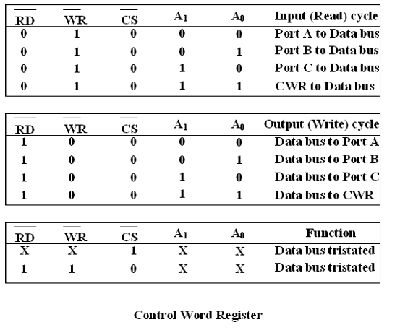
Block Diagram of 8255 (Architecture)

Slide 9
• It has a 40 pins of 4 groups.
1. Data bus buffer
2. Read Write control logic
3. Group A and Group B controls
4. Port A, B and C
Data bus buffer: This is a tristate bidirectional buffer used to interface the 8255 to system data bus. Data is transmitted
or received by the buffer on execution of input or output
instruction by the CPU.
• Control word and status information are also transferred through this unit

Slide 10
a) CS – Chipselect : A low on this PIN enables the communication between CPU and 8255.
b) RD (Read) – A low on this pin enables the CPU to read the data in the ports or the status word through data bus buffer.
c) WR ( Write ) : A low on this pin, the CPU can write data on to the ports or on to the control register through the data bus buffer.
d) RESET: A high on this pin clears the control register and all ports are set to the
input mode
e) A0 and A1 ( Address pins ): These pins in conjunction with RD and WR pins
control the selection of one of the 3 ports.

Slide 11
• Group A and Group B controls : These block receive control from the CPU and issues commands to their respective ports.
• Group A - PA and PCU ( PC7 –PC4)
• Group B - PCL ( PC3 – PC0)
• Control word register can only be written into no read operation of the CW register is allowed.
• a) Port A: This has an 8 bit latched/buffered O/P and 8 bit input latch. It can be programmed in 3 modes – mode 0
mode 1, mode 2.
b) Port B: This has an 8 bit latched / buffered O/P and 8 bit input latch. It can be programmed in mode 0, mode1.

Slide 12
c) Port C : This has an 8 bit latched input buffer and 8 bit out put latched/buffer. This port can be divided into two 4 bit
ports and can be used as control signals for port A and port B.
it can be programmed in mode 0.
Modes of Operation of 8255
• These are two basic modes of operation of 8255. I/O mode and Bit Set-Reset mode (BSR).
• In I/O mode, the 8255 ports work as programmable I/O ports, while in BSR mode only port C (PC0-PC7) can be used
to set or reset its individual port bits

Slide 13
• Under the I/O mode of operation, further there are three modes of operation of 8255, so as to support different types
of applications, mode 0, mode 1 and mode 2
.
BSR Mode : In this mode any of the 8-bits of port C can be set or reset depending on D0 of the control word. The bit
to be set or reset is selected by bit select flags D3, D2 and D1
of the CWR as given in table.
• I/O Modes :
a) Mode 0 ( Basic I/O mode ): This mode is also called as basic input/output mode. This mode provides simple
input and output capabilities using each of the three
ports. Data can be simply read from and written to the input and output ports respectively, after appropriate initialisation.

Slide 14
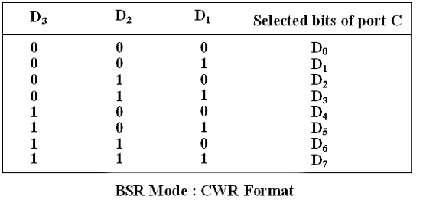
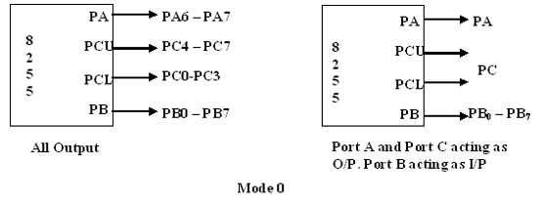

Slide 15
• The salient features of this mode are as listed below:
1. Two 8-bit ports ( port A and port B )and two 4-bit ports (port C upper and lower ) are available. The two 4-bit ports
can be combinedly used as a third 8-bit port.
2. Any port can be used as an input or output port.
3. Output ports are latched. Input ports are not latched
4. A maximum of four ports are available so that overall 16 I/O configuration are possible.
• All these modes can be selected by programming a register internal to 8255 known as CWR.

Slide 16
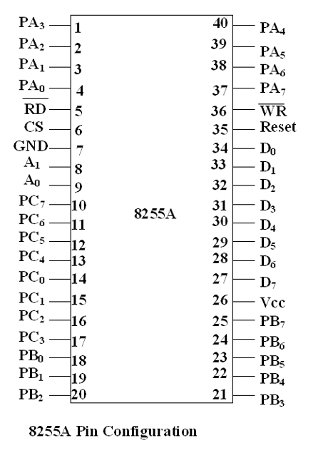

Slide 17
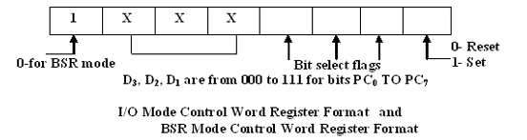

Slide 18
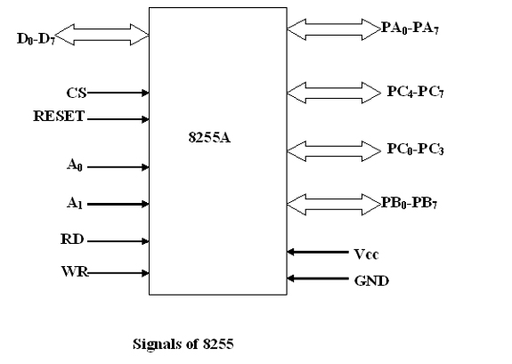
• The control word register has two formats. The first format is valid for I/O modes of operation, i.e. modes 0, mode 1
and mode 2 while the second format is valid for bit set/reset
(BSR) mode of operation. These formats are shown in following

Slide 19
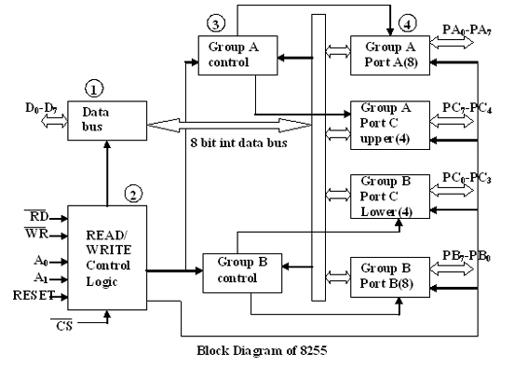

Slide 20
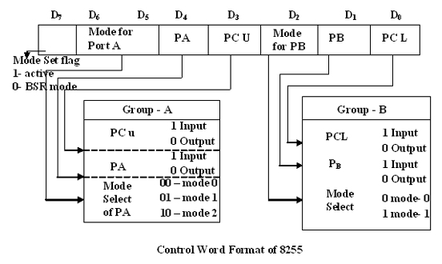
Mode 1: ( Strobed input/output mode ) In this mode the handshaking control the input and output action of the
specified port.
Port C :lines PC0-PC2, provide strobe or handshake lines for port B. This group which includes port B and PC0-PC2
is called as group B for Strobed data input/output Port C lines PC3-PC5 provide strobe lines for port

Slide 21
This group including port A and PC3-PC5 from group A. Thus port C is utilized for
generating handshake signals. The salient features of mode 1 are listed as follows:
1. Two groups – group A and group B are available for strobed data transfer.
2. Each group contains one 8-bit data I/O port and one 4-bit control/data port.
3. The 8-bit data port can be either used as input and output port. The inputs and outputs both are latched.
.

Slide 22
4. Out of 8-bit port C, PC0-PC2 are used to generate control signals for port B and PC3-PC5 are used to generate control
signals for port A. the lines PC6, PC7 may be used as
independent data lines
• The control signals for both the groups in input and output modes are
explained as follows:
Input control signal definitions (mode 1 ):
STB ( Strobe input ) – If this lines falls to logic low level, the data available at 8-bit input port is loaded into input latches.

Slide 23
IBF ( Input buffer full ) – If this signal rises to logic 1, it indicates that data has been loaded into latches, i.e. it works as an acknowledgement. IBF is set by a low on STB and is
reset by the rising edge of RD input.
INTR ( Interrupt request ) – This active high output signal can be used to interrupt the CPU whenever an input device
requests the service. INTR is set by a high STB pin and a high
at IBF pin. INTE is an internal flag that can be controlled by
the bit set/reset mode of either PC4(INTEA) or PC2(INTEB)
INTR is reset by a falling edge of RD input. Thus an external input device can be request the service of the processor
by putting the data on the bus and sending the
strobe signal.

Slide 24
Output control signal definitions (mode 1) :
• OBF (Output buffer full ) – This status signal, whenever falls to low, indicates that CPU has written data to the specified
output port. The OBF flip-flop will be set by a rising edge
of WR signal and reset by a low going edge at the ACK input.
• ACK ( Acknowledge input ) – ACK signal acts as an acknowledgement to be given by an output device. ACK signal
whenever low, informs the CPU that the data transferred by
the CPU to the output device through the port is received by
the output device.
• INTR ( Interrupt request ) – Thus an output signal that can be used to interrupt the CPU when an output device
acknowledges the data received from the CPU. INTR is set when ACK OBF and INTE

Slide 25
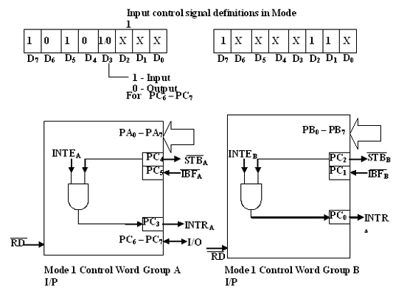

Slide 26
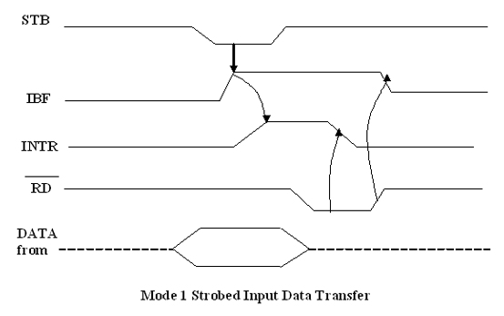
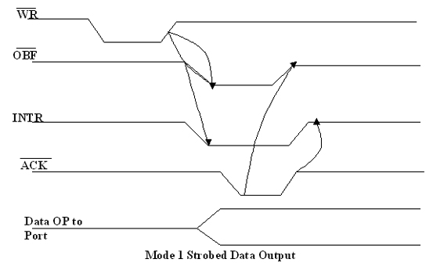

Slide 27
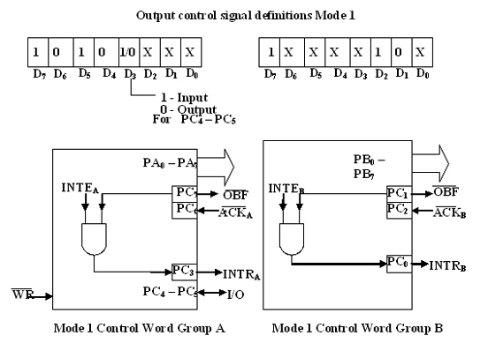

Slide 28
Mode 2 ( Strobed bidirectional I/O ):
This mode of operation of 8255 is also called as strobed bidirectional I/O. This mode of operation provides 8255 with
an additional features for communicating with a peripheral
device on an 8-bit data bus. Handshaking signals are provided
to maintain proper data flow and synchronization between the data transmitter and receiver. The interrupt generation
and other functions are similar to mode 1.
• In this mode, 8255 is a bidirectional 8-bit port with handshake signals. The Rd and WR signals decide whether
the 8255 is going to operate as an input port or output port

Slide 29
1. The single 8-bit port in group A is available.
2. The 8-bit port is bidirectional and additionally a 5-bit control port is available.
3. Three I/O lines are available at port C.( PC2 – PC0 )
4. Inputs and outputs are both latched.
5.The 5-bit control port C (PC3-PC7) is used for generating / accepting hand shake signals for the 8-bit data transfer on port A.
• Control signal definitions in mode 2:
• INTR – (Interrupt request) As in mode 1, this control signal is active high and is used to interrupt the microprocessor
to ask for transfer of the next data byte to/from it. This signal is used for input ( read ) as well as output ( write ) operations

Slide 30
.
Control Signals for Output operations:
OBF ( Output buffer full ) – This signal, when falls to low level, indicates that the CPU has written data to port A.
ACK ( Acknowledge ) This control input, when falls to logic low level, acknowledges that the previous data byte is received by the destination and next byte may be sent by the
processor. This signal enables the internal tristate buffers
to send the next data byte on port A.
INTE1 ( A flag associated with OBF ) This can be controlled by bit set/reset mode with PC6.

Slide 31
Control signals for input operations :
STB (Strobe input ) A low on this line is used to strobe in the data into the input latches of 8255.
IBF ( Input buffer full ) When the data is loaded into input buffer, this signal rises to logic ‘1’. This can be used as an
acknowledge that the data has been received by the receiver.
• The waveforms in fig show the operation in Mode 2 for output as well as input port.
• Note: WR must occur before ACK and STB must be activated before RD .

Slide 32
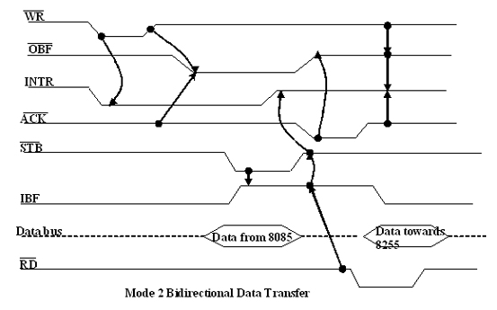
• The following fig shows a schematic diagram containing an 8-bit bidirectional port, 5-bit control port and the relation of
INTR with the control pins. Port B can either be set to Mode 0 or 1 with port A( Group A ) is in Mode 2

Slide 33
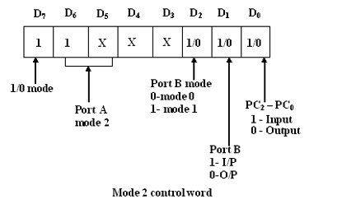
Mode 2 is not available for port B. The following fig shows the control word. The INTR goes high only if either IBF INTE2,
STB and RD go high or OBF, INTE1, ACK and WR go high.
The port C can be read to know the status of the peripheral device in terms of the control signals, using the normal I/O
instructions

Slide 34
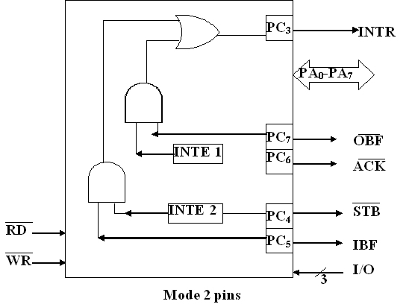

Slide 35
8254
• Compatible with All Intel and Most other Microprocessors
• Handles Inputs from DC to 10 MHz
• 8 MHz 8254
• 10 MHz 8254-2
• Status Read-Back Command
• Six Programmable Counter Modes
• Three Independent 16-Bit Counters
• Binary or BCD Counting
• Single a 5V Supply
• Standard Temperature Range
• The Intel 8254 is a counter/timer device designed to solve the common timing
control problems in microcomputer system design.

Slide 36
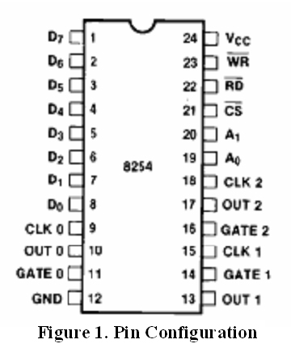
• It provides three independent 16-bit counters, each capable of handling clock inputs up to 10 MHz.

Slide 37
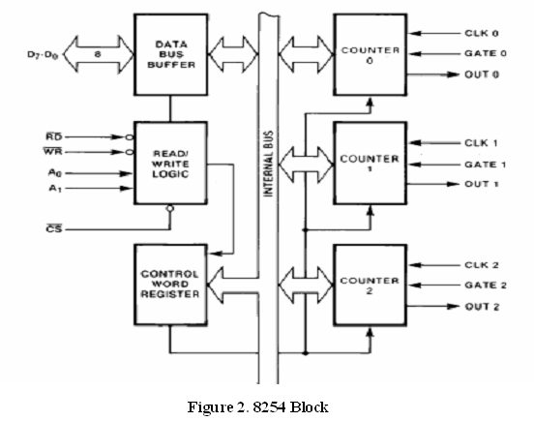
• All modes are software programmable. The 8254 is a superset of the 8253.The 8254 uses HMOS technology and
comes in a 24-pin plastic or CERDIP package

Slide 38
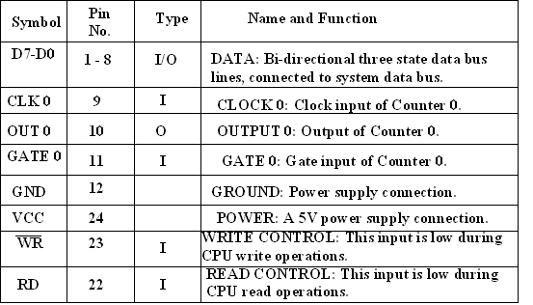
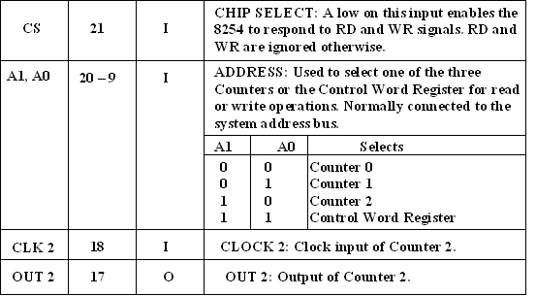

Slide 39
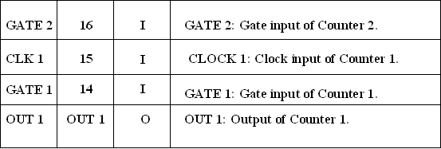
Functional Description
• The 8254 is a programmable interval timer/counter designed for use with Intel microcomputer systems.
• It is a general purpose, multi-timing element that can be treated as an array of I/O ports in the system software.

Slide 40
• The 8254 solves one of the most common problems in any microcomputer system, the generation of accurate time delays under software control. Instead of setting up timing
loops in software, the programmer configures the 8254 to match his requirements and programs one of the counters
for the desired delay.
• After the desired delay, the 8254 will interrupt the CPU. Software overhead is minimal and variable length delays
can easily be accommodated.
• Some of the other counter/timer functions common to microcomputers which can be implemented with the 8254

Slide 41
• Real time clock
• Event-counter
• Digital one-shot
• Programmable rate generator
• Square wave generator
• Binary rate multiplier
• Complex waveform generator
• Complex motor controller

Slide 42
Block Diagram
• DATA BUS BUFFER: This 3-state, bi-directional, 8-bit buffer is used to interface the 8254 to the system bus Data Bus Buffer and Read/Write Logic Functions.
• READ/WRITE LOGIC : The Read/Write Logic accepts inputs from the system bus and generates control signals for the other functional blocks of the 8254. A1 and A0 select one of
the three counters or the Control Word Register to be read
from/written into.
• A ``low'' on the RD input tells the 8254 that the CPU is reading one of the counters.

Slide 43
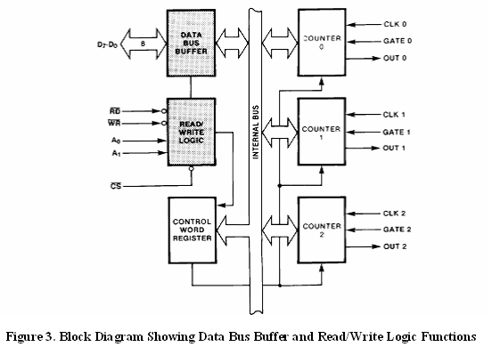

Slide 44
A ``low'' on the WR input tells the 8254 that the CPU is writing either a Control Word or an initial count. Both RD and WR are qualified by CS; RD and WR are ignored unless the 8254 has been selected by holding CS low.
CONTROL WORD REGISTER :The Control Word Register (see Figure 4) is selected by the Read/Write Logic when A1,
A0 = 11. If the CPU then does a write operation to the 8254
the data is stored in the Control Word Register and is
interpreted as a Control Word used to define the operation of the Counters

Slide 45
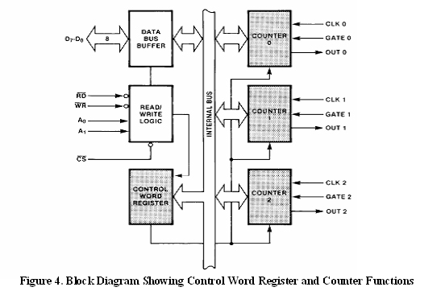

Slide 46
• COUNTER 0, COUNTER 1, COUNTER 2 :These three functional blocks are identical in operation, so only a single
Counter will be described. The internal block diagram of a single counter is shown in Figure 5.
• The Counters are fully independent. Each Counter may operate in a different Mode.
• The Control Word Register is shown in the figure, it is not part of the Counter itself, but its contents determine how
the Counter operates.
.

Slide 47
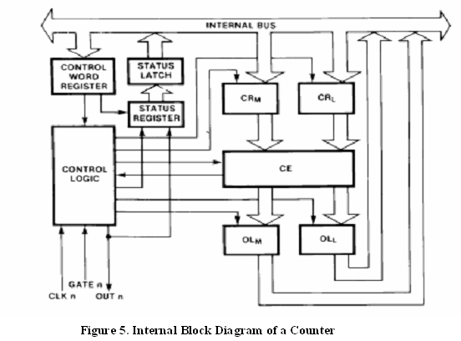

Slide 48
• The status register, shown in Figure 5, when latched, contains the current contents of the Control Word Register
and status of the output and null count flag.
• The actual counter is labelled CE (for ``Counting Element''). It is a 16-bit presettable synchronous down counter.
OLM and OLL are two 8-bit latches. OL stands for ``Output Latch''; the subscripts M and L stand for``Most significant
byte'' and ``Least significant byte’‘respectively

