Slide 1

STANFORD ME344 . FINAL PROJECT . ANH NGUYEN
Train, Tune, And Scale Qwen3-4B
on a TPU v5e-8
Forty minutes on eight v5e chips, 5.3 chip-hours, answering three questions.
WHAT FITS
(^_^) TP8, not DP8
Tensor parallel shards the 16 bytes per parameter of training state eight ways and fits in 8.23 GiB per chip. Data parallel replicates it, needs 59.94, and dies at 65.47 against 15.75 available. Both predicted before running.
WHAT IS WORTH RUNNING
(^_^) global batch 32
Throughput saturates at 16,562 tokens/s using 59.4% of HBM. The memory wall is four doublings later at gb512. Everything in between spends memory for nothing.
WHAT BREAKS
(x_x) the fabric
16 chips in one ICI slice: 100% efficiency. The same 16 across two slices, so the gradient all-reduce crosses DCN: 65% strong, 54% weak.
run qanh-20260813t194806z . MaxText 17c7172 . every number traces to a named artifact file . areporeporepo.github.io/me344-run/final/
Notes:
0:00 to 0:45. This is Train, Tune and Scale Qwen3-4B on a TPU v5e-8. Forty minutes of wall clock on eight v5e chips, about 5.3 chip-hours, spent answering three questions: what fits, what is worth running, and what breaks when you add more chips. The short version of all three is on this slide. What fits is tensor parallel, not data parallel, and I predicted that before running it. What is worth running is global batch 32, which is nowhere near the memory limit. And what breaks is not the chip count, it is the network fabric. Everything I show you traces to a named artifact file from one run.
[GERTY, top right: setting up]

Slide 2

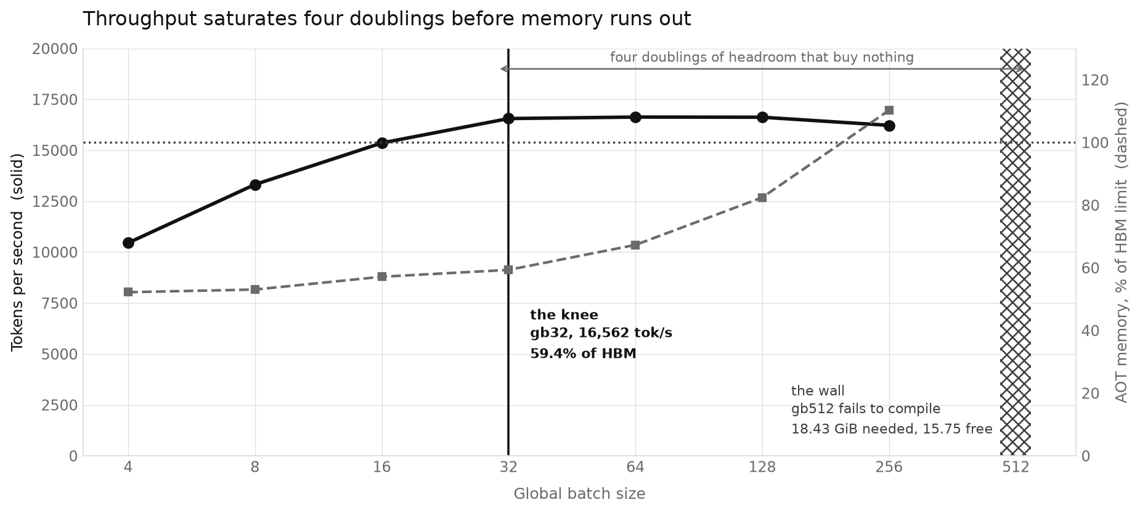
1 OF 4 . MEMORY
The useful batch and the memory wall are not the same shape
(^_^) The knee: gb32
16,562 tokens/s at 59.4% of HBM. gb64 buys 0.4% more throughput for 13% more memory.
(x_x) The wall: gb512
Fails to compile. 18.43 GiB of temporaries against 15.75 available.
(-_-) The ceiling: 25.5%
Of the 197 BF16 TFLOP/s peak, and it plateaus there across an 8x range of batch sizes.
(^_^) It was the sharding, not the chip
Open on the day, closed since: FSDP8 on this same v5e host reaches 52.7% MFU. TP8 all-reduces activations every layer, so its traffic scales with tokens and no batch size escapes it.
sweep_results.csv . capacity_report.json . 8 batch sizes, AOT compiled then benchmarked at 8 steps each
Notes:
0:45 to 1:45. This chart has throughput on the left axis and the compiler's memory estimate on the right. Throughput saturates at global batch 32: 16,562 tokens a second, using 59% of HBM. The first shape that actually fails to compile is global batch 512. That is four doublings of headroom between as fast as this gets and out of memory, and everything in between spends memory for nothing. Going from 32 to 64 buys 0.4% more throughput for 13% more memory. Why does a bigger batch stop helping? Not because the arithmetic units are saturated: we are sitting at a quarter of peak, so they clearly are not. I left this open on the day and have since closed it. FSDP instead of tensor parallel, same chip, same memory footprint, more than doubles it to 52.7%. Tensor parallelism all-reduces activations at every layer, so its traffic grows with token count and no batch size escapes it.
[GERTY, top right: predicted, then confirmed]

Slide 3

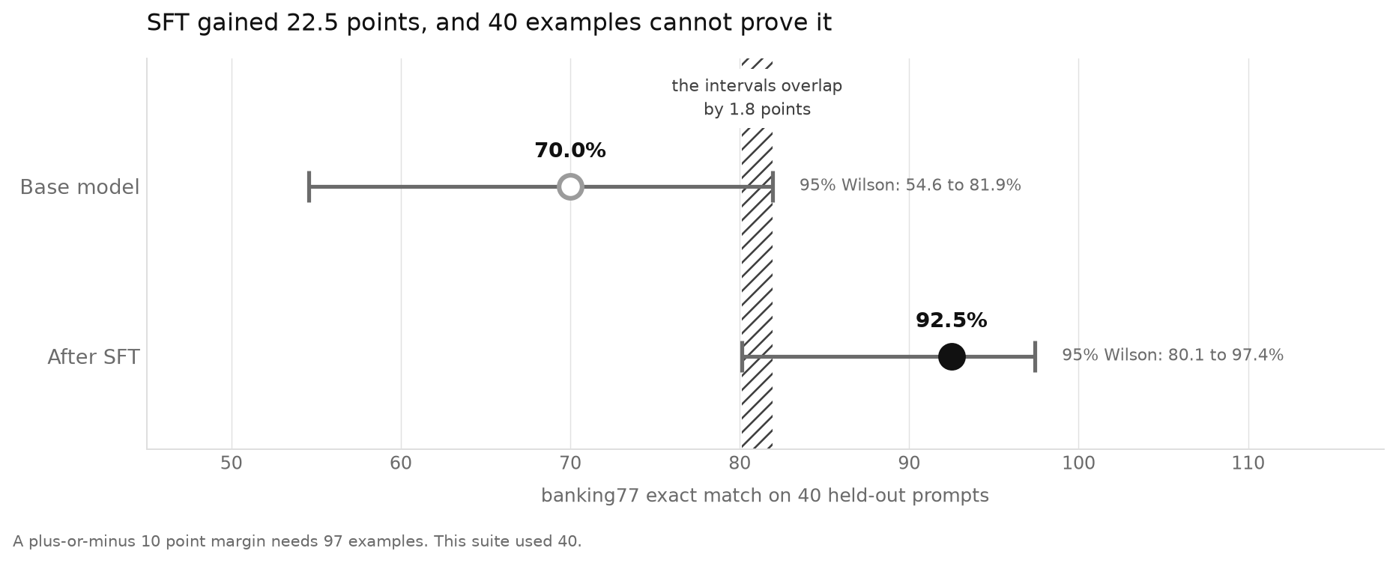
2 OF 4 . THE MODEL
Fine-tuning worked. Forty examples cannot prove it.
(^_^) SFT: 70.0% to 92.5%
On 40 held-out banking77 prompts, format compliance holding at 100%, GSM8K retention rising 81.25% to 87.5%.
(-_-) But the intervals overlap
95% Wilson: base 54.6 to 81.9, SFT 80.1 to 97.4. They overlap by 1.8 points, so the delta is not formally established.
(x_x) And GRPO did not reproduce
Plus 12.5 points here, minus 12.5 on an identically configured run three days earlier, with the guardrail flipping pass to fail. Two examples out of sixteen.
(._.) So: a smoke test
97 examples would be needed for a plus-or-minus 10 point margin. I used 40.
evaluation_results.csv . evaluation_uncertainty.json . Wilson score interval, 95%, n=40
Notes:
1:45 to 2:45. Fine-tuning worked, and the evidence for it is thinner than the headline suggests. Two hundred steps of SFT moved banking77 exact match from 70% to 92.5% on forty held-out prompts, format compliance held at 100%, and GSM8K retention went up rather than down, 81.25 to 87.5. That is the result I would ship. Here is the problem. Those bars are Wilson intervals, which are the honest range of true accuracy you can claim from a small sample, and they overlap by 1.8 points. On top of that, GRPO's accuracy effect came out plus 12.5 points here and minus 12.5 on an identically configured run three days earlier, with the guardrail flipping from pass to fail. That is a two-example swing on a sixteen-item set. I would need 97 examples for a plus or minus ten point margin. I used forty.
[GERTY, top right: did not reproduce]

Slide 4

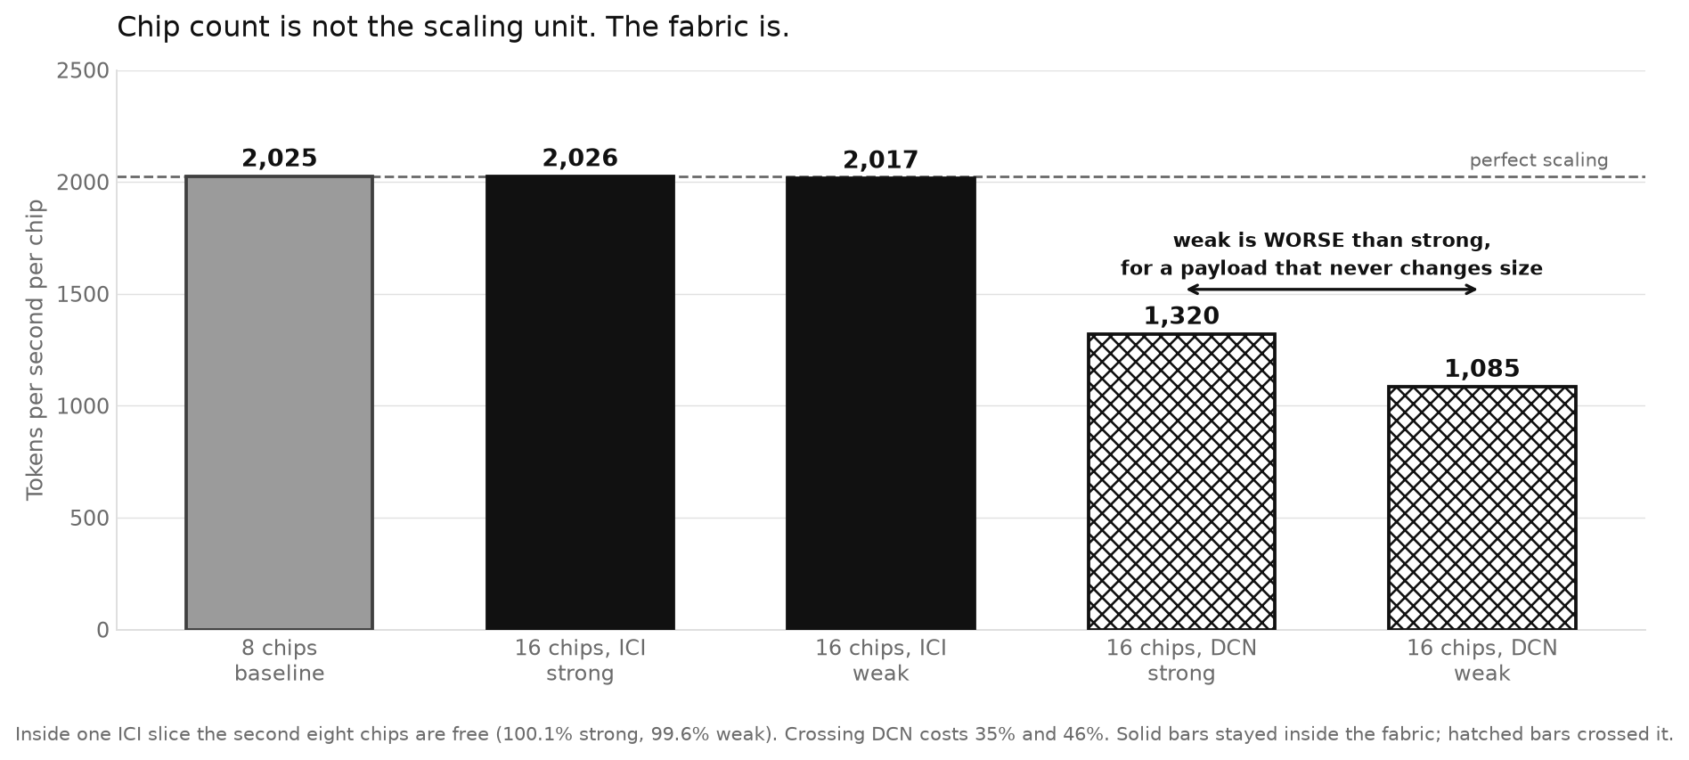
3 OF 4 . SCALING
Chip count is not the scaling unit. The fabric is.
(^_^) Inside one ICI slice: free
8 to 16 chips holds 100.1% strong and 99.6% weak efficiency. Per chip throughput goes 2,025 to 2,026.
(x_x) Across DCN: 35% gone
Same model, same batches, same logical layout. Only the fabric the gradient all-reduce travels over changed.
(o_o) One result I cannot explain
DCN weak is worse per chip than DCN strong, 1,085 against 1,320. An all-reduce payload is fixed by parameter count, so doubling the batch should not hurt.
(._.) Three candidates, no evidence
Lost compute/communication overlap, rematerialization at 110% of the AOT limit, or shared-fabric contention. The GKE jobs saved no traces.
scale_out.json . 5 trials . the GKE results are dated 2026-08-10 and reused, each records a source_checkpoint from that run
Notes:
2:45 to 3:45. This is the result I would actually defend. Going from 8 to 16 chips inside one ICI slice is free: per chip throughput goes from 2,025 tokens a second to 2,026, so the second eight chips cost nothing. Take those same sixteen chips, split them across two slices so the gradient all-reduce has to cross DCN instead of ICI, same model, same batches, same layout, and it drops to 1,320 and then 1,085. And look at the last two bars, because that ordering should be impossible. An all-reduce averages gradients, which is one value per parameter, so its payload is fixed by the model and does not grow when you double the batch. Weak scaling should not be worse than strong. Exposed communication went from 1.08 seconds to 3.51 for the same payload. Lost overlap, rematerialization at 110% of the memory limit, and contention from other students are all consistent, the GKE jobs saved no traces, and I genuinely cannot tell you which it is.
[GERTY, top right: I cannot explain this one]

Slide 5

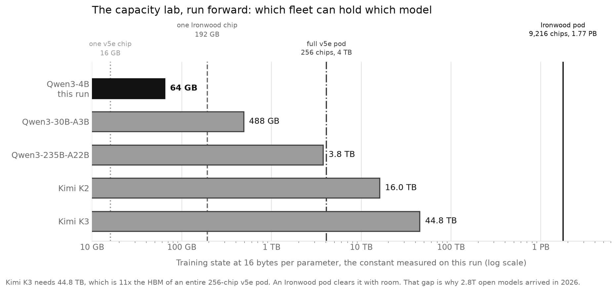
4 OF 4 . OUTLOOK
What I would ship, and what this pod says about 2027
(^_^) Ship SFT step 202
The only candidate with a domain gain, no retention regression, and a serving measurement behind it. Not GRPO: its gain did not reproduce.
(._.) The arithmetic outlives the number
16 bytes per parameter is what says which models a fleet can train. Kimi K3 needs 11x an entire v5e pod. That is why 2.8T open models arrived in 2026.
(^_^) The fabric result ages best
On Ironwood the boundary moves from 256 chips to 9,216 but does not vanish. TPU 8i drops the 3D torus for a topology cutting 16 hops to 7, claiming 50% better all-to-all, and names MoE serving as the reason.
(-_-) 99% matmul is about L=256
Attention scales as L squared against matmul's L, so at 1M context the same step is 97% attention. That is why Kimi K3 and Qwen3.5 replaced most of their attention.
(o_o) Prediction, not measurement
Google says 8t and 8i were built for world models like Genie 3. If so, 2027's systems question is a simulate-act-learn loop, not tokens/s on a training step.
16 bytes/parameter measured on this run . chip capacities from Google Cloud docs and the TPU 8t/8i deep dive, 2026-04-22
Notes:
3:45 to 5:00. What I would ship, and what survives this hardware. I would ship the SFT checkpoint at step 202, not GRPO, because GRPO's gain did not reproduce. Now the part that outlives the assignment. This chart takes the 16 bytes per parameter I measured and applies it forward. Kimi K3, at 2.8 trillion parameters, needs 44.8 terabytes of training state, which is eleven times the HBM of an entire 256-chip v5e pod. An Ironwood pod clears it with room. That gap is why 2.8-trillion-parameter open models arrived in 2026 and not 2023. The fabric result ages best. On Ironwood the boundary moves from 256 chips to 9,216, but it does not disappear, and mixture-of-experts models add a second collective, a per-layer all-to-all. Google's new inference part drops the 3D torus for a topology that cuts network diameter from 16 hops to 7 for a claimed 50% better all-to-all latency, and names MoE serving as the reason, so they reached the same conclusion I did. One caveat on my own numbers: the 99% matmul figure is a claim about sequence length 256 only. Attention scales as L squared against matmul's L, so at a million tokens the same step is 97% attention, which is why Kimi K3 and Qwen3.5 replaced most of their attention layers. And a prediction to close on. Google says these chips were built to train and serve world models like Genie 3, so millions of agents can rehearse in simulation. If that is where the compute goes, the systems question of 2027 is not tokens per second on a training step, it is the throughput and latency of a simulate, act, learn loop, and the fabric question I measured reappears between the model and its environment. Thanks.
[GERTY, top right: a forecast, not a measurement]

