Slide 1

Program Analysis Basics
COMP130159.01
XU, Hui
xuh@fudan.edu.cn
April 27, 2020

Slide 2
About Me
徐辉
Ph.D. from CUHK in 2018
Research Interest:
To make software more reliable.
Rust, LLVM, symbolic execution, etc.
AI-software reliability.
To design usable security features for systems.
Smartphones, continuous authentication, etc.
Fake voice detection.
Office: 软件楼328室

Slide 3
1. Applications of Program Analysis

Slide 4
Compiler
Syntax Checking
Semantic Checking
int main()
{
// invalid operator (<)
std::cout < "Hi there";
// missing “;”
return 0
}
int main()
{
int a = 10;
int b = 0; //b = getchar();
// division by 0 is undefined
std::cout << a / b;
return 0;
}
much easy
(abstract syntax tree)
difficult
(need to consider the flow/context)

Slide 5
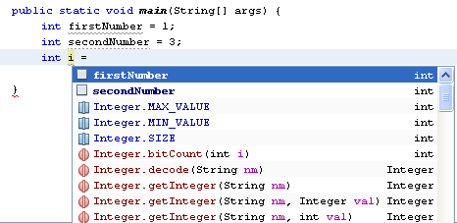
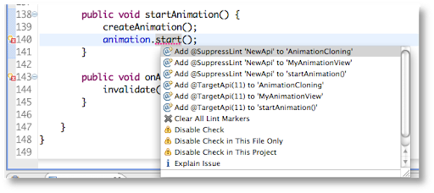
Integrated Development Environment
Code Suggestion
Style Checking
(lint)

Slide 6

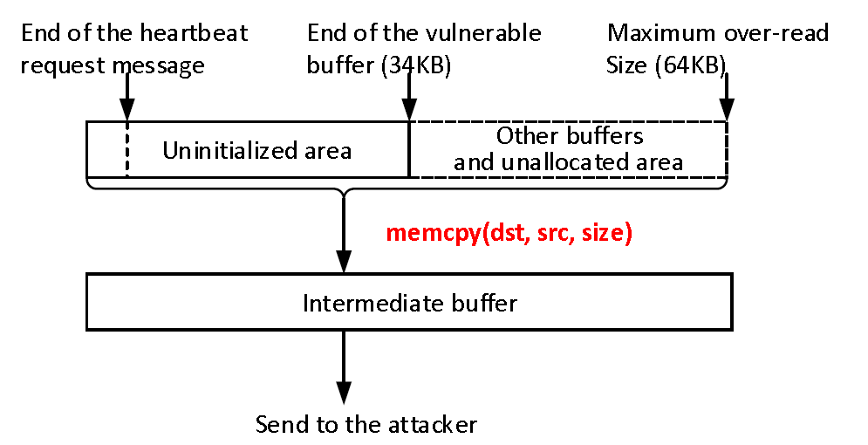
Find Bugs/Code Review
Heartbleed (CVE-2014-0160)
buffer = OPENSSL_malloc(1 + 2 + size + padding);
bp = buffer;
/*Enter response type, length and copy payload*/
*bp++ = TLS1_HB_RESPONSE;
s2n(size, bp);
/*src and size are controlled by attacker*/
memcpy(bp, src, size);
bp += size;
/* Random padding */
RAND_pseudo_bytes(bp, padding);
r = ssl3_write_bytes(s,
TLS1_RT_HEARTBEAT,
buffer, 3 + size + padding);
Jun Wang, et al. “Risk assessment of buffer" Heartbleed" over-read vulnerabilities.” DSN, 2015.

Slide 7
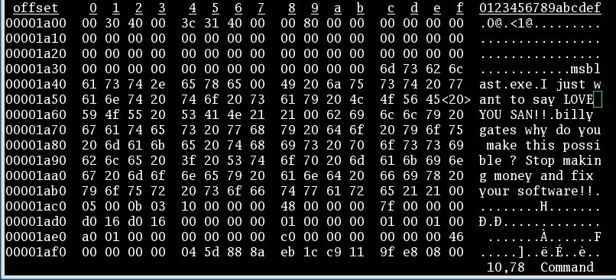
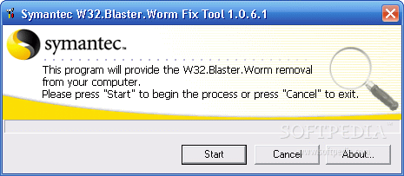
Malware Analysis/Detection
Blaster Worm (2003), or 冲击波病毒, Lovesan
Behavior:
Spread by exploiting a buffer overflow in the DCOM RPC service.
Launch SYN flood to windows update service.
Auto start when system boot:
HKEY_LOCAL_MACHINE\SOFTWARE\Microsoft\Windows\CurrentVersion\Run\
windows auto update=msblast.exe

Slide 8
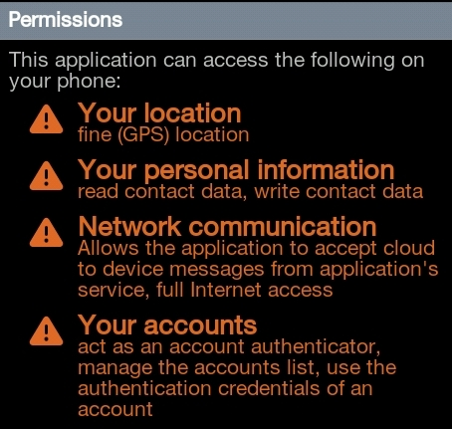
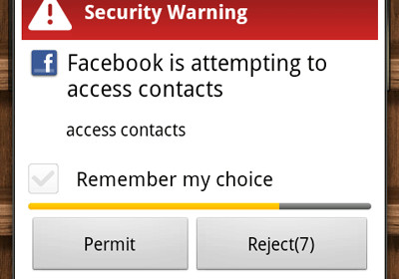
Privacy Leakage Detection
Instructions
Read
Send
Leakage Happens
Taint Propagation
Data
Private
Data
Variable1
Variable2

Slide 9
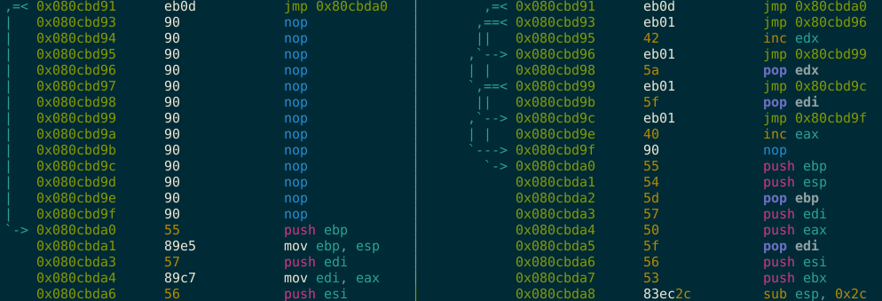
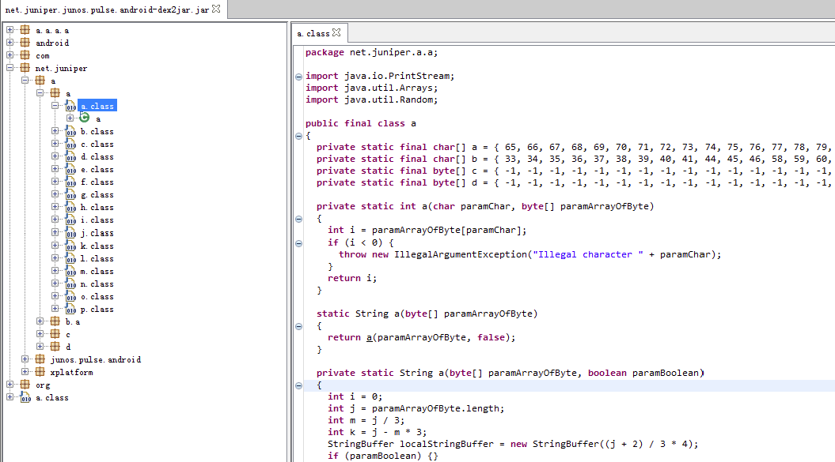
Camouflage/Code Obfuscation
Virus:
camouflage
by metame
Android App:
obfuscation
by proguard

Slide 10
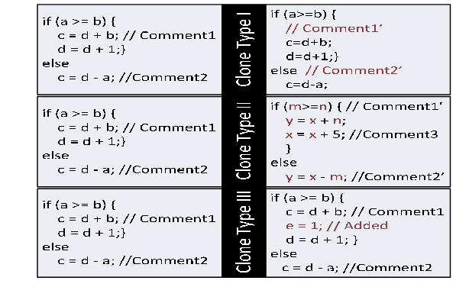
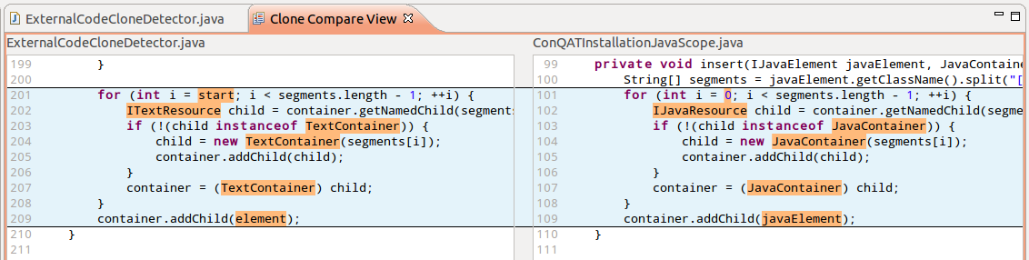
Clone Detection
Different Types
Different Layouts

Slide 11
All these tasks are related to program analysis and software security.

Slide 12
Developer’s Perspective
Developers do not trust (malicious) users.
For developers, software security could mean:
Correctness (bug free)
Code integrity (tamer-resilience)
Intellectual property (license, algorithm, keys)
We are not interested in application security issues, e.g.,
Authentication/authorization
Encryption

Slide 13
User’s Perspective
Users/hosts do not trust the software, or its developer, or the delivery agent (like app market).
For users, software security could mean:
No privacy leakage
No malware
…

Slide 14
Tentative Schedule
Week 9: Program Analysis Basics
Week 10: Static Program Analysis
Week 11: Taint Analysis
Week 12: Symbolic Execution
Week 13: Fuzz Testing
Week 14: Bug Search
Week 15: Memory-Safety Programing
Week 16: Program Obfuscation

Slide 15
2. Terminology of Program Analysis

Slide 16
What is Program Analysis?
Body of work to automatically discover useful facts (properties) about programs.
Broadly classified into:
Static analysis: without running the program
Dynamic analysis: run the program
Hybrid: static + dynamic

Slide 17
Case Study: Privacy Leakage
int main(){
//private data: IMEI
int imei = getIMEI();
int seed = getchar();
srand(seed);
int x = rand()%1000;
if (x == 99)
leak(imei);
return x;
}
Does the program leak private data?

Slide 18
By Dynamic Analysis
int main(){
//private data: IMEI
int imei = getIMEI();
int seed = getchar();
srand(seed);
int x = rand()%1000;
if (x == 99)
leak(imei);
return x;
}
Execute each possible test case
(seed = ‘a’) does not leak.
(seed = ‘b’) does not leak.
…
The program may or may not leak privacy. Difficult to guarantee !!!
The analysis is complete.
Accurate, no false positives
May have false negatives

Slide 19
By Static Analysis
int imei = getIMEI();
Two possible paths:
The left path leaks private data;
The right path does not leak.
The program may leak privacy.
The analysis is sound.
No false negatives.
May have false positives.
int seed = getchar();
srand(seed);
int x = rand()%1000;
(x == 99)?
yes
leak(imei)
no
return x

Slide 20
Example Static Analysis Problem
void main() {
int y, z = 3;
int x = getchar();
while (true) {
if (x == 1)
y = 7; else y = z + 4;
assert (y == 7); } }
Find variables that have a constant value at a given program point.

Slide 21
Iterative Approximation
entry
[x=?, y=?, z=?]
int y, z = 3
[x=?, y=?, z=3]
int x = getchar()
[x=?, y=?, z=3]
[x=?, y=?, z=3]
[x=?, y=7, z=3]
(x > 0)?
false
exit
true
[x=?, y=?, z=3]
(x == 1)?
[x=1, y=?, z=3]
[x=?, y=?, z=3]
true
false
y =7
y = z + 4
[x=1, y=7, z=3]
[x=?, y=7, z=3]
assert (y == 7)

Slide 22
Iterative Approximation
Fill in the value of variable b that the analysis infers at: 1) the loop header 2) entry of loop body 3) exit of loop body
Enter “?” if a definite value cannot be inferred.
[b=?]
b = 1
1)
[b=1]
[b=1]
false
while (true)
2)
[b=?]
true
[b=1]
[b=?]
b = b + 1
3)
[b=?]
[b=2]
[b=?]

Slide 23
Terminology
Control-flow graph
Abstract vs concrete states
Termination
Completeness
Soundness

Slide 24
Dynamic vs. Static Analysis
Match each box with its corresponding feature.
 | Dynamic Analysis | Static Analysis
Cost
Effectiveness
C
D
A
B
A, Unsound: may miss errors
B, Incomplete: may report spurious errors
C, Proportional to program’s execution time
D, Proportional to program’s size

Slide 25
3. Undecidability of Program Properties

Slide 26
Undecidability of Program Properties
Can program analysis be sound and complete?
No if we want it to terminate.
Questions like “if a variable has a constant value?” is undecidable.
Design a program analysis algorithm is an art.

Slide 27
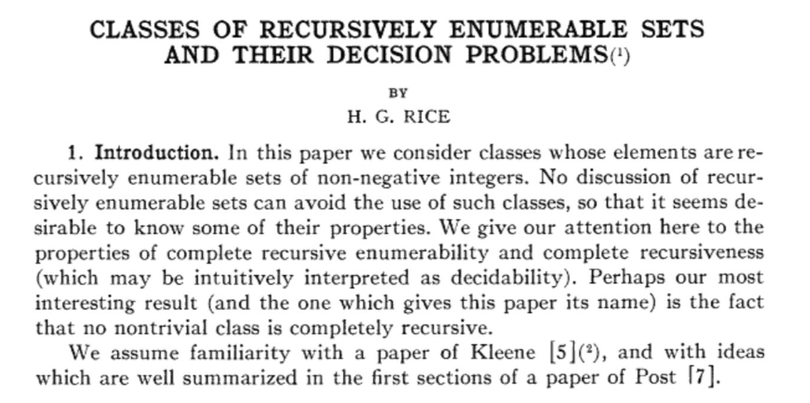
The Bad News: Rice's Theorem
“Any nontrivial property about the language recognized by a Turing Machine is undecidable.”
- Henry Gordon Rice, 1953

Slide 28



Proof: Reduction to The Halting Problem
Can we decide if a variable has a constant value?
$$Yes$$
A
If the value of x always equal to k when P is executed?
$$(P,x,k)$$
$$No$$
Can you exploit the algorithm?
x = 17;
if (TM(j))
x = 18;
X is constant if and only if the j’th Turing machine does not halt on empty input.

Slide 29

Proof: By Contradiction
Suppose there exists a program A that can decide whether a Turing machine is correct (accept, reject)
yes
accept
$$T$$
A
no
reject
If we model the program as a deterministic Turing Machine, failures can be represented with a special state, fail.

Slide 30
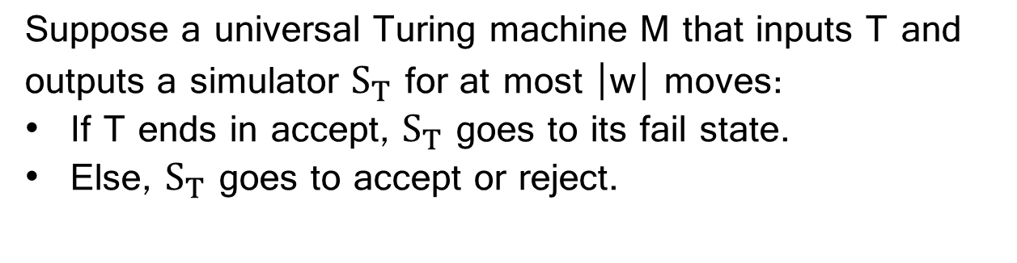



Proof: By Contradiction
M
accept
yes
$$T$$
Construct $S_{T}$ from $T$
$S_{T}$
A
no
reject
Suppose a universal Turing machine M that inputs T and outputs a simulator $S_{T}$ for at most |w| moves:
If T ends in accept, $S_{T}$ goes to its fail state.
Else, $S_{T}$ goes to accept or reject.

Slide 31

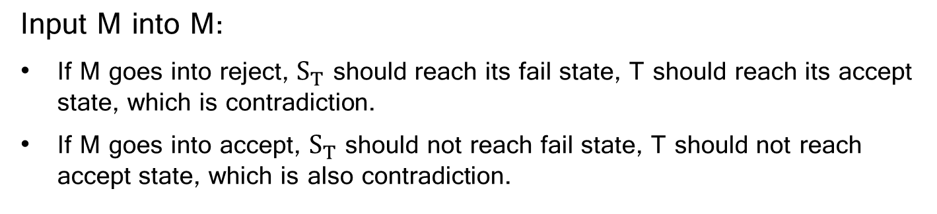


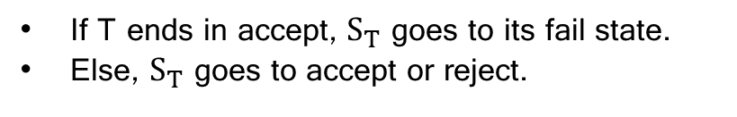
Proof: By Contradiction
If T ends in accept, $S_{T}$ goes to its fail state.
Else, $S_{T}$ goes to accept or reject.
M
accept
yes
$$T$$
Construct $S_{T}$ from $T$
$S_{T}$
A
no
reject
Input M into M:
If M goes into reject, $S_{T}$ should reach its fail state, T should reach its accept state, which is contradiction.
If M goes into accept, $S_{T}$ should not reach fail state, T should not reach accept state, which is also contradiction.

Slide 32
What Have We Learned?
What is program analysis?
Dynamic vs. static analysis: pros and cons
Iterative approximation method for static analysis
Undecidability => program analysis cannot ensure termination + soundness + completeness

Slide 33
Recommended Reading
“Static Program Analysis,” Anders Møller and Michael I. Schwartzbach, Aarhus University
Link: https://cs.au.dk/~amoeller/spa/
CIS 700: Software Analysis and Testing, Mayur Naik, University of Pennsylvania.
https://www.cis.upenn.edu/~mhnaik/edu/cis700/index.html

