Slide 1

Bug Search
COMP130159.01
XU, Hui
xuh@fudan.edu.cn
June 2, 2020

Slide 2
Motivation
Bugs have similar patterns
If rules can be extracted:
Search possible bugs based on rules
Typical cases are related to exception handling
Otherwise
Search possible bugs based on a bug repository
Similarity-based approach

Slide 3
Bug Avoidance Approaches
Static analysis
Dynamic analysis
Compiler techniques
Type checking
Abstract interpretation
Testing
Symbolic execution
Fuzzing
Bug Avoidance
Search
Rule-based
Similarity-based

Slide 4
1. Rule-based Approach

Slide 5
Error Handling
In error handling paths, the driver should release the acquired resources and execute the operations that are opposite to its previous execution.
Bugs occur if developers forget/fail to handle the errors properly.
Liu, Huqiu, et al. "PF-Miner: A new paired functions mining method for Android kernel in error paths." ACSAC 2014.

Slide 6
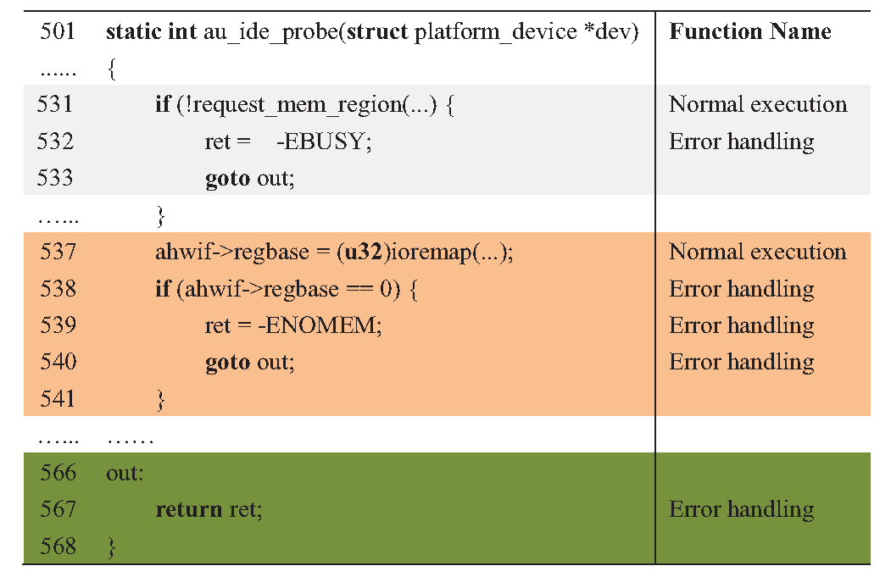
An Example
A bug found in Android kernel 3.10.0: drivers/ide/au1xxx-ide.c
1. request memory (successful)
2. ioremap (fail), goto out
3. return without memory release

Slide 7
Paired Function Mining
Some functions should be used pairwise, e.g.,
pci_ioremap, pci_iounmap
pci_enable_device, pci_disable_device
Basic idea of PF-Miner:
Find paired functions of a target project.
Assuming paired functions are unknown in advance.
Otherwise, a dictionary of paired functions can be employed.
Label paired functions on the control-flow graph;
Detect violations by checking all control flows.
Liu, Huqiu, et al. "PF-Miner: A new paired functions mining method for Android kernel in error paths." ACSAC 2014.

Slide 8
How to Detect Paired Functions?
Host Function
Callee 1
Callee 2
…
Callee n
Step 1: classify callees into two sets based on their context:
Callees of normal paths;
Callees of exception paths.
Step 2: find paires of callees between the two sets.

Slide 9
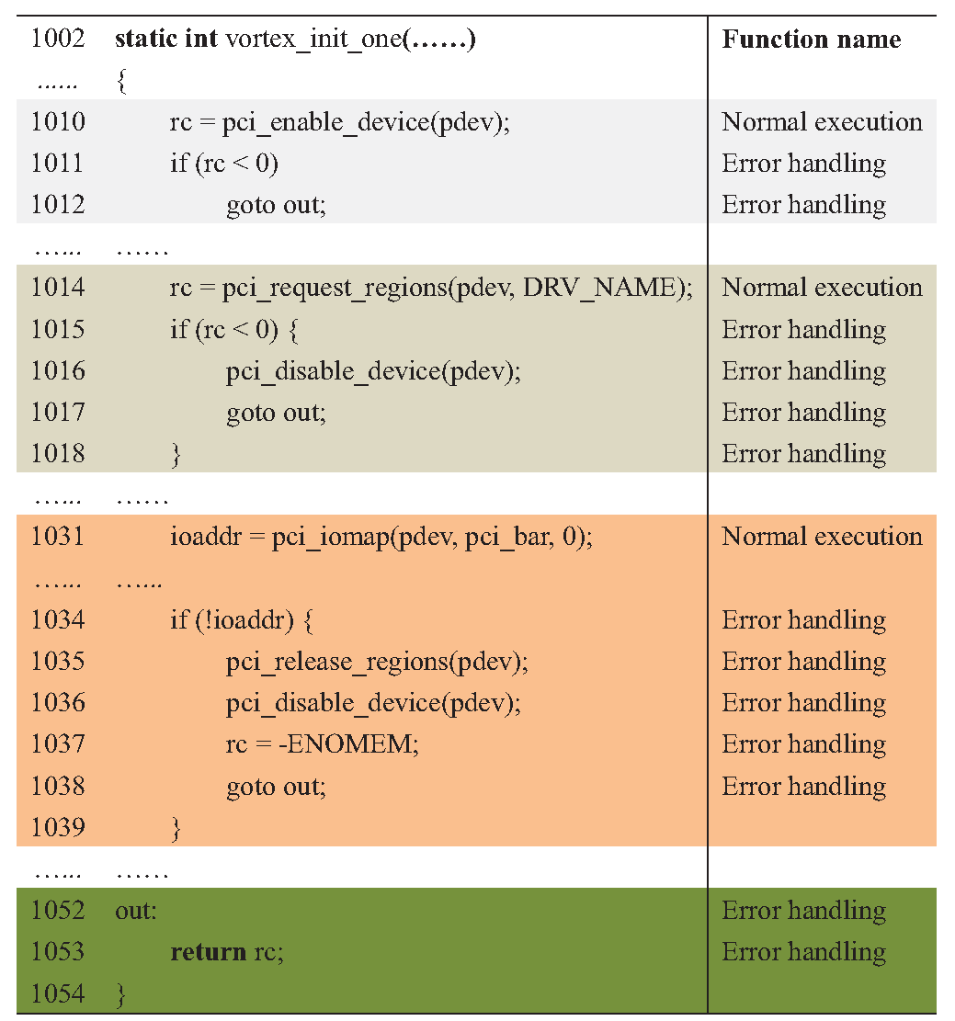
Find Possible Paired Callees
pc_enable_device()
fail
successful
fail
pci_request_regions()
pci_disable_device()
successful
pci_iomap()
fail
successful
pci_releason_regions()
pci_disable_device()
Callees of normal paths
pci_enable_device()
pci_request_regions()
pci_iomap()
Callees of exception paths
pci_disable_device()
pci_release_regions()

Slide 10
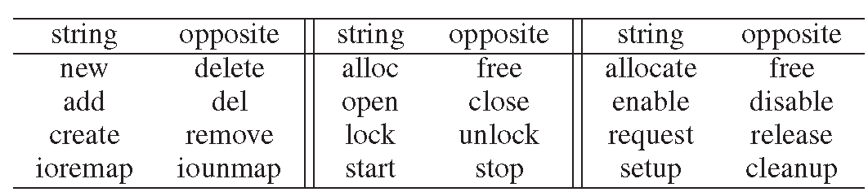
Evaluate If Two Callees Can Be Paired
Paired functions should operate on the same resource in an opposite manner, e.g., by splitting the identifier of pci_enable_device() and pci_disable_device()
Resource: pci_device
Opposite operation: enable, disable

Slide 11
Detect Violations
request_mem_region()
fail
successful
ioremap()
fail
successful
out
Violation condition (no resource release): a route with only one of the paired function that is successfully executed.

Slide 12
Evaluation
Android kernel version 2.6.39 (forked from Linux).
81 bugs reported by PF-Miner (all fixed in 3.10.0)
26 paired functions
50 drivers
Android kernel 3.10.0
983 violations from 4225 drivers
Top 51 are potential bugs
Need to confirm with developers.
546 paired functions

Slide 13
3. Similarity-based Approach

Slide 14
Code Similarity
To measure how much two code snippets/functions are alike or different from each other.
“Hello World” Compiled with GCC
“Hello World” Compiled with Clang
push rbp
mov rbp, rsp
lea rdi, s; "Hello World"
call _puts
mov eax, 0
pop rbp
retn
var_8= dword ptr -8
var_4= dword ptr -4
push rbp
mov rbp, rsp
sub rsp, 10h
mov rdi, offset format ; "Hello World\n"
mov [rbp+var_4], 0
mov al, 0
call _printf
xor ecx, ecx
mov [rbp+var_8], eax
mov eax, ecx
add rsp, 10h
pop rbp
retn

Slide 15
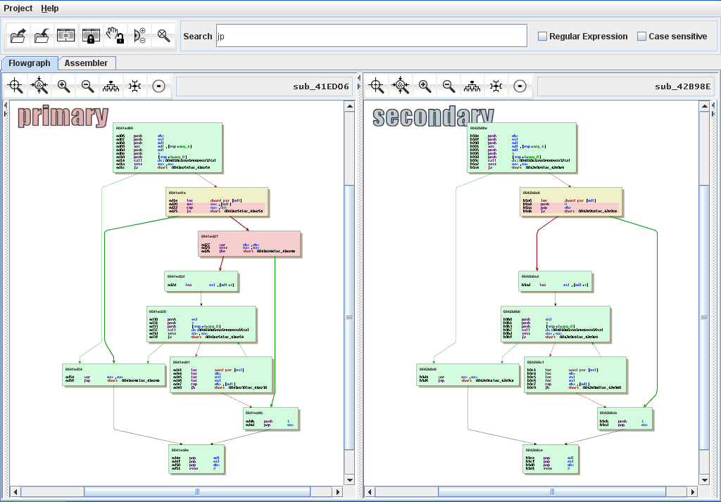
Preliminary Features in BinDiff
Function Matching
hash matching
name hash matching
address
string references
loop count
call sequence
…
Basic Block Matching
hash matching
call reference matching
string reference matching
…
https://www.zynamics.com/bindiff/manual/

Slide 16
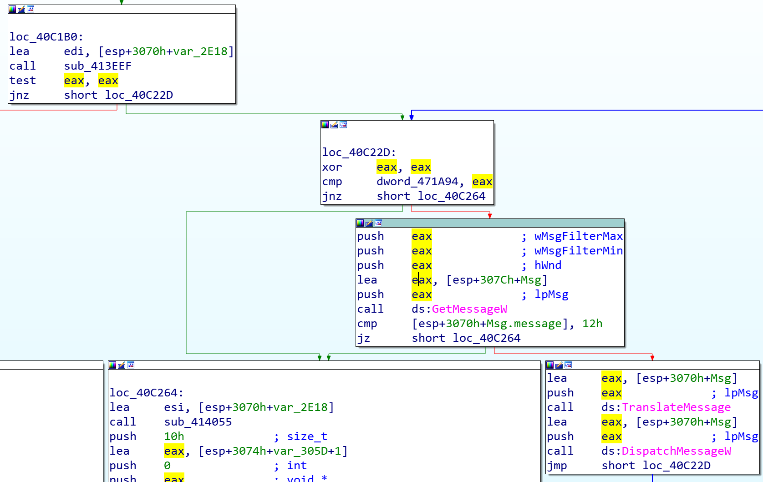
Problem Definition and Ideas
Problem: searching bugs with a set of bug samples as conditions, which is more difficult than searching documents.
Bug Repo
bug code 1
bug code 2
…
bug code n
Search
Idea 1:
Locate suspicious code snippets, and then compare the similarity
Pairwise Graph Matching
Idea 2:
Create an embedding for each bug (codebook), and then search similar embeddings
Graph Embedding

Slide 17
Pairwise Graph Matching
Step 1: compute the distance between each basic-block pair of Graph-A and Graph-B
Generate a block distance matrix
Step 2: match Graph-A and Graph-B
Bipartite matching
Maximum common subgraph

Slide 18
CFG Matching as Bipartite Matching
A1
B1
A2
A3
VS
B3
B2
B4
A4
A5
B5
A1
A2
VS
B1
B3
A3
A4
B4
B2
A5
B5

Slide 19
Block Similarity: Edit Distance
Remove the variables/constants of each instruction
Compute edit distance
Longest common subsequence (LCS) distance: allow only insertion and deletion, not substitution.
Levenshtein distance: allow deletion, insertion and substitution.
push eax
lea eax, [esp+11Ch+var_108]
push eax
call sub_404F5E
lea ecx, [esp+118h+var_F0]
call ds:__imp_??1?$CStringT@D@Cmm@@UAE@XZ
mov esi, [edi+18h]
mov edi, [edi]
cmp [esp+118h+var_108], ebx
jz short loc_408D5F
push
lea
push
call
lea
call
mov
mov
cmp
jz
stem

Slide 20
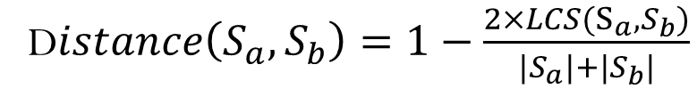
Find the Longest Common Subsequence
push | mov | sub | mov | mov | mov | call | xor | mov | mov | add | pop | retn
Use the length of the longest common subsequence for distance calculation, e.g.,
D$istance\left(S_{a},S_{b}\right)=1−\frac{2×LCS(S_{a},S_{b})}{|S_{a}|+|S_{b}|}$
//sample solution with dynamic programming
//a is a sequence with i instructions
//b is a sequence with j instructions
LCS(a,b,i,j){
if (i == 0 or j == 0)
return 0;
if (a[i] = b[j])
return LCS(a,b,i-1,j-1)+1
else
return max(LCS(a,b,i-1,j),LCS(a,b,i,j-1))
}
push | mov | lea | call | mov | pop | retn

Slide 21
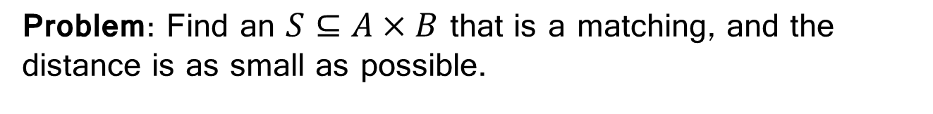
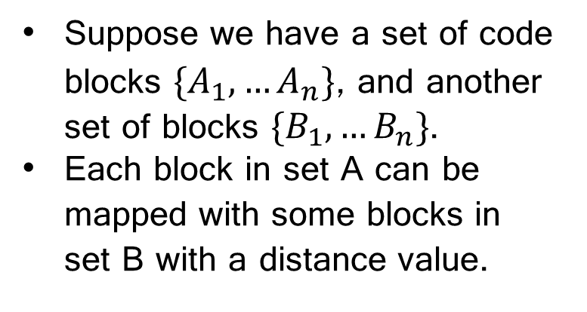
Weighted Bipartite Graph Matching
Suppose we have a set of code blocks $\{A_{1},…A_{n}\}$, and another set of blocks $\{B_{1},…B_{n}\}$.
Each block in set A can be mapped with some blocks in set B with a distance value.
A1
B1
A2
B2
A3
B3
A4
B4
A5
B5
Code A
Code B
Problem: Find an $S⊆A×B$ that is a matching, and the distance is as small as possible.

Slide 22
Kuhn-Munkres Algorithm (Matrix View)
Hungarian Maximum Matching Algorithm
Step 1: Initiate adjacent matrix
Step 2: Subtract the smallest value in each row from the other values in the row
Cost | B1 | B2 | B3
A1 | 0.2 | 0.35 | 0.40
A2 | 0.40 | 0.10 | 0.20
A3 | 0.15 | 0.20 | 0.70
Cost | B1 | B2 | B3
A1 | 0 | 0.15 | 0.20
A2 | 0.30 | 0 | 0.10
A3 | 0 | 0.05 | 0.55
Step 3: subtract the smallest value in each column from all other values in the column
Step 4: Draw lines through the row and columns that have the 0 entries such that the fewest lines possible are drawn.
Cost | B1 | B2 | B3
A1 | 0 | 0.15 | 0.10
A2 | 0.30 | 0 | 0
A3 | 0 | 0.05 | 0.45
Cost | B1 | B2 | B3
A1 | 0 | 0.15 | 0.10
A2 | 0.30 | 0 | 0
A3 | 0 | 0.05 | 0.45

Slide 23
Kuhn-Munkres Algorithm (Matrix View)
Hungarian Maximum Matching Algorithm
Step 5: If there are n lines drawn, an optimal assignment of zeros is possible and the algorithm is finished. If the number of lines is less than n, then the optimal number of zeroes is not yet reached. Go to the next step.
Cost | B1 | B2 | B3
A1 | 0 | 0.15 | 0.10
A2 | 0.30 | 0 | 0
A3 | 0 | 0.05 | 0.45
Step 6: Find the smallest entry not covered by any line. Subtract this entry from each row that isn’t crossed out, and then add it to each column that is crossed out. Then, go back to Step 4.
Cost | B1 | B2 | B3
A1 | 0 | 0.10 | 0.5
A2 | 0.30 | 0 | 0
A3 | 0 | 0 | 0.40
Cost | B1 | B2 | B3
A1 | 0 | 0.10 | 0.5
A2 | 0.30 | 0 | 0
A3 | 0 | 0 | 0.40
Cost | B1 | B2 | B3
A1 | 0.20 | 0.35 | 0.40
A2 | 0.40 | 0.10 | 0.20
A3 | 0.15 | 0.20 | 0.70

Slide 24
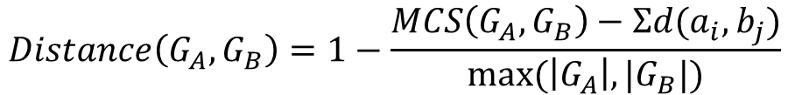
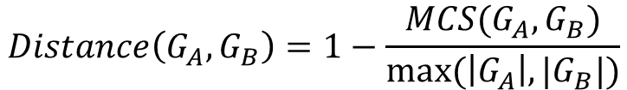
CFG Matching as MCS
General Maximum Common Subgraph (MCS) Problem: Find the largest subgraph isomorphic to two graphs.
$$Distance\left(G_{A},G_{B}\right)=1−\frac{MCS(G_{A},G_{B})}{max⁡(\left|G_{A}\right|,|G_{B}|)}$$
Weighted Maximum Common Subgraph (MCS) Problem: consider the distance between blocks.
$$Distance\left(G_{A},G_{B}\right)=1−\frac{MCS\left(G_{A},G_{B}\right)−Σd(a_{i},b_{j})}{max⁡(\left|G_{A}\right|,|G_{B}|)}$$
Eschweiler et al. "discovRE: Efficient Cross-Architecture Identification of Bugs in Binary Code." NDSS. 2016.

Slide 25
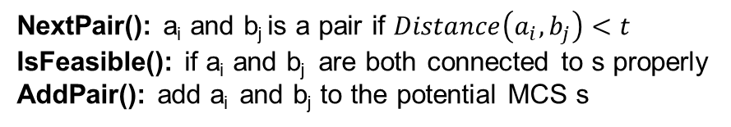
McGregor Algorithm for MCS Approximation
//incremental search
//start with an initial subgraph s
While(NextPair(s,a_{i},b_{j})){
If(IsFeasible(s,a_{i},b_{j})){
snew=AddPair(s, a_{i},b_{j})
If (snew is expandable){
MCS(snew)
BackTrack(snew)
}
}
}
A1
B1
A2
A3
B3
B2
B4
A4
A5
B5
current s
A2
B2
possible pairs
A1
B1
NextPair(): a_{i} and b_{j} is a pair if $Distance\left(a_{i},b_{j}\right)<t$
IsFeasible(): if a_{i} and b_{j} are both connected to s properly
AddPair(): add a_{i} and b_{j} to the potential MCS s
A5
B5
feasible pairs
A1
B1
Eschweiler et al. “discovRE: Efficient Cross-Architecture Identification of Bugs in Binary Code.” NDSS. 2016.
Wang, et al. "A novel efficient algorithm for determining maximum common subgraphs." IV, 2005.

Slide 26
Graph Embedding
An embedding is a high-dimensional vector for representing the graph.
Idea：
Create an embedding for each bug.
Create an embedding for each function of the target project.
Search similar embeddings
Xu et al. "Neural network-based graph embedding for cross-platform binary code similarity detection." CCS 2017.

Slide 27
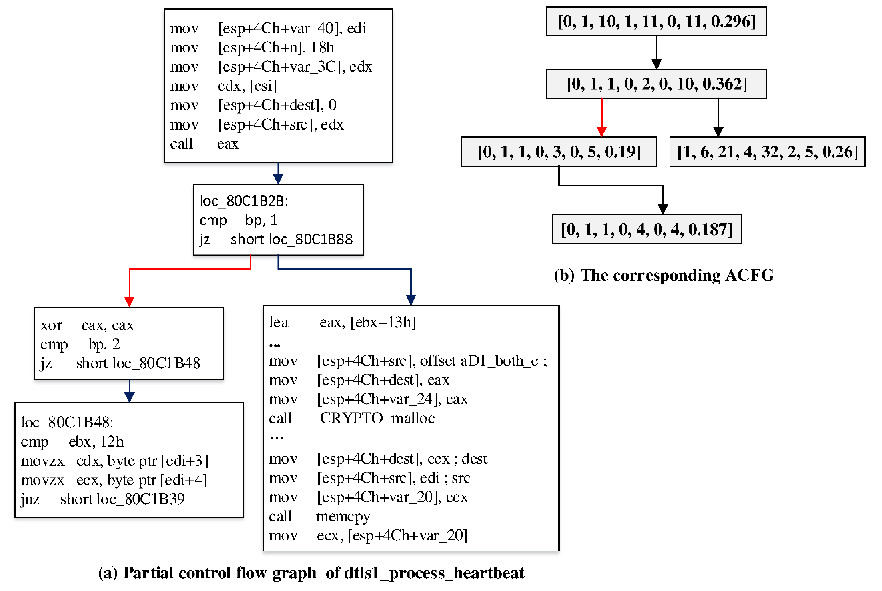
Generate Attributed Control-flow Graph
Block-level Attributes: number of
string constants,
numeric constant,
transfer instructions,
function calls,
instructions,
arithmetic instructions
Inter-block Attributes:
number of offsprings
betweenness.
https://www.tutorialspoint.com/microprocessor/microprocessor_8086_instruction_sets.htm

Slide 28
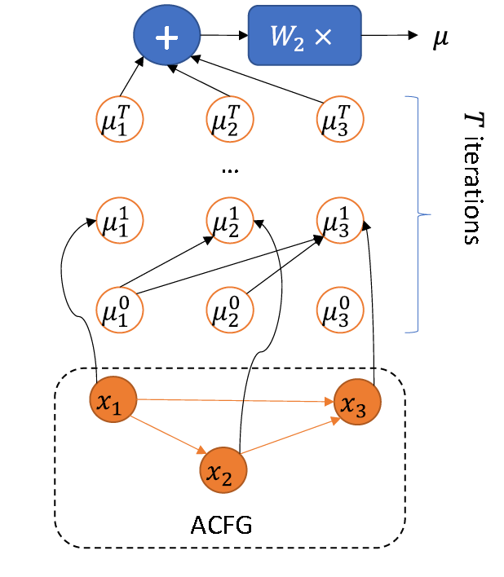
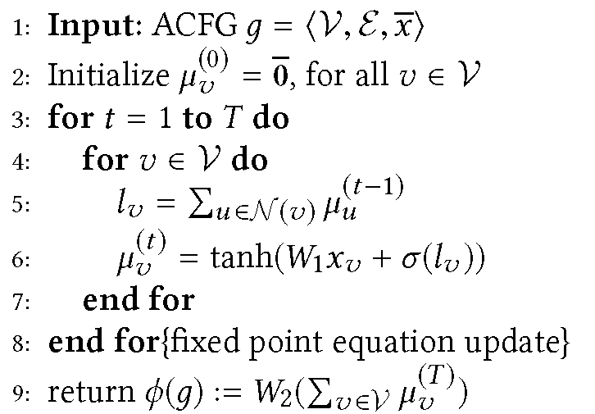
Graph Embedding Generation
V: vertex
E: edges
T: # of iterations

Slide 29
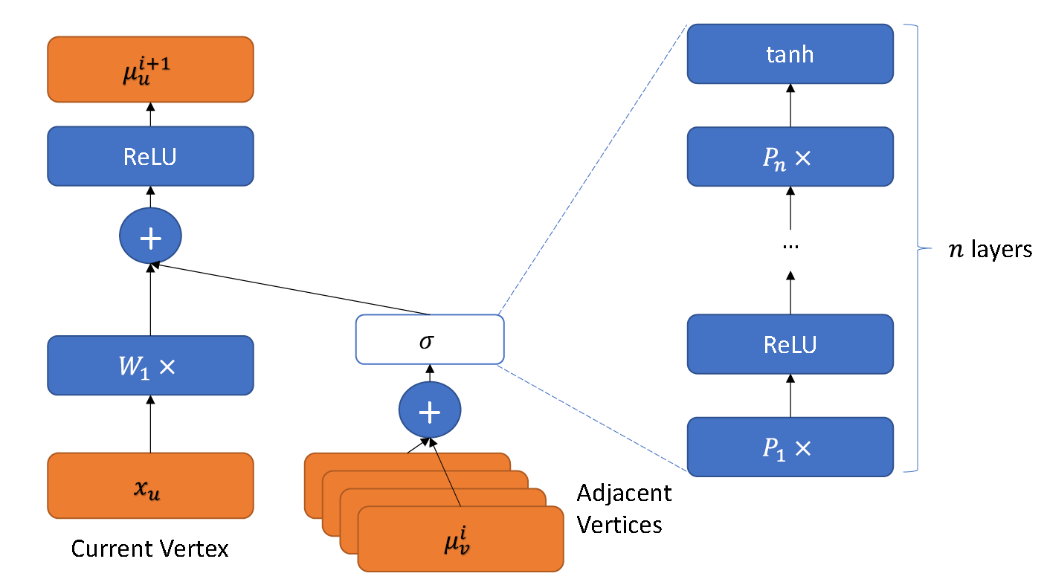
More Details About the Network

Slide 30
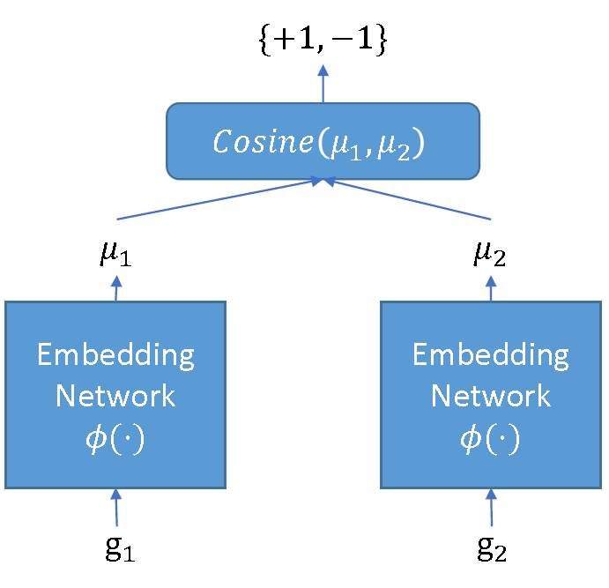
Use Siamese Architecture to Train the Network
Challenge:
Lack well-labeled data to train the model.
Solution:
Use Siamese Architecture
Similar code should generate similar embeddings

Slide 31
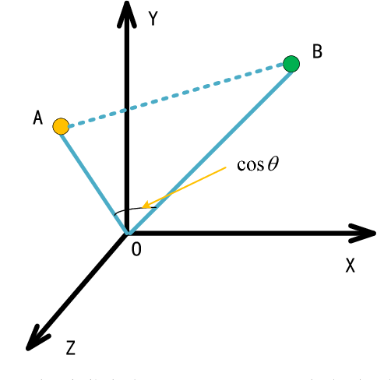
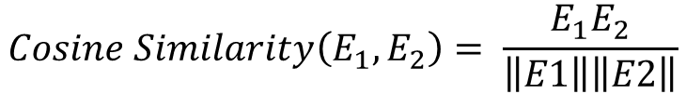
Similarity/Distance of Embeddings
$$Cosine Similarity\left(E_{1},E_{2}\right)= \frac{E_{1}E_{2}}{\left\|E1\right\|\left\|E2\right\|}$$
E1
E2
Other possible approaches: Manhattan distance (L1 norm), Euclidean distance (L2 norm).

Slide 32
What We Have Learnt
Some bugs have similar patterns.
Rule-based approach for searching driver bugs related to error handling.
Similarity-based approach for searching cross-architecture bugs.
Pairwise graph matching
Graph embedding

