Slide 1

Memory-Safety Programming with Rust
XU, Hui
xuh@fudan.edu.cn
June 16, 2020

Slide 2
1. Memory-Safety Bugs

Slide 3
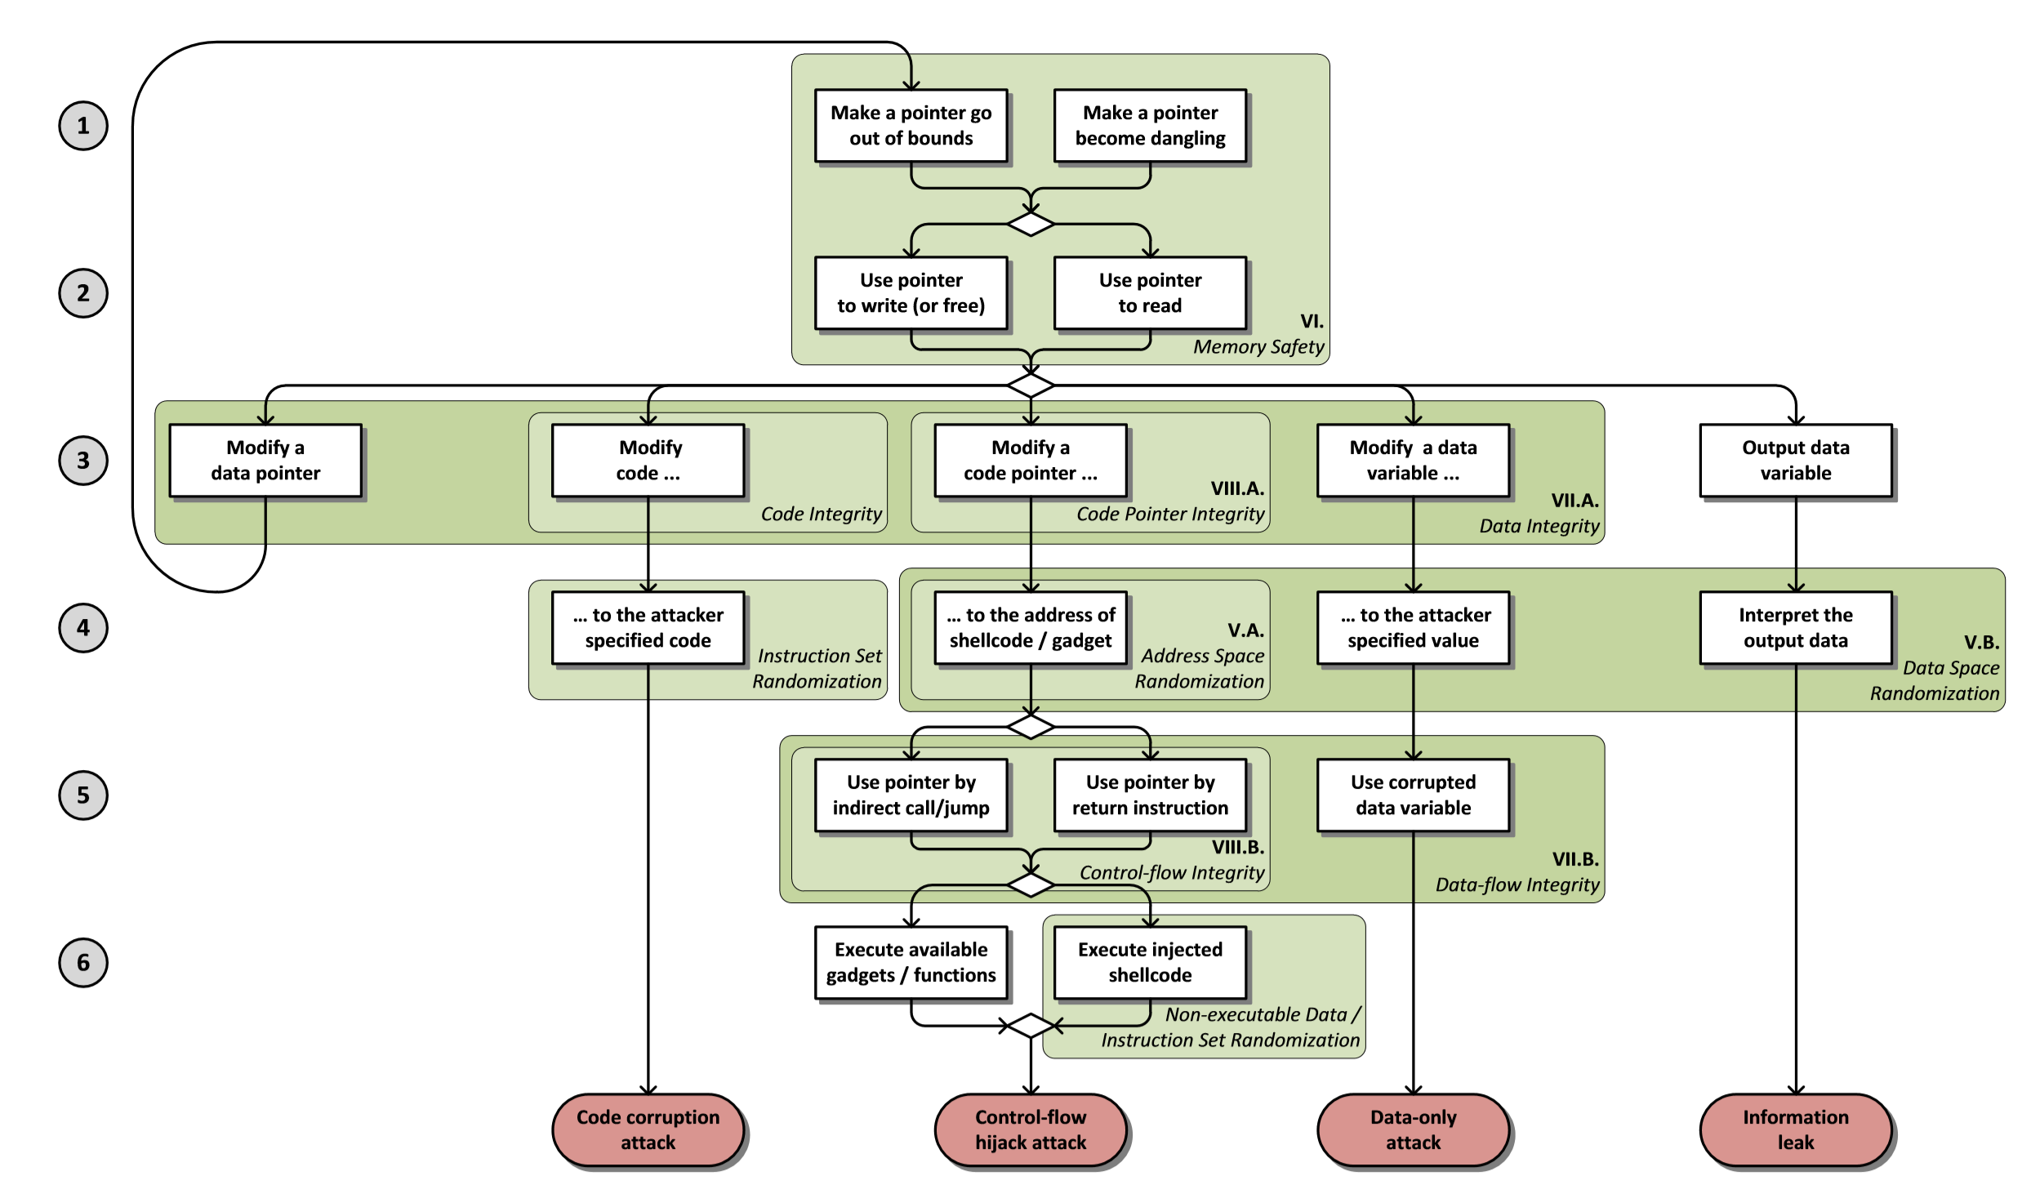
Eternal War in Memory
Laszlo Szekeres, et al. “Sok: Eternal war in memory.” IEEE Symposium on Security and Privacy, 2013.

Slide 4
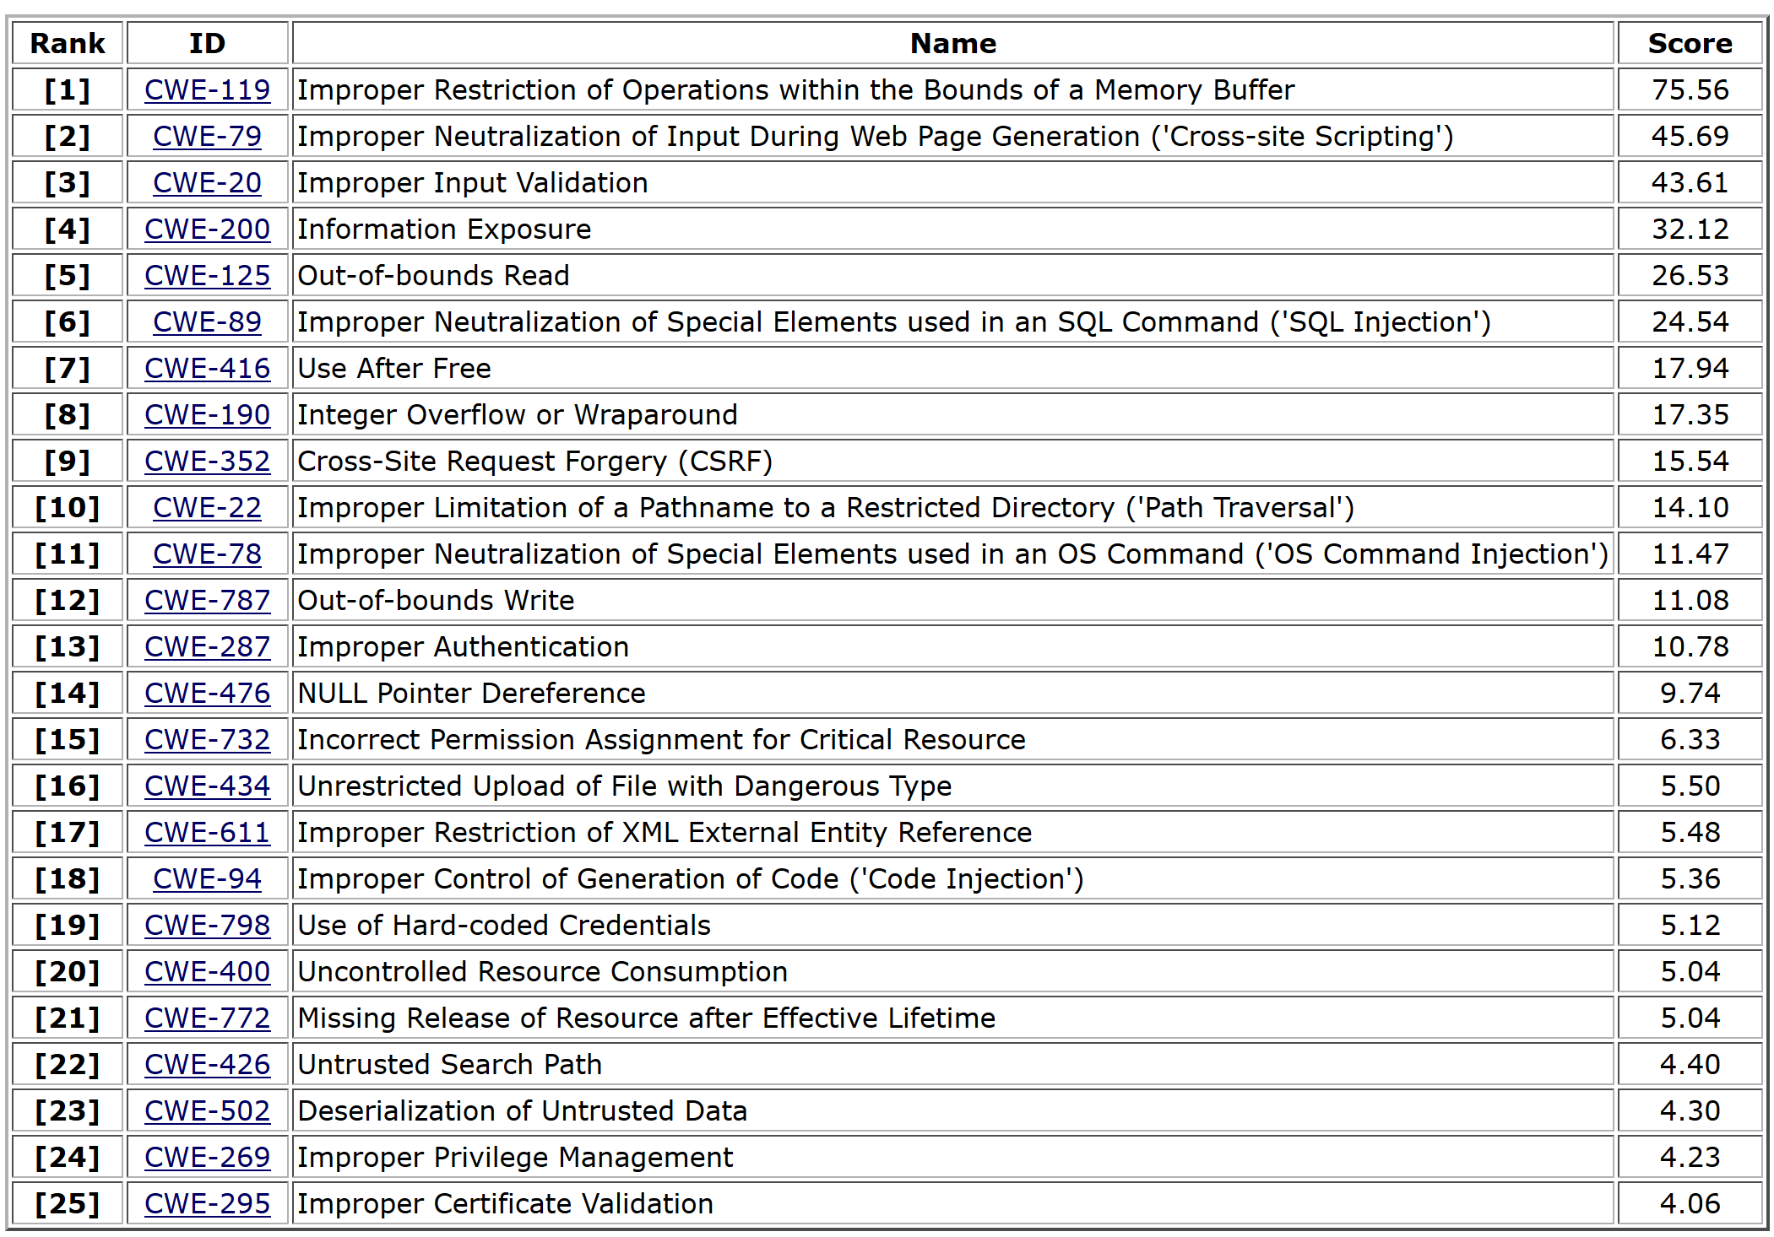
Top 25 Most Dangerous Software Errors
https://cwe.mitre.org/top25/archive/2019/2019_cwe_top25.html

Slide 5
Buffer Overflow
Out-of-bound (pointer) + Write
char buf[64];
read(STDIN_FILENO, buf, 160);
if(strcmp(buf,LICENCE_KEY)==0){
write(STDOUT_FILENO,
"Key verified!\n", 14);
}else{
write(STDOUT_FILENO,
"Wrong key!\n", 11);
}
…
return address (8 bytes)
current frame
Overwrite the return address
higher address
rbp
buf: -0x50(rbp)
stack growth
rsp: -0x70(rbp)

Slide 6

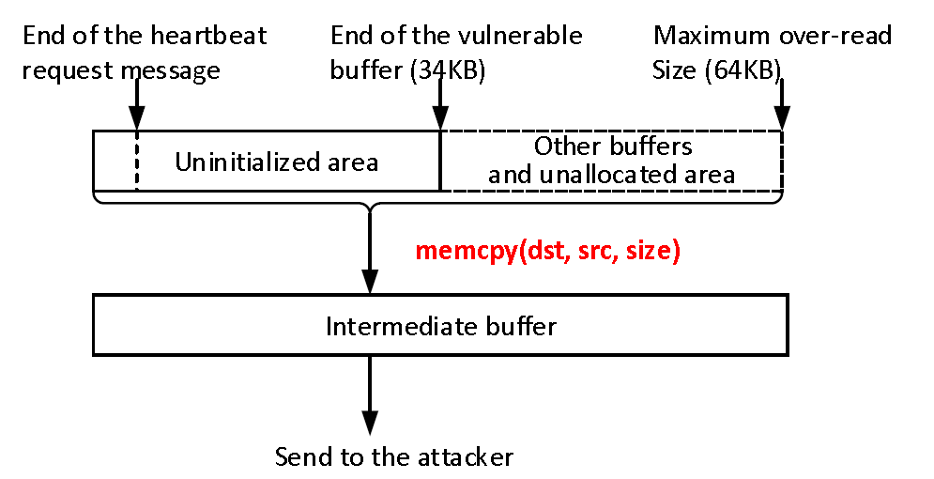
Buffer Over-read
Heartbleed
CVE-2014-0160 - CVE
Out-of-bound (pointer) + Read
buffer = OPENSSL_malloc(1 + 2 + payload + padding);
bp = buffer;
/*Enter response type, length and copy payload*/
*bp++ = TLS1_HB_RESPONSE;
s2n(payload, bp);
memcpy(bp, pl, payload);
bp += payload;
/* Random padding */
RAND_pseudo_bytes(bp, padding);
r = ssl3_write_bytes(s,
TLS1_RT_HEARTBEAT,
buffer, 3 + payload + padding);
Jun Wang, et al. “Risk assessment of buffer" Heartbleed" over-read vulnerabilities.” DSN, 2015.

Slide 7
More Heap-Safety Issues
Use-after-free, double free
Dynamic Memory Management in C
Memory allocation: malloc(size_t n)
Allocates n bytes and returns a pointer to the allocated memory; memory not cleared
Also calloc(), realloc()
Memory deallocation: free(void * p)
Frees the memory space pointed to by p, which must have been returned by a previous call to malloc(), calloc(), or realloc()
If free(p) has already been called before, undefined behavior occurs
If p is NULL, no operation is performed

Slide 8
Use-After-Free in C
Make a pointer become dangling
#define BUFSIZE 128
int main(int argc, char **argv) {
char *buf1;
char *buf2;
buf1 = (char *) malloc(BUFSIZE);
buf2 = (char *) malloc(BUFSIZE);
strncpy(buf1, argv[1], BUFSIZE);
strncpy(buf2, argv[1], BUFSIZE);
free(buf1);
free(buf2);
printf("buf1:%s\n",buf1);
printf("buf2:%s\n",buf2);
}
#./a.out 123456
buf1:buf1:b
buf2:123456
Free:
The pointer value remains.
The pointed memory may be reallocated.
Consequences:
Depend on the instantiation and timing of the flaw.
Notes:
Malloc(glibc): based on system calls: mmap(), sbrk(), brk()
Free: munmap()…

Slide 9
Use-After-Free Exploit
typedef struct UAFME { void (*vulnfunc)(); } UAFME;
void good(){ printf("I AM GOOD :)\n"); }
void bad(){ printf("I AM BAD >:|\n"); }
void helper_call_goodfunc(UAFME *uafme){
UAFME *private_uafme = uafme;
private_uafme->vulnfunc = good;
private_uafme->vulnfunc();
free(private_uafme);
}
int main(int argc, const char * argv[]){
UAFME *malloc1 = malloc(sizeof(UAFME));
helper_call_goodfunc(malloc1);
long *malloc2 = malloc(0);
*malloc2 = (long)bad;
malloc1->vulnfunc();
}
The bad function is triggered!
https://sensepost.com/blog/2017/linux-heap-exploitation-intro-series-used-and-abused-use-after-free/

Slide 10
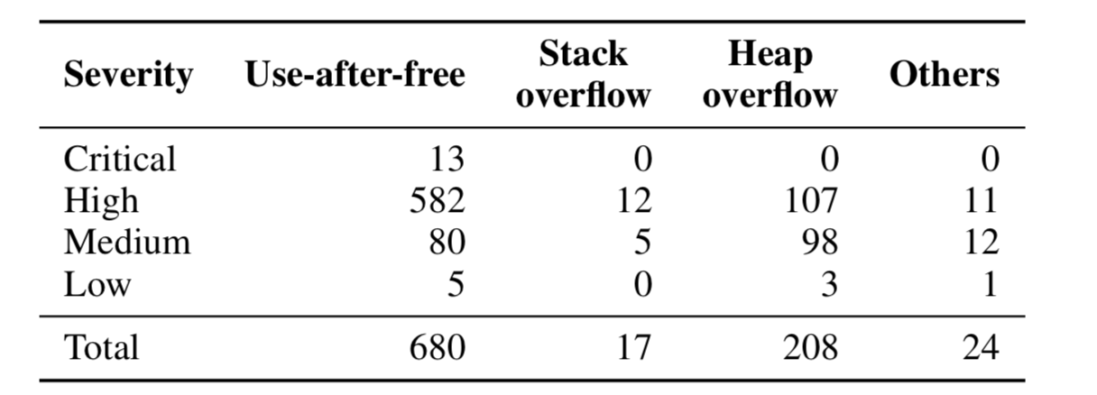
Dangerous Dangling Pointers
Use-after-free bugs often lead to security exploits
Security Vulnerabilities of Chromium Browser (2011-2013)
Lee, Byoungyoung, et al. "Preventing Use-after-free with Dangling Pointers Nullification." NDSS. 2015.

Slide 11
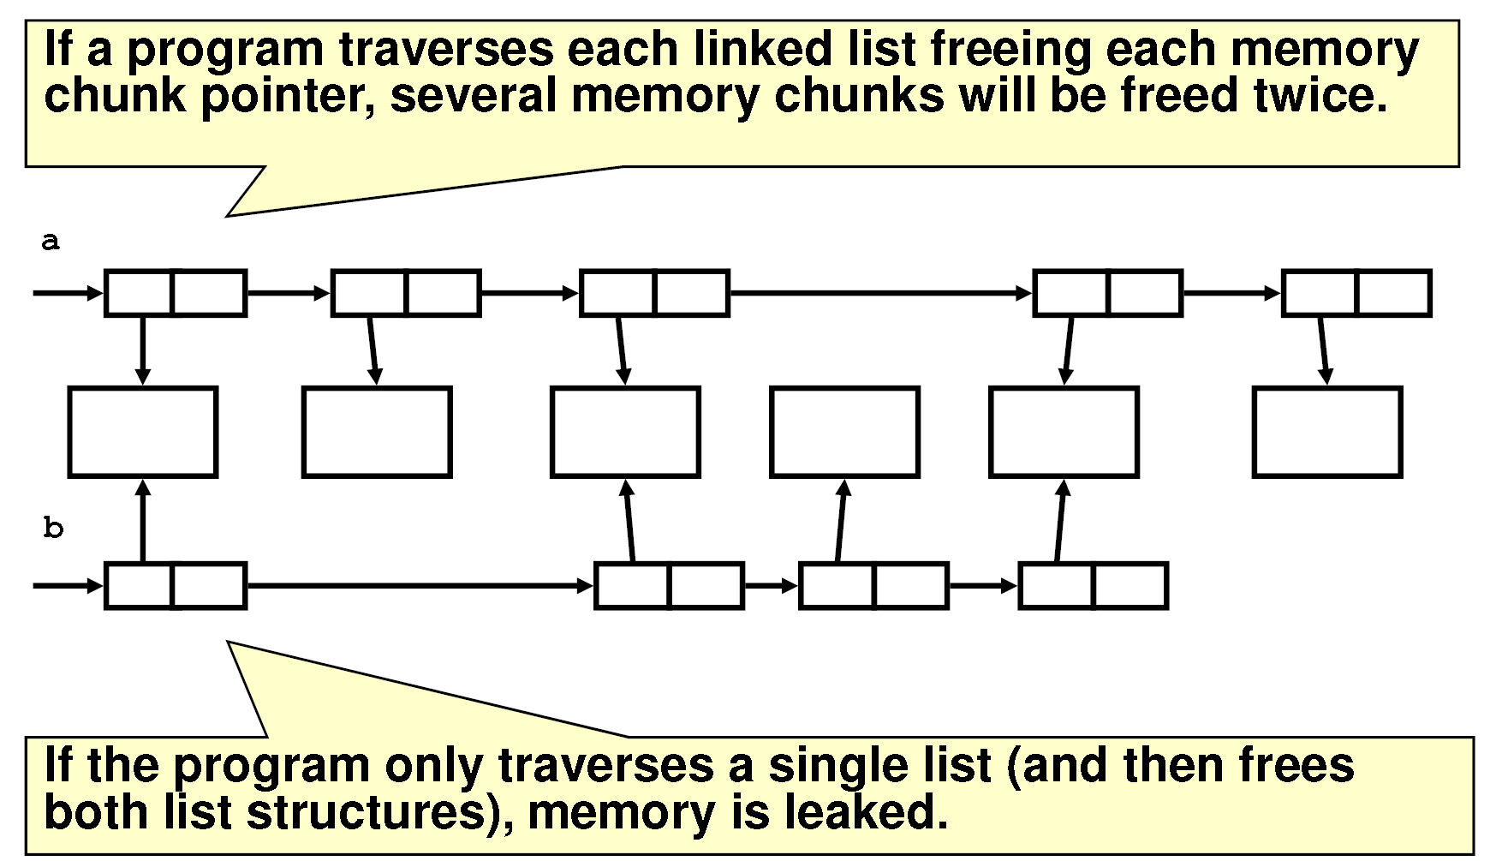
Vulnerable Code to UAF and Double Free
Two objects share the same memory regions
Robert C. Seacord, Dynamic Memory Management: Dlmalloc (secure coding in C and C++), 2008

Slide 12
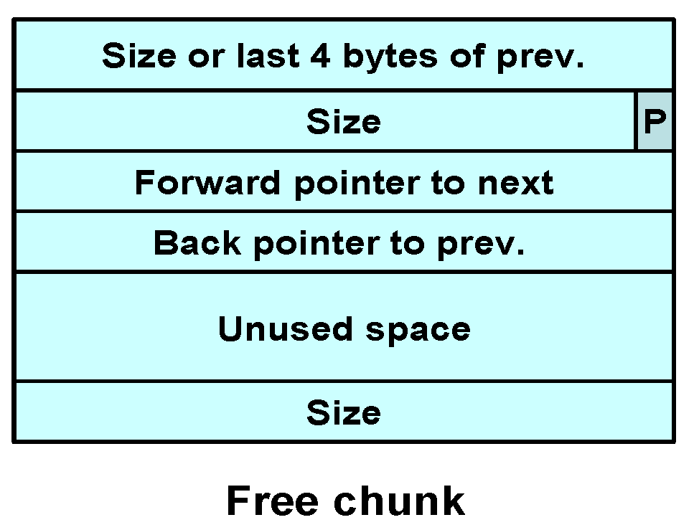
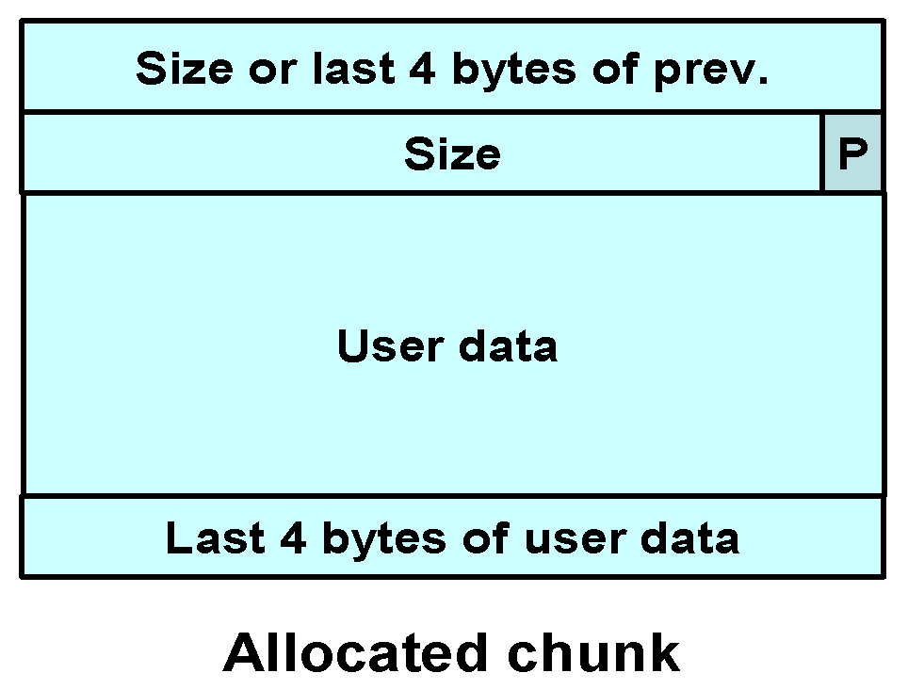
Doug Lea’s Memory Allocator
The GNU C library is based on Doug Lea’s malloc (dlmalloc) as the default native version of malloc.
Free chunks are organized into double-linked lists.
Each chunk on a free list contains forward and back pointers to the next and previous free chunks in the list
These pointers occupy the same eight bytes of memory as user data in an allocated chunk.
Robert C. Seacord, Dynamic Memory Management: Dlmalloc (secure coding in C and C++), 2008

Slide 13
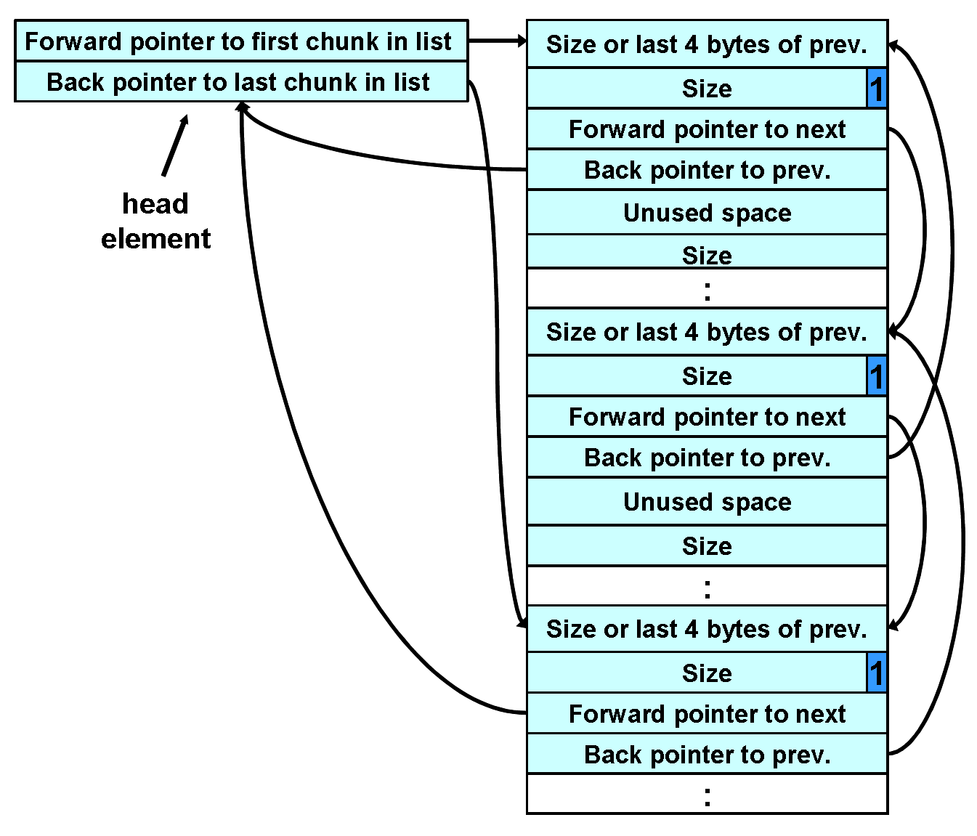
Free List Double-linked Structure
Robert C. Seacord, Dynamic Memory Management: Dlmalloc (secure coding in C and C++), 2008

Slide 14
Double Free Vulnerability
Freeing the same chunk of memory twice, without it being reallocated in between.
To simplify the discussion, let’s assume a simple scenario with two chunks.
…
Free this block once
User data
head element
…
Forward pointer
Backward pointer
…
Forward pointer
Backward pointer
…

Slide 15
Free Twice
Free once
…
Forward pointer
Backward pointer
Forward pointer
…
Backward pointer
…
head element
Forward pointer
Backward pointer
…
Free twice
…
//To free P, it adds a
P to the free list bin.
#define link(bin, P) {
chk = bin->fd;
bin->fd = P;
P->fd = chk;
chk->bk = P;
P->bk = bin;
}
Forward pointer
Backward pointer
Forward pointer
…
Backward pointer
…
head element
Forward pointer
Backward pointer
…

Slide 16
Allocate and Write
Overwrite by user data
…
//To allocate P, removes P
to free the list.
#define unlink(P, BK, FD) {
FD = P->fd;
BK = P->bk;
FD->bk = BK;
BK->fd = FD;
}
Forward pointer
Backward pointer
Forward pointer
…
Backward pointer
…
Forward pointer
Backward pointer
…
In another malloc, the allocated memory can be controlled by user data

Slide 17
Double Free
bin
GOT
…
Forward pointer
Backward pointer
shellcode
…
static char *GOT_LOCATION = (char *)0x0804c98c;
static char shellcode[] = "\xeb\x0cjump12chars_\x90\x90\x90\x90\x90\x90\x90\x90"
int main(void){
int size = sizeof(shellcode);
void *shellcode_location;
void *first, *second, *third, *fourth, *fifth, *sixth, *seventh;
shellcode_location = (void *)malloc(size);
strcpy(shellcode_location, shellcode);
first = (void *)malloc(256);
second = (void *)malloc(256); //avoid the first chunk from being consolidated
third = (void *)malloc(256);
fourth = (void *)malloc(256); //avoid the third chunk from being consolidated
free(first); // put into cache bin
free(third); // put into cache bin
fifth = (void *)malloc(128); //split off from the third chunk, put first into bin
free(first);
sixth = (void *)malloc(256);
*((void **)(sixth+0))=(void *)(GOT_LOCATION-12);
*((void **)(sixth+4))=(void *)shellcode_location;
seventh = (void *)malloc(256);
strcpy(fifth, "something");
return 0;
}
Free first twice, allocated to sixth
Assign FP and BP
Seventh points to first
Notes:
https://linux.die.net/man/3/free
man7.org/linux/man-pages/man2/brk.2.html
Normally, malloc() allocates memory from the heap, and adjusts the size of the heap as required, using sbrk(2). When allocating blocks of memory larger than MMAP_THRESHOLD bytes, the glibc malloc() implementation allocates the memory as a private anonymous mapping using mmap(2). MMAP_THRESHOLD is 128 kB by default, but is adjustable using mallopt(3). Allocations performed using mmap(2) are unaffected by the RLIMIT_DATA resource limit (see getrlimit(2)).

Slide 18
Race Condition
Popular in concurrent programs.
if (!access("/tmp/X", W_OK)) {
/* the real user ID has access right */
f = open("/tmp/X", O_WRITE);
write_to_file(f);
}
else {
/* the real user ID does not have access right */
fprintf(stderr, "Permission denied\n");
}
Attack scenario: there is another thread modifying /tmp/X concurrently.
Before access(/tmp/X, W_OK)), the file /tmp/X is indeed /tmp/X.
After access(/tmp/X, W_OK), change /tmp/X to /etc/passwd (via symbolic link).

Slide 19
2. Rust and Its Security Features
The Beast adopted new raiment and studied the ways of Time and Space and Light and the Flow of energy through the Universe. From its studies, the Beast fashioned new structures from oxidised metal and proclaimed their glories. And the Beast's followers rejoiced, finding renewed purpose in these teachings.
from The Book of Mozilla, 11:14

Slide 20
Rust Profile
A programming language focusing on security:
Memory safety
Concurrency safety
As efficient (execution) as C/C++
Compile to native code
No garbage collection (Go)
Release:
First stable version in 2015
Self-hosting since 2011

Slide 21
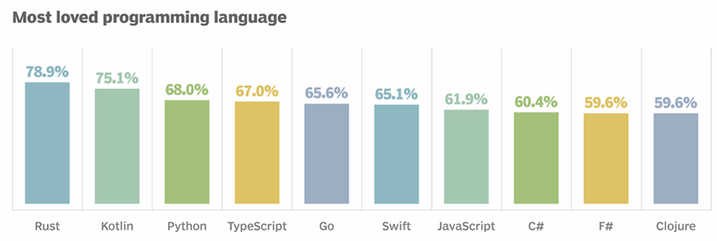
Adoption of Rust
Web browser: Firefox(Servo, Quantum)
Operating systems:
TockOS: an embedded system
RedoxOS: a micro kernel
Magic Pocket (Dropbox file system)
Straits: Fedora file system
Railcar: a container runtime by Oracle
Others:
Microsoft Azure IoT Edge components
OpenDNS components
MesaLink (OpenSSL)
More: https://github.com/rust-unofficial/awesome-rust

Slide 22
Overview of Rust’s Safety
User Programs
risky code
Safe Rust
call
call
Unsafe Rust
Safe APIs
Unsafe APIs
Ownership-based Memory Management
exclusive mutable alias
Unsafe API
reference/no raw pointers
call
FFI
lifetime validation
raw pointer dereference
automatic destruction
call
call
Unsafe APIs
access
access
Memory

Slide 23
Ownership
Define a variable V
Transfer ownership =V
Shared Access &V “read-only”
Exclusive Access &mut V “mutable”
Ownership
Borrow
Purpose: Alias + Mutable is prohibited

Slide 24
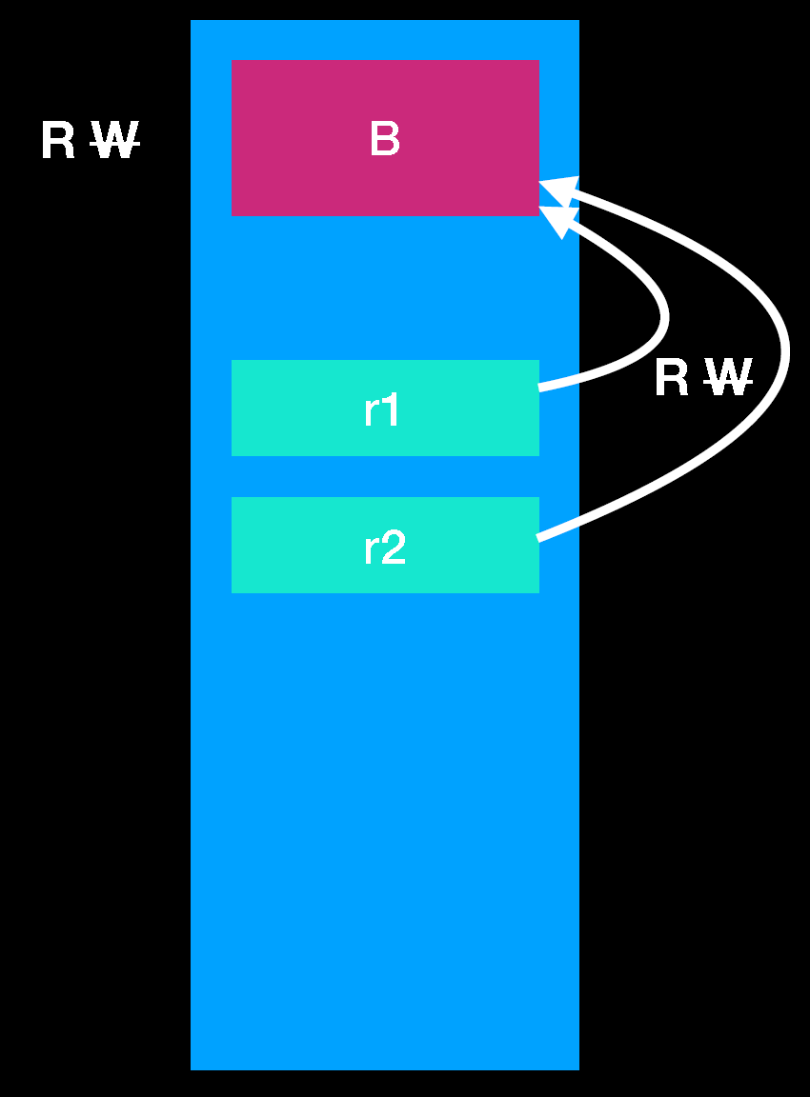
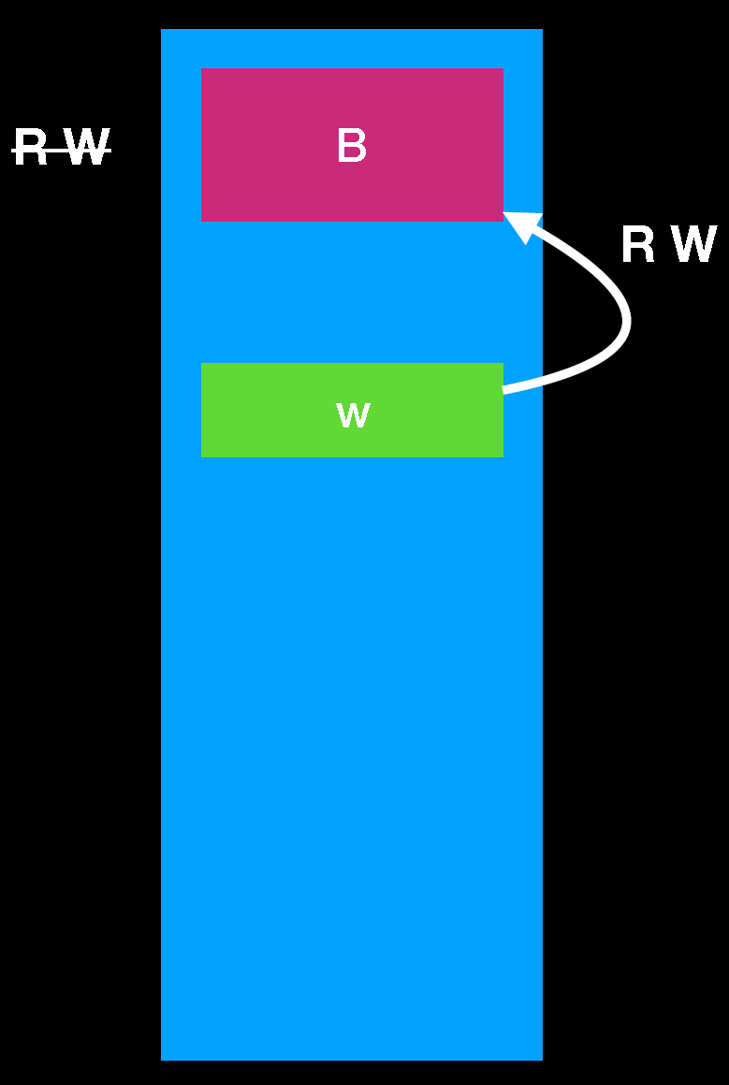
Ownership & Borrowing
let b = B:new();
let r1: &B = &b;
let r2: &B = &b;
Immutable borrows, b has lost the write capability.
let b = B:new();
let r1: &mut B = &mut b;
Mutable borrows, b temporarily lost read and write capability.

Slide 25
Example: Borrowing
fn main(){
let alice = vec![1,2,3];
{
let bob = alice;
println!("bob:{}", bob[0]);
}
println!("alice:{}", alice[0]);
}
fn main(){
let alice = vec![1,2,3];
{
let bob = &alice;
println!("bob:{}", bob[0]);
}
println!("alice:{}", alice[0]);
}
error[E0382]: borrow of moved value: `alice`
--> ownership.rs:7:24
|
2 | let alice = vec![1,2,3];
| ----- move occurs because `alice` has type `std::vec::Vec<i32>`, which does not implement the `Copy` trait
3 | {
4 | let bob = alice;
| ----- value moved here
...
7 | println!("alice:{}", alice[0]);
| ^^^^^ value borrowed here after move

Slide 26
Alias + Mutable is Prohibited
fn main(){
let mut alice = 1;
{
let bob = &mut alice;
*bob = 2;
alice = 3;
println!("bob:{}", bob);
}
println!("alice:{}", alice);
}
fn main(){
let mut alice = 1;
{
let bob = &mut alice;
*bob = 2;
println!("bob:{}", bob);
}
alice = 3;
println!("alice:{}", alice);
}
error[E0506]: cannot assign to `alice` because it is borrowed
--> ownership2.rs:6:5
|
4 | let bob = &mut alice;
| ---------- borrow of `alice` occurs here
5 | *bob = 2;
6 | alice = 3;
| ^^^^^^^^^ assignment to borrowed `alice` occurs here
7 | println!("bob:{}", bob);
| --- borrow later used here

Slide 27
Data Sharing Among Threads
use std::thread;
fn main() {
let mut v = vec![1,2,3];
thread::spawn(|| {
v.push(4);
});
}
use std::thread;
fn main() {
let mut v = vec![1,2,3];
thread::spawn(move || {
v.push(4);
});
}
error[E0373]: closure may outlive the current function, but it borrows `v`, which is owned by the current function
--> thread.rs:5:17
|
5 | thread::spawn(|| {
| ^^ may outlive borrowed value `v`
6 | v.push(4);
| - `v` is borrowed here
|
note: function requires argument type to outlive `'static`
--> thread.rs:5:3
…
help: to force the closure to take ownership of `v` (and any other referenced variables), use the `move` keyword
|
5 | thread::spawn(move || {
| ^^^^^^^

Slide 28
Concurrent Access
use std::thread;
fn main() {
let mut v = vec![1,2,3];
for i in 0..10 {
thread::spawn(move || {
v.push(i);
});
}
}
use std::sync::{Arc, Mutex};
use std::thread;
fn main() {
let v = Arc::new(Mutex::new(vec![1,2,3]));
for i in 0..3 {
let cloned_v = v.clone();
thread::spawn(move || {
cloned_v.lock().unwrap().push(i);
});
}
}
error[E0382]: use of moved value: `v`
--> thread2.rs:6:21
|
4 | let mut v = vec![1,2,3];
| ----- move occurs because `v` has type `std::vec::Vec<i32>`, which does not implement the `Copy` trait
5 | for i in 0..10 {
6 | thread::spawn(move || {
| ^^^^^^^ value moved into closure here, in previous iteration of loop
7 | v.push(i);

Slide 29
Concurrency Safety: Atomic Operation
Arc<T>: Atomically Reference Counted
Arc<T> uses atomic operations for its reference counting (thread same)
provides shared ownership of a value of type T, allocated in the heap.
Invoking clone on Arc produces a new pointer to the same value in the heap
If you need to mutate through an Arc, use Mutex, RwLock, or one of the Atomic types.
Arc<T> vs Rc<T>
Rc<T> is single thread.
Notes:
https://doc.rust-lang.org/std/sync/struct.Arc.html

Slide 30
Lifetime
{
let r;
{
let x = 1;
r = &x;
}
assert_eq!(*r, 1);
}
Lifetime of &x must not exceed this range
Lifetime of anything stored in r must cover at least this range
error[E0597]: `x` does not live long enough
--> src/main.rs:6:13
6 | r = &x;
| ^^ borrowed value does not live long enough
7 | }
| - `x` dropped here while still borrowed
8 | assert_eq!(*r, 1);
| ------------------ borrow later used here

Slide 31
Lifetime for Functions
fn foo<'a, 'b: 'a>(x: &'a str, y: &'b str) -> &'a str { }
fn main(){
let str1 = String::from("alice");
let str2 = String::from("bob");
let r = longer(&str1, &str2);
println!("The longer one is {}", r);
}
fn longer<'a>(x:&'a String, y:&'a String) -> &'a String{
if x.len()>y.len(){ x }
else { y }
}
$$Lifetime(r) ⊆ ( Lifetime(x) ∩ Lifetime(y))$$

Slide 32
Example: Lifetime
fn main(){
let str1 = String::from("alice");
let r;
{
let str2 = String::from("bob");
r = longer(&str1, &str2);
}
println!("The longer one is {}", r);
}
fn longer<'a>(x:&'a String, y:&'a String) -> &'a String{
if x.len()>y.len(){ x }
else { y }
}
fn longer<'a,'b:'a>(x:&'b String, y:&'a String) -> &'b String{
x
}
error[E0597]: `str2` does not live long enough
--> src/main.rs:6:23
6 | r = longer(&str1, &str2);
| ^^^^^ borrowed value does not live long enough
7 | }
| - `str2` dropped here while still borrowed
8 | println!("The longer one is {}", r);
| - borrow later used here

Slide 33
3. Security Challenges of Rust
User Programs
risky code
Safe Rust
call
call
Unsafe Rust
Safe APIs
Unsafe APIs
Ownership-based Memory Management
exclusive mutable alias
Unsafe API
reference/no raw pointers
call
FFI
lifetime validation
raw pointer dereference
automatic destruction
call
call
Unsafe APIs
access
access
Memory

Slide 34
Unsafe Keyword
Rust’s memory safety guarantees enforced at compile time.
However, Rust is too restrictive to account for many low-level data structures and synchronization mechanisms.
Rust has a second language hidden inside it that doesn’t enforce these memory safety guarantees: unsafe
Dereference a raw pointer
Call an unsafe function or method
Access or modify a mutable static variable
Implement an unsafe trait
https://doc.rust-lang.org/book/ch19-01-unsafe-rust.html

Slide 35
Unsafe Example
Dereference a pointer
Call an unsafe function
let mut num = 5;
let r1 = &num as *const i32;
let r2 = &mut num as *mut i32;
unsafe {
println!("r1 is: {}", *r1);
println!("r2 is: {}", *r2);
}
unsafe fn dangerous() {
let address = 0x012345usize;
let r = address as *const i32;
}
unsafe {
dangerous();
}
Foreign Function Interface (FFI)
Mutable Static Variable
extern "C" {
fn abs(input: i32) -> i32;
}
fn main() {
unsafe {
println!("{}", abs(-3));
}
}
static mut COUNTER: u32 = 0;
fn add_to_count(inc: u32) {
unsafe { COUNTER += inc; }
}
fn main() {
add_to_count(3);
unsafe {println!("{}",COUNTER);}
}

Slide 36
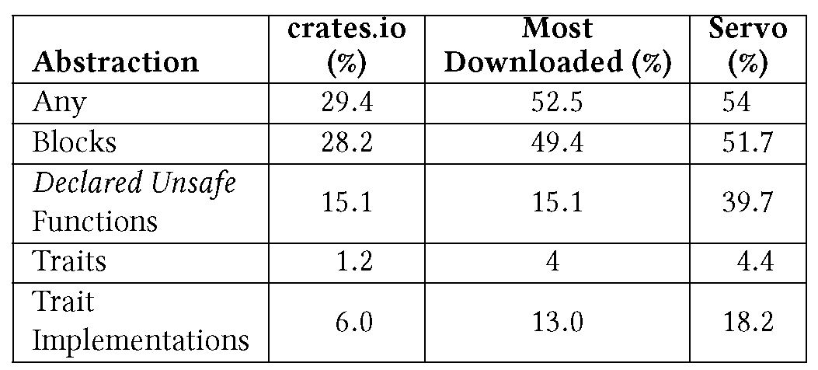
Unsafe is Widely Used
A. Evans, et al. Is Rust Used Safely by Software Developers, ICSE 2020.

Slide 37
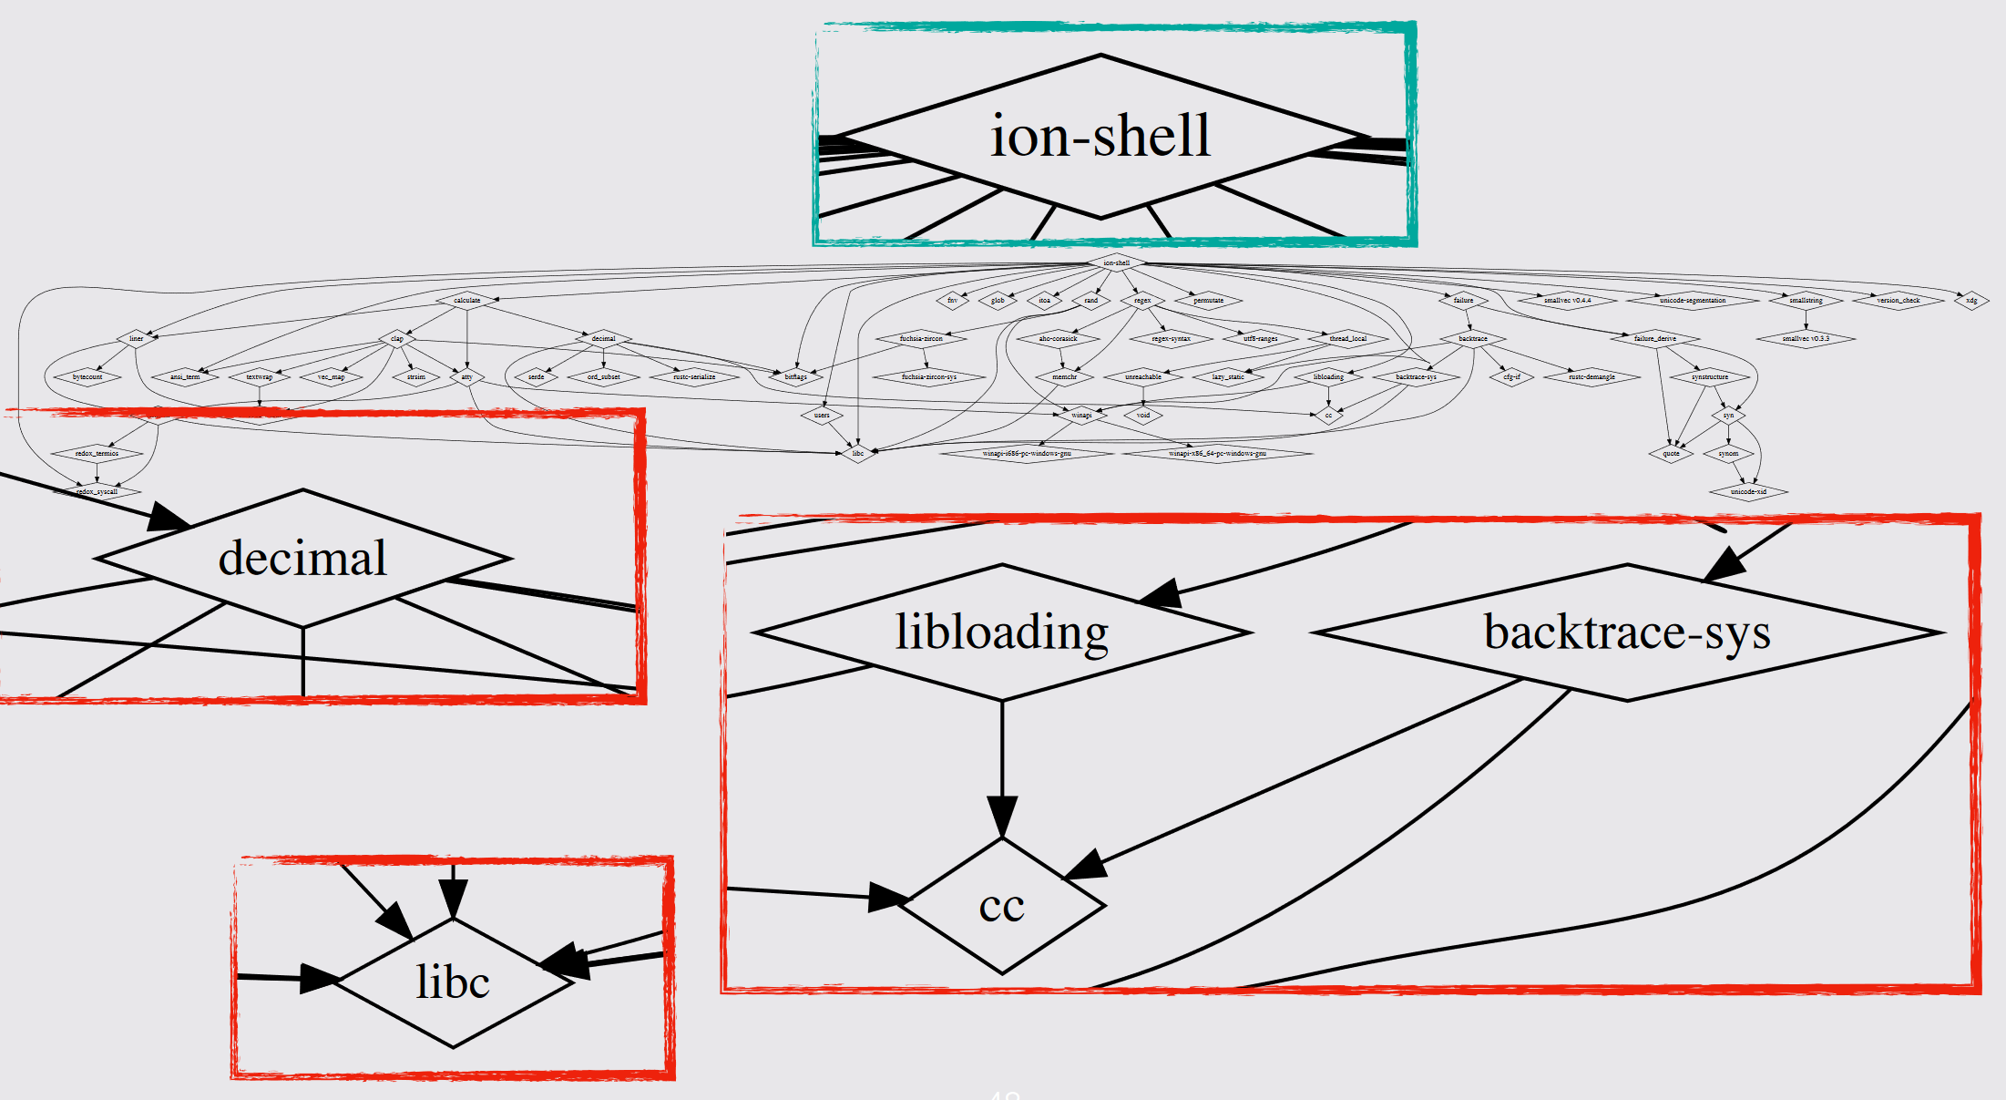
Foreign Functions Are Widely Used
M. Sun, Building Safe and Secure Systems in Rust: Challenges, Lessons Learned, and Open Questions, Northeastern University, Boston, October 2018

Slide 38
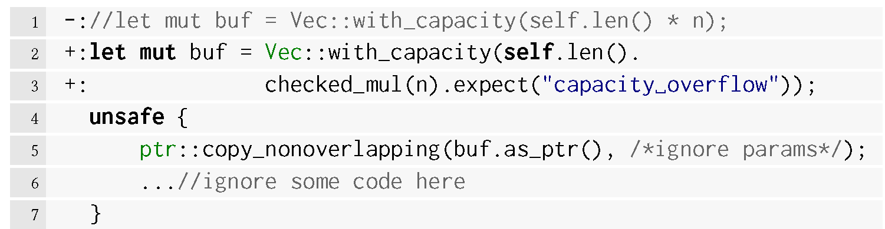
CVE-2018-1000810
Integer overflow leads to buffer overflow

Slide 39
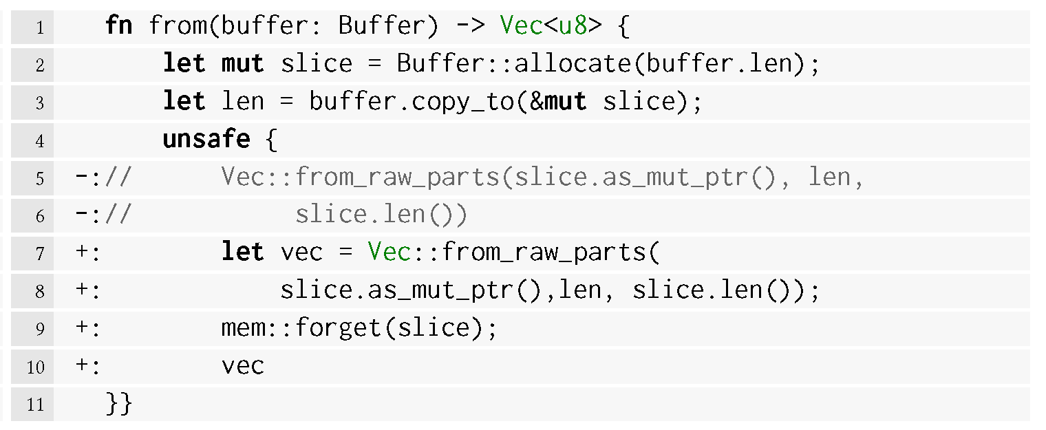
CVE-2019-16140
Use-after-free in chttp
https://github.com/rust-lang/rust/issues/27282

Slide 40
Summary
Memory-safety bugs are generally caused by out-of-bound buffer access or dangling pointers.
Rust is a system programming language to prevent memory-safety bugs.
Prevent shared mutable aliases (ownership and borrow)
Prevent dangling pointers (lifetime)
The use of unsafe functions make Rust vulnerable to memory-safety bugs.

