Slide 1

Program Obfuscation
COMP130159.01
XU, Hui
xuh@fudan.edu.cn
June 9, 2020

Slide 2
1. Overview

Slide 3



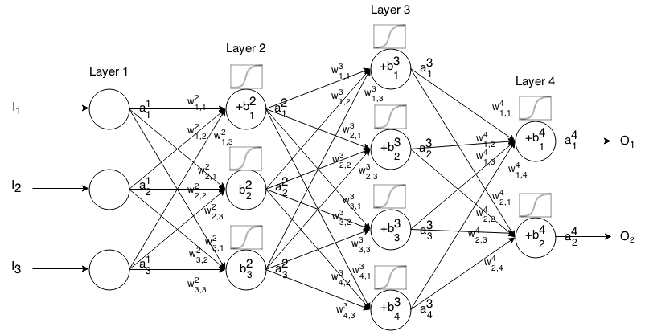

The Problem of Software IP Protection
Software intellectual property:
Server side (secure)
Client side (vulnerable)
MATE (Man-At-The-End) attack [Collberg’11]: reverse engineer
Examples of MATE attacks:
if (verifyLicense (key))
startProgram();
else{
printf (“invalid key”);
exit(-1);
}
Disable License Checking
Clone Codes
Steal Algorithms
[Collberg’11] C. Collberg, et al. Toward digital asset protection. IEEE Intelligent Systems, 2011.

Slide 4
Software Obfuscation for IP Protection
Obfuscator: a program that transforms the application into one that is functionally identical to the original but which is much more difficult to understand.
Evaluation Criteria
Potency: to what degree is a human reader confused
Resilience: how well are automatic deobfuscation attacks resisted
Cost: how much overhead is added to the application
Stealth: how well does obfuscated code blend in with the original code
C. Collberg, et al. A taxonomy of obfuscating transformations, 1997

Slide 5
2. Software Obfuscation

Slide 6
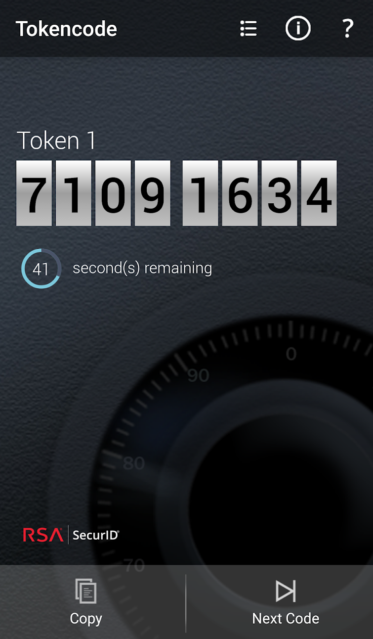
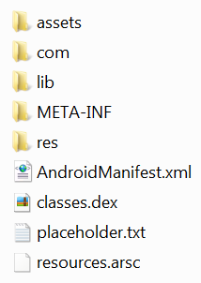

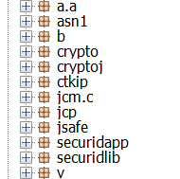
Obfuscation Target
Components

Slide 7

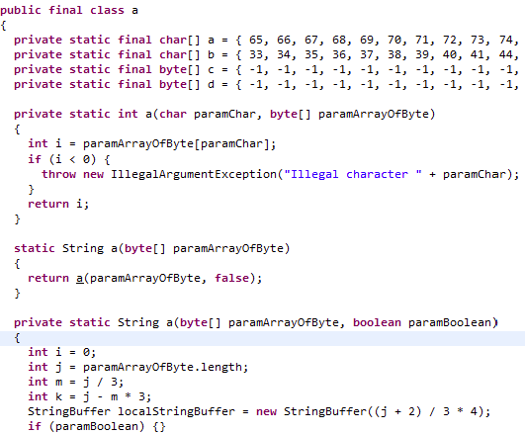

Decompile Java Bytecode is Easy
APK
unzip
dex2jar
view
jd-gui

Slide 8
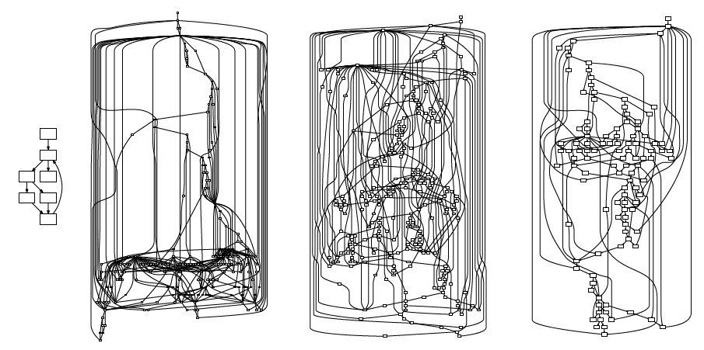
Software Obfuscation
Lexical obfuscation
Use meaningless identifiers to replace meaningful ones,
Typically with alphabets or short random strings.
Control-flow obfuscation
Increase the complexity of the control-flow graph, e.g., by adding bogus control flows.
Data obfuscation
Original program
Different Versions of obfuscated program
Yadegari, et. al, A Generic Approach to Automatic Deobfuscation of Executable Code, S&P 2015

Slide 9
Lexical Obfuscation
What lexical information can be scrambled?
Variable name
Method name
Field name
Perform a def-use analysis for each identifier to obfuscate.
Make sure both def and use are changed
Try it yourself via static data-flow analysis
What cannot be changed?
Identifiers defined by other libraries

Slide 10
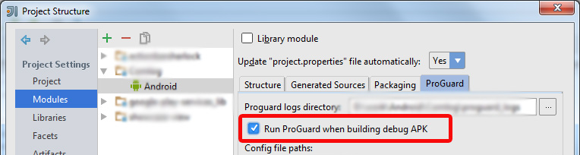
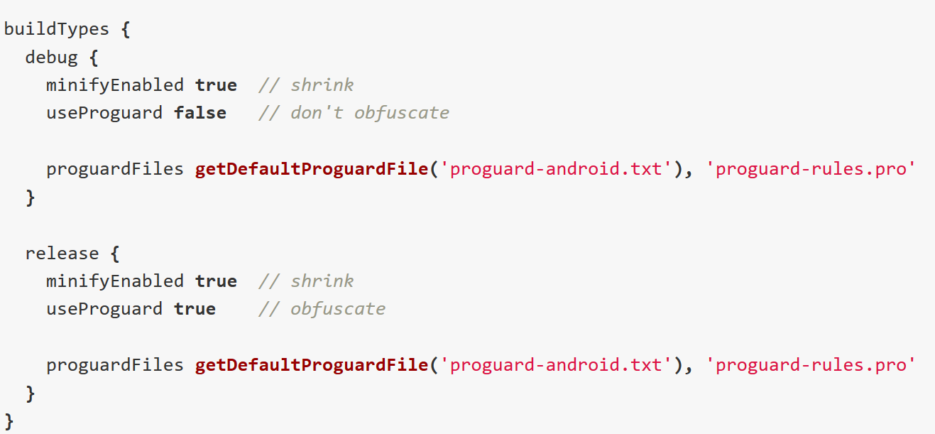
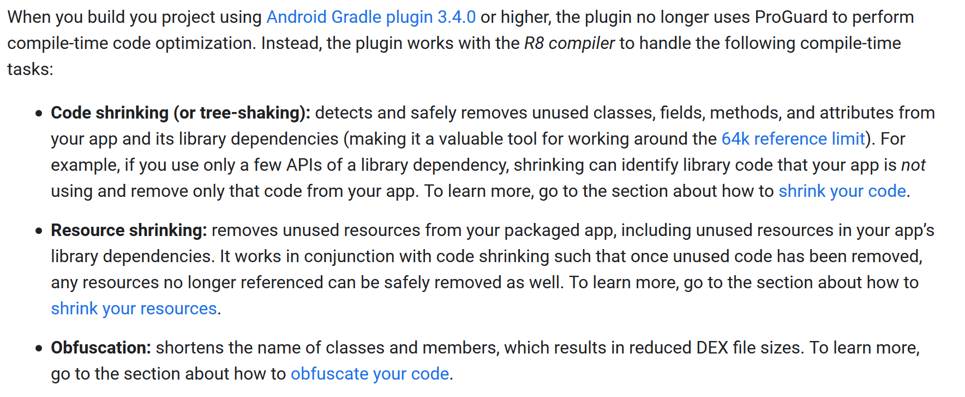
Obfuscating Android Apps During Compilation
Classic tool: ProGuard
Latest tool in Android Studio: R8

Slide 11
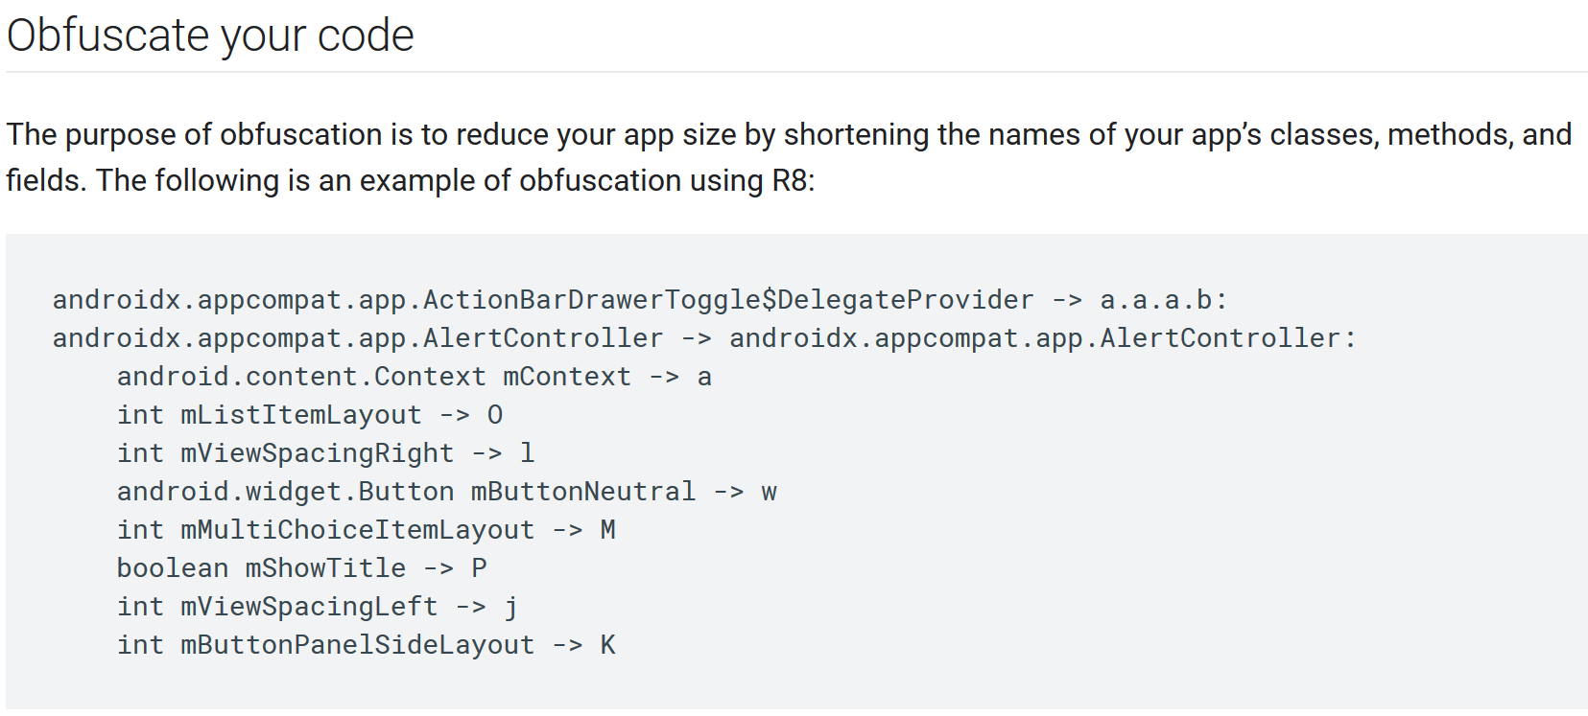
Effectiveness of Obfuscation

Slide 12
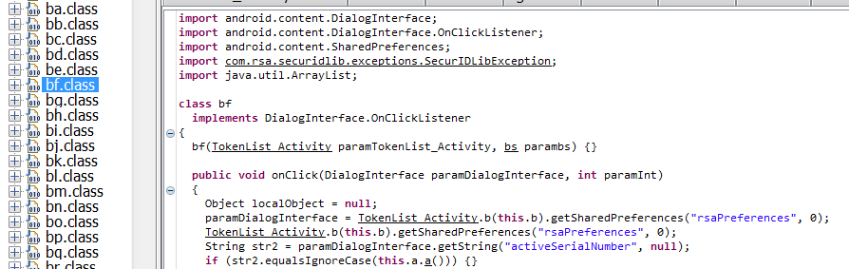
Residual Information
Java Source Code
invocation
Java API
Third-party Libraries
Android Framework API
residual information
“We can recover a large portion of lexical information based on the residual information, e.g., names of invoked methods and strings.”
B. Bichsel, et al. Statistical deobfuscation of android applications, CCS, 2016.

Slide 13
How to Obfuscate Inter-Component Information?
Use call wrappers and dispatchers
Java Class
funB()
3-rd party library
Java Class
dispatcher()
Wrapper Class
3-rd party library
invoke
funA()
invoke
invoke
funA()
dispatcher()
funB()
funB()
funC()
funC()
Original Version
Obfuscated Version

Slide 14




Control-flow Obfuscation
Increase the (Cyclomatic) complexity of the program with
Bogus control flow
Control-flow flattening
a
a
dispatcher
b
b
bogus
a
b
c
c
$$M=1$$
$$M=2$$
c
$$M=3$$
$$M=E−N+2P$$
E = the number of edges of the graph.
N = the number of nodes of the graph.
P = the number of connected components.

Slide 15
Obfuscation with Obfuscator-LLVM
Use LLVM to compile C programs with the following arguments:
-mllvm -bcf: activates the bogus control flow pass
-mllvm -bcf_loop=3: if the pass is activated, applies it 3 times on a function. Default: 1
-mllvm -bcf_prob=40: if the pass is activated, a basic bloc will be obfuscated with a probability of 40%. Default: 30
Other features in Obfuscator-LLVM
Control-flow flattening
Instructions substitution
https://github.com/obfuscator-llvm/obfuscator

Slide 16
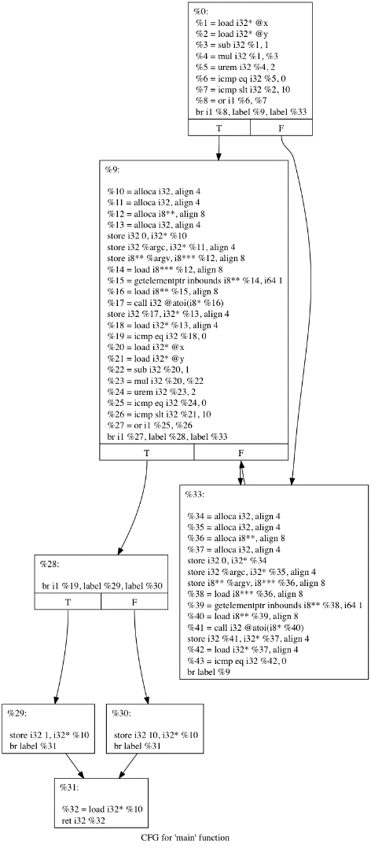
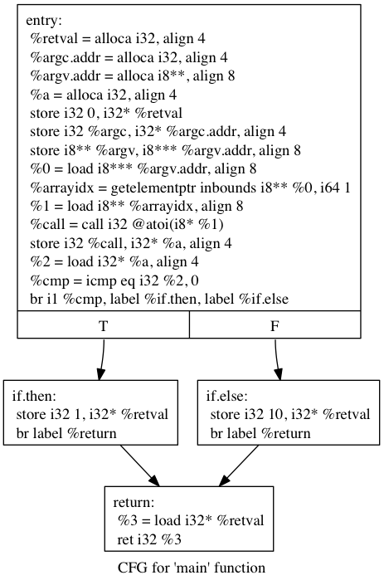
Bogus Control Flow
add junk codes
If-else
P. Junod, et. al, Obfuscator-LLVM -- Software Protection for the Masses, 2015

Slide 17

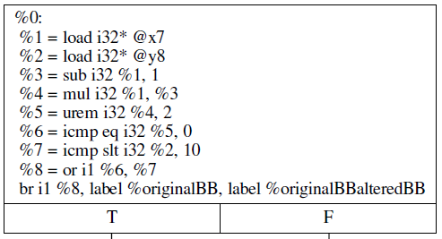
Opaque Predicate Used in Obf-LLVM
x7 = 0;
y8 = 0;
if(x7(x7 – 1)%2 == 0||y8<10){
originalBB;
} else {
alteredBB;
}
convert back
LLVM Intermediate Code
(single static assignment)

Slide 18
Opaque Predicate
Definition [Collberg’97] :
The value is known before compilation time.
Reverse analysis is difficult.
Application: Control-flow obfuscation.
Predicate
Predicate
True
False
True
False
Bogus Code
Bogus Code
[Collberg’97] Collberg, et al. “A taxonomy of obfuscating transformations.” Department of Computer Science, 1997.

Slide 19
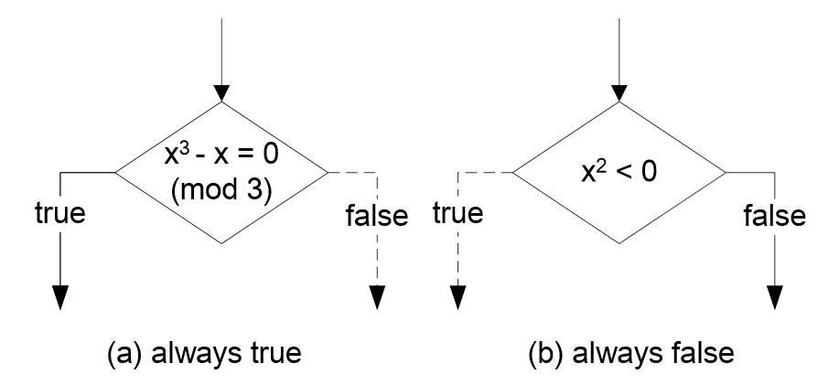
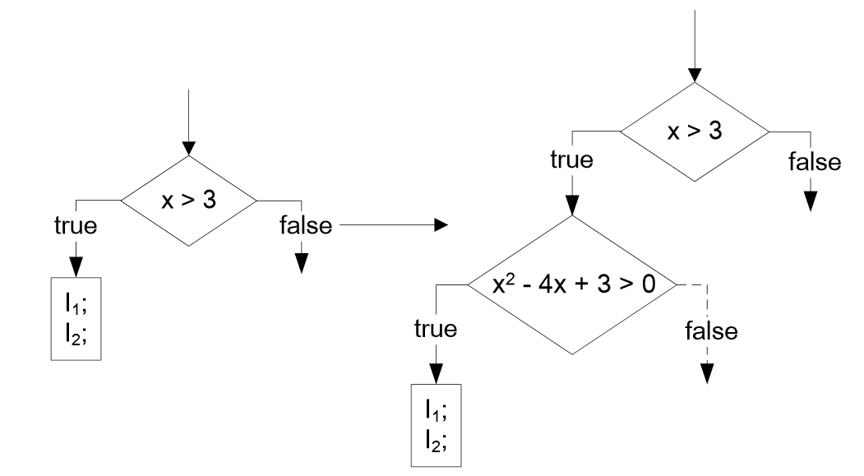


Types of Opaque Predicates
Opaque Constant
$$p$$
a*(a+1)%2 == 0
(a-2)*(a-1)*a%6 != 0
Contextual Opaque Constant
$$p⇒q$$
Ming, et al. LOOP: Logic-Oriented Opaque Predicate Detection inObfuscated Binary Code, CCS 2015

Slide 20
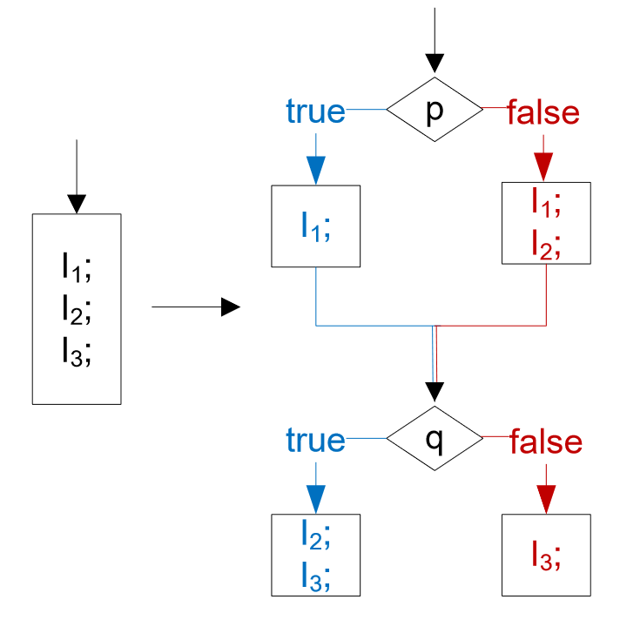

Types of Opaque Predicates
int x
…
while (x>1){
if(x%2==1)
x=3*x+1;
else x = x/2;
if (x == 1) //always reachable
OriginalCode();
}
Collatz (unsolved) conjectures
(contextual but more complicated)
Dynamic opaque predicate
$$(p⇒q)∧(¬p⇒¬q)$$
Ming, et al. LOOP: Logic-Oriented Opaque Predicate Detection inObfuscated Binary Code, CCS 2015

Slide 21
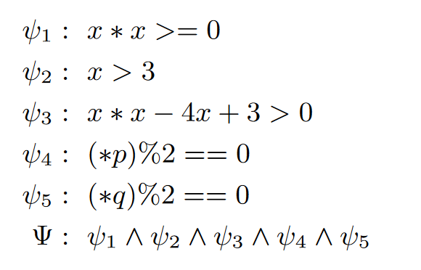



Relationship with Symbolic Execution
int opaque(int x){
int *p=&x;
int*q=&x;
int y=0;
if(x*x<0)//opaque constant
7x=x+1;
if(x>3){//contextual opaque predicate
if(x*x-4x+3>0)
x=x<<1;
}
if((*p)%2==0)//dynamic opaque predicate
y=x+1;
else {
y=x+1;
y=y+2;
}
if((*q)%2==0){
y=y+2;
x=y+3;
} else
x=y+3;
return x;
}
Use symbolic execution to analyze these path constraints
$$ψ_{1}$$
$$ψ_{2}⇒ψ_{3}$$
$$(ψ_{4}⇒ψ_{5})∧(¬ψ_{4}⇒¬ψ_{5})$$

Slide 22
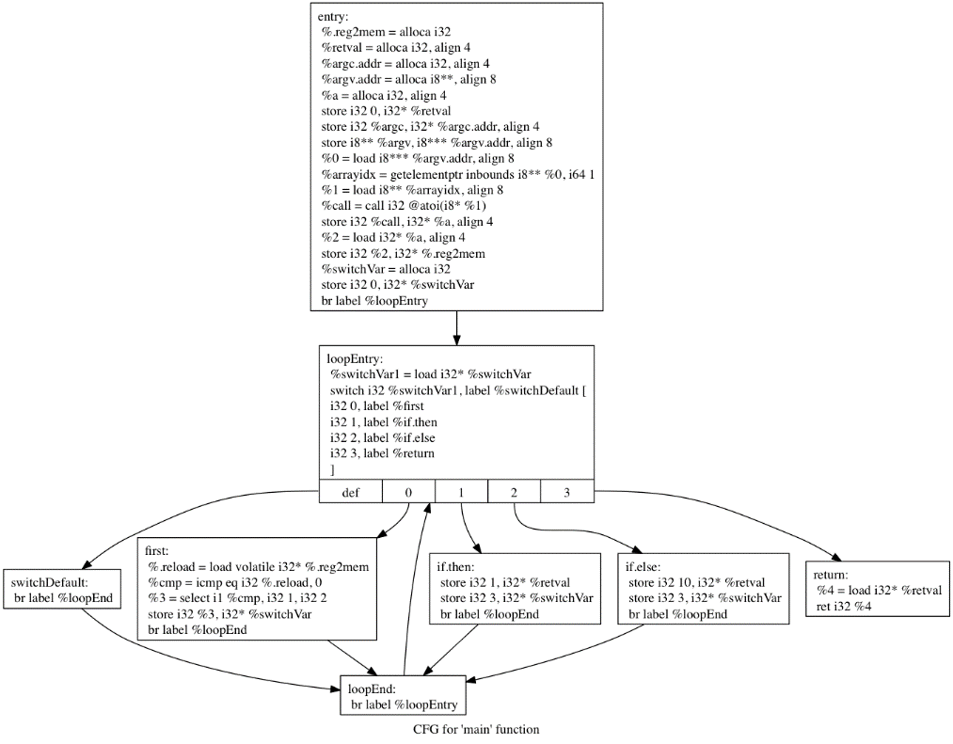
Control-Flow Flattening
Flattening
if-else
while+switch-case

Slide 23
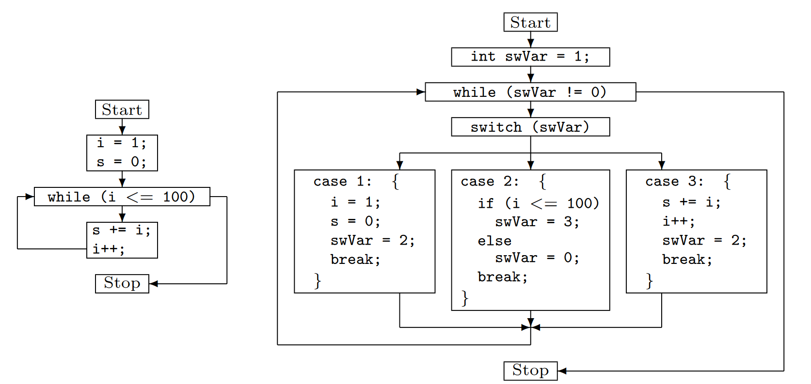
Control-Flow Flattening
László, Tımea, and Ákos Kiss. "Obfuscating C++ programs via control flow flattening." 2009

Slide 24
VM-based Obfuscation
Camouflage widely used by malware.
Convert x86 machine code into virtual machine bytecode and execute it at runtime
Available tools:
VMProtect
Code Virtualizer
RolfRolles x86 Virtualizer
http://www.openrce.org/blog/view/1110/Compiler_1,_X86_Virtualizer_0

Slide 25
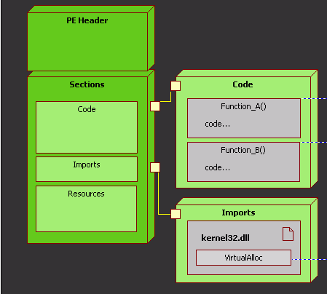
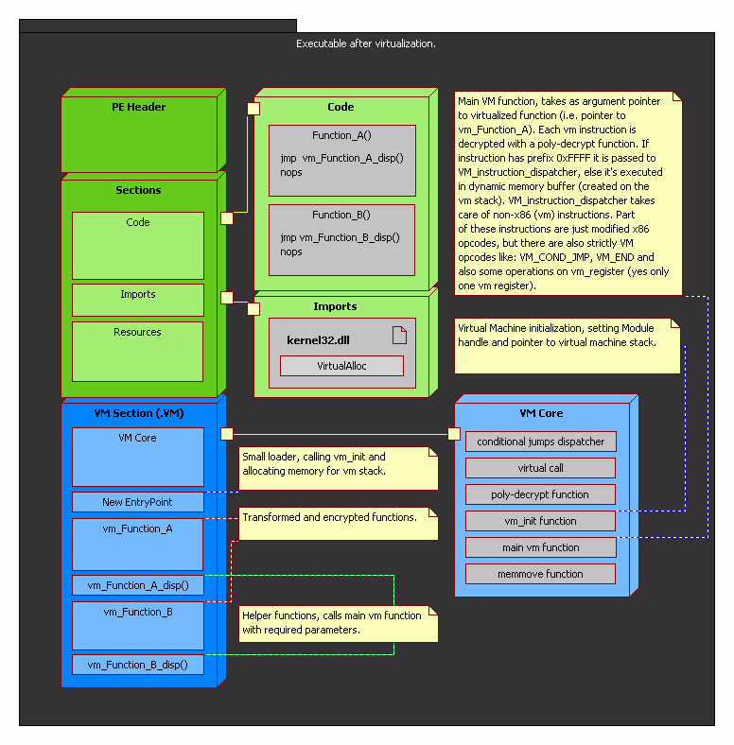
Virtualization
Virtualization
http://www.openrce.org/blog/view/847/x86_Virtualizer_-_source_code

Slide 26
VM Section

Slide 27
3. Theoretical Limitations

Slide 28
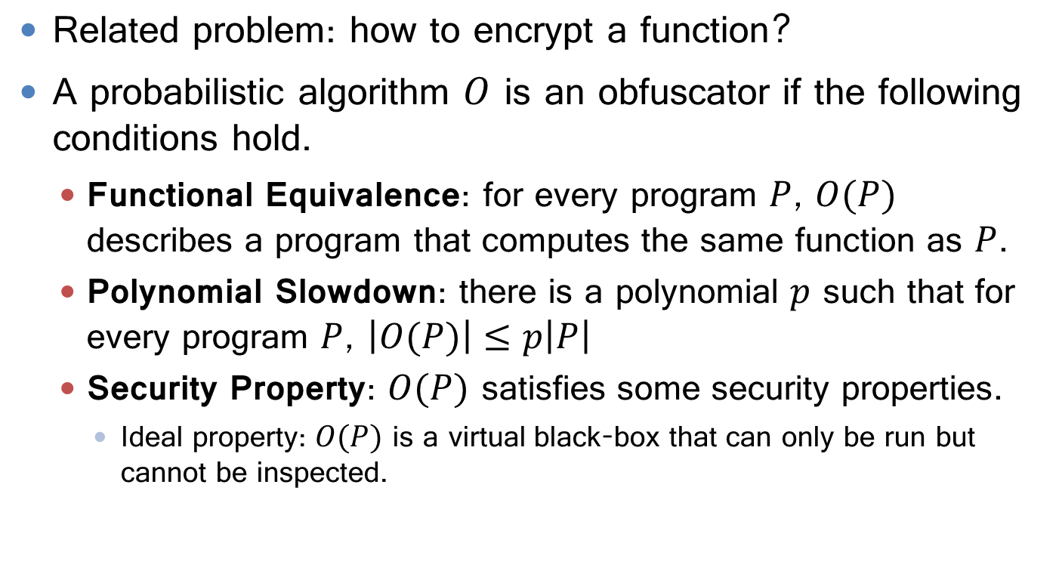
Program Obfuscator
Related problem: how to encrypt a function?
A probabilistic algorithm $O$ is an obfuscator if the following conditions hold.
Functional Equivalence: for every program $P$, $O(P)$ describes a program that computes the same function as $P$.
Polynomial Slowdown: there is a polynomial $p$ such that for every program $P$, $\left|O(P)\right|≤p\left|P\right|$
Security Property: $O(P)$ satisfies some security properties.
Ideal property: $O(P)$ is a virtual black-box that can only be run but cannot be inspected.
B. Barak et al., On the (im) possibility of obfuscating programs, CRYPTO, 2001

Slide 29
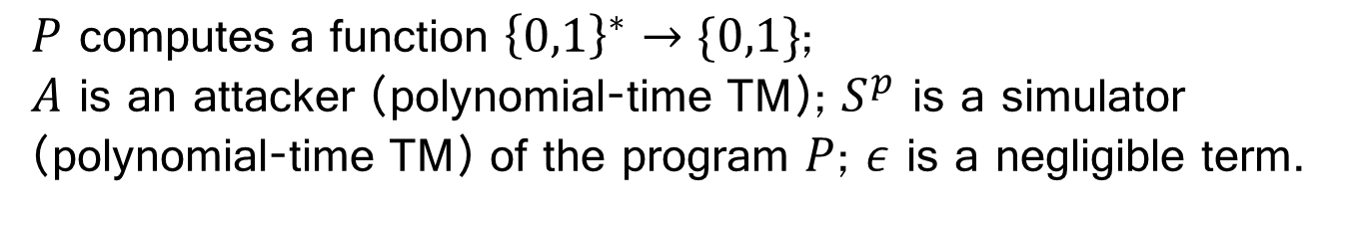
Theoretical Limitation of Obfuscation
Virtual block-box property (VBBP):
The obfuscated program does not help in determine the program result (even leaks 1-bit information) than given only oracle access.
VBBP is not always possible.
$$\left|Pr\left[A\left(O\left(P\right)\right)=1\right]− Pr\left[S^{P}=1\right]\right|≤ε$$
$P$ computes a function ${\left\{0,1\right\}}^{∗}→\{0,1\}$;
$A$ is an attacker (polynomial-time TM); $S^{p}$ is a simulator (polynomial-time TM) of the program $P$; $ε$ is a negligible term.
B. Barak et al., On the (im) possibility of obfuscating programs, CRYPTO, 2001

Slide 30
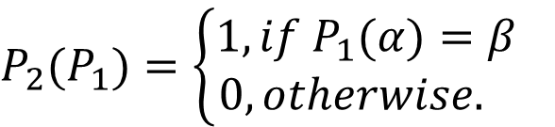
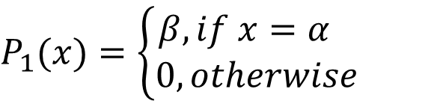
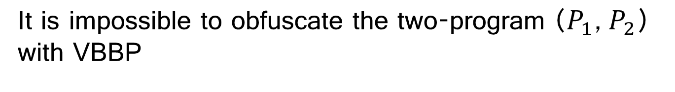
Proof VBBP with A Counter Example
Construct a point function $P_{1}$, and a distinguisher $P_{2}$
$$P_{1}(x)=\left\{\begin{aligned}β, if x=α \\ 0, otherwise\end{aligned}\right.$$
$$P_{2}(P_{1})=\left\{\begin{aligned}1, if P_{1}(α)=β \\ 0, otherwise. \end{aligned}\right.$$
It is impossible to obfuscate the two-program ($P_{1}$, $P_{2}$) with VBBP
$$\left|Pr\left[A\left(O\left(P_{1}\right),O(P_{2})\right)=1\right]− Pr\left[S^{P_{1},P_{2}}=1\right]\right|≤ε$$
Proof by contraction. Details can be found in Barak’s paper.
B. Barak et al., On the (im) possibility of obfuscating programs, CRYPTO, 2001

Slide 31
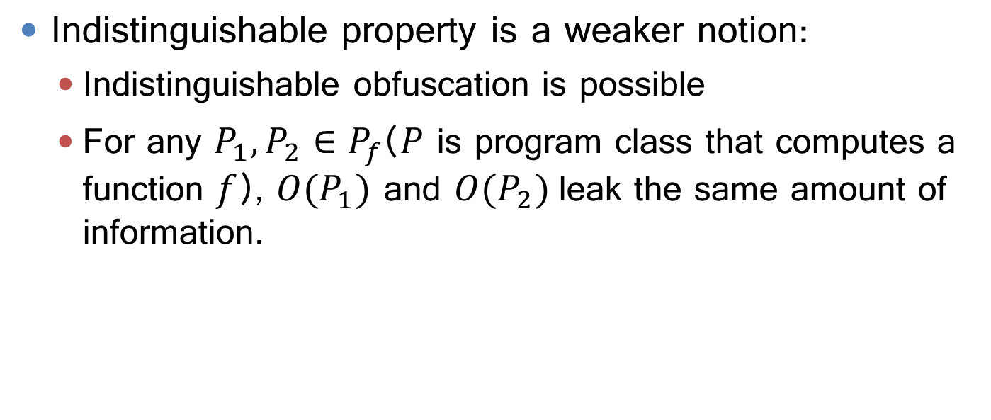
Indistinguishable Property
Indistinguishable property is a weaker notion:
Indistinguishable obfuscation is possible
For any $P_{1},P_{2}∈P_{f}$($P$ is program class that computes a function $f$), ${O(P}_{1})$ and ${O(P}_{2})$leak the same amount of information.
$\left|Pr\left[A(O(P_{1}))=1\right]−Pr\left[A(O(P_{2}))=1\right]\right|≤ε$

Slide 32
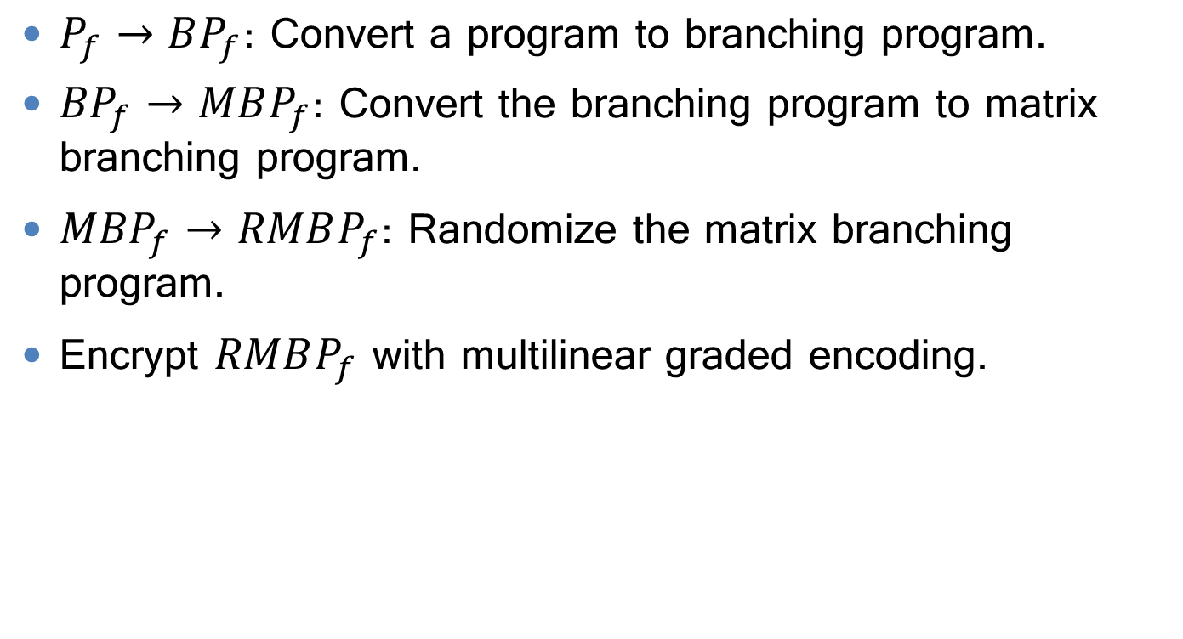
Idea for Achieving IO
$P_{f}→BP_{f}$: Convert a program to branching program.
${BP}_{f}→MBP_{f}$: Convert the branching program to matrix branching program.
${MBP}_{f}→RMBP_{f}$: Randomize the matrix branching program.
Encrypt $RMBP_{f}$ with multilinear graded encoding.
S. Garg et al., Candidate indistinguishability obfuscation and functional encryption for all circuits, FOCS 2013

Slide 33
Convert to Branching Program
if(x == 7)
return 1;
else
return 0;
Example: convert a point function
bit₁
bit₂
bit₃
bit₄
bit₅
bit₆
bit₇
bit₈
1
1
1
0
0
0
0
0
s₁
s₂
s₃
s₄
s₅
s₆
s₇
s₈
s₁₀
0
0
0
1
1
1
1
1
s₉

Slide 34




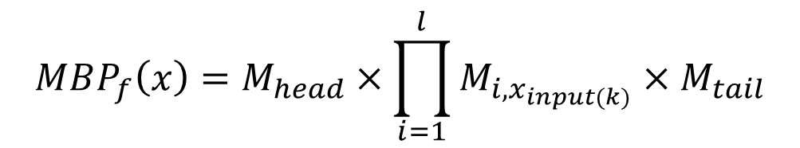

Convert to Matrix Branching Programs
An MBP that computes a function f can be represented as:
$MBP_{f}$ can be computed as
$M_{i,x_{Input(k)}}$ is the adjacent matrix of the $i$th step of $BP_{f}$ and $k$th input bit,
$$MBP_{f}(Input,M_{head},{\left(M_{i,0},M_{i,1}\right)}_{i∈l},M_{tail})$$
$$MBP_{f}\left(x\right)=M_{head}×\prod_{i=1}^{l}{M_{i,x_{input(k)}}}×M_{tail}$$
$${\left[\begin{aligned}1 \\ 0 \\ 0 \\ ⋮ \\ 0 \\ 0 \\ 0\end{aligned}\right]}^{T}$$
$$M_{1,0}=\left[\begin{matrix}\begin{aligned}1 \\ 0 \\ 0\end{aligned}\begin{aligned} 0 \\ 1 \\ 0 \end{aligned}\begin{aligned}0 \\ 0 \\ 1\end{aligned} & ⋯ & \begin{aligned}0 \\ 0 \\ 0\end{aligned}\begin{aligned} 1 \\ 0 \\ 0 \end{aligned}\begin{aligned}0 \\ 0 \\ 0\end{aligned} \\ ⋮ & ⋱ & ⋮ \\ \begin{aligned}0 \\ 0 \\ 0\end{aligned}\begin{aligned} 0 \\ 0 \\ 0 \end{aligned}\begin{aligned}0 \\ 0 \\ 0\end{aligned} & ⋯ & \begin{aligned}1 \\ 0 \\ 0\end{aligned}\begin{aligned} 0 \\ 1 \\ 0 \end{aligned}\begin{aligned}0 \\ 0 \\ 1\end{aligned}\end{matrix}\right]$$
$$M_{1,1}=\left[\begin{matrix}\begin{aligned}1 \\ 0 \\ 0\end{aligned}\begin{aligned} 1 \\ 1 \\ 0 \end{aligned}\begin{aligned}0 \\ 0 \\ 1\end{aligned} & ⋯ & \begin{aligned}0 \\ 0 \\ 0\end{aligned}\begin{aligned} 0 \\ 0 \\ 0 \end{aligned}\begin{aligned}0 \\ 0 \\ 0\end{aligned} \\ ⋮ & ⋱ & ⋮ \\ \begin{aligned}0 \\ 0 \\ 0\end{aligned}\begin{aligned} 0 \\ 0 \\ 0 \end{aligned}\begin{aligned}0 \\ 0 \\ 0\end{aligned} & ⋯ & \begin{aligned}1 \\ 0 \\ 0\end{aligned}\begin{aligned} 0 \\ 1 \\ 0 \end{aligned}\begin{aligned}0 \\ 0 \\ 1\end{aligned}\end{matrix}\right]$$
$${\left[\begin{aligned}0 \\ 0 \\ 0 \\ ⋮ \\ 0 \\ 0 \\ 1\end{aligned}\right]}^{ }$$
…
head matrix
matrices for bit₁
tail matrix

Slide 35




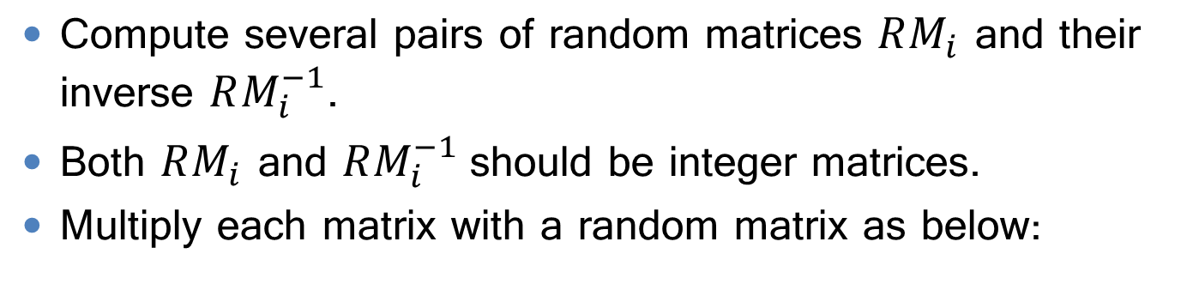

MBP Randomization
Compute several pairs of random matrices $RM_{i}$ and their inverse $RM_{i}^{−1}$.
Both $RM_{i}$ and $RM_{i}^{−1}$should be integer matrices.
Multiply each matrix with a random matrix as below:
$$RM_{head}=M_{head}×RM_{1}$$
$$RM_{1,0}=RM_{1}^{−1}×M_{1,0}×RM_{2}$$
$$RM_{1,1}=RM_{1}^{−1}×M_{1,1}×RM_{2}$$
$$…$$
$$RM_{tail}=RM_{l+1}^{−1}×M_{tail}$$

Slide 36
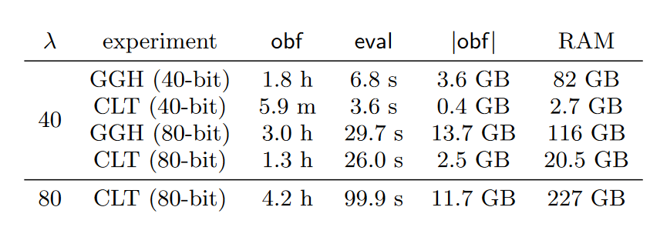
Encrypt RMBP with Graded Encoding
Candidate algorithms: GGH, CLT
Encrypt each element with a key, like public key encryption.
The computation is noisy (non-deterministic) by introducing some small integers.
The final evaluation function (zero-testing) is deterministic.
Far from practical usage
Results achieved when encrypting a point function.
Lewi, et al. "5gen: A framework for prototyping applications using multilinear maps and matrix branching programs.“CCS 2016.

Slide 37
Comparison of The Two Fields
 | PROGRAM OBFUSCATOR (THEORETICAL) | CODE OBFUSCATOR
RESEARCH COMMUNITY | theory scientists | software scientists
Target Program | circuit/Turing-Machine | code/software
OPERATOR | simple arithmetic operations | functions calls and high-level instructions
EVALUATION | probability in guessing (input, output) pair | recover the hidden logic /locate functionality
UNOBFUSCATABLE INFO | unknown | yes
HARD PROBLEMS | e.g., multi-linear maps | e.g., pointer analysis

Slide 38
Summary
Obfuscation is a technique for software intellectual property protection.
Widely used obfuscation transformations include:
lexical obfuscation
control-flow obfuscation (bogus control flow, control flattening).
Camouflage
Theoretical limitations and possibilities of program obfuscation.
Virtual black-box obfuscation is impossible
Indistinguishable obfuscation is possible

