Slide 1

Static Program Analysis
COMP130159.01
XU, Hui
xuh@fudan.edu.cn
May 23, 2020

Slide 2
1. Why Static Analysis?

Slide 3
Review: Static vs Dynamic Analysis
 | Dynamic Analysis | Static Analysis
Cost | Proportional to program’s execution time | Proportional to program’s execution size
Effectiveness | Unsound: may miss errors | Incomplete: may report spurious errors
Static Analysis is Sound

Slide 4
The Disaster of Ariane 5 Rocket in 1996

Slide 5
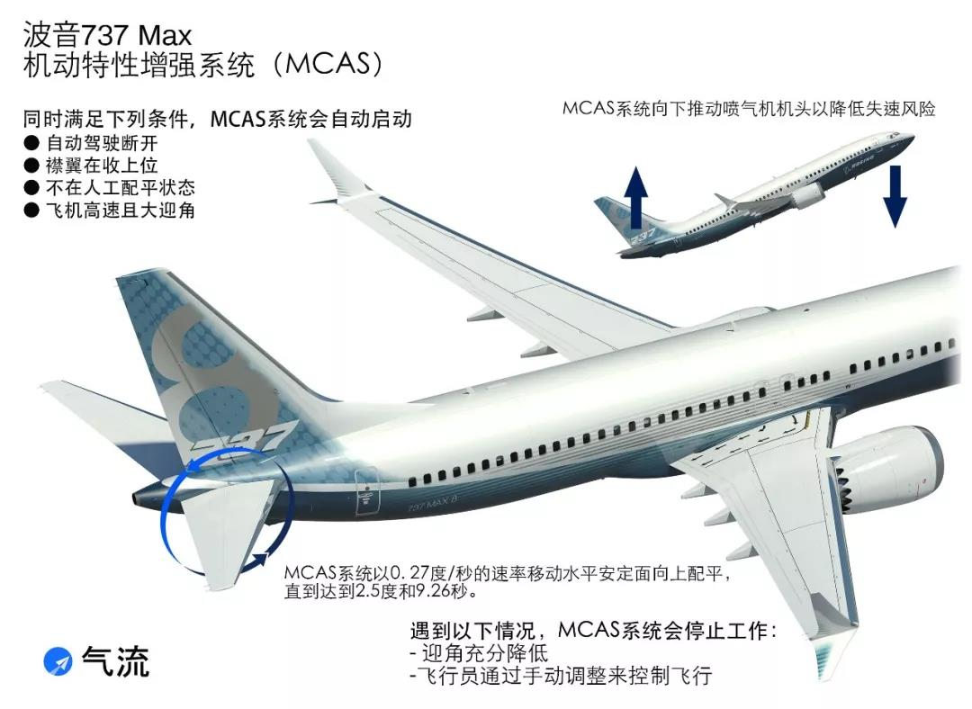
Boeing 737 Max
Indonesia Lion Air Flight 610
Ethiopian Airlines Flight 302
Maneuvering Characteristics Augmentation System

Slide 6
Can You Find the Bug?
static OSStatus SSLVerifySignedServerKeyExchange(SSLContext *ctx,
bool isRsa, SSLBuffer signedParams, uint8_t *signature,
UInt16 signatureLen){
…
if ((err = SSLHashSHA1.update(&hashCtx, &serverRandom)) != 0)
goto fail;
if ((err = SSLHashSHA1.update(&hashCtx, &signedParams)) != 0)
goto fail;
goto fail;
if ((err = SSLHashSHA1.final(&hashCtx, &hashOut)) != 0)
goto fail;
…
fail:
SSLFreeBuffer(&signedHashes);
SSLFreeBuffer(&hashCtx);
return err;
}
Apple ‘goto fail;’ vulnerability:
Signature verification on the “Server Key Exchange” passed
https://www.synopsys.com/blogs/software-security/understanding-apple-goto-fail-vulnerability-2/
Notes:
More reading: https://dwheeler.com/essays/apple-goto-fail.html

Slide 7
Can You Find the Bug?
/* from Linux 2.3.99 drivers/block/raid5.c */
static struct buffer_head *get_free_buffer(
struct stripe_head * sh, int b_size) {
unsigned long flags;
save_flags(flags);
cli(); // disables interrupts
if ((bh = sh->buffer_pool) == NULL)
return NULL;
sh->buffer_pool = bh -> b_next;
bh->b_size = b_size;
restore_flags(flags); // re-enables interrupts
return bh;
}
ERROR: function returns with interrupts disabled!
What happens if you return from a driver with interrupts disabled?

Slide 8
Testing is Not Enough
Defects are on uncommon or difficult-to-force execution paths.
Executing (or interpreting/otherwise analyzing) all paths concretely to find such defects is infeasible.
What we really want to do is check the entire possible state space of the program for particular properties.

Slide 9
Static Analysis
Learn about program’s properties without executing it.
Systematic examination of an abstraction of a program.
Abstraction: produce a representation of a program that is simpler to analyze.
Results in fewer states to explore; makes difficult problems tractable.
Analyze programs as data.
Abstract-syntax tree
Control-flow graph

Slide 10
2. AST Analysis

Slide 11
Abstraction: Abstract Syntax Tree
Tree representation of the syntactic structure of source code.
Parsers convert concrete syntax into abstract syntax, and deal with resulting ambiguities.
Records only the semantically relevant information.
Abstract: doesn’t represent every detail (like parentheses); these can be inferred from the structure.
(How to build one? Take compilers!)
Example: x = 3+(y+z);
=
x
+
3
+
y
z

Slide 12
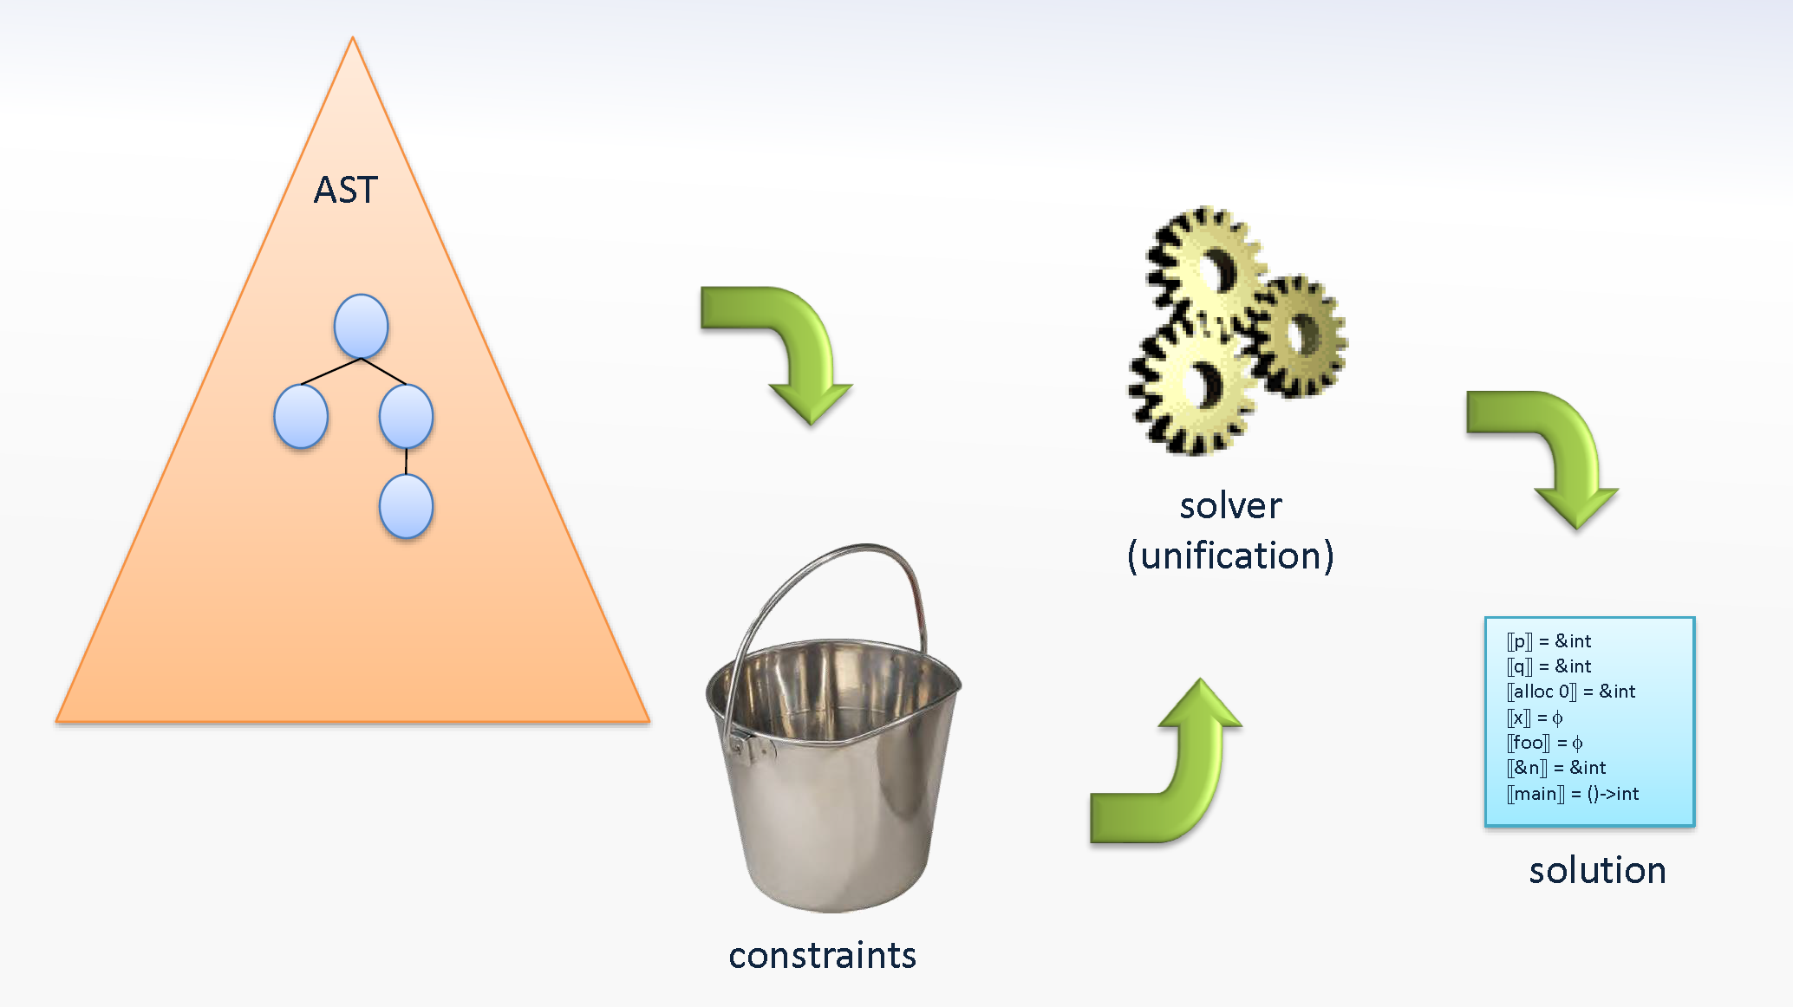
Framework for Type Checking

Slide 13
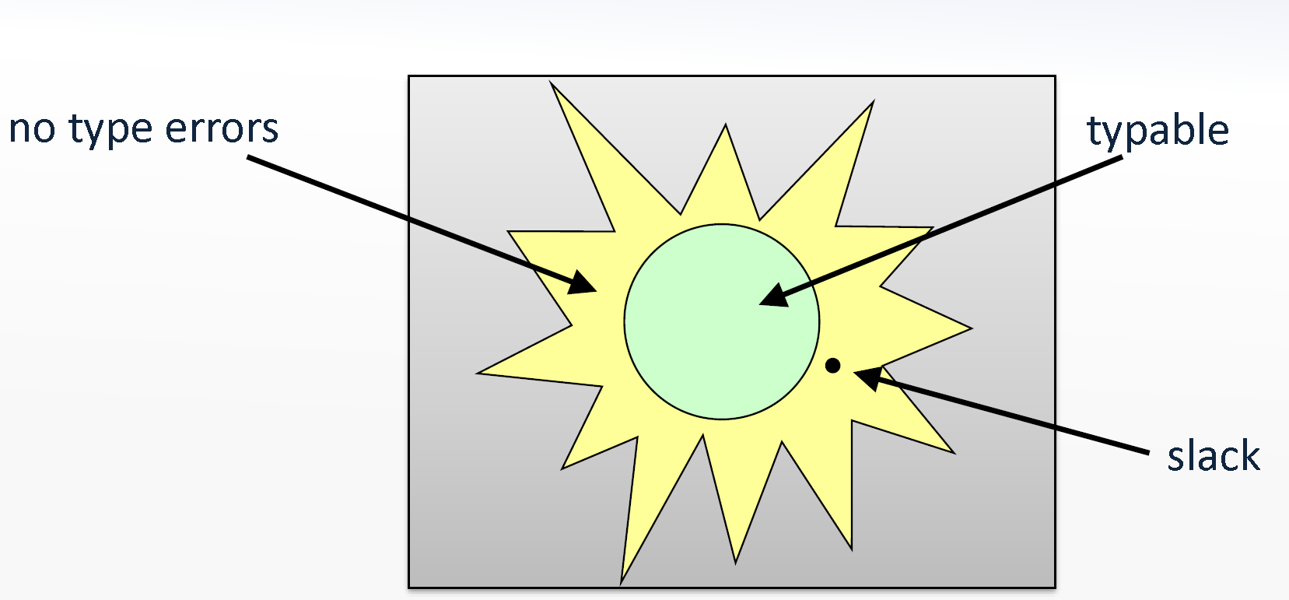
Type checking
We use conservative approximation
a program is typable if it satisfies some type constraints
these are systematically derived from the syntax tree
if typable, then no runtime errors occur
but some programs will be unfairly rejected (slack)
What we shall see next is the essence of the
Damas–Hindley–Milner type inference technique,
which forms the basis of the type systems of e.g. ML, OCaml, and Haskell

Slide 14
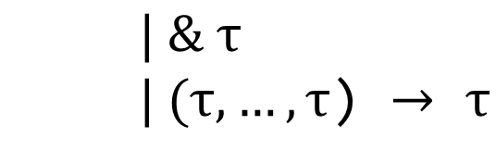


Types in a Tiny Language System
Types describe the possible values:
$$τ→int$$
integer
$| \& τ$
$| (τ,…,τ$) $→$ $τ$
pointer
function
Types generate by this grammar, e.g.,
$$\left(int, \&int\right)→\&\&int$$

Slide 15
Type Constraints
We generate type constraints from an AST:
all constraints are equalities
they can be solved using a unification algorithm
Type variables:
for each identifier declaration X we have the variable ⟦X⟧
for each non-identifier expression E we have the variable ⟦E⟧
Recall that all identifiers are unique
The expression E denotes an AST node, not syntax
(Possible extensions: polymorphism, subtyping, …)

Slide 16

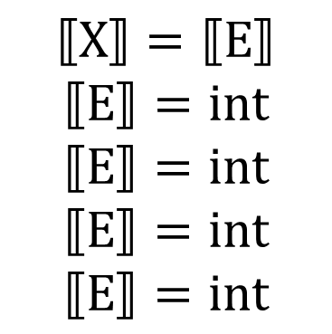


Generating constraints (1/2)
I:
E1 op E2:
E1 == E2:
input:
X = E:
Output E:
if(E){S}:
if(E){S1}else{S2}:
while(E){S}:
$$⟦I⟧=int$$
I is a constant
$$⟦E_{1}⟧=⟦E_{2}⟧=⟦E_{1} op E_{2}⟧=int$$
$$⟦E_{1}⟧=⟦E_{2}⟧∧⟦E_{1}==E_{2}⟧=int$$
$$⟦Input⟧=int$$
$$⟦X⟧=⟦E⟧$$
$$⟦E⟧=int$$
$$⟦E⟧=int$$
$$⟦E⟧=int$$
$$⟦E⟧=int$$

Slide 17




Generating constraints (2/2)
X(X1,...,Xn){... Return E; }:
$$⟦X⟧=(⟦X_{1}⟧,,,⟦X_{n}⟧)→⟦E⟧$$
E(E1,...,En):
$$⟦E⟧=(⟦E_{1}⟧,,,⟦E_{n}⟧)→⟦E(E_{1},…E_{n})⟧$$
alloc E:
$$⟦alloc E⟧=\&⟦E⟧$$
&X:
$$⟦\&X⟧=\&⟦X⟧$$
*E:
$$⟦E⟧=\&⟦∗E⟧$$
*X=E:
$$⟦X⟧=\&⟦E⟧$$

Slide 18




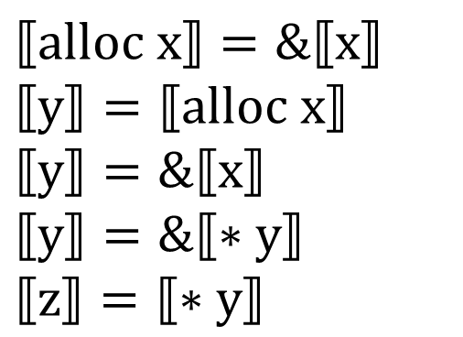

Exercise
main(){
var x, y, z;
x = input;
y = alloc x;
*y = x;
z = *y;
return z;
}
$$⟦main⟧=()→⟦z⟧$$
$$⟦input⟧=int$$
$$⟦x⟧=⟦input⟧$$
$$⟦alloc x⟧=\&⟦x⟧$$
$$⟦y⟧=⟦alloc x⟧$$
$$⟦y⟧=\&⟦x⟧$$
$$⟦y⟧=\&⟦∗y⟧$$
$$⟦z⟧=⟦∗y⟧$$
Solving the constraint:
$$⟦x⟧=int,⟦y⟧=\&int,⟦z⟧=int$$
$$⟦main⟧=()→int$$

Slide 19
The Unification Problem
An equality between two terms with variables, e.g., X, Y, Z:
k(X,b,Y) = k(f(Y,Z),Z,d(Z))
A solution (a unifier) is an assignment from variables to closed terms that makes both sides equal:
X = f(d(b),b)
Y = d(b)
Z = b

Slide 20



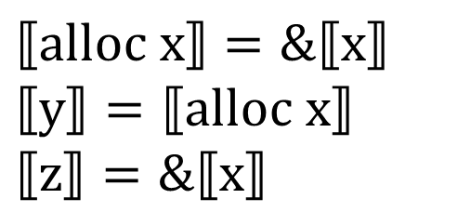

Practice
main(){
var x, y, z;
x = alloc 1;
y = alloc x;
*z = x;
return z;
}
Infer the types of variables x,y,z
$$⟦main⟧=()→⟦z⟧$$
$$⟦alloc 1⟧=\&⟦1⟧$$
$$⟦x⟧=⟦alloc 1⟧$$
$$⟦alloc x⟧=\&⟦x⟧$$
$$⟦y⟧=⟦alloc x⟧$$
$$⟦z⟧=\&⟦x⟧$$
Solving the constraint:
$$⟦x⟧=\&int,⟦y⟧=\&\&int,⟦z⟧=\&\&int$$
$$⟦main⟧=()→\&\&int$$

Slide 21
Other Languages are Similar
class X {
Logger logger;
public void foo() {
if (logger.inDebug()) {
logger.debug(“We have ”
+ conn
+ “connections.”);
}
}
}
class Logger {
bool inDebug() {…}
void debug(String msg) {…}
}
Class X
Field logger
Method foo
If Stmt
Expects: bool
Method Invocation
Block
bool
logger
inDebug
Method Invocation
void->bool
Expect: String
logger
debug
param
String->void
String

Slide 22
Basic Syntactic/Structural Analyses
Analyzing token streams or code structures (ASTs)
Useful to find patterns
Local/structural properties
Flow-insensitive
The execution order of statements doesn’t matter

Slide 23
How about Detecting “goto fail”?
static OSStatus SSLVerifySignedServerKeyExchange(SSLContext *ctx,
bool isRsa, SSLBuffer signedParams, uint8_t *signature,
UInt16 signatureLen){
…
if ((err = SSLHashSHA1.update(&hashCtx, &serverRandom)) != 0)
goto fail;
if ((err = SSLHashSHA1.update(&hashCtx, &signedParams)) != 0)
goto fail;
goto fail;
if ((err = SSLHashSHA1.final(&hashCtx, &hashOut)) != 0)
goto fail;
…
fail:
SSLFreeBuffer(&signedHashes);
SSLFreeBuffer(&hashCtx);
return err;
}

Slide 24
3. Control-Flow Analysis

Slide 25
Control-flow Analysis
Reason about all possible executions, via paths through a control-flow graph.
Track information relevant to a property of interest at every program point.
Including exception handling, function calls, etc.
Define an abstract domain that captures only the values/states relevant to the property of interest.
Track the abstract state, rather than all possible concrete values, for all possible executions(paths!) through the graph.

Slide 26
Control-flow Graph
A graph-based representation of the flow of control through the program.
Captures all possible execution paths.
Each node is a basic block
Edges represent control flow options between nodes.
Intra-procedural: within one function.
Handle inter-procedural?
entry
a=5+(2+3)
a = 5 + (2 + 3);
if = (b > 10){
b = lg(a+b);
}
return b;
if(b>10)
b=lg(a+b)
return b
exit

Slide 27
More on representation
Basic definitions:
pred(n) = set of all predecessors of node n
succ(n) = set of all successors of node n
Program points:
One program point before each node
One program point after each node
Join point: point with multiple predecessors
Split point: point with multiple successors
entry
a=5+(2+3)
if(b>10)
split point
b=lg(a+b)
join point
return b
exit

Slide 28
Draw the Control-Flow Graph
static OSStatus SSLVerifySignedServerKeyExchange(SSLContext *ctx,
bool isRsa, SSLBuffer signedParams, uint8_t *signature,
UInt16 signatureLen){
…
if ((err = SSLHashSHA1.update(&hashCtx, &serverRandom)) != 0)
goto fail;
if ((err = SSLHashSHA1.update(&hashCtx, &signedParams)) != 0)
goto fail;
goto fail;
if ((err = SSLHashSHA1.final(&hashCtx, &hashOut)) != 0)
goto fail;
…
fail:
SSLFreeBuffer(&signedHashes);
SSLFreeBuffer(&hashCtx);
return err;
}

Slide 29
entry
…
true
if ((err = SSLHashSHA1.update(&hashCtx, &serverRandom)) != 0)
false
true
if ((err = SSLHashSHA1.update(&hashCtx, &signedParams)) != 0)
false
Fail:
SSLFreeBuffer(&signedHashes);
SSLFreeBuffer(&hashCtx);
return err;
true
Dead code
exit
if ((err = SSLHashSHA1.final(&hashCtx, &hashOut)) != 0)
false
…

Slide 30
Draw the Control-Flow Graph
/* from Linux 2.3.99 drivers/block/raid5.c */
static struct buffer_head *get_free_buffer(
struct stripe_head * sh, int b_size) {
unsigned long flags;
save_flags(flags);
cli(); // disables interrupts
if ((bh = sh->buffer_pool) == NULL)
return NULL;
sh->buffer_pool = bh -> b_next;
bh->b_size = b_size;
restore_flags(flags); // re-enables interrupts
return bh;
}

Slide 31
entry
unsigned long flags;
save_flags(flags);
cli();
if ((bh = sh->buffer_pool) == NULL)
true
false
sh->buffer_pool = bh -> b_next;
bh->b_size = b_size;
restore_flags(flags);
return bh;
return NULL;
exit

Slide 32
Reasoning about a CFG
Updates state at program points: points between nodes.
For each node:
determine state on entry by examining/combining state from predecessors.
Join: effect of control flow
evaluate state on exit of node based on effect of the operations (transfer).
Transfer function: effect of instructions on state
Iterate through successors and over entire graph until the state at each program point stops changing.
Output: state at each program point

Slide 33
The Interrupt Checker
Abstraction
Three abstract states:
{enabled, disabled, maybe-enabled}
Warning if we can reach the end of the function with interrupts disabled.
Transfer function:
If a basic block includes a call to cli(), then it transfers the state from enabled to disabled.
If a basic block includes a call to restore_flags(), then it transfers the state from disabled to enabled.
Join
Join(enabled, enabled) => enabled
Join(disabled, disabled) => disabled
Join(disabled, enabled) => maybe-enabled
Join(maybe-enabled, *) => maybe-enabled

Slide 34
entry
enabled
unsigned long flags;
save_flags(flags);
cli();
if ((bh = sh->buffer_pool) == NULL)
true
false
disabled
disabled
sh->buffer_pool = bh -> b_next;
bh->b_size = b_size;
restore_flags(flags);
return bh;
return NULL;
disabled
enabled
exit
maybe-disabled

Slide 35
Why Join?
When we get to a branch, what should we do?
Path-sensitive: explore each path separately
Most exact information for each path
But how many paths could there be?
Leads to state explosion, loops add an infinity problem.
Path-insensitive: Join!
Less exact, loses information (…Rice’s theorem...)
But no state explosion, and terminates
entry
exit

Slide 36
4. Dataflow Analysis

Slide 37
Data- vs. Control-Flow
Control-flow analysis:
tracks state global to the function in question.
Dataflow analysis:
tracks abstract values for each of (some subset of) the variables in a program.

Slide 38
Example: Zero/Null-pointer Analysis
Could a variable x ever be 0?
Abstraction:
every variable is in {NZ, Z, MZ}
NZ: non-zero
Z: zero
MZ: maybe zero

Slide 39
Define the Operations
Transfer for Zero-Checking.
What operations are relevant?
+, -, *, /, %...
Join for Zero-Checking
Join(zero, zero) => zero
Join(not-zero, not-zero) => not-zero
Join(zero, not-zero) => maybe-zero
Join(maybe-zero, *) => maybe-zero

Slide 40
Example
Use zero analysis to determine if y could be zero at the division.
entry
x = 10;
y = x;
z = 0;
while (y>-1){
x = x/y;
y = y-1;
z = 5;
}
x = 10
x=NZ, y=?, z=?
y = x
x=NZ, y=NZ, z=?
z = 0;
x=NZ, y=NZ, z=Z
(y>-1)?
exit
x = x/y;
x=NZ, y=NZ, z=Z
x=NZ, y=MZ, z=MZ
y = y-1;
x=NZ, y=MZ, z=Z
x=NZ, y=MZ, z=MZ
z = 5;
x=NZ, y=MZ, z=NZ
x=NZ, y=MZ, z=MZ
Notes:
x

Slide 41
Applications and Algorithm Design
Reaching definition analysis
Find usage of uninitialized variables
Very busy expression analysis
Reduce code size
Available expression analysis
Avoid recomputing the same expressions
Live variable analysis
Allocate registers efficiently

Slide 42
Reaching Definition Analysis
Determine for each program point, which assignments have been made and not overwritten, when execution reaches that point along some path.
“Assignment” == “Definition”
1:
entry
2:
x = y
The assignment y = 1 reaches P1
The assignment y = 1 cannot reach P2
3:
y = 1
P1
4:
x! = 1
5:
y = y*x
exit
7:
6:
x = x-1
P2

Slide 43
Reaching Definition Analysis
Give distinct label to each node.
IN(n): set of facts at entry of node n.
OUT(n): set of facts at exit of node n.
Dataflow analysis computes IN(n) and OUT(n) for each node.
Repeat two operations until IN(n) and OUT(n) stop changing
Called “saturated” or “fixed point”
1:
entry
2:
x = y
3:
y = 1
4:
x! = 1
5:
y = y*x
exit
7:
6:
x = x-1

Slide 44
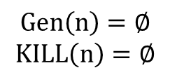


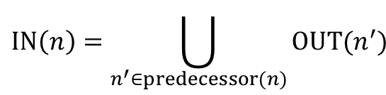
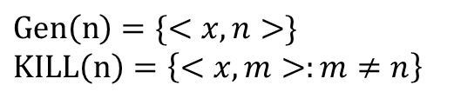
Operations of Reaching Definitions Analysis
Transfer
IN(n)
Join
n1
n2
OUT(n)
n
$$OUT\left(n\right)=(IN\left(n\right)−KILL(n))∪Gen(n)$$
$$IN\left(n\right)=OUT(n1)∪OUT(n2)$$
n:
$$Gen\left(n\right)=∅$$
$$KILL\left(n\right)=∅$$
$$IN\left(n\right)=\bigcup_{n^{′}∈predecessor(n)}{OUT(n^{′})}$$
cond=?
n:
$$Gen\left(n\right)=\{<x,n>\}$$
$$KILL\left(n\right)=\left\{<x,m>:m≠n\right\}$$
x=a

Slide 45
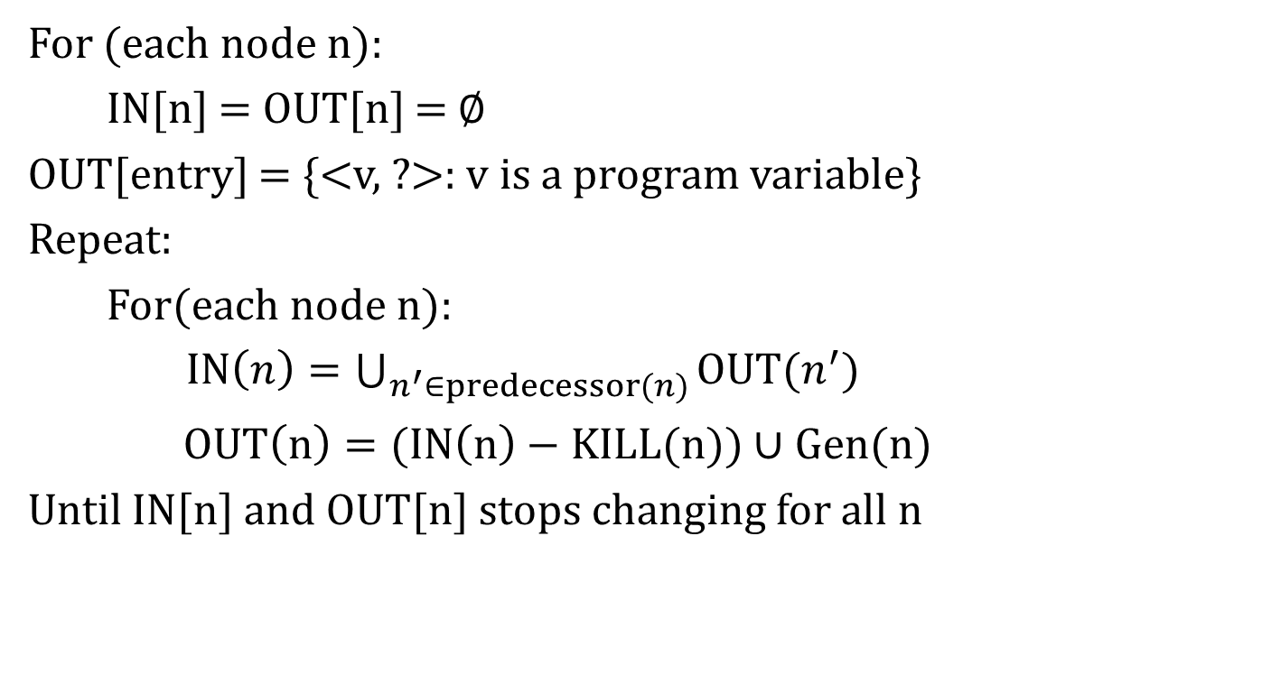
Overall Algorithm: Chaotic Iteration
For (each node n):
IN[n] = OUT[n] = $∅$
OUT[entry] = {<v, ?>: v is a program variable}
Repeat:
For(each node n):
$IN\left(n\right)=\bigcup_{n^{′}∈predecessor(n)}{OUT(n^{′})}$
$OUT\left(n\right)=(IN\left(n\right)−KILL(n))∪Gen(n)$
Until IN[n] and OUT[n] stops changing for all n

Slide 46
Overall Algorithm: Chaotic Iteration
Note of representation:
<x, n>: x is assigned by the nth node.
1:
entry
2:
x = y
n | IN(n) | OUT(n)
1 | -
2
3
4
5
6
7
{<x,?><y,?>}
3:
y = 1
{<x,?><y,?>}
{<x,2><y,?>}
4:
x! = 1
{<x,2><y,?>}
{<x,2><y,3>}
{<x,2><y,3>}
<x,6><y,5>}
{<x,2><y,3>}
<x,6><y,5>}
5:
y = y*x
exit
7:
{<x,2><y,3>}
<x,6><y,5>}
{<x,2><y,5>}
<x,6>}
{<x,2><y,5>}
<x,6>}
{<x,6><y,5>}
6:
x = x-1
{<x,2><y,3>}
<x,6><y,5>}
{<x,2><y,3>}
<x,6><y,5>}

Slide 47
Does It Always Terminate?
Chaotic Iteration algorithm always terminates
The two operations of reaching definition analysis are monotonic
IN and OUT sets never shrink, only grow.
Largest they can be set of all definitions in program
IN and OUT cannot grow for ever.
IN and OUT will stop changing after some iteration.

Slide 48
Very Busy Expression Analysis
An expression is very busy if, no matter what paths taken, the expression is used before any of the variable occurring in it are redefined.
1:
entry
2:
(a!=b)?
3:
x=b-a
4:
y=b-a
5:
a=0
7:
y=a-b
6:
x=a-b
8:
exit

Slide 49

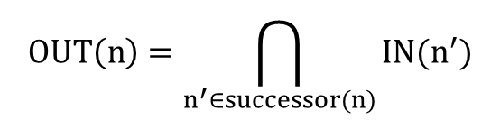
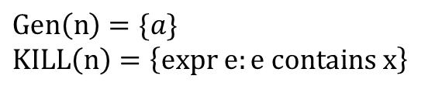
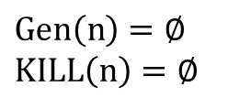

Define the Operations
Transfer
IN(n)
Join
n
OUT(n)
n1
n2
$$IN\left(n\right)=(OUT\left(n\right)−KILL(n))∪Gen(n)$$
$$Gen\left(n\right)=∅$$
$$KILL\left(n\right)=∅$$
$$OUT\left(n\right)=IN(n1)∩IN(n2)$$
n:
cond?
$$OUT\left(n\right)=\bigcap_{n^{′}∈successor(n)}{IN(n^{′})}$$
$$Gen\left(n\right)=\{a\}$$
$$KILL\left(n\right)=\left\{expr e:e contains x\right\}$$
n:
x=a

Slide 50
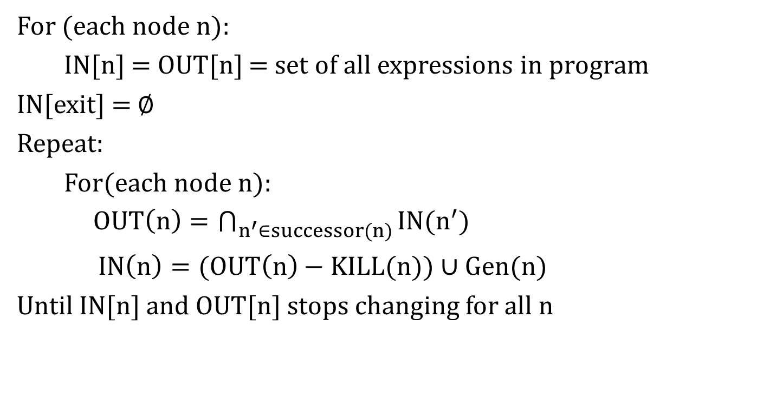
Overall Algorithm: Chaotic Iteration
For (each node n):
IN[n] = OUT[n] = set of all expressions in program
IN[exit] = $∅$
Repeat:
For(each node n):
$OUT\left(n\right)=\bigcap_{n^{′}∈successor(n)}{IN(n^{′})}$
$IN\left(n\right)=(OUT\left(n\right)−KILL(n))∪Gen(n)$
Until IN[n] and OUT[n] stops changing for all n

Slide 51
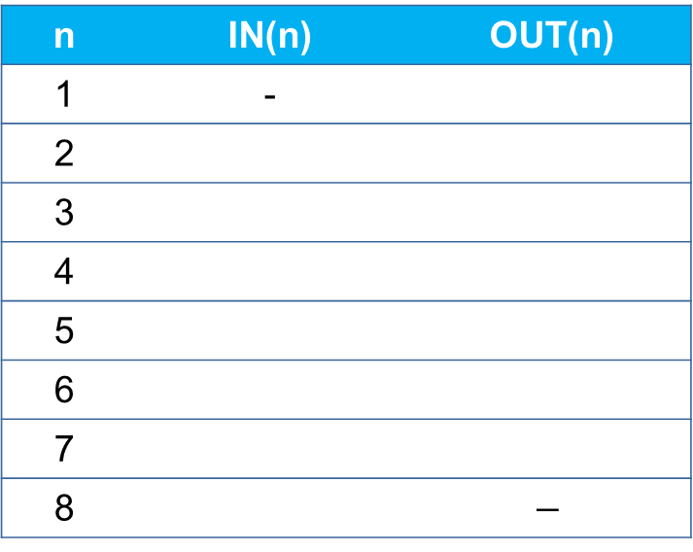
Exercise
Assume each cell has been initiated with
available expressions: {a-b, b-a}
1:
entry
n | IN(n) | OUT(n)
1 | -
2
3
4
5
6
7
8 |  | $$−$$
2:
(a!=b)?
{b-a}
{b-a}
{b-a}
3:
x=b-a
4:
y=b-a
{a-b, b-a}
{a-b}
5:
a=0
{b-a}
∅
∅
{a-b}
7:
y=a-b
6:
x=a-b
{a-b}
∅
{a-b}
∅
8:
exit
∅

Slide 52
Available Expression Analysis
Determine for each program point, which expressions must have already been computed, and no later modified, on all paths to the program point.
1:
entry
2:
x=a-b
3:
y=a*b
7:
4:
(y!=a-b)?
exit
5:
a=a-1
6:
x=a-b

Slide 53
Available Expression Analysis
Forward analysis
1:
entry
n | IN[n] | OUT[n]
1 | -- | ∅
2
3
4
5
6
7 |  | --
2:
x=a-b
3:
y=a*b
∅
{a-b}
7:
4:
(y!=a-b)?
exit
{a-b}
{a-b, a*b}
a=a-1
{a-b, a*b}
{a-b, a*b}
5:
{a-b, a*b}
∅
6:
x=a-b
∅
{a-b}
{a-b, a*b}

Slide 54
Live Variables Analysis
A variable is live if there is a path to a use of the variable that doesn’t redefine the variable
1:
entry
2:
y=4
3:
x = 2
4:
(y!=x) ?
true
false
5:
z=y
6:
z = y*y
7:
x=z
8:
exit

Slide 55
Live Variables Analysis
Backward analysis
1:
entry
n | IN[n] | OUT[n]
1 | --
2
3
4
5
6
7
8 | ∅ | --
2:
y=4
∅
3:
x = 2
∅
{y}
4:
(y!=x) ?
{y}
{x,y}
true
false
{x,y}
{y}
5:
z=y
6:
z = y*y
{y}
{z}
7:
x=z
{y}
{z}
8:
exit
{z}
∅

Slide 56
Data-flow Analysis Review
[n] = ( [n] - KILL[n]) ∪ GEN[n]
[n] = [n’]
n’ ∈ (n)
= U (may) or ∩ (must)
= IN or OUT
= predecessors or successors

Slide 57
Reaching Definitions Analysis
OUT
[n] = ( [n] - KILL[n]) ∪ GEN[n]
IN
IN
[n] = [n’]
U
OUT
n’ ∈ (n)
pred.
= U (may) or ∩ (must)
= IN or OUT
= predecessors or successors

Slide 58
Very Busy Expression Analysis
IN
[n] = ( [n] - KILL[n]) ∪ GEN[n]
OUT
OUT
[n] = [n’]
∩
OUT
n’ ∈ (n)
successors
= U (may) or ∩ (must)
= IN or OUT
= predecessors or successors

Slide 59
Available Expressions Analysis
OUT
[n] = ( [n] - KILL[n]) ∪ GEN[n]
IN
IN
[n] = [n’]
∩
OUT
n’ ∈ (n)
pred.
= U (may) or ∩ (must)
= IN or OUT
= predecessors or successors

Slide 60
Live Variable Analysis
IN
[n] = ( [n] - KILL[n]) ∪ GEN[n]
OUT
OUT
[n] = [n’]
U
IN
n’ ∈ (n)
successors
= U (may) or ∩ (must)
= IN or OUT
= predecessors or successors

Slide 61
Classifying Dataflow Analysis
 | May Analysis (U) | Must Analysis (∩)
Forward
Backward
Reaching Definitions
Available Expressions
Live Variables
Very Busy Expressions
Very Busy Expressions
Reaching Definitions
Live Variables
Available Expressions

Slide 62
What We Have Learnt
AST Analysis
Type checking
Flow-insensitive
Control-flow Analysis
Flow-sensitive
Data-flow Analysis
Forward/backward
May/must

Slide 63
Pros and Cons of Static Analysis
Benefit
Analyzes all possible executions of the program.
Pinpoint in code where issues occur.
Detects issues in the early stages of development.
Cons
Rice’s Theorem: Every static analysis is necessarily incomplete or unsound or undecidable (or multiple of these).
Difficult to track runtime properties.
Can analyze parts of the program that are never executed.

