Slide 1

Symbolic Execution
COMP130159.01
XU, Hui
xuh@fudan.edu.cn
May 17, 2020

Slide 2
1. Background

Slide 3
Motivation
Software Testing
Test case generation and maintenance is tedious
Good test cases: high coverage (e.g., lines of code/path).
Idea: Automated Test Generation

Slide 4
Capture the Flag
The problem is solved by angr in 2 seconds.
char *sneaky = "SOSNEAKY";
int authenticate(char *username, char *password)
{
char stored_pw[9];
stored_pw[8] = 0;
int pwfile;
if (strcmp(password, sneaky) == 0) return 1;
pwfile = open(username, O_RDONLY);
read(pwfile, stored_pw, 8);
if (strcmp(password, stored_pw) == 0) return 1;
return 0;
}
Code source: https://github.com/angr/angr-doc/tree/master/examples/fauxware
Platform: * Intel(R) Core(TM) i7-8086K CPU @ 4.00GHz, 16GB DDR4 RAM

Slide 5
Execution Paths of a Program
Programs can be seen as trees with possibly infinite depth
Typically in binary tree called computation tree
Each node represents the execution of a conditional statement
Each edge represents the execution of a sequence of non-conditional statements
Each path in the tree represents an equivalence class of inputs
1
F
T
7
2
F
T
F
T
8
10
3
11
T
F
T
9
12
4
T
5
F
T
6
13
13

Slide 6
Example of Computation Tree
void test_me(int x, int y) {
if (2*y == x) {
if (x <= y+10)
print(“OK”);
else {
print(“something bad”);
ERROR; }
} else
print(“OK”);
}
2*y==x
F
T
x <= y+10
F
T
ERROR

Slide 7
How to Traverse the Tree? Approach I
Random Testing
Generate random inputs
Execute the program on those (concrete) inputs
Problem:
Probability of reaching error could be astronomically small
Probability of ERROR: 1/2³² ≈ 0.000000023%
void test_me(int x) {
if (x == 94389) {
ERROR;
}
}

Slide 8
How to Traverse the Tree? Approach II
Symbolic Execution
Use symbolic values for inputs
Execute program symbolically on symbolic input values
Collect symbolic path constraints
Use theorem prover to check if a branch can be taken
void test_me(int x) {
if (x*3 == 15) {
if (x % 5 == 0)
print(“OK”);
else {
print(“something bad”);
ERROR; }
} else
print(“OK”);
}

Slide 9
Issues of Static Symbolic Execution
void test_me(int x) {
// c = product of two large primes
if (pow(2,x) % c == 17) {
print(“something bad”);
ERROR;
} else
print(“OK”);
}
Discrete logarithm problems are computationally intractable on classical computers
Does not scale for large programs

Slide 10
2. Dynamic Symbolic Execution
Concolic (Concrete + Symbolic) Execution

Slide 11
Dynamic Symbolic Execution
Stores program state concretely and symbolically
Step:
Start with random input values
Keep track of both concrete values and symbolic constraints
Use concrete values to simplify symbolic constraints
Incomplete theorem-prover

Slide 12
An Illustrative Example
Concrete
Execution
Symbolic
Execution
int foo(int v) {
return 2*v;
}
void test_me(int x, int y) {
int z = foo(y);
if (z == x)
if (x > y+10)
ERROR;
}
concrete
state
symbolic
state
path
condition
x = 22
y = 7
x = x₀
y = y₀
2*y₀ != x₀
z = 14
z = 2*y₀
Solve: 2*y₀ == x₀
Solution: x₀ = 2, y₀ = 1

Slide 13
An Illustrative Example
Concrete
Execution
Symbolic
Execution
int foo(int v) {
return 2*v;
}
void test_me(int x, int y) {
int z = foo(y);
if (z == x)
if (x > y+10)
ERROR;
}
concrete
state
symbolic
state
path
condition
x = 2
y = 1
x = x₀
y = y₀
2*y₀ == x₀
x₀ <= y₀+10
z = 2
z = 2*y₀
Solve: (2*y₀ == x₀) and (x₀ > y₀+10)
Solution: x₀ = 30, y₀ = 15

Slide 14
An Illustrative Example
Concrete
Execution
Symbolic
Execution
int foo(int v) {
return 2*v;
}
void test_me(int x, int y) {
int z = foo(y);
if (z == x)
if (x > y+10)
ERROR;
}
concrete
state
symbolic
state
path
condition
x = 30
y = 15
x = x₀
y = y₀
2*y₀ == x₀
x₀ > y₀+10
z = 30
z = 2*y₀
Program Error

Slide 15
QUIZ: Computation Tree
Check all constraints that DSE might possibly solve in exploring the computation tree shown below:
C1
C2
¬C1
¬C2
✓
C1 ∧ C2
C1 ∧ ¬C2
¬C1 ∧ C2
¬C1 ∧ ¬C2
C1
F
T
✓
C2
F
T
✓

Slide 16
A More Complex Example
Concrete
Execution
Symbolic
Execution
int foo(int v) {
return hash(v);
}
void test_me(int x, int y) {
int z = foo(y);
if (z == x)
if (x > y+10)
ERROR;
}
concrete
state
symbolic
state
path
condition
x = 22
y = 7
x = x₀
y = y₀
hash(y₀) != x₀
z = 601...129
z₀ = hash(y₀)
Solve: hash(y₀) == x₀
Don’t know how to solve! Stuck?
No, replace y₀ by 7
Solve: 601...129 == x₀
Solution: x₀ = 601...129, y₀ = 7

Slide 17
A More Complex Example
Concrete
Execution
Symbolic
Execution
int foo(int v) {
return hash(v);
}
void test_me(int x, int y) {
int z = foo(y);
if (z == x)
if (x > y+10)
ERROR;
}
concrete
state
symbolic
state
path
condition
x = 601...129
y = 7
x = x₀
y = y₀
hash(y₀) == x₀
x₀ > y₀+10
z = 601...129
z = hash(y₀)
Program Error

Slide 18
QUIZ: Example Application
DSE tests the below program starting with input x = 1. What is the input and constraint (C1 ∧ C2 ∧ C3) solved in each run of DSE? Use depth-first search and leave trailing constraints blank if unused.
int test_me(int x) { int[] A = { 5, 7, 9 }; int i = 0;
while (i < 3) {
if (A[i] == x) break;
i++;
}
return i;
}
Run | x | C1 | C2 | C3
1 | 1
2
3
4
5 != x0
7 != x0
9 == x0
9
5 != x0
7 == x0
7
5 == x0
5

Slide 19
A Third Example
Concrete
Execution
Symbolic
Execution
int foo(int v) {
return hash(v);
}
void test_me(int x, int y) {
if (x != y)
if (foo(x) == foo(y))
ERROR;
}
concrete
state
symbolic
state
path
condition
x = 22
y = 7
x = x₀
y = y₀
x₀ != y₀
hash(x₀)!=hash(y₀)
Solve: x₀ != y₀ and hash(x₀) == hash(y₀)
Use concrete state: replace y₀ by 7.
Solve: x₀ != 7 and hash(x₀) == 601...129
Use concrete state: replace x₀ by 22.
False negative!
Solve: 22 != 7 and 438...861 == 601...129
Unsatisfiable!

Slide 20
QUIZ: Properties of DSE
Assume that programs can have infinite computation trees. Which statements are true of DSE applied to such programs?
DSE is guaranteed to terminate.
DSE is complete: if it ever reaches an error, the program can reach that error in some execution.
DSE is sound: if it terminates and did not reach an error, the program cannot reach an error in any execution.
✓

Slide 21
Approach in a Nutshell
Generate concrete inputs, each taking different program path
On each input, execute program both concretely and symbolically
Both cooperate with each other:
Concrete execution guides symbolic execution
Enables it to overcome incompleteness of theorem prover
Symbolic execution guides generation of concrete inputs
Increases program code coverage

Slide 22
3. Constraint Model: SAT

Slide 23
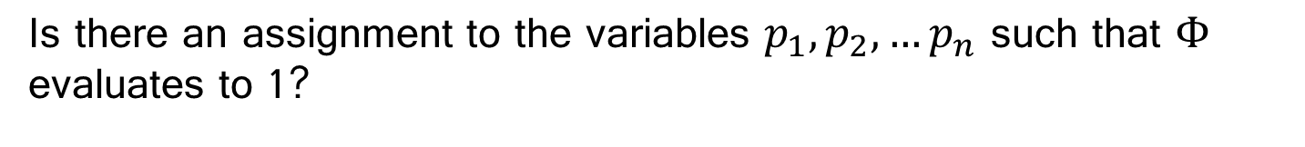

Boolean Satisfiability (SAT)
p₁
v
p₂
ᴧ
¬
$$Φ$$
.
.
.
ᴧ
v
v
p_{n}
Is there an assignment to the variables $p_{1},p_{2},…p_{n}$ such that $Φ$
evaluates to 1?
Notes:
Clark Barrett, Sanjit A. Seshia, Introduction to Satisfiability Modulo Theories (SMT), ICCAD Tutorial, November 2, 2009

Slide 24
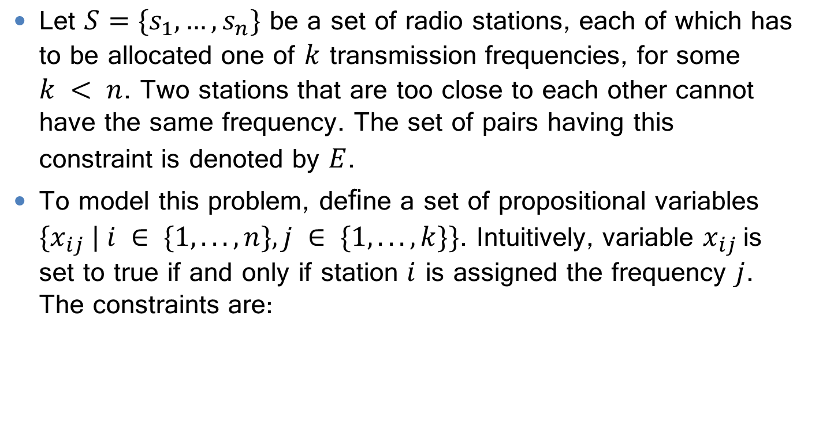
Example 1
Let $S=\{s_{1},…,s_{n}\}$ be a set of radio stations, each of which has to be allocated one of $k$ transmission frequencies, for some $k < n$. Two stations that are too close to each other cannot have the same frequency. The set of pairs having this constraint is denoted by $E$.
To model this problem, deﬁne a set of propositional variables $\{x_{ij} | i ∈ \{1, . . . , n\}, j ∈ \{1, . . . , k\}\}$. Intuitively, variable $x_{ij}$is set to true if and only if station $i$ is assigned the frequency $j$. The constraints are:

Slide 25
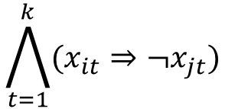
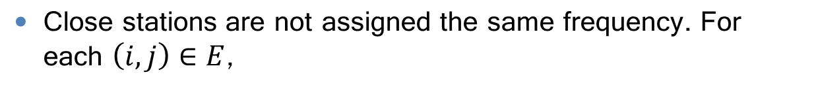
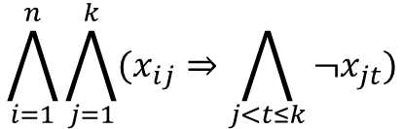
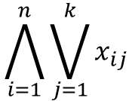
Example 1: Propositional Logic
Every station is assigned at least one frequency
$$\bigwedge_{i=1}^{n}{\bigvee_{j=1}^{k}{x_{ij}}}$$
Every station is assigned only one frequency
$$\bigwedge_{i=1}^{n}{\bigwedge_{j=1}^{k}{(x_{ij}⇒\bigwedge_{j<t≤k}{¬x_{jt}})}}$$
Close stations are not assigned the same frequency. For each $\left(i,j\right)∈E$,
$$\bigwedge_{t=1}^{k}{(x_{it}⇒¬x_{jt})}$$

Slide 26
Example 2
Are they equivalent?
if(!a && !b)
h();
else
if(!a)
g();
else
f();
if(a)
f();
else
if(b)
g();
else
h();
Hint: $\left(if x then y else z\right)≡(x⋀y)⋁(¬x⋀z)$
Left: $\left(¬a⋀¬b⋀h)⋁(¬(¬a⋀¬b\right)⋀(\left(¬a⋀g\right)⋁\left(a⋀f\right)))$
Right: $\left(a⋀f)⋁(¬a⋀((b⋀g\right)⋁(¬b⋀h))$

Slide 27



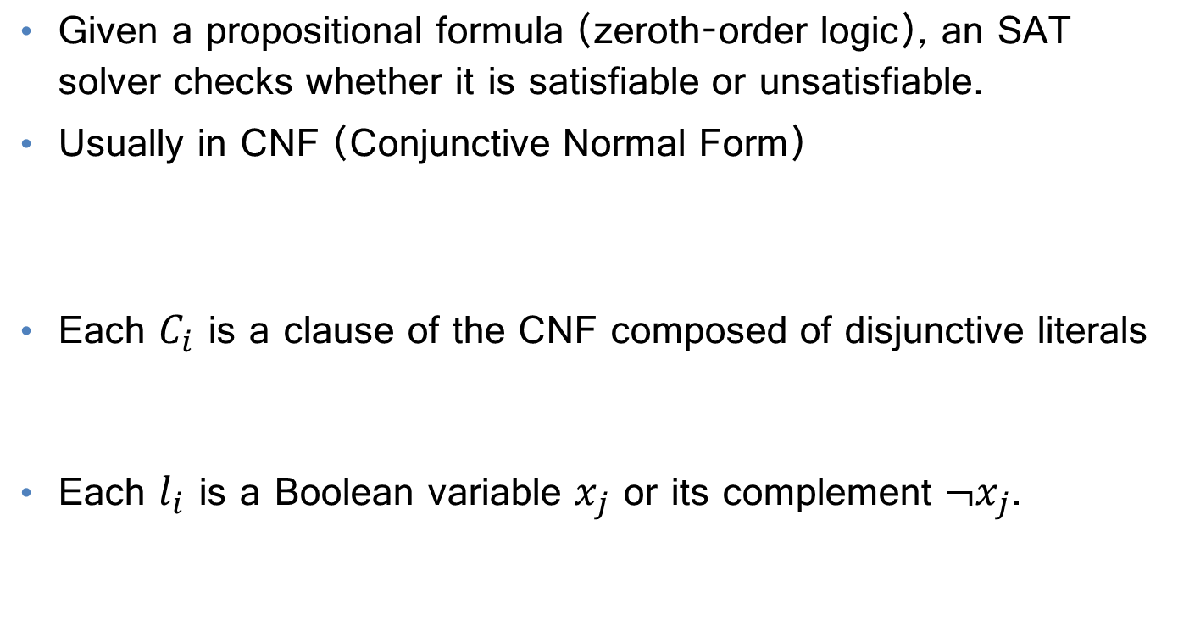
Satisfiability for Propositional Logic
Given a propositional formula (zeroth-order logic), an SAT solver checks whether it is satisfiable or unsatisfiable.
Usually in CNF (Conjunctive Normal Form)
Each $C_{i}$ is a clause of the CNF composed of disjunctive literals
Each $l_{i}$ is a Boolean variable $x_{j}$ or its complement ${¬x}_{j}$.
$$C_{1}∧C_{2}∧…∧C_{n}$$
$$l_{1}∨l_{2}∨…∨l_{n}$$
$$\left(x_{1}∨x_{2}\right)∧…∧(x_{n−1}∨{¬x}_{n})$$

Slide 28

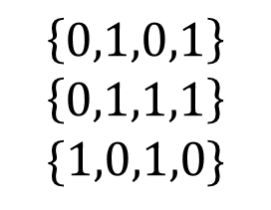
Examples
$$(x_{2}⋁x_{3})⋀(¬x_{1}⋁¬x_{4})⋀(¬x_{2}⋁x_{4})$$
Solution:
$$\left\{0,1,0,1\right\}$$
$$\left\{0,1,1,1\right\}$$
$$\{1,0,1,0\}$$
$$(x_{2}⋁x_{3})⋀(¬x_{1}⋁¬x_{4})⋀(¬x_{2}⋁x_{4})⋀(x_{1}⋁x_{3})$$
$$(x_{2}⋁x_{3})⋀(¬x_{1}⋁¬x_{4})⋀(¬x_{2}⋁x_{4})⋀(x_{1}⋁x_{3})⋀(¬x_{3}⋁x_{4})$$
$$(x_{2}⋁x_{3})⋀(¬x_{1}⋁¬x_{4})⋀(¬x_{2}⋁x_{4})⋀(x_{1}⋁x_{3})⋀(¬x_{3}⋁x_{4})⋀(x_{1}⋁¬x_{2})$$

Slide 29
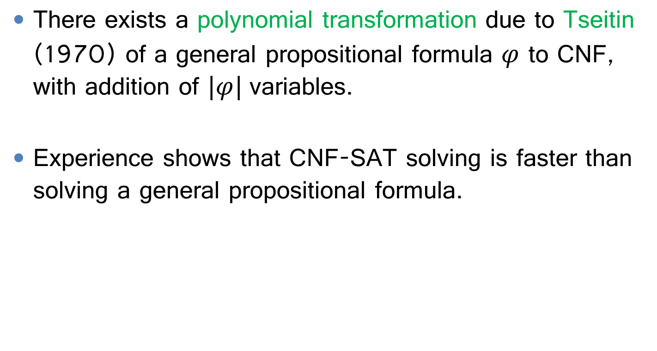
CNF-SAT
There exists a polynomial transformation due to Tseitin (1970) of a general propositional formula $φ$ to CNF, with addition of $|φ|$variables.
Experience shows that CNF-SAT solving is faster than solving a general propositional formula.

Slide 30
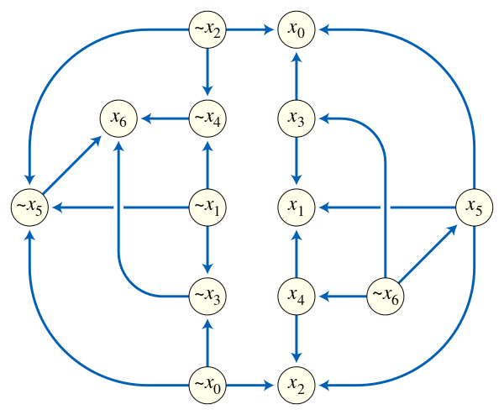
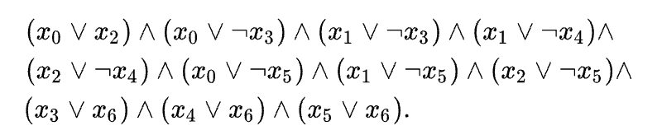
2-SAT is in P
2 stands for the number of literals per clause.
Implication graph.
Unsat: a path between any var and its negation

Slide 31

3-SAT is NP-Complete
The first known NP-complete problem, by Stephen Cook in 1971.
Proof hint: Unrestricted SAT problem can be reduced to 3-SAT.
$$(l_{1}⋁l_{2}⋁...⋁l_{n−1}⋁l_{n})$$
$$\left(l_{1}⋁l_{2}⋁x_{1}\right)∧\left(¬x_{1}⋁l_{3}⋁x_{2}\right)∧...∧(¬x_{n−3}⋁l_{n−1}⋁l_{n})$$
Stephen A. Cook: “The Complexity of Theorem-Proving Procedures,” 1971

Slide 32
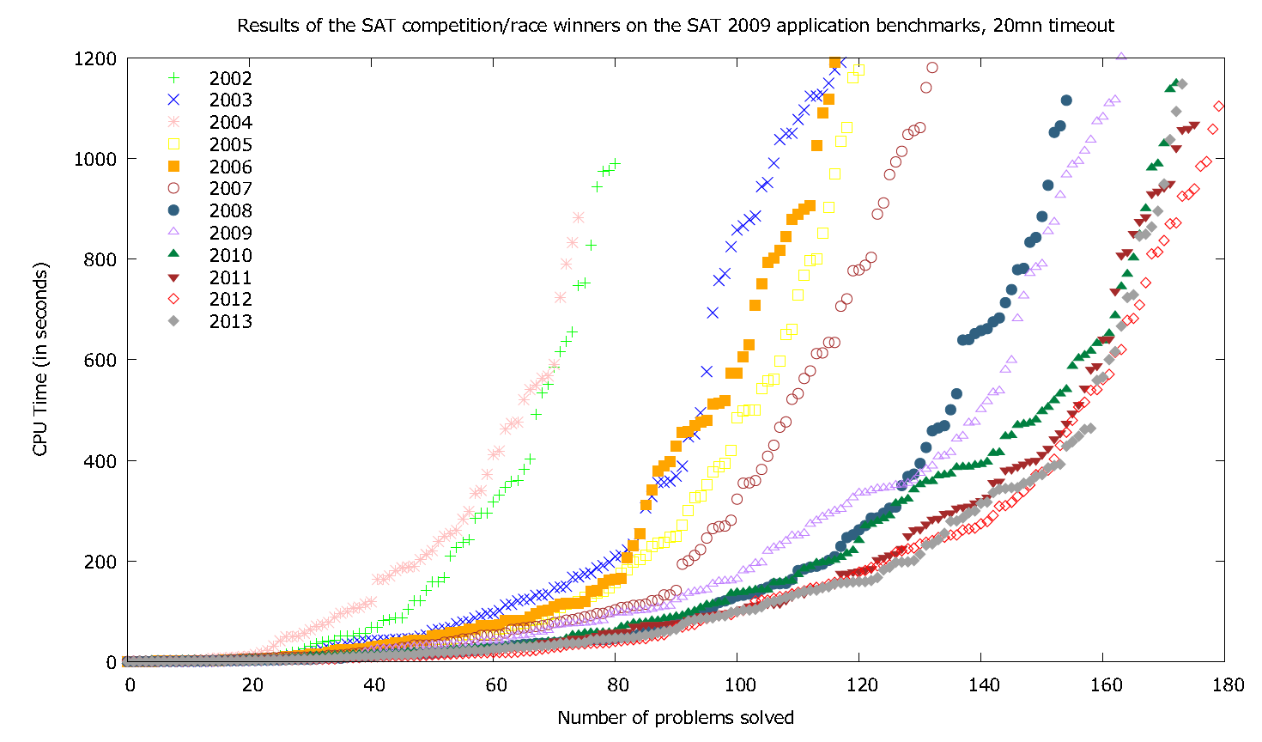
SAT is an Active Research Area

Slide 33
Basic Search-based Solving
Given ϕ in CNF: $(x,y,z)⋀(−x,y)⋀(−y,z)⋀(−x,−y,−z)$
ϕ
Decide()
Deduce()
X
√
X
X
X
X
Resolve_Conflict()

Slide 34
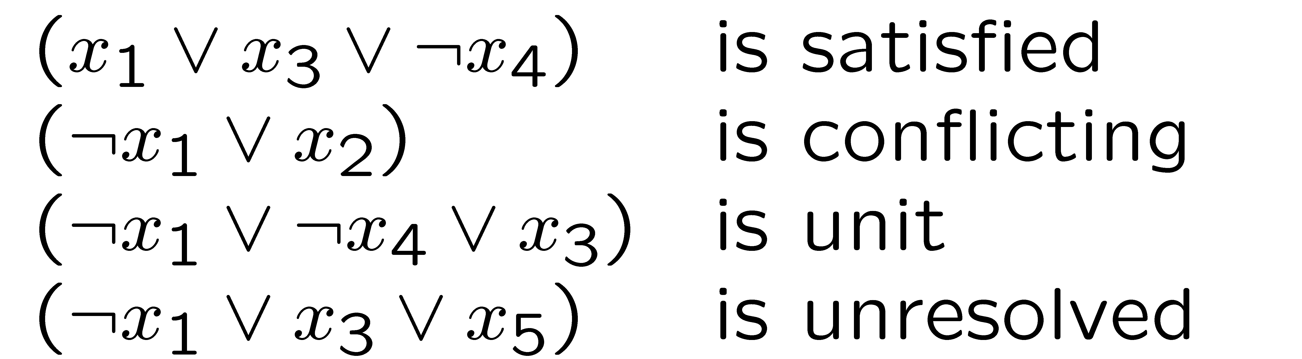

State of Clauses
A clause under a partial assignment is:
Satisfied if at least one literal is satisfied,
Conflicting if all literals are unsatisfied,
Unit if it is unsatisfied, and all but one literals are assigned
Unresolved otherwise.
Given the partial assignment
$\{x_{1}⟼1,x_{2}⟼0$, $x_{4}⟼1\}$

Slide 35



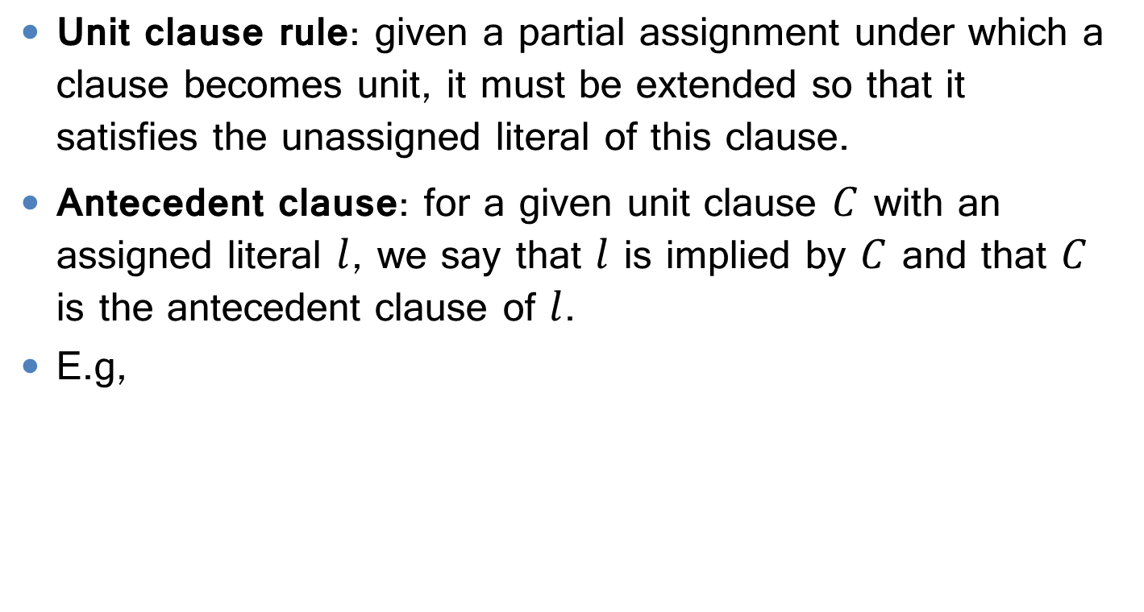
Unit Clause Rule
Unit clause rule: given a partial assignment under which a clause becomes unit, it must be extended so that it satisfies the unassigned literal of this clause.
Antecedent clause: for a given unit clause $C$ with an assigned literal $l$, we say that $l$ is implied by $C$ and that $C$ is the antecedent clause of $l$.
E.g,
Clause:
$$C:=\left\{¬x_{1}⋁¬x_{4}⋁x_{3}\right\}$$
Assignment:
$\{x_{1}⟼1,$ $x_{4}⟼1\}$
$$Antecedent\left(x_{3}\right)=C$$

Slide 36
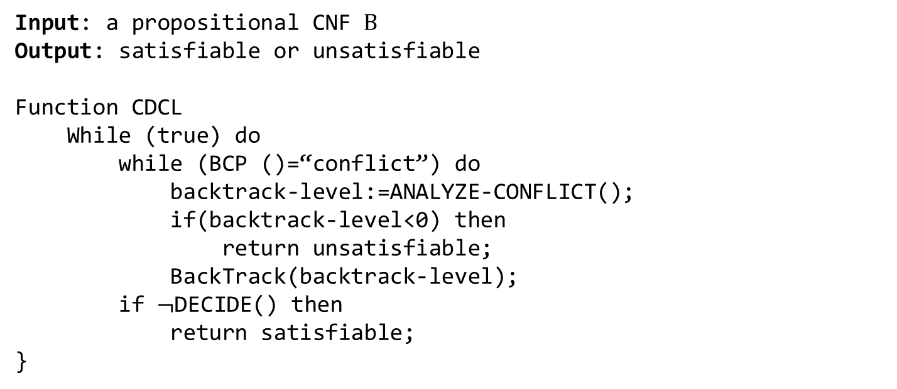
Conflict-Driven Clause Learning: CDCL-SAT
CDCL is a serious of improvements to the DPLL (Davis-Putnam-Logemann-Loveland) framework.
Input: a propositional CNF $Β$
Output: satisfiable or unsatisfiable
Function CDCL
While (true) do
while (BCP ()=“conflict”) do
backtrack-level:=ANALYZE-CONFLICT();
if(backtrack-level<0) then
return unsatisfiable;
BackTrack(backtrack-level);
if $¬$DECIDE() then
return satisfiable;
}
Martin Davis, George Logemann, and Donald W. Loveland. A machine program for theorem-proving. New York University, Institute of Mathematical Sciences, 1961.

Slide 37
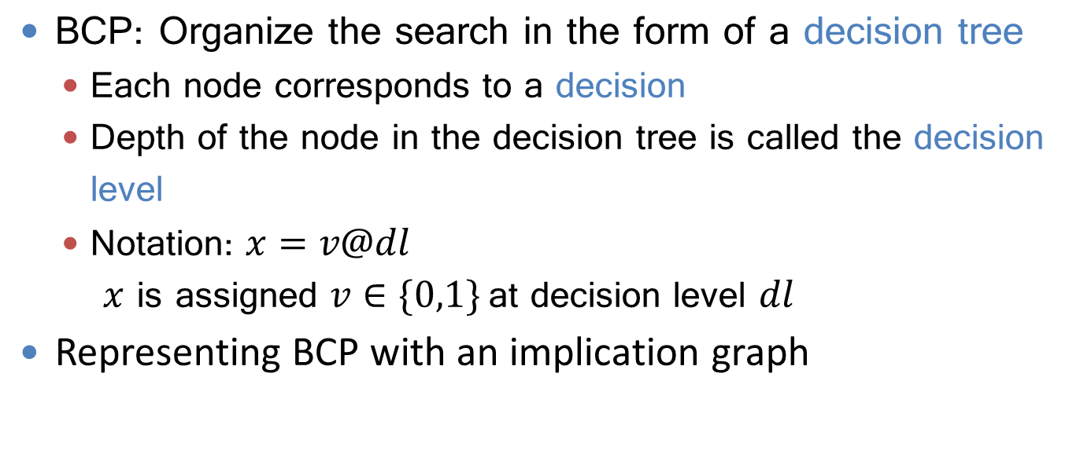
Boolean Constraint Propagation (BCP)
BCP: Organize the search in the form of a decision tree
Each node corresponds to a decision
Depth of the node in the decision tree is called the decision level
Notation: $x=v@dl$ $x$ is assigned $v∈\{0,1\}$at decision level $dl$
Representing BCP with an implication graph

Slide 38
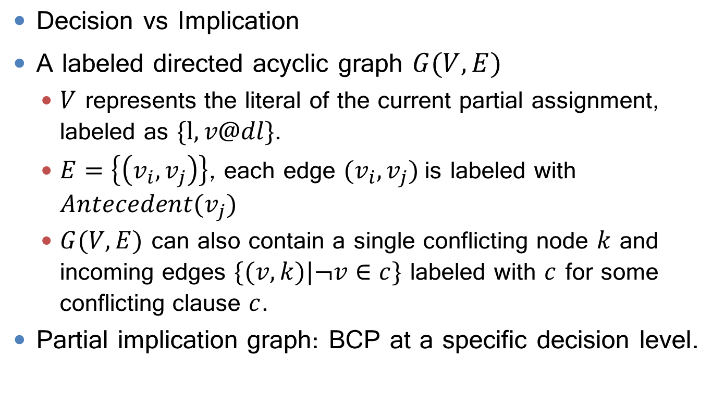
Implication Graph
Decision vs Implication
A labeled directed acyclic graph $G(V,E)$
$V$ represents the literal of the current partial assignment, labeled as $\{l,v@dl\}$.
$E=\left\{\left(v_{i},v_{j}\right)\right\}$, each edge ${(v}_{i},v_{j})$is labeled with $Antecedent(v_{j})$
$G(V,E)$ can also contain a single conflicting node $k$ and incoming edges $\{(v,k)|¬v∈c\}$ labeled with $c$ for some conflicting clause $c$.
Partial implication graph: BCP at a specific decision level.

Slide 39
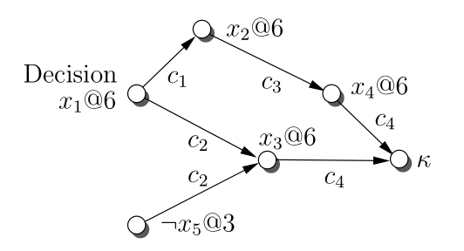
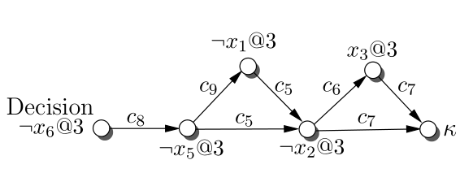









An example
$$c_{1}=(¬x_{1}{⋁x}_{2})$$
$$c_{2}=(¬x_{1}{⋁x}_{3}{⋁x}_{5})$$
$$c_{3}=(¬x_{2}{⋁x}_{4})$$
$$c_{4}=(¬x_{3}{⋁¬x}_{4})$$
$$c_{5}=(x_{1}{⋁x}_{5}{⋁¬x}_{2})$$
$$c_{6}=(x_{2}{⋁x}_{3})$$
$$c_{7}=(x_{2}{⋁¬x}_{3})$$
$$c_{8}=(x_{6}{⋁¬x}_{5})$$
$$c_{9}=(x_{5}{⋁¬x}_{1})$$

Slide 40
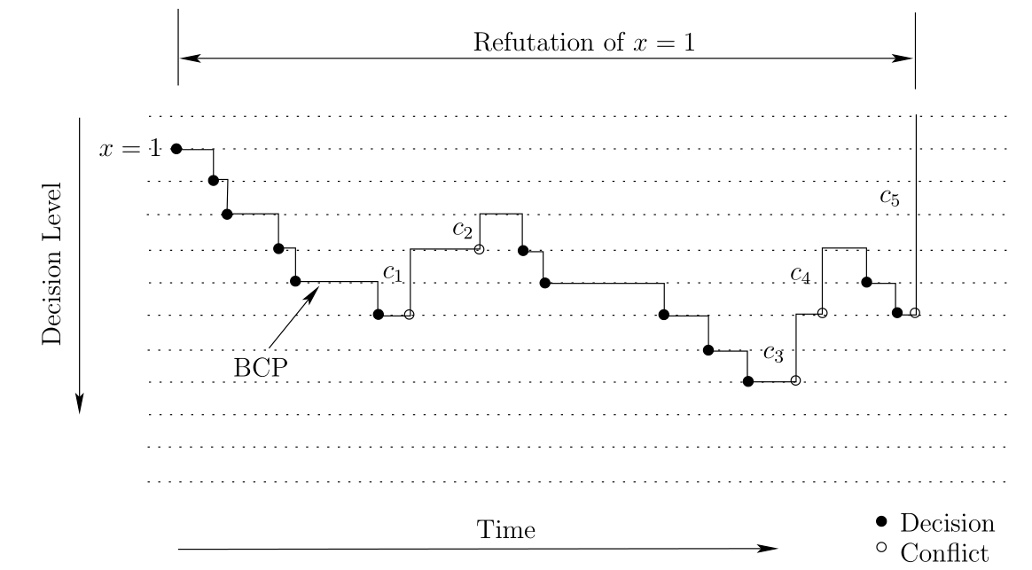
Process of Conflict-Driven Backtracking

Slide 41
Decision Heuristics
Which Literal to Choose
Jeroslow-Wang
This strategy gives higher priority to literals that appear frequently in short clauses
Dynamic Largest Individual Sum (DLIS)
Choose unassigned literal that satisfies the largest number of currently unsatisfied clauses.
Clause-based Heuristics
Literals in recent conflict clauses has absolute priority.

Slide 42




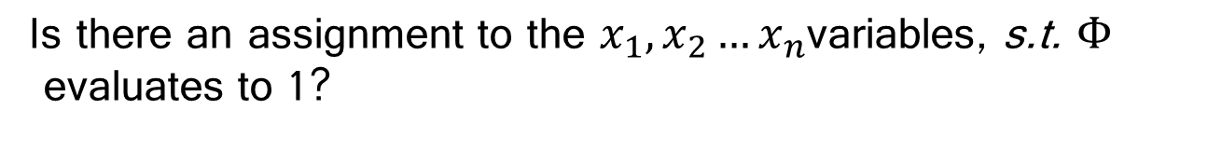

Propositional Logics with Predicates
p₁
$$x_{1}=x_{2}$$
v
p₂
$$x_{1}+x_{3}≥1$$
ᴧ
¬
$$Φ$$
.
.
.
ᴧ
$$x_{4} \& 0xFF=x_{1}$$
v
v
p_{n}
$$x_{1}\%26=x_{n}$$
Is there an assignment to the $x_{1},x_{2}…x_{n}$variables, s.t. $Φ$
evaluates to 1?

Slide 43
More Examples
Equalities
$(x_{1}=x_{2}⋁x_{1}=x_{3})⋀$ $(x_{1}=x_{2}⋁x_{1}=x_{4})⋀x_{1}≠x_{2}⋀x_{1}≠x_{3}⋀x_{1}≠x_{4}$
Linear predicates
$${(x}_{1}+2x_{3}<5)⋁¬\left(x_{3}≤1\right)$$
Arrays
$$(i=j⋀a\left[j\right]=1)⋀¬\left(a\left[i\right]=1\right)$$

Slide 44
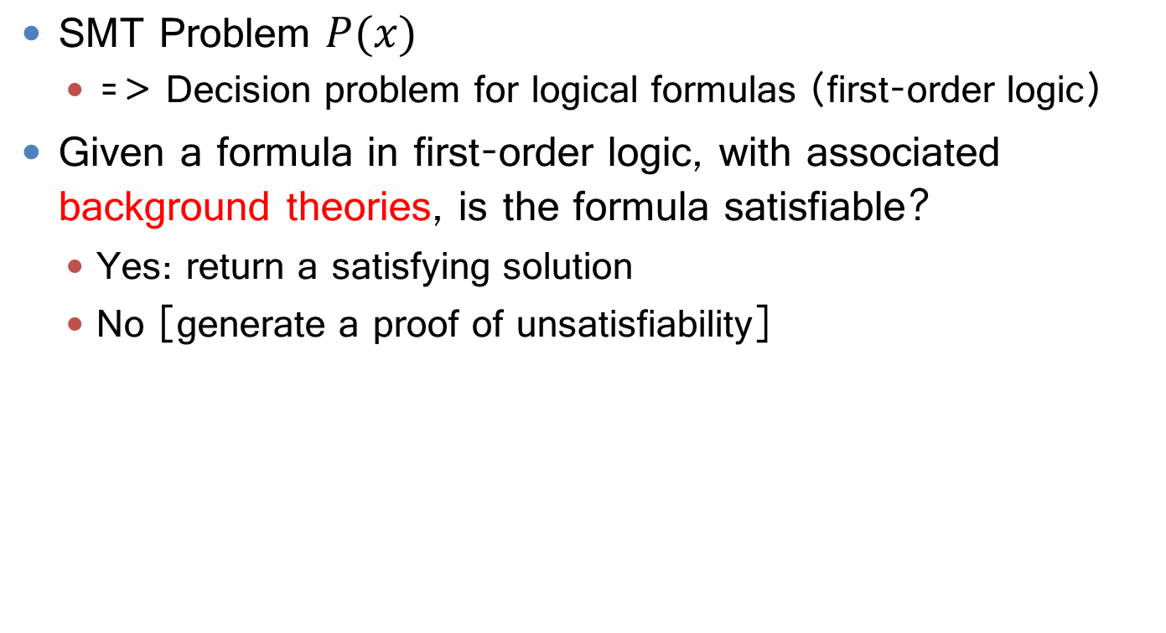
Satisfiability Modulo Theories
SMT Problem $P(x)$
=> Decision problem for logical formulas (first-order logic)
Given a formula in first-order logic, with associated background theories, is the formula satisfiable?
Yes: return a satisfying solution
No [generate a proof of unsatisfiability]

Slide 45
Eager Methods vs Lazy Methods
Input Formula
Eager Methods
Convert SMT problem into an equisatisfiable SAT problem
Example theories: bitvectors, array…
Lazy Methods
Close integration of a SAT solver and decision procedures
Example theories: LOD
Equisatisfiable Boolean Encoder
Boolean Formula
SAT Solver
satisfiable
unsatisfiable
EAGER ENCODING

Slide 46
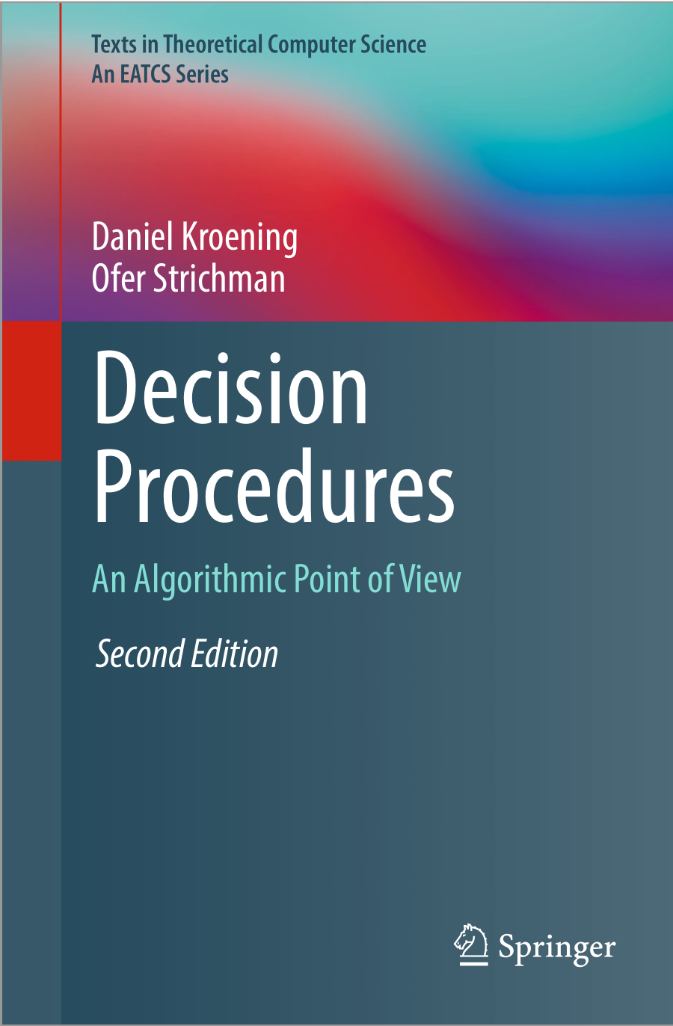

Reference

Slide 47
Backup Slides

Slide 48
Analyze Conflict
Analyzing Conflict Algorithm
Input:
Output: Backtracking decision level + a new conflict clause
if current-decision-level = 0 then
return 1;
cl := current-conflicting-clause;
while(!STOP-CRITERION-MET(cl)) do //usually the fist UIP ()
literal := LAST-ASSIGNED-LITERAL(cl);
variable:= VARIABLE-OF-LITERAL(literal);
ante := ANTECEDENT(literal);
cl := RESOLVE(cl, ante, variable);
add-clause-to-database(cl);
return clause-asserting-level(cl);

Slide 49
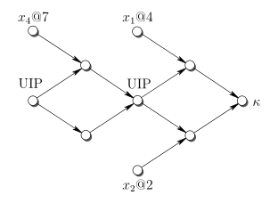



Analyze Conflict
Stop Criterion
$$(¬l_{1}⋁¬x_{1}{⋁¬x}_{2})$$
$$(¬l_{2}⋁¬x_{1}{⋁¬x}_{2}{⋁¬x}_{4})$$
Resolution
$$\frac{\left(a_{1}⋁…⋁a_{n}⋁β\right) (b_{1}⋁…⋁b_{n}⋁¬β)}{\left(a_{1}⋁…⋁a_{n}⋁b_{1}⋁…⋁b_{n}\right)}$$

Slide 50
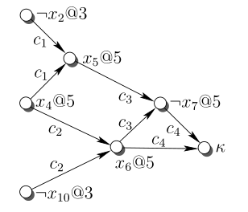
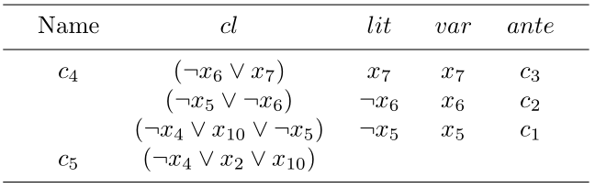




Case Study
$$c_{1}=(¬x_{4}{⋁x}_{2}{⋁x}_{5})$$
$$c_{2}=(¬x_{4}{⋁x}_{10}{⋁x}_{6})$$
$$c_{3}=(¬x_{5}{⋁¬x}_{6}{⋁¬x}_{7})$$
$$c_{4}=(¬x_{6}{⋁x}_{7})$$
lit := LAST-ASSIGNED-LITERAL(cl);
var:= VARIABLE-OF-LITERAL(lit);
ant := ANTECEDENT(lit);
cl := RESOLVE(cl, ant, var);

Slide 51
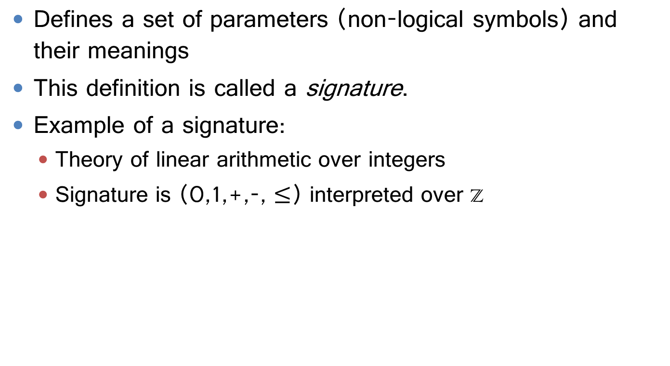
Logical Theory
Defines a set of parameters (non-logical symbols) and their meanings
This definition is called a signature.
Example of a signature:
Theory of linear arithmetic over integers
Signature is (0,1,+,-, $≤$) interpreted over Z

Slide 52
Quantifier-free Subset of FOL
Constants Z, FudanU,...
Predicates >, Student,...
Functions Sqrt, LeftLegOf,...
Variables x, y, a, b,...
Connectives ¬, ⇒, ∧, ∨, ⇔
Equality =
Quantifiers ∀, ∃
Propositional Logic (SAT)
First-order Logic (SMT)

