Slide 1

Fuzz Testing
COMP130159.01
XU, Hui
xuh@fudan.edu.cn
May 23, 2020

Slide 2
1. Background

Slide 3


Monkey for Android Testing
900
(0,0)
X
1600
#：adb shell monkey -p com.myapp --throttle 500 -v 1000
Y
-p: package name
-s <seed>: seed
--throttle <millisecond>: interval between two events
--randomize-throttle
--pct-touch<percent>: percentage of touch events
--pkg-blacklist-file PACKAGE_BLACKLIST_FILE
…

Slide 4
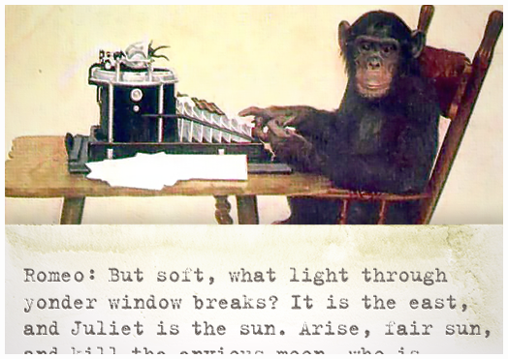
The Infinite Monkey Theorem
“A monkey hitting keys at random on a typewriter keyboard will produce any given text, such as the complete works of Shakespeare, with probability approaching 1 as time increases.”

Slide 5
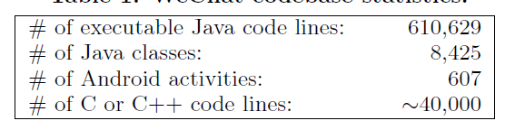
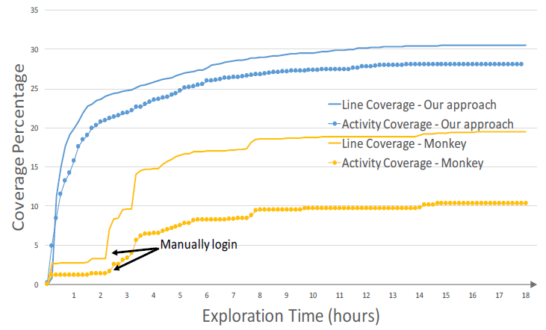
WeChat Fuzzing
LoC in WeChat v6.3.15
Xia Zeng, et al. "Automated Test Input Generation for Android: Are We Really There Yet in an Industrial Case?." FSE 2016.

Slide 6
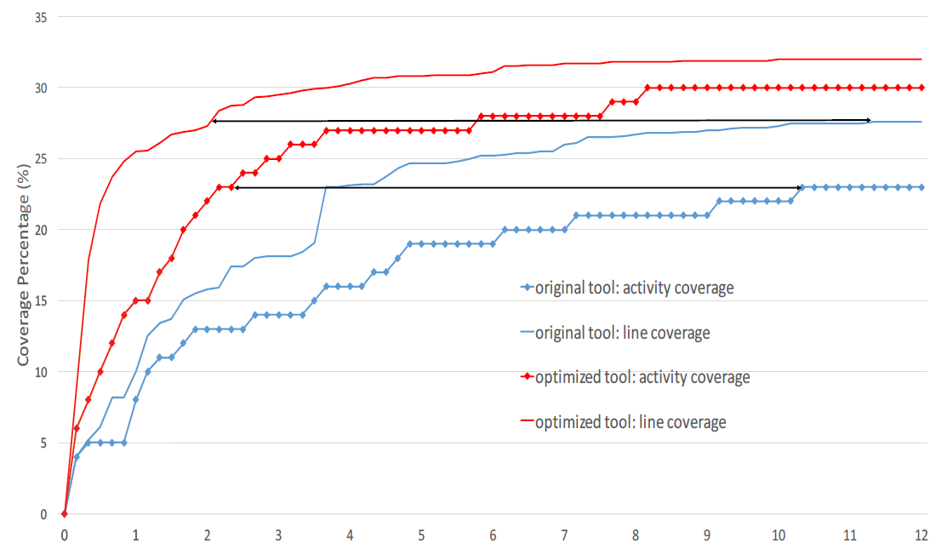
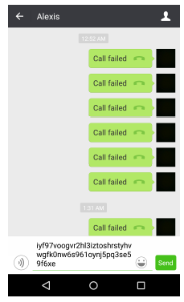
Optimized WeChat Fuzzing
UI recognition
Stateful: duplication avoidance
Zheng, Haibing, et al. "Automated test input generation for Android: Towards getting there in an industrial case." ICSE 2017.

Slide 7
Functionality Testing vs Security Testing
Normal testing will look at right, wanted behaviour for sensible inputs (aka the happy flow), and some inputs on borderline conditions
Security testing also requires looking for the wrong, unwanted behaviour for really strange inputs
Similarly, normal use of a system is more likely to reveal functional problems than security problems:
users will complain about functional problems, hackers won't complain about security problems

Slide 8
Security Testing is HARD
space of all possible inputs
.
.
.
input that triggers
security bug
normal inputs
.
.
.
.
.
.
.
.

Slide 9
Simple fuzzing ideas
What inputs would you use for fuzzing?
very long or completely blank strings
max. or min. values of integers, or simply zero and negative values
depending on what you are fuzzing, include special values, characters or keywords likely to trigger bugs, e.g,
nulls, newlines, or end-of-file characters
format string characters
semi-colons, slashes and backslashes, quotes
application specific keywords: DROP TABLES, ...

Slide 10
2. Blackbox Fuzzing
Throw random garbage to programs and make them crash . . . in interesting ways
American Fuzzy Lop (美种费斯垂耳兔、猫猫兔)

Slide 11
Evolutionary Fuzzing with afl
afl (American Fuzzy Lop) takes an evolutionary approach to learn interesting mutations based on measuring code coverage
Basic idea: if a mutation of the input triggers a new execution path through the code, then it is an interesting mutation & it is kept; if not, the mutation is discarded.
By trying random mutations of the input and observering their effect on code coverage, afl can learn what interesting inputs are.
http://lcamtuf.coredump.cx/afl/

Slide 12
Moral of the Story
If you ever produce code that handles some non-trivial input format, run a tool like afl to look for bugs

Slide 13
Overall Algorithm
Init: load user-supplied initial test cases into the queue
Load: take next input file from the queue
Trim: attempt to trim the test case to the smallest size that doesn’t alter the measured behavior of the program
Mutate: repeatedly mutate the file using a balanced and well-researched variety of traditional fuzzing strategies
Score: if any of the generated mutations resulted in a new state transition recorded by the instrumentation, add mutated output as a new entry in the queue
The discovered test cases are also periodically culled to eliminate ones that have been obsoleted by newer, higher-coverage finds
https://lcamtuf.coredump.cx/afl/technical_details.txt

Slide 14
Instrumentation
Supports programs
written in C/C++/Objective C
variants for Python/Go/Rust/OCaml
Code instrumented to observe execution paths:
if source code is available, by using modified compiler
if source code is not available, by running code in an emulator
Code coverage represented as a 64KB bitmap, where control flow jumps are mapped to changes in this bitmap
different executions could result in the same bitmap, but chance is small
http://lcamtuf.coredump.cx/afl

Slide 15
Sample of Compiled Code
Source code: inject at every branch point in the code
Intuition: for every jump from src to dest in the code a different byte in shared_mem is changed.
This byte is determined by the compile time randoms inserted at source and destination.
cur_location = <COMPILE_TIME_RANDOM_FOR_THIS_CODE_BLOCK>;
shared_mem[cur_location ⨁ (prev_location >> 1)]++,
where shared_mem is a 64 KB memory region;

Slide 16
For Binaries
cur_location = (block_address >> 4) ⨁ (block_address << 8);
shared_mem[cur_location ⨁ (prev_location >> 1)]++,
where shared_mem is a 64 KB memory region;
31
20
4
0
31
⨁
0
0~20

Slide 17
More about the Design
Branch cnt | Colliding tuples | Example targets
------------+------------------+-----------------
1,000 | 0.75% | giflib, lzo
2,000 | 1.5% | zlib, tar, xz
5,000 | 3.5% | libpng, libwebp
10,000 | 7% | libxml
20,000 | 14% | sqlite
50,000 | 30% | -
Edge Coverage
A -> B -> C -> D -> E
(tuples: AB, BC, CD, DE)
Why shift 1 bit? To differentiate edges.
Block A
Block A
Block B
Block B
Case 1
Block A -> Block B
Block B -> Block A
Case 2
Block A -> Block A
Block B -> Block B

Slide 18
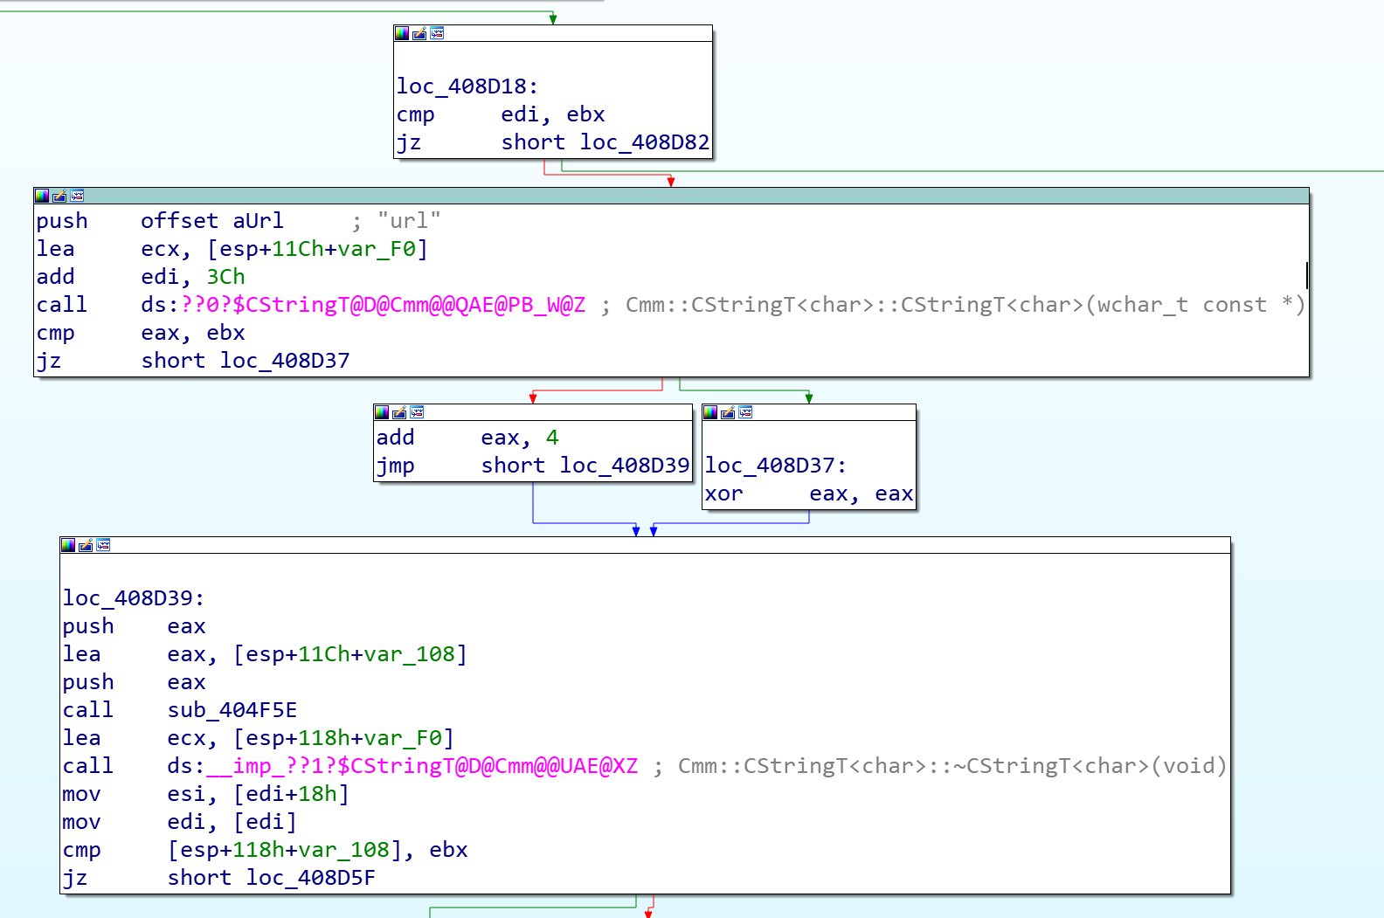
Visualize Bitmap
 | 1
 |  |  |  |  |  | 2
 |  |  |  | 1
 |  | 1 |  |  |  | 1
Bitmap (64KB)
Why 64KB?
Collision
Efficiency
Shuitao Gan, et al, CollAFL: Path Sensitive Fuzzing, Orkland’18

Slide 19
Mutation Strategies
No need to specify the input format!
Bit flip
Increase/decrease integers
Use predefined interesting integer values (eg., 0, -1, MAX_INT,...)
Delete/combine/zero input block
The AFL forks the Software Under Test to quickly process lots of test cases

Slide 20
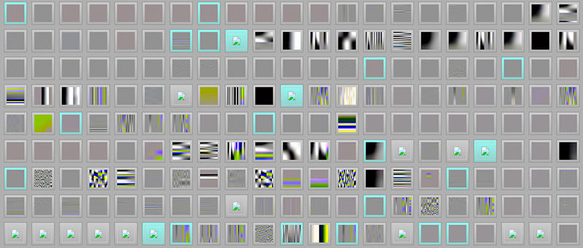
Example: Learning the JPG file format
Fuzzing a program that expects a JPG as input, starting with 'hello world' as initial test input,
Not a JPEG file: starts with 0x68 0x65
Not a JPEG file: starts with 0xff 0x65
Premature end of JPEG file
Invalid JPEG file structure: two SOI markers
Quantization table 0x0e was not defined
The first image, hit after about six hours on an 8-core system, looks very unassuming . . . But the moment it is discovered, the fuzzer starts using the image as a seed - rapidly producing a wide array of more interesting pics
https://lcamtuf.blogspot.it/2014/11/pulling-jpegs-out-of-thin-air.html
Notes:
http://lcamtuf.blogspot.nl/2014/11/pulling-jpegs-out-of-thin-air.html

Slide 21
3. Whitebox Fuzzing
SAGE: Symbolic Execution with Fuzzing
Godefroid, et al."Automated Whitebox Fuzz Testing." NDSS 2008.

Slide 22
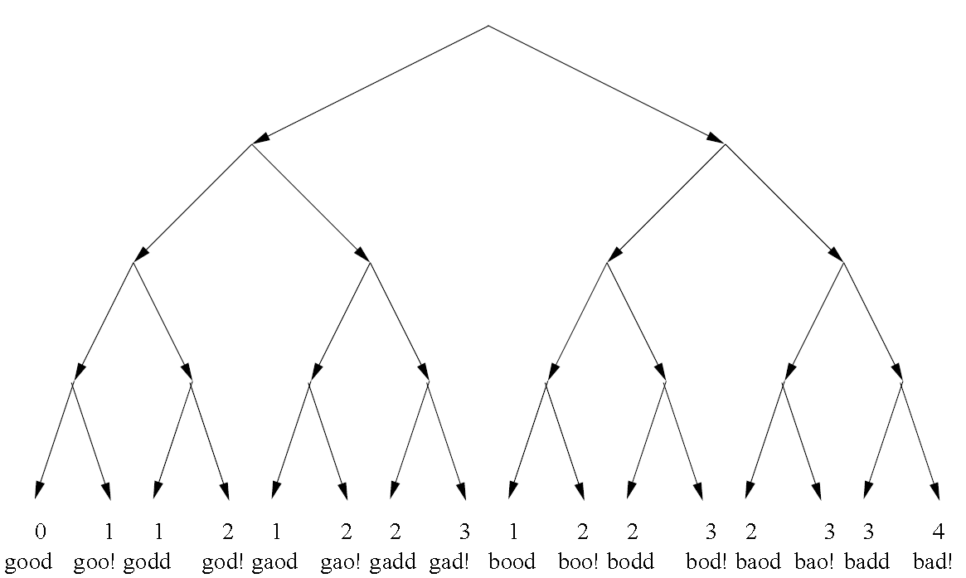
Traversal of the Computation Tree
void top(char input[4]) {
int cnt=0;
if (input[0] == ’b’) cnt++;
if (input[1] == ’a’) cnt++;
if (input[2] == ’d’) cnt++;
if (input[3] == ’!’) cnt++;
if (cnt >= 3) abort(); // error
}

Slide 23
Hard Problems for Symbolic Execution
Math problems or crypto functions:
void test_me(int x) {
// c = product of two large primes
if (pow(2,x) % c == 17) {
print(“something bad”);
ERROR;
} else
print(“OK”);
}
Discrete logarithm problems are computationally intractable on classical computers.

Slide 24
Hard Problems for Symbolic Execution
Floating point issues
int logic_bomb(int x) {
float a = x/70.0;
float b = 0.1;
if(a != 0.1){ //this is constantly true
if(a - b == 0)
return BOMB_ENDING;
}
return NORMAL_ENDING;
}
Reversing floating pointer arithmatic is difficult.

Slide 25
Hard Problems for Symbolic Execution
Alias analysis problems
int logic_bomb(int i) {
int j = abs(i%11);
int a[] = {(i+5)%11,(i+6)%11,(i+7)%11,(i+8)%11,(i+9)%11,
(i+10)%11,i%11,(i+1)%11,(i+2)%11,(i+3)%11,(i+4)%11};
int* p = &a[a[a[j]]];
int* q = &a[a[a[a[a[*p]]]]];
if(p == q){
return BOMB_ENDING;
}
else
return NORMAL_ENDING;
}

Slide 26
Why Fuzzing
Imperfect symbolic execution.
Divergence: the actual path does not match the path predicted by symbolic execution
Reason: symbolic execution is bounded to imprecise due to complex program statements, e.g.,
crypto functions,
alias analysis,
floating-point arithmetic,
external function calls.
When symbolic execution is impossible, we may
use concrete values to simplify constraint models (partial symbolic execution).
use random input as concrete values.

Slide 27
Generational Search of SAGE
Systematically yet partially explore the state spaces of large applications executed with large inputs (thousands of symbolic variables) and with very deep paths (hundreds of millions of instructions);
Maximize the number of new tests generated from each symbolic execution (which are long and expensive in our context) while avoiding any redundancy in the search;
Uses heuristics to maximize code coverage as quickly as possible, with the goal of ﬁnding bugs faster;
Be resilient to divergences: whenever divergences occur, the search is able to recover and continue.

Slide 28
Intuition
Generate multiple child inputs in one symbolic execution round
Evaluate and prioritize child inputs before symbolic execution

Slide 29
Search Algorithm of SAGE
Search(inputSeed){
inputSeed.bound = 0; //an offset for symbolic execution
workList = {inputSeed};
Run&Check(inputSeed);
while (workList not empty) {//new children input = PickFirstItem(workList);
childInputs = ExpandExecution(input);
while (childInputs not empty) {
newInput = PickOneItem(childInputs);
Run&Check(newInput);
Score(newInput);//# of new blocks triggered
workList = workList + newInput;
}
}
}

Slide 30
Search Algorithm of SAGE
ExpandExecution(input) {
childInputs = {};
// symbolically execute (program,input)
PC = ComputePathConstraint(input);
for (j=input.bound; j < |PC|; j++) {
if((PC[0..(j-1)] and not(PC[j])) has a solution I){
newInput = input + I;
newInput.bound = j;
childInputs = childInputs + newInput;
}
return childInputs;
}

Slide 31
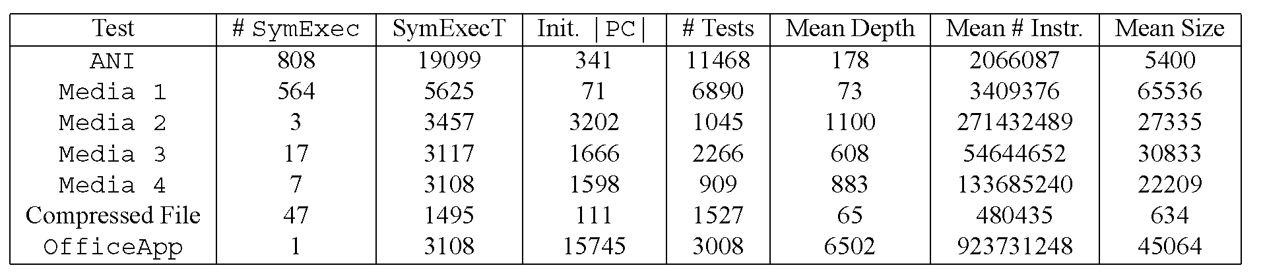
Performance of SAGE
Statistics from 10-hour searches on seven test applications,
Each seeded with a well-formed input ﬁle.
#SymExec: number of symbolic execution tasks during the search
SymExecT: total time (in seconds) spent in symbolic execution tasks
Init. |PC|: number of constraints generated from the seed ﬁle
#Tests: total number of test cases generated
Mean depth: mean depth per test case in number of constraints
Mean #Instr.: mean number of instructions executed after reading the input ﬁle,
Mean Size: mean size of the symbolic input in bytes.

Slide 32
Conclusions
Fuzzing is a great technique to find security flaws.
Challenge of fuzzing: randomness with smartness.
Successful approaches include
Blackbox evolutionary mutation-based fuzzing with afl
White-box fuzzing based on symbolic execution with SAGE

