Slide 1
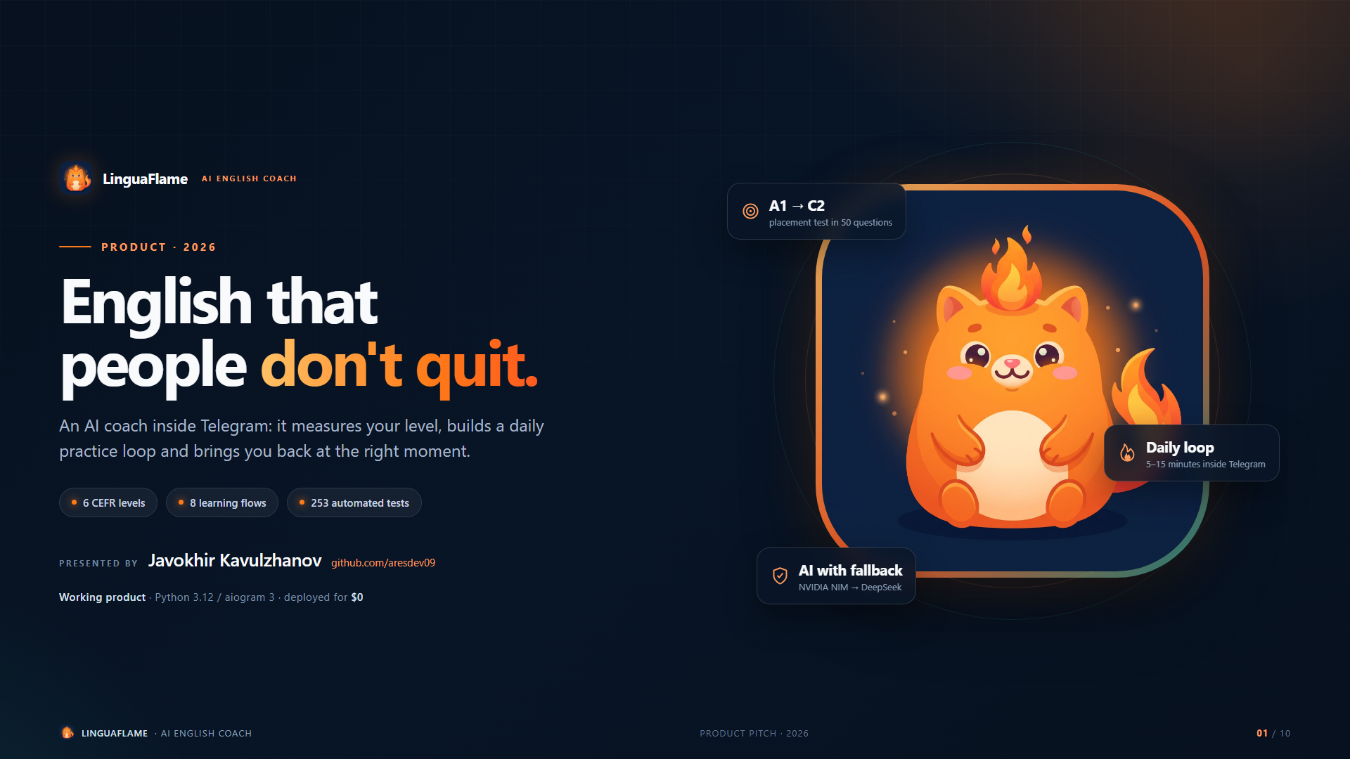
Notes:
LinguaFlame is an AI English coach in Telegram that measures the level, drives daily practice and brings the learner back.

Slide 2
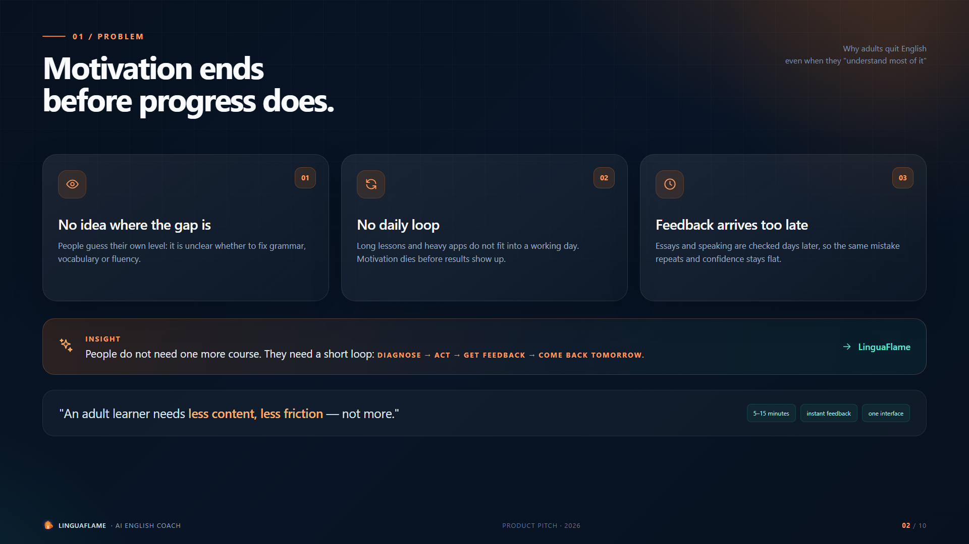
Notes:
There is plenty of content but no loop: people cannot see their gap, do not get fast feedback, and quit.

Slide 3
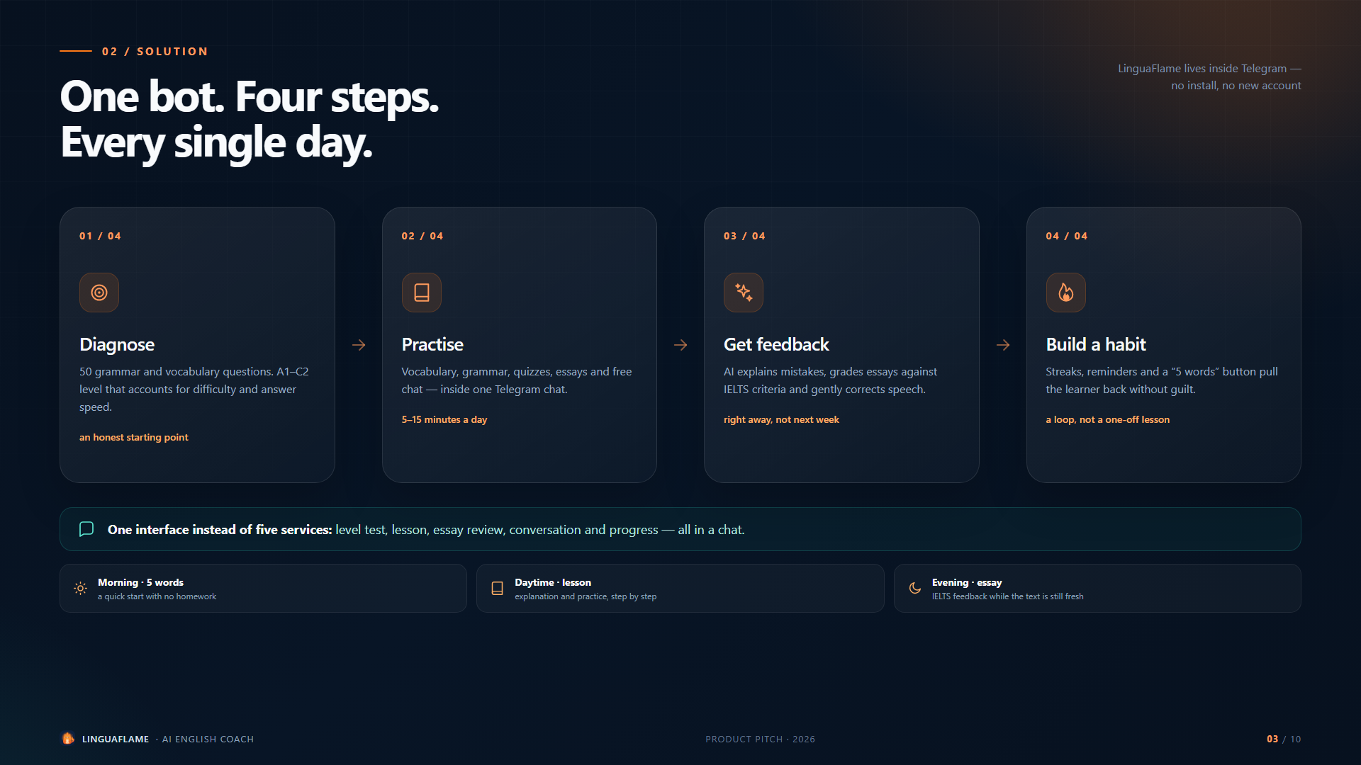
Notes:
Four steps - diagnose, short practice, feedback, habit - inside a single Telegram bot.

Slide 4
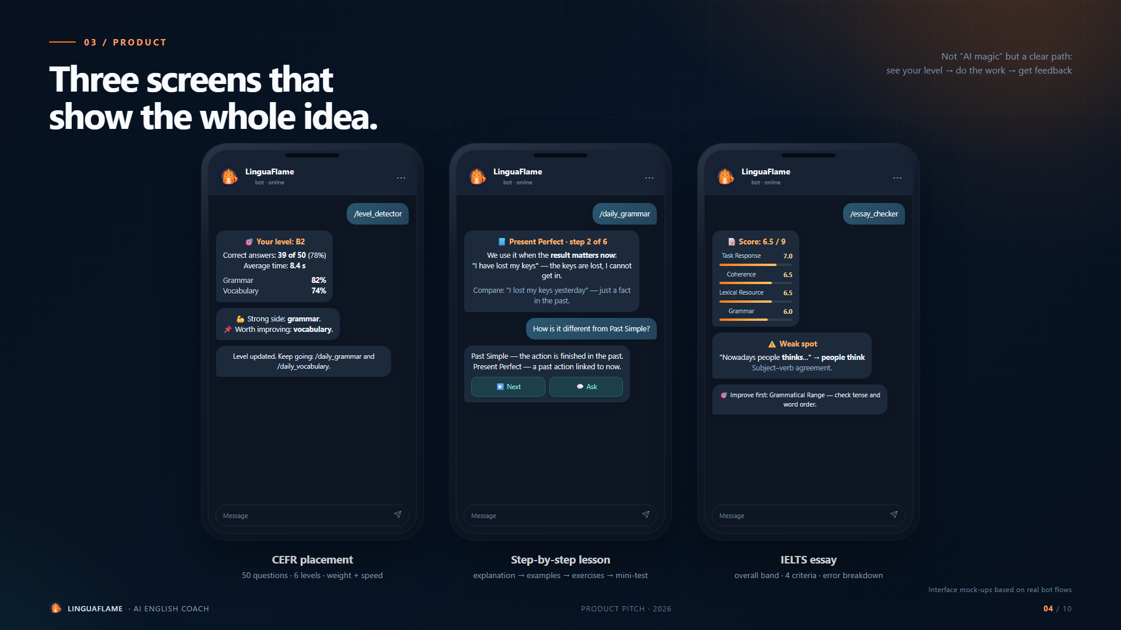
Notes:
Three key screens: the CEFR result, the step-by-step lesson and the IELTS essay review.

Slide 5
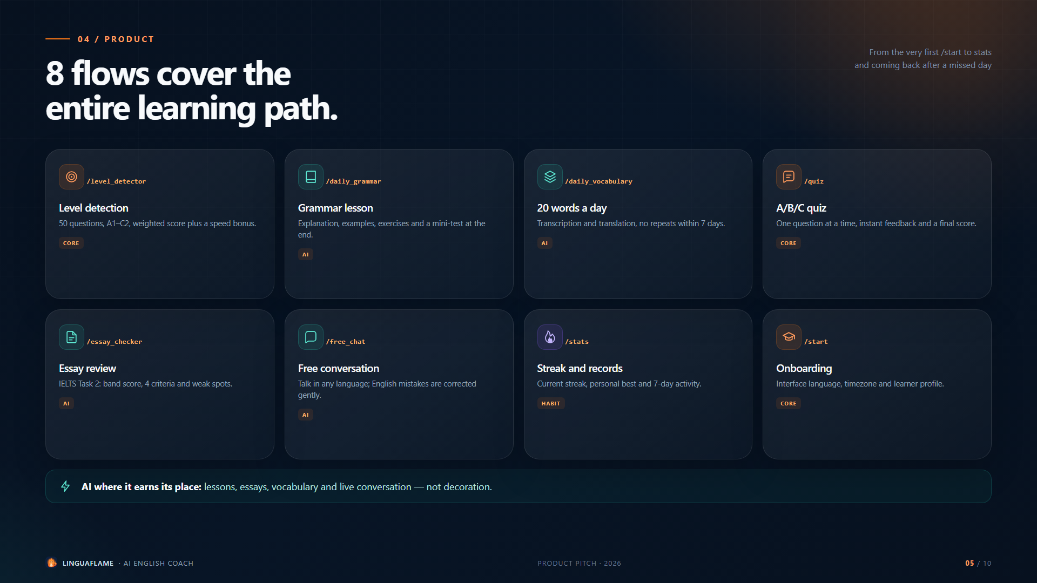
Notes:
Eight flows cover the whole path - from onboarding to stats and returning after a missed day.

Slide 6
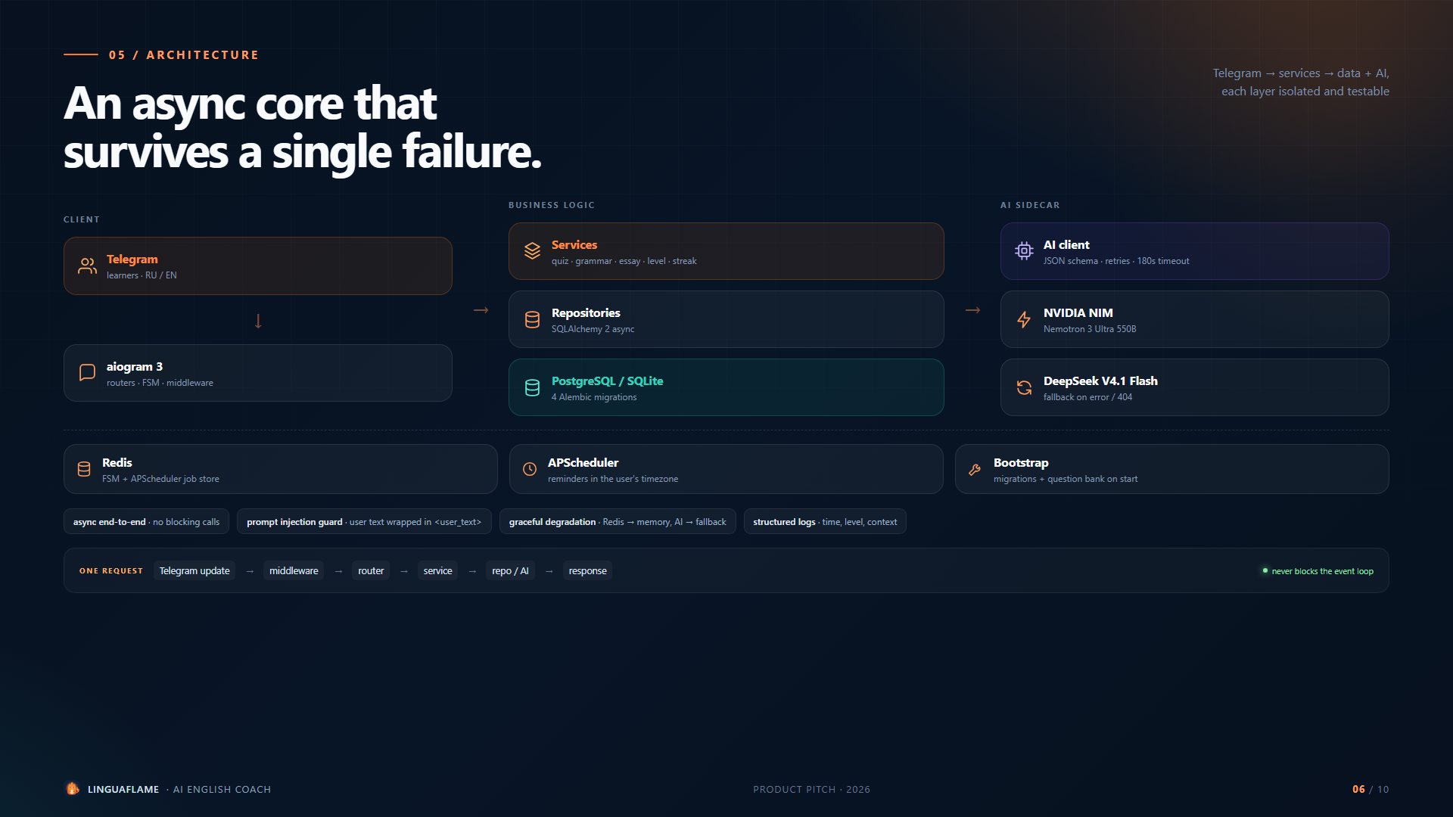
Notes:
Async layers, PostgreSQL, Redis, APScheduler and an AI client with fallback. Every layer is testable on its own.

Slide 7
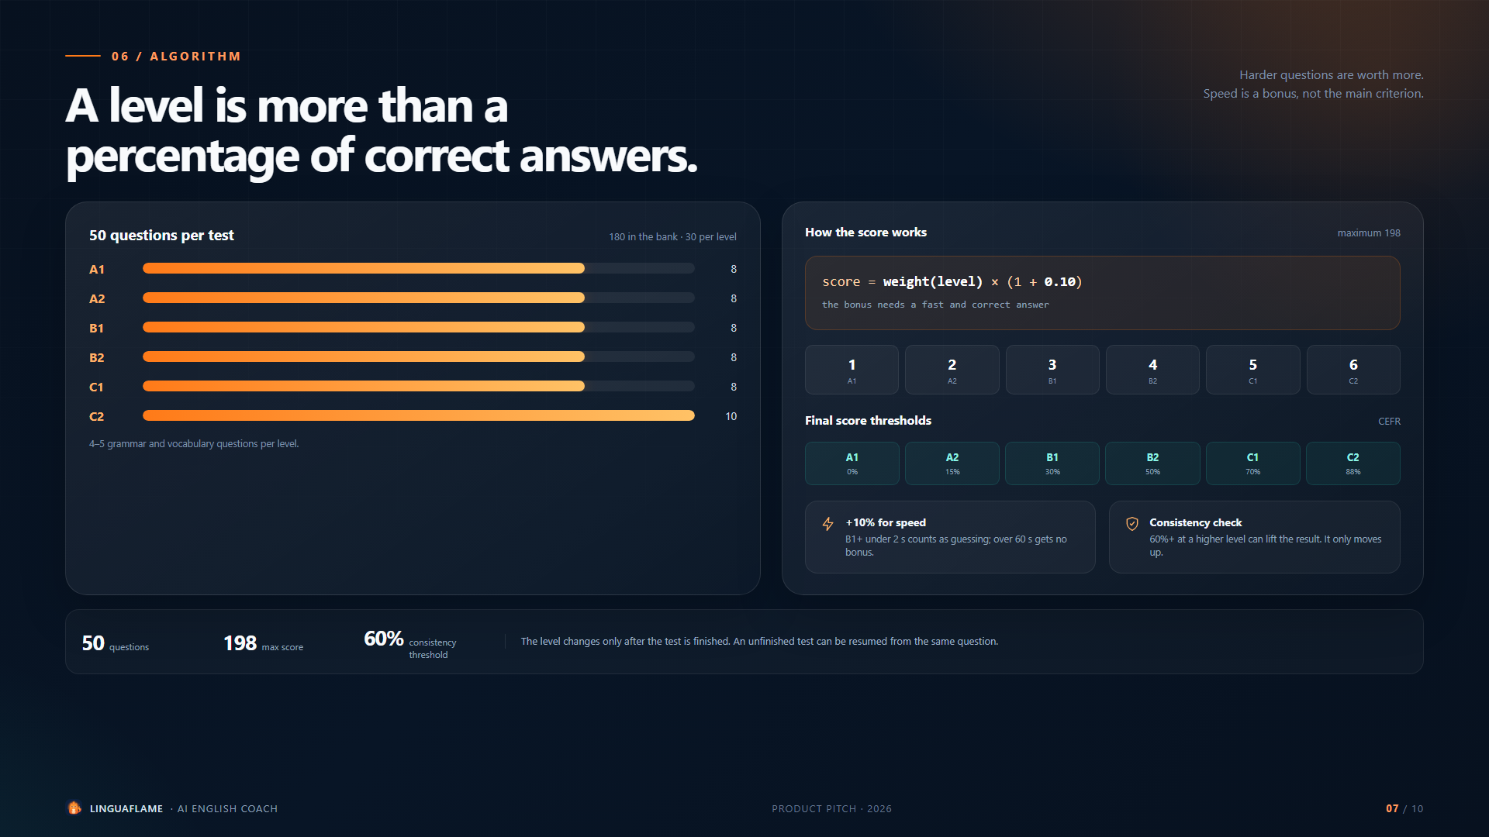
Notes:
The level uses a weighted score: harder questions are worth more, speed adds a bonus, consistency can lift the result.

Slide 8
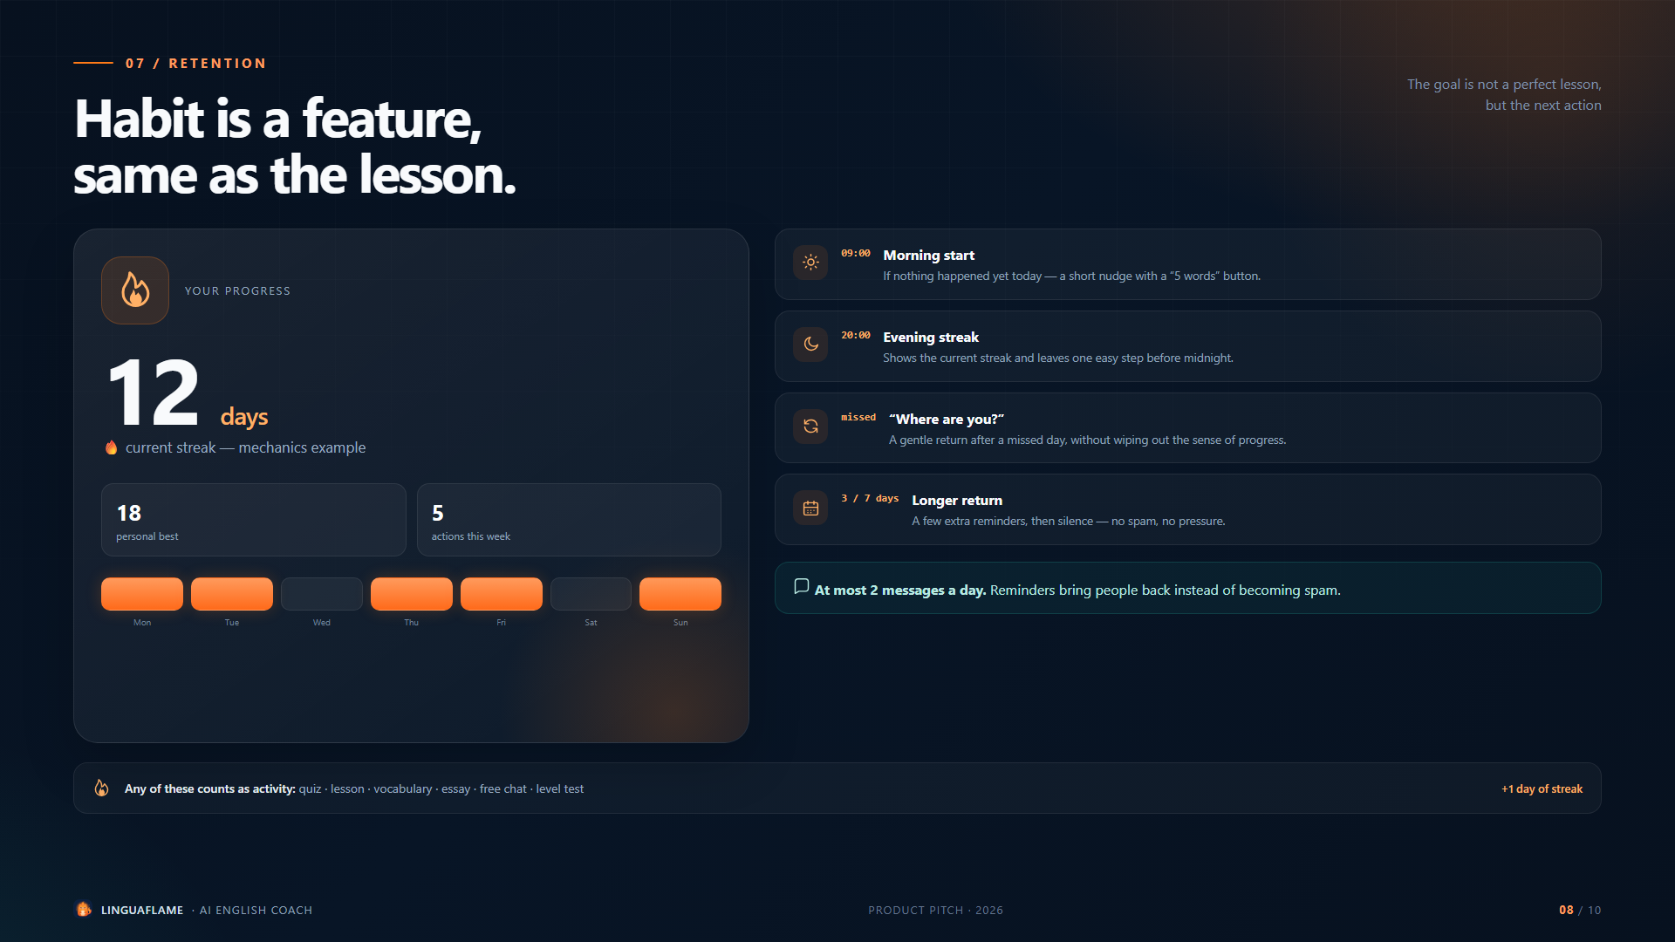
Notes:
Streaks and reminders are built around the next action, not around a perfect lesson. At most two messages a day.

Slide 9
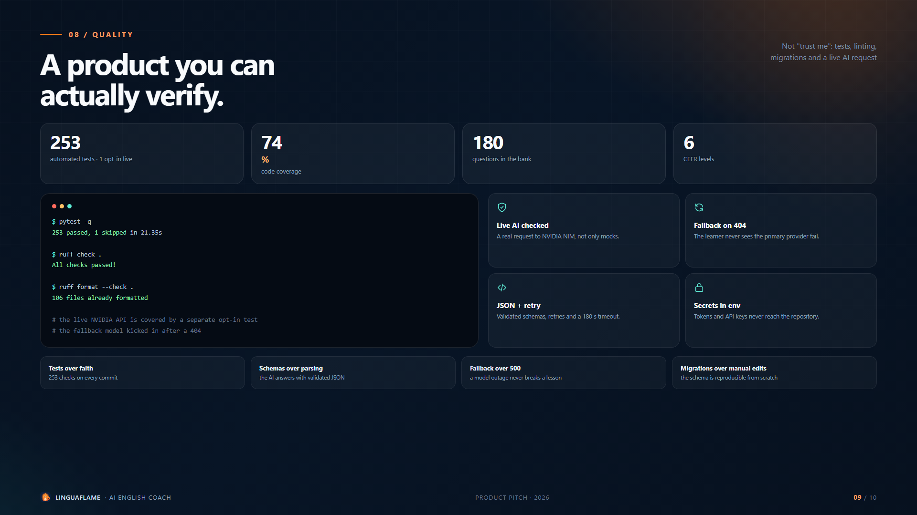
Notes:
253 tests, 74% coverage, Ruff, Alembic migrations and a verified live request to NVIDIA NIM.

Slide 10
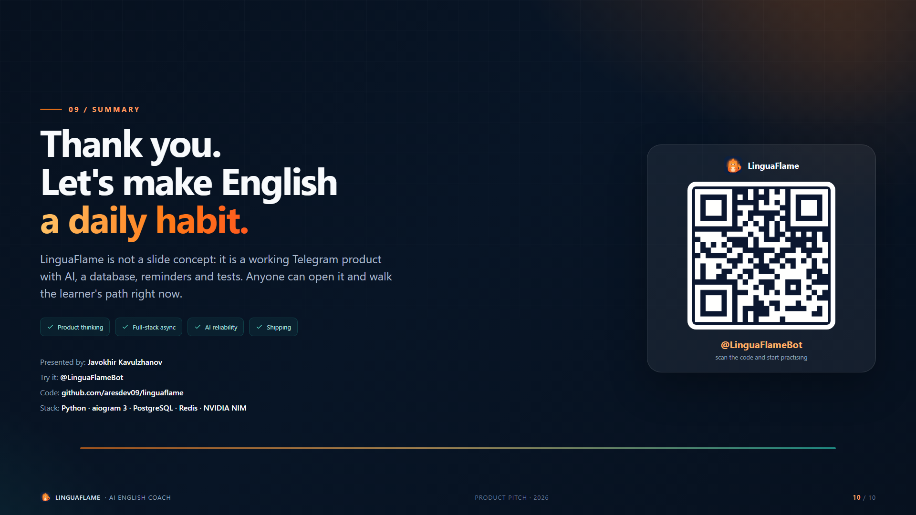
Notes:
A working product that can be opened in Telegram and walked through as a learner.

