Slide 1
Methodology
In 2013, the donation threshold for assigning a donor to a relationship manager was lowered from $2,500 to $1,000. To begin assessment in the effectiveness of this strategy, the initial step of ETL: Extract, Transform, Load was performed to prepare the data for analysis. Additionally, it was important to start mapping the research strategy and what variables will help to assess donor loyalty and revenue growth.
1
Extract: read the data by loading the csv to “Pandas” Python Library
Transform: Pandas allowed me to clean and structure the data as needed to answer my research questions
Load: All data was sent to SQL – a relational database for storage
Some of my research questions include,
Total Revenue: What is the total revenue amount every year? Did the amount increase or decrease after 2013? How was revenue prior the change in threshold amount?
Dollar Retention: What is the annual dollar retention rate?
Percent Change: What is the percent change of revenue every year?
Donations: Did the number of donations increase? Or, did the dollar amount of donations increase?
Donor Retention: What is the annual donor retention rate ? Did the total number of donors per year increase? Or Decrease?
2
3
Cohort Analysis: For the purpose of this assessment, the Revenue Data from 2010 to 2017 was placed into cohorts to unpack each year individually to find out the total revenue amount, total number of donations, percent change in revenue, customer retention rate, and dollar retention rate. Additionally, I used cohorts to split gift amounts into different gift group ranges to see potential fluctuation in numbers.
GitHub Link

Slide 2
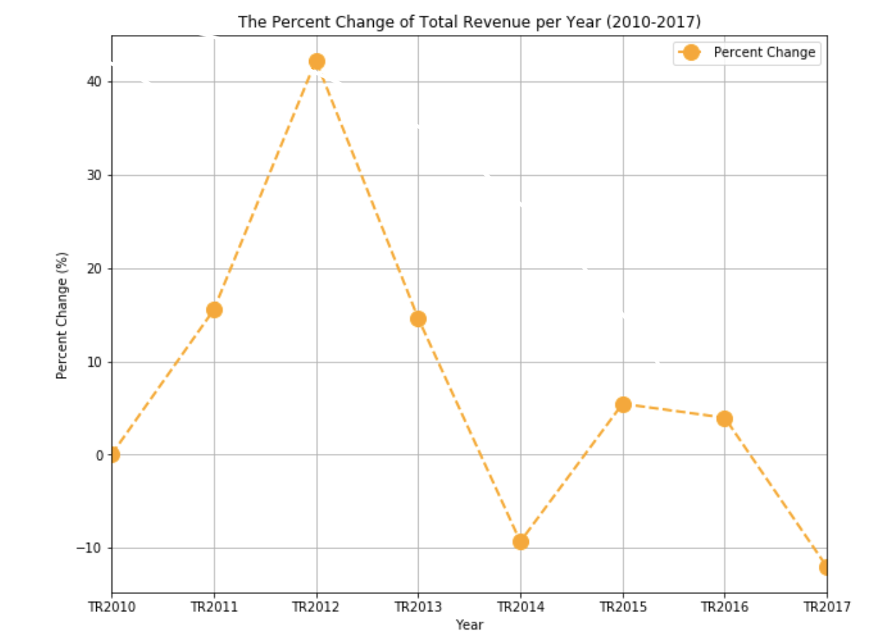
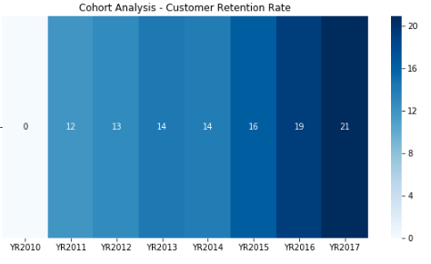
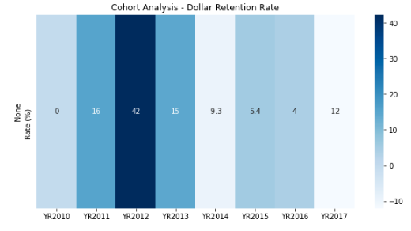
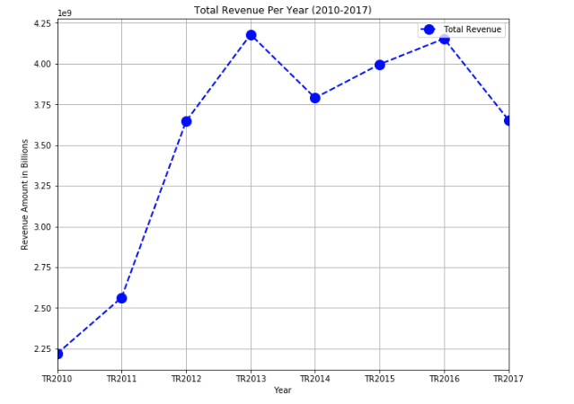
Results
Revenue growth was evident throughout all the years except 2014, when the revenue total of $3.7 Billion was reported lower than during 2013 in the amount of $4.2Billion (after the donation threshold decrease).
For 2014, the percent change in revenue amount was -9.33% while for 2013, it was 14.63% and 42.26% for 2012.
Customer Retention Analysis revealed that the retention rate has been increasing since 2011 and only continued to increase at a faster rate after 2013.
Dollar Retention Analysis showed that Year 2012 had the highest dollar retention rate of 42% while it was -9.3% in 2014. During 2017, dollar retention rate is showed to drastically drop to -12% despite strong customer retention rate
Year2010 reported to have the highest number of accounts who did not give a donation followed by the year of 2011 and 2013. In addition, the number of gifts of less than $1,000 continued to increase every year except 2013.
GitHub Link

Slide 3
Recommendations
Based on the results of the analysis, the strategy shows to have a positive affect on strengthening donor loyalty. Assigning a relationship manager to a donor encourages people to continue their relationship with the foundation.
However, the analysis also revealed that the dollar retention rate has been fluctuating, meaning that some accounts either lower their gift amounts or decide to not donate overall.
Other points for analysis to consider,
Measure Dollar Retention Rate per Year by distributing amounts within Cohorts
Analyze accounts individually to see potential fluctuation in gift sizes per year. Find accounts who continue to increase their gift size and accounts who continue to decrease the amount
Measure how many accounts gave a gift one year, but opt out in the next
Unpack the existing cohorts and the amounts within by creating additional bins
Dollar Retention Strategy:
Create a membership program that offers incentives or special perks in exchange for donor’s charitable contribution
Different variety of special perks, event access and activities are unlocked depending on the size of the donor’s donation
Host donor stewardship events to invite donors to learn about MJFF’s future and current projects, learn on new developments, interact with the foundation personally and provide an opportunity for an additional donation towards the project of their choice.
Show people that they have a voice of where their donation is going towards to by updating them via email or newsletter, or allowing them to be more involved in the process
GitHub Link

