Slide 1
Methodology
Gotham Goats is a professional box lacrosse franchise based in Gotham City. They want to build a better understand of their ticketing customer base. Tools used to analyze Gotham Goats’ customer base were Microsoft Excel, Python-Pandas, and Tableau.
1
Quality & Quantity Assessment:
Extract: used Excel and Python-Pandas to read the data, check for missing values
Transform: Python-Pandas showed columns in the dataset with the missing values, Excel helped to prepare data for the analysis in Tableau
Load: All data was sent to Tableau to build data visualizations
Data Quality Findings: Tickets and events sheets didn’t have any missing values, while Customer Data had missing values in all the columns including First and Last Names, Address, City, State, Zip Code. Account ID and Country fields showed no missing values.
2
Research Questions:
Customer Base Summary: Where are they located? What is their age, gender, occupation? Who do they support? What events attended? Was it a game with a specific opponent?
Tickets: What is the total number of tickets sold every year? Did this number increase or decrease? What is the percent change in ticket sales yearly?
Customer Retention: What is the total number of customers of Gotham Goats? What is the total number of customers purchased tickets annually? What is the percent change in the number of customers yearly?
Revenue Retention: What is the total revenue amount per year? Did the amount increase or decrease? What is the year over year growth in revenue from ticket sales?
3
Customer Base Analysis: To unpack the customer base, customers were placed into four cohorts/segmentations including geographic, demographic, behavioral, and psychological. Segments will help to identify the targeted customers as well as understand their needs and wants.

Slide 2
Customer Base Segmentation
The initial step to analysing Gotham Goats’ customer base is to learn who their customers are. This analysis included breaking down the customer base into four segmentations as shown below.
Customer’s Location
(i.e. State, City, Zip Code)
Customer Loyalty, Willingness to Purchase
(How many tickets bought? How often?)
Geographic
Behavioral
01.
02.
03.
04.
Demographic
Psychological
Customer’s Occupation, Gender (depending on info available)
Personality Attributes
(chose to look at the Gotham Goats’ Games vs. Opponent)

Slide 3
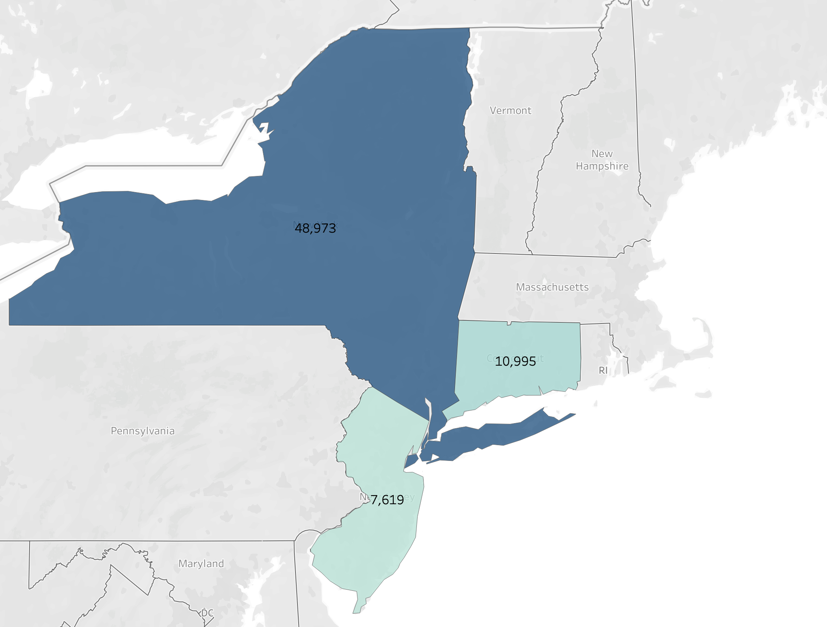
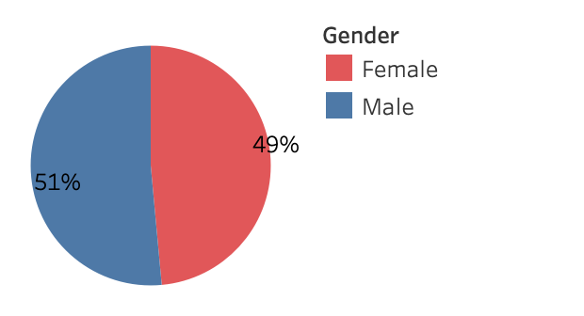
Customer Base Segmentation Analysis
Geographic & Demographic
Key Findings:
1. Geographic: Most Gotham Goats’ customers are in NY (73%) followed by CT (16%) and NJ (11%), excluding Null Values
Demographic: A slightly higher percentage of Customers reported who are Male (51%) and Female (49%), which excluding Null Values

Slide 4
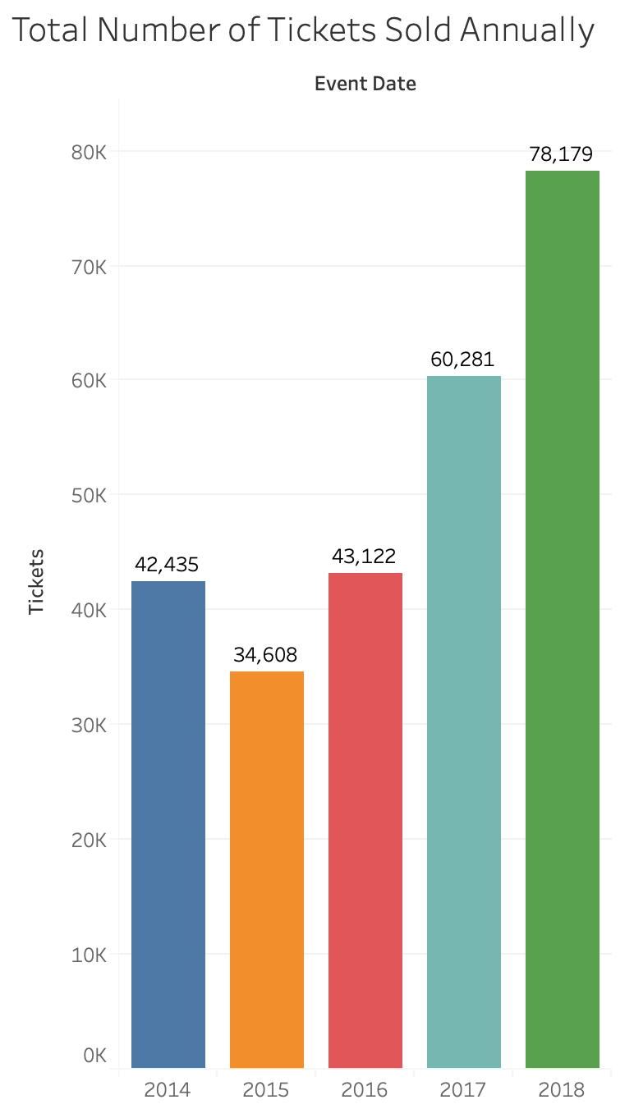
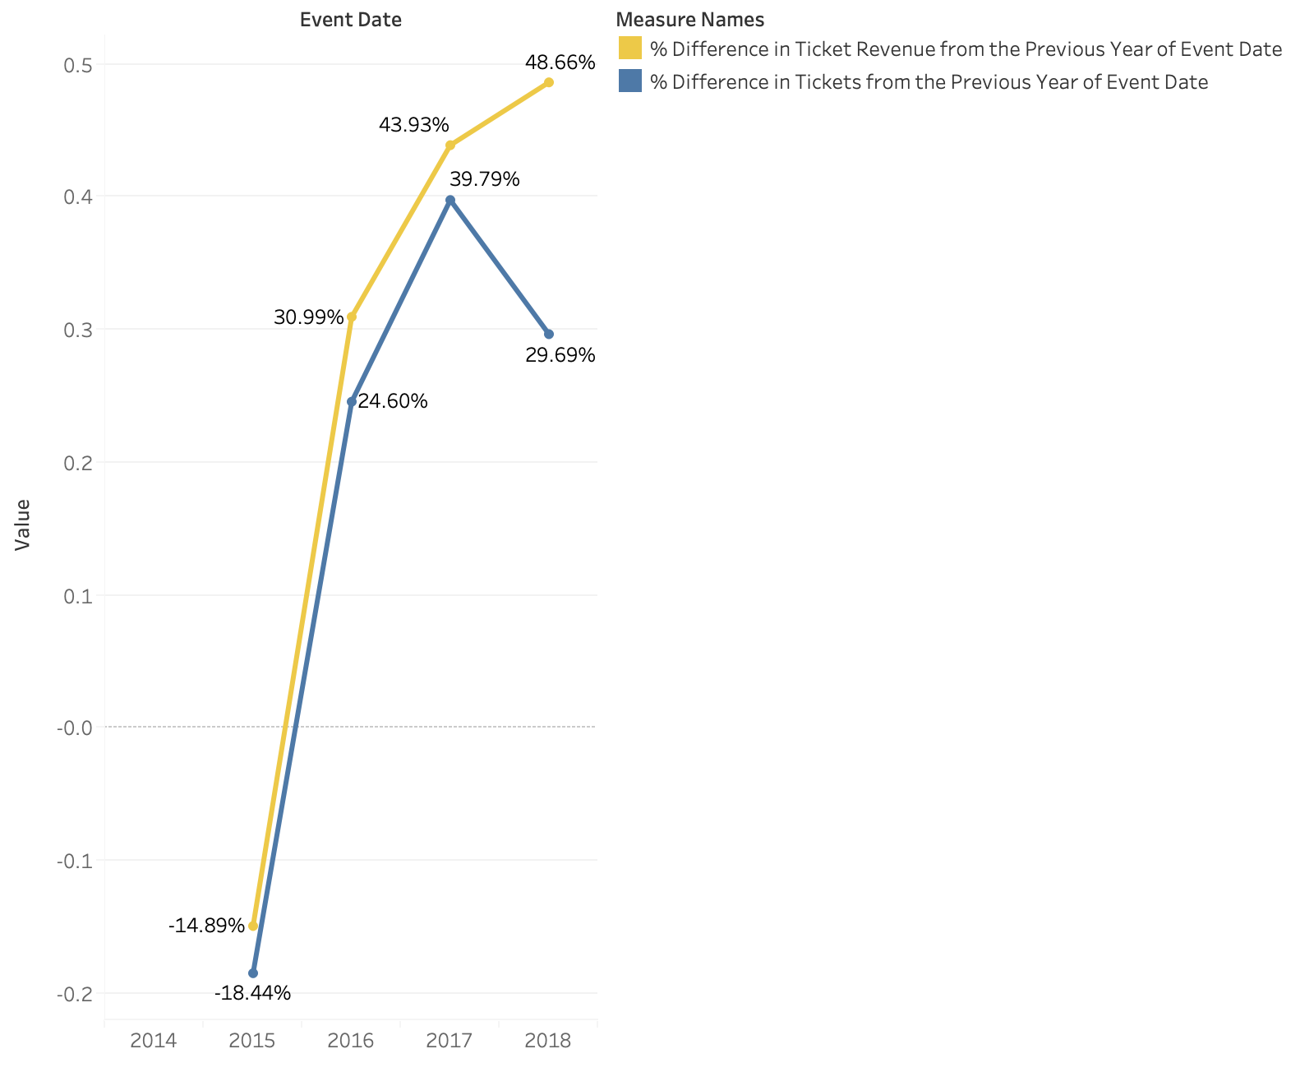
Customer Base Segmentation Analysis
Behavioral
Key Findings:
In 2015, the total number of tickets sold dropped from 42,435 to 34,608, which is almost a 19% drop in ticket sales
Ticket sales showed to have increased in 2016 by 25%, followed by a 40% increase in 2017
Year 2018 reported a higher number of ticket sales of 78, 179. Yet, the year over year growth was still reported lower (29.7%) than in 2017

Slide 5
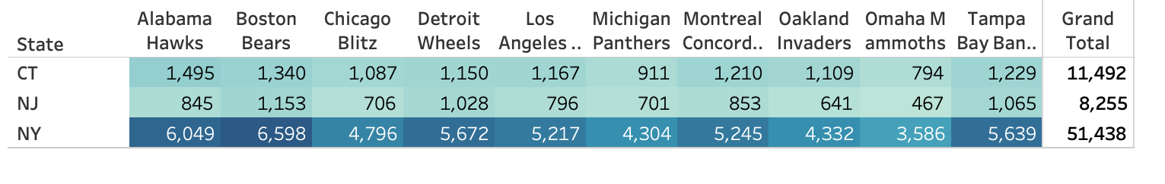
Customer Base Segmentation Analysis
Psychological
Gotham Goats’ Games Vs. Opponent Team
Key Findings:
Most of Gotham Goats’ customers (72%) are reported to be from New York, with a preference of watching the Gotham Goats play against Boston Bears (13%), Alabama Hawks (12%), and Detroit Wheels (11%)
Customers located in Connecticut comprise 16% of Gotham Goats’ customer base, with a preference to watch the games against Alabama Hawks (13%), Boston Bears(12%), and Montreal Concords(11%)
Customers from New Jersey comprise almost 12% of the team’s customer base, with a preference to watch the games against Boston Bears (14%), Tampa Bay (13%), and Detroit Wheels (13%)

Slide 6
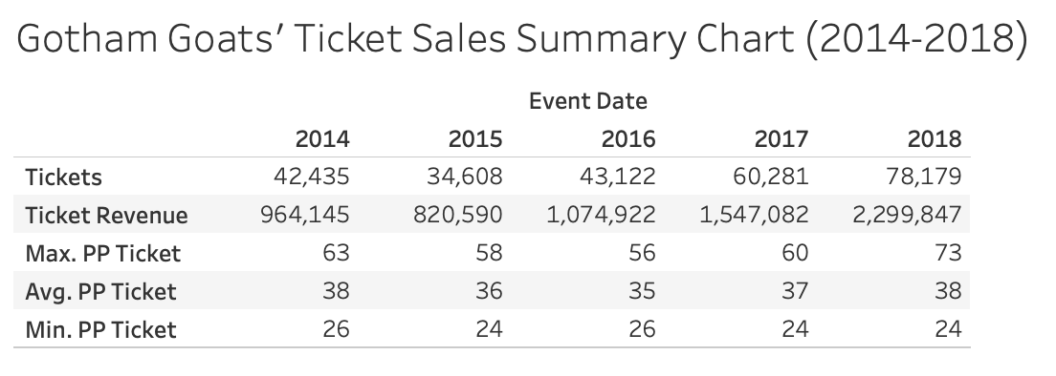
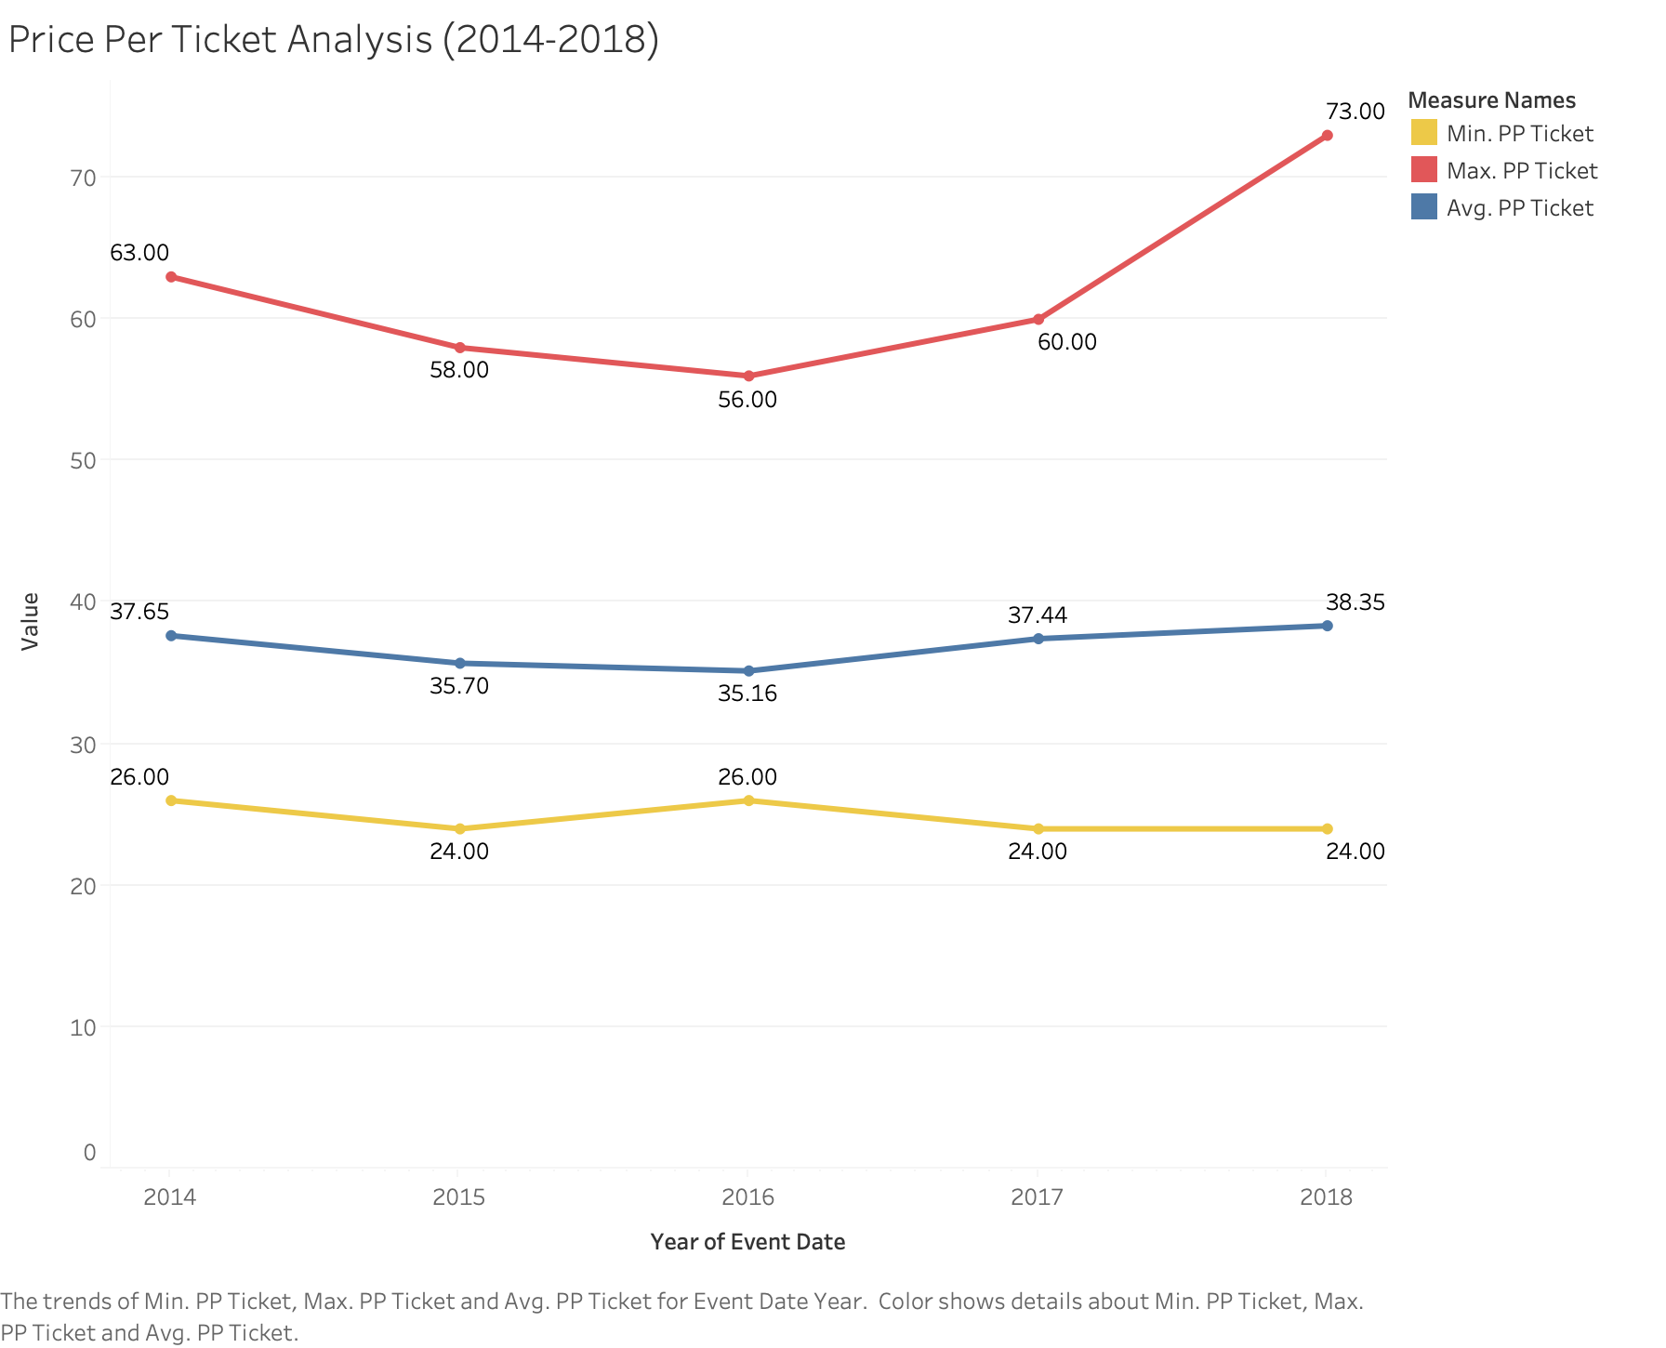
Customer & Revenue Retention Analysis
Key Findings:
The total revenue amount earned from the ticket sales fell by almost 15% in 2015, but the amount increased by 31% in 2016, 44% in 2017, and 49% in 2018.
Gotham Goats’ show to have a strong revenue retention when it comes to selling the tickets to their games. This may be caused by an annual increase in ticket prices as shown in Price Per Ticket Analysis.
However, the customer retention analysis showed that Gotham Goats’ need to strengthen their customer retention. Regardless of the revenue amount that rose by 49% in 2018, the total number of customers who purchased game tickets in the same year reported to be at a lower rate than in 2017.

