Slide 1

Note: The data and information in this document is reflective of a hypothetical situation and client. This document is to be used for KPMG Virtual Internship purposes only.
Sprocket Central Pty Ltd
Data analytics approach
[Division Name] - [Engagement Manager], [Senior Consultant], [Junior Consultant]

Slide 2
Note: The data and information in this document is reflective of a hypothetical situation and client. This document is to be used for KPMG Virtual Internship purposes only.
Agenda
Introduction
Data Exploration
Model Development
Interpretation

Slide 3
Note: The data and information in this document is reflective of a hypothetical situation and client. This document is to be used for KPMG Virtual Internship purposes only.
Introduction
Use Old Customer Data to Predict New Customer Value
Analyze old customer by RFM model, explore and classify them by RFM value
Predict new customer's RFM score, and predict potential customer value

Slide 4
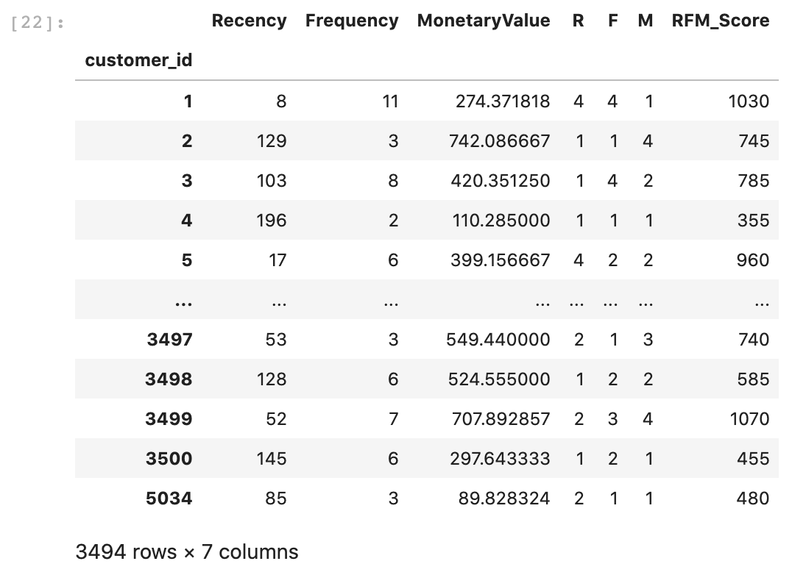
Note: The data and information in this document is reflective of a hypothetical situation and client. This document is to be used for KPMG Virtual Internship purposes only.
Data Exploration
Data Cleaning of old customer data and transaction data
Data is accessed with completeness, tidiness and consistency issues
Feature engineering with missing values
Use transaction data and group by customer id, to look for RFM values of each customer, like the image here
Combine RFM values with old customer demographic data, and one-hot encode the categorical features

Slide 5
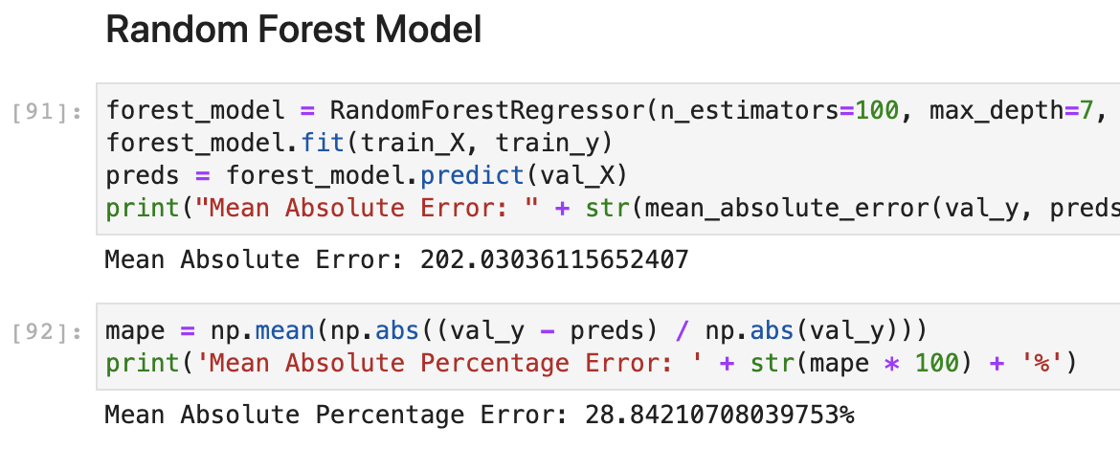
Note: The data and information in this document is reflective of a hypothetical situation and client. This document is to be used for KPMG Virtual Internship purposes only.
Model Development
Random Forest Model and Gradient Boosting Model
Optimize the modesl with mean absolute error and mean absolute percentage error
Compare the two models to find the better solution
Use the model to predict RMS score of new customers

Slide 6
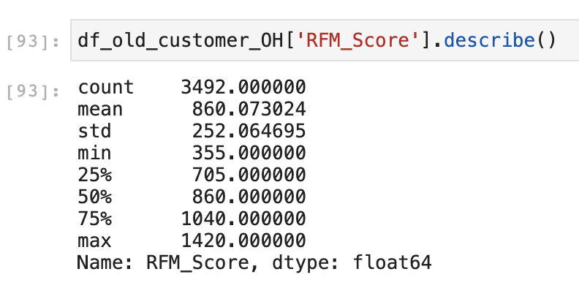
Note: The data and information in this document is reflective of a hypothetical situation and client. This document is to be used for KPMG Virtual Internship purposes only.
Interpretation
Predict new customer value
Explore old customer RFM score for quantiles and classify their value
Use the old customer quantiles and the predicted RMS score of the new customers to classify new customer value

Slide 7
Note: The data and information in this document is reflective of a hypothetical situation and client. This document is to be used for KPMG Virtual Internship purposes only.
Appendix

Slide 8
Note: The data and information in this document is reflective of a hypothetical situation and client. This document is to be used for KPMG Virtual Internship purposes only.
Appendix

