Slide 1


Iteratively Learning Data Transformation Programs from Examples
Department of Computer Science
Bo Wu
Ph.D. defense
2015-10-21

Slide 2
Agenda
Introduction
Previous work
Our approach
Learning conditional statements
Synthesizing branch transformation programs
Maximize user correctness with minimal effort
Related work
Conclusion and future work

Slide 3
Programming by example
Accession | Credit | Dimensions | Medium | Name
01.2 | Gift of the artist | 5.25 in HIGH x 9.375 in WIDE | Oil on canvas | John Mix Stanley
05.411 | Gift of James L. Edison | 20 in HIGH x 24 in WIDE | Oil on canvas | Mortimer L. Smith
06.1 | Gift of the artist | Image: 20.5 in. HIGH x 17.5 in. WIDE | Oil on canvas | Theodore Scott Dabo
06.2 | Gift of the artist | 9.75 in|16 in HIGH x 13.75 in|19.5 in WIDE | Oil on canvas | Leon Dabo
…
09.8 | Gift of the artist | 12 in|14 in HIGH x 16 in|18 in WIDE | Oil on canvas | Gari Melchers
Notes:
To do:
Change the table format here

Slide 4
Programming by Example
 | Raw Value | Target Value
R1 | 5.25 in HIGH x 9.375 in WIDE
R2 | 20 in HIGH x 24 in WIDE
R3 | 9.75 in|16 in HIGH x 13.75 in|19.5 in WIDE
R4 | Image: 20.5 in. HIGH x 17.5 in. WIDE
R5 | 12 in|14 in HIGH x 16 in|18 in WIDE
9.375
24
null
17.5
null
24
19.5
17.5
18
24
19.5
17.5
null
. . .

Slide 5
Challenges
Various formats and few examples
Stringent time limits
Verifying the correctness on large datasets
Notes:
One figure for one bullet and one built in for one bullet.

Slide 6
Research problem
Enabling PBE approaches to efficiently generate correct transformation programs for large datasets with multiple formats using minimal user effort

Slide 7
Iterative Transformation
Examples
Users
PBE systems
Synthesizing
programs
and transforming
records
Examining records
and providing
examples
Transformed records

Slide 8
Agenda
Introduction
Previous work
Our approach
Learning conditional statements
Synthesizing branch transformation programs
Maximize user correctness with minimal effort
Related work
Conclusion and future work

Slide 9

R₁ | 5.25 in HIGH x 9.375 in WIDE | 9.375
R₂ | 20 in HIGH x 24 in WIDE | 24
R₃ | 9.75 in|16 in HIGH x 13.75 in|19.5 in WIDE | 19.5
R₄ | Image: 20.5 in. HIGH x 17.5 in. WIDE | 17.5
GUI
Examples
Clustering
classify
R_{1,} R_{2,} R₄
Example Cluster 1
R₃
Learning Classifier
…
Example Cluster K
Synthesizing
…
Synthesizing
substring(pos_{1,} pos₂)
substring(pos_{3,} pos₄)
Branch
Program 1
Branch
Program k
Conditional
Statement
…
Combining
Transformation program
Notes:
Remove

Slide 10
Transformation Program
BNK: blankspace
NUM([0-9]+): 98
UWRD([A-Z]): I
LWRD([a-z]+): mage
WORD([a-zA-Z]+): Image
START:
END:
VBAR: |
…
Conditional
statement
Branch
transformation
program
Segment program:
return a substring
Position program:
return a position in the input
Branch
transformation
program
9.75 in|16 in HIGH x 13.75 in|19.5 in WIDE➔ 19.5
Notes:
Transformation programs
Conditional / branch
Branch is a concatenation of several segment programs
Segment program basically returns a substring
One way of specifying the segment program is to specify where to extract this substring from the input.

Slide 11
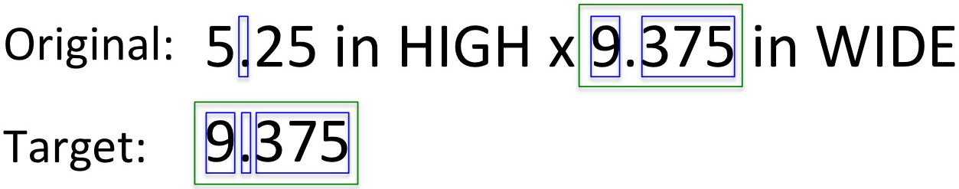
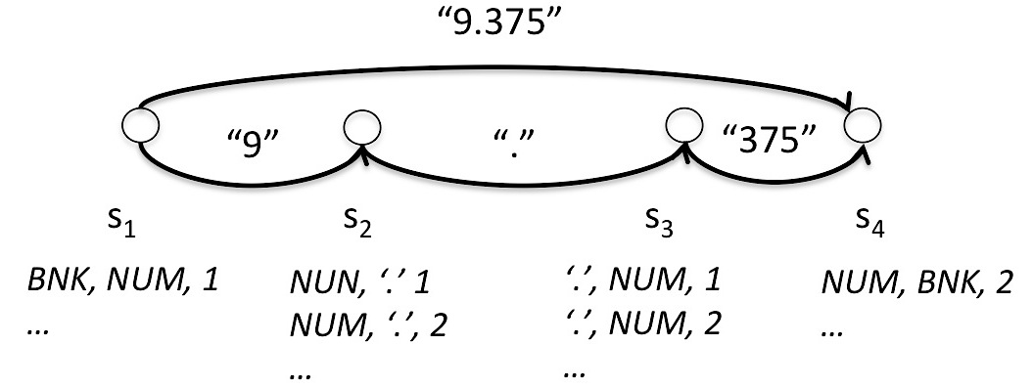
Creating Hypothesis Spaces
Create traces
Derive hypothesis spaces
Traces: A trace here defines how the output string is constructed from
a specific set of substrings from the input string.
Notes:
Creating traces
Derive hypothesis space
1.Node contains all
2. Edges contains all the segment programs
3. Each path contains all the programs that transform the inputs into the outputs

Slide 12

Generating Branch Programs
Generate programs from hypothesis space
Generate-and-test
Generate simpler programs first
Programs with one segment programs
earlier than
Programs with three segment programs

Slide 13
Learning Conditional Statements
Cluster examples
R₁ | 5.25 in HIGH x 9.375 in WIDE | 9.375
R₂ | 20 in HIGH x 24 in WIDE | 24
R₄ | Image: 20.5 in. HIGH x 17.5 in. WIDE | 17.5
Cluster1-format₁
R₃ | 9.75 in|16 in HIGH x 13.75 in|19.5 in WIDE | 19.5
Cluster2-format₂
Learn a multiclass classifier
Recognize the format of the inputs
R₅ | Image: 20.5 in. HIGH x 17.5 in. WIDE
R₆ | 12 in|14 in HIGH x 16 in|18 in WIDE
format₁
format₂

Slide 14
Agenda
Introduction
Previous work
Our approach
Learning conditional statements
Synthesizing branch transformation programs
Maximize user correctness with minimal effort
Related work
Conclusion and future work
Notes:
18:08

Slide 15
Our contributions
Efficiently learning accurate conditional statements [DINA, 2014]
Efficiently synthesizing branch transformation programs [IJCAI, 2015]
Maximizing the user correctness with minimal user effort [IUI, 2014; IUI, 2016(submitted)]

Slide 16
Agenda
Introduction
Previous work
Our approach
Learning conditional statements
Synthesizing branch transformation programs
Maximize user correctness with minimal effort
Related work
Conclusion and future work
Notes:
18:08

Slide 17
Motivation
Example clustering is time consuming
Many ways (2^{n}) to cluster the examples
Many examples are not compatible
Verifying compatibility is expensive
Learned conditional statement is not accurate
Users are willing to provide a few examples
✕
R₁ | 5.25 in HIGH x 9.375 in WIDE | 9.375
R₂ | 20 in HIGH x 24 in WIDE | 24
R₃ | 9.75 in|16 in HIGH x 13.75 in|19.5 in WIDE | 19.5

Slide 18
Utilizing known compatibilities
✕
R₁
R₂
R₃
✕
After providing
3 examples
R₁ | 5.25 in HIGH x 9.375 in WIDE | 9.375
R₂ | 20 in HIGH x 24 in WIDE | 24
R₃ | 9.75 in|16 in HIGH x 13.75 in|19.5 in WIDE | 19.5
After providing
4 examples
R₁
R₂
R₃
R₄
Notes:
Provide the intuition here

Slide 19
Constraints
Two types of constraints:
Cannot-merge constraints:
Ex:
Must-merge constraints:
Ex:
5.25 in HIGH x 9.375 in WIDE | 9.375
9.75 in|16 in HIGH x 13.75 in|19.5 in WIDE | 13.75
20 in HIGH x 24 in WIDE | 24
5.25 in HIGH x 9.375 in WIDE | 9.375
20 in HIGH x 24 in WIDE | 24
Notes:
Every time user provides an example, the system will tries to generate a program.
During this process, the system has figure out certain programs shouldn’t be put into same partition and certain examples can be put into same partition.
We use two types of constraints to model this information

Slide 20
Constrained Agglomerative Clustering
Distance between clusters (p_{i} and p_{j}) :
R₁
R₂
R₃
R₄
R₁
R₄
R₂
R₃
R₁ | 5.25 in HIGH x 9.375 in WIDE
R₄ | Image: 20.5 in. HIGH x 17.5 in. WIDE
R₁
R₂
R₄
R₃
✕
R₁ | 5.25 in HIGH x 9.375 in WIDE
R₂ | 20 in HIGH x 24 in WIDE
R₃ | 9.75 in|16 in HIGH x 13.75 in|19.5 in WIDE

Slide 21

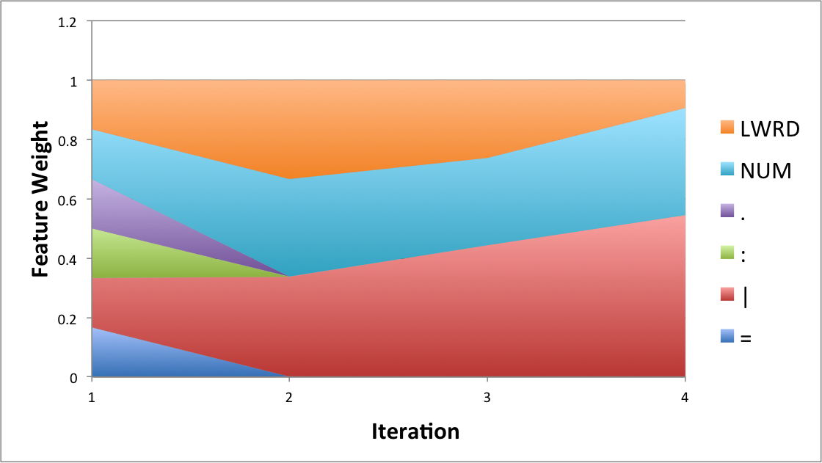
Distance Metric Learning
Distance metric learning
Objective function
Close to
each other
far away
Notes:
The reason why learning a distance metric
Why weighted eucldiean distance
How to model the two constraints

Slide 22
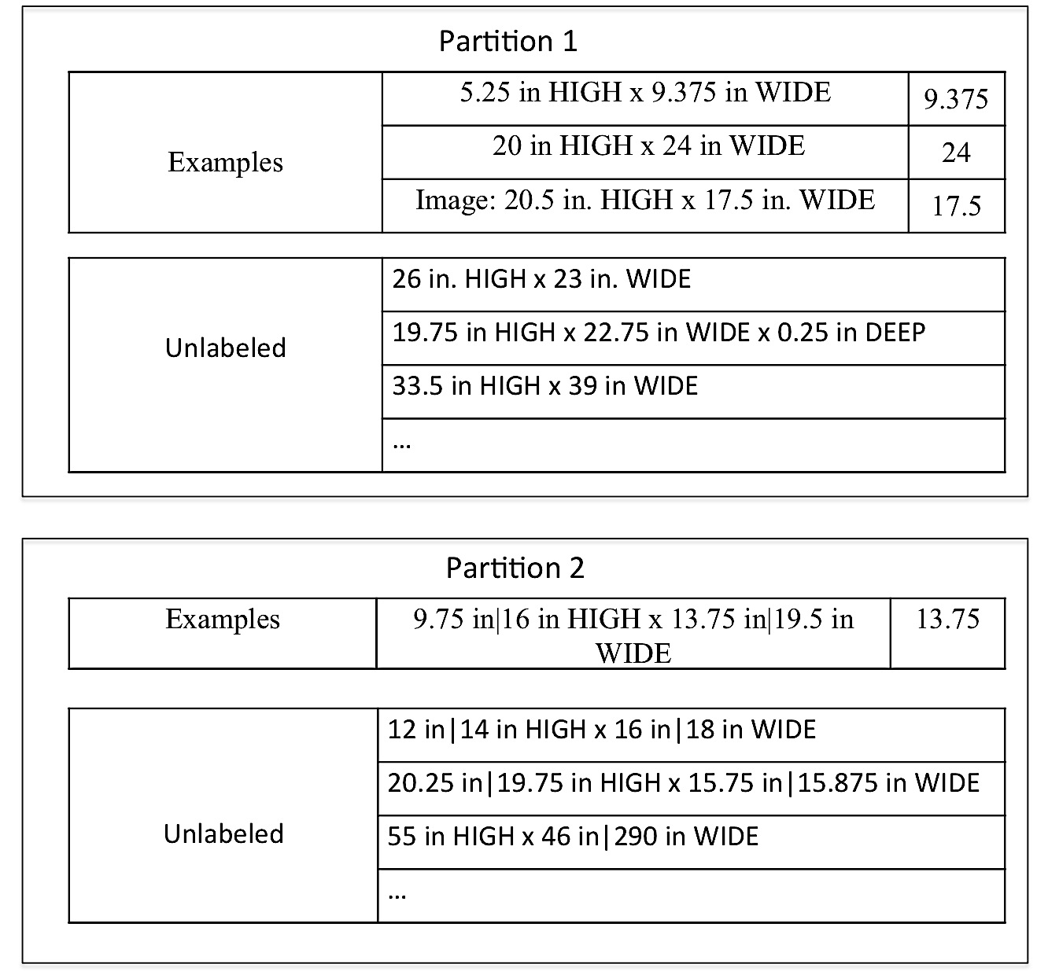
Utilizing Unlabeled data

Slide 23
Evaluation
Dataset:
30 editing scenarios collected from student course projects
Methods:
SP
The state-of-the-art approach that uses compatibility score to select partitions to merge
SPIC
Utilize previous constraints besides using compatibility score
DP
Learn distance metric
DPIC
Utilize previous constraints besides learning distance metric
DPICED
Our approach in this paper
Avg records | Min formats | Max formats | Avg formats
350 | 2 | 12 | 4.4
Notes:
Verifying 3 design decisions
Whether using constraints from previous iterations are helpful
Whether the learned distance metric can outperform directly applying euclidean distance and CBS
Whether incorprating unlabeled data is helpful

Slide 24
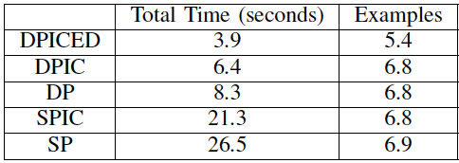
Results
Time and Examples:

Slide 25
Agenda
Introduction
Previous work
Our approach
Learning conditional statements
Synthesizing branch transformation programs
Maximize user correctness with minimal effort
Related work
Conclusion and future work
Notes:
35 mininutes

Slide 26
Learning Transformation Programs by Example
Input Data | Target Data
2000 Ford Expedition 11k runs great los angeles $4900 (los angeles)
1998 Honda Civic 12k miles s. Auto. - $3800 (Arcadia)
2008 Mitsubishi Galant ES $7500 (Sylmar CA) pic
1996 Isuzu Trooper 14k clean title west covina $999 (west covina) pic
… | …
2000 Ford Expedition los angeles $4900
1998 Honda Civic 12k miles s. Auto. - $3800 (Arcadia)
1998 Honda Civic Arcadia $3800
2008 Mitsubishi Galant Sylmar CA $7500
2008 Mitsubishi Galant ES $7500 (Sylmar CA) pic
1996 Isuzu Trooper west covina $999
Time complexity is exponential in the number
and a high polynomial in the length of examples
Notes:
Syntax transformation entity extraction.

Slide 27
Reuse subprograms
After 1st
example
After 2nd
example
After 3rd
example
Notes:
Trace specifies one way of generating the
Program from the trace will look like ….

Slide 28
Identify incorrect subprograms
Input | Output
2000 Ford Expedition 11k runs great los angeles $4900 (los angeles) | 2000 Ford Expedition los angeles $4900
1998 Honda Civic 12k miles s. Auto. - $3800 (Arcadia) | 1998 Honda Civic Arcadia $3800
Program
(START, NUM, 1)
(BNK, NUM, 1)
(’(’, WORD, 1)
(LWRD, ’)', 1)
(ANY,BNK’$', 1)
(NUM, BNK, 2)
Execution Result:
Null
Null
0 -1
33 -1
␣$7500
=
≠
=
≠
0 23
33 43
Target
output:
2008 Mitsubishi Galant Sylmar CA $7500
Input:
2008 Mitsubishi Galant ES $7500 (Sylmar CA) pic
Notes:
Change color of the dashed lines

Slide 29
Update hypothesis spaces
Program
(START, NUM, 1)
(BNK, NUM, 1)
(’(’, WORD, 1)
(LWRD, ’)', 1)
(ANY,BNK’$', 1)
Hypothesis H₃
2000 Ford Expedition 11k runs great los angeles $4900 (los angeles)
H₃
1998 Honda Civic 12k miles s. Auto. - $3800 (Arcadia)
h₃₁
h₃₂
h₃₃
h₃₂
^{e}
h₃₁
h₃₂
h₃₂
^{s}
h₃₁
^{s}
h₃₂
Left context:
LWRD
WORD
…
^{e}
^{e}
^{e}
Right context:
“)”
…
Left context:
WORD
…
Right context:
“)”
…
2008 Mitsubishi Galant ES $7500 (Sylmar CA) pic

Slide 30
Evaluation
Dataset
D1: 17 scenarios used in (Lin et al., 2014)
5 records per scenario
D2: 30 scenarios collected from student data integration projects
about 350 records per scenario
D3: synthetic dataset
designed to evaluate scale-up
Alternative approaches
Our implementation of Gulwani’s approach: (Gulwani, 2011)
Metagol: (Lin et al., 2014)
Metric
Time (in seconds) to generate a transformation program

Slide 31
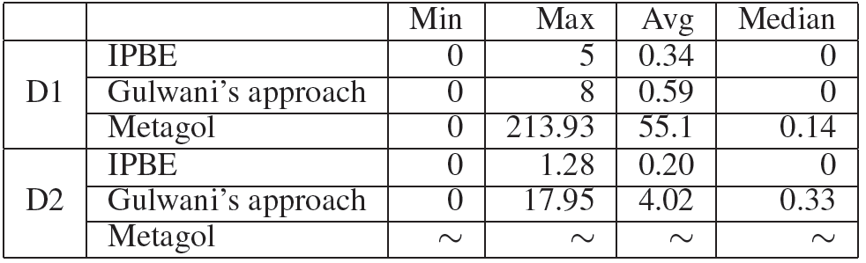
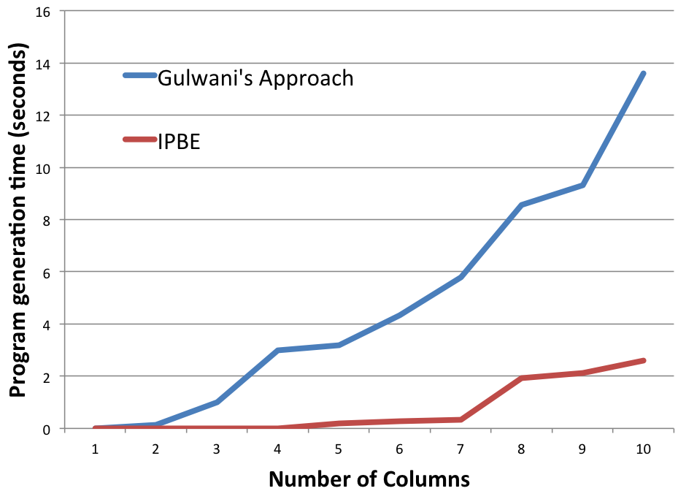
Program generation time comparisons
Table: time (in seconds) to generate programs on D1 and D2 datasets
D3
Figure: scalability test on D3

Slide 32
Agenda
Introduction
Previous work
Our approach
Learning conditional statements
Synthesizing branch transformation programs
Maximize user correctness with minimal effort
Related work
Conclusion and future work
Notes:
12 minutes

Slide 33
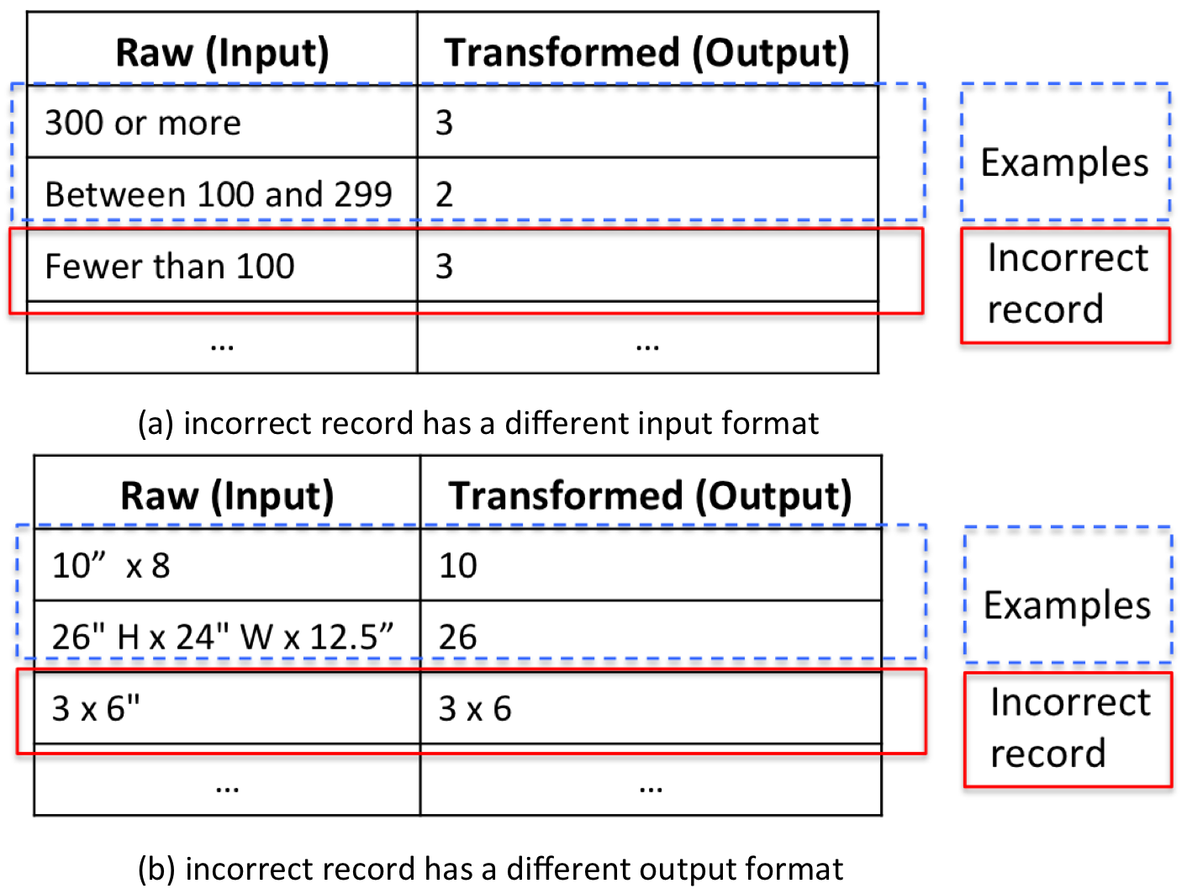
Motivation
Thousands of records in datasets
Various transformation scenarios
Overconfident users

Slide 34
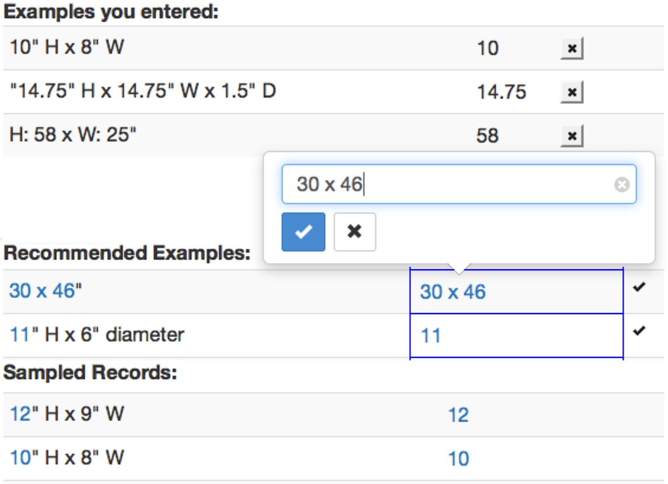
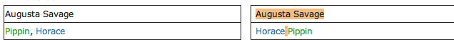
User Interface
Notes:
buildin

Slide 35
Learning from various past results
Raw | Transformed
26" H x 24" W x 12.5 | 26
Framed at 21.75" H x 24.25” W | 21
12" H x 9" | 12
…
Examples
Incorrect
records
Correct
records
Raw | Transformed
Ravage 2099#24 (November, 1994) | November, 1994
Gambit III#1 (September, 1997) | September, 1997
(comic) Spidey Super Stories#12/2 (September, 1975) | comic
…
…

Slide 36
Approach Overview
Entire dataset
Sampled records
Raw | Transformed
10“ H x 8” W | 10
H: 58 x W:25” | 58
12”H x 9”W | 12
11”H x 6” | 11
… | …
30 x 46” | 30 x 46
Random
Sampling
Raw | Transformed
10“ H x 8” W | 10
11”H x 6” | 11
… | …
30 x 46” | 30 x 46
Verifying records
Sorting and
color-coding
Raw | Transformed
11”H x 6” | 11
30 x 46” | 30 x 46
… | …
Raw | Transformed
30 x 46” | 30 x 46
11”H x 6” | 11
… | …

Slide 37
Verifying Records
Recommend records causing runtime errors
Records cause the program exit abnormally
Recommend potentially incorrect records
Learn a binary meta-classifier
Program: (LWRD, ‘)’, 1)
Input: 2008 Mitsubishi Galant ES $7500 (Sylmar CA) pic
Ex:
Raw | Transformed
11”H x 6” | 11
30 x 46” | 30 x 46
… | …

Slide 38
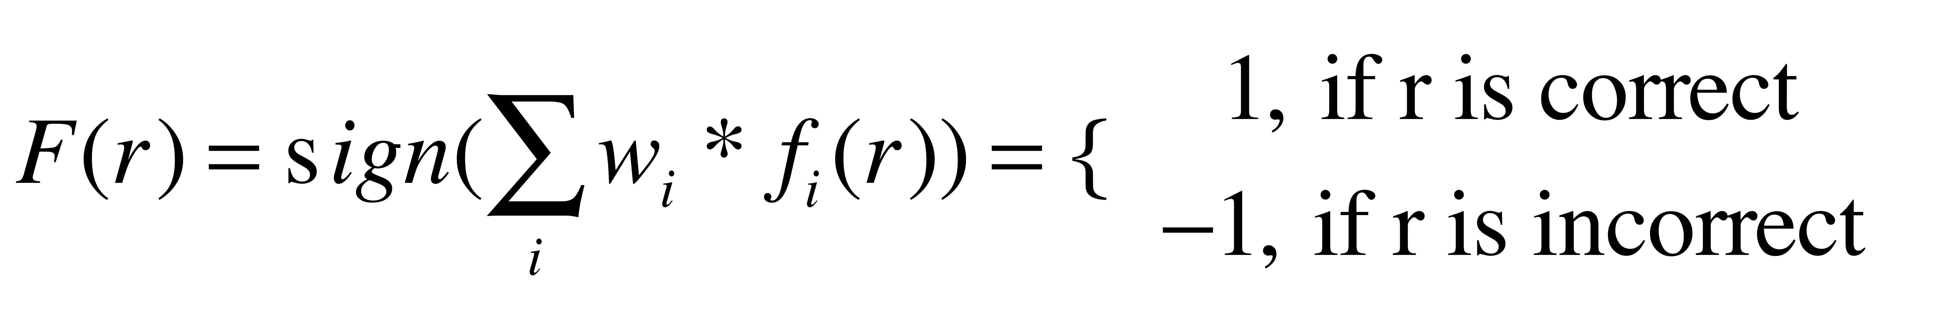
Learning the Meta-classifier
Learn an ensemble of classifiers using ADABOOST:
Select a f_{i} from a pool of binary classifiers
Assign weight w_{i} to f_{i}
Loop until error below a threshold
Notes:
How detail should I describe the classifiers

Slide 39
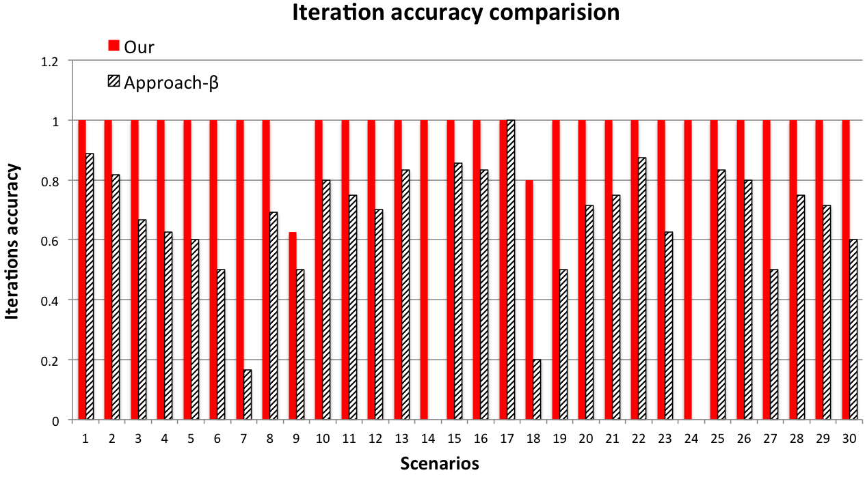
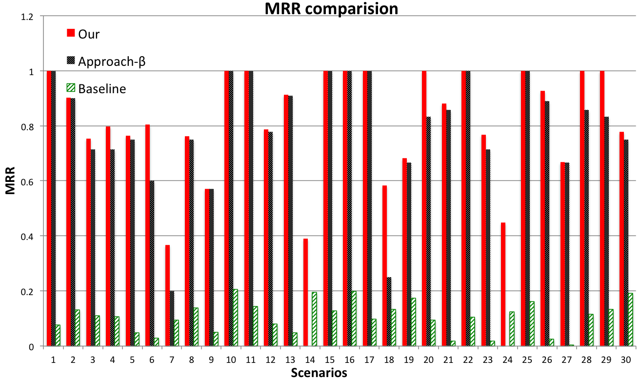

Evaluation
Dataset:
30 scenarios
350 records per scenario
Experiment setup:
Approach-β
Baseline
Metrics:
Iteration correctness
MRR

Slide 40
Agenda
Introduction
Previous work
Our approach
Learning conditional statements
Synthesizing branch transformation programs
Maximize user correctness with minimal effort
Related work
Conclusion and future work
Notes:
15 minutes

Slide 41
Related Work
Approaches not focusing on data transformation
Wrapper induction
Kushmerick,1997; Hsu and Dung, 1998; Muslea et al., 1999
Inductive programming (we learn )
Summers, 1977; Kitzelmam and Schmid, 2006;Shaprio, 1981; Muggleton and Lin, 2013
Approaches not learning program iteratively
FlashFill (Gulwani, 2011); SmartPython (Lau, 2001), SmartEdit (Lau, 2001); Singh and Gulwani 2012; Raza et al., 2014; Harris, et al., 2011
Approaches learning part of the programs iteratively
Metagol_{DF} (Lin et al., 2014); Preleman, et al 2014

Slide 42
Conclusion: contributions
Enable users to generate complicated programs in real time
Enable users to work on large datasets
Improve the performance of other PBE approaches

Slide 43
Conclusion: future work
Managing user expectation
Incorporating third-party functions
Handling user errors

Slide 44

Questions ?

Slide 45
Different number of segments
32
39
41
48
Input:
1998 Honda Civic 130 k miles - $3800 (Arcadia)
Trace
Output:
1998 Honda Civic Arcadia $3800
h₃₁
h₃₂
h₃₃
Hypothesis Spaces:
H₃
Execution Result:
2000 Ford Expedition los angeles $4900
Old Program:
(START, NUM, 1)
(BNK, NUM, 1)
(BNK, LWRD, 2)
(NUM, BNK, -1)
Start = 24
End = 39

Slide 46

Evaluation
Dataset:
30 scenarios
350 records per scenario
Experiment setup:
Approach-β
Baseline
Metrics:
Iteration correctness
MRR

Slide 47
Related Work
Data transformation systems
Requiring users to write programs
Excel Macro, OptiWrangler (Sujeeth et al., 2013)
Require users to specify transformation steps without coding
OpenRefine (Huynh and Stefano), Potter’s wheel (Raman and Hellerstein, 2001), SmartEditor (Lau et al., 2003), Data wrangler(Kandel et al.,2011)
PBE systems
Wrapper induction
Kushmerick,1997; Hsu and Dung, 1998; Muslea et al., 1999
Inductive programming
Summers, 1977; Kitzelmam and Schmid, 2006;Shaprio, 1981; Muggleton and Lin, 2013

Slide 48
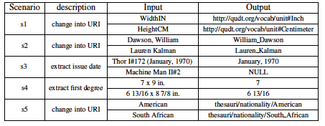

Slide 49
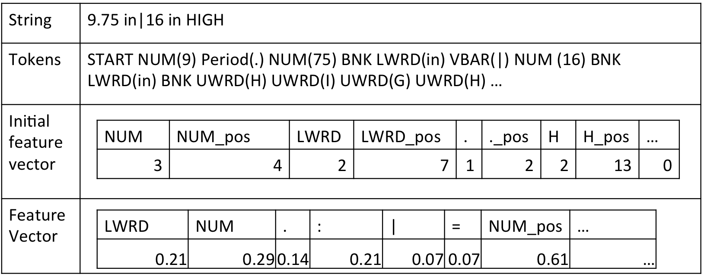
Data Preprocessing

Slide 50
Agenda
Introduction
Previous work
Our approach
Learning conditional statements
Synthesizing branch transformation programs
Maximize user correctness with minimal effort
Related work
Conclusion and future work

Slide 51
GUI
Examine results and
enter examples
Examples
Clustering
Information
from previous iterations
Example Cluster 1
…
Example Cluster K
Learning Classifier
Synthesizing
…
Synthesizing
Branch
Program 1
Branch
Program k
Conditional
Statement
…
Combining
Transformation program
Notes:
Remove

Slide 52

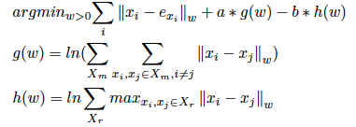
Distance Metric Learning
Distance metric learning
Objective function
Close to each other
Too far away
Notes:
The reason why learning a distance metric
Why weighted eucldiean distance
How to model the two constraints

Slide 53
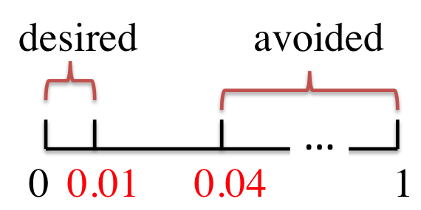
Sampling Records
Model the correctness of the records using binomial distribution
Decide the sample size (n) and allowable incorrect records (z_{α}) using hypothesis testing
Randomly sample n records
n = 300, z_{α}=7
Percentage of incorrect records
Notes:
Need Example

Slide 54
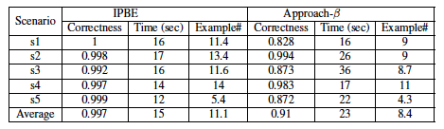
User Study
Dataset:
5 scenarios
4000 records per scenario
Experiment Setup:
10 students in 2 groups
Results:

Slide 55
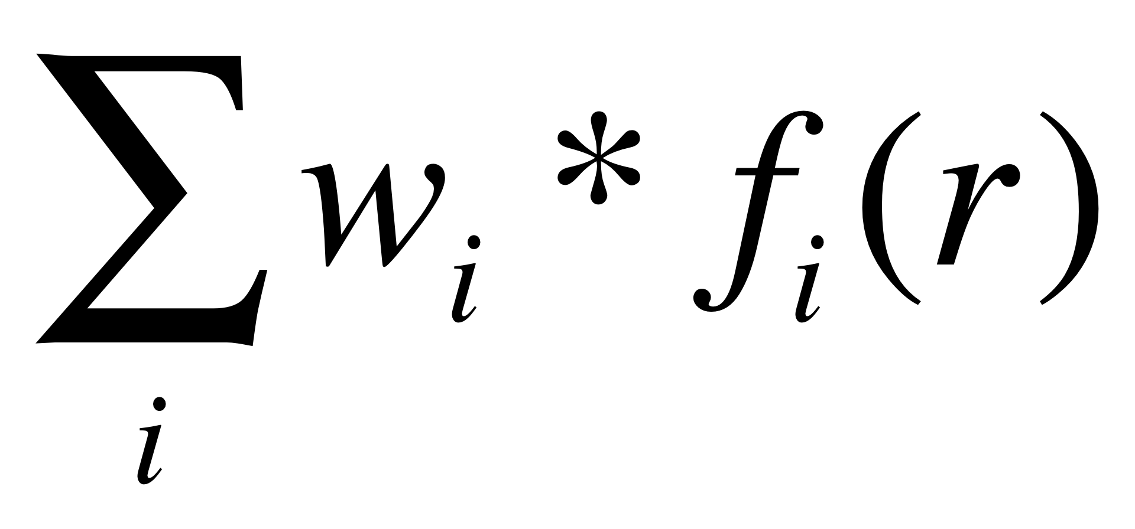
Sorting and Color-coding
Sorting
Sorting the records causing runtime errors
Number of failed subprograms
Sorting the potentially incorrect records
value of
Color-coding
Executing the subprograms independently
2000 Ford Expedition 11k runs great los angeles $4900 (los angeles)
2000 Ford Expedition los angeles $4900

Slide 56
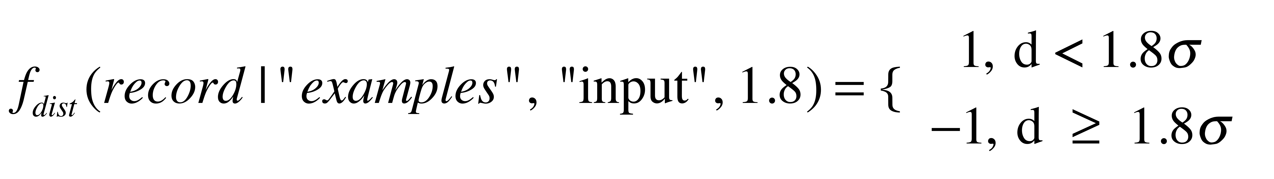
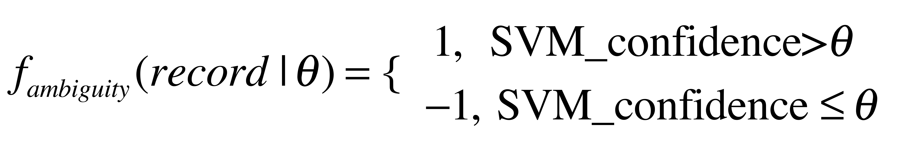
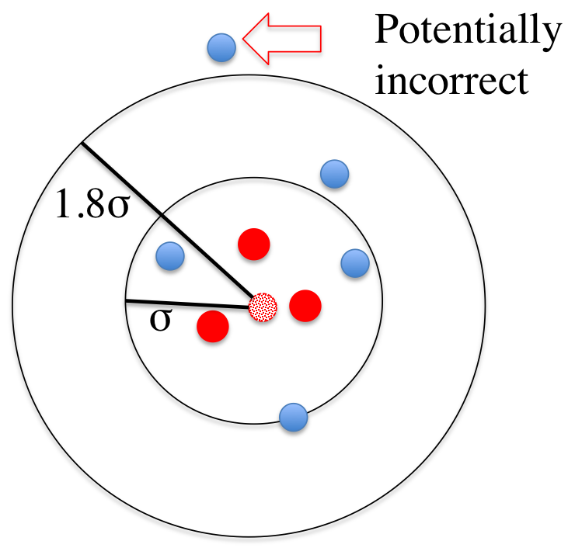
Three Types of Classifiers
Three types of classifiers f_{i}(r) are used to construct the F(r)
Classifiers based on distance
Classifiers based on program agreement
Classifiers based on format ambiguity
(START, NUM,1), (NUM, BNK,1)
30.75 x 46 ➔ 30.75
(START, NUM,1), (NUM, ANY,1)
30.75 x 46 ➔ 30

