Slide 1

Learning Data Transformation Rules through Examples: Preliminary Results
Bo Wu, Pedro Szekely, Craig A.Knoblock
Information Science Institute
University of Southern California

Slide 2
Transforming Data
Original | Transformed
30/07/2010 | 2010-07-30
30/09/2010 | 2010-09-30
14/01/2011 | 2011-01-14
Notes:
Pro:
1 one slide only convey one simple idea. Easy to explain it clearly and easy to follow
It is a good practice for introducing the motivation.
2 we might need two scenarios to illustrate the versatile of our tool.

Slide 3
Transforming Data
Original | Transformed
1 Lombard Street,London | London,1 Lombard Street
1 Dominick Street,New York | New York, 1 Dominick Street
1 North Belmont Avenue,Richmond | Richmond, 1 North Belmont Avenue

Slide 4
Transforming Data by Example
Example
1 Lombard Street,London | London,1 Lombard Street
Original
1 Lombard Street,London
1 Dominick Street,New York
1 North Belmont Avenue,Richmond
Transformed
London, 1 Lombard Street
New York,1 Dominick Street
Richmond,1 North Belmont Avenue

Slide 5
Examples Are Ambiguous
Example
1 Lombard Street,London | London,1 Lombard Street
Original
1 Lombard Street,London
1 Dominick Street,New York
1 North Belmont Avenue,Richmond
Result 1
London ,1 Lombard Street
New,1 Dominick Street York
Richmond ,1 North Belmont Avenue
Result 2
London ,1 Lombard Street
New,1 Dominick Street York
, Avenue1 North Belmont Richmond
522 interpretations given this example

Slide 6
Objective
Minimize number of examples users have to give to produce the desired transformation program

Slide 7
Outline
Transformation Grammar
System Overview
Search spaces
Searching
Ranking
Evaluation

Slide 8
Transformation Grammar
program➔(ins|del|mov)+
del➔DEL what∨ DEL range
ins➔INS(token)+ where
mov➔ MOV tokenspec where ∨MOV range where
what➔quantifier tokenspec
quantifier ➔ANYNUM∨NUM
tokenspec➔singletokenspec∨singletokenspec tokenspec
singletokenspec➔token∨type∨ANYTOK
type➔NUMTYP∨WRDTYP∨SYBTYP∨BNKTYP
range ➔start end
scanningOrder➔FRM_BEG∨FRM_END
start➔scanningOrder posquantifier
end➔scanningOrder posquantifier
where➔scanningOrder posquantifier
where➔scanningOrder posquantifier
posquantifier➔INCLD? tokenspec∨NUM

Slide 9
Transformation Grammar
Specifying the target pattern(tokenspec)
any two tokens
“,”London
symbol word
“,” word
…
Specifying the position(range)
[5,6]
after “,” before END
after 5, before END
…
Example
1 Lombard Street,London
1 Lombard Street
Notes:
We don’t know what user to do. There are many interpretations given the few examples.
Large search space
cross product

Slide 10

Challenges
Large search space
Many interpretations

Slide 11
System Overview
Untransformed Data
Transformation Program Identification
Step 1:Subgrammar spaces generation
Step 2: Search in subgrammar spaces
Transformation Program Ranking
Examples
Transformation
Programs
Top K results
Transformation Grammar
Notes:
No abbreviations
Reduce the bottom box

Slide 12
Subgrammar space
<START>1 Dominick Street,New York<END> || New York,1 Dominick Street
MOV | MOV
Tokenspec: <S>1 Domininick Street <S>NUM BNK WRD BNK WRD ANYTOK ANYTOK ANYTOK ANYTOK ANYTOK ANYTOK <S>NUM BNK Dominick BNK Street … … Start: 0 START NUM … | Tokenspec: , SYB Start: 0 START SYB
MOV | MOV
Tokenspec: <S>1 Domininick Street <S>NUM BNK WRD BNK WRD ANYTOK ANYTOK ANYTOK ANYTOK ANYTOK ANYTOK <S>NUM BNK Dominick BNK Street … … Start: 0 START NUM … | Tokenspec: New York<END> WRD BNK WRD<END> New BNK York<END> WRD BNK York<END> … Start: 1 WRD SYB
<START>1 Dominick Street
,
New York<END>
<START>1 Dominick Street
,
New York<END>
Notes:
Subgrammar spaces are generated using examples

Slide 13
Subgrammar space
Example 1
1 Dominick Street,New York New York,1 Dominick Street
Edit Sequences
[mov: 0,5,11[], mov: 0,0,5[]]
... …
MOV | MOV
Tokenspec: 1 Domininick Street NUM BNK WRD BNK WRD ANYTOK ANYTOK ANYTOK ANYTOK ANYTOK NUM BNK Dominick BNK Street … … Start: 0 START NUM … | Tokenspec: , SYB Start: 0 START SYB
Notes:
Tell what is subspace first, what does it looks like given one example.
Split the slide to more slides.
Finally tell how to generate a subgrammar space

Slide 14
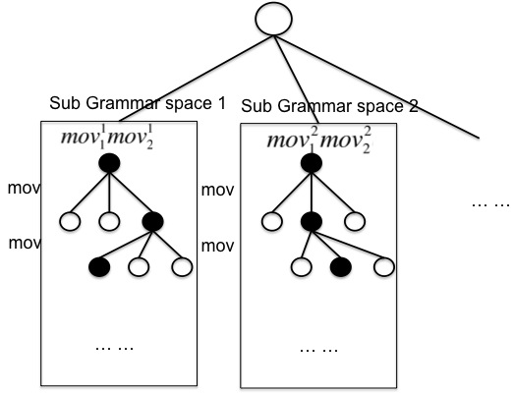
Search
Search Space is still large: do sampling-based search
1 Sample a subgrammar space to search
2 Do UCT (Levente Kocsis et al.) search in the sampled search space

Slide 15
Ranking
Result 1 | / count | Result 2 | / count
2010-07-30 | 0 | 2010-07-30 | 0
2010-09-30 | 0 | /09/2010--30 | 2
2011-01-31 | 0 | /03/2011--31 | 2
Assumption:
User wouldn’t want to transform data into a noisy and irregular state
Features: capture the homogeneity
enp_cnt_/: entropy of the distribution of the slash count
enp_cnt_-: … …
… …
Approach:
Build a logistic regression classifier
Use confidence score as result’s score
Notes:
Same example as before

Slide 16
Evaluation
Editing Scenarios
Address 1
First row: Brankova&nbsp;13 , Brankova 13
Address2
First row: 1 Lombard Street,London , London,1 Lombard Street
Date1
First row: 2010-07-30 , 07/30/2010
Date2
First row: 13/05/2010 , 2010-05-13
Tel1
First row: Tel:</B> 020-7928 3131 , 020-7928 3131
Tel2
First row: 020-8944 9496 , (020)8944 9496
Time
First row:1 January 2007 4:48pm , January 1,2007 4:48pm
Notes:
Use better quality screen short. It is legible.

Slide 17
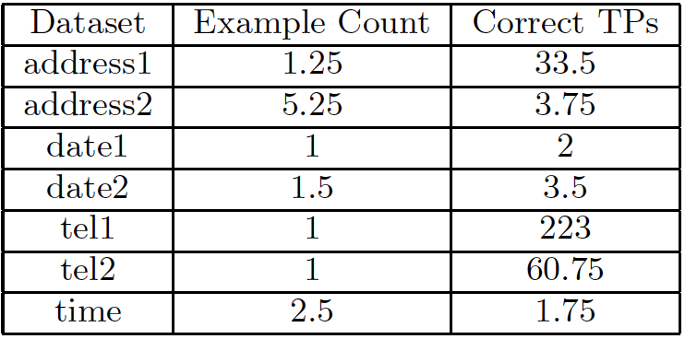
Results
Run experiment 20 times and average the result.
Notes:
The meaning of the number
Good or bad

Slide 18
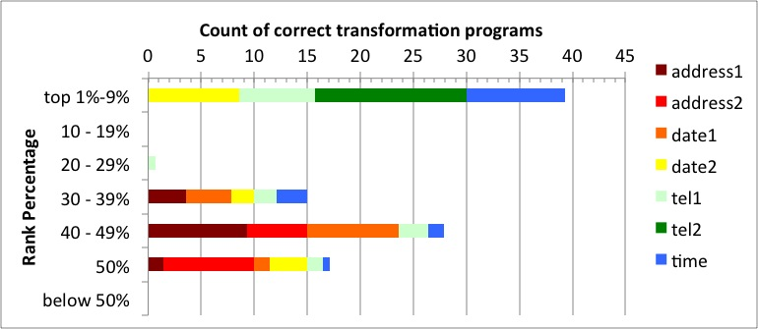
Results
Notes:
Put the title in the graph
No need to create some b
Leave 2 mins for question

Slide 19
Thank You !

