Slide 1
Computer Vision
Autumn 2018
Problem Set #4
Darragh Hanley
darragh.hanley@gatech.edu
Computer Vision @ GT

Slide 2

1a: Base Shift0 and ShiftR2
ps4-1-a-1.png
Computer Vision @ GT

Slide 3
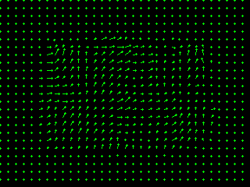
1a: Base Shift0 and ShiftR5U5
ps4-1-a-2.png
Computer Vision @ GT

Slide 4
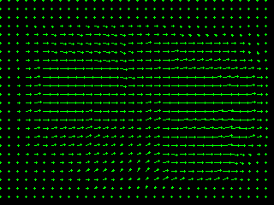
1b: Base Shift0 and ShiftR10
ps4-1-b-1.png
Computer Vision @ GT

Slide 5
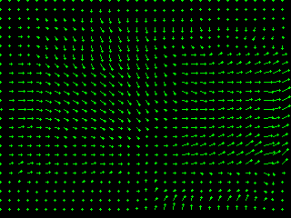
1b: Base Shift0 and ShiftR20
ps4-1-b-2.png
Computer Vision @ GT

Slide 6
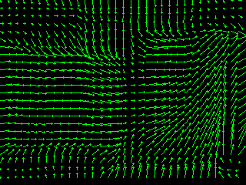
1b: Base Shift0 and ShiftR40
ps4-1-b-3.png
Computer Vision @ GT

Slide 7
1b: Text Response
Does LK still work? Does it fall apart on any of the pairs? Try using different parameters to get results closer to the ones above. Describe your results and what you tried.
LK does not work great on the pairs with the larger shift. A shift of 10 works pretty well, but the shifts of 20 and particularly 30 work poorly. I tried switching to a gaussian kernel but it did not help much. I got my best results in the larger shifts by increasing the blurring which happens in my preprocessing and increasing the kernel size used in the optic flow.
Computer Vision @ GT

Slide 8
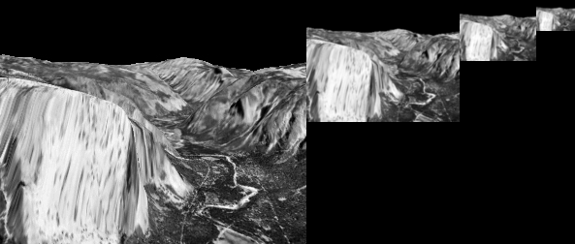
2a: Gaussian Pyramid
ps4-2-a-1.png
Computer Vision @ GT

Slide 9
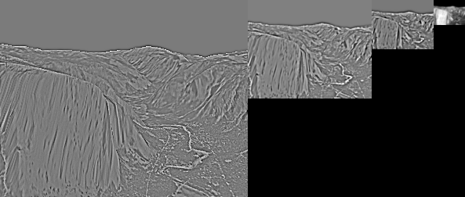
2b: Laplacian Pyramid
Laplacian Pyramid Image - ps4-2-b-1.png
Computer Vision @ GT

Slide 10
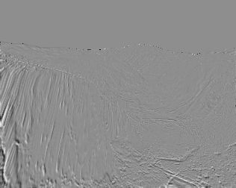
3a: Difference images
ps4-3-a-1.png
Computer Vision @ GT

Slide 11
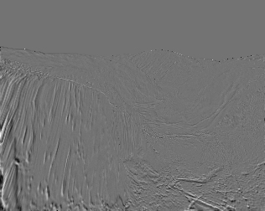
3a: Difference images (cont.)
ps4-3-a-2.png
Computer Vision @ GT

Slide 12
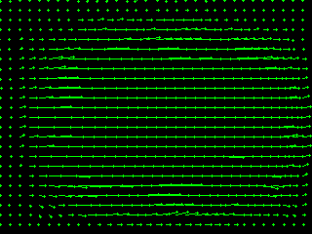
4a: Hierarchical LK
ps4-4-a-1.png
Computer Vision @ GT

Slide 13
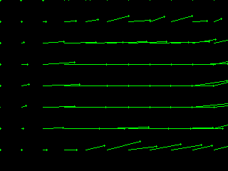
4a: Hierarchical LK (cont.)
ps4-4-a-2.png
Computer Vision @ GT

Slide 14
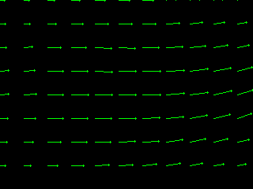
4a: Hierarchical LK (cont.)
ps4-4-a-3.png
Computer Vision @ GT

Slide 15
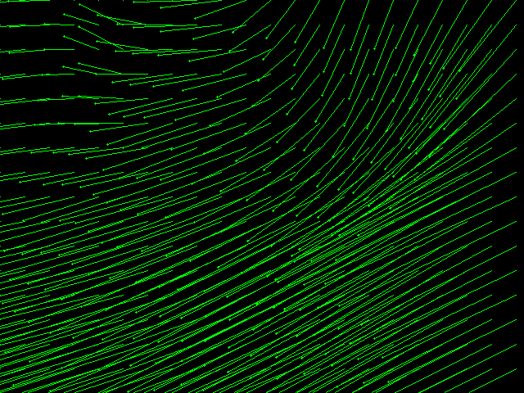
4b: Hierarchical LK (cont.)
ps4-4-b-1.png
Computer Vision @ GT

Slide 16
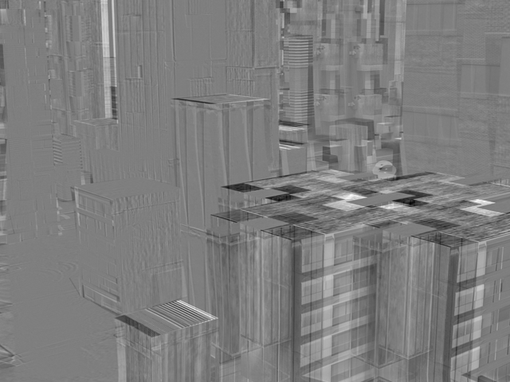
4b: Hierarchical LK (cont.)
ps4-4-b-2.png
Computer Vision @ GT

Slide 17
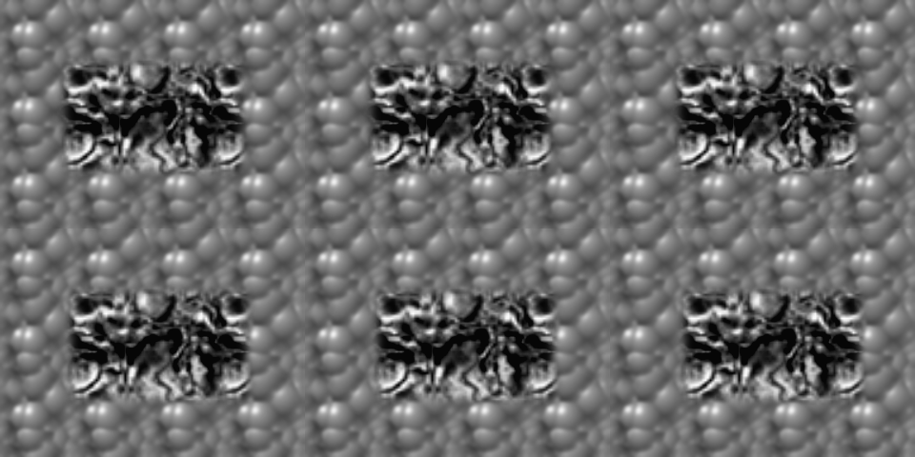
5a: Frame Interpolation
ps4-5-a-1.png
Computer Vision @ GT

Slide 18
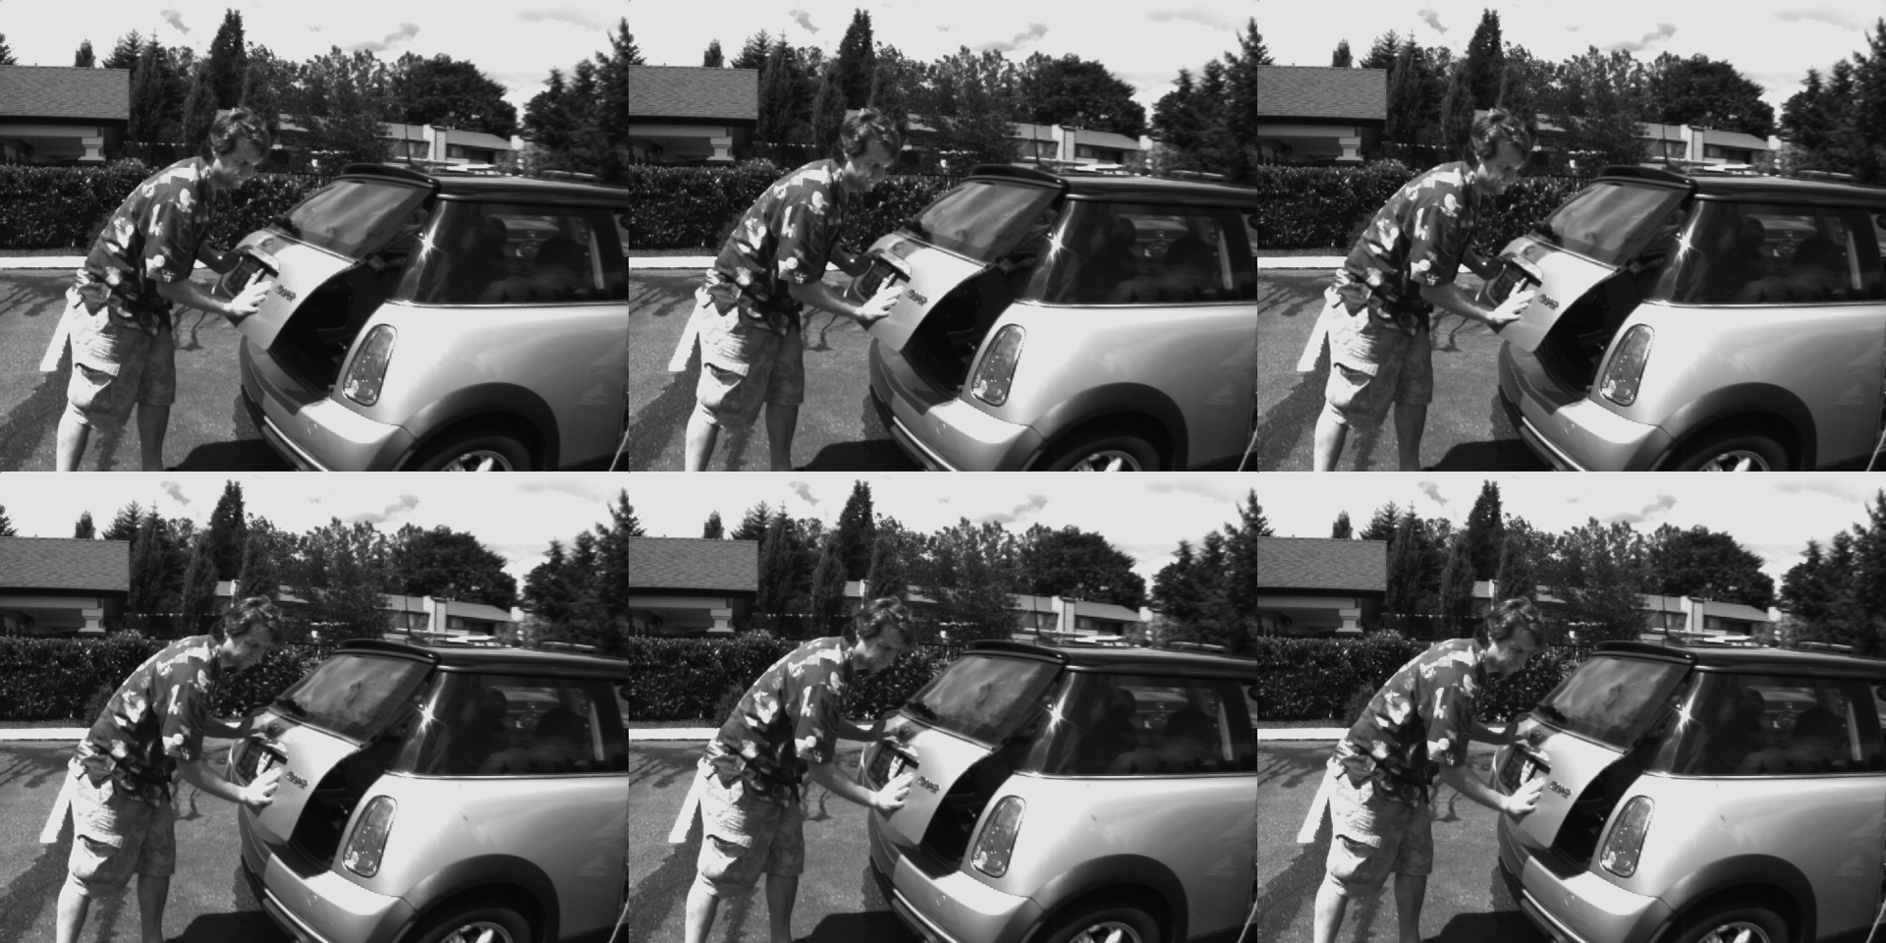
5b: Frame Interpolation
ps4-5-b-1.png
Computer Vision @ GT

Slide 19
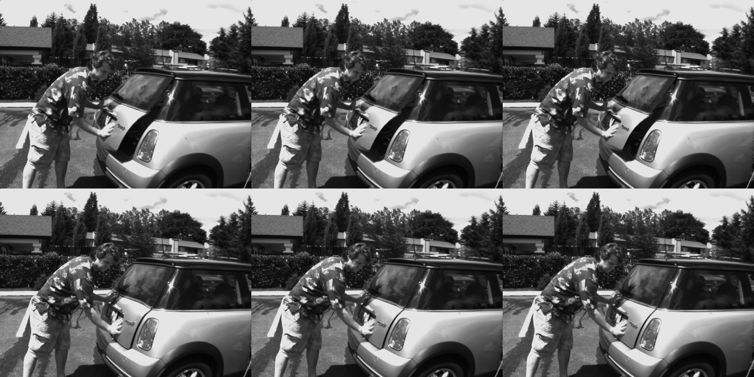
5b: Frame Interpolation
ps4-5-b-2.png
Computer Vision @ GT

Slide 20
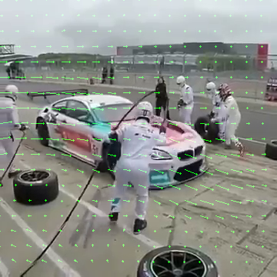
6: Challenge Problem
ps4-6-a-1.png
Computer Vision @ GT

Slide 21
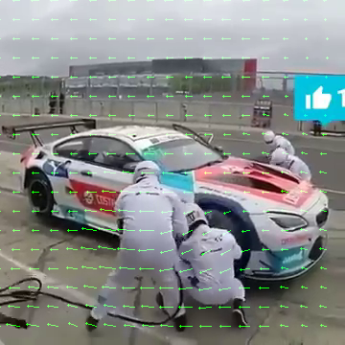
6: Challenge Problem (cont.)
ps4-6-a-2.png
Computer Vision @ GT

Slide 22
6: Challenge Problem (cont.)
Video Link
https://youtu.be/ULyw1tetzfU
Computer Vision @ GT

