Slide 1
Computer Vision
(TERM YEAR)
Problem Set #6
Darragh Hanley
darragh.hanley@gatech.edu
Computer Vision @ GT

Slide 2
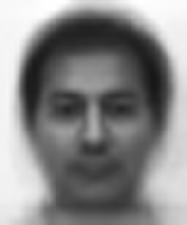
1a: Average face
ps6-1-a-1.png
Computer Vision @ GT

Slide 3
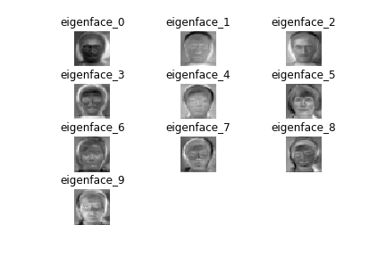
1b: Eigenvectors
ps6-1-b-1.png
Computer Vision @ GT

Slide 4
1c: Analysis
- Analyze the accuracy results over multiple iterations.Do these “predictions” perform better than randomly selecting a label between 1 and 15?
Below are the random accuracy results vs. the average PCA prediction over 10 iterations. You can see the the random results get nowhere near the PCA averaged results. The split % value is 0.5 and k =5 for all the below runs. For the random runs we randomly selected target predictions of 1 to 15 in each iteration.
------------------------------------------------------------
Part 1C : Random accuracy iter 0 : 4.85%
Part 1C : Random accuracy iter 1 : 6.67%
Part 1C : Random accuracy iter 2 : 6.67%
Part 1C : Random accuracy iter 3 : 6.67%
Part 1C : Random accuracy iter 4 : 7.88%
Part 1C : Random accuracy iter 5 : 4.85%
Part 1C : Random accuracy iter 6 : 8.48%
Part 1C : Random accuracy iter 7 : 6.67%
Part 1C : Random accuracy iter 8 : 7.88%
Part 1C : Random accuracy iter 9 : 5.45%
-*-*-*-*-*-*-*-*-*-*-*-*-*-*-*-*-*-*-*-*-*-*-*-*-*-*-*-*-*-*
------------------------------------------------------------
PCA Good predictions = 51 Bad predictions = 32
61.45% accuracy over 1 iteration
-*-*-*-*-*-*-*-*-*-*-*-*-*-*-*-*-*-*-*-*-*-*-*-*-*-*-*-*-*-*
63.86% accuracy over 10 iterations
Computer Vision @ GT

Slide 5
1c: Analysis
Are there any changes in accuracy if you try low values of k​ ? How about high values?
Below the results for in increasing values of k. It can be seen that very low values perform significantly worse; however the results perform close to optumal at around 15 and above.
------------------------------------------------------------
PCA k: 1, 15.66% accuracy
PCA k: 2, 45.78% accuracy
PCA k: 3, 53.01% accuracy
PCA k: 4, 62.65% accuracy
PCA k: 6, 65.06% accuracy
PCA k: 8, 67.47% accuracy
PCA k: 10, 78.31% accuracy
PCA k: 15, 79.52% accuracy
PCA k: 20, 79.52% accuracy
PCA k: 30, 81.93% accuracy
PCA k: 100, 80.72% accuracy
-*-*-*-*-*-*-*-*-*-*-*-*-*-*-*-*-*-*-*-*-*-*-*-*-*-*-*-*-*-*
Computer Vision @ GT

Slide 6
1c: Analysis
Does this algorithm improve changing the split percentage ​ p ​ ?
Below the results for in increasing values of p. It can be seen that very low values perform significantly worse; however the results perform close to optumal at around 0.4 and above.
------------------------------------------------------------
Split p: 0.1, 46.31% accuracy
Split p: 0.2, 59.85% accuracy
Split p: 0.3, 62.07% accuracy
Split p: 0.4, 72.73% accuracy
Split p: 0.5, 67.47% accuracy
Split p: 0.6, 77.27% accuracy
Split p: 0.7, 74.00% accuracy
Split p: 0.8, 66.67% accuracy
Split p: 0.9, 70.59% accuracy
-*-*-*-*-*-*-*-*-*-*-*-*-*-*-*-*-*-*-*-*-*-*-*-*-*-*-*-*-*-*
Computer Vision @ GT

Slide 7
2a: Average Accuracy
Below can be seen the accuracy for the Random, Weak and Boosting in both Train and Test. We see with a split of 0.8 and 5 random runs, and with 5 boosted iterations the Training and Testing accuracy for each is very close.
However the random significantly underperforms. The Boosting seems to do about 2% points better than the Weak classifier in both train and test.
p,split; Iters ;Trn Rand; Trn Weak; Trn Boost; Tst Rand; Tst Weak; Tst Boost
[ 0.8 5. 49.95305 87.48044 90.20344 50.5 87. 89.25 ]
Computer Vision @ GT

Slide 8
2a: Analysis
Now we test the boosting accuracy over a different number of iterations, averaging the results each time over 5 runs.
We see that the number of iterations has a large impacts on the test and train accuracy. The more iterations the better.
------------------------------------------------------------
p,split; Iters ;Trn Rand; Trn Weak; Trn Boost; Tst Rand; Tst Weak; Tst Boost
[ 0.8 2. 49.95305 87.48044 87.48044 50.5 87. 87. ]
[ 0.8 5. 49.95305 87.48044 90.20344 50.5 87. 89.25 ]
[ 0.8 10. 49.95305 87.48044 94.99218 50.5 87. 92.5 ]
[ 0.8 20. 49.95305 87.48044 99.31142 50.5 87. 99.25 ]
-*-*-*-*-*-*-*-*-*-*-*-*-*-*-*-*-*-*-*-*-*-*-*-*-*-*-*-*-*-*
Computer Vision @ GT

Slide 9
2a: Analysis
Now we test the boosting accuracy over a different splits, each time using 10 boostings iterations, averaging the results each time over 5 runs.
We see that the number of iterations has little impacts on the test and train accuracy. It seems to be only random change. This is interesting as, p of 0.2 is significantly less image data as the rest of the runs. It seems the algorithms are robust to lower data sets.
------------------------------------------------------------
p,split; Iters ;Trn Rand; Trn Weak; Trn Boost; Tst Rand; Tst Weak; Tst Boost
[ 0.2 10. 49.68553 87.67296 96.98113 50.09375 85.28125 93.3125 ]
[ 0.4 10. 51.72414 87.7116 95.98746 49.70833 87.08333 93.5 ]
[ 0.6 10. 48.51775 87.80793 95.36534 50.125 86.3125 93.5 ]
[ 0.8 10. 49.95305 87.48044 94.99218 50.5 87. 92.5 ]
-*-*-*-*-*-*-*-*-*-*-*-*-*-*-*-*-*-*-*-*-*-*-*-*-*-*-*-*-*-*
Computer Vision @ GT

Slide 10

3a: Haar Features
ps6-3-a-1.png
Computer Vision @ GT

Slide 11

3a: Haar Features
ps6-3-a-2.png
Computer Vision @ GT

Slide 12

3a: Haar Features
ps6-3-a-3.png
Computer Vision @ GT

Slide 13

3a: Haar Features
ps6-3-a-4.png
Computer Vision @ GT

Slide 14

3a: Haar Features
ps6-3-a-5.png
Computer Vision @ GT

Slide 15
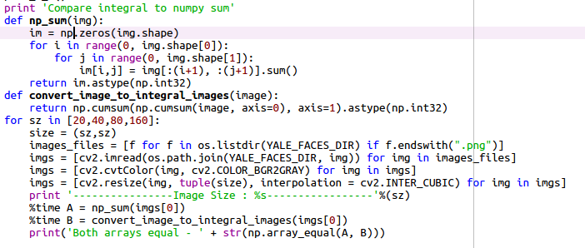
3c: Analysis
Text Answer: How does working with integral images help with computation time? Give some
examples comparing this method and np.sum.
Numpy sum was seen to take a lot longer that integral arrays. Numpy recalculates the values for each position in the array over the respective axis; however integral arrays are calculated once and the values are stored in memory.
With integral arrays we can take advantage of numpy’s cumsum using just the points of the slice of the array.
Below can be seen time results of numpy sum vs integral array along with the code.
----------------Image Size : 20-----------------
CPU times: user 1.23 ms, sys: 0 ns, total: 1.23 ms
Wall time: 1.26 ms
CPU times: user 27 µs, sys: 0 ns, total: 27 µs
Wall time: 28.8 µs
Both arrays equal - True
----------------Image Size : 40-----------------
CPU times: user 5.23 ms, sys: 0 ns, total: 5.23 ms
Wall time: 5.29 ms
CPU times: user 33 µs, sys: 0 ns, total: 33 µs
Wall time: 36 µs
Both arrays equal - True
----------------Image Size : 80-----------------
CPU times: user 29 ms, sys: 0 ns, total: 29 ms
Wall time: 29.7 ms
CPU times: user 52 µs, sys: 0 ns, total: 52 µs
Wall time: 55.1 µs
Both arrays equal - True
----------------Image Size : 160-----------------
CPU times: user 231 ms, sys: 3.93 ms, total: 235 ms
Wall time: 248 ms
CPU times: user 156 µs, sys: 3 µs, total: 159 µs
Wall time: 163 µs
Both arrays equal - True
Computer Vision @ GT

Slide 16
4b: Viola Jones Features
ps6-4-b-1.png
Computer Vision @ GT

Slide 17
4b: Viola Jones Features
ps6-4-b-2.png
Computer Vision @ GT

Slide 18
4b: Analysis
Report the classifier accuracy both the training and test sets with a number of classifiers set to 5. What do the selected Haar features mean? How do they contribute in identifying faces in an image?
Prediction accuracy on training: 94.29%
Prediction accuracy on testing: 68.57%
The Haar features represent filters which can represent the properties of the face, or the most relevant features. These features, when used give the minimum error rate for classifying the faces.
In the detection phase of the Viola–Jones algorithm, a window is moved over the input image, and for each subsection of the image the Haar-like feature is calculated. This difference is then compared to a learned threshold that separates non-objects from objects. Because Haar-like feature is only a weak learner or classifier a large number of Haar-like features are necessary to accurately describe an object. In the Viola–Jones object detection, the Haar features are organized in a classifier cascade to form a strong learner or classifier.
In recent years Haar features have been mostly replaced in object detection by CNN methods such as RetinaNet, RCNN or Yolo – there build up dynamic feature bank, where each feature adapts over training to best classify the objects in data inputted.
Computer Vision @ GT

Slide 19

4c: Viola Jones Face Recognition
ps6-4-c-1.png
Computer Vision @ GT

