Slide 1

New SCT status updates v1.6
Giorgio Parma
22/11/2023

Slide 2



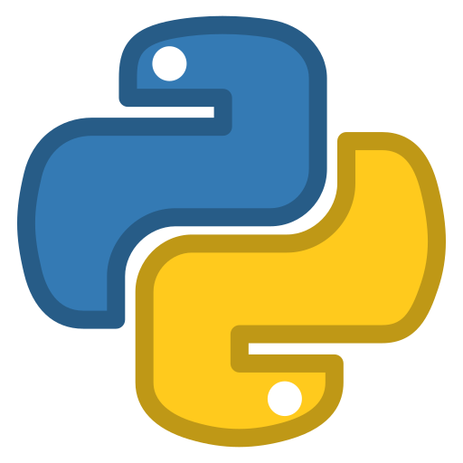





High Level Software Architecture
Arepytools (>v1.6.0)
Perturbations data download
Calibration sites DB
Arepyextras
Perturbations (1.1.0)
Core algorithms and tools
iers_solid_tides (1.0.0)
quality (1.1.0)
eo_products (1.0.0)
Product format auto-detection
Analysis type auto-detection
Apply perturbations and corrections
Reporting and results storage
Private Side
- multi-mission input
- external orbit
- conversion to protocol-compliant object
- select proper analysis based on inputs
- import calibration sites database if needed
- atmospheric and geophysics perturbations
- time corrections
- notebook report
- interactive plots
- results storage in DB-like format
Open-Source Side

Slide 3
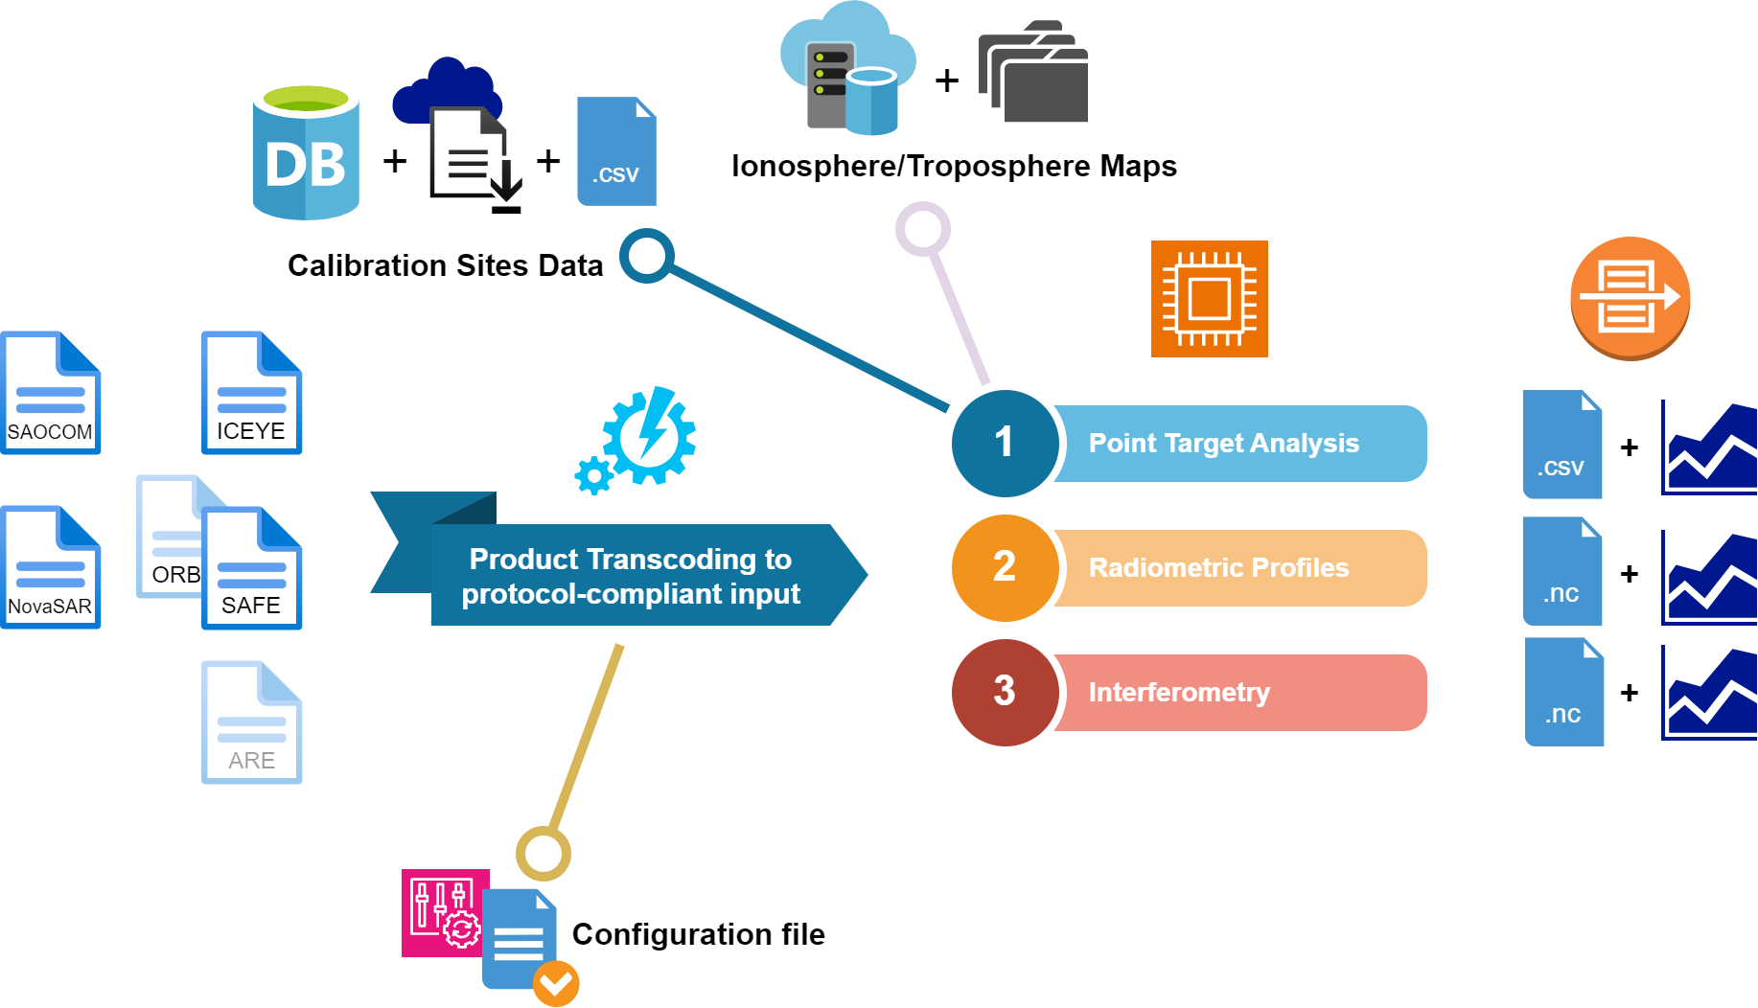
High Level Software Architecture

Slide 4
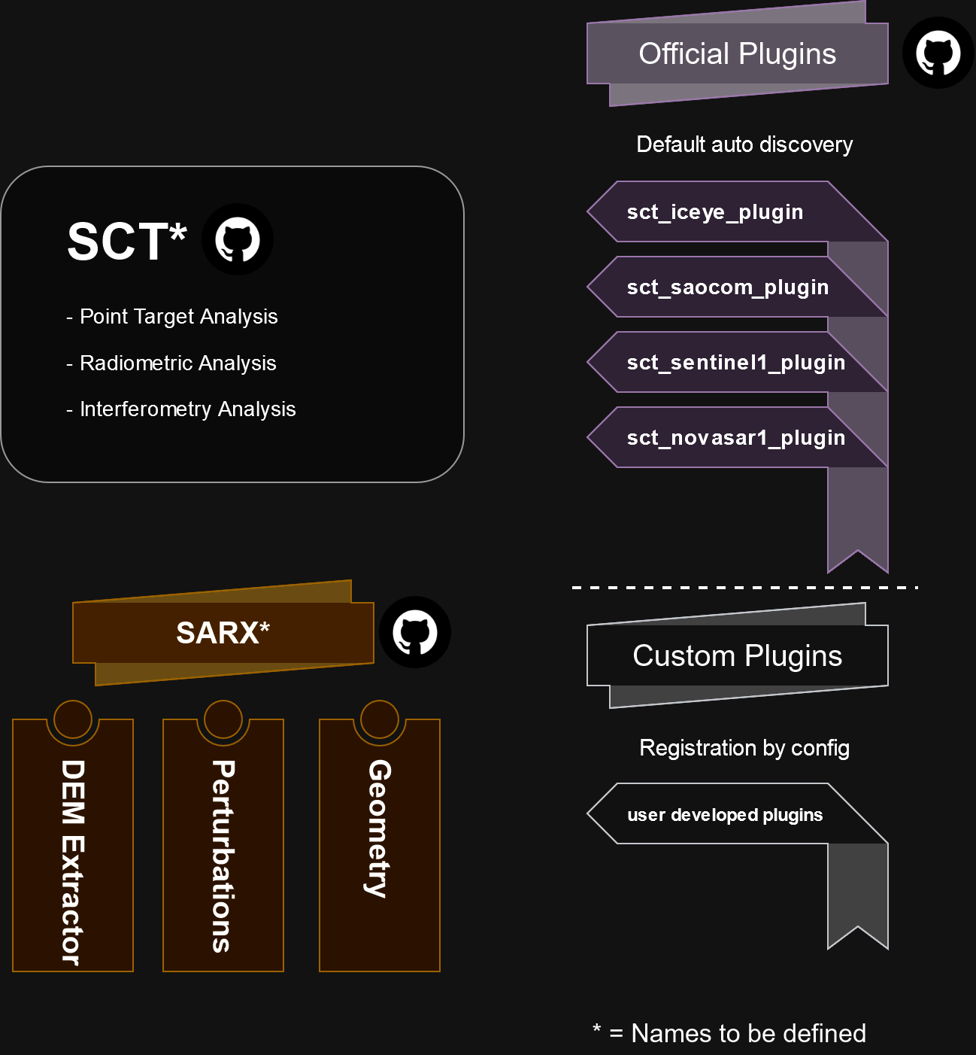
High Level Software Architecture

Slide 5
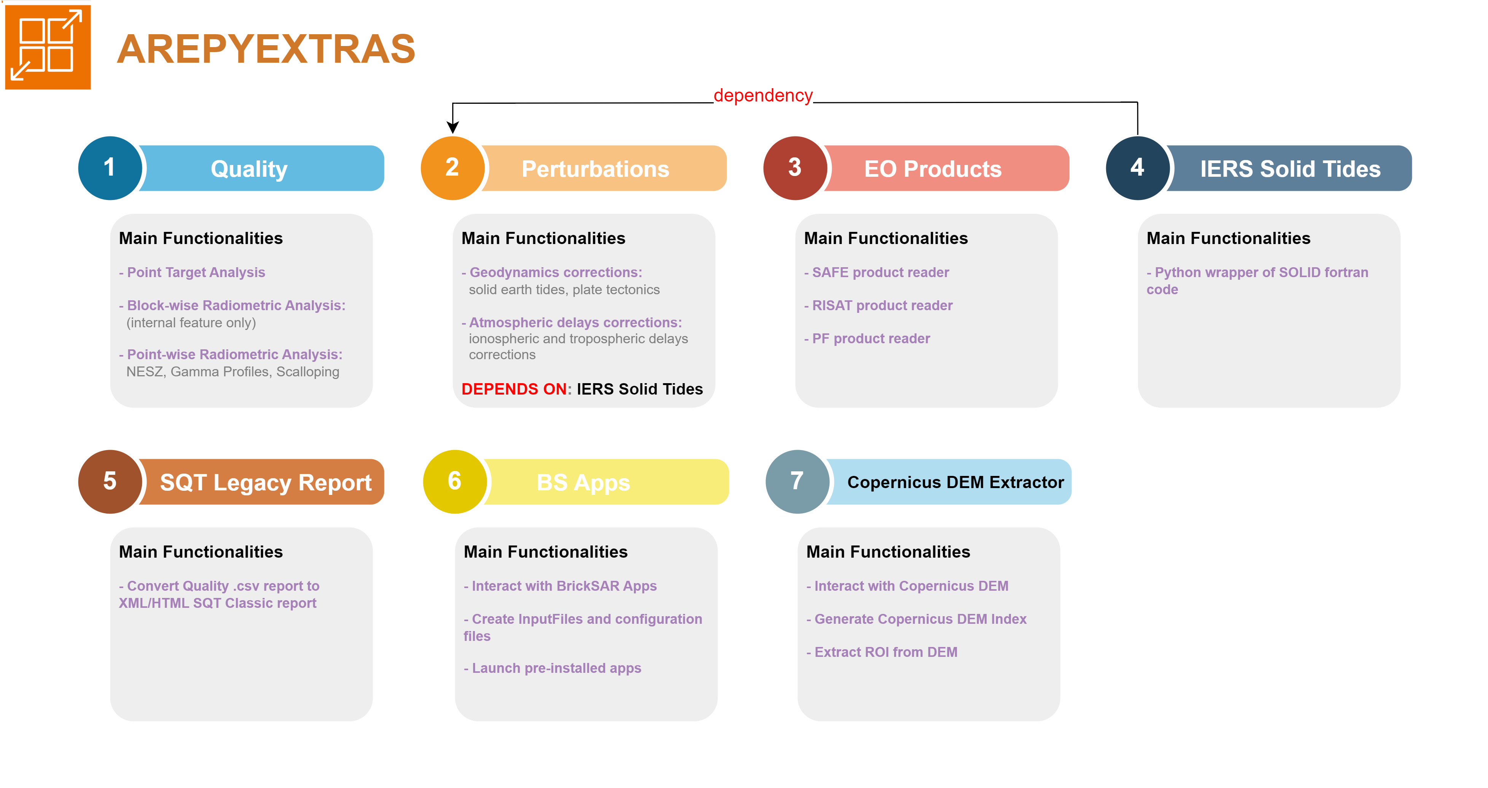
High Level Software Architecture - Arepyextras
SCT Dependencies

Slide 6
Supported Missions and Products
Product/Mission | Code Availability | Status | Priority
Aresys Product Folder | Matlab/Python | DONE | 0
Sentinel-1 SAFE | Python | DONE | 0
RISAT-1A (US4) | - | ONGOING | 1
NOVASAR | Python | DONE | 2
SAOCOM | Matlab | ONGOING | 2
ICEYE | Matlab | DONE | 2
PAZ | Matlab | TBD | 3
TERRASAR-X | - | TBD | 3
COSMO | - | TBD | 3
RADARSAT-2 | - | TBD | 3
ROSE-L | - | TBD | 4
KOMPSAT-5 | - | TBD | 4
April Release
EDAP
MPC

Slide 7
OPEN POINTS (ESA)
Issue | Possible Solutions | Status
Change IERS Solid Tides Fortran code management (deploy issue) | - build_ci_tools: multiple wheels platform dependent - wheel compiled on target machine - microservice? | TBD
Add configuration settings to output | Save same input configuration to output folder | TBD
OPEN POINTS (Internal)
Issue | Possible Solutions | Status
Internal Docker for analysis | Docker container with volume mounted from server where data persist? | TBD
Integrate RCS Model | Integrate existing scripts? | TBD
Interferometry: implement scripts (co-registration + coherency) | Integrate existing scripts? | TBD
ETAD products | Develop support for etad products in eo_products? | DONE
RISAT reader | Develop reader in eo_products | TBD

Slide 8
Private Side – UPDATES
MILESTONE 2/2
SLC complete Point Target Analysis and benchmarking with old SCT [DONE]
GRD complete Point Target Analysis and benchmarking with old SCT [DONE]
Arepyextras Quality
SCT
define operation flow and configurability (accessible tunable parameters) [~DONE]
documentation [ONGOING]
introduction of new products (ETAD and MPC) [TBD]
calibration sites gathering and database population + rethinking? [ON-HOLD]
interferometry analysis [?]

Slide 9
Private Side – COMPLETED TASKS 1/2
Arepytools
new Aresys product folder format implementation [DONE]
new internal point target products management implementation [DONE]
Arepyextras Quality
refactoring to allow protocol-compliant input injection [DONE]
refactoring to allow new Aresys product folder format from arepytools [DONE]
Radiometric Profiles (NESZ, Gamma, Scallop) implementation [DONE]
SCT legacy report conversion [DONE]
SCT 1/2
perturbations management: understand where and how [DONE]
time corrections management: understand where and how [DONE]
calibration sites SQLite database schema definition [DONE]
create a new internal repository to host the project [DONE]
external orbits management: understand where and how [DONE]
SAFE reader, compliant with input protocol [DONE]
calibration sites SQLite database schema definition [DONE]
SQLite calibration site generation (scripts + DB) [DONE]

Slide 10
Private Side – COMPLETED TASKS 2/2
SCT 2/2
external orbits management: understand where and how [DONE]
external orbits module (specific for sentinel-1) implementation [DONE]
time corrections module (specific for sentinel-1) implementation [DONE]

Slide 11
Private side – Calibration Sites
INFORMATION NEEDED
Calibration sites DB management:
How to manage calibration sites different from Surat Basin?
Delays? RCS? In DB or to be evaluated through formulas? (if they are signal dependent, they cannot be in a DB)
Support for external .csv template source file
Rosamond? Very difficult to add to DB

Slide 12
Private side – Web Scraping
INFORMATION NEEDED
Automatic download of what is needed to perform a complete
Analysis:
Rosamond point target data download (free access) DONE
Troposphere maps download (free access) DONE
Ionosphere maps download (authentication needed)
As a separate module? Internal only?

Slide 13
Private side – Open-Source Boundaries
INFORMATION NEEDED
Understand what’s open-source and what’s not.
Define boundaries for the application as per ESA request.

Slide 14
Public Side – Status Updates
Arepytools
Release wheel v1.6.0 publishing on Python Package Index (PyPI) [TBD]
Arepyextras
Quality
Release wheel v1.1 publishing on Python Package Index (PyPI) [TBD]
Perturbations
Release wheel v1.1 publishing on Python Package Index (PyPI) [TBD]
SCT
Create new public github repository [TBD]
Release SCT side of project as open-source code and pre-built docker image [TBD]

Slide 15




Thank you

