Slide 1
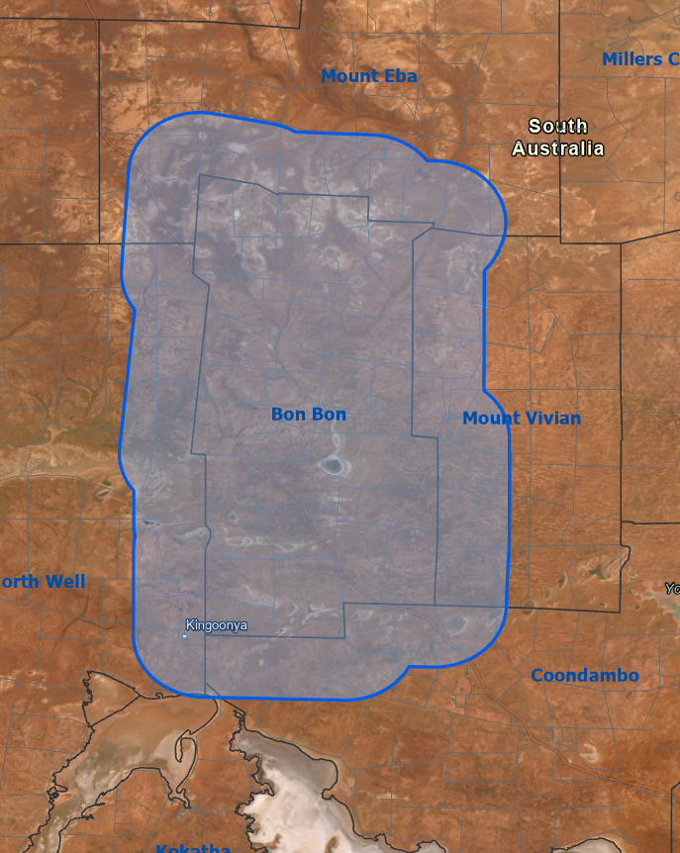
Analysis 1: Bon Bon Analysis
Bon Bon and 10 km buffer around

Slide 2
Current approach
Tried GAMs
However results are a bit tricky
Maybe not a great study design
Only one destock event, the effects of destock are then hard to separate from climatic events that happened at the same time.
i.e. millennium drought immediately before destock.

Slide 3
Current approach
So then, a more simple comparative approach between stations
Consider station anomalies rather than trying to model cover values themselves.

Slide 4
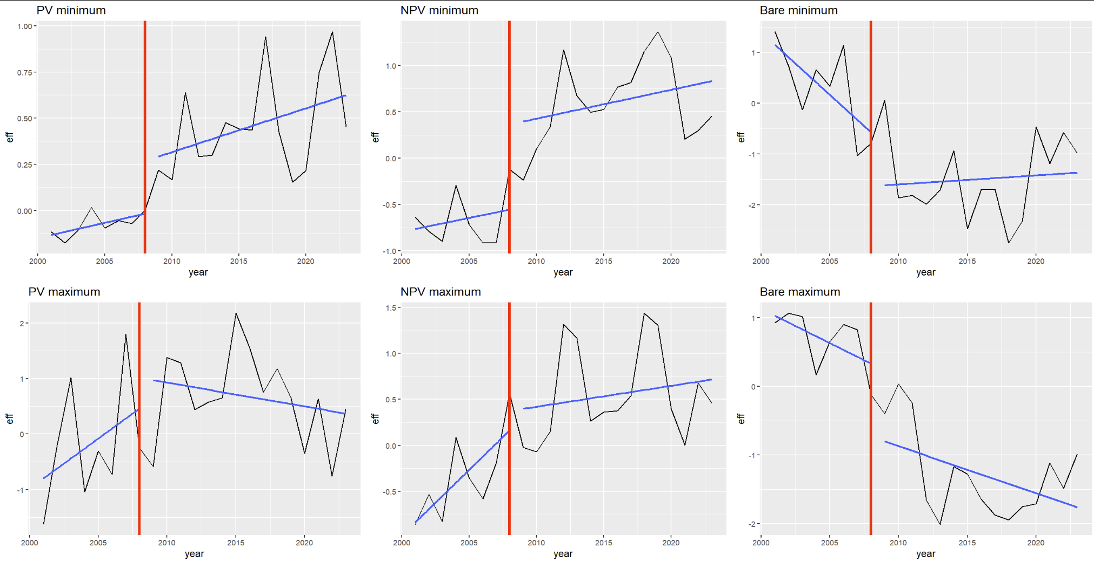
Current approach
1. Extract minimum/maximum cover values per pixel per year
2. Get cells where minimum annual PV is greater than 0
3. For each year, calculate the mean min / max. Just for Bon Bon, and just for the surrounding stations
4. Subtract these two values. This is the effect.

Slide 5
Current approach
0 = cover value at BB the same as surrounding stations.
> 0 = cover value more than at surrounding stations
Blue lines = linear model for pre and post 2008 to show trend in the effect.

Slide 6
Analysis 2: Olympic Dam analysis
Stations surrounding Olympic Dam
Have actual stock density values for this study area
Haven’t revisited this part yet.
Maybe try the GAMs still. Wouldn’t be able to use the same comparative approach as with Bon Bon as all stations are always stocked.

Slide 7
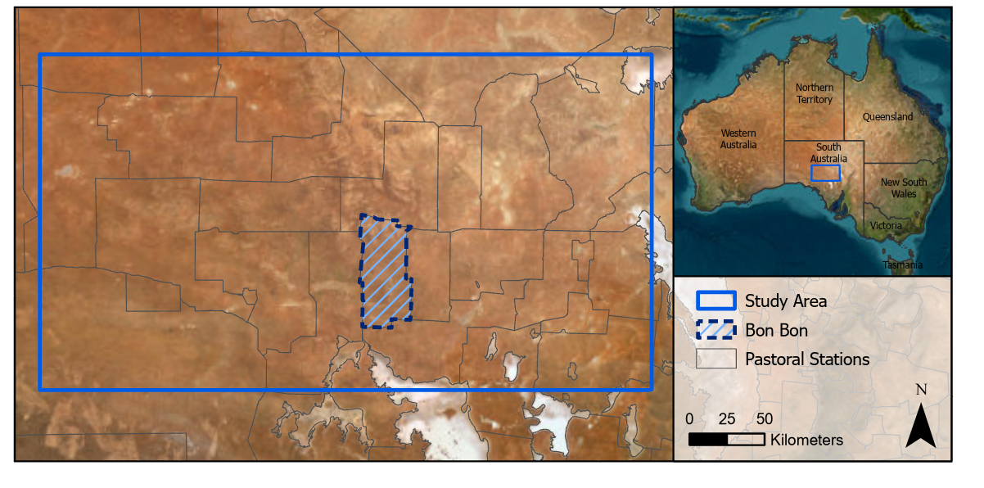
Analysis 3: Broad scale analysis.
The original idea for this part was to look at a wider study area around Bon Bon and Olympic dam. Without using GAMs
And generally compare nearby stations to see if any differences may be explainable by management.
This part may be somewhat redundant. Could apply the same analysis as used for Bon Bon to any selection of nearby stations.

Slide 8
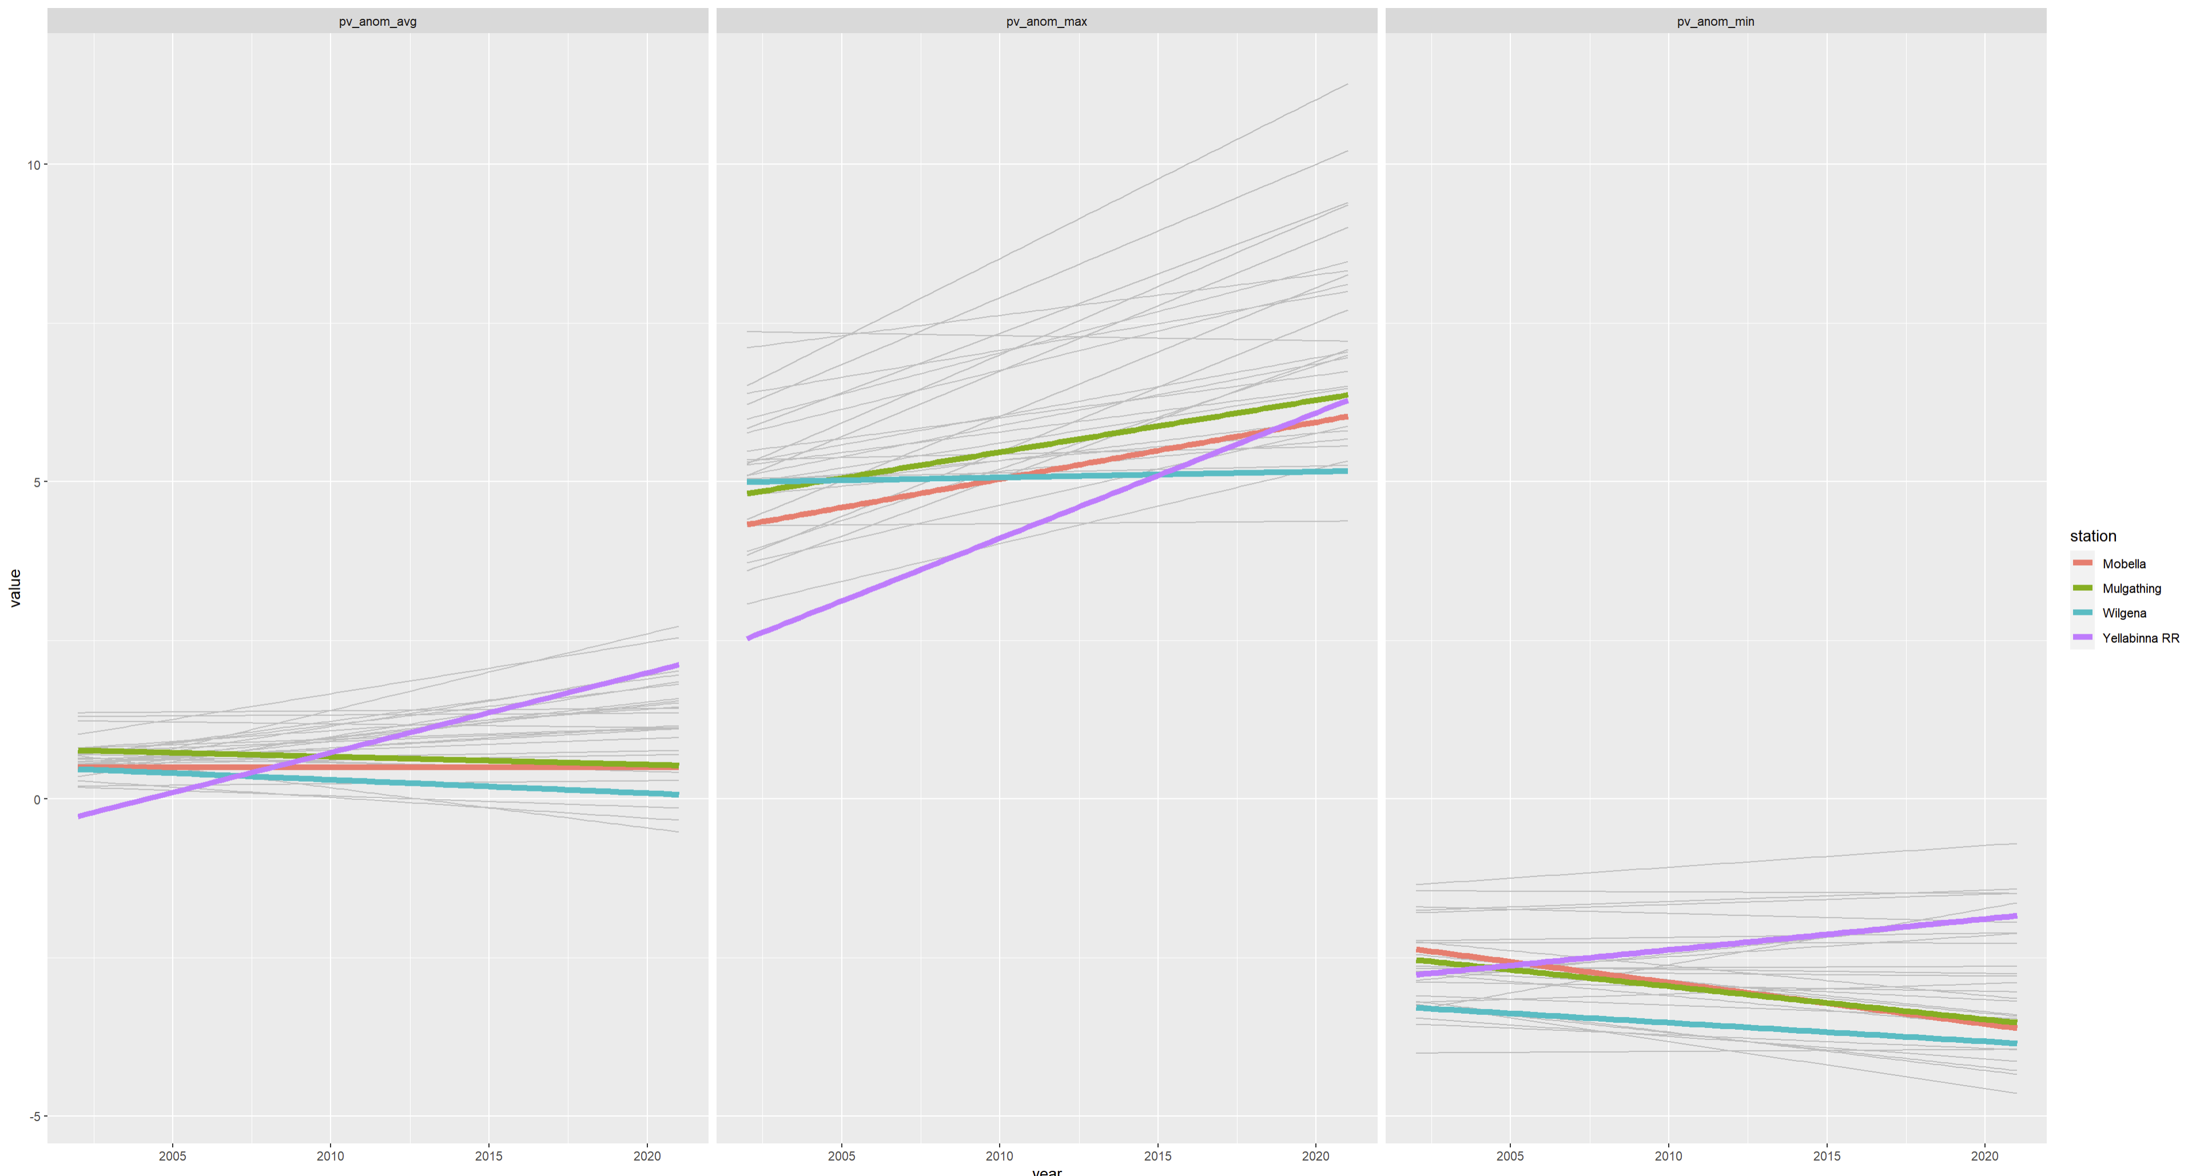
Analysis 3: Broad scale analysis.
This is the sort of thing we had previously.
Similar to the lines plotted through the BB graphs above.
Although no specific date of management change. So maybe normalise to the starting cover value. I.e. Yellabinna started with low cover, so that would increase its potential for greening.

Slide 9
Plan
Focus first on the Bon Bon and surrounding analysis.
Then the Olympic Dam analysis. Although will need to think of how well the GAMs may work for this.
May also be difficult as stocking rates likely fluctuate with rainfall and therefore cover as well.
Maybe also include some other comparisons in a similar approach as used for Bon Bon.

