Slide 1
Clustering Results

Slide 2
Tasks
Clustering steps
Clustering based on HM_X, HM_Y, and HM_Z values
Two types of analysis
User-level analysis
CDF plots for K=2,3 for segments
Cluster-wise user distribution for segments
Frame-level analysis
Bounding box calculation

Slide 3
User-level Analysis
For every segment of the video
Clustering is done based on HM_X, HM_Y, and HM_Z values
A user is assigned to that cluster, which contains most of her samples

Slide 4
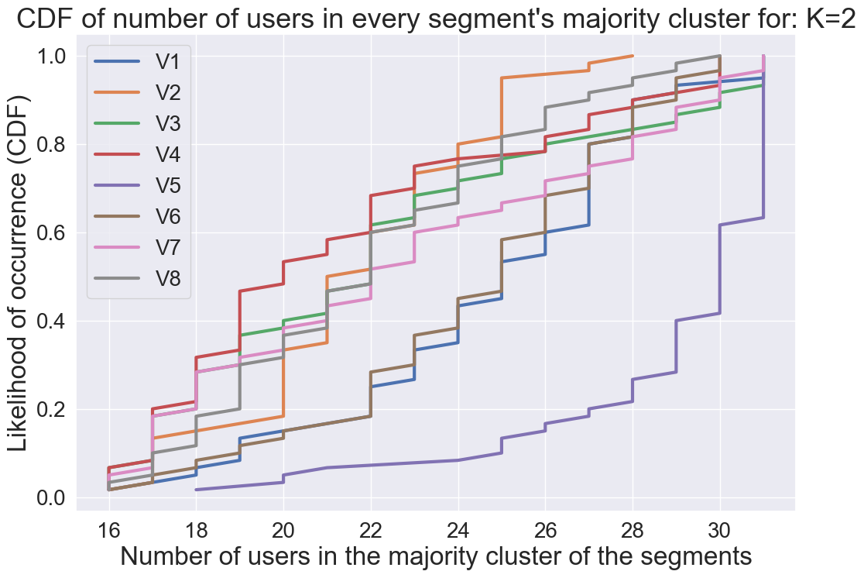
CDF of the number of users in majority cluster (K=2)
For all videos, 80% of the segments’ majority cluster contains at least 18 users

Slide 5
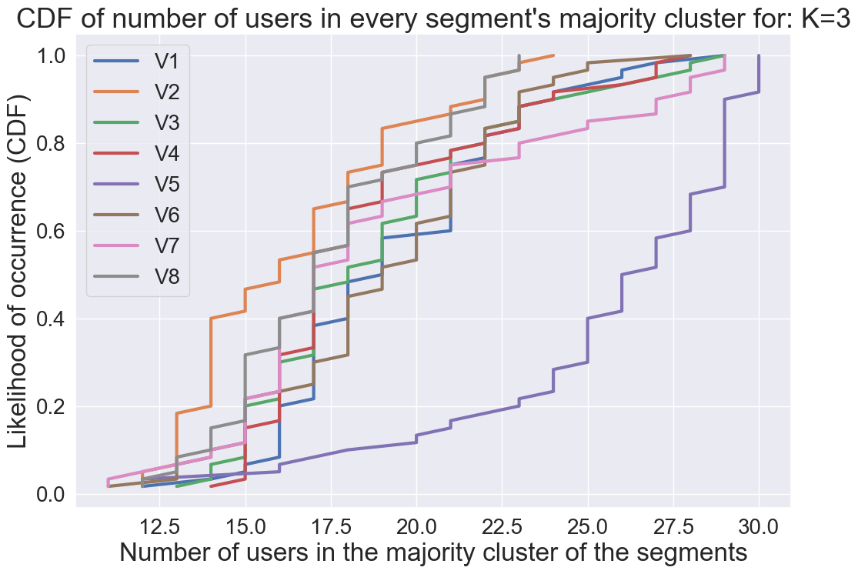
CDF of the number of users in majority cluster (K=3)
For all videos, 80% of the segments’ majority cluster contains at least 14 users

Slide 6
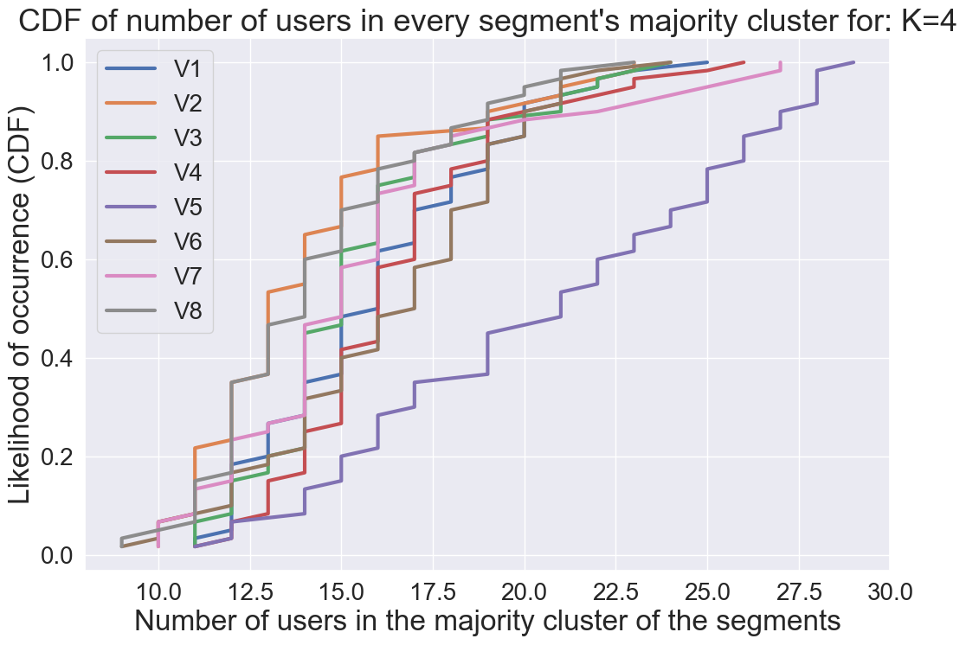
CDF of the number of users in majority cluster (K=4)
For all videos, 80% of the segments’ majority cluster contains at least 11 users

Slide 7
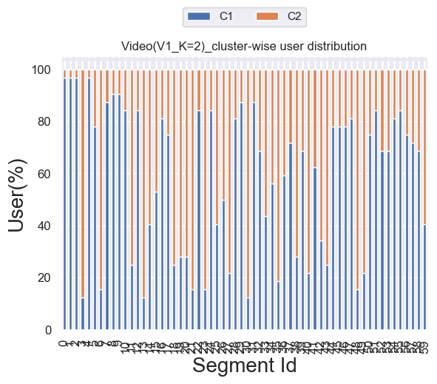
Cluster-wise user distribution

Slide 8
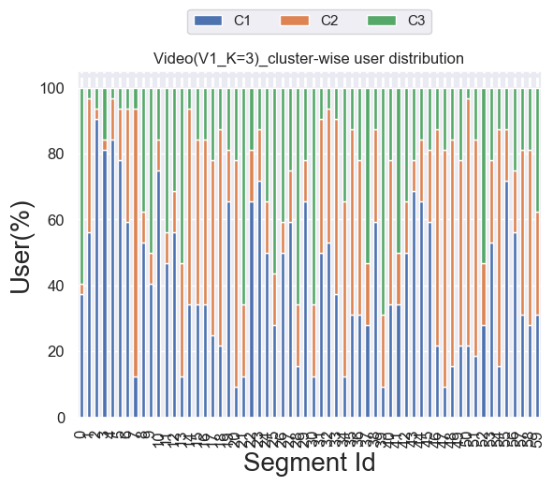
Cluster-wise user distribution

Slide 9
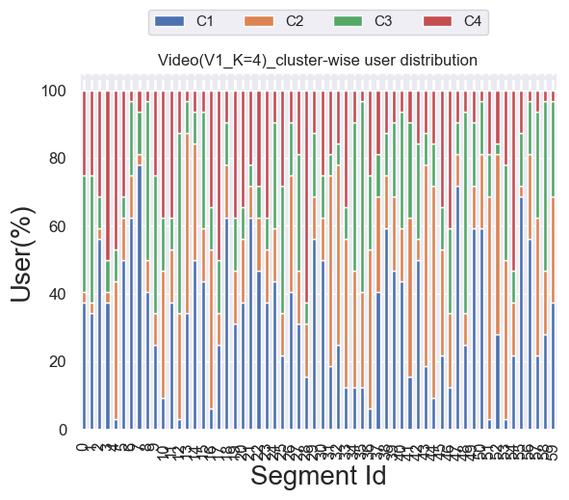
Cluster-wise user distribution

Slide 10
Frame-level Analysis
For every segment of the video
Clustering is done based on HM_X, HM_Y, and HM_Z values
Part of the samples (frames, pitch, yaw) of one user can be in one cluster, and other samples in another cluster

Slide 11
Bounding box calculation
For every cluster of the segment
2-types of bounding boxes are provided
Based on Pitch and Yaw (Min Pitch, Min Yaw; Max Pitch, Max Yaw) of the cluster
Based on HM_X and HM_Y (Min HM_X, Min HM_Y; Max HM_X, Max HM_Y) of the cluster

Slide 12
Related files
Code
clustering_users.py
Clustering output files
clustering_op_K=2.csv
clustering_op_K=3.csv
clustering_op_K=4.csv
CDF files
K=2_segment_wise_no_of_similar_users_CDF.PNG
K=3_segment_wise_no_of_similar_users_CDF.PNG
K=4_segment_wise_no_of_similar_users_CDF.PNG
Cluster-wise user distribution
Cluster_wise_user_dist_V1K=2.PNG
Cluster_wise_user_dist_V1K=3.PNG
Cluster_wise_user_dist_V1K=4.PNG

