Slide 1
Clustering Results

Slide 2
Tasks
Clustering steps
Clustering based on HM_X, HM_Y, and HM_Z values
Two types of analysis
User-level analysis
CDF plots for K=2,3
Frame-level analysis
Bounding box calculation

Slide 3
User-level Analysis
For every segment of the video
Clustering is done based on HM_X, HM_Y, and HM_Z values
A user is assigned to that cluster, which contains most of her samples

Slide 4
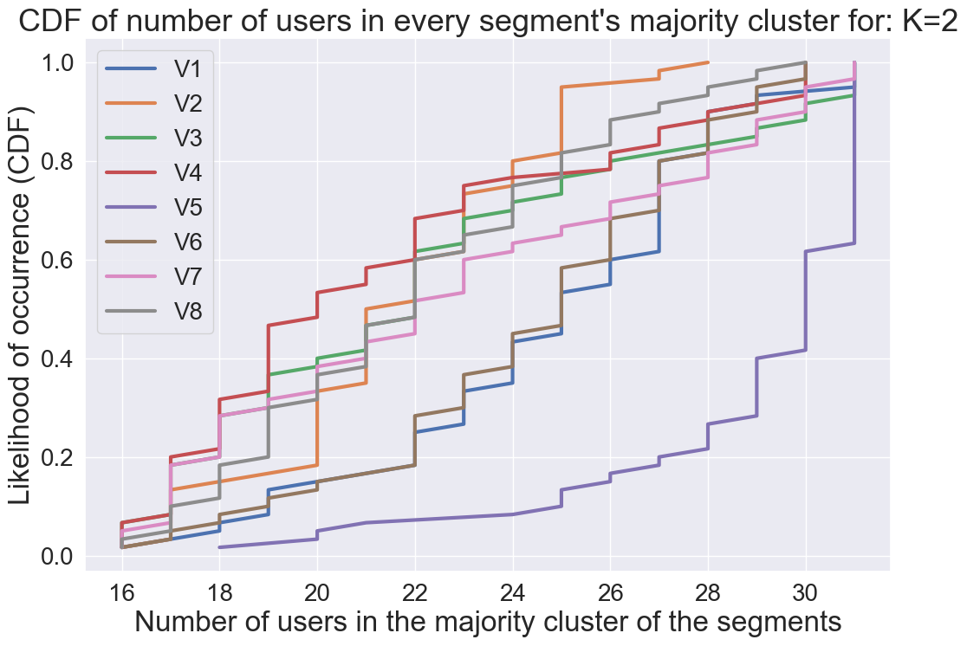
CDF of the number of users in majority cluster (K=2)
For all videos, 80% of the segments’ majority cluster contains at least 18 users

Slide 5
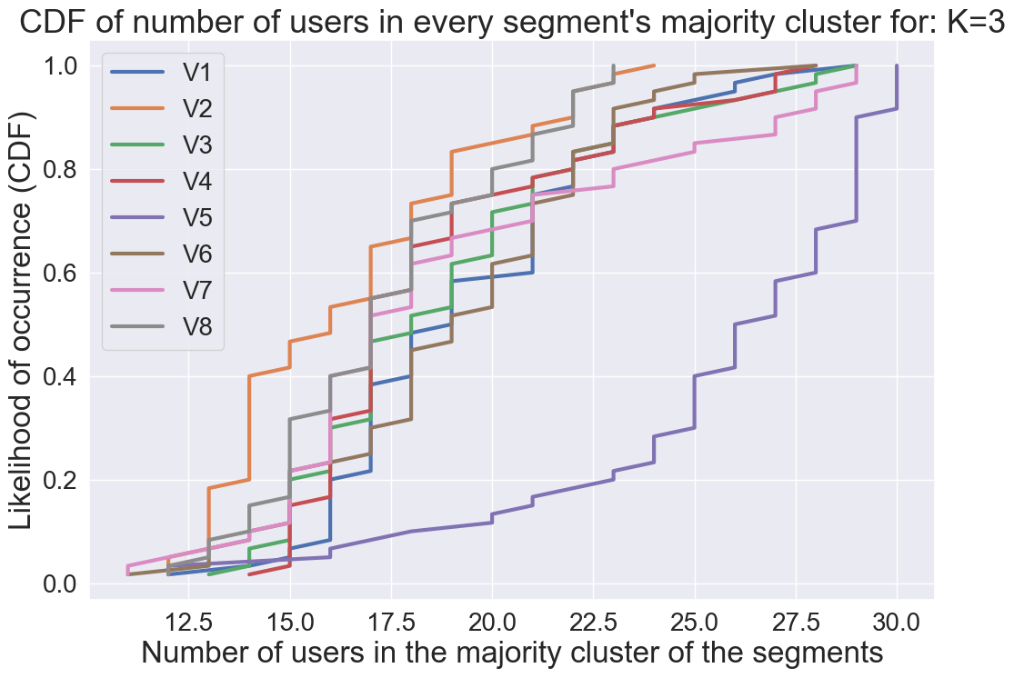
CDF of the number of users in majority cluster (K=3)
For all videos, 80% of the segments’ majority cluster contains at least 14 users

Slide 6
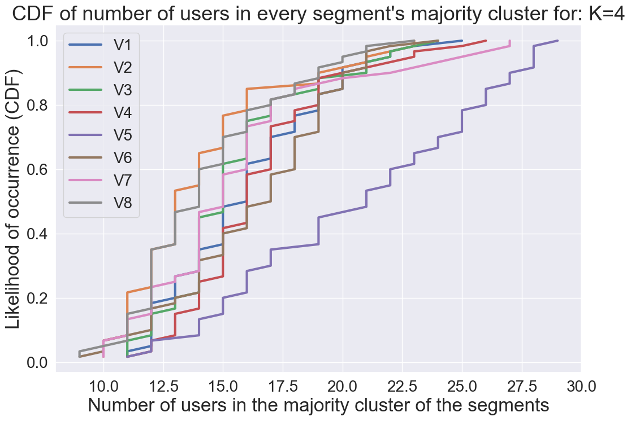
CDF of the number of users in majority cluster (K=4)
For all videos, 80% of the segments’ majority cluster contains at least 11 users

Slide 7
Frame-level Analysis
For every segment of the video
Clustering is done based on HM_X, HM_Y, and HM_Z values
Part of the samples (frames, pitch, yaw) of one user can be in one cluster, and other samples in another cluster

Slide 8
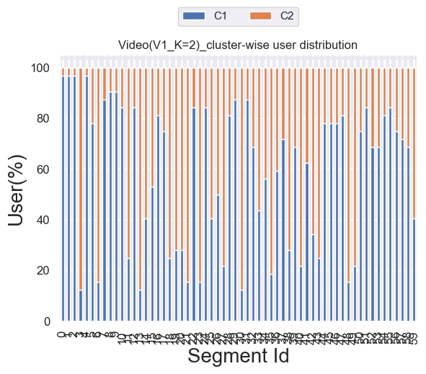
Cluster-wise user distribution

Slide 9
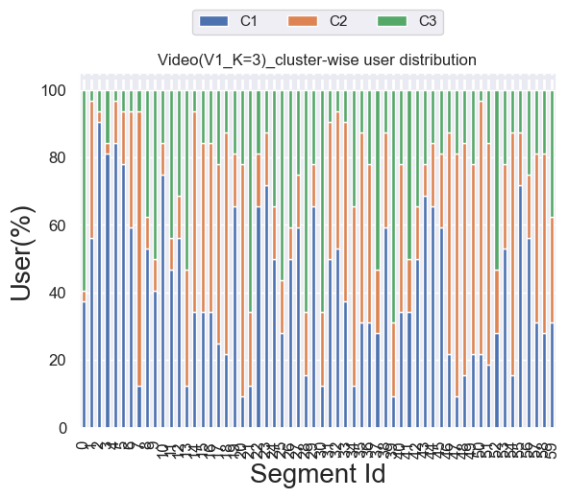
Cluster-wise user distribution

Slide 10
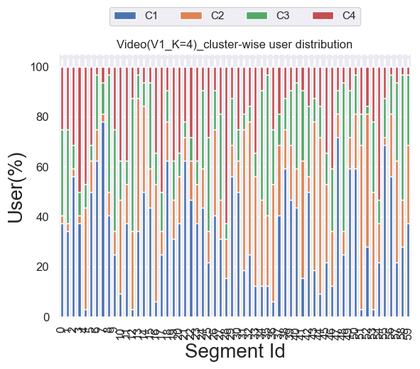
Cluster-wise user distribution

Slide 11
Bounding box calculation
For every cluster of the segment
2-types of bounding boxes are provided
Based on Pitch and Yaw (Min Pitch, Min Yaw; Max Pitch, Max Yaw) of the cluster
Based on HM_X and HM_Y (Min HM_X, Min HM_Y; Max HM_X, Max HM_Y) of the cluster

Slide 12
Related files
Code
clustering_users.py
Clustering output files
clustering_op_K=2.csv
clustering_op_K=3.csv
clustering_op_K=4.csv
CDF files
K=2_segment_wise_no_of_similar_users_CDF.PNG
K=3_segment_wise_no_of_similar_users_CDF.PNG
K=4_segment_wise_no_of_similar_users_CDF.PNG
Cluster-wise user distribution
Cluster_wise_user_dist_V1K=2.PNG
Cluster_wise_user_dist_V1K=3.PNG
Cluster_wise_user_dist_V1K=4.PNG

