Slide 1

SESSION 1
First Programs and the Shell
print, input, variables, and the edit–run–debug loop
Dr. Ibrahim Said Ahmad · Arewa Data Science Academy

Slide 2
Getting Started with Python Programming
Early 1990s: Guido van Rossum invented the Python programming language
Python is a high-level, general-purpose programming language for solving problems on modern computer systems
Useful resources at www.python.org

Slide 3
Two Ways to Write Python in This Course
VS Code — an editor you install on your own computer
Works fully offline once installed — no internet needed
This is what we will use by default
Google Colab — Python running in a web browser
Nothing to install, but you must be online to use it
Use it if you cannot install VS Code on your machine
The Python you write is identical in both
Notes:
Ask who has reliable internet at home. That answer decides which option each fellow should default to. Nobody needs both.

Slide 4
Running Code in the Interactive Shell (1 of 2)
Python is an interpreted language
Simple Python expressions and statements can be run in the shell
Easiest way to open a Python shell is to launch terminal on VS Code or Command Prompt
To quit, select the window’s close box or press Control+D
Shell is useful for:
Experimenting with short expressions or statements
Consulting the documentation

Slide 5
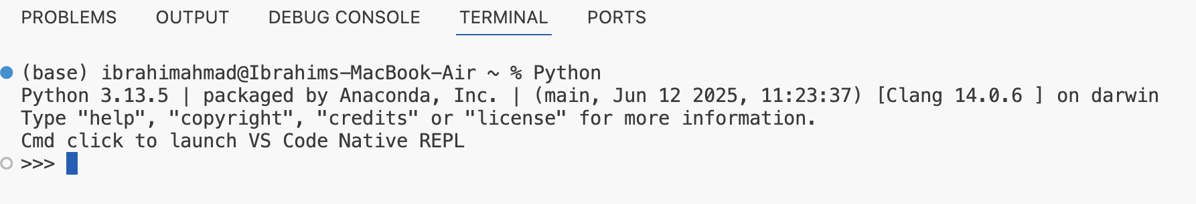
Running Code in the Interactive Shell (2 of 2)
FirstNameLastName@computername
Figure 1 Terminal window on VS Code

Slide 6
Input, Processing, and Output (1 of 5)
Programs usually accept inputs from a source, process them, and output results to a destination
In terminal-based interactive programs, these are the keyboard and terminal display
In Python, inputs are Python expressions or statements
Outputs are the results displayed in the shell
Programmers can also force output of a value by using the print function:
Example:
print (<expression>)
>>>print ("Hi there")
Hi there

Slide 7
Input, Processing, and Output (2 of 5)
The following example receives an input string from the user and saves it for further processing:
>>> name = input("Enter your name: ") Enter your name: Ken Lambert >>> name 'Ken Lambert' >>> print(name) Ken Lambert >>>

Slide 8
Input, Processing, and Output (3 of 5)
The input function always builds a string from the user’s keystrokes and returns it to the program
Strings that represent numbers must be converted from strings to appropriate number types
Two type conversion functions: int (for integers) and float (for floating-point numbers)

Slide 9
Input, Processing, and Output (4 of 5)
The next session inputs two integers and displays their sum: >>> first = int(input("Enter the first number: ")) Enter the first number: 23 >>> second = int(input("Enter the second number: ")) Enter the second number: 44 >>> print("The sum is", first + second) The sum is 67

Slide 10
Input, Processing, and Output (5 of 5)
Function | What It Does
float(<a string of digits>) | Converts a string of digits to a floating-point value.
int(<a string of digits>) | Converts a string of digits to an integer value.
input(<a string prompt>) | Displays the string prompt and waits for keyboard input. Returns the string of characters entered by the user.
print(<expression>, ..., <expression>) | Evaluates the expressions and displays them, separated by one space, in the console window.
<string 1> + <string 2> | Glues the two strings together and returns the result.
Notes:
Table 1-2 Basic Python functions for input and output

Slide 11
Editing, Saving, and Running a Script (1 of 3)
We can run Python program files or scripts within VS Code or from the OS’s command prompt (shell)
Python program files use the .py extension
Running a script from VS Code allows you to construct some complex programs, test them, and save them in program libraries to reuse or share with others

Slide 12
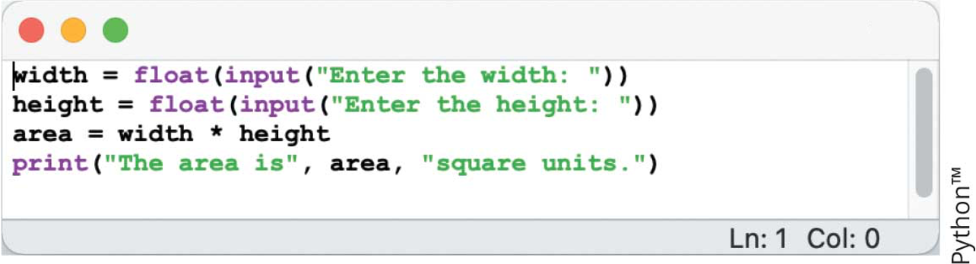
Editing, Saving, and Running a Script (2 of 3)
Figure 2 Python script in an IDLE window

Slide 13
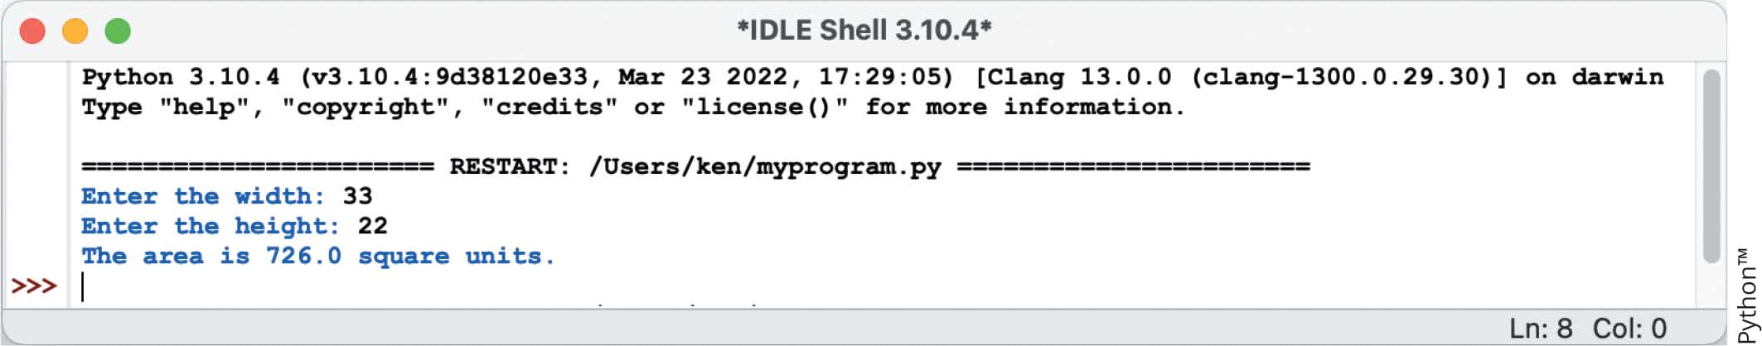
Editing, Saving, and Running a Script (3 of 3)
Figure 3 Interaction with a script in a shell window
Notes:
UPDATE IMAGE

Slide 14
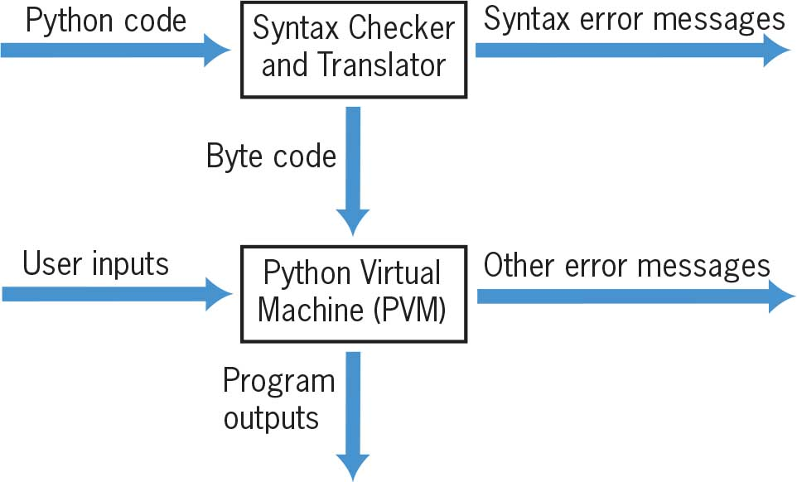
Behind the Scenes: How Python Works
Figure 4 Steps in interpreting a Python program

Slide 15
Activity 1.2: Knowledge Check
What does the input function do?
Name the two functions that convert strings to number types.
What does the print function do?
Notes:
Instructions:
Use the Knowledge Check questions to periodically pose a question to students during class to gauge how well they can recall the material that was presented.

Slide 16
Activity 1.2: Knowledge Check Answers
What does the input function do? Answer: The input function builds a string from the user’s keystrokes and returns it to the program.
Name the two functions that convert strings to number types. Answer: int (for integers) and float (for floating-point numbers)
What does the print function do? Answer: The print function evaluates expressions and displays them, separated by one space, in the console window.
Notes:
Instructions:
Use the Knowledge Check questions to periodically pose a question to students during class to gauge how well they can recall the material that was presented.

Slide 17
Detecting and Correcting Syntax Errors (1 of 2)
Programmers inevitably make typographical errors when editing programs, called syntax errors
Syntax: rules for forming sentences in a language
Example: >>> length = int(input("Enter the length: ")) Enter the length: 44 >>> print(lenth) Traceback (most recent call last): File "<py shell#l>", line 1, in <module> NameError: name 'lenth' is not defined

