Slide 1
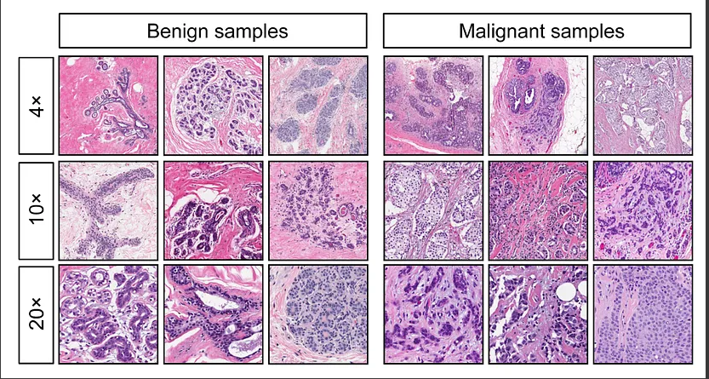
Breast Cancer Wisconsin (Diagnostic) Prediction
Reza Zare
CS504 - Programming Languages for Data Analysis final report
Professor: Yasir Malik
Notes:
The objective of this study is to develop a machine learning model that can accurately diagnose breast tumors as either malignant or benign based on the provided features in the Breast Cancer Wisconsin (Diagnostic) dataset.

Slide 2
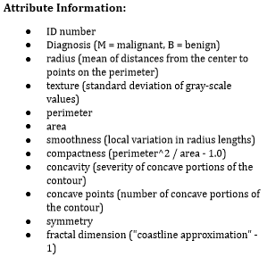
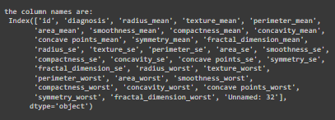
About our Dataset
It was created by the University of Wisconsin in 1992, and was collected from 569 breast cancer patients
Each data point is composed of the attributes of the nuclei of a cluster of cells obtained via fine needle aspiration and analyzed under a microscope.
The dataset is available in UCI Machine Learning Repository.
The dataset has been preprocessed to remove missing values, standardize the features, and convert the diagnosis to a binary variable (0 for benign, 1 for malignant).
The dataset is slightly imbalanced, with more benign cases than malignant cases, which may affect the performance of some classification algorithms.
Attribute Interpretation: The mean, standard error and “worst” or largest (mean of the three largest values) of these features were computed for each image, , each contains 10 parameters (radius, texture, area, perimeter, smoothness, compactness, concavity, concave points, symmetry, and fractal dimension), resulting in 30 features. For instance, field 3 is Mean Radius, field 13 is Radius SE, and field 23 is the Worst Radius.
Notes:
Standard deviation (SD) measures the amount of variability, or dispersion, from the individual data values to the mean. SD is a frequently-cited statistic in many applications from math and statistics to finance and investing.
Standard error of the mean (SEM) measures how far the sample mean (average) of the data is likely to be from the true population mean. The SEM is always smaller than the SD.

Slide 3
Approach Overview
Pre-processing: We started off by importing the dataset and performing some initial data exploration to understand the features and target variable distribution. We then preprocessed the data by removing any missing values, standardizing the features, and encoding the target variable as a binary variable (0 for benign, 1 for malignant).
Feature Selection: Since the dataset contains 30 features, we explored feature selection with correlation technique to identify the most informative features for our classification task by removing the multicollinearity to select the most relevant features.
Model Selection & building: We evaluated different classification algorithms, including logistic regression, support vector machines, k-nearest neighbors, decision trees, random forests, and naive Bayes, to identify the most accurate and reliable model for this task.
Model Evaluation: We used cross-validation and hyperparameter tuning to optimize the models' performance and prevent overfitting. We used several evaluation metrics, such as accuracy, precision, recall, F1-score, and AUC-ROC, to assess the models' performance and compare them against each other. We also used a confusion matrix to visualize the models' predictions and identify any potential errors.

Slide 4
Library & Tools Used
TOOLS: VARIOUS DATA ANALYSIS AND MACHINE LEARNING TOOLS SUCH AS PYTHON, JUPYTER NOTEBOOK.
LIBRARIES: ANY RELEVANT LIBRARIES AND PACKAGES SUCH AS:
import numpy as np # linear algebra
import pandas as pd # data processing, CSV file I/O (e.g. pd.read_csv), data manipulation as in SQL
import time # get the execution time
# visualizations
import matplotlib.pyplot as plt # matplotlib - this is used for plotting the graphs
import seaborn as sns # seaborn - used for plot interactive graph. I like it most for plot
# plotly - interactive plotting
import plotly.graph_objs as go
import plotly.express as px
# models
from sklearn.linear_model import LogisticRegression
# model selection
from sklearn.model_selection import GridSearchCV, cross_val_score, train_test_split
# metrics
from sklearn.preprocessing import StandardScaler
from sklearn.metrics import precision_score, recall_score, confusion_matrix, auc, roc_curve, precision_recall_curve, accuracy_score, balanced_accuracy_score, f1_score, classification_report

Slide 5
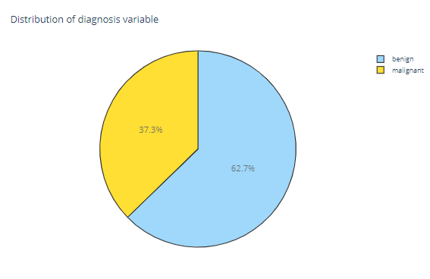
Descriptive Statistics & Data Exploration
Label Distribution:
Number of cells labeled Benign: 357
● Number of cells labeled Malignant : 212
● % of cells labeled Benign 62.74 %
● % of cells labeled Malignant 37.26 %
with 212 malignant cases and 357 benign cases.
Each instance has 30 features, including the diagnosis (M = malignant, B = benign) and 10 real-valued features representing the mean, standard error, and worst (mean of the three largest values) of different measurements such as radius, texture, perimeter, area, smoothness, and more.
the shape of the dataset: (569, 33)
the size of the dataset: 18777
data types of the dataset: int64, object, and
float64
There are no missing values except the last column, we dropped “Unnamed:32” column and also “Id” which was useless for our analysis.

Slide 6
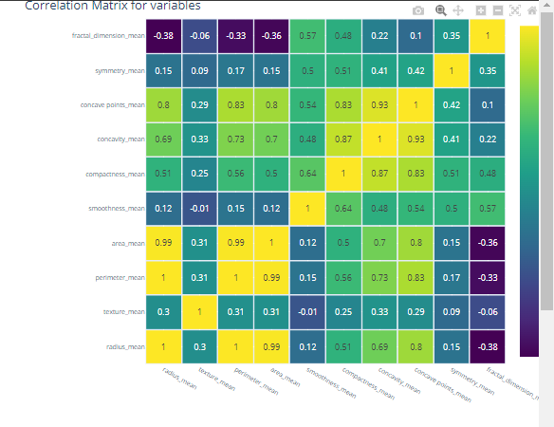
EDA (Exploratory Data Analysis)
Overall, the dataset contains a mix of features with different distributions and correlations with the diagnosis.
We divided features into groups of mean, se and worst for easier kernel subplot readability.
We used correlation matrix to find the correlation between variables in our dataset. Looking at the matrix, we can immediately verify the presence of multicollinearity between some of our variables which is caused by a high correlation between variables and hence it’s important to be aware of the relationships between each variable to better interpret the results of a model.
Observation: the radius_mean column has a correlation of 1 and 0.99 with the perimeter_mean and area_mean columns, respectively. This is probably because the three columns essentially contain the same information. In fact, each of the 10 key attributes displays very high (from 0.7 up to 0.97) correlations between its "mean" and "worst" columns.

Slide 7
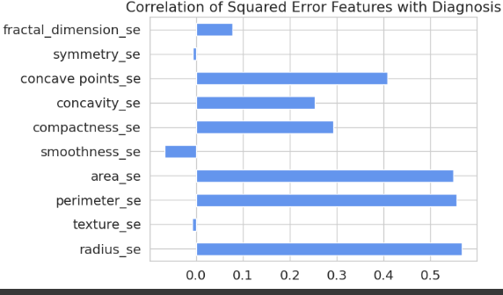
EDA (Exploratory Data Analysis)
We also we used different visualization plottings such as:
Barplot: in this plot we aimed to find the least correlated features of our subset variables with the target variable.
Observations:
texture_se, smoothness_se, symmetry_se, and fractal_dimension_se are least correlated with the target variable.
All other squared error features have a significant correlation with the target variable.

Slide 8
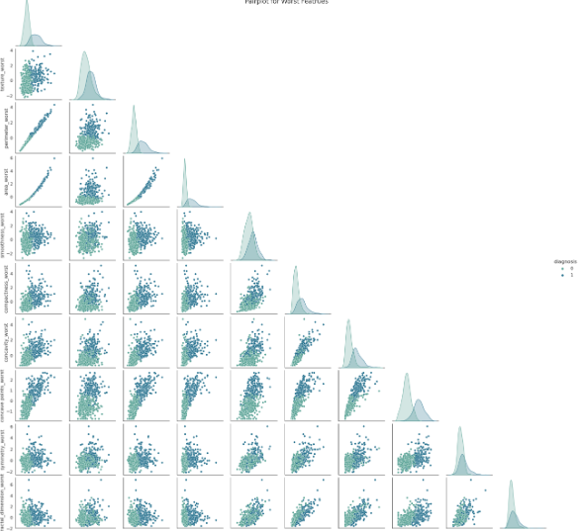
EDA (Exploratory Data Analysis)
Pairplot: we used it to check multicollinearity between distinct features, it gives a general outlook of all correlation which mixes scatter plot and line plot.
Observation: Almost perfectly linear patterns between the radius, perimeter, and area attributes are hinting at the presence of multicollinearity between these variables. Another set of variables that possibly imply multicollinearity are concavity, concave points, and compactness.

Slide 9
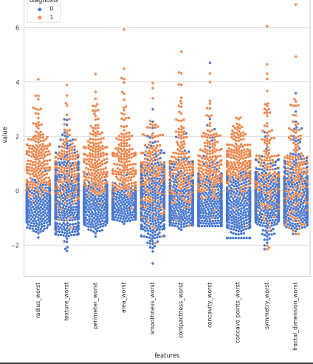
EDA (Exploratory Data Analysis)
Stripplot: to go deeper into the distribution of datapoint based on the label, in this plot, we aimed to find the distinction between our labels to choose it for our analysis.
Observation:
A certain level of separation in the values for the radius, perimeter, and area in the benign & malignant data points.
Each of the features appears to have outliers.
The area_worst looks like malignant and benign are separated not totally but mostly. However, smoothness_worst looks like malignant and benign are mixed so it is hard to classify while using this feature.

Slide 10
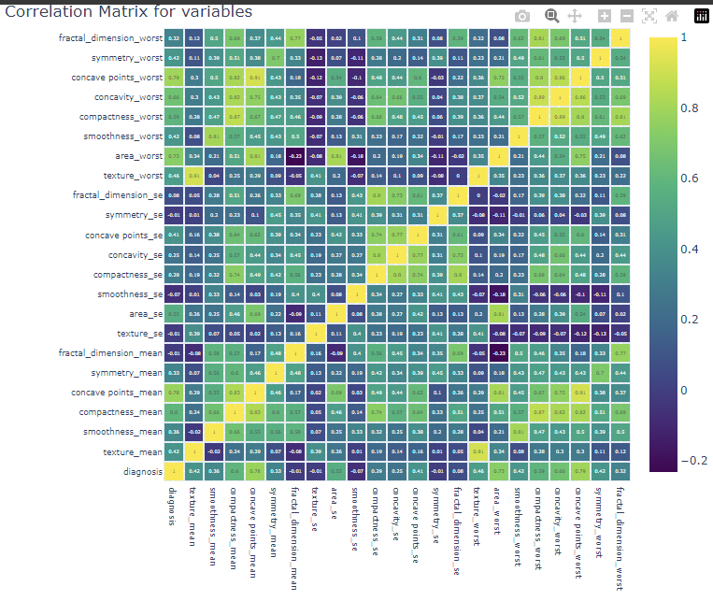
Feature Selection
a process of selecting a subset of relevant features from a large set of features to improve model performance, reduce the risk of overfitting, and reduce computational time and cost.
> We selected features based on correlation.
Feature Selection with Correlation
Based on our plots and correlation matrix, we will select the best features with the best correlation with the target variable.
We can see that there are many columns that are very highly correlated which causes multicollinearity so we have to remove highly correlated features to have a better result.
We will remove columns with more than 0.92 correlation to avoid multicollinearity.
Notes:
In short, multicollinearity may not interfere with model performance, but it does negatively impact the interpretation of the predictors used to build the model.

Slide 11
Model Selection
Divided the dataset into two parts, X as in our features and y as the target feature.
Splitted the dataset into train and test test using train_test_split method, we dedicated 70% of the entire dataset to the training set and the rest 30% for the test set.
Standardized our data to put all data points into a mean of 0 and standard deviation of 1.
Then we initialized, fitted and trained multiple classifier such as Random Forest, Decision Tree, Naïve Bayes, Support Vector Machines, K-Nearest Neighbor and Logistic Regression to see which one performs better.
Notes:
Standardization: since the total distribution of data follows the Gaussian Distribution and has a bell-shaped trend and is skewed to the sides for most plots.

Slide 12
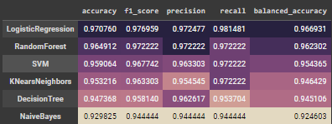
Model Building
This dataset turned out to yield highly accurate models (intrinsic to the kind of data)
All methods had a predictive accuracy of >94%.
Which model outperformed the other classifiers?

Slide 13
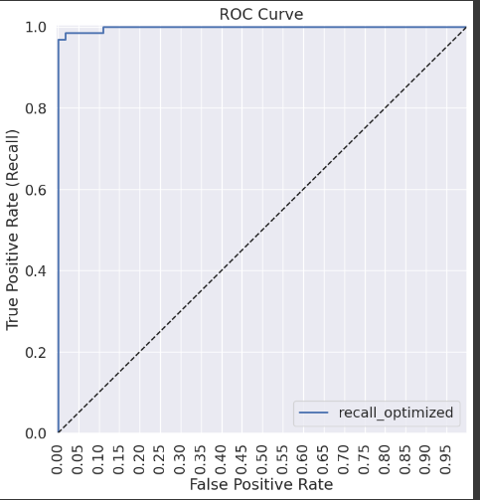
Model Evaluation
Used different metrics such as accuracy, precision, recall, balanced_accuracy, f2-score, cross_val_score, auc, roc_curve to evaluate the performance of our model.
Optimized the model by tuning the hyperparameter of our selected model (Logistic Regression) with GridSearchCV
Selected hyperparameters were {'C': 1, 'penalty': 'l2', 'solver': 'saga'} and set the max iteration (max_iter=500) for solving the convergence issue
The AUC (measure of separability) score is around 99.79% which
means it successfully predicts 0 classes as
0 and 1 classes as 1.
The overall accuracy increased to 98.28% with FP=1 & FN=2.
Notes:
GridSearchCV: (It's a cross-validation technique which is used for finding the optimal parameter values from a given set of parameters in a grid).
Convergence: When the data are separated (or nearly so), the maximum likelihood estimates can be infinite and the algorithm will fail to converge.

Slide 14
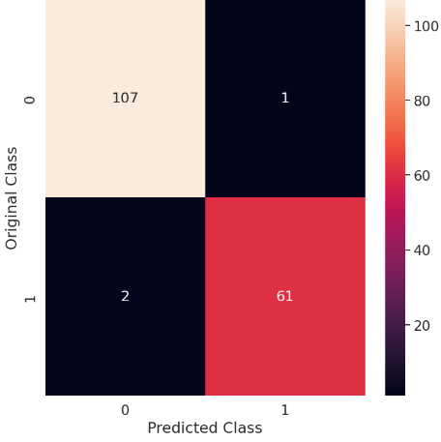


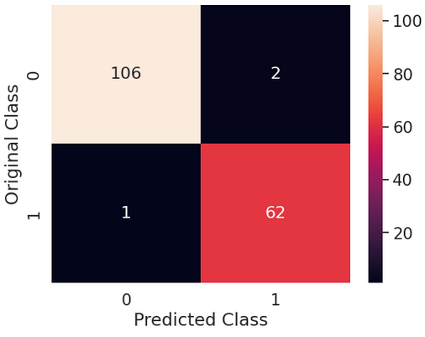

Summary of Results
Before hyperparameter tuning:
After hyperparameter tuning with penalty L1:
After hyperparameter tuning with penalty L2:
The balanced accuracy of Logistic Regression increased using GridSearchCV from 96.69 to 97.94 with FP=1 & FN=2 with penalty=L1 and 98.28 with FP=2 & FN=1 with penalty=L2

Slide 15
Conclusion
We found the correlation of all the features with the target variable as well as among each other. We then found the 22 most optimal features by removing highly correlated variables. We have reduced the number of features from 30 to 22.
We then implemented multiple classifiers and selected Logistic Regression as our best classifier for further analysis with 96.69% accuracy.
We also increased the accuracy of our model from to ~98.2% during the process using hyperparameter tuning.

Slide 16
THANK YOU FOR
YOUR ATTENTION

