Slide 1
Forecasting the Number of Meal Orders for Upcoming 10 Weeks
Arezoo Memarian

Slide 2

Problem statement
Predict meal orders for the next 10 weeks
Various fulfillment centers in multiple cities
Challenges:
Perishable raw materials.
Weekly replenishment.
Precise procurement planning
Approach:
Utilize regression models: Linear Regression, Decision Tree, Random Forest, and XGBoost.
Model Selection:
Choose the model with the best performance on the test dataset.
Notes:
This is a meal delivery company which operates in multiple cities and has fulfillment centers across these locations to dispatch meal orders to customers.
The goal is to forecast orders for the upcoming weeks to help these centers in planning their raw material stocks based on these orders.
So, Since most raw materials are replenished weekly and are perishable, a precise procurement planning is important. Accurate demand forecasts also significantly impact staffing decisions at these centers.

Slide 3
Data Information
Data source: Kaggle
Datasets:
Fulfillment Center Information: 77 centers
Meal Information: 52 meals
Orders: 423k orders over 135 weeks
Data Organization:
Merged all the datasets
Ordered by week (temporal nature)
Total features: 15
id | week | center_id | meal_id | checkout_price | base_price | email_promotion | homepage_featured | num_orders | city_code | region_code | center_type | op_area | meal_category | cuisine
1379560 | 1 | 55 | 1885 | 136.83 | 152.29 | 0 | 0 | 177 | 647 | 56 | TYPE_C | 2 | Beverages | Thai
1272063 | 1 | 65 | 2290 | 305.58 | 306.58 | 0 | 0 | 878 | 602 | 34 | TYPE_A | 4.8 | Rice Bowl | Indian
Notes:
I got the data from kaggle website.
The data consists of 77 Fulfillment Center Information (contains 5 features), 52 Meal Information (contains 3 features), and more than 400k orders over 135 weeks ((contains 9 features). (145, 10 weeks for forecasting)
I merged these datasets on key features, center Id and meal ID. And sort them by week to maintain tis temporal nature.
The datasets are in CSV format
Id, week, center_id-meal_id, checkout_price, base_price, emailer_for_promotion, homepage_featured, num_orders,
city_code, region_code, center_type, op_area,
meal_category, cuisine

Slide 4
Data Cleaning
Check for Missing Values:
There are no missing value in the dataset
Notes:
Identify and Understand Missing values: It's essential to identify the patterns and reasons for missing data. Random? Systematic?
1-Data Imputation: fill the missing values
Need to check the distribution of the variable
Mean: Continuous Numerical Data: Use the mean to impute missing values when dealing with continuous numerical data, especially when the data is normally distributed or symmetrically distributed around the mean. The mean is sensitive to extreme values (outliers), so ensure that outliers do not unduly influence the mean.
2-Median:
Skewed Data: If the data is skewed (positively or negatively), the median may be a more robust measure than the mean. The median is less affected by extreme values or outliers, making it suitable for handling skewed distributions.
Ordinal Data: For ordinal data or categorical data with an inherent order, the median can be used to impute missing values while preserving the ordinality of the data.
3-Mode:
Categorical Data: Use the mode for imputing missing values in categorical variables or discrete data where specific categories or values are more frequent. The mode represents the most common value in the dataset and is suitable for handling categorical variables.
Nominal Data: When dealing with nominal data (categories without inherent order), the mode is often the preferred measure for imputation.
2-Delete Missing Data

Slide 5

Exploratory Data Analysis
Individual Feature Distributions
Exploring Target Distribution Across Features
Exploring Feature Relationships

Slide 6
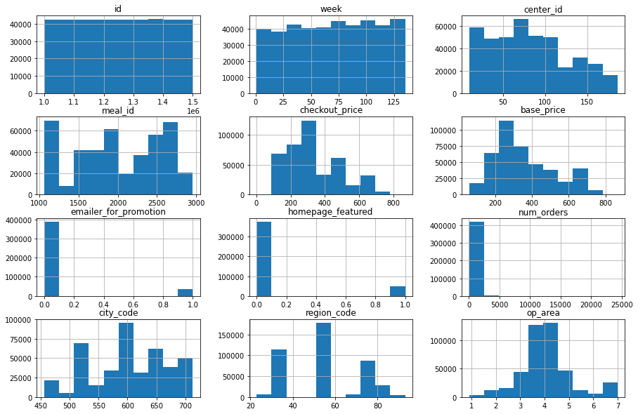
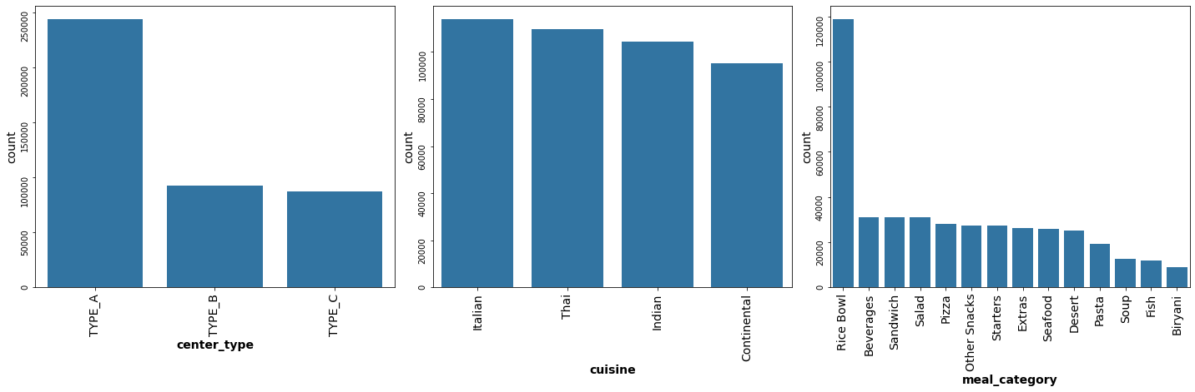
Individual Feature Distributions
Most Features Appears Sensible
Concern with 'num_orders':
Wide range despite mostly low values
High-volume orders
'Rice Bowl' and sandwiches on week 5
Linked to email promotions or homepage features
No clear evidence of outliers :
May be tied to special events or promotions during that week
Notes:
No clear evidence of outliers is found, suggesting these occurrences could be linked to a promotions during that week.

Slide 7
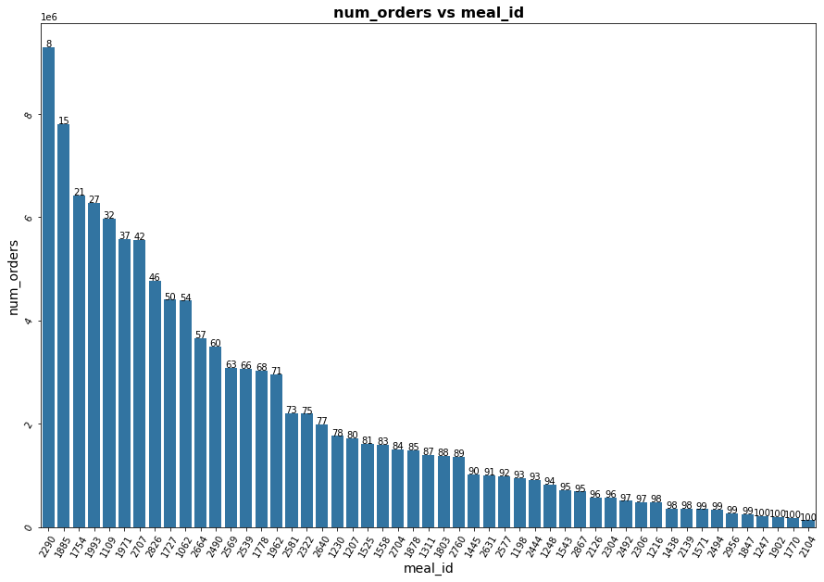
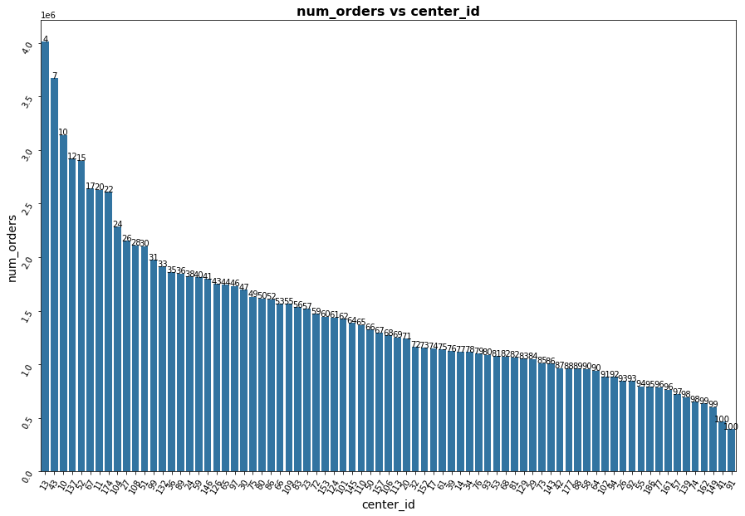
Exploring Order Concentration: Identify Significant Contributors
Meals:
41% of meal Ids contains 80% of orders
Centers:
Dispersed pattern in orders
66% of centers contribute to 80%
Notes:
I also explored ... to identify ...across features.
Meal:This suggests that these meal IDs play an important role in driving a substantial portion of the overall order volume
Centers:the orders are spread out among a majority of centers rather than being concentrated in a few.
To identified the significant contributors across features. For example, if there is a notable cuisine or center, I can assess the model performance for these significant contributors and fine-tune the model to achieve better performance specifically for these influential factors. This approach depends on aligning with the business goals.
By closely examining these aspects, we can identify those that contribute significantly.
This t is important for fine-tuning our models and using our resources wisely, It helps us focus on the key features that heavily influence how orders are distributed overall.

Slide 8
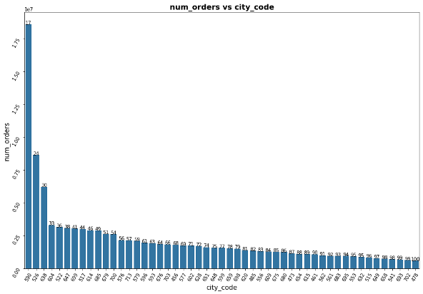
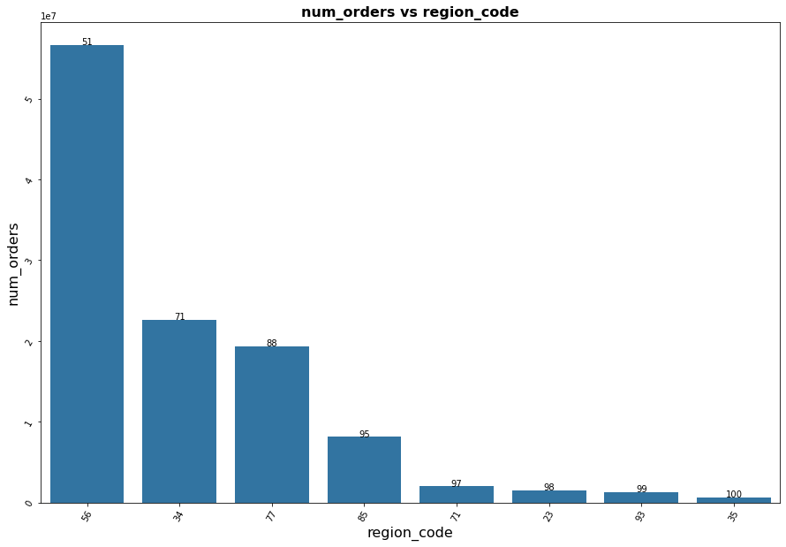
Exploring Order Concentration: Identify Significant Contributors
Cities:
30% of orders belong to three cities
80% of orders are spread across 57%
Regions:
88% of orders belong to three regions (37%)
Notes:
Cities: 30% of orders belong to three cities and the remaining orders spread out among other cities
Regions:This highlights the significance of these centers compared to others

Slide 9
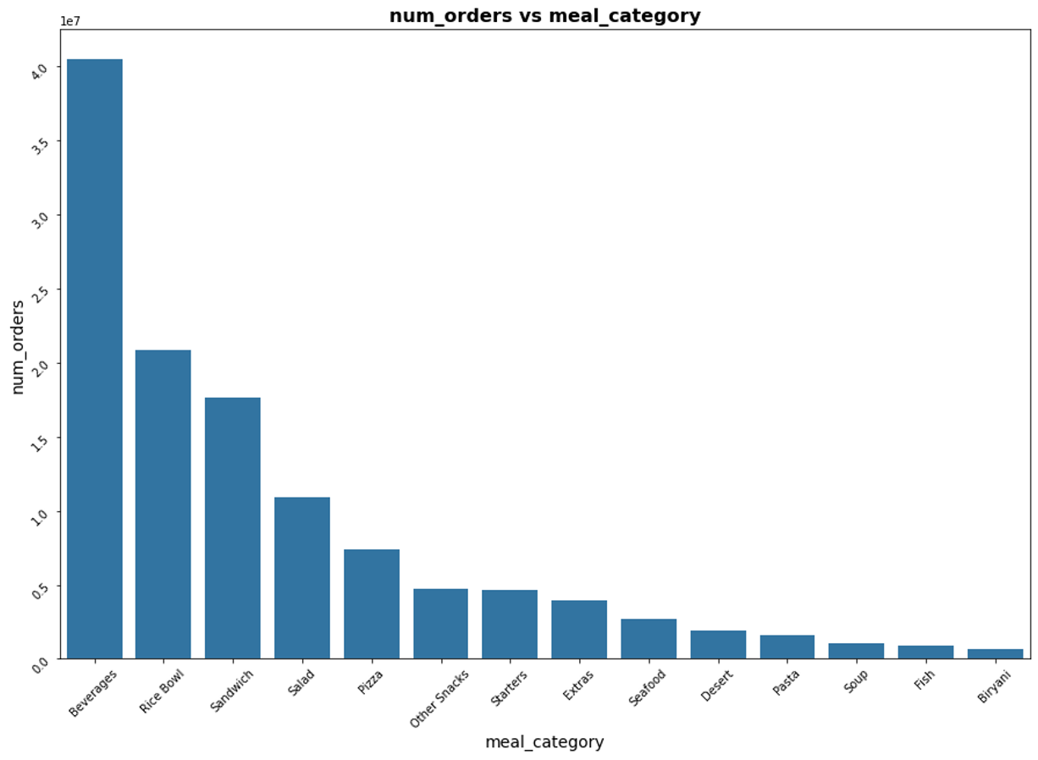
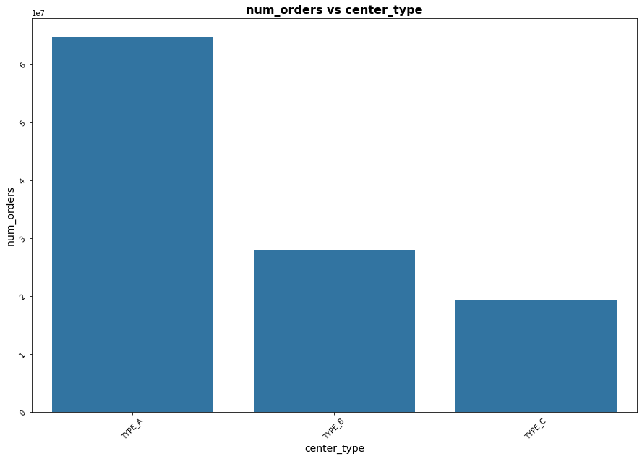
Exploring Order Concentration: Identify Significant Contributors
Meal category :
5 meal categories (36%) account for more than 80% of orders
Center Type:
58% of orders belong to Center type A.
58
83
100

Slide 10
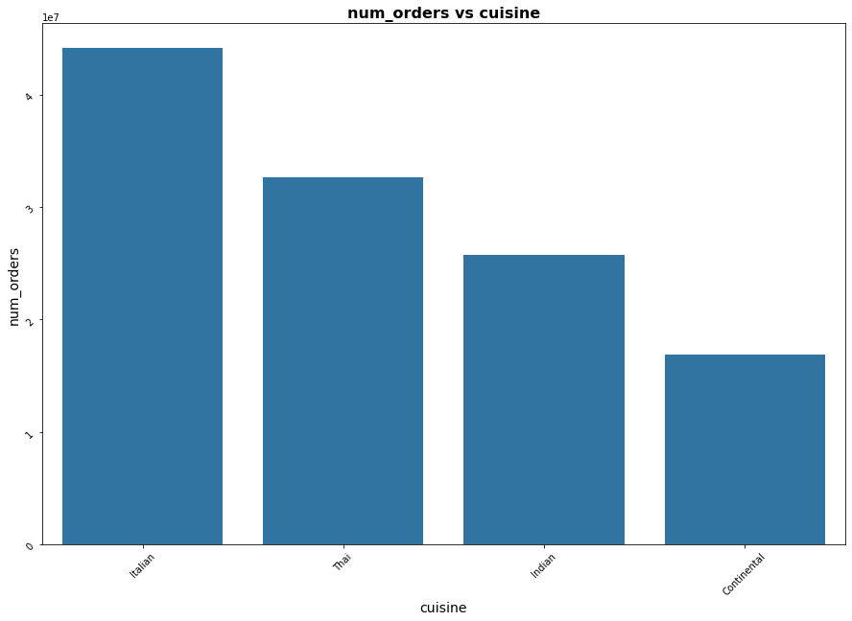
Exploring Order Concentration: Identify Significant Contributors
Cuisine :
Italian Cuisine contains more than 30% of orders
37
64
86
100
Notes:
I identified the significant contributors across features. For example, if there is a notable cuisine or center, I can assess the model performance for these significant contributors and fine-tune the model to achieve better performance specifically for these influential factors. This approach depends on aligning with the business goals.
By closely exploring these aspects, we can identify those that contribute significantly.
This t is important for fine-tuning our models and using our resources wisely, It helps us focus on the key features that heavily influence how orders are distributed overall.

Slide 11
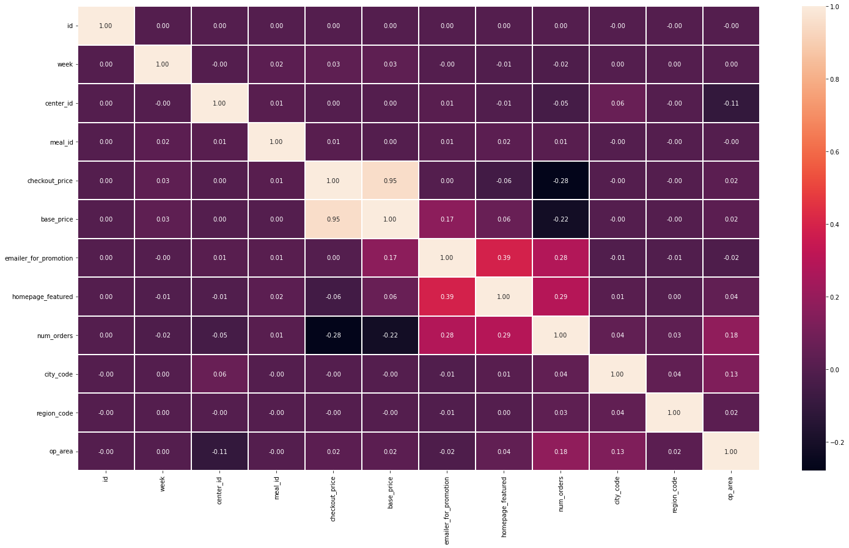
Exploring Feature Relationships
Strong positive correlation
Base price and checkout price (0.95)
Moderate to mild correlations
Email promotion and homepage featured (0.39)
Number of orders and (Email promotion (0.28), homepage featured (0.29), operation area (0.18))
Moderate Negative Correlation
Number of orders and checkout price(0.28)
Number of orders and base price (0.22)
Notes:
I also explored the relationship between variables. We can see the important independent variables for predicting the dependent variable

Slide 12
Modeling
Model selection
Refit the Model on the Entire Training Dataset
Feature Importance

Slide 13
Model Selection
Regression models:
Linear Regression
Decision Tree
Random Forest
XGBoost
Notes:
I employed 4 regression models to predict the number of orders since the target variable is continues.
- I started with the Linear Regression model, which is a simple and interpretable model that provides baseline performance. However, the results were not satisfactory.
I then considered the Decision Tree model, which can capture non-linear relationships between features and the number of orders and is more interpretable. Although the results improved, they were still not satisfactory.
I continued with the Random Forest model, an ensemble learning method that constructs multiple decision trees and aggregates their predictions. This model can capture more complex relationships in the data, and the results improved significantly, albeit with a higher computation time.
therefore, I considered the XGBoost model, a gradient boosting algorithm that utilizes an ensemble of weak learners, typically decision trees, to sequentially correct errors and build a robust predictive model. The results showed that the XGBoost model is a compelling choice for accurate and efficient predictions.
Linear Regression: Linear regression is a simple and interpretable model that can provide baseline performance
Regulization Penalize large coefficients for overfitting
Ridge: penalizes large positive or negative coefficients a2
Lasso: shrinks the coefficients of less important features to zero |a|
Decision Tree Regressor
can capture non-linear relationships between features and number of orders
interpretable, allowing us to understand the decision-making process of the model
Hyper parameter tunning: "max_depth", "min_samples_split", and "max_leaf_nodes” common hyperparameters
Randomize search
Random Forest model
an ensemble learning method that constructs multiple decision trees and aggregates their predictions
capture more complex relationships in the data compared to individual decision trees
improved generalization and reduced overfitting compared to standalone decision trees.
handle a large number of features and robustness to noisy data
Hyper parameter tunning: the number of trees in the forest (n_estimators), the maximum depth of the trees (max_depth), and the minimum number of samples required to split a node (min_samples_split)
XGBoost model: ML algorithm belonging to the gradient boosting family.
It follows a framework where an ensemble of weak learners, typically decision trees, is constructed sequentially. Each tree corrects errors from the preceding ones, resulting in a robust predictive model.
incorporates regularization techniques to prevent overfitting and employs tree pruning during construction.
Initially building deep trees, it then prunes them backward, removing branches that do not significantly contribute to model performance, effectively controlling overfitting.
supports parallel and distributed computing
predictive performance, speed, and robustness,
n_estimators,' 'learning_rate,' 'max_depth,' 'min_child_weight,' 'gamma,' and 'colsample_bytree

Slide 14
Model Comparisons/Model Performance
Models | R-Squared | Root Mean Squared Error | Mean Absolute Error | Computation Time (s)
Linear Regression | 0.42 | 300 | 168 | 14.33
Decision Tree | 0.56 | 259 | 120 | 47.63
Random forest | 0.71 | 211 | 99 | 515.6
XGBoost | 0.75 | 198 | 96 | 245.36
Notes:
To measure model performance I used a sequential split for training and testing sets to maintain the temporal order of the data.
Adjusted R-squared (R2_adj):
useful when comparing models with different numbers of independent variables
Computation Time:
Real-time Applications,
Resource Constraints(memory, budget for cloud),
Large Datasets
RMSE:
When you want a metric that:
penalizes large errors more than smaller errors,
When distribution of errors is approximately normal,
is more sensitive to the magnitude of errors
MAE:
Robust (less sensitive) to outliers,
easier to interpret and explain,
straightforward measure of average prediction error without the influence of large errors

Slide 15
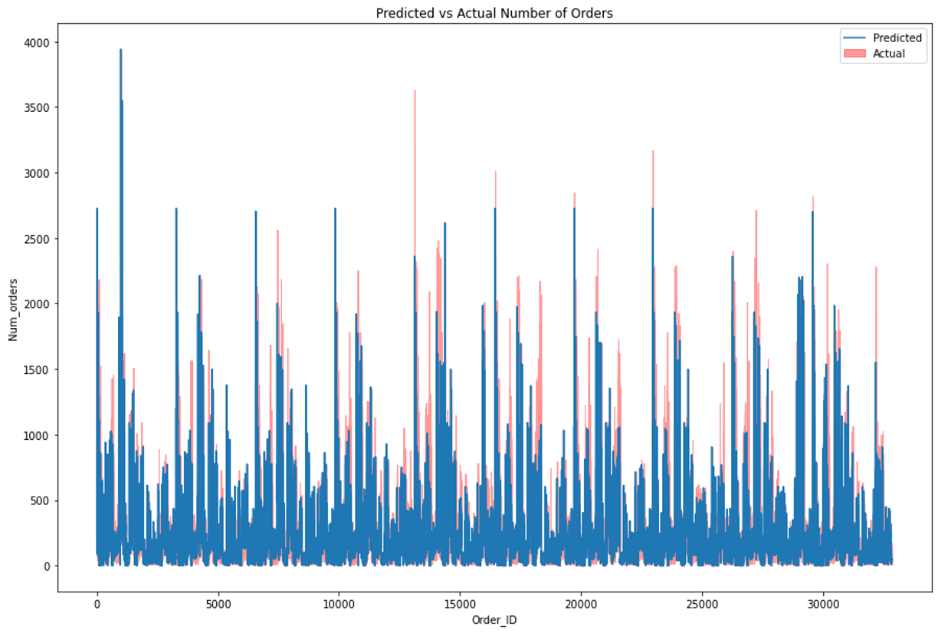
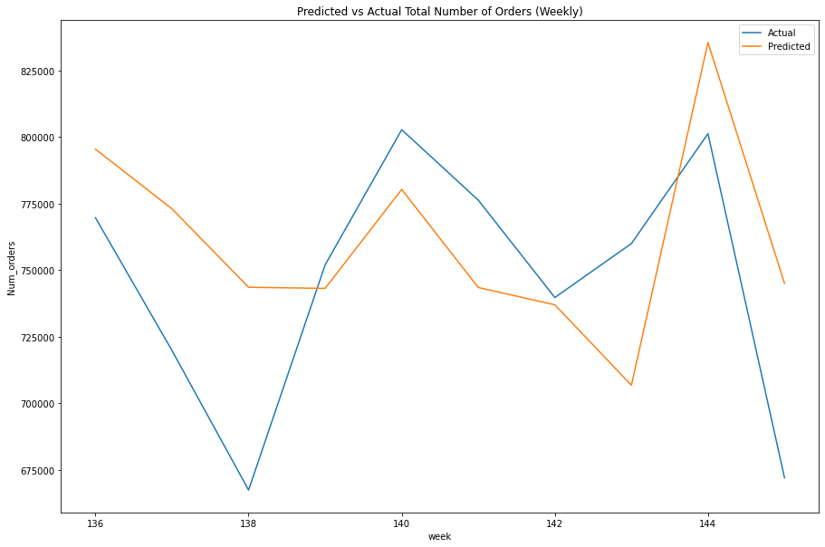
Refit the Model on the Entire Training Dataset
RMSE: 151
MAE: 91
R²: 0.70

Slide 16
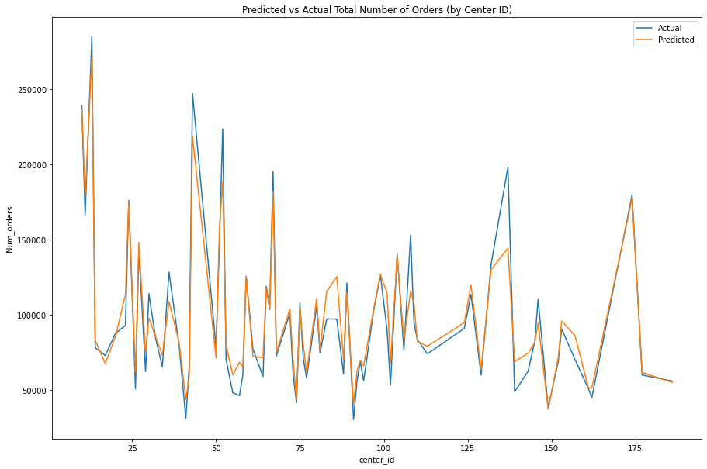
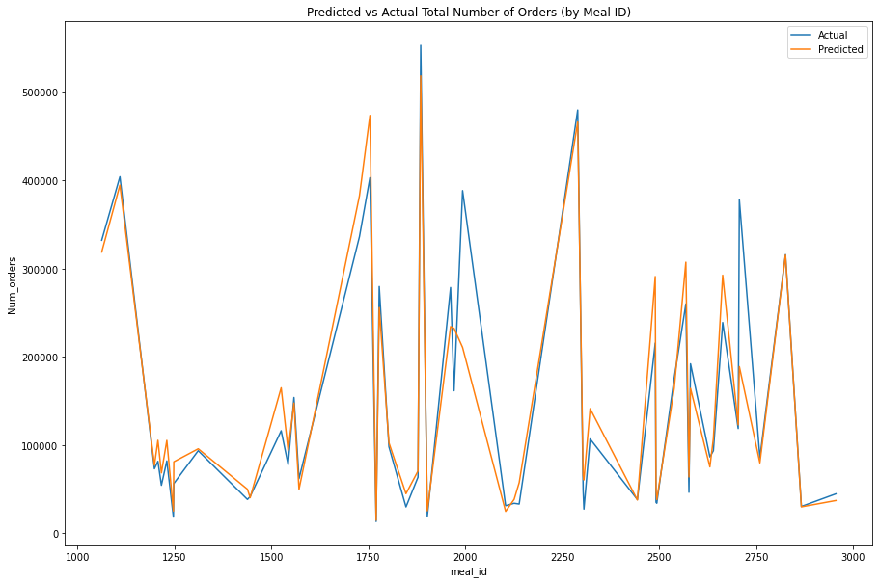
Refit the Model on the Entire Training Dataset

Slide 17
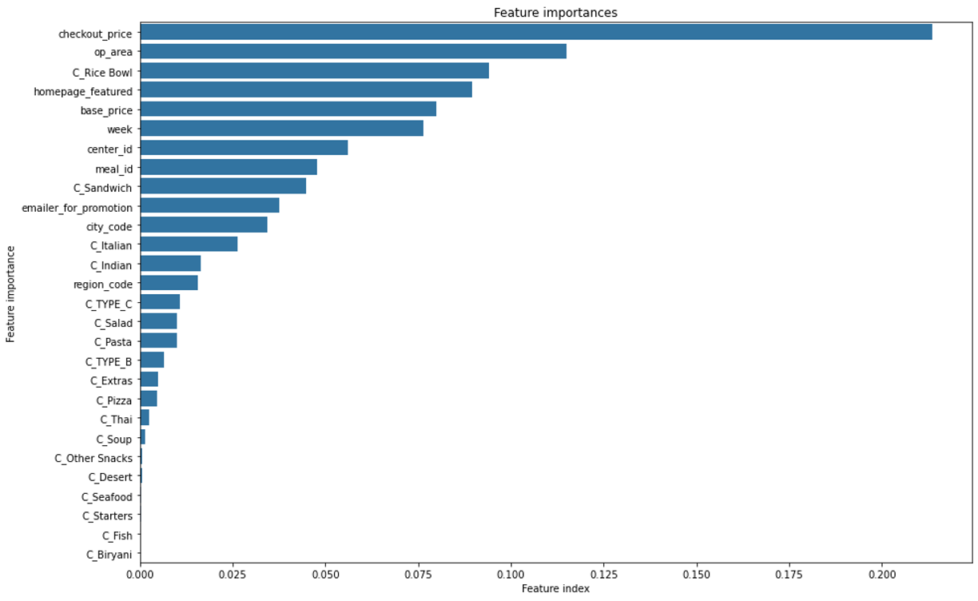
Feature Importance
Notes:
checkout price and base price are highly influential, showing that pricing strategies significantly impact customer behavior and sales.
Operational area (op_area) follows closely, highlighting the importance of outlet size in sales patterns.
Specific meal categories such as Rice Bowl, Sandwich, and Italian, and Indian cuisines also play significant roles, suggesting that meal category and cuisine types strongly influence customer choices.
Additionally, features related to promotions (homepage_featured, emailer_for_promotion) influences the predictions.
and geographic factors (city_code, region_code) have a moderate impact on predictions.
Checkout_price,op_area,homepage_featured, based_price and emailer_for_promotion: They seem to be significant contributors to the model, indicating that whether a meal is featured on the homepage or promoted via email strongly influences the prediction
meal_category and cuisine: features like C_Rice_Bowl, and C_Thai, among others, indicate that their presence significantly influences the predictions.
homepage_featured and emailer_for_promotion: They seem to be significant contributors to the model, indicating that whether a meal is featured on the homepage or promoted via email strongly influences the predictions.
op_area, and checkout_price: These numerical features have a moderate impact on predictions.
Other Features like region_code, center_type, city_code, week, and base_price contribute to the model's predictions but are not among the important features.

Slide 18
Feature Importance
Checkout price and base price are highly influential, showing the impact of pricing strategies on customer behavior and sales.
Operational area (op_area) is significant, emphasizing the importance of it in sales patterns.
Meal category and cuisine types, such as Rice Bowl, Sandwich, Italian, and Indian cuisines, strongly influence customer choices.
Promotional features (homepage_featured, emailer_for_promotion) are also significant, indicating that whether a meal is featured on the homepage or promoted via email influences the prediction.
Geographic factors (city_code, region_code) also play crucial roles in sales variations.
Notes:
Checkout price and base price are highly influential, showing the impact of pricing strategies on customer behavior and sales.
Operational area (op_area) is significant, emphasizing the importance of it in sales patterns.
Meal category and cuisine types, such as Rice Bowl, Sandwich, Italian, and Indian cuisines, strongly influence customer choices.
Promotional features (homepage_featured, emailer_for_promotion) are also significant, indicating that whether a meal is featured on the homepage or promoted via email influences the prediction
and geographic factors (city_code, region_code) also play crucial roles in sales variations.

Slide 19
Remarks
Gained valuable insights into customer behavior, sales patterns, and influential factors affecting order volumes
Developed advanced machine learning models, including regression techniques and ensemble methods, to create accurate order forecasts.
Significant business implications, including optimized procurement strategies, and targeted operational decisions to enhance sales and customer satisfaction.

Slide 20
Future Direction
incorporate additional data sources
Exploring other ensemble models such as the Adaboost model
Exploring other models such as neural network and deep learning
Notes:
While the models did a good job balancing performance and computation time, it's always smart to think about ways we can make them even better.
Utilizing more data: Currently, we have data spanning three years. Exploring additional data from another year or two can enhance the model's predictive capabilities.
Exploring other ensemble models: like the Adaboost model, could provide valuable insights and potentially lead to improved results.
Incorporating feature engineering: Employing advanced feature engineering techniques can contribute to refining the model's performance.
Neural Network Regression: Deep learning models like feedforward neural networks can be used for regression tasks.
They are capable of learning intricate patterns from data but may require more data and computational resources compared to traditional regression models.
AdaBoostRegressor builds an ensemble of weak learners (usually decision trees) sequentially, with each subsequent model focusing more on the instances that the previous models struggled with, thereby improving overall predictive accuracy.
Strengths of AdaBoost Regression: AdaBoost has several strengths that make it a good candidate for regression:
Adaptability: AdaBoost can adapt to complex relationships in the data and handle non-linearities effectively.
Feature Importance: It provides insights into feature importance, helping identify which features are most influential in predicting the number of orders.
Robustness to Overfitting: AdaBoost tends to be less prone to overfitting compared to individual decision trees, especially when using shallow trees as base learners.
Ensemble Learning Benefits: By combining multiple weak learners, AdaBoost can often achieve higher predictive accuracy than any individual model.
Considerations: While AdaBoost has many strengths, it's important to consider a few factors:
Data Size: AdaBoost can be computationally intensive, especially with large datasets or when using complex base learners.
Hyperparameters: Tuning hyperparameters such as the number of estimators (base learners) and learning rate is crucial for optimal performance.
Interpretability: While AdaBoost provides feature importance scores, the ensemble nature of the model can ma

Slide 21
Thank you!

Slide 22

Who might care?
Meal delivery companies

Slide 23
Data Preprocessing
Categorical variables transformed into dummy features
Total features: 28
Sequential split for training and testing sets to preserve temporal order

