Slide 1
Forecasting the Number of Meal Orders for Upcoming 10 Weeks
Arezoo Memarian

Slide 2
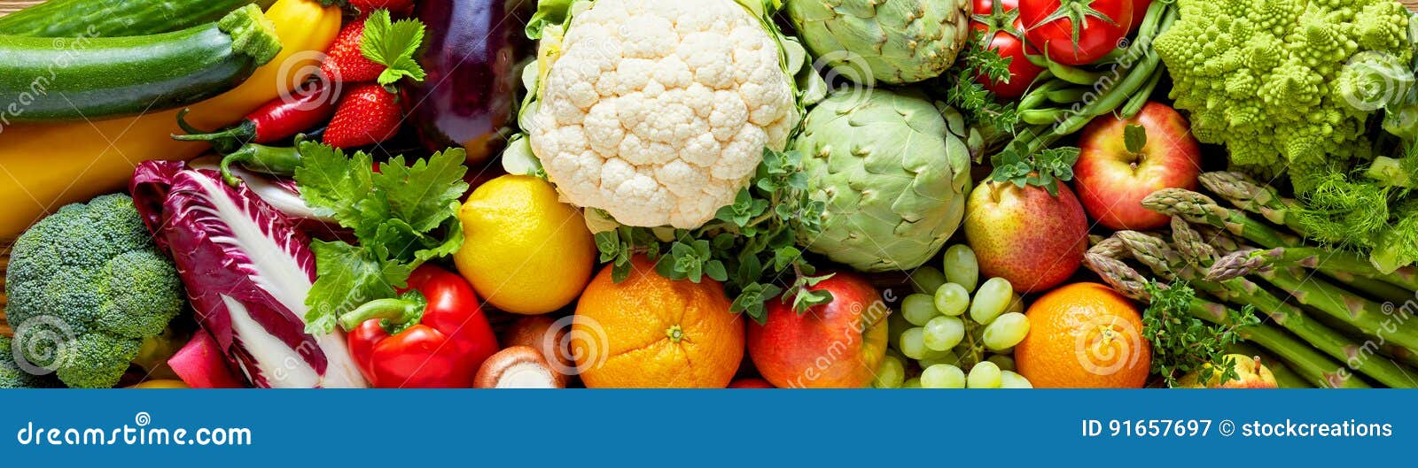
Problem statement
Predict meal orders for the next 10 weeks
Various fulfillment centers in multiple cities
Challenges:
Perishable raw materials.
Weekly replenishment.
Precise procurement planning required
Approach:
Utilize regression models: Linear Regression, Decision Tree, Random Forest, and XGBoost.
Model Selection:
Choose the model with the best performance on the test dataset.

Slide 3
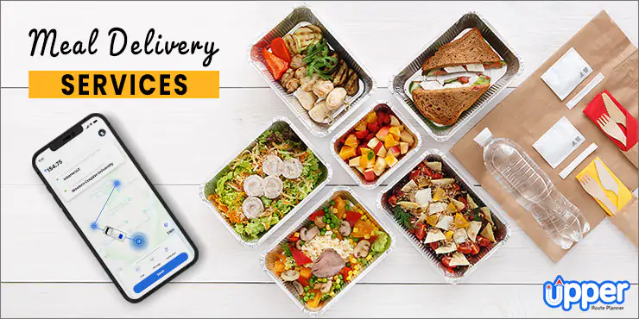
Who might care?
Meal delivery companies

Slide 4
Data Information
Data source: Kaggle
Key Datasets:
Fulfillment Center Information: 77 centers
Meal Information: 52 meals
Number of Orders: 423k orders over 135 weeks
Data Organization:
Merged all the datasets
Ordered by week (temporal nature)
Total features: 15

Slide 5

Exploratory Data Analysis
Individual Feature Distributions
Exploring Target Distribution Across Features
Exploring Feature Relationships

Slide 6
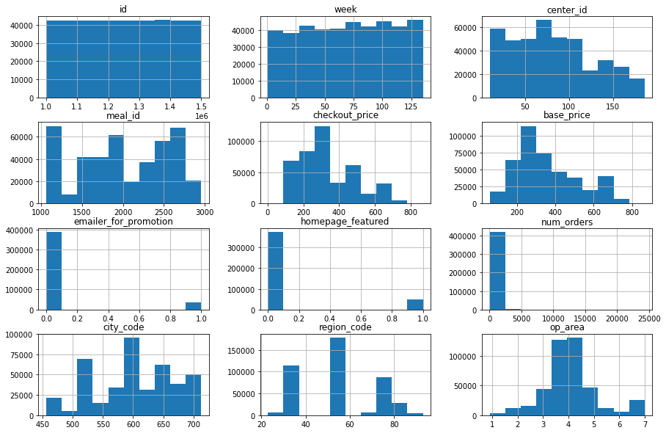
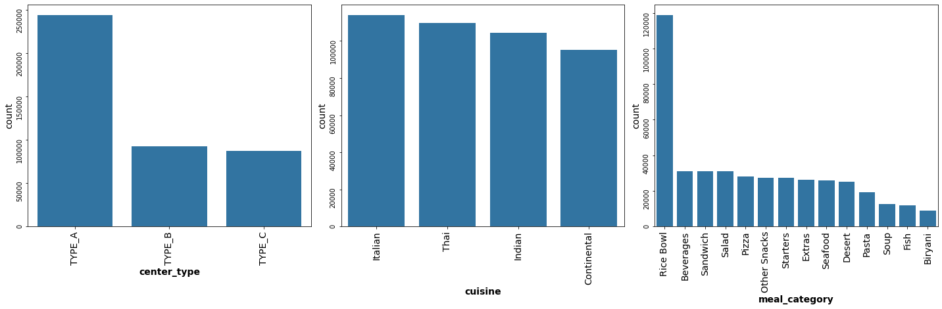
Individual Feature Distributions
Most Features Appears Sensible
Concern with 'num_orders':
Wide range despite mostly low values
High-volume orders
'Rice Bowl' and sandwiches on week 5
Linked to email promotions or homepage features
No clear evidence of outliers :
May be tied to special events or promotions during that week

Slide 7
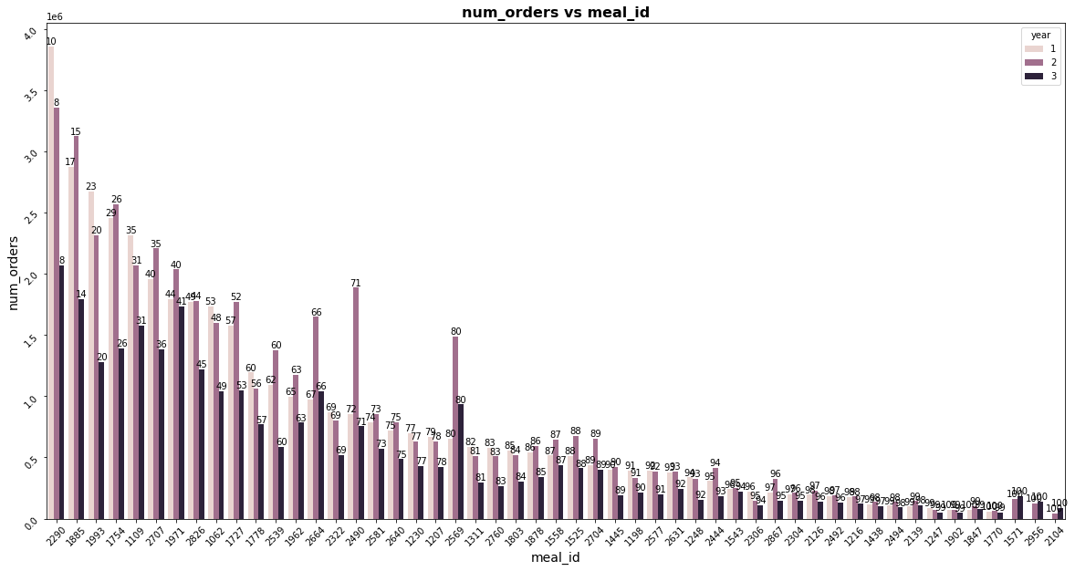
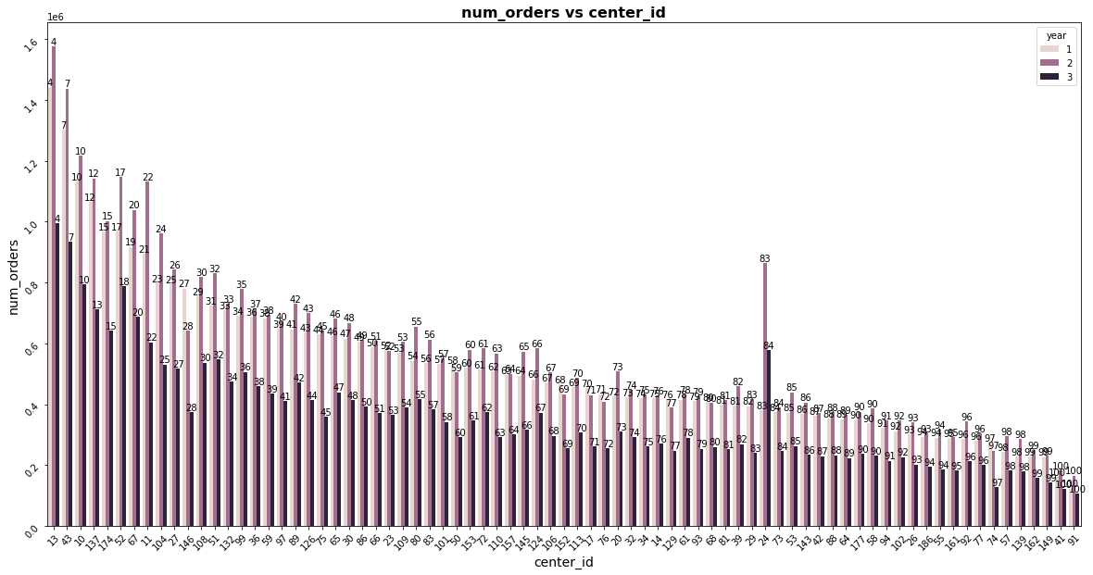
Exploring Target Distribution Across Features
Meals:
41% of meal Ids contains 80% of orders
Centers:
Dispersed pattern in orders
66% of centers contribute to 80%

Slide 8
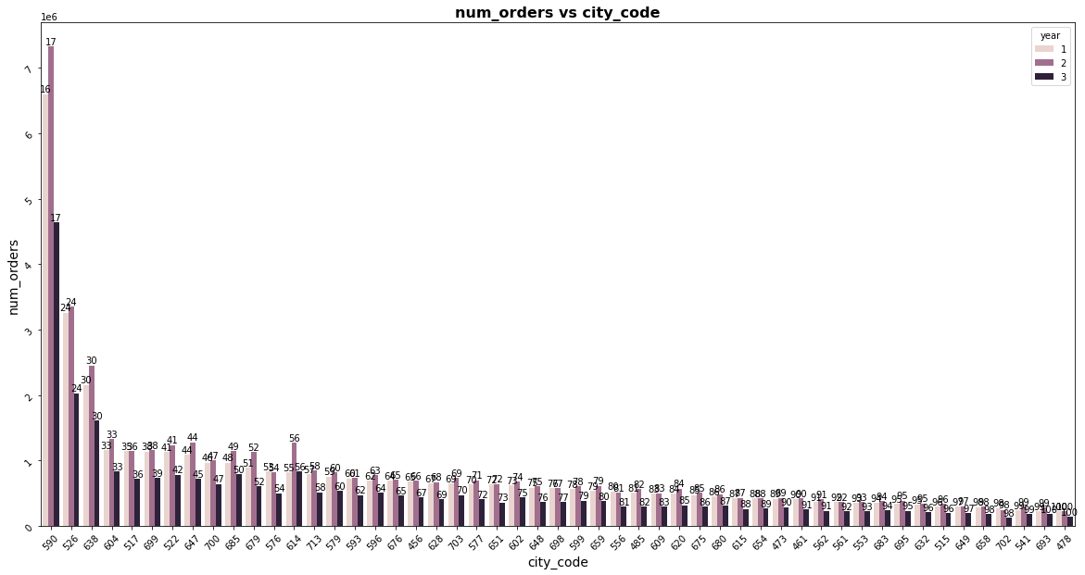
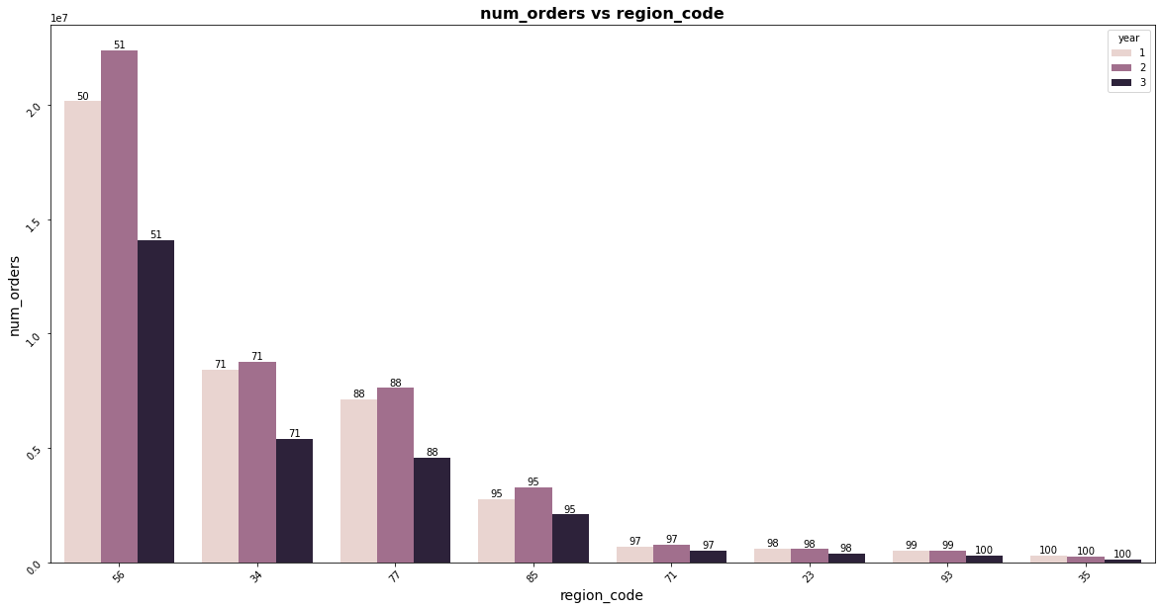
Exploring Target Distribution Across Features-cont.
Cities:
30% of orders belong to three cities
80% of orders are spread across 57%
Regions:
88% of orders belong to three regions

Slide 9
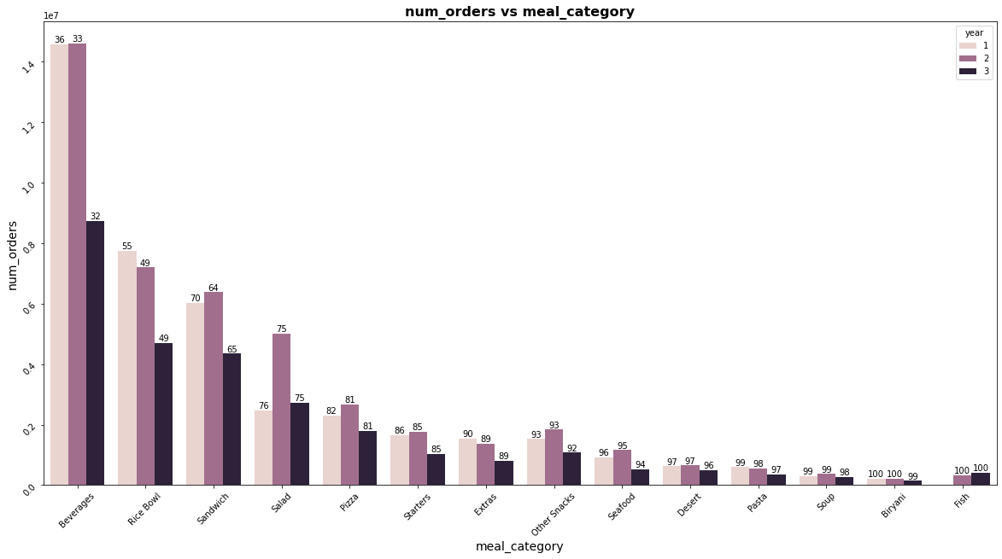
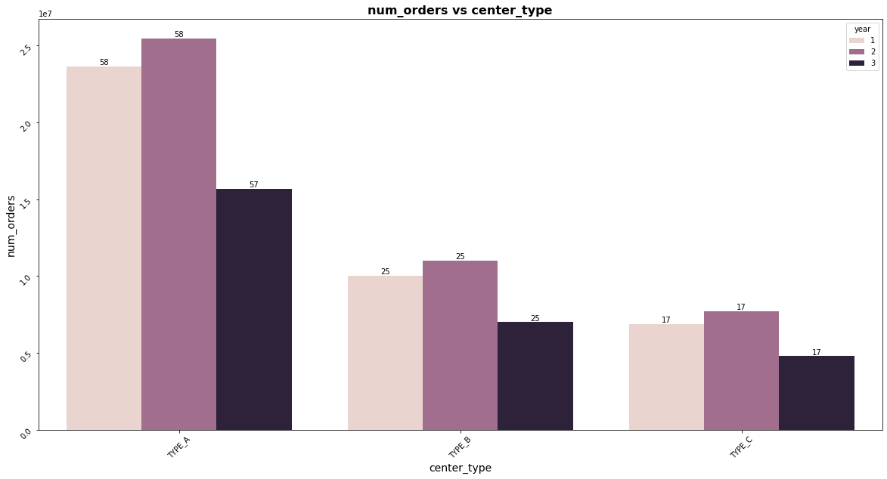
Exploring Target Distribution Across Features-cont.
Meal category :
5 meal categories account for more than 80% of orders
Center Type:
58% of orders belong to Center type A.

Slide 10
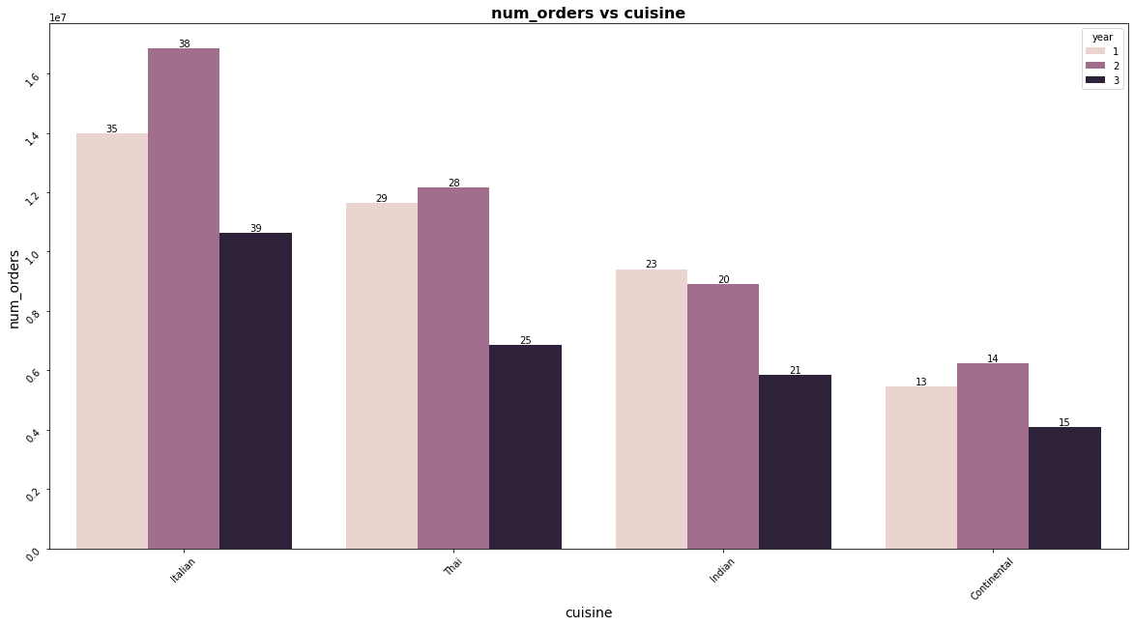
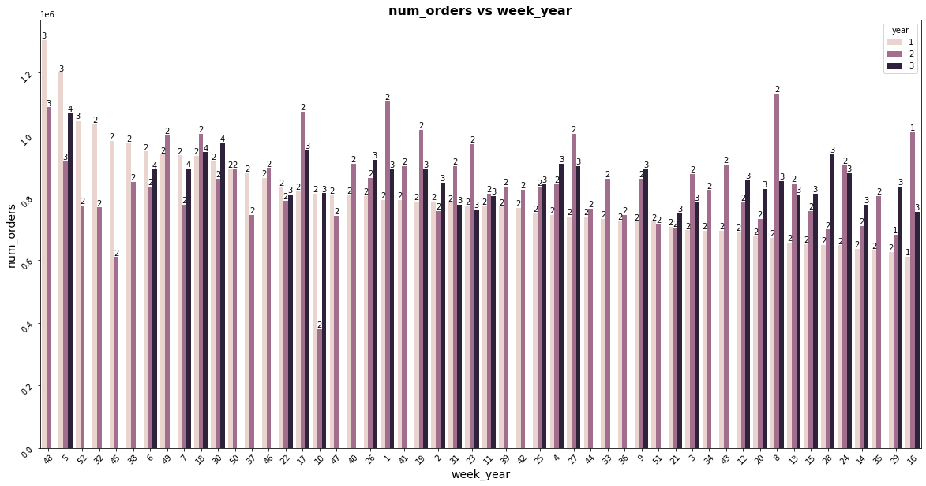
Exploring Target Distribution Across Features-cont.
Cuisine :
Italian Cuisine contains more than 30% of orders
Week:
Weeks 48, 5, and 52 in the first year each contribute to 3% of orders.
Other weeks are around 2 %.

Slide 11
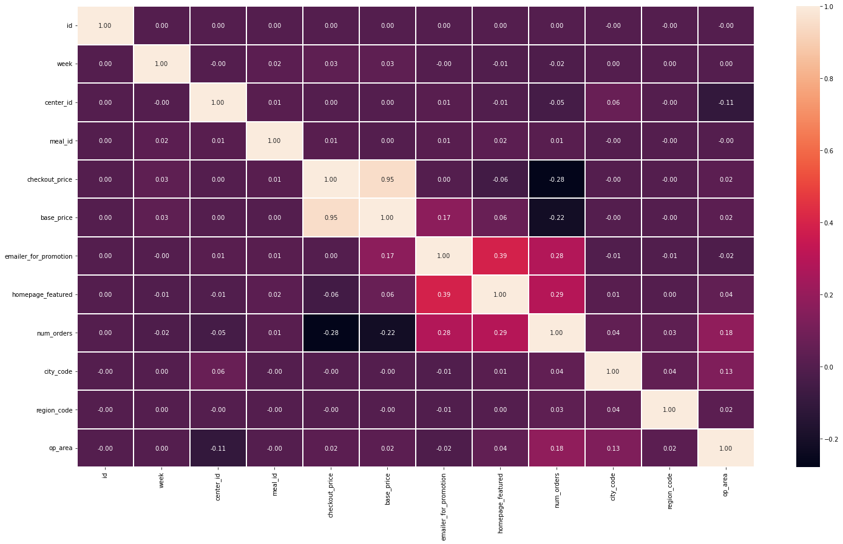
Exploring Feature Relationships
Strong positive correlation
Base price and checkout price (0.95)
Moderate to mild correlations
Email promotion and homepage promotion (0.39)
Number of orders and op_area (0.18)
Moderate Negative Correlation
Number of orders and checkout price(0.28)
Number of orders and base price (0.22)

Slide 12
Modeling
Data Preprocessing
Model selection
Refit the Model on the Entire Training Dataset
Feature Importance

Slide 13
Data Preprocessing
Categorical variables transformed into dummy features
Total features: 28
Sequential split for training and testing sets to preserve temporal order

Slide 14
Model Selection
Linear Regression
Decision Tree
Random Forest
XGBoost

Slide 15
Model Comparisons
Models | R-Squared | Mean Squared Error | Mean Absolute Error | Computation Time
Linear Regression | 0.41 | 90,254 | 169 | 1.23
Decision Tree | 0.47 | 81,155 | 126 | 1.81
Random forest | 0.71 | 45,037 | 99 | 116.30
XGBoost | 0.65 | 53,446 | 119 | 1.64
Tunned XGBoost | 0.75 | 39,369 | 96 | 245.36

Slide 16
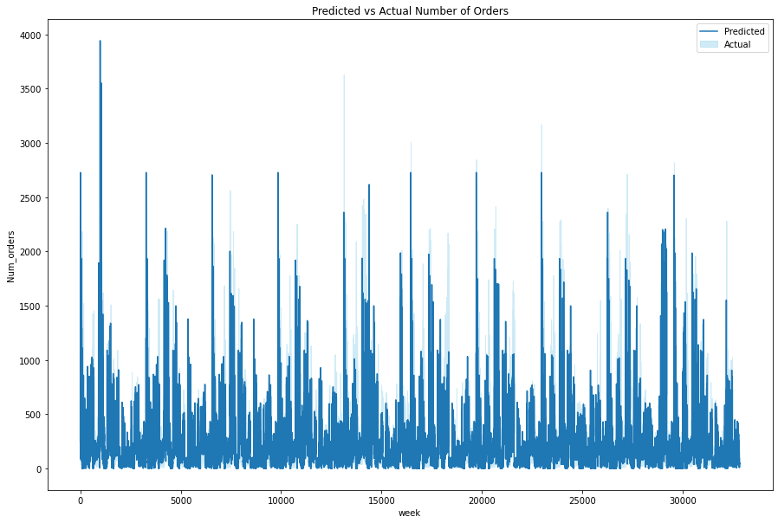
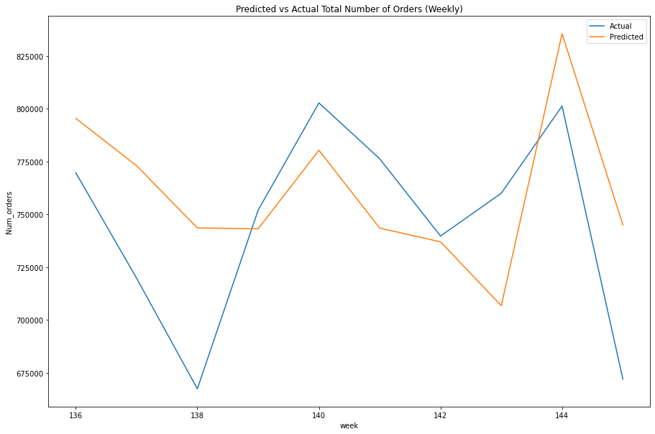
Refit the Model on the Entire Training Dataset
MSE: 22,870
MAE: 91
R²: 0.70

Slide 17
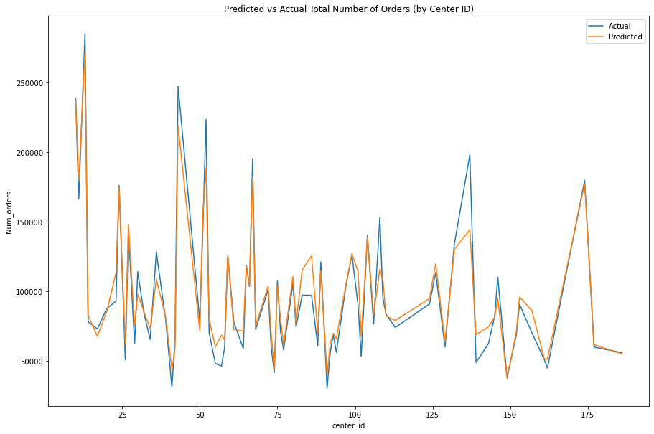
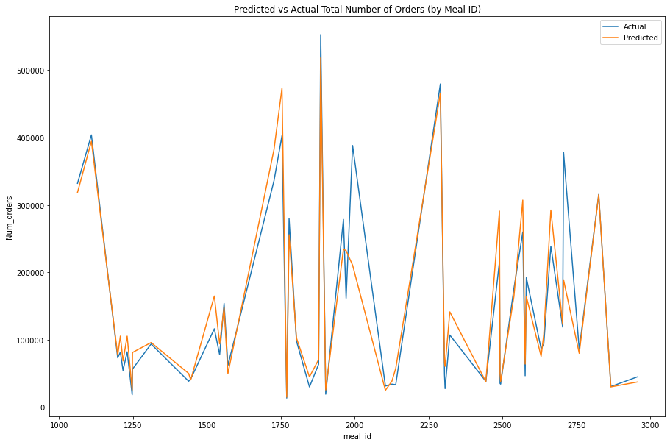
Refit the Model on the Entire Training Dataset

Slide 18
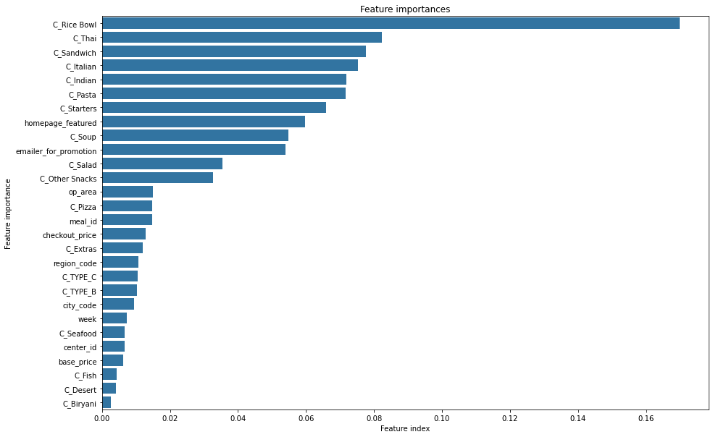
Feature Importance

Slide 19
Conclusion and Future Direction
Among the five regression models, the tuned XGBoost model yielded the best results
All 28 features were utilized in the model
The model's performance on the test set resulted in an R2 score of 0.7 and an MAE of 91.
Utilizing more data
Incorporating feature engineering
Exploring other ensemble models such as the Adaboost model

Slide 20
Thank you!

