Slide 1

Health Monitoring System(HMS)
PRESENTED BY: GROUP 7
PRESENTED TO: Mr. Nasir Mahmood
MEMBERS:
Arfa Faheem (23-1247)
Amna Sajid (23-1245)

Slide 2
Introduction
This Health Monitoring System(HMS) is designed to monitor vital health parameters such as heart rate and blood oxygen level (SpO₂) using IoT technology.
The system uses ESP32 along with MAX30100 pulse oximeter sensor to collect real-time health data and display it on an OLED display as well as on the Blynk mobile application and dashboard, making it useful for home-based health monitoring.
If there is health risk, it sends alert on mobile app and email notification. A buzzer activates to indicate a health risk.

Slide 3
Objectives
To measure heart rate using MAX30100 sensor
To monitor blood oxygen level(SpO₂)
To display sensor values on OLED display
To send real time data to Blynk cloud and mobile app
To generate an alert by using buzzer when heart rate exceeds limit and also sends email message.

Slide 4
Libraries used:
#include <Wire.h> //enables I2C communication between ESP32 and sensors, oled.
#include <MAX30100_PulseOximeter.h> //sensors to read heart rate and SpO2
#include <Adafruit_GFX.h> //for displaying text
#include <Adafruit_SSD1306.h> //for oled driver
#include <WiFi.h> //enables WiFi connectivity for ESP32
#include <BlynkSimpleEsp32.h> //Connects the ESP32 to the Blynk IoT platform for remote monitoring and control.

Slide 5
Hardware Components:
ESP32: Used as main microcontroller
MAX30100: Used to measure heart rate and SpO₂
OLED Display: Used to display sensor values
Buzzer: Used for alert indication
Software Components:
PlatformIO (VSCode): IDE with advanced features and library management.
Blynk Dashboard and Cloud: IoT platform for real-time data visualization, app notifications and remote device control.
Blynk Email Event: For sending email notifications and alerts.
Wi-Fi Libraries: For network connectivity on microcontrollers.

Slide 6
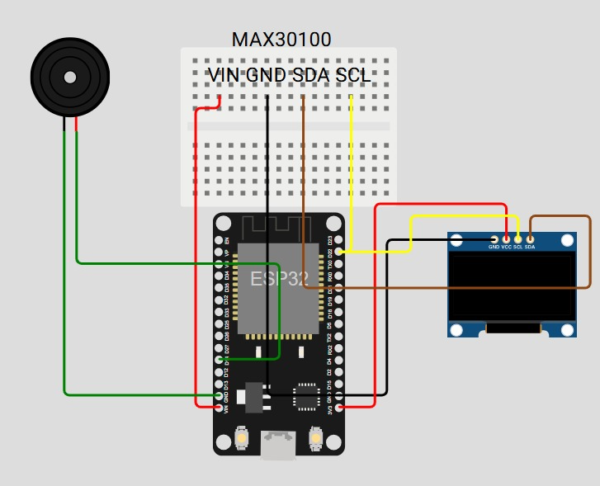
Circuit Diagram

Slide 7
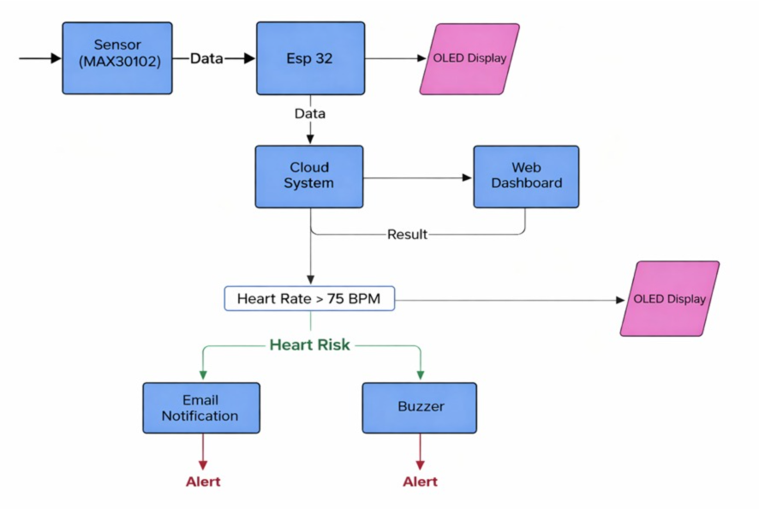
Flow Chart:

Slide 8
Working:
The ESP32 connects to WiFi and Blynk Cloud using an authentication token.
The MAX30100 sensor continuously measures heart rate (HR) and SpO₂ values.
These values are updated every 3 seconds and displayed on the OLED screen.
Data is simultaneously sent to the Blynk application for real-time monitoring.
If the heart rate exceeds 75 bpm, the buzzer is activated and an email notification is sent to alert about heart risk. (Normal value is 95 bpm but for testing, 75 bpm is used)
The ESP32 stores recent sensor readings in memory to track trends over time.

Slide 9
Wiring Connections (Pins):
MAX30100 Pulse Oximeter
SDA → ESP32 GPIO 21
SCL → ESP32 GPIO 22
VCC → 3.3V
GND → GND
OLED Display (SSD1306 – I²C)
SDA → ESP32 GPIO 21
SCL → ESP32 GPIO 22
VCC → 3.3V
GND → GND
Buzzer
Positive (+) → ESP32 GPIO 14
Negative (–) → GND
ESP32
Powered via USB
Wi-Fi used for Blynk cloud connectivity

Slide 10
The system can differentiate between normal and abnormal SpO₂ levels and triggers alerts accordingly.
Users can monitor their health remotely using the Blynk mobile app.
The system logs data for future analysis and can generate reports on health conditions.
All sensor readings are continuously monitored to provide immediate feedback.
Alerts and notifications ensure timely action in case of critical health conditions.
An email is also sent to the device owner to check their health status.

Slide 11
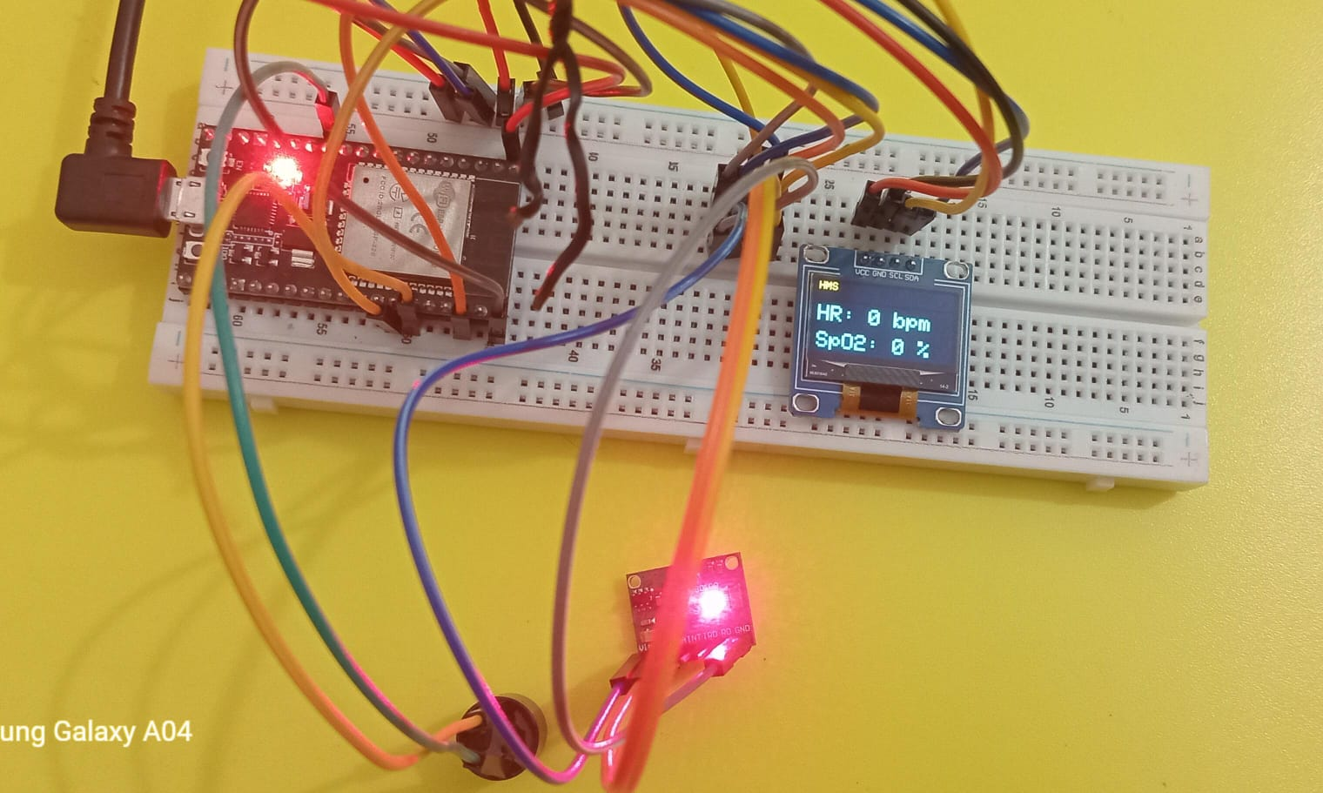
Hardware Wiring connection:

Slide 12
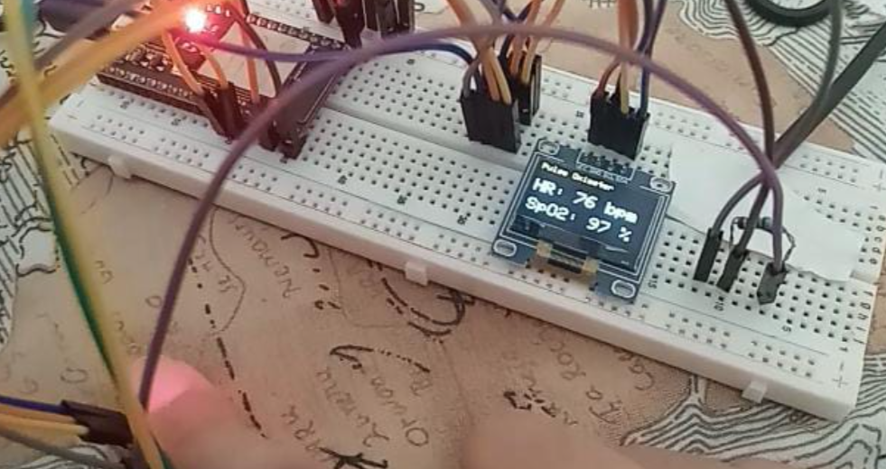
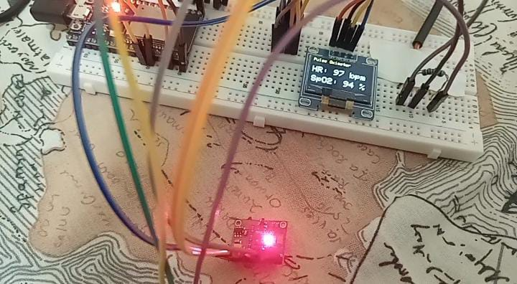
Project Working (hardware):

Slide 13
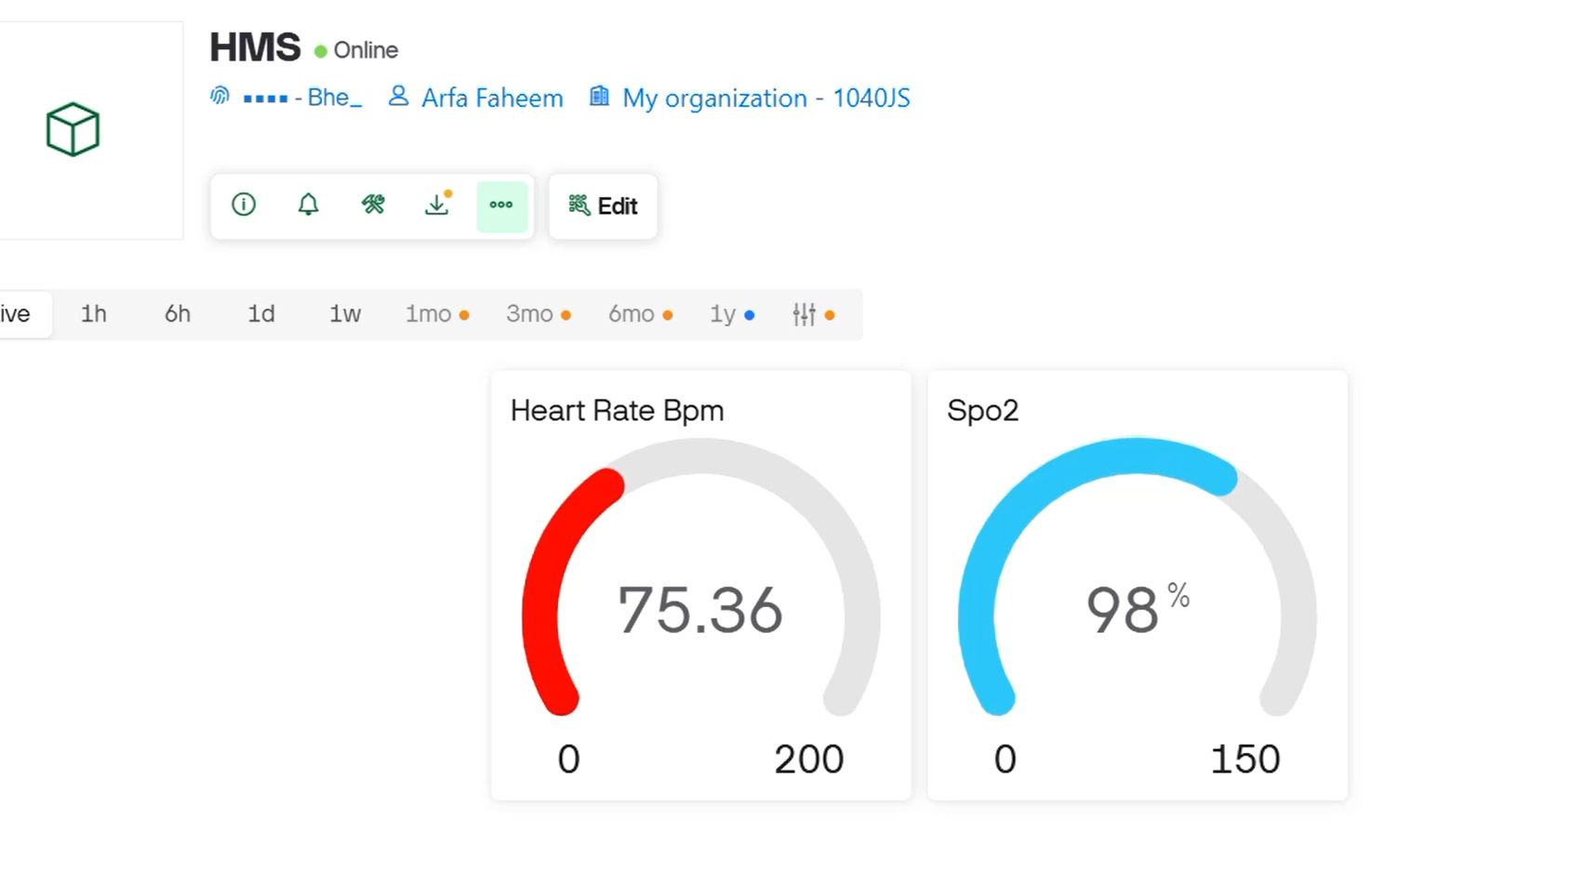
Blynk Dashboard:

Slide 14
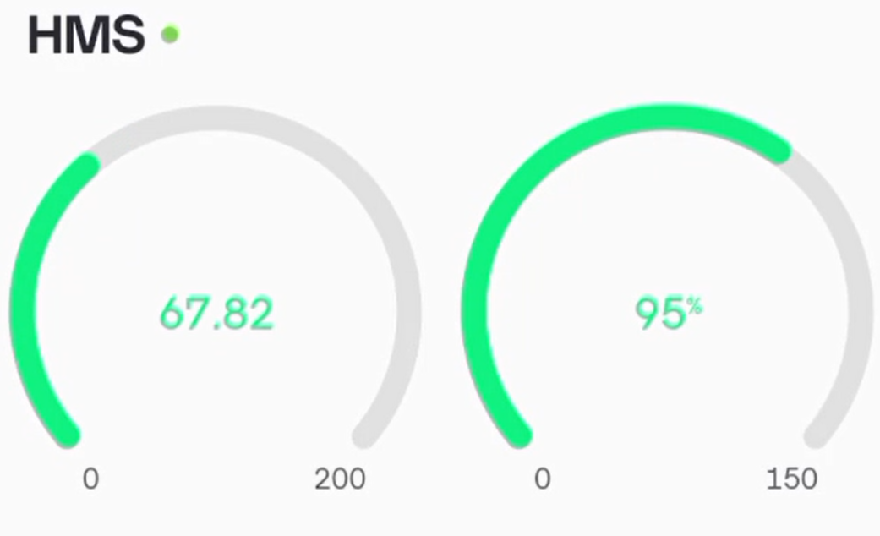
Blynk App:

Slide 15
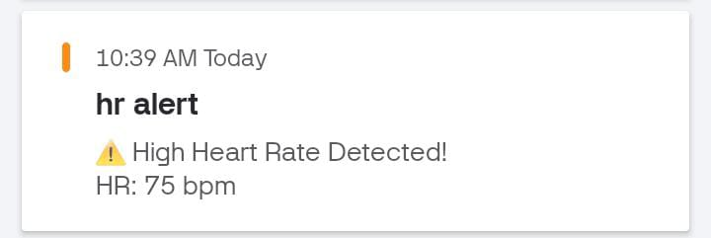
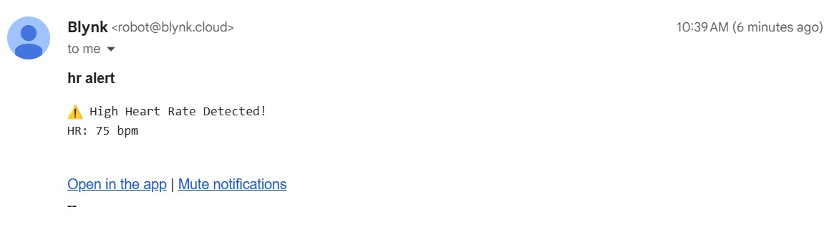
App notification:
Email notification:

Slide 16
Limitations:
The MAX30100 pulse oximeter sensor shows limited compatibility when used side by side with other sensors in the same ESP32. During implementation, it was observed that when the MAX30100 was used together with the DS18B20 body temperature sensor, the MAX30100 failed to provide accurate heart rate and SpO₂ readings, while the DS18B20 continued to function normally.
This issue occurs due to timing and resource conflicts, as the MAX30100 requires continuous I²C communication and frequent data updates, whereas the DS18B20 relies on precise timing for One Wire communication. Managing both sensors simultaneously on the ESP32 caused synchronization issues, leading to unreliable MAX30100 readings.

Slide 17
This limitation has been addressed in the MAX30102 sensor, which offers improved internal timing control and better stability when used in multi-sensor environments. However, the MAX30102 was not easily available in the local market at the time of development, so the MAX30100 was used instead. As the project was about health monitoring, we use MAX30100 with alert system.

Slide 18
Any Questions ?

