Slide 1
ECOSHIELD – SMART DISASTER ALERTING & ENVIRONMENTAL MONITORING SYSTEM

Slide 2
ABSTRACT
This project integrates GIS, AI, remote sensing, and mobile technology to strengthen disaster management, coastal protection, and climate resilience. It uses AI and GIS tools to identify erosion-prone areas, forecast disaster risks, and analyze geospatial data to select optimal coastal plantation sites.
A mobile platform will deliver instant disaster alerts and allow users to report hazards, enhancing situational awareness. The system will also track the environmental benefits of shelter belt plantations to support long-term climate resilience.
Additionally, the system provides real-time analytics and risk assessment features to help agencies prioritize actions and allocate resources effectively.

Slide 3
LITERATURE SURVEY
S. NO | TITLE | CONCEPT | AUTHOR | YEAR
1) | A Hybrid Prediction Model Integrating Artificial Intelligence and Geospatial Analysis for Disaster Management | This study addresses the need for timely, accurate disaster predictions and proposes a hybrid machine learning model combining CNNs, GBMs, and SVMs to improve forecasts for floods, earthquakes, and wildfires. | Muhammad Asim Saleem, Watit Benjapolakul, Surachai Chaitusaney, Pasu Kaewplung, Wattanasak Srisiri | 2025
2) | Multisensor Remote Sensing and AI-Driven Analysis for Coastal and Urban Resilience Classification. | The study presents an LSTM-based deep learning model using ocean current and remote sensing data to assess urban and coastal resilience. It outperforms traditional methods and offers a scalable tool for climate adaptation and urban planning. | Sumei Ren, Bushra Ghaffar, Muhammad Mubbin, Dmitry E. Kucher, Muhammad Haseeb, Olga D. Kucher, Zainab Tahir, M. Abdullah-Al-Wadud | 2025

Slide 4
PROBLEM STATEMENT
Traditional disaster management systems suffer from delayed response times, inaccurate predictions, and fragmented coordination, leading to inefficient emergency handling and increased casualties. They rely heavily on historical data and lack real-time monitoring capabilities, making it difficult to predict disasters accurately.
Additionally, false incident reports, lack of environmental risk assessment, and limited integration with local communities contribute to poor disaster preparedness. The absence of a unified platform for data-driven risk assessment, crowdsourced incident reporting, and environmental analysis creates gaps in disaster response and resilience.

Slide 5
EXISTING SYSTEM
Fragmented Data Sources: Climate and erosion data are scattered across multiple platforms with no unified system.
Lack of Predictive Capabilities: Current methods react to disasters rather than proactively predicting risks.
Manual Decision-Making: Shelter belt plantation sites are selected based on outdated techniques.
Limited Community Involvement: No real-time crowdsourced reporting on disaster impact.
Absence of Integrated Carbon Accounting: No structured tracking of plantation benefits on climate mitigation

Slide 6
DISADVANTAGES
Delayed updates via TV, newspapers.
Difficult to verify on-ground incidents quickly.
Slow government response.
Inaccurate location data.
No platform for community participation.

Slide 7
PROPOSED SYSTEM
GIS-based Analysis: Mapping erosion-prone zones using satellite imagery & geospatial models.
AI-Powered Predictions: Using machine learning algorithms to forecast coastal erosion & disaster risks.
Real-Time Alerts: Mobile app integrated with Firebase Cloud Messaging for disaster warnings.
Crowdsourced Reporting: Communities contribute real-time updates on disaster impacts via the app.
Carbon Accounting Dashboard: Tracks shelter belt plantations' environmental impact using AI models.

Slide 8
ADVANTAGES
Identify erosion-prone zones.
Suggest areas for shelterbelt plantations.
Track shelterbelt density changes.
Estimate carbon sequestration potential.
Send notifications based on region and disaster type.

Slide 9
SYSTEM REQUIREMENTS
Hardware Requirements:
Processor : Intel core i5 processor
RAM : 8GB
Hard disk : 512 GB
Operating system : Windows 10 or later.
Devices: Android smartphones with camera and GPS enabled.
Network: Broadband Internet (at least 20+ Mbps)

Slide 10
Software Requirements:
Front End: React Native (Expo)
Backend: Node.js + Express.js
Database: MongoDB (Atlas)
Browser: Latest versions of Chrome, Firefox, or Edge.
GIS Tools: Google Earth Engine, Mapbox
AI/ML: Python for model training API: REST APIs for reporting & alerts

Slide 11
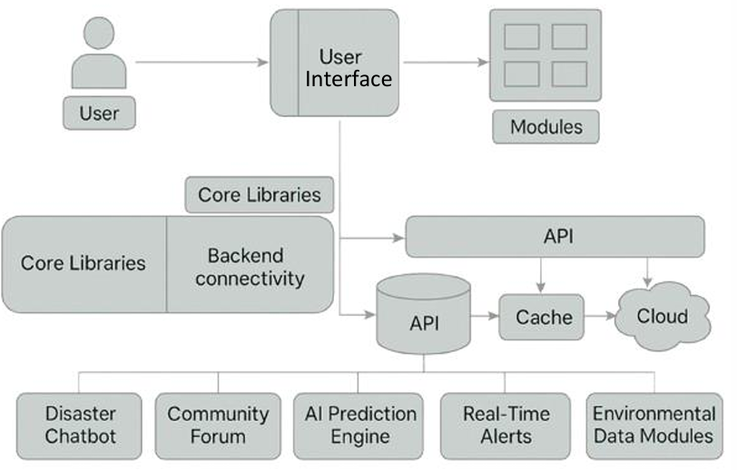
ARCHITECTURE DIAGRAM

Slide 12
MODULES
Module 1: Incident Reporting (Text, image, GPS)
Module 2: Disaster Prediction and Analysis
(Floods, Earthquakes, Cyclones, Wildfires, Tsunamis, Landslides)
Module 3: Alert Notification System
Module 4: GIS-Based Environmental Analysis
Module 5: Crisis Management Console

Slide 13
      Module 1: Incident Reporting (Text, image, GPS)
Users can report ongoing or witnessed disasters directly through the app using text descriptions, photos, and GPS-tagged locations.
AI-based validation checks the authenticity of each report using metadata, image analysis, and cross-referencing with external data.
Each report is processed and stored in a database where it is analyzed alongside live satellite and weather data for accuracy and urgency.
Location-based filtering helps emergency teams to prioritize reports coming from highly vulnerable or densely populated regions.
Offline mode allows users in remote areas to submit reports, which sync automatically when internet access is restored.

Slide 14
      Module 2: Disaster Prediction and Analysis (Floods, Earthquakes, Cyclones, Wildfires, Tsunamis, Landslides)
Machine learning models analyze historical trends, live environmental data, and sensor inputs to predict multiple types of disasters.
Floods, earthquakes, cyclones, wildfires, landslides, and tsunamis are forecasted using real-time inputs from weather APIs and IoT devices.
Risk heatmaps and vulnerability zones are generated to guide early warning systems and preparedness planning.
The platform continuously learns and adapts, refining its predictions as more data becomes available.
This predictive analysis enables proactive mitigation efforts, such as alerts, evacuations, and infrastructure protection.

Slide 15
      Module 3: Alert Notification System
The system sends instant alerts to users in disaster-prone areas, tailored to their real-time location and the severity of the threat.
Messages include critical safety instructions, maps of safe zones, medical aid centers, and emergency contacts.
Multiple channels—push notifications, SMS, and email—are used to ensure timely and wide dissemination.
The alert logic can escalate warnings based on live environmental updates and incoming incident reports.
Users have the option to configure alert preferences and sensitivity thresholds based on their region and risk tolerance.

Slide 16
      Module 4: GIS-Based Environmental Analysis
Geographic Information System (GIS) technology is used to map affected regions, disaster-prone zones, and population exposure.
The system overlays incident reports, satellite imagery, and real-time environmental data for visual risk assessment.
Helps in identifying long-term environmental degradation such as coastal erosion, water scarcity, or forest loss.
Supports layered visualizations to help disaster responders and policymakers understand the ground situation effectively.
Provides predictive zoning insights for disaster preparedness and land-use planning.

Slide 17
      Module 5: Crisis Management Console
A powerful console built for government officials, NGOs, and disaster response teams to manage real-time data and operations.
Allows authorities to monitor reports, validate predictions, and track resource distribution across multiple regions.
Interactive analytics help in understanding trends, incident density, and high-risk locations during an emergency.
Role-based access control ensures that sensitive information is only accessible to authorized users.
Includes support for post-disaster assessment reports, incident playback, and decision-logging for future learning.

Slide 18
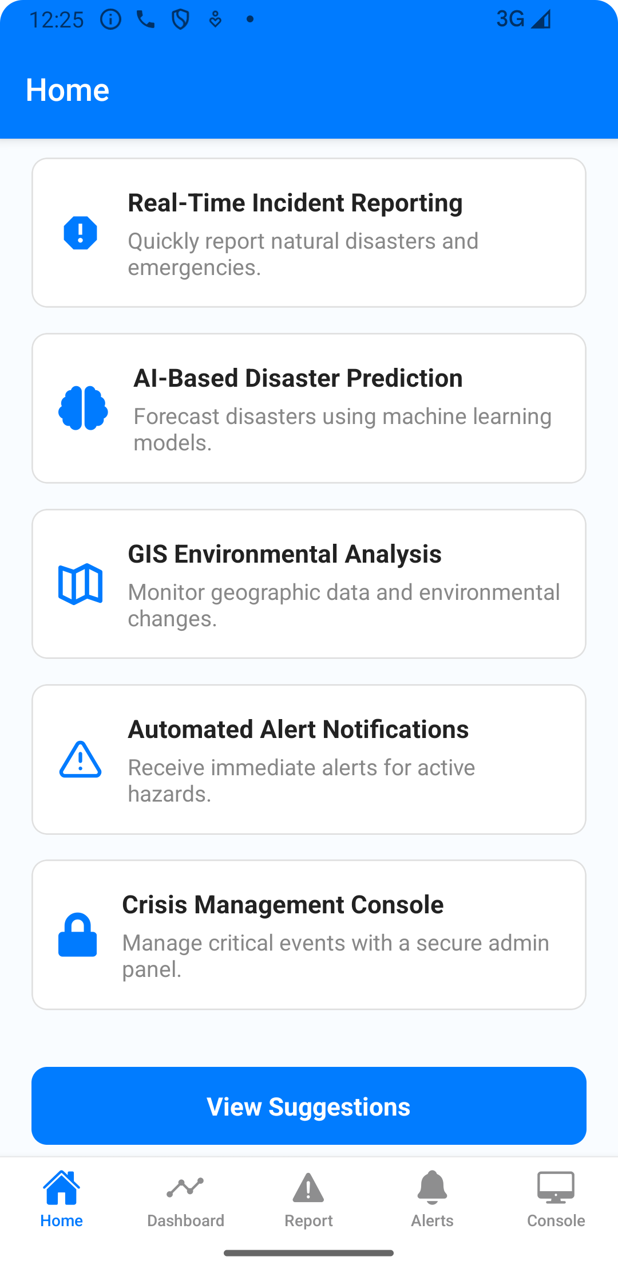
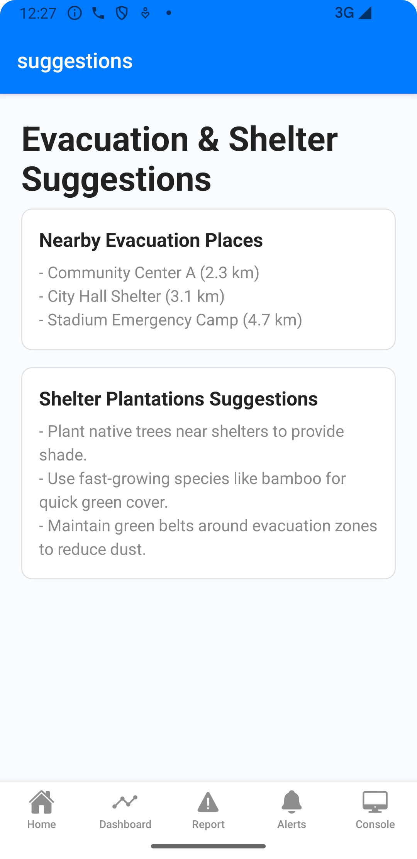
      OUTPUT

Slide 19
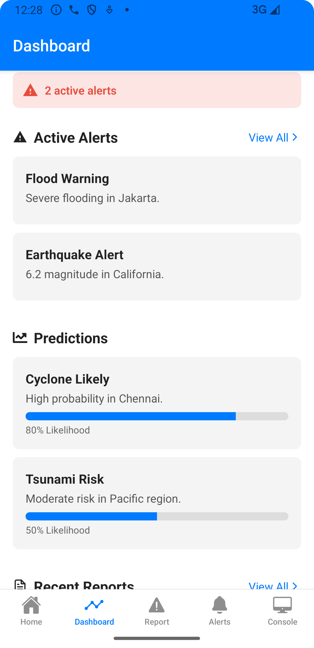
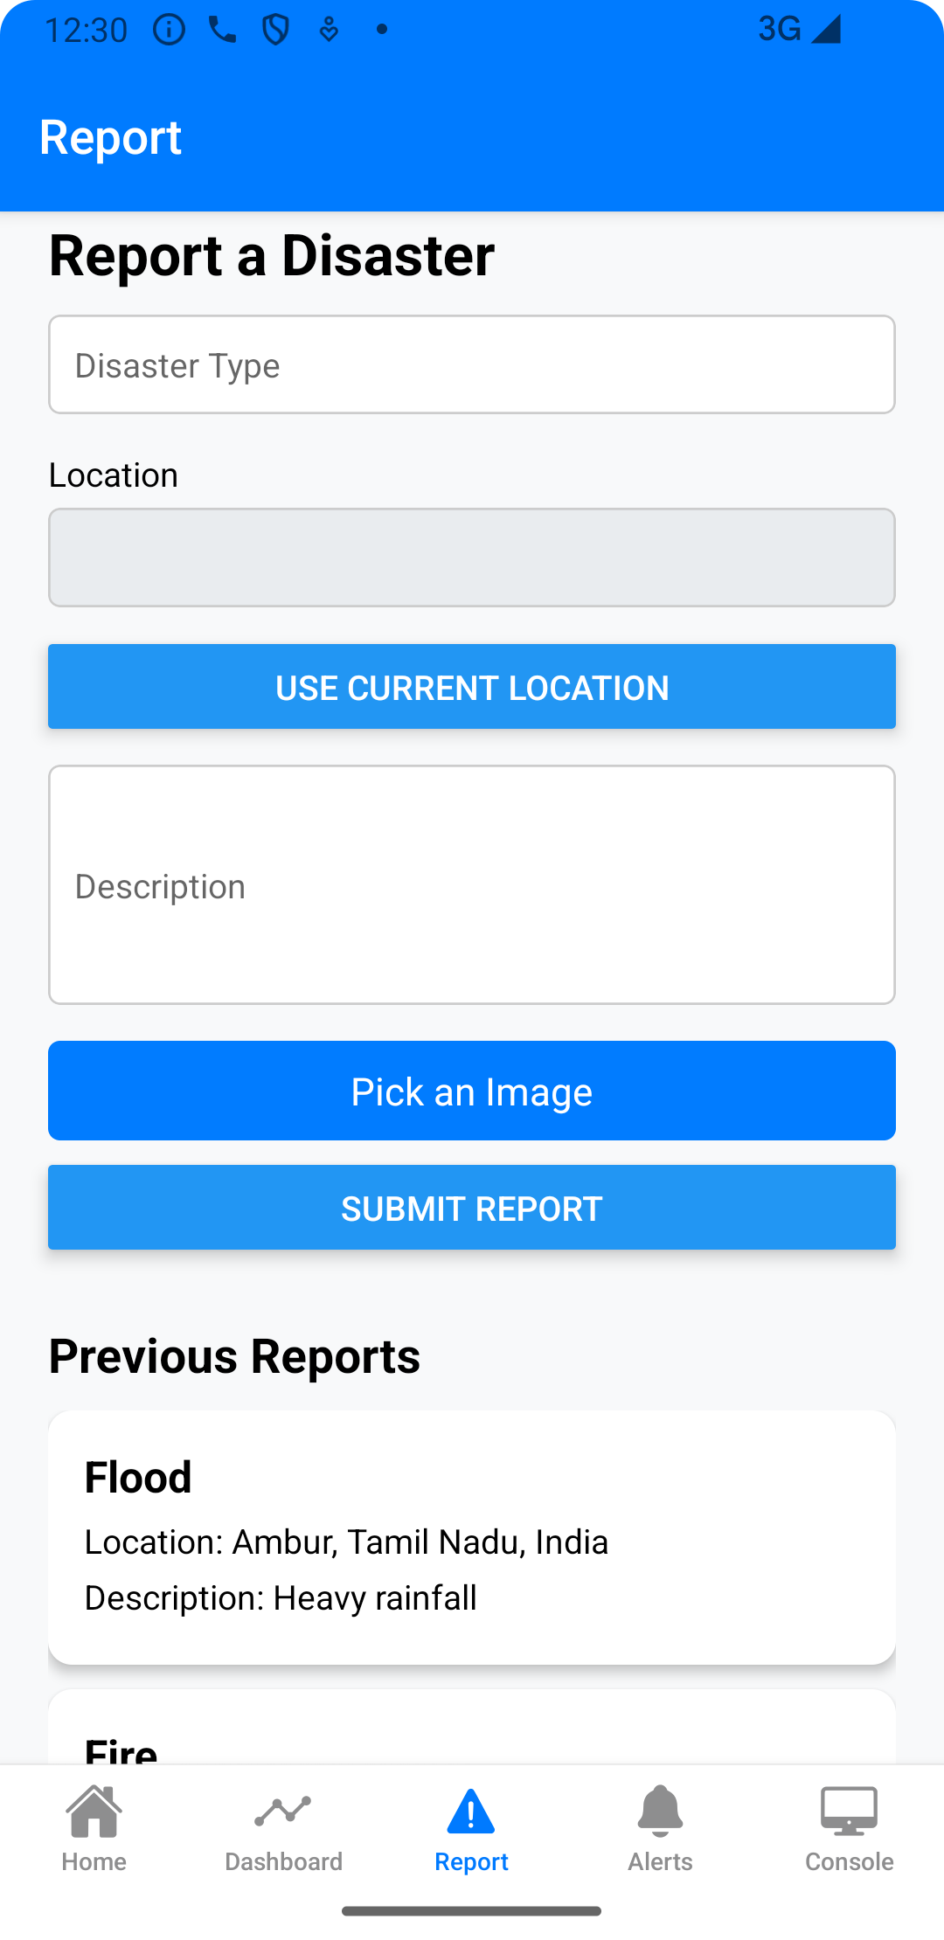

Slide 20
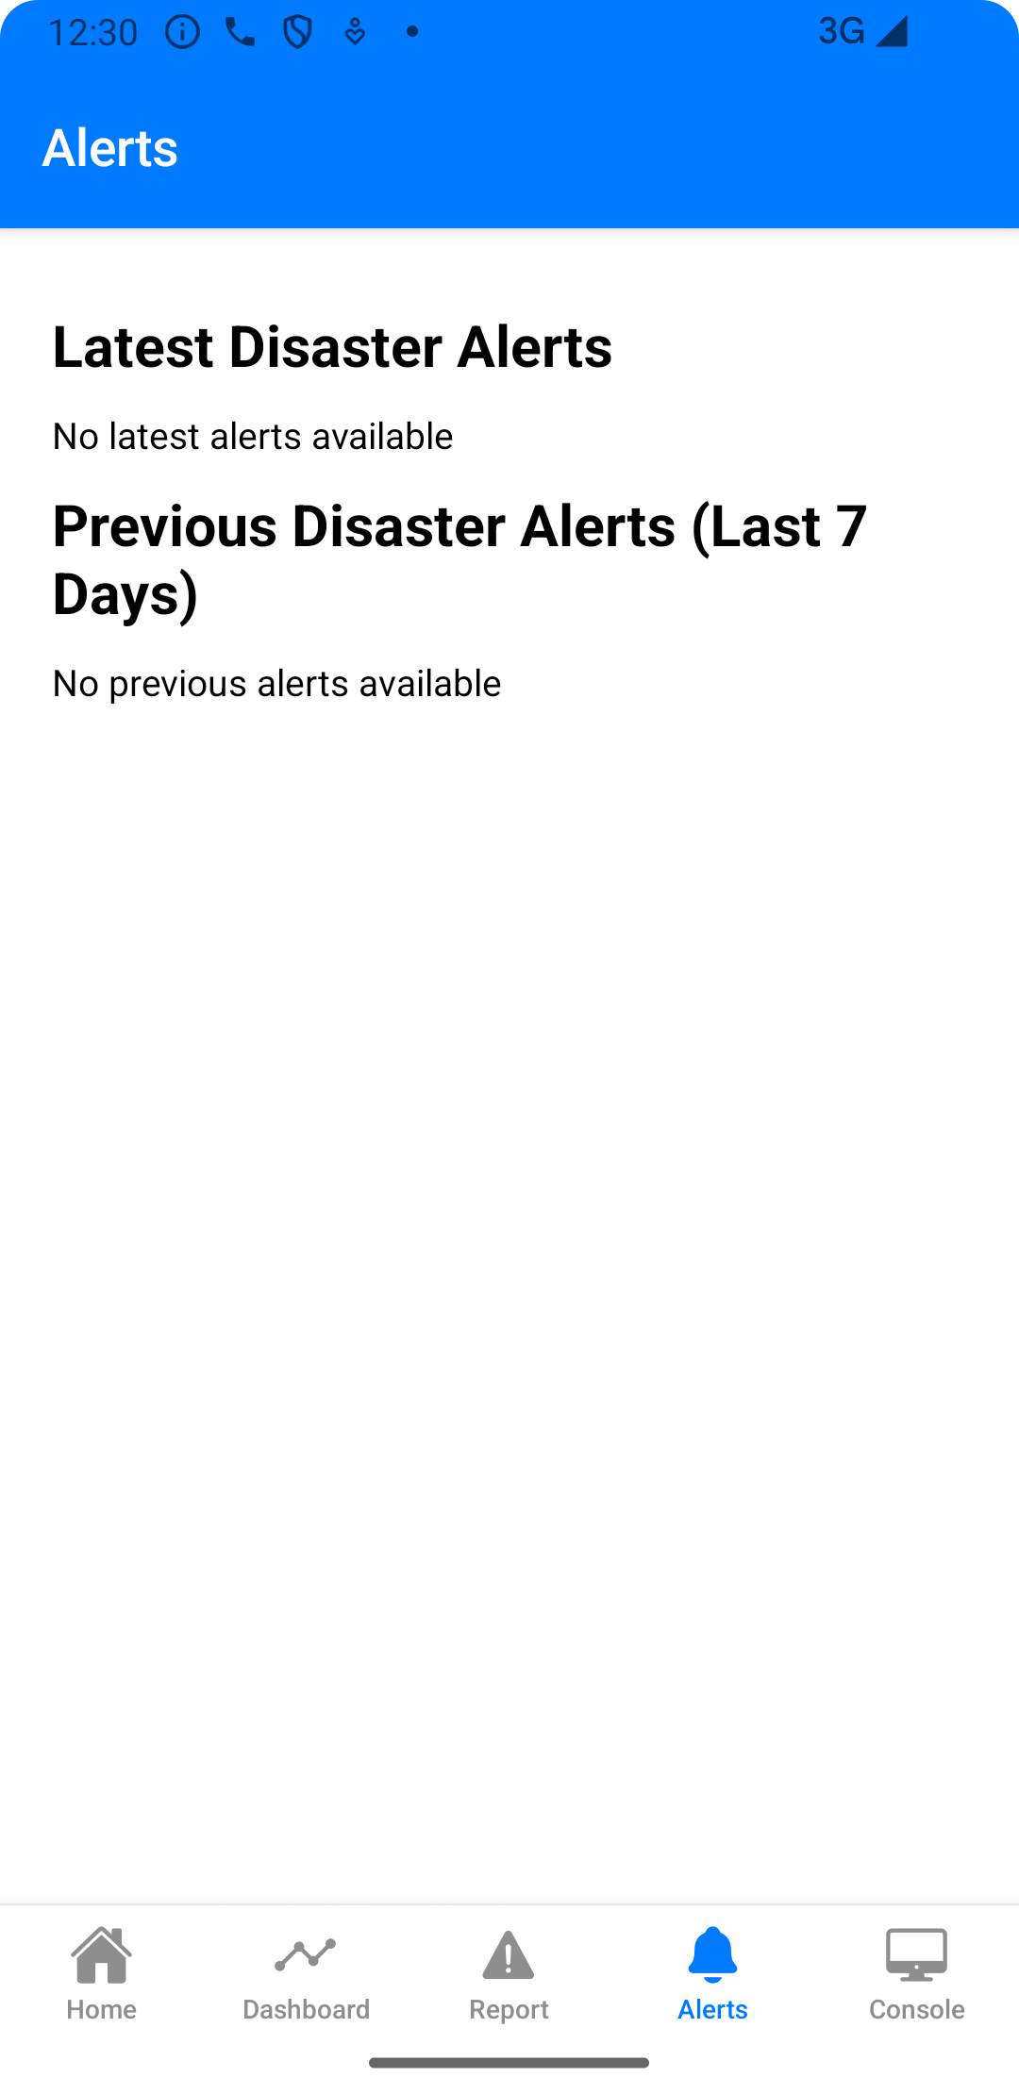
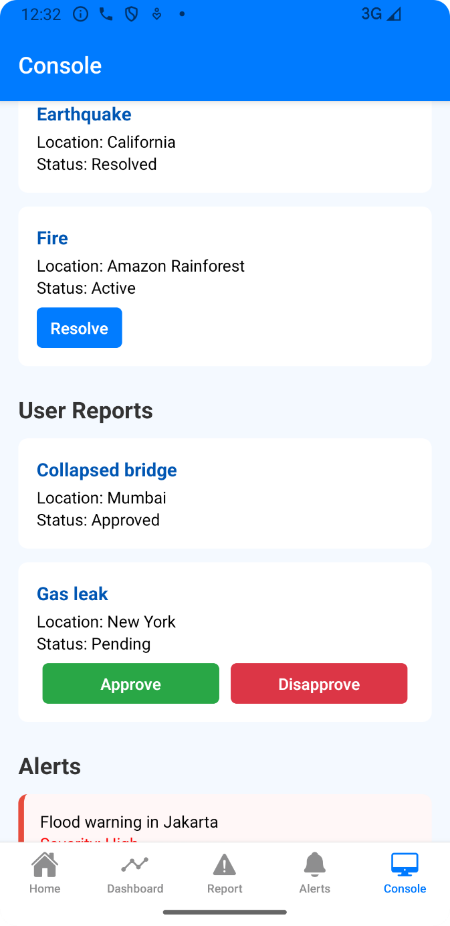

Slide 21
FEATURES
Real-Time Incident Reporting
Automated Early Warning System
GIS and Remote Sensing Integration
Role-Based Access Control
AI-Powered Recommendations
Real-Time Monitoring and Admin Panel

Slide 22
CONCLUSION
EcoShield is a transformative disaster management system that combines AI, GIS, remote sensing, and mobile technology to improve disaster prediction, coastal protection, and climate resilience. By enabling real-time alerts, community participation, and environmental conservation, the platform shifts disaster response from a reactive approach to proactive mitigation.
With future enhancements, EcoShield will become an intelligent, scalable, and globally adaptable solution—helping communities stay safer while strengthening long-term climate resilience and disaster preparedness!

Slide 23
FUTURE ENHANCEMENTS
Drone & IoT-Based Disaster Monitoring
Blockchain for Verified Disaster Reports
AR & VR for Disaster Preparedness Training
Integration with Global Disaster Response Agencies
Improved Carbon Accounting with IoT Sensors

Slide 24
REFERENCES
M. Danesh Miah and A. Raihan, “Role of Casuarina shelterbelt for climate change adaptation and mitigation: An evidence from Cox’s Bazar, Bangladesh,” ResearchGate, 2022. https://www.researchgate.net/publication/358922221
M. Karimiziarani, “Social Media Analytics in Disaster Response: A Comprehensive Review,” arXiv preprint arXiv:2307.04046, 2023. https://arxiv.org/pdf/2307.04046
F. Sufi and I. Khalil, “Automated Disaster Monitoring from Social Media Posts Using AI-Based Location Intelligence and Sentiment Analysis,” ResearchGate, Mar. 2022 https://www.researchgate.net/publication/359388774
S. Al Shafian and D. Hu, “Integrating Machine Learning and Remote Sensing in Disaster Management: A Decadal Review of Post-Disaster Building Damage Assessment,” Buildings, vol. 14, no. 8, p. 2344, 2024. doi: 10.3390/buildings14082344
E.-S. Apostol, C.-O. Truică, and A. Paschke, “ContCommRTD: A Distributed Content-Based Misinformation-Aware Community Detection System for Real-Time Disaster Reporting,” arXiv preprint arXiv:2301.12984, Jan. 2023. https://arxiv.org/abs/2301.12984

