Slide 1
keylogger SECURITY
CAPSTONE PROJECT
Presented By:
Arfah Manaal-Priyadarshini Engineering College-Computer Science and Engineering

Slide 2
OUTLINE
Problem Statement
Proposed System/Solution
System Development Approach
Algorithm & Deployment
Result
Conclusion
Future Scope
References

Slide 3
Problem Statement
In today's digital age, where cybersecurity threats loom large, one of the significant concerns is the proliferation of keyloggers, stealthy software tools designed to monitor and record keystrokes on a user's computer without their knowledge. Keyloggers pose a severe threat to individuals and organizations as they can capture sensitive information such as passwords, credit card details, and other personal data, leading to identity theft, financial loss, and privacy breaches.

Slide 4
Proposed Solution
Software keyloggers can be deployed remotely and do not require physical access to the target system, they are very popular. The proposed software is capable of installing tself in a targeted system when the user, for example, clicks on a malicious link sent to him via email or social media, and then captures all of the user's keystrokes while logged into the system, saves the logs in a folder.
Importing necessary libraries:
Import the necessary libraries, including tkinter for the GUI, pynput for keylogging, and json for saving the keylogger data as a JSON file.
Defining global variables:
The code defines global variables, including keys_used, flag, keys, and functions for generating text logs and JSON files
Defining keylogger functions:
The code defines functions for handling key presses and releases, which are used to log the keys and update the JSON file.
Implementing keylogger:
Run the python file that consist of python code to implement keylogger. A GUI will appear. Clicl on start. It will start capturing all the key strokes and stores it in key_log.txt file until it is stopped.

Slide 5
System Approach
System requirements:
RAM: 4GB or above.
Operating system: Windows 7/Windows 10.
Programming Language: Python.
IDE: Python IDLE/PyCharm/Jupyter Notebook.
Library required to build the model:
tkinter: A standard GUI library for Python, used here to create the application window and buttons.
pynput: This library allows you to control and monitor input devices. In the context of this code, it’s used to monitor keyboard events.
json: A built-in Python library used for working with JSON data. Here, it’s used to encode the logged keys into a JSON format before writing to a file.

Slide 6
Algorithm & Deployment
ALGORITHM:
Initialize: Set up the Tkinter GUI with start and stop buttons.
Start Keylogger: When the user clicks “Start”, begin monitoring keyboard events.
Key Press Event:
On key press, check if it’s the first key event.
If true, log the key as ‘Pressed’ and set the flag to true
If the flag is already true, log the key as ‘Held’.
Key Release Event:
Log the key as ‘Released’.
Reset the flag to false if it was true.
Logging: After each key event, append the event to a list and write it to a JSON file.
Stop Keylogger: When the user clicks “Stop”, stop monitoring keyboard events.
Exit: Close the application when the user closes the window.

Slide 7
Algorithm & Deployment
DEPLOYMENT:
Package the Application: Use a tool like PyInstaller to package the Python script into an executable.
Set Up Environment: Ensure the target system has the required Python version and dependencies installed.
Deploy Executable: Transfer the packaged executable to the target system.
Run the Application: Execute the program on the target system to start the keylogger.
Monitor: The application will run in the background, logging key events until stopped.
This keylogger program is designed to be simple and straightforward, capturing keyboard input events and logging them in both text and JSON formats. It’s important to note that deploying a keylogger on systems without explicit permission is illegal and unethical.

Slide 8
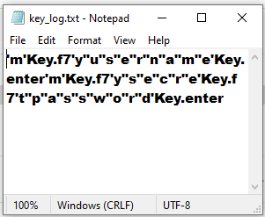
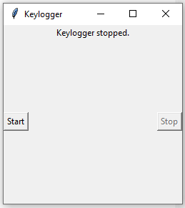
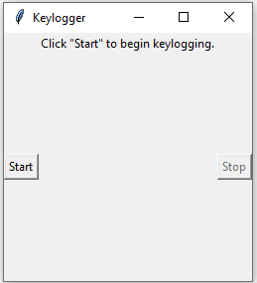
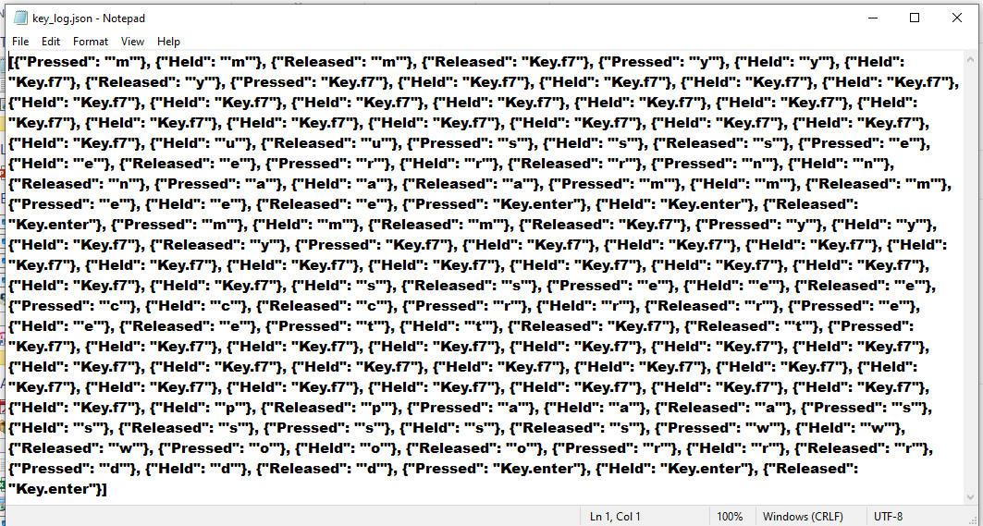
Result

Slide 9
Conclusion
The keylogger project encapsulates the essence of digital monitoring tools, serving as a functional prototype for recording keystrokes. It is meticulously designed to capture and log each key press and release, providing a chronological record of keyboard activity. The deployment of such a tool is streamlined through a user-friendly interface, allowing for easy operation with start and stop controls. The project’s conclusion highlights the dual nature of keyloggers: while they can be invaluable for system administrators for monitoring and troubleshooting, they also bear the potential for misuse. Therefore, the project serves as a stark reminder of the ethical considerations inherent in the deployment of surveillance software and the imperative to uphold stringent standards of privacy and consent.

Slide 10
Future scope
The future scope of the keylogger project can be envisioned as follows:
Enhanced Security Features: Implementing encryption for the logged data to ensure privacy and security.
User Behavior Analysis: Extending the keylogger to analyze user behavior patterns for cybersecurity purposes.
Remote Monitoring: Developing the capability for remote deployment and monitoring, useful for parental control or enterprise security.
Integration with Other Systems: Allowing the keylogger to interface with other applications or systems for comprehensive monitoring.
Advanced Data Management: Introducing more sophisticated data handling, such as real-time analysis and cloud storage.
Customization Options: Providing users with customizable options for what is logged and how data is reported.
Legal and Ethical Safeguards: Establishing clear usage policies to ensure the keylogger is used responsibly and ethically.
These enhancements could broaden the utility of the keylogger, making it a more robust tool while also addressing important ethical and legal considerations

Slide 11
References
B. Whitty, “The ethics of key loggers,” Article on Technibble.com, June 2007
(accessed May 8, 2010), http://www.technibble.com/ the-ethics-of-key- loggers/
Use of legal software products for computer monitoring, keylogger.org
Andrew Kelly (2010-09-10). "Cracking Passwords using Keyboard Acoustics and Language Modeling"
C. Wood and R. K. Raj, “Sample keylogging programming projects,” 2010
(accessed May 8, 2010), http://www.cs.rit.edu/~rkr/ keylogger2010.
D. Le, C. Yue, T. Smart, and H. Wang, “Detecting kernel level keyloggers
through dynamic taint analysis,” College of William & Mary, Department of
Computer Science, Williamsburg, VA, Tech. Rep. WM-CS-2008-05, May
2008 AA.

Slide 12
THANK YOU

