Slide 1
Title: Creating a Model to predict House Prices
Author: <Enter your name here>

Slide 2
Introduction
The Project is to create a Model to predict House Prices
Importing the required Data into Jupytor Notebook
Data Analysis and Cleaning
Data Visualization on the house price data
Modeling the data using the algorithms
Evaluating the built model using the test Model
*Please add slides as required.

Slide 3
The Data
The data is related to house prices and the factors that affects it. Different factors such as number are rooms garage area etc are in columns. There are 100 rows and 82 columns.
*Please add slides as required.

Slide 4
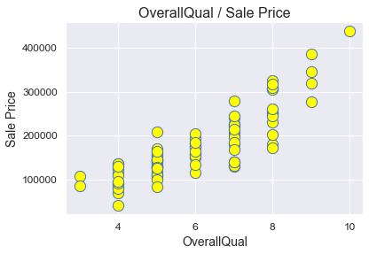
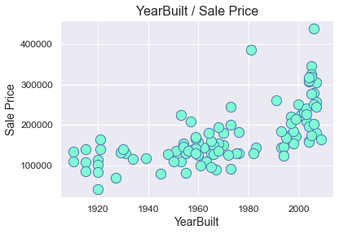
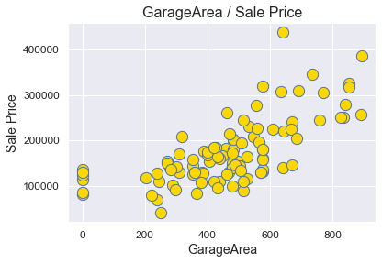
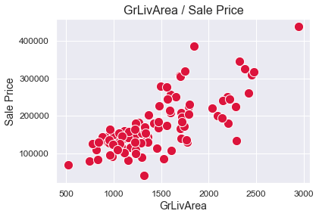
Data Exploration:
Initial analysis shows 4 Strong Correlations With House Prices
*Please add slides as required.

Slide 5
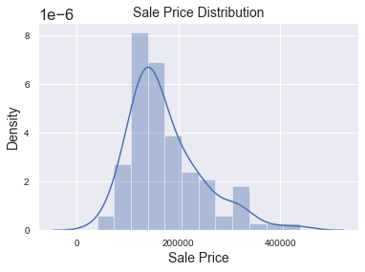
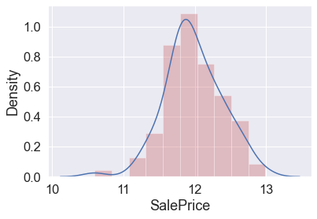
Graphs
Histograms shows the average Sale price is between 100K to 300K
The Second plot represent the log of prices

Slide 6
Data Preparation
Created a train data
Changed null Values with mean Values for some columns
Selected only columns with numbers only
Dropped columns with no values
Calculated correlation between Sale Prices and different variables
*Please add slides as required.

Slide 7
Correlation
Variable with more than than .5
correlation with SalePrices
GrLivArea 0.735129
GarageArea 0.688249
GarageCars 0.663441
YearBuilt 0.658636
TotalBsmtSF 0.616297
GarageYrBlt 0.589361
FullBath 0.579505
MasVnrArea 0.571836
TotRmsAbvGrd 0.553603
1stFlrSF 0.550912
YearRemodAdd 0.548330
Variable with less than .5 Correlation:
LotArea 0.497124
Fireplaces 0.487907

Slide 8
Project Description
<Summarize which algorithms you used to analyze the data. Why was the algorithm you chose suitable for this predictive model?>
I used linear regression for this model because It’s used to predict values within a continuous range (e.g. sales, price) rather than trying to classify them into categories.
*Please add slides as required.

Slide 9
Analysis and Results
Groups of variables for Models
I picked the variables with strong positive correlation with Sale Prices.
First Group
'SalePrice', 'OverallQual', 'GrLivArea', 'GarageArea', 'GarageCars',
score: 79percet
Second Group
'SalePrice', 'OverallQual', 'GrLivArea', 'GarageArea', 'GarageCars',
'YearBuilt', 'TotalBsmtSF', 'GarageYrBlt', 'FullBath', 'MasVnrArea',
Score: 85 percent
Third Group
'SalePrice', 'OverallQual', 'GrLivArea', 'GarageArea', 'GarageCars',
'YearBuilt', 'TotalBsmtSF', 'GarageYrBlt', 'FullBath', 'MasVnrArea',
'TotRmsAbvGrd', '1stFlrSF', 'YearRemodAdd', 'LotArea', 'Fireplaces'
Score: 88 percent
*Please add slides as required.

Slide 10
Verification
Model performance with Test Data
First Model with 5 variables perform less desirable
Second Model with 10 performed less than 75
Third model with 15 model performed 75
Extra Model was created with 20 variables which performed 55
*Please add slides as required.

Slide 11
Conclusion
The model created using train data has 88 percent score. When tested with test data the Model score is 75.45 percent. The best model was created using 15 independent variables. When tested with more and less Variables the accuracy of model decreased on test data. the accuracy went down to 55 percent on test data when tested the model created by using 20 variables. What I learned while working with different variables sets is that we need to avoid using a large number of independent variables since it will overfit our data and but would not yield a good prediction while work with other data.
*Please add slides as required.

Slide 12
References
-Acharya, Shweta."How to improve the accuracy of a Regression Model"towardsdatascience.com. Towards data science. 2021.https://towardsdatascience.com/how-to-improve-the-accuracy-of-a-regression-model-3517accf8604.
-Adithiyan, Nikhil "House Price Prediction With Machine Learning in Python".medium.com.22020.https://medium.com/codex/house-price-prediction-with-machine-learning-in-python-cf9df744f7ff.
*Please add slides as required.

