Slide 1
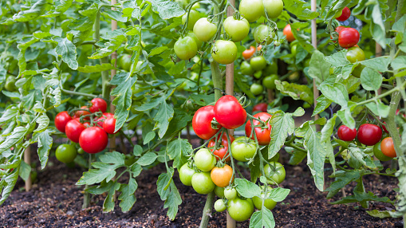
Tomato Leaf Disease Detection Based on Image Processing and Machine Learning

Slide 2

Agenda
Introduction
Novelty and Contribution
Image Acquisition
Pre-Processing
Image Enhancement
Image Segmentation
Feature Extraction
Classification
Conclusion

Slide 3
Introduction
Food is necessity for human life
Food crises in Mountainous regions of Pakistan, Kyrgyzstan, and Tajikistan
Disease in tomatoes are favored by cool and wet weather
New and noble idea
Simple Web application
Not only limited tomatoes

Slide 4
Novelty and Contribution
No any previous research in targeted area (Gilgit-Baltistan and Central Asia)
Solely focused on mountainous area
Aims to improve life
First research in Mountainous regions of Pak, Kyrgyzstan, and Tajikistan
Applying more Image processing and Machine Learning techniques

Slide 5
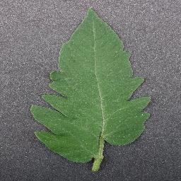
Image Acquisition
Multiple Datasets will be used
One dataset from Kaggle will be solely used for training models
Dataset size is approx. 3 gb
One dataset taken from University of Malakand, Pakistan
One local dataset for testing purpose

Slide 6
Pre-Processing
Prepares image for further processing
Improve quality of image
Noise removing
Salt and pepper removing
Image resizing

Slide 7
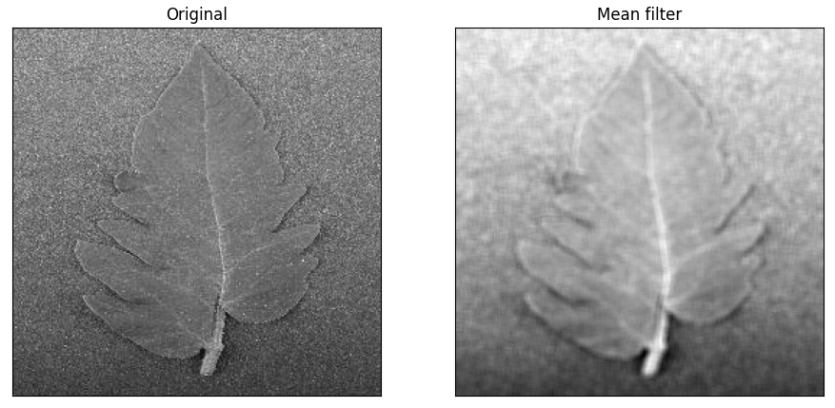
Mean Filter
Advantages
Remove noise
Improves quality: Brightens image
Disadvantages
Edges get blurred
Reduce resolution

Slide 8
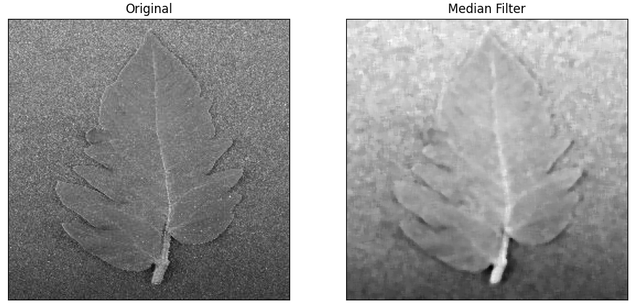
Median Filter
Non-linear filter
Advantages
Remove Salt-and –pepper noise

Slide 9
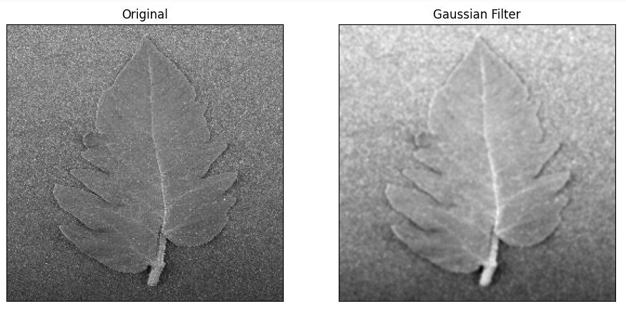
Gaussian Filter
Used to remove unnecessary noise
Smoothing filter
Apply weighted average to pixel

Slide 10

Image Enhancement
Usually done to reduce negative impact caused by filters
Improve visual quality of images
Make images more clear, crisp, and visually appealing
Highlights specific features

Slide 11
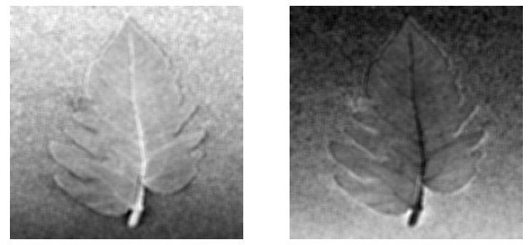
Image Inverse
Improve visual quality of image
Works by reversing pixel values
Values must be normalized to range of 0 to 1
Then apply image inverse using this formula
Inverse = 1 - value

Slide 12
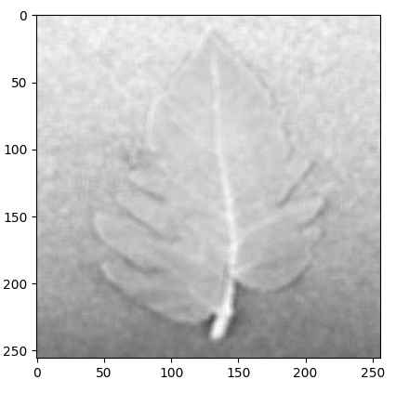
Log Transformation
Improves quality of image
Increase contrast and visual appeal
Compressing the range of pixel values
output = c * log(1 + input)
Input is original image
C is constant to control contrast

Slide 13
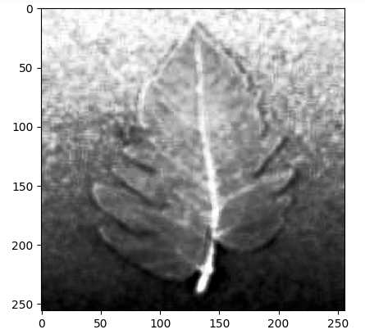
Histogram Equalization
Image enhancement technique
Enhance visual appeal
Adjust pixel values so that they are evenly distributed
Helps in visibility of features

Slide 14
Image Segmentation
It is a technique to divide image into multiple segments or regions
Segments corresponds to different objects
Goal is to partition into meaningful regions
Helps to extract features

Slide 15
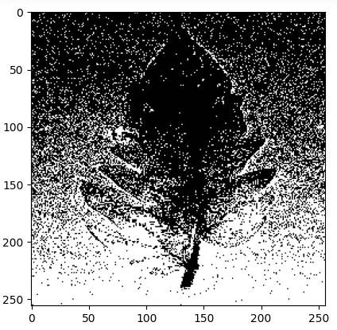
Otsu Segmentation
Named after Nobuyuki Otsu
It is used for image thresholding
Thresholding: divide image into regions based on pixel values intensity
Maximize variance between two regions
Variance results to distinct between regions

Slide 16
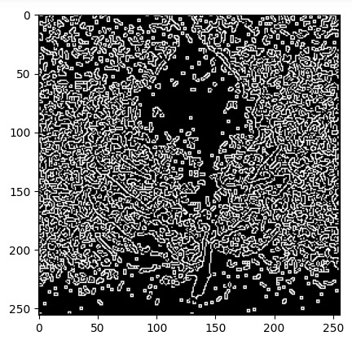
Feature Extraction
Process to extract features which helps to classify image
Goal is to find and extract most important info while ignoring redundant info in image
37 different features have been extracted using Gabor, Roberts, Sobel, and Prewitt.

Slide 17
Classification
Machine Learning techniques
Classify the images into the specific group
Applied Random Forest
Accuracy= 24.14 %
KNN
Accuracy= 28.83 %
Decision Tree
Accuracy= 28.83 %

Slide 18


