Slide 1
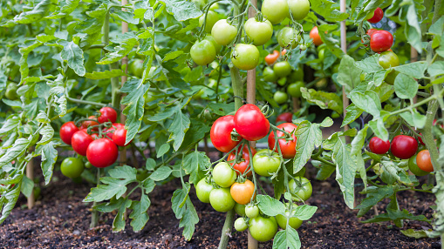
An Efficient Machine Learning and Image Processing Based Methodology for Tomato Leaf Disease Detection and Classification Author: Arfan Shah Supervisor: Dr. Muhammad Fayaz

Slide 2

Agenda
Problem
Solution
Methodology
Current Progress
Demo
Conclusion

Slide 3

Problem
Food is necessity for human life
Disease in tomatoes are favored by cool and wet weather
Food crises in Mountainous regions of Pakistan, Kyrgyzstan, and Tajikistan
Farmers need to visit city to cure disease

Slide 4

Solution
Freely available software to predict disease
Farmers do not need to visit city
Simple Web application

Slide 5

Methodology
Dataset Collection
Pre-Processing (Image resizing, image enhancement)
Image Segmentation
Feature Extraction
Data Labelling
Training and Testing
Classification

Slide 6

Current Progress
Done:
Dataset Collection
Pre-Processing (Image resizing, image enhancement)
Image Segmentation
Feature Extraction
Data Labelling
Training and Testing
Classification

Slide 7

Demo

Slide 8
Classification
Machine Learning techniques
Classify the images into the specific group
Applied Random Forest
Accuracy= 24.14 %
KNN
Accuracy= 28.83 %
Decision Tree
Accuracy= 28.83 %

Slide 9

Thank you

