Slide 1

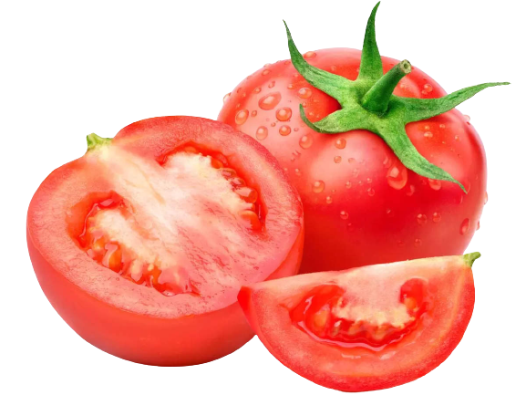
An Efficient Machine Learning and Image Processing Based Methodology for Tomato Leaf Disease Detection and Classification
Student: Arfan Shah
Supervisor: Dr. Muhammad Fayaz

Slide 2
Outline
Importance
Objectives
Proposed Model
Pre-processing
Mean Filter
Median Filter
Min Filter
Max Filter
Feature Scaling
Image Enhancement
Image Inverse
Image Segmentation
Feature Extraction
Data Labelling
Classification
Supervised Machine Learning
Unsupervised Machine Learning
Boosting algorithms
Model Evaluations
Accuracy, Precision, Recall, F1-Score
Models Ranking
Contribution
Application

Slide 3
Importance
Helps farmers to identify and classify diseases
Save time and money
Increase household income
Focused on mountainous regions

Slide 4
Objectives
Binary and multi-class classification
Apply more than 10 ML models
Helps farmers to detect disease in mountainous areas
Nobel and unique

Slide 5
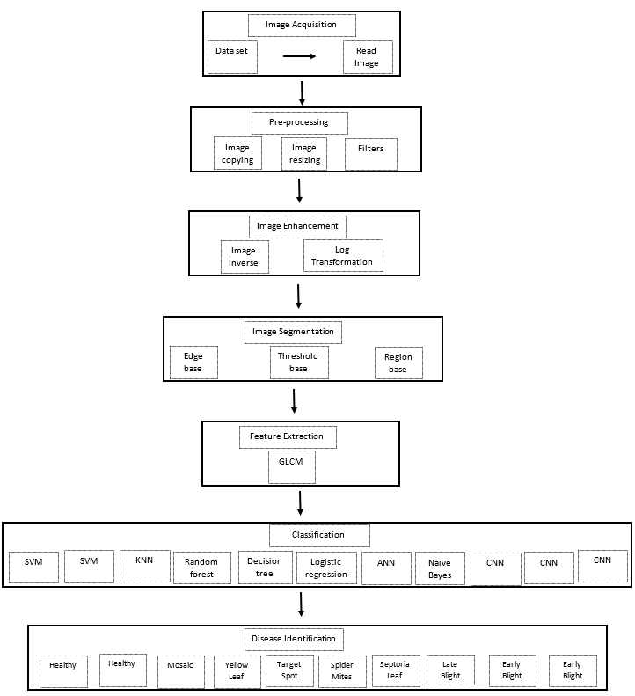
Proposed Model

Slide 6
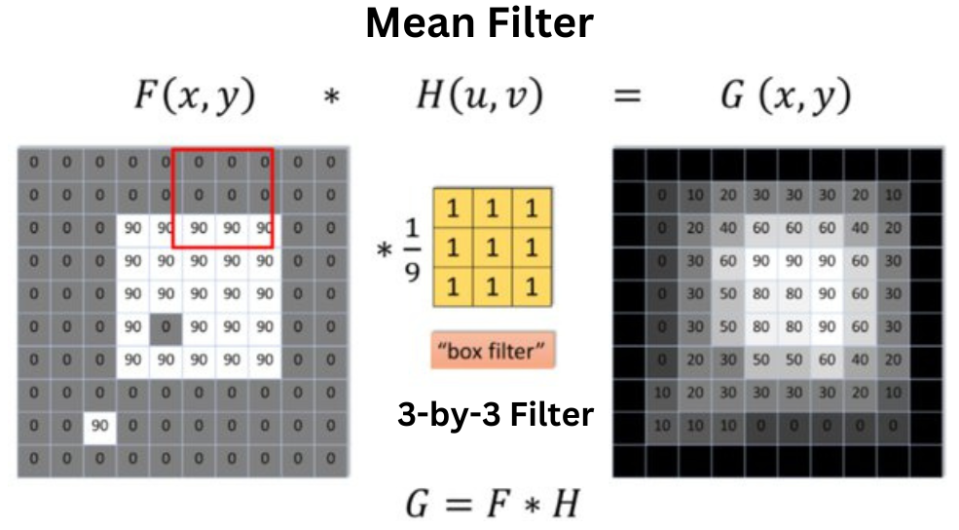
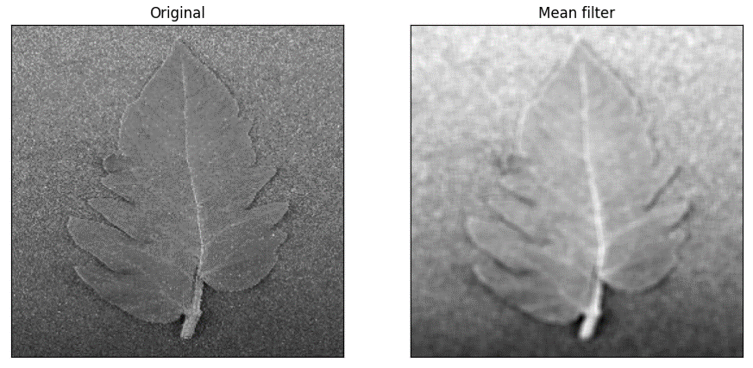
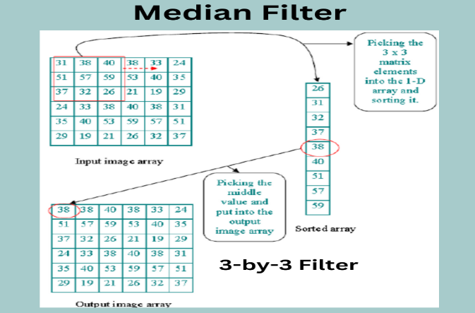
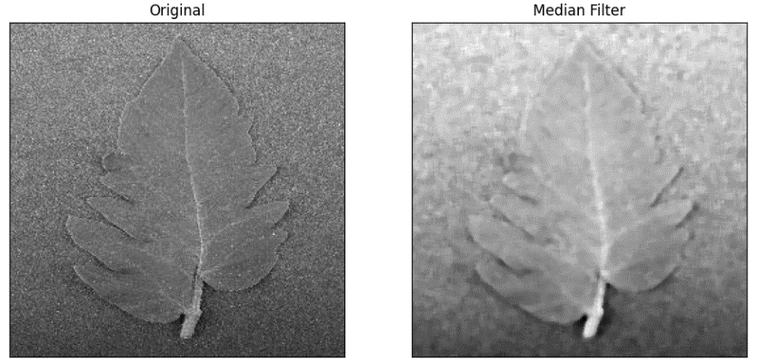
Pre-Processing
Mean Filter
Median Filter
Remove noise
Enhance quality by brightening
Remove salt and pepper noise
Sharpen edges

Slide 7
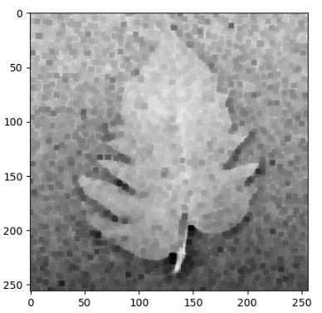
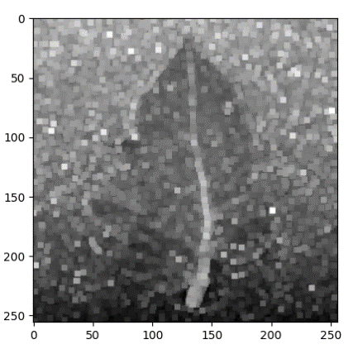
Pre-Processing
Min Filter
Max Filter
Enhance darker points
Enhances the bright points/pixels

Slide 8
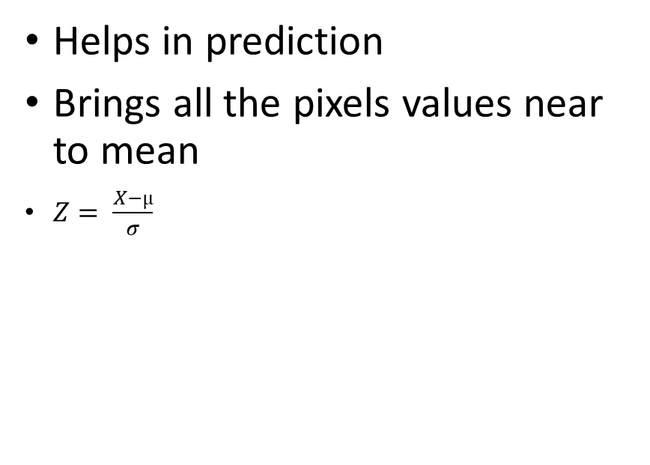
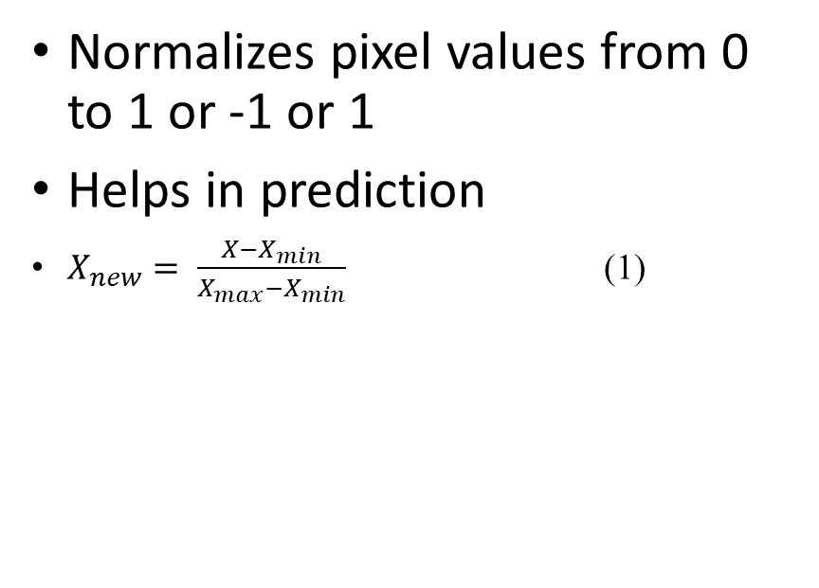
Pre-Processing
Normalization
Standardization
Normalizes pixel values from 0 to 1 or -1 or 1
Helps in prediction
$X_{new}= \frac{X−X_{min}}{X_{max}−X_{min}}$ (1)
Helps in prediction
Brings all the pixels values near to mean
$Z= \frac{X−µ}{σ}$

Slide 9
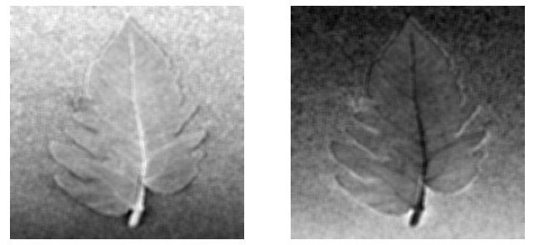
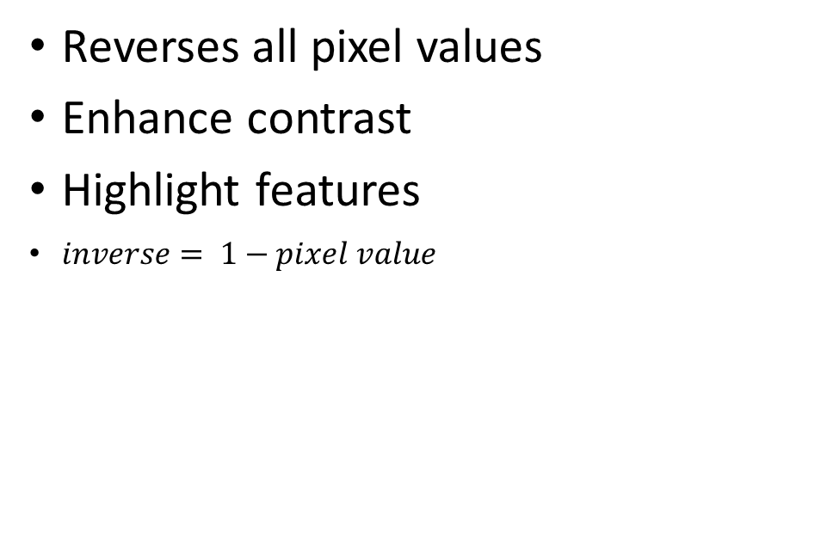
Image Enhancement
Inverse Image
Reverses all pixel values
Enhance contrast
Highlight features
$inverse= 1−pixel value$

Slide 10
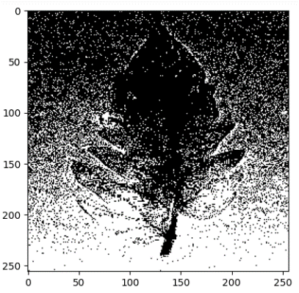
Image Segmentation
Otsu Segmentation
Creates differences among different portions in image
Maximizes difference in pixel values
Groups are created

Slide 11
Feature Extraction
Mean
Root Mean Square (RMS)
Median
Variance
Standard Deviation
Skewness
Kurtosis
Contrast
Homogeneity
Correlation
Smoothness
Inverse Difference Moment (IDM)

Slide 12
Data Labelling
Binary Classification
Multi-class Classification
Image | Label
Healthy | 0
Unhealthy | 1
Image | Label
Healthy | A
Mosaic | B
Yellow Leaf | C
Target Spot | D
Spider Mites | E
Septoria Leaf | F
Leaf Mold | G
Late Blight | H
Early Blight | I
Bacterial Spot | J

Slide 13
Classification
Supervised Machine Learning Algorithms
Decision Tree
Random Forest
Artificial Neural Network
Convolutional Neural Network
Support Vector Machine
Naïve Bayes
K-Nearest Neighbor
Logistic Regression

Slide 14
Classification
Unsupervised Machine Learning Algorithms
K-Means

Slide 15
Classification
Boosting Machine Learning Algorithms
AdaBoost
LightGBM

Slide 16
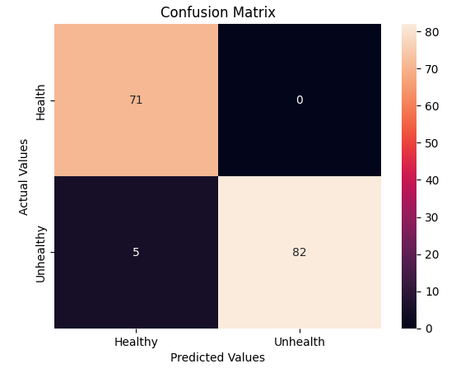
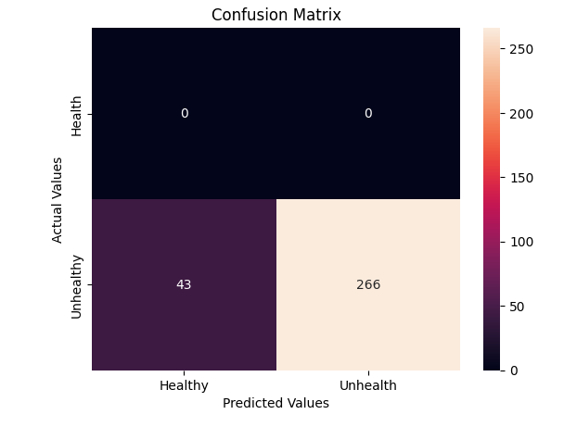
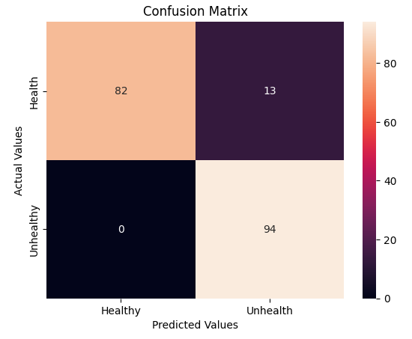
Models Evaluation
AdaBoost
ANN
Decision Tree

Slide 17
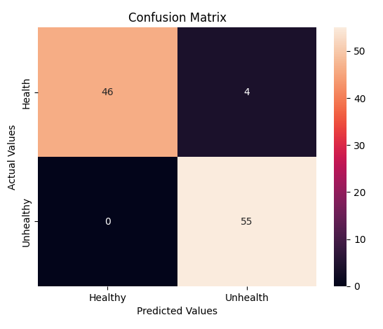
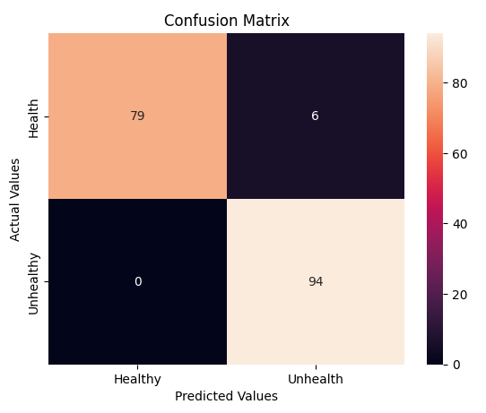
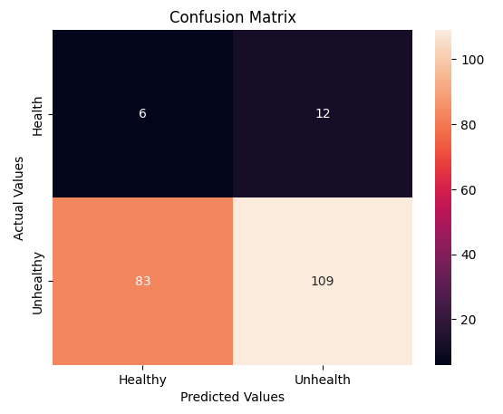
Models Evaluation
KMeans
KNN
LightGBM

Slide 18
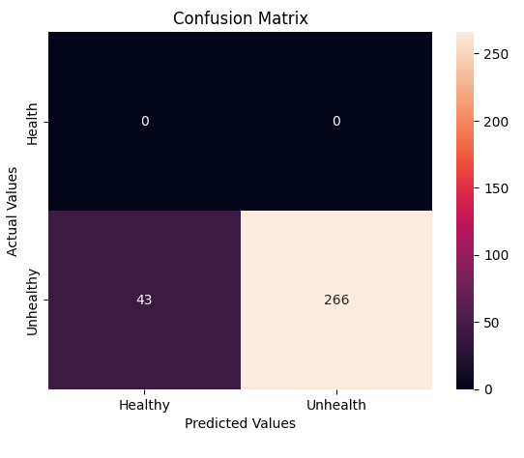
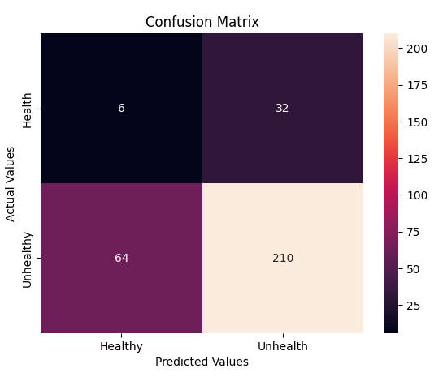
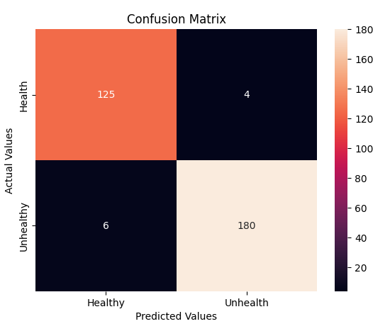
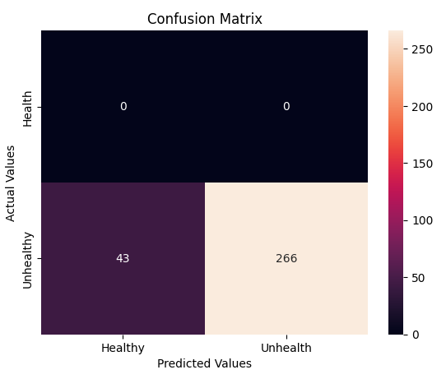
Models Evaluation
Logistic Regression
Naïve Bayes
Random Forest
SVM

Slide 19
Performance Evaluation
AdaBoost
ANN
Decision Tree

Slide 20
Performance Evaluation
KMeans
KNN
LightGBM

Slide 21
Performance Evaluation
Logistic Regression
Naïve Bayes
Random Forest
SVM

Slide 22
Ranking

Slide 23
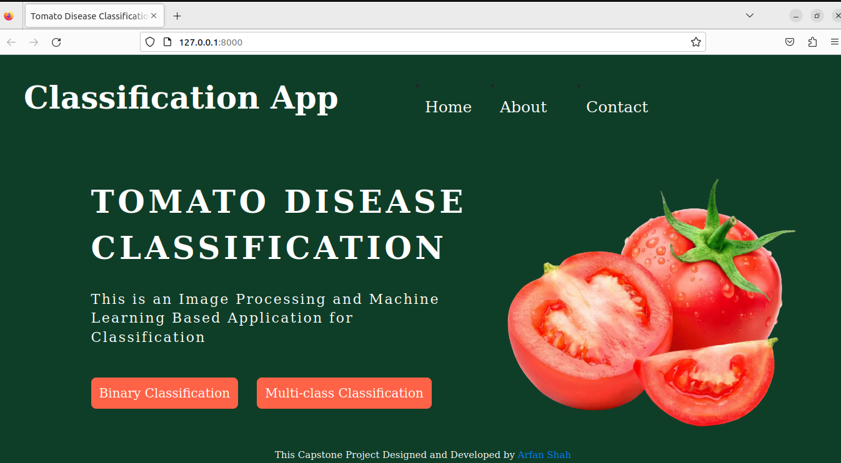
Web Application

Slide 24
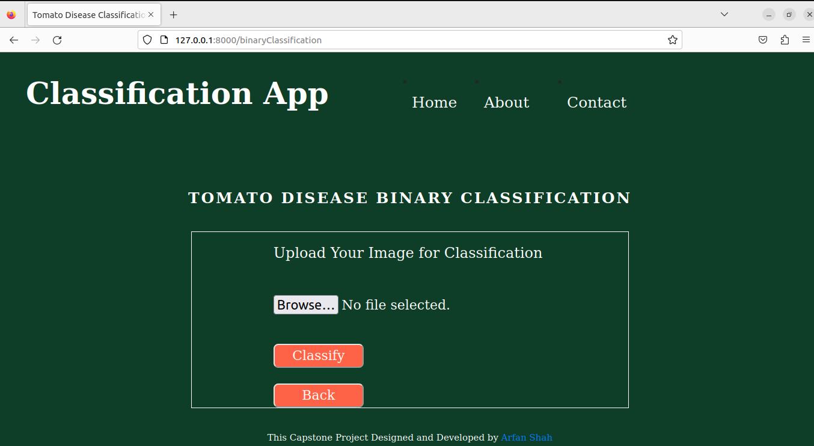
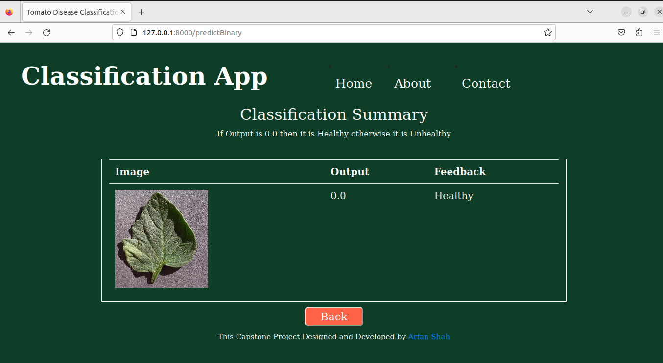
Application
Binary Classification

Slide 25
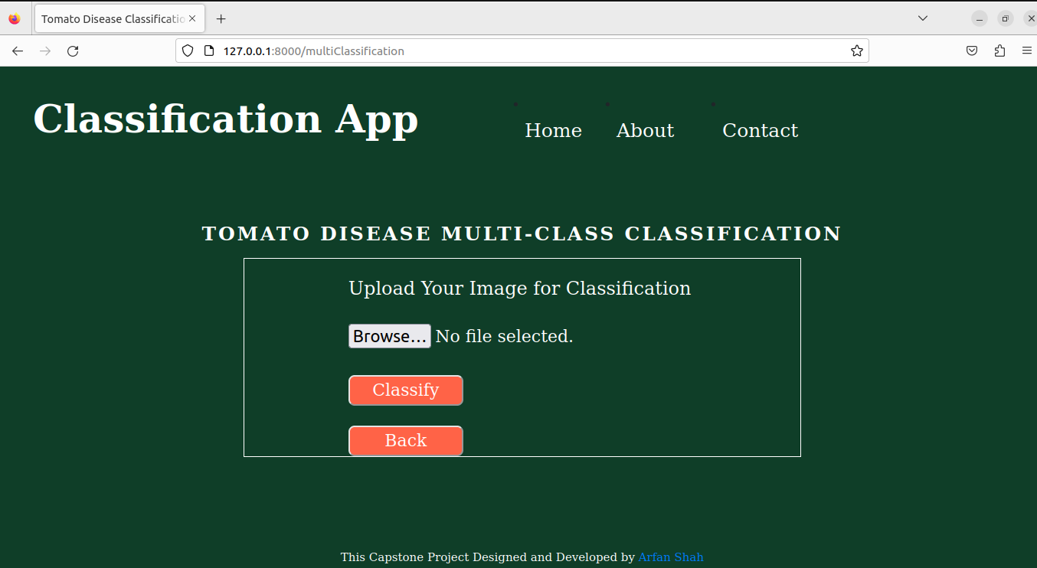
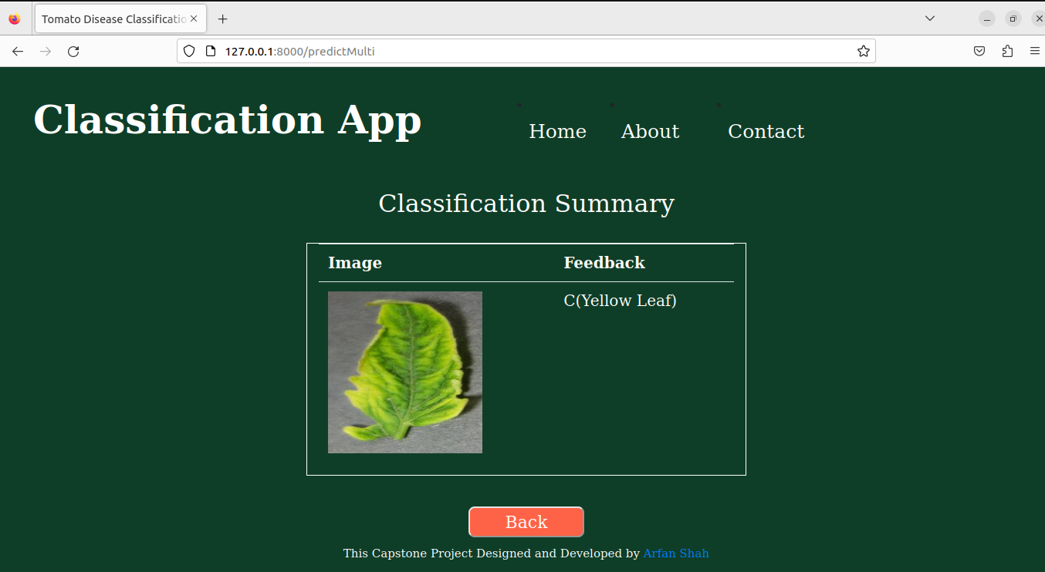
Application
Multi-class Classification

Slide 26
Contribution
Simple Web application for mountainous regions
Applied more than 10 Machine Learning Models
14 statistical features
Best Models

Slide 27


Slide 28
References
Rahman, S. U., Alam, F., Ahmad, N., & Arshad, S. (2022). Image processing-based system for the detection, identification and treatment of tomato leaf diseases. Multimedia Tools and Applications, 1-15.
Nagamani, H. S., & Sarojadevi, H. (2022). Tomato Leaf Disease Detection using Deep Learning Techniques. International Journal of Advanced Computer Science and Applications, 13(1).
Chowdhury, M. E., Rahman, T., Khandakar, A., Ibtehaz, N., Khan, A. U., Khan, M. S., ... & Ali, S. H. M. (2021). Tomato Leaf Diseases Detection Using Deep Learning Technique. Technology in Agriculture, 453.
Gadade, H. D., & Kirange, D. D. (2020). Machine Learning Approach towards Tomato Leaf Disease Classification. International Journal of Advanced Trends in Computer Science and Engineering, 9(1), 490-495.
Sreelatha, P., Udayakumar, M. S., Karthick, S., Ch, S. C., Kavya, K. C. S., & Madiajagan, M. (2021). Managing The Tomato Leaf Disease Detection Accuracy Using Computer Vision Based Deep Neural Network. Journal of Contemporary Issues in Business and Government Vol, 27(1).
Trivedi, N. K., Gautam, V., Anand, A., Aljahdali, H. M., Villar, S. G., Anand, D., ... & Kadry, S. (2021). Early detection and classification of tomato leaf disease using high-performance deep neural network. Sensors, 21(23), 7987.
Shoaib, M., Hussain, T., Shah, B., Ullah, I., Shah, S. M., Ali, F., & Park, S. H. (2022). Deep learning-based segmentation and classification of leaf images for detection of tomato plant disease. Frontiers in Plant Science, 13, 1031748.
Khasawneh, N., Faouri, E., & Fraiwan, M. (2022). Automatic Detection of Tomato Diseases Using Deep Transfer Learning. Applied Sciences, 12(17), 8467.

