Slide 1
Theory of Automata
Lecture # 15
Dr. Muhammad Fayaz

Slide 2
Chomsky Normal Form

Slide 3
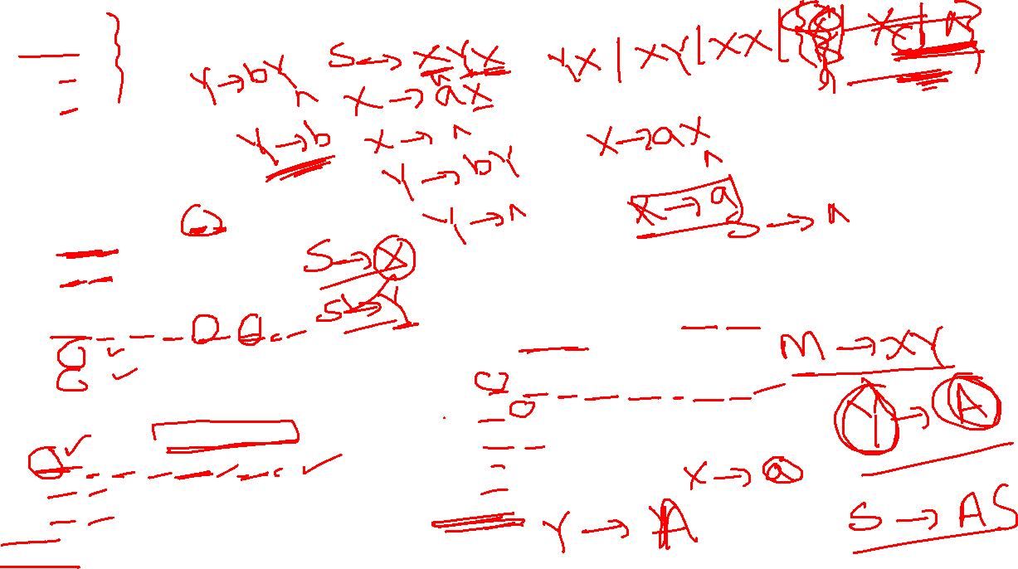
Rules
Example 6:
Given CFG:
1. S→ XYX
2. X→ aX/ ^
3. Y→ bY/ ^
Convert CFG to CNF
Chomsky Normal Form (CNF)
I. e.g.: S→^
II. e.g. A→BB
III. e.g. A→a
Steps for CFG to CNF Conversion
I. Remove Null Production
II. Remove Unit Production
II. Remove Useless Productions
Solution:
Step-1: Remove Null Production:
S→XYX/XY/XX/YX/X/Y/^
X→ aX/a
Y→ bY/b
Step-2: Eliminate Unit Productions:
S→XYX/XY/XX/YX/aX/a/bY/b/^
X→ aX/a
Y→ bY/b
Step-4: Eliminate more than two non-terminal in concatenation by replacing XY with M and make a production M→ XY
S → MX/XY/XX/YX/ R₁Y /a/ R₂Y /b/^
X→R₁X/a
Y→ R₂Y/b
R₁→ a
R₂→ b
M→ XY
Step-3:Eliminate Useless Productions by introducing R₁→ a, R₂→ b
S→XYX/XY/XX/YX/R₁X/a/R₂Y/b/^
X→ R₁X/a
Y→ R₂Y/b
R₁→ a
R₂→ b

Slide 4
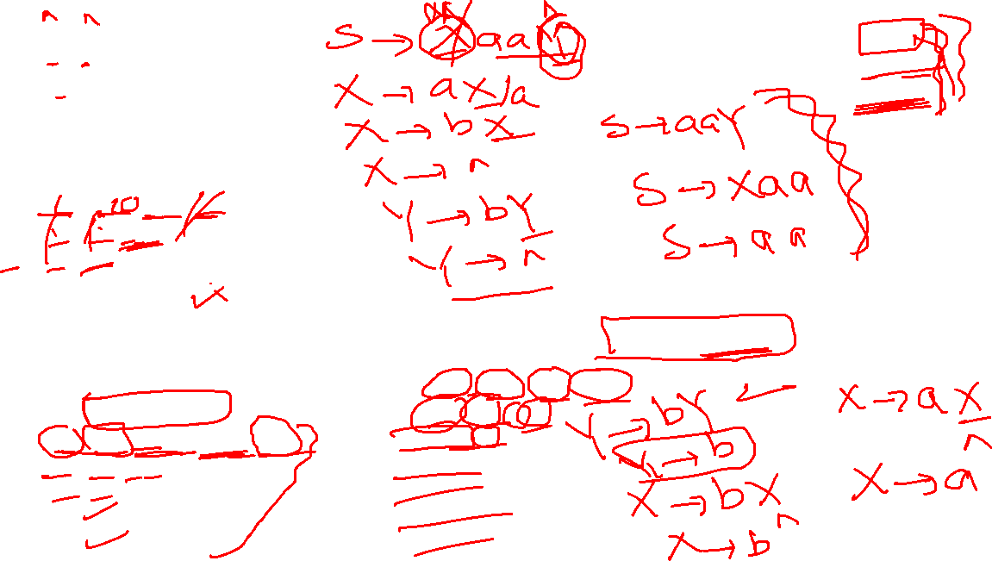
Rules
Example :
Given CFG:
1. S→ XaaY
2. X→ aX/bX/ ^
3. Y→ bY/ ^
Convert CFG to CNF
Chomsky Normal Form (CNF)
I. e.g.: S→^
II. e.g. A→BB
III. e.g. A→a
Solution:
Step-1:
Remove Null Production:
S→XaaY/Xaa/aaY/aa
X→ aX/ bX/a/b
Y→ bY/b
Steps for CFG to CNF Conversion
I. Remove Null Production
II. Remove Unit Production
II. Remove Useless Productions
Step-2:
Eliminate Unit Productions:
No Unit Productions
Step-4:
Eliminate more than two non-terminal in concatenation by replacing XR₁ with M and R₁Y with N and make productions M→ XR₁, N→ R₁Y
S → MN/MR₁/R₁N/R₁R₁
X→R₁X/R₂Y/a/b
Y→ R₂Y/b
R₁→ a
R₂→b
M→ XR₁
N→ R₁Y
Step-3:
Eliminate Useless Productions by introducing R₁→ a, R₂→ b
S → XR₁R₁Y/XR₁R₁/R₁R₁Y/R₁R₁
X→R₁X/R₂Y/a/b
Y→R₂Y/b
R1→ a
R2→ b

Slide 5
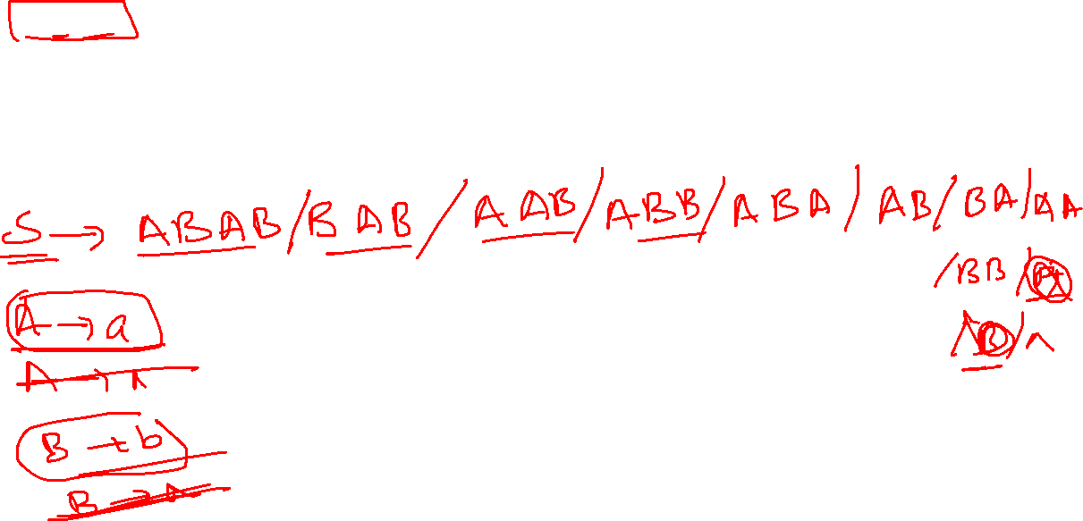
Example
Example 5:
Given CFG:
S→ABAB
A→ a
A→^
B→ b
B→ ^
I. e.g.: S→^
II. e.g. A→BB
III. e.g. A→a
Rules
Steps for CFG to CNF Conversion
I. Remove Null Production
II. Remove Unit Production
II. Remove Useless Productions

Slide 6
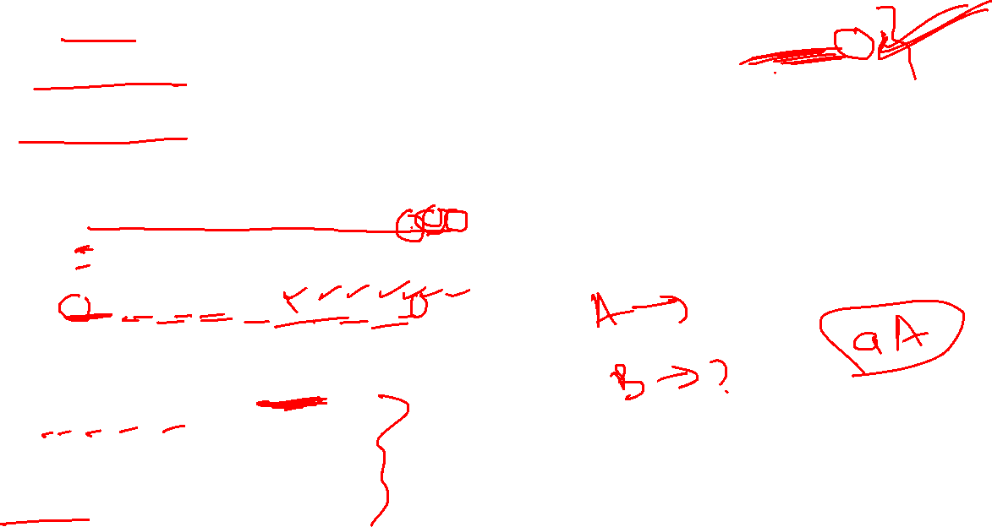
Rules
Chomsky Normal Form (CNF)
Example 5:
Given CFG:
S→ABAB
A→ a
A→^
B→ b
B→ ^
I. e.g.: S→^
II. e.g. A→BB
III. e.g. A→a
Steps for CFG to CNF Conversion
I. Remove Null Production
II. Remove Unit Production
III. Remove Useless Productions
Convert the Above CFG into CNF form
Step-1: Remove Null Production:
S → ABAB|BAB|AAB|ABB|ABA|AA|AB|BA|BB|A|B |^
A → a
B → b
Step-2: Remove Unit Production
S → ABAB|BAB|AAB|ABB|ABA|AA|AB|BA|BB|a|b |^
A → a
B → b
Step-3: Remove Useless Production
Introduce the nonterminal C where C → AB, so that
S → CC|BC|AC|CB|CA|AA|AB|BA|BB|a|b/^
A → a
B → b
C → AB

Slide 7
Rules
Chomsky Normal Form (CNF)
I. e.g.: S→^
II. e.g. A→BB
III. e.g. A→a
Example 7:
Given CFG:
S → aSb
S→Y
Y→aYc
Y→ab
Convert CFG to CNF
Steps for CFG to CNF Conversion
I. Remove Null Production
II. Remove Unit Production
II. Remove Useless Productions
Solution:
Step-1: Remove Null Production:
No Null Production
Step-2: Eliminate Unit Productions:
1.S→ aSb
2.S→ aYc/ab
3.Y→ aYc/ab
Step-5: Eliminate more than two non-terminal in concatenation by replacing R₁S with M and R₁Y with N and make productions M→ R₁S, N→ R₁Y
S → MR₂
S→NR₃/R₁R₃
Y→NR₃/R₁R₃
R₁→ a
R₂→ b
R₃→c
M→ R₁S
N→ R₁Y
Step-3: Eliminate Useless Productions by introducing R₁→ a, R₂→ b, R₃→ c
S→R₁SR₂
S→ R₁YR₃/R₁R₃
Y→ R₁YR₃/R₁R₃
R₁→ a
R₂→ b
R₃→c

Slide 8
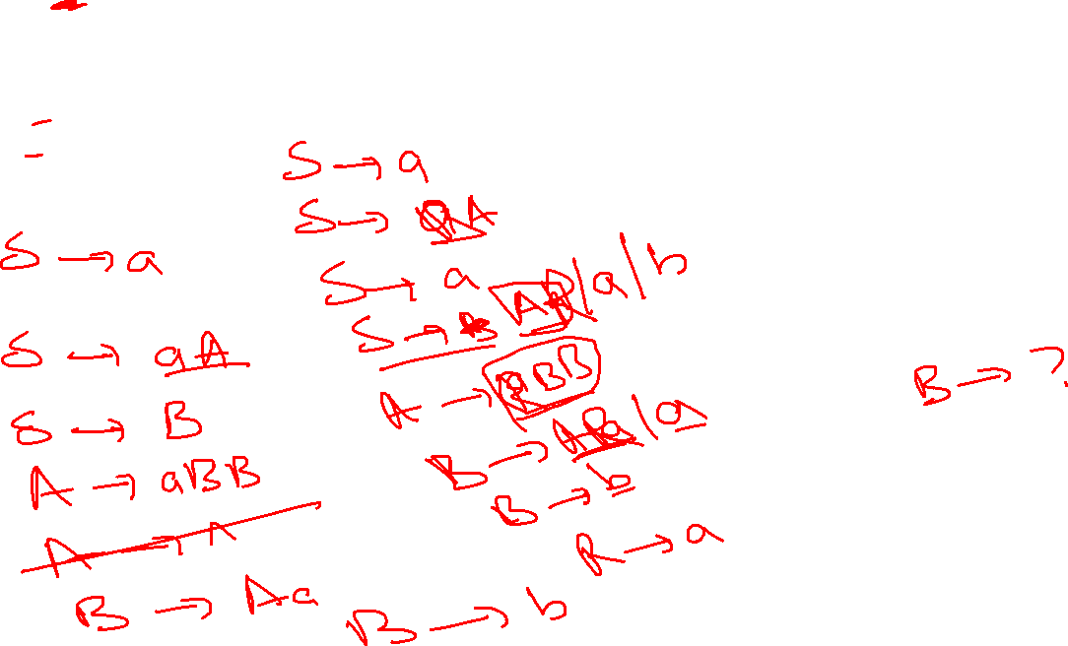
Rules
Chomsky Normal Form (CNF)
I. e.g.: S→^
II. e.g. A→BB
III. e.g. A→a
Example 1:
Given CFG:
S→a/aA/B
A→aBB/^
B→Aa/b
Convert to CNF
Steps for CFG to CNF Conversion
I. Remove Null Production
II. Remove Unit Production
III. Remove Useless Productions

Slide 9
Rules
Chomsky Normal Form (CNF)
I. e.g.: S→^
II. e.g. A→BB
III. e.g. A→a
Example 1:
Given CFG:
S→a/aA/B
A→aBB/^
B→Aa/b
Convert to CNF
A→^
Replace A with ^ and write with that production
Steps for CFG to CNF Conversion
I. Remove Null Production
II. Remove Unit Production
III. Remove Useless Productions
Solution:
Step-1:
Remove Null Productions
S→a/aA/B
A→aBB
B→Aa/b/a
Replace B with B productions
Step-2:
Eliminate Uni Productions
S→a/aA/Aa/b
A→aBB
B→Aa/b/a
Change Aa, aA, and aBB with AX, XA and XBB
by replacing a with X and add a production X→ a in CFG
Eliminate concatenation of more than two non-terminals by using decomposition method
Step-4:
Eliminate Useless Productions
S→a/XA/AX/b
A→RB
R→XB
B→AX/b/a
X → a
Step-3:
Eliminate Useless Productions
S→a/XA/AX/b
A→XBB
B→AX/b/a
X→a

Slide 10
Thanks

